Slide 1
Tourism Marketing
Petra Koudelková
Tourism and its history

Slide 2
Tourism
The 2nd largest industry in European Union
Could envelopes other sector and industry and therefore has no clear boundary
Attractions: nation, culture-historical and organized

Slide 3
Definition of Tourism
„Tourism is a collection of activities, services and industries which deliver a travel experience comprising transportation, accommodation, eating and drinking establishments, retail shops, entertainment business and other hospitality services provided for individuals or groups travelling away from home“
UNWTO: „tourism comprises the activities of person travelling to and staying in places outside their usual environment for not more than one consecutive year for leisure, business and other purposes“

Slide 4
Tourism
Tourism is based on services
We can distinguish :
  main services: accommodation, restaurant and hospitality, transport
  additional services: others

Slide 5
Pay attention!
Travel and Tourism
Tourism is travel for recreation, leisure or business purpose….
Travel: is the movement of people between relatively distant geographical location.

Slide 6
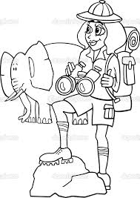
Types of Tourism
According to place
Domestic Tourism – Taking Holidays and Trips in your own country.
Inbound Tourism – Visitors from abroad coming into the (my) country.
Outbound Tourism –Travelling to a different country for a visit or a holiday.
According to the length of stay
Short-term (usually up to three days)
Long-term (usually more than three days)
According to the way of organization (arrangement)
Organized (arranged by specialized subjects)
Non-organized
According to the number of participants
Individual (individuals, family),
Group (groups, tours),
Mass (mass events such as pilgrimages, sports events).
https://www.youtube.com/watch?v=ACkE2QEayeY

Slide 7
Other Types of Tourism
Film Tourism
Sport Tourism and Adventure Tourism
Wedding Tourism
Spa and Wellness Tourism
Dark Tourism (Disaster Tourism)
Gastro Tourism
Business and Congress Tourism
Cultural and Historical Tourism
Recreational Tourism
Pilgrimage Tourism
Space Tourism ☺

Slide 8

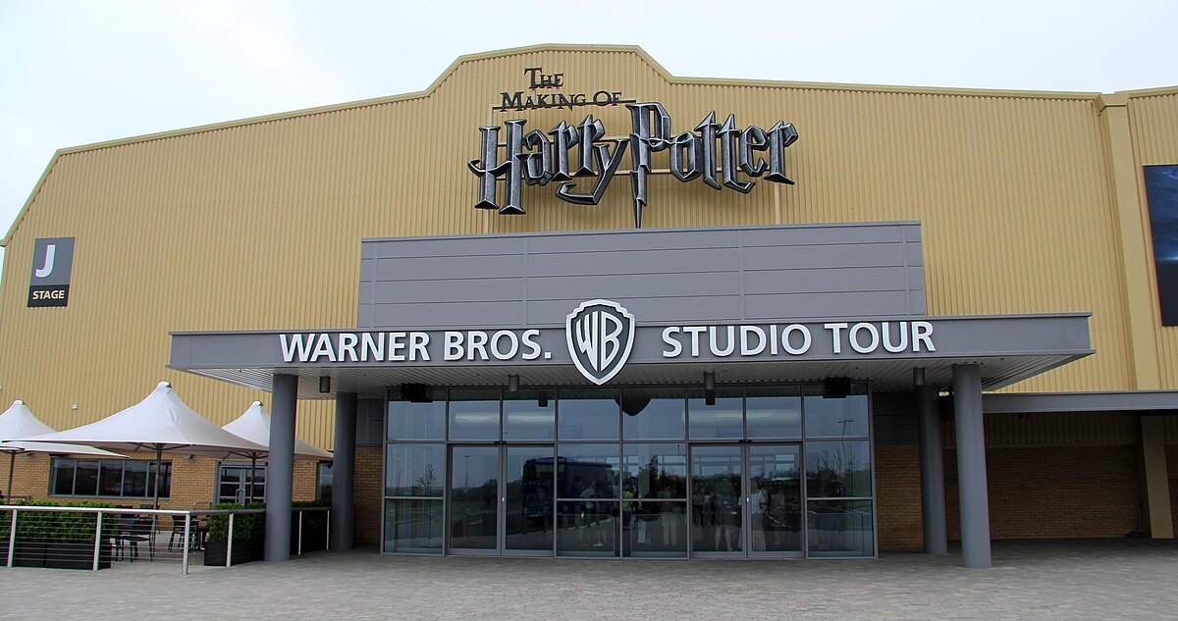
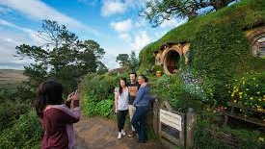
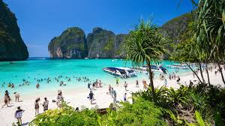
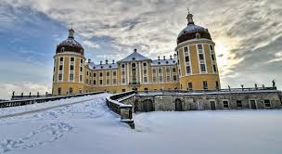
Film tourism

Slide 9
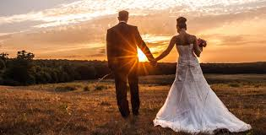
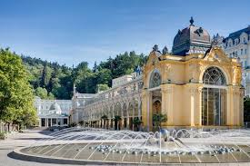
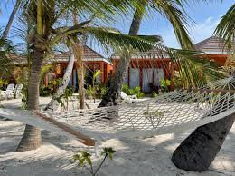
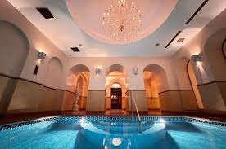
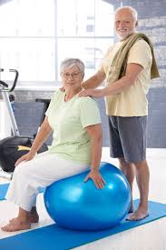
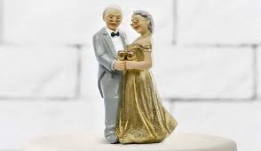
Spa tourism
Wedding tourism

Slide 10
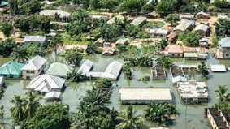
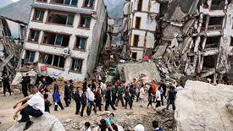
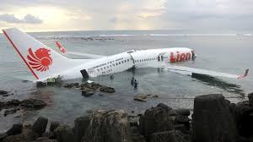

Disaster tourism

Slide 11
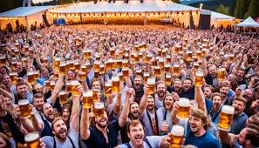
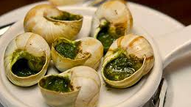
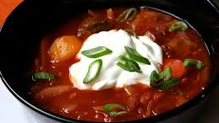
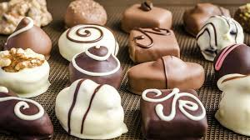
Gastrotourism

Slide 12


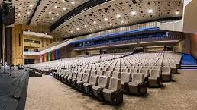
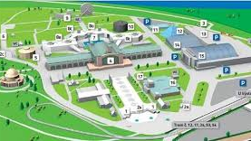
Business tourism (including MICE)

Slide 13
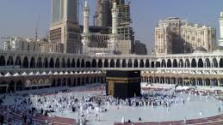
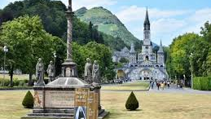
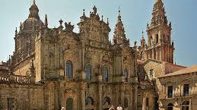
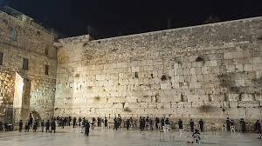
Pilgrimage tourism

Slide 14
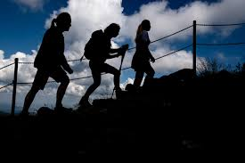
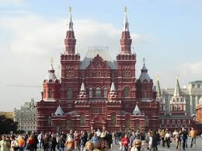
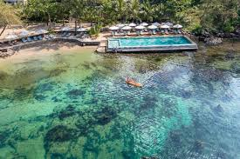
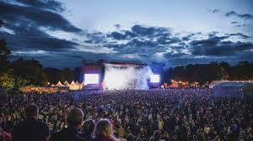
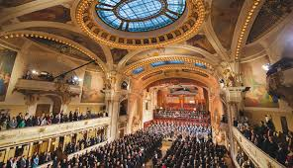
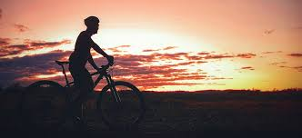
Recreation tourism
Cultural tourism

Slide 15
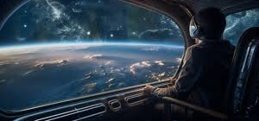
Space tourism

Slide 16
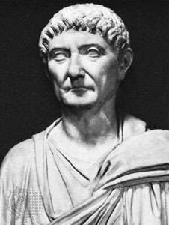
History in brief
In ancient Rome and Ancient Greece travelled the people because of fun. They don´t want to spent their vacation in home.
The 1st itinerary from the season Emperor Diocletian
Peutinger map of paths (Tabula Peutingeriana)

Slide 17
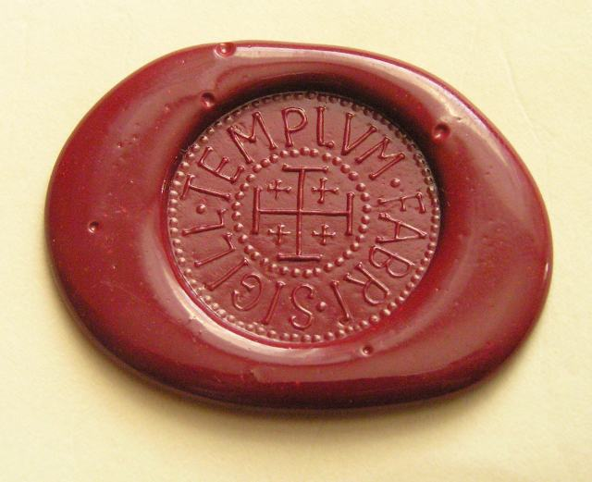
History in brief
In midlle age was the main reason pilgrimage. The organisers arranged the tourism basics of itineraries and places to eat and sleep.
Later: military journeys and/or business travelling

Slide 18
Pioneers in Tourism
Thomas Cook – organised tourism
  5.7.1841 first organised journey by train from Leicester to Loughborough for 570 people
  Some services are still use in modern management of TA
Karl Beadecker
  First print book guide with detail information
Mickele de Montaign
  Description of Spas and Spa Map

Slide 19
Modern Tourism
From the 20th century
1 World War
2 World War
Development of Tourism different in west countries and countries with communistic régime
After the 1989 was the boom of travel agencies. In CZ were more than 3000 TA. Until this time there were 3-5 TA (The most famous is Čedok – est.1920)
COVID – 19 - a pandemic that has affected the world of travel

Slide 20
Homework☺
Mandatory HW:
Watching:
https://www.youtube.com/watch?v=xVRb9EU-bkE
Recommended text:
http://ieg-ego.eu/en/threads/europe-on-the-road/the-history-of-tourism

