Slide 1
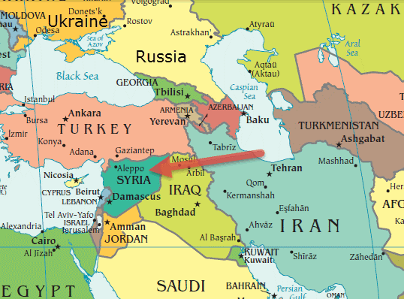
Russia and the Middle East
Ekaterina Ananyeva
PhD candidate

Slide 2
Throw-back
Close long-standing connections to the Arab and Islamic worlds
Medieval Russia = bridge between north and south
Clashes over the Black Sea with the Ottoman since 16th century
Turn to Persia, facilitating trade especially in the 17th century
19th century: support of the Christian Arabs in Jordan and Syria
The Anglo-Russian Agreement on northern Persia

Slide 3
Throw Back 2: USSR
1920, the Congress of the Peoples of the East in Baku
Call for revolutions against colonial powers
Active role in creating Israel BUT: no support from Israel → constant critique
Direct involvement via Central Asian republics (Uzbekistan)
Middle East = region of ‘Hot War’ with the USA

Slide 4
Overview of today
Russia = alternative source for trade and technology
Putin`s great-powerness → more involvement in the region
Energy diplomacy
Bilateral relations of Russian Muslim republics with the Middle East
Mutual compromise for Iran and Syria
Russia`s shift from economic to security concerns

Slide 5
Main directions: Israel
Huge number of Russian-speaking immigrants to Israel
Direct investments
Business relations
Soviet support of pro-Palestine movement
Israeli support of military actions against Chechnya
Relations complicated by Russian arms exports to Iran and Syria https://www.youtube.com/watch?v=28YjvYgh_RE

Slide 6
Iran
no interest in Soviet times (Iran strongly anti-Soviet)
Sanctions on Iran → Tehran main consumer of Russian technologies
Arab spring → mutual rapprochement
‘limited cooperation of convenience’

Slide 7
Turkey: dynamic and controversial
Collapse of the USSR opened opportunities (esp. consumer goods and construction)
Cooperation in energy sector, Turkey as a bridge + Russia supplies 65% of Turkish gas + Russian construction of nuclear power infrastructure in Turkey
Russia – top trading partner of Turkey (10.44%)
Turkish growing investment in Tatarstan (12.9% of all investments, 15% of local jobs) → pro-Turkey lobby in Russia

Slide 8
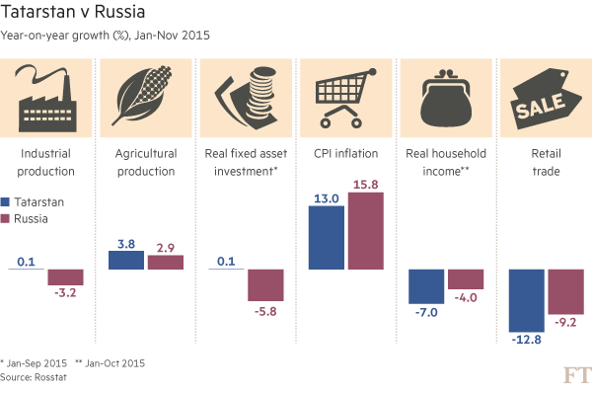

Slide 9
Syria
Syria turned to the USSR in the 1950-s
US invasion of Iraq + Israel-Syrian peace talks → Syrian concerns of growing US presence in the region
Tartus – the only Russian naval facility far from its borders
Russia - top supplier of weapons to Syria
Active and important role in current civil war https://www.youtube.com/watch?v=kVS1EmPmqXc

Slide 10
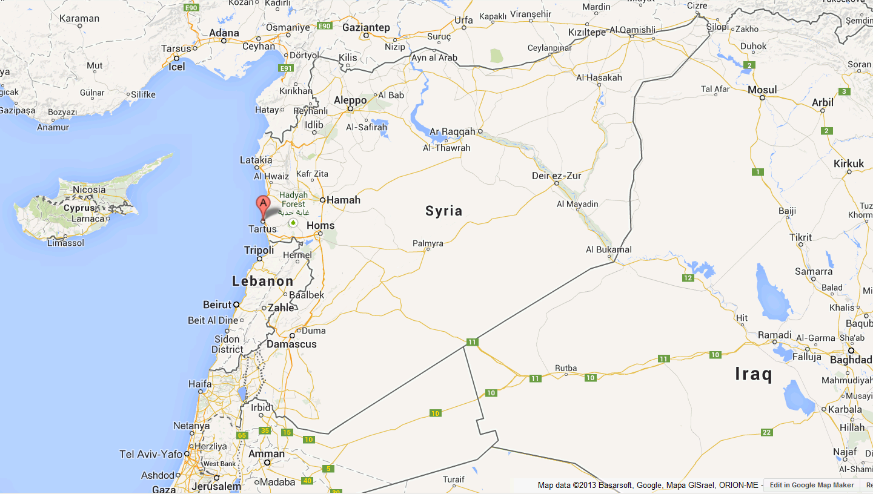

Slide 11
Summary
Historical interest in the Middle East
Switch from purely economic interests to security
Exercise of power and might
Russia for Middle eastern countries – alternative to US prevalence
The Arab Spring (2011) – new openings in RFP

Slide 12
Choose one out of the three questions:
Why is the Middle East important for RFP? Please, outline and briefly explain 3 reasons
Outline and briefly explain the main ideas of RFP in the region (not strategies!)
Outline and briefly explain the main issues of the Soviet FP towards the region that are still active in RFP

Slide 13
Extra-questions, not for assignment
https://www.youtube.com/watch?v=VBWos6e0qXM https://www.youtube.com/watch?v=2Iu_4GMKEXM on Russia in Syria
What is Syrian conflict for Russia? Who decides? Why did it intervene?
why is Turkey interested in Russia?
How would you characterize current talks on Syria? Who are the main players?

Slide 14
https://www.youtube.com/watch?v=VBWos6e0qXM

