Slide 1
Russia and the Far East
Ekaterina Ananyeva
PhD candidate

Slide 2
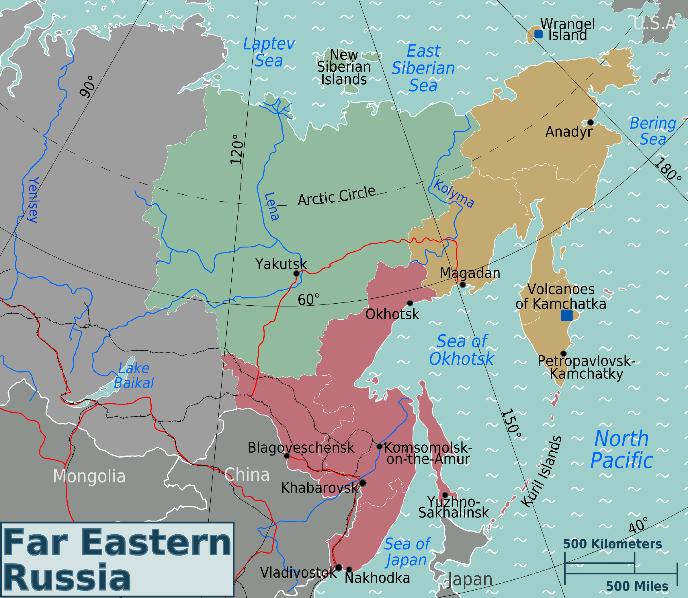

Slide 3
Main drivers of current RFP in the region
Power asymmetry vis-à-vis China
Identity and discourse on Eurasia
Geography and challenges that it imposes
Doubtful diversification after the Ukrainian crisis
search for a post-European identity
resolving border issues

Slide 4
Throw-back
Mongol conquest and suzerainty from 1237 to 1480
Russian conquest of Siberia from 16th century onwards
--> Extensive encounters with China, establishing diplomatic relations
Broadening till India → rivalry with Great Britain
Weakened China + proponents of ‘Yellow Russia’ policy = war with Japan for Manchuria

Slide 6
ff

Slide 7
China
USSR and later Russia – biggest arms exporter after sanctions imposed on China
Russian disappointment with the West → China as a new friend
October 2004 – resolving border dispute
Non-compliance with US-led world order and common vetoes in the UNSC in mid-2000s
BUT: uneven relations (China for Russia is among the biggest trade partners, while Russia for China – 9th)

Slide 8
Japan
Slow increase in trade volume (from 6.6% in 2013 to 13.9% in 2014)
Historically complicated relations (Sakhalin and the Kuril Islands) https://www.youtube.com/watch?v=WjdhzHaUY1E
Japan need in energy and Russian readiness to provide it
Now: high hopes from both sides

Slide 9
Korea
Role of the USSR in the Korean war (geostrategic interests) → support of the North
Perestroika and successful economic cooperation with Seoul
By the mid-2000, it was 3d largest trading partner of the Russian Far East
The North not forgotten: Russia – mediator in negotiations and write-off of debts

Slide 10
Vietnam
Simultaneous perestroika in Vietnam and the USSR
Establishing ‘strategic partnership’ in 2001
Vietnam – 4th largest buyer of Russian arms Russia – largest arms importer for Vietnam
Energy cooperation and joint ventures
Chinese factor

Slide 11
Summary
Russian low presence in the region changed
Pragmatic relations with China
Balancing Chinese role successful pivot to
Final resolution of the conflict with Japan Asia?
Asia is interested in Russia

Slide 12
Supershort essay questions (choose one out of three)
Outline the main features of Sino-Russian relations
Describe RFP priorities in Asia
Compare and contrast RFP towards Japan and China

Slide 13
Extra questions (not for assignment)
https://www.youtube.com/watch?v=YMcrAKSY0r0
Do you think these relations have a future?
Is there a potential for a conflict or cooperation?
Apply interests as opposed to positions to these relations

