Slide 1
Central Europe in Russian Foreign Policy
Ekaterina Ananyeva
PhD candidate

Slide 2
Choose one out of the three questions and write max. 250 words on them:
What are the three main ideas behind the RFP towards the Central European region?
What is the “new Yalta” tactic as related toward Central Europe?
In your own words, describe the latest case brought by the EU against Gazprom?

Slide 3
Historical overview
Poland as the main representative of the region vis-à-vis then-Russia
Post-WWII and the Yalta Agreement → Moscow rule over Central Europe (questionable legitimacy of communist regimes there)
The Warsaw pact est. 1955: Bulgaria, Czechoslovakia, Soviet Union, GDR, Hungary, Poland, Romania

Slide 4
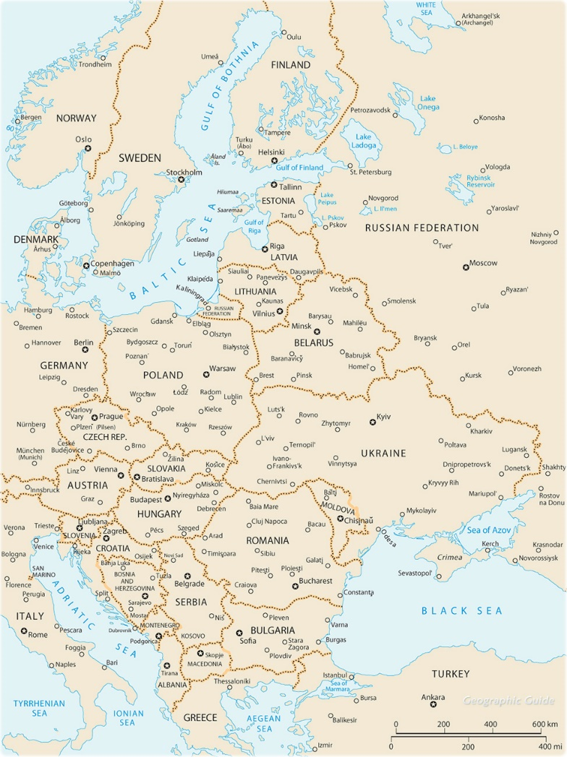

Slide 5
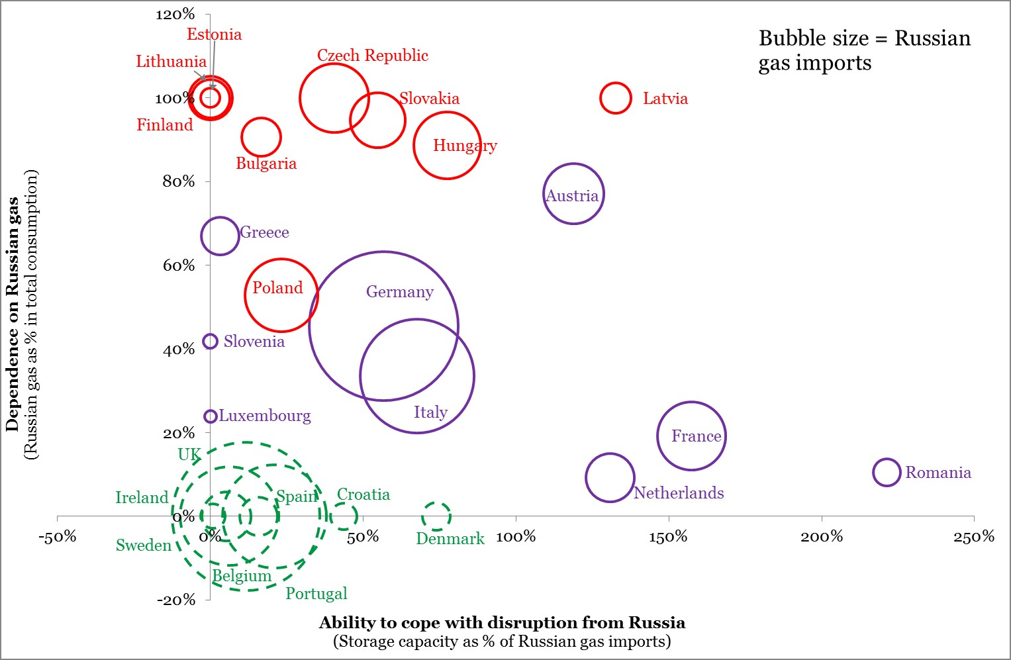
Dependence on Russian gas imports

Slide 6
Latest case against Gazprom

Slide 7
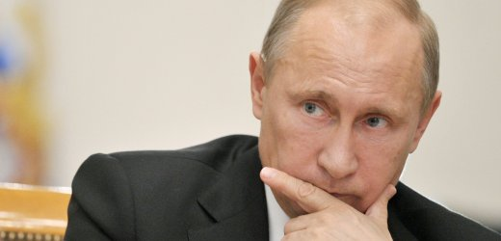
RFP: what to do with the CEE??
No idea

