Slide 1
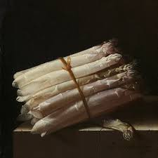
DUTCH VISUAL ART
INTRODUCTION

Slide 2
Still Life with Asparagus, Adriaen Coorte, 1697
Notes:
https://www.rijksmuseum.nl/en/collection/SK-A-2099

Slide 3
The Garden of Earthly Delights
Notes:
(He spoke and it was there, He commanded and they were created) Ps. 33: 9, 148: 5

Slide 4
hieronymus bosch
Notes:
Innovator of visual tradition
'Den duvelmakere' (the creator of devils)
Northern renaissance?
Themes desired by clients? (debauchery debauchery, deceit deception обман, laziness and begging)
Social criticism? Social chriticism
Modern Devotion?

Slide 12
Pieter Brueghel de Oude The fall of Icaris (1558)
Notes:
Dutch landscape painters
Characteristics:
Fantasy landscapes (not a representation of reality, but composed of many geographical elements)
Harmonic composition
Successful, also in Italy
Responded to curiosity

Slide 13
Hunters in the snow (1565)

Slide 14
Hendrick Goltzius (1558-1617): Danae and Zeus as a rain of gold (1603)

Slide 15
Jan van Kessel's Signature of Caterpillars and Snakes (1657)

Slide 16
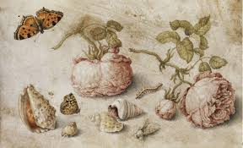
Notes:
many genres including studies of insects, floral still lifes, marines, river landscapes, paradise landscapes, allegorical compositions, scenes with animals and genre scenes.

Slide 17
Peter paul rubens 1623
Notes:
Peter Paul Rubens (1577-1640)
Flemish baroque
Painter, draftsman, graphic artist, sculptor, architect, diplomat

Slide 18
Portret of Hélène Fourment (1630-1631)

Slide 19
the Night watch (1642)

Slide 20
Rembrandt Harmenszoon van Rijn (1606-1669) the jewish bride (1665-1669)
Notes:
Leiden period (1625-1631): small paintings, richly detailed (costumes, jewels)
Amsterdam 1632-1636: large paintings, dramatic mythological scenes (wild Rubens surpass)
1636-1640: landscapes (threatening cloudy skies and uprooted trees), portraits
1640-1650: his work becomes austere, inner emotions, Old Testament, classical composition, more expressive brushstroke
1650-1660: larger paintings, more colors, powerful brushstroke, goes against fashion, rough light treatment, no gloss (coarse-grained)
1660-1669: Biblical themes remain, but shift from dramatic group scenes to intimate portrait-like figures, self-portraits (1652-1669)

Slide 21
Vincent van Gogh was so impressed with The Jewish Bride when he saw it together with a friend in 1885 he said: 'Believe me, I sincerely mean that I would give ten years of my life, if only I could stay here for fourteen days in front of this painting with a crust of dry bread for food. "Van Gogh wrote to his brother Theo in October that year: 'What an intimate, what an infinitely sympathetic painting'.

Slide 22
The painter in his atelier (1626-1628)
Notes:
Van Gogh – At Eternity’s Gate 2018

Slide 23
Johannes Vermeer (1632-1675) girl with the pearl earring (1665)
Notes:
girl with the pearl earring 2003 moovie

Slide 24
Notes:
Portrait of Père Tanguy (1887)

Slide 25
Vincent van Gogh: Drawbridge in New-Amsterdam (1883)

Slide 26
Cafeterias by night (1888)
Notes:
Loving Vincent 2017

Slide 27
Jan Toorop: Oh Grave, where is thy Victory (1892)

Slide 28
The Three Brides (1892-1893)

Slide 29
Piet Mondriaan. Victory boogie woogie 1942-1944

Slide 30
Boerderij met wasgoed aan de lijn (1897)

Slide 31
Still life with ginger jar (1911-1912)

Slide 32
The red tree 1908-1910

Slide 33
A tree 1912-1913

Slide 34
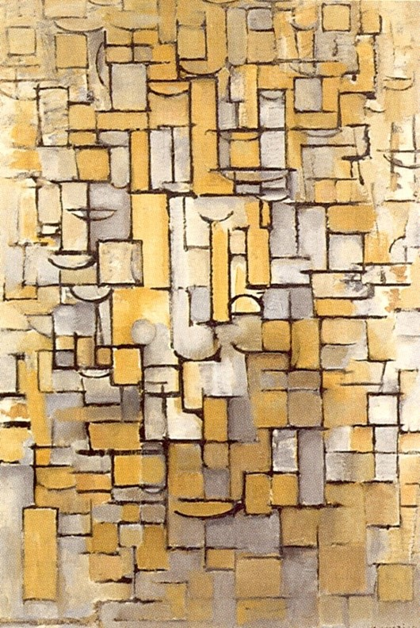
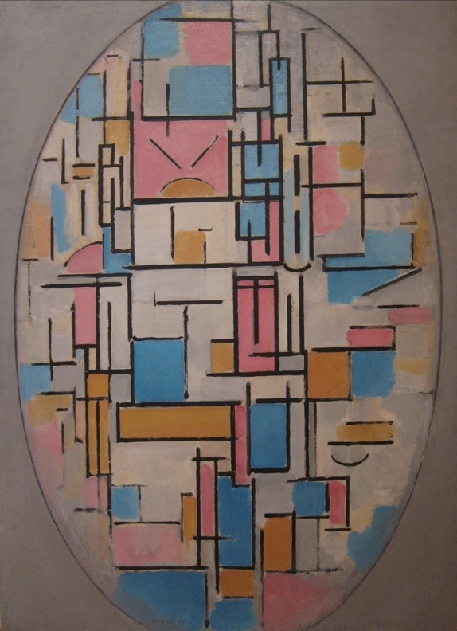
1913 1913 1914

Slide 35
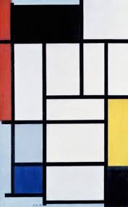
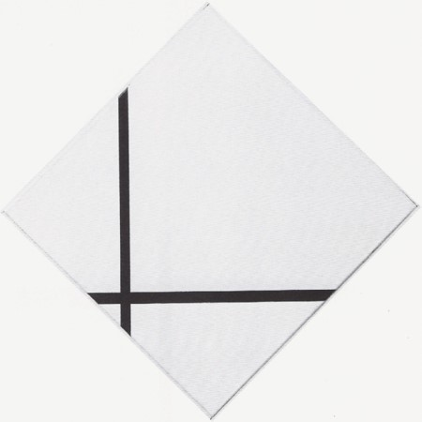
1920s – 1930s

Slide 36
Ruitcompositie met geel, zwart, blauw, rood en grijs (1921)
Notes:
He proclaimed in 1914: "Art is higher than reality and has no direct relation to reality. To approach the spiritual in art, one will make as little use as possible of reality, because reality is opposed to the spiritual. We find ourselves in the presence of an abstract art. Art should be above reality, otherwise it would have no value for man.“
1944

Slide 37
Bas Jan Ader
Notes:
Bastiaan Johan Christiaan "Bas Jan" Ader (19 April 1942 – disappeared 1975) was a Dutch conceptual and performance artist, and photographer.

Slide 38
Dick raaijmakers
https://v2.nl/archive/articles/chronology-work-and-life-of-dick-raaymakers
Notes:
(also Raaymakers; 1 September 1930 – 4 September 2013) was a Dutch composer, theater maker and theorist. He was known as a pioneer in the field of electronic music and tape music. In addition, he realized numerous music theater pieces, art installations, and has published many theoretical essays.

Slide 39
Daan roosegarde
Notes:
(born 1979) is a Dutch artist and founder of Studio Roosegaarde, which develops projects that merge technology and art in urban environments.

Slide 40
Theo Jansen – Straandbesten https://www.youtube.com/watch?v=LewVEF2B_pM

