Slide 1
The depths of the Dutch Youtube
Rafał Janczewski

Slide 2
THANKS YOU! – DANKJEWEL
Eva K.
Kim S.

Slide 3
Attention !

Slide 4
Stefan & Sean FT. Bram Krikke - Potentie

Slide 5
Youtubers
Intagramers
They are famous because ,, Potje Rijden”
In 2019, they started create music
It’s possibility to rent them on party as a DJs
,,Very vulgar, very funny and very very catchy ‘’ – Eva

Slide 6
https://www.youtube.com/watch?v=04ZNPpwdLs4

Slide 7
MEROL - HOU JE BEK EN BEF ME

Slide 8
Merel Baldé, born in 1991 in Dordrecht
She graduated Amsterdam School of Drama i Small Art Academy
Actor and singer
Her music debut was in 2018
Genre - Vapor Wave
,,Most shocking song. It is really weird, buy also a pretty cool comment on the patriarchy hahaha’’ – Eve

Slide 9
https://www.youtube.com/watch?v=7DZsIknkKJg

Slide 10
Zondag met Lubach

Slide 11
(Dutch for Sunday with Lubach) is a Dutch weekly satirical television programme presented by Arjen Lubach and broadcast on NPO 3. Each week Lubach talks for half an hour about the news of the past week through various fragments from the media infographics and investigative journalism. The show's main scriptwriters are Tex de Wit and Pieter Jouke. The program is recorded in the big room of the Theater Bellevue in Amsterdam.

Slide 12
https://www.youtube.com/watch?v=jHxqdhux_TU&t=91s

Slide 13
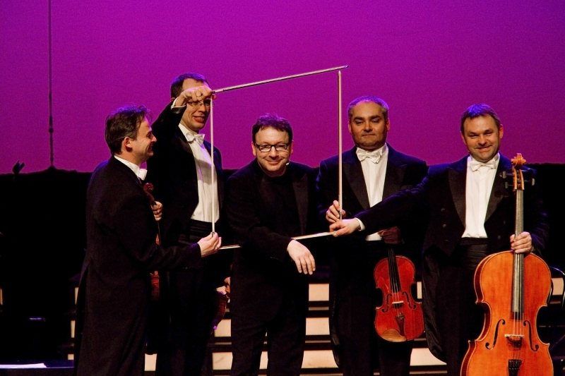
MoCart Group & Zbigniew Zamachowski – Kobiety jak te kwiaty

Slide 14
MoCart Group – Four nice guys which making jokes with classic music
Zbigniew Zamachowski – Theater and movie actor, composer. Really great and really famous

Slide 15
https://www.youtube.com/watch?v=3rX_S9eoV7I

