Slide 1
Dutch Borrowings

Slide 2
Borrowing vs Cognate
Bread
Brood
Cognates: forms of the same word existing independently in different languages, e.g. Skt. raja, Lat. rex (reg-), and OE rice meaning ‘king, kingdom’. These are direct continuations from a single original word in the parent language, in this case *reg in Proto-Indo-European. (Arnovick, 111).
Often, the meaning is slightly different: English deer/ Dutch dier and German tier rom Proto-Germanic *deuzą, from Proto-Indo-European *dʰewsóm (“living thing”). In English – specialization.

Slide 3
Borrowings
Words “copied” from other languages for various reasons: we may lack the word for a thing or a concept, the foreign term may be shorter or simpler, the foreign term may capture a nuance of meaning that we lack, or the language from which the word comes may carry prestige or dominate in a particular field. (Arnovick, 62)
“animal”
“regal” vs “rice” and OD “riki (kingdom, empire)”
https://en.wiktionary.org/wiki/Reconstruction:Proto-Germanic/r%C4%ABkij%C4%85

Slide 4
Borrowings in English

Slide 5
Skipper
From schipper /ˈsxɪ.pər/ ( crew member, someone who ships)
Meaning:
  1. ship captain
  2. Coach, director
  3. Sports captain

Slide 6
Smuggler
From smokkelen /ˈsmɔ.kə.lə(n)/ (transport contraband)

Slide 7
Avast
From hou vast (hold tight,
hold fast)
Meaning halt, stop

Slide 8
Brackish
From MD brac (salty)
Meaning:
  “salty,” especially of water.
  “distasteful”
  “repulsive”

Slide 9
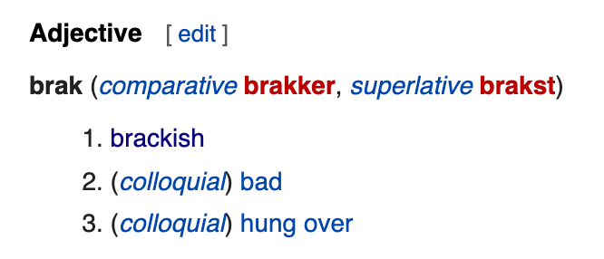

Slide 10
Cruise
From kruisen (cross, intersect, sail across, go through)
Meaning:
  sea or lake voyage (taken for pleasure)
  Flight of a plane at constant speed and altitude
  https://en.wiktionary.org/wiki/cruiser

Slide 11
Gas
From gas, a termed coined by chemist Jan Baptist van Helmont.
Probably derived from Dutch chaos from Greek khaos (chasm, void)

Slide 12
Yankee
Term originally denoting a settler from the NE USA, its meaning varies by time period and user.
https://en.wikipedia.org/wiki/Yankee#Origin_and_history_of_the_word

Slide 13
Boss
From baas (master, chief)
Recorded in English from 1620s as a standard word for a Dutch ship captain.

Slide 14
Mannequin
Through French from manneken (man+ken meaning “little man”)
In Dutch: mannequin, etalagepop (display figure)

Slide 15
Cookie
From koekje /kuk.jə/
Diminutive of koek from ME coeke
https://en.wiktionary.org/wiki/Reconstruction:Proto-Germanic/k%C5%8Dk%C3%B4

Slide 16
Iceberg
From ijsberg (ice mountain)
Ijs:
https://en.wiktionary.org/wiki/Reconstruction:Proto-Germanic/%C4%ABs%C4%85
Berg:
https://en.wiktionary.org/wiki/Reconstruction:Proto-Germanic/bergaz

Slide 17
Dutch Borrowings in Czech

Slide 18
Duna
From MD dūne
https://en.wiktionary.org/wiki/dune#Middle_Dutch

Slide 19
Kajuta
From kajuit meaning cabin on a ship
Possibly borrowed from OF
German Kajüte, possibly borrowed from MD kayhute
English hut.
https://en.wiktionary.org/wiki/kajuit#Dutch

Slide 20
Komando (Afrikaans)
From kommando (An organized force of Boer troops in South Africa; a raid by such troops)
Meaning a small fighting force specially trained for making quick destructive raids against enemy-held areas.

Slide 21
References
Brinton, J.Laurel, and Arnovick, Leslie K.. The English Language, A Linguistic History, second edition. Oxford University Press.
https://en.wiktionary.org/
https://www.learndutch.org/
https://www.dailywritingtips.com

