Slide 1
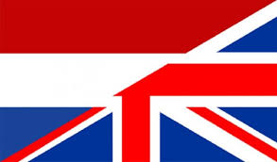
THE anglo-dutch relations
Monika Bílková

Slide 2
structure
1. Brief common history overview
2. Expressions in the English language involing the Dutch

Slide 3
1. HISTORY OVERVIEW

Slide 4
IMPORTANT MILESTONES
MIDDLE AGES
economic relations since then

Slide 5
IMPORTANT MILESTONES
17TH CENTURY
the Dutch "Golden Age"
beginning of rivalry between the UK and the Netherlands
various reasons:
the navy, mercantilism - expansion, colonies, development
complex relations, Anglo-Dutch wars (4 in total)

Slide 6
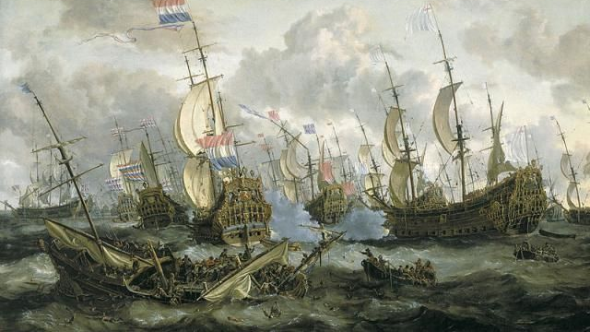

Slide 7
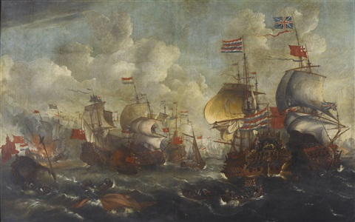

Slide 8
2.THE DUTCH INFLUENCE ON THE ENGLISH LANGUAGE

Slide 9
Borrowings
British x American English - differences, Dutch as some of the first Europeans to settle in the US
→ "Santa Claus" from "Sinterklaas", Dutch and Flemish feast celebrated on the 5th and 6 December respectively, he came to the Netherlands and then moved to America.

Slide 10
various sectors:
food and drinks - "Coleslaw" from "koolsla" – literally cabbage salad
sea and sailing, travelling (for example: "deck' from "dek", meaning "covering", "boss" from "baas" - Dutch ship´s captain,"landscape" from "landschap"- same menaings , "iceberg" from "ijsberg" - literally ice mountain
names of places - Breukelen → Brooklyn

Slide 11
b)Expressions involving the Dutch
Dutch agreement - between men who had drunk too much alcohol
Dutch courage - the false courage produced by the effects of drinking alcohol
Dutch leave - what a soldier took when he left his base without permission
Dutch treat – long ago: a dinner at which the invited guests were expected to pay for their own share of the food and drink, now: when friends go out to have fun, each person pays his own share (in the US also used an expression "going Dutch/let's go Dutch" - the difference is that with a Dutch treat, you don't expect it and it is an unpleasant surprise

Slide 12
In Dutch - someone said this to you, they were telling you that you were in trouble – someone was angry at you, etc.
To talk to someone like a Dutch uncle – to speak in a severy way (Dutch uncle – someone very hostile
Dutch roll - the left to right tipping movement made by an aircraft, it is said to derive from the rolling motion of a particular design of Dutch ship, it could also come from the movement made while speed skating
Double Dutch – a rope skipping game played by two
Dutch Oven – cooking pot in America

Slide 13
THANK YOU FOR YOUR ATTENTION :)

