Slide 1
From PIE to Dutch
Justas Petrosius

Slide 2
Index
PIE Homeland
Germanic
West-Germanic
Low Franconian
Dutch
Netherlandic

Slide 3
PIE Homeland
North Pole? North Africa? The Atlantic? The Pacific? (Mallory 1989:143)
Flora & Fauna in PIE
Anatolian Hypothesis
Kurgan Hypothesis

Slide 4
Flora & Fauna in PIE
Fauna: Stork, Crane, Falcon, Vulture etc.
Trout, Salmon.
Fox, Wolf, Elk, Hedgehog.
Suggest the PIE homeland in at least a partially forested area.
Flora: Oak, Birch, Cherry, Bean, Berry etc.
Suggest a temperate climate.
(Fortson 2004: 39-40)

Slide 5
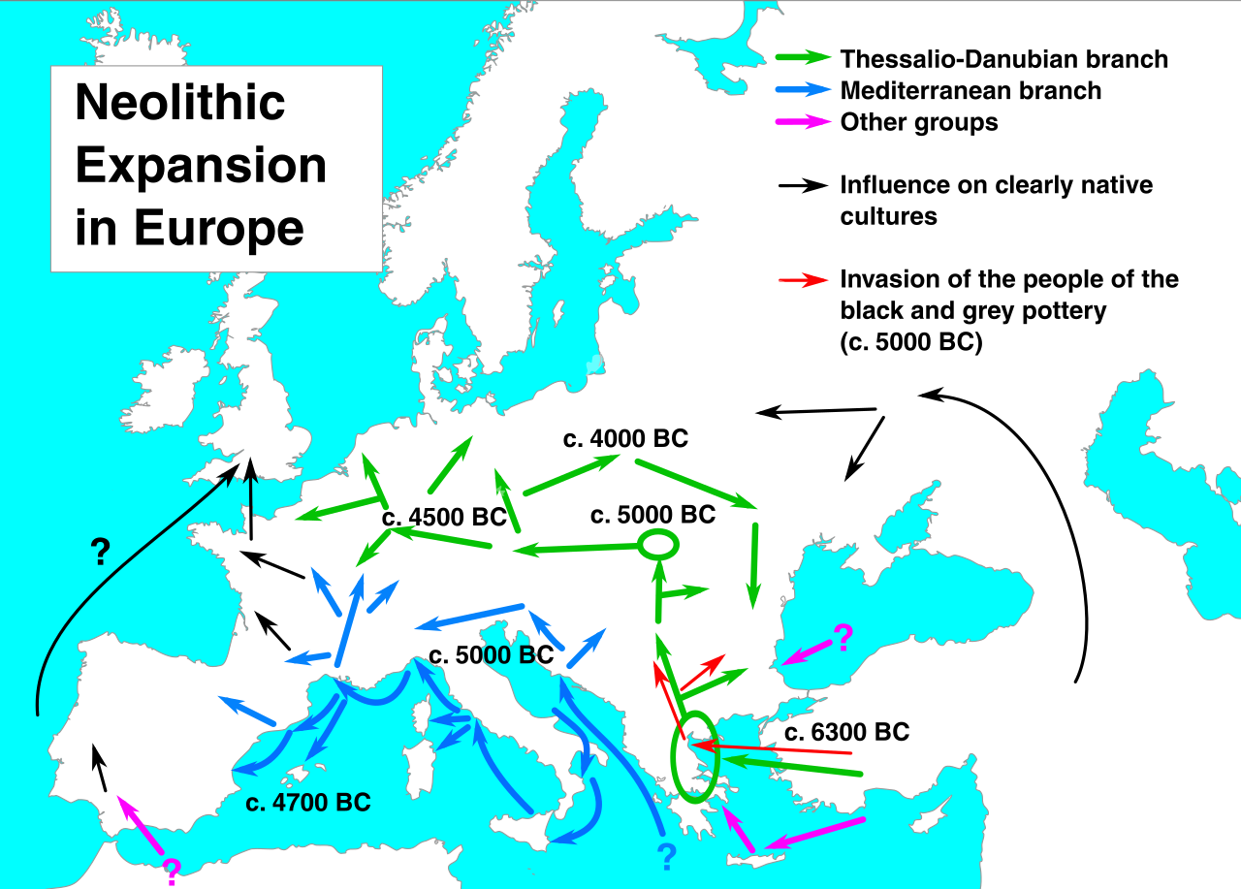
Anatolian Hypothesis
Colin Renfrew in 1987 suggests that Indo-Europeans spread out of Asia Minor with the Neolithic advance in farming.
(David & Ringe 2015: 201)

Slide 6
Kurgan Hypothesis
PIE burial practices in IE texts.
Dead persons buried in individual tombs & heaped over with earth (a burial Mound). The Body was sometimes cremated.
Buried with items needed in the afterlife: tools, food, animals, sometimes other people.
Burial mounds in the Russian Steppe (Kurgans) match the IE practices.
According to Gimbutas their society had : a pastoral economy, patriarchy, domesticated horses, the wheel, worship of a solar deity. (Fortson 2004: 41)

Slide 7
Germanic
Germanic (Form. Teutonic) lived in southern Scandinavia in the 1 mil. BCE.
Attested in the I C. BCE by the Romans.
(Fortson 2004: 300)
P.I.E.
Germanic
West Germanic
East Germanic
North Germanic

Slide 8
Grimm's Law
Rasmus Kristian Rask discovered the sound changes now named after Grimm in 1814.
(Fortson 2004: 302)
Grimm’s Law
Grimm I
p > f
t > θ
k > h
kʷ > hʷ
Grimm III
bh > b
dh > d
gh > g
gʷh > gʷ
Grimm II
b > p
d > t
g > k
gʷ > kʷ
Notes:
Proto-Indo-European voiceless stops change into voiceless fricatives.
Proto-Indo-European voiced stops become voiceless stops.
Proto-Indo-European voiced aspirated stops become voiced stops or fricatives (as allophones).

Slide 9
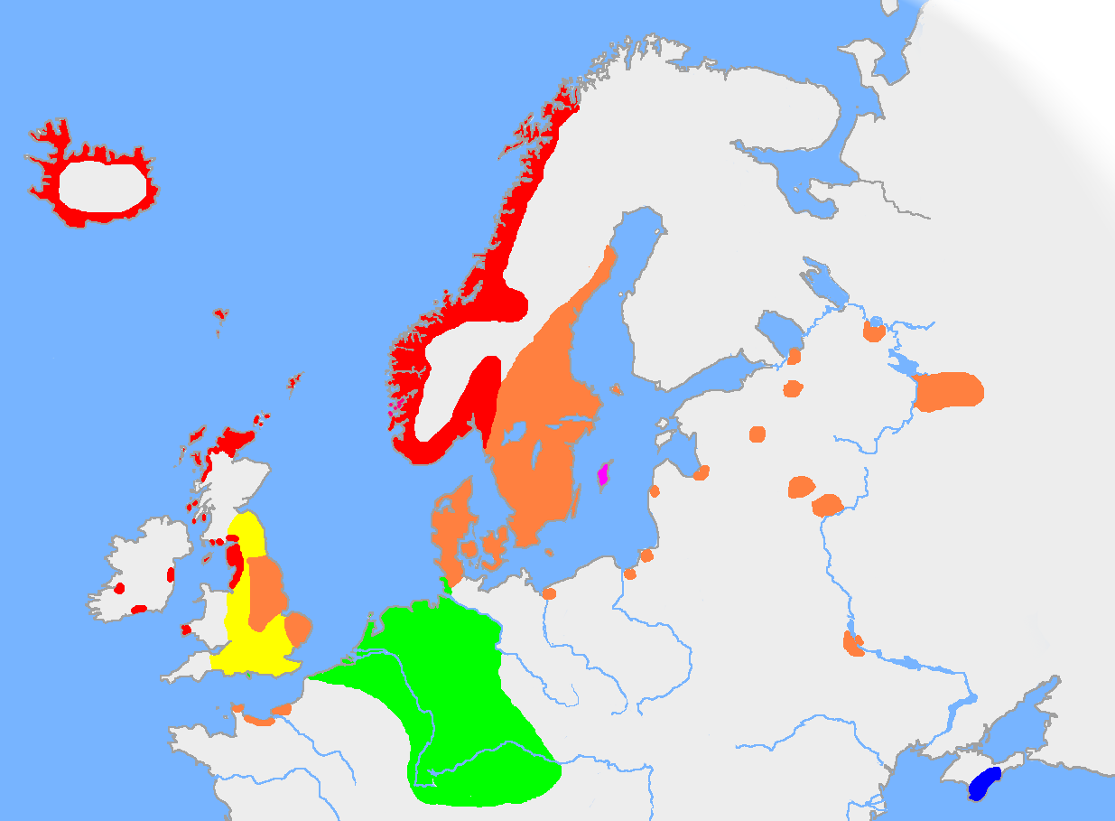
West Germanic
3 languages meaningfully attested before the year 1000: Old English, Old Saxon, Old High German.
Old Low Franconian (Old Dutch) attested later.
(Fortson 2004: 314)

Slide 10
Hebban olla vogala
“Hebban olla vogala nestas hagunnan hinase hic enda thu, uuat unbidan uue nu.”
"All birds have started making nests, except me and you, what are we waiting for?“
Dated to around 1100 A.D.
(Fortson 2004: 315)
Notes:
425/450–1150: Old Dutch

Slide 11
Middle Dutch
Well attested starting in the 12 C. Principally in Flanders and Brabant.
Spoken and written between 1150 and 1500.
“The literature of this time consist of courtly romances, epics, miracle plays, and religious writings. “
also called Diets, Dietsch in popular use, though not by linguists.
(Fortson 2004: 328)
Notes:
1150–1500: Middle Dutch (also called Dietsch in popular use, though not by linguists)

Slide 12
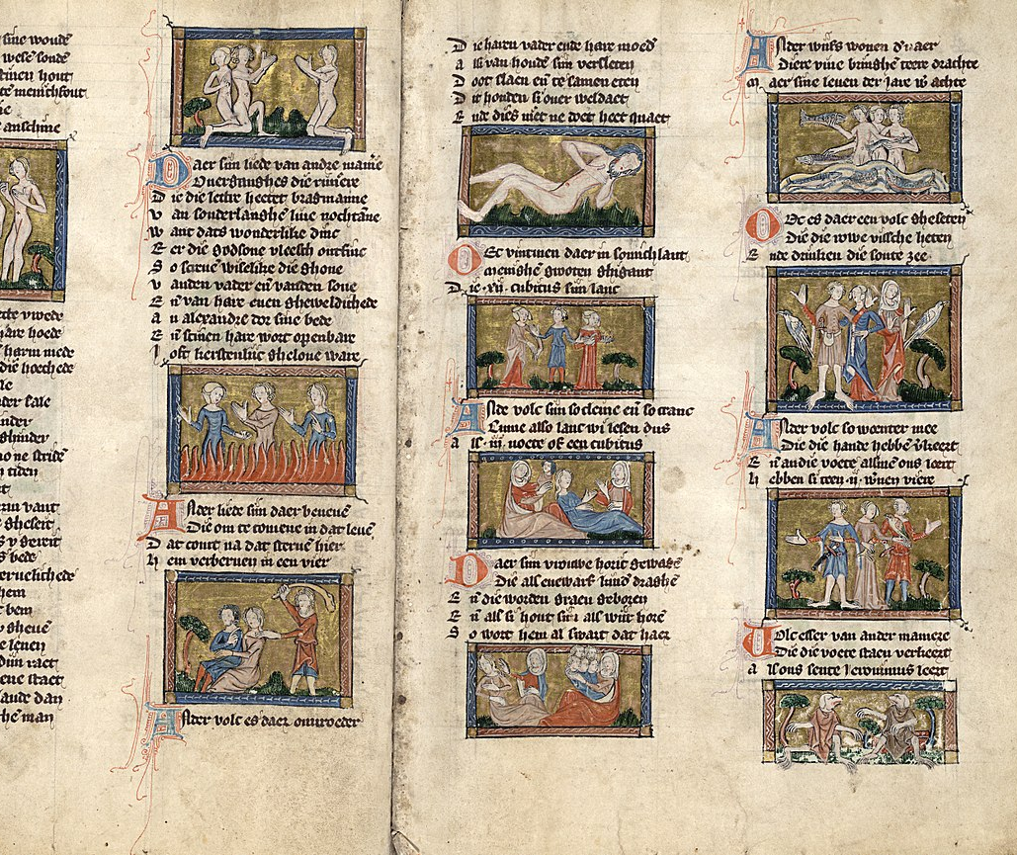
Jacob van Maerlant
Der Naturen Bloeme (1263) - a collection of moral and satirical addresses to all classes of society.
De Spieghel Historiael (1284) - an adaptation with additions of his own of Vincent de Beauvais’s Speculum Historiale. Written to satisfy the rising class of commoners who wished for instructive reading in their own language.
(King P.K. & P.F. Vincent 2019)
Notes:
Jacob van Maerlant, (born 1225, Vrije van Brugge [Damme?]—died 1291, Damme), The founder and creator of original Dutch literature was Jacob van Maerlant. pioneer of the didactic poetry that flourished in the Netherlands in the 14th century.
Pic - Strange peoples in Der naturen bloeme

Slide 13
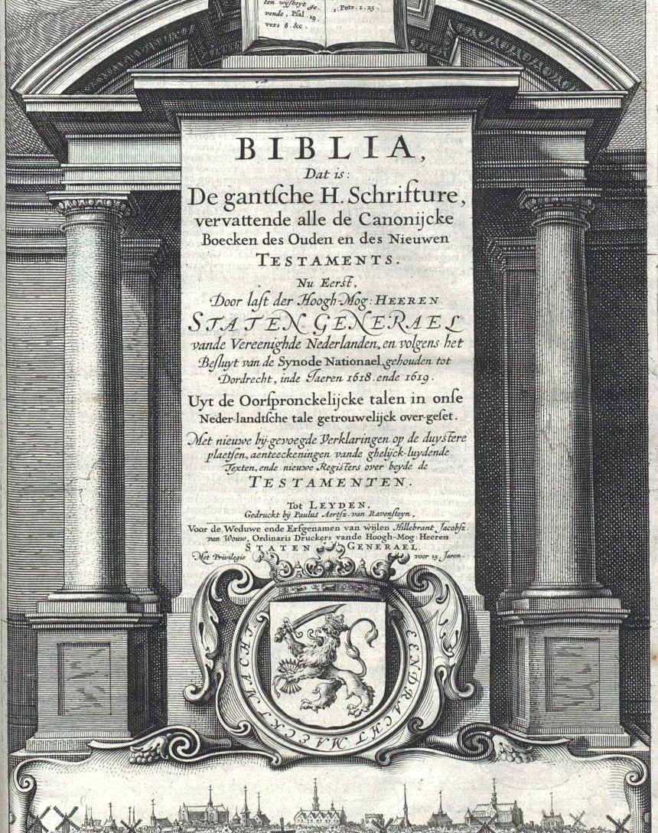
Modern Dutch
From the 1500 to present.
Flanders and Brabant were the most influential at first.
The 1585 fall of Antwerp.
Process of Standardization became quite strong in the 16th century.
The Statenvertaling bible (1637), predominantly based on the urban dialects of Holland. Also used elements from various, even Dutch Low Saxon.
(King P.K. & P.F. Vincent 2019)
Notes:
1500–present: Modern Dutch (saw the creation of the Dutch standard language and includes contemporary Dutch)

Slide 14
Netherlandic
In the 17th century the Dutch colonized South Africa. The language spoken by the colonists developed into Afrikaans.
Flemish refers to the variety of Dutch which developed around Flanders.
Dutch, Afrikaans and Flemish are often called Netherlandic.
(Fortson 2004: 328)

Slide 15
Summary
PIE (Kurgan) Homeland
Germanic tribes in Northern Europe
West-Germanic
425/450–1150: Old Dutch
1150–1500: “Dietsch”
1500–present: Modern Dutch
Netherlandic

Slide 16
Sources
David A. & D. Ringe. 2015. The Indo-European Homeland from Linguistic and Archaeological Perspectives. Annual Review of Linguistics 1:199–219.
Encyclopaedia Britannica, 8th ed., s.v. “Jacob van Maerlant” Chicago: Encyclopaedia Britannica, 2019. https://www.britannica.com/biography/Jacob-van-Maerlant (accessed November 11, 2019)
Fortson B.W. 2004. Indo-European Language and Culture. Oxford: Blackwell.
King P.K. & P.F. Vincent. Encyclopaedia Britannica, 8th ed., s.v. “Dutch literature” Chicago: Encyclopaedia Britannica, 2019. https://www.britannica.com/art/Dutch-literature (accessed November 11, 2019)
Mallory, J.P. 1989. In Search of the Indo-Europeans. New York: Thames & Hudson.

Slide 17
CONTACTS
Justas.petrosius@flf.stud.vu.lt

