Slide 1
Afsluitdijk
Filip Kopecký

Slide 2
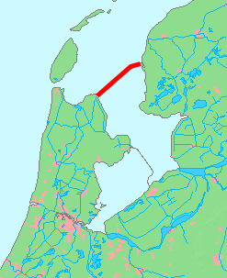
Afsluitdijk
Dam dividing the North Sea from the South Sea
For gaining more land, flood protection
Built between 1927 and 1932
Construction began at 4 points simultaneously
32.5 km long
7.25 m above sea level
90 m wide
9 years of negotiation due to high costs

Slide 3
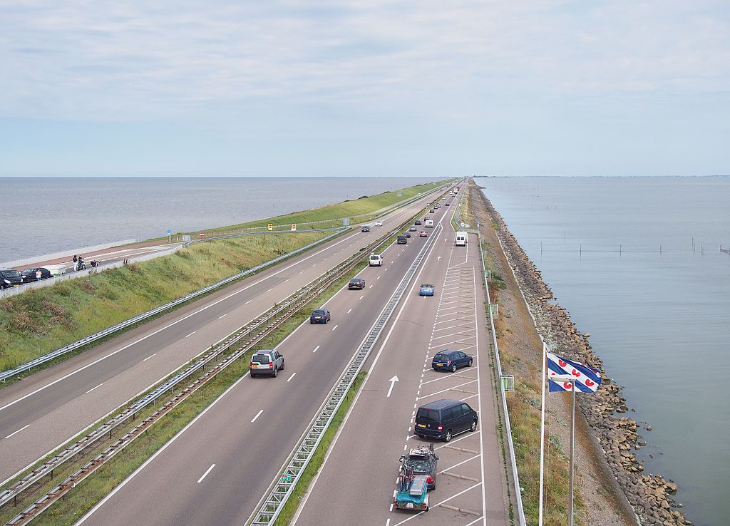
Highway on the Afsluitdijk
Opened since 1934
The first 130 km/h highway in the NL
Meant to include railway
Railway never built due to the cost
Space used for another two lanes of the highway
Connects Den Oever and Zurich

Slide 4
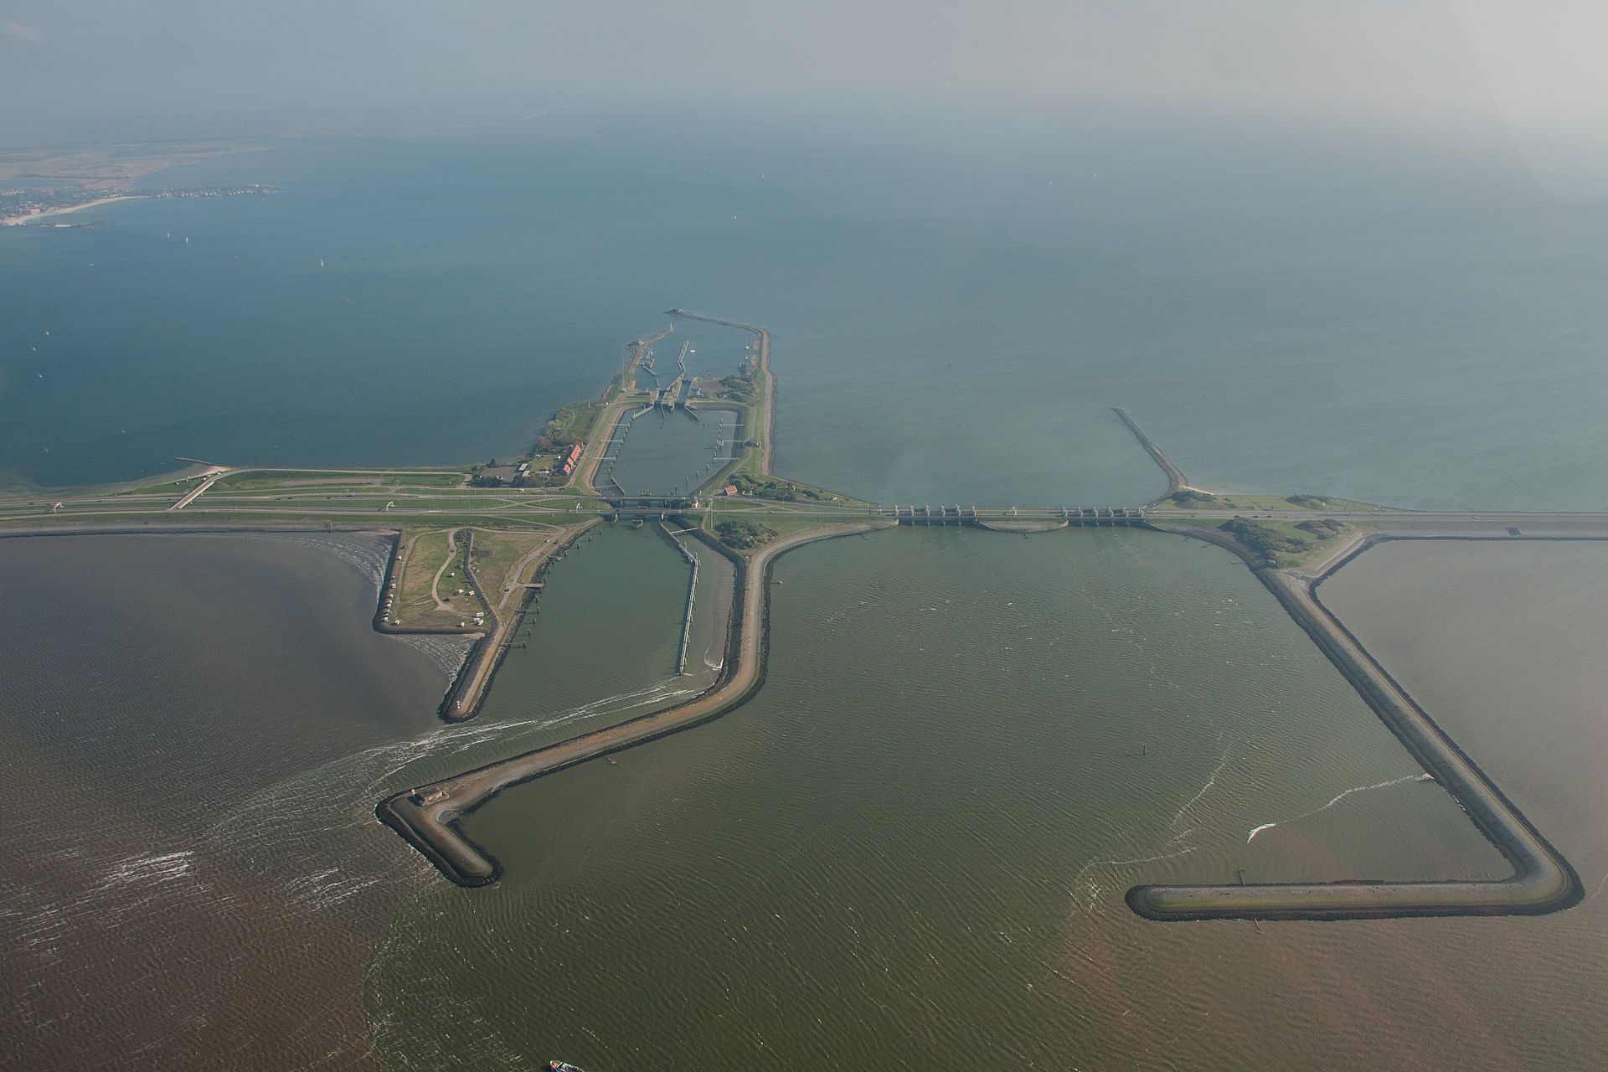
Battle of the Afsluitdijk
12 – 14 May 1940
Wehrmacht lost the battle
Attacked by planes and artillery
The Germans used bikes
NL was prepared – 20 defensive structures
Fought in (or in front of) the fortress Kornwerderzand ↑

Slide 5
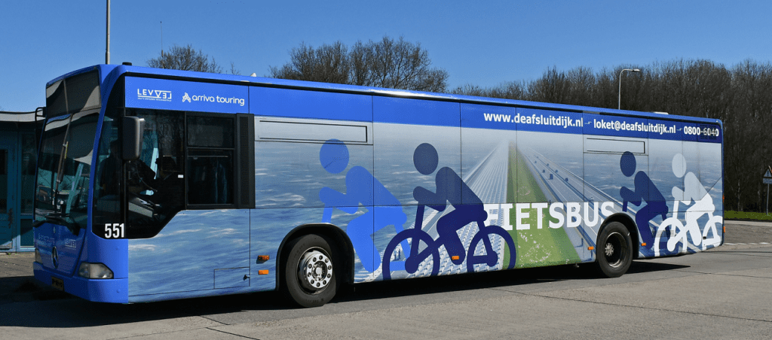
Other traffic on the Afsluitdijk
Closed to cyclists, pedestrians
1 April 2019 – 1 April 2022
Free bus service
You can take a bike with you
You can request transport of
other types of vehicles

Slide 6
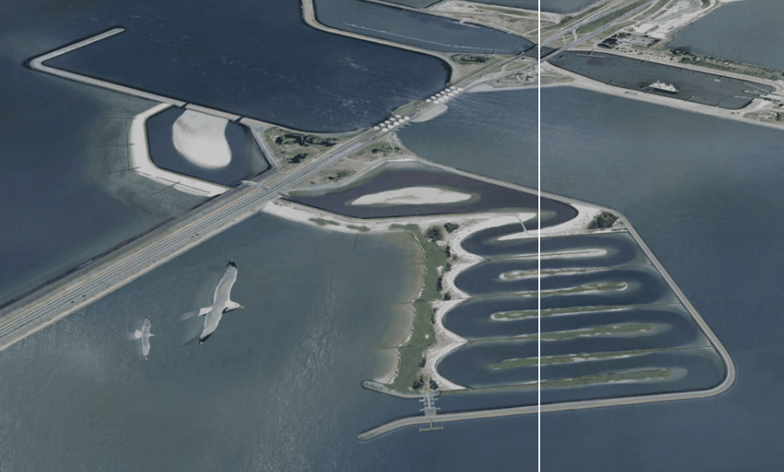
Passage for fish

Slide 7
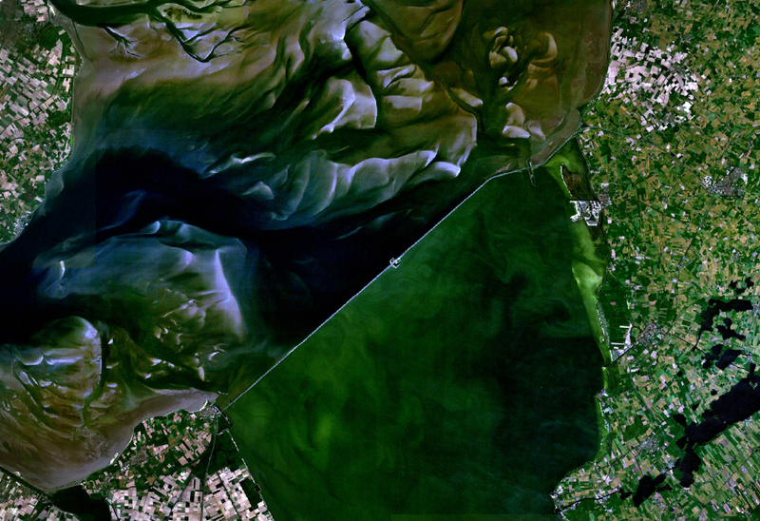

Slide 8
Sources
https://en.wikipedia.org/wiki/Afsluitdijk (mostly)
Other related wikipedia pages
https://www.holland.com/global/tourism/destinations/provinces/friesland/the-afsluitdijk.htm
https://theafsluitdijk.com/

