Slide 1
Art and Politics
Jacques ranciÈre

Slide 2
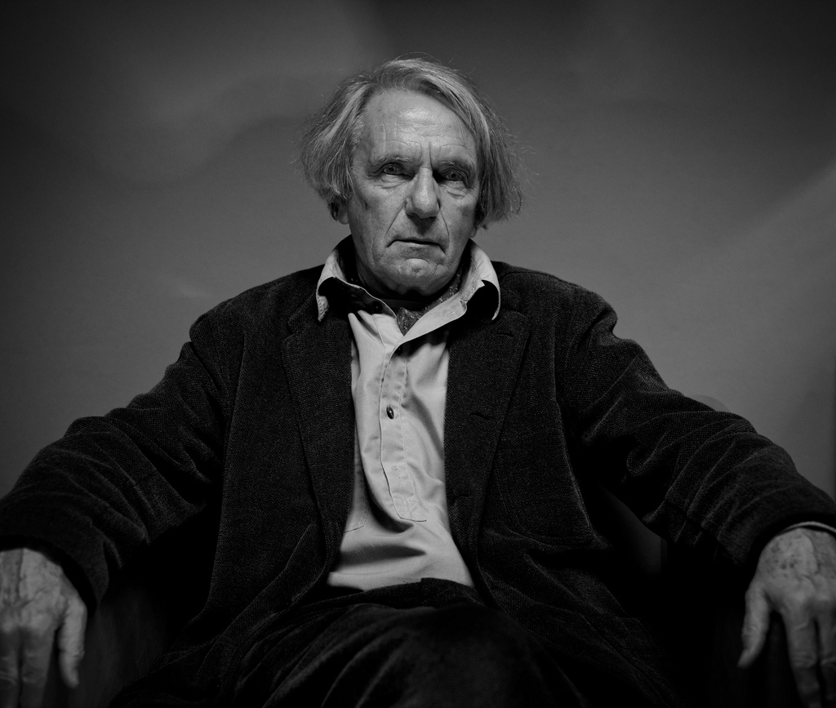

Slide 3
Jacques Rancière (*1940)
French philosopher
Student of marxist philosopher Louis Althusser – after 1968 Rancière part ways with Althusser and marxism

Slide 4
The Ignorant Schoolmaster (1987)
Mute Speech: Literature, Critical Theory, and Politics (1998)
The Politics of Aesthetics: The Distribution of the Sensible/Le Partage du sensible (2004/2000)
The Future of the Image (2003)
The Emancipated Spectator (2008)
Dissensus: On Politics and Aesthetics (2010)

Slide 5
The Notion of Aesthetics
Rancière elaborates on the tradition of aesthetics from the end of 18th century (Kant, Schiller)
Aesthetics is not a science about art but a historical type of thinking about art
frame of perception and cognition in which objects labeled as art can exist
works of art understood as objects of a certain type of experience (i.e. the aesthetic experience) can exist only in a special space of thinking
the aesthetic experience is impossible outside of a specific historical situation

Slide 6
Three Regimes of „Art“/Images
1. The Ethical Regime
understanding of art based on the ideas of Plato
not art in modern sense
artistic representations judged by their truthfulness and ethical import
2. The Representative Regime
based on the ideas of Aristotle
special sphere of imitating arts
regulating idea of mimesis which constitutes norms for discerning good imitations from bad ones

Slide 7
2. The Representative Regime
based on the ideas of Aristotle
special sphere of imitating arts
regulating idea of mimesis which constitutes norms for discerning good imitations from bad ones
representations governed by rules, hierarchy
representations are fictions

Slide 8
The Aesthetic Regime of Art
3. The Aesthetic Regime of Art
established throught the aesthetic revolution in the philosophy of Kant and Schiller, romanticism and realism (mainly in literature)
unity of concious and unconcious, acting and passivity, intentional and unintentional
realistic novel as an emblematic genre
everything can be equally representable
no means of representation are more or less adequate

Slide 9
Aesthetic Autonomy
Radical autonomy of the aesthetic regime of art in which the boundaries between mimetic art and other human activities are cancelled
Aesthetic autonomy contains heteronomy
Art presents itself as an autonomous form of life – that is as something transgressing the realm of art
In the aesthetic regime art is more then a technique or a mimetic skill

Slide 10
Modernism
Rancière rejects modernist, avantgarde and postmodernist interpretations of art
Modernism as a one-sided, reductive story of modern art determined by the abandonment with the mimetic function of art
The aesthetic regime of art is not characterized simply by abstraction
the principle of post-mimetic art is not novelty
The change is the re-interpretation of art, including art of the past

Slide 11
Two versions of modernity
development of art towards a pure medium or form
dissolution of art in life
Both movements aim at the end of art
Both are expressions of the same regime of art
renunciation of the hierarchy of representative art
anything can be represented in art, art has no natural limitation
no boundaries between art and non-art, between high art and the ordinary objects

Slide 12
Politics and Police
Politics as undermining the division of power and the classifications of society
critical perspective towards the prevailing social order
including those who are muted, excluded
negation of the existing social order
Police as organization of power in society
includes only those who are already represented
those outside are „the others“ (victims without rights or evil)

Slide 13
Aesthetics and Politics
Politics suggests the re-distribution of the sensible, i.e. of what is visible, represented in society => the aesthetic dimension of politics as collapse of the regulative laws of representation
Political dimension of art => artwork (in aesthetic regime) is a singular perspective, intervention into the configurations of the sensible, conceivable
artworks intervene in the relations between what we can see, think or imagine
our imagination is also political in the ability to imagine different configuration of the sensible

Slide 14
The Distribution of the Sensible
Le partage du sensible
Ultimately aesthetic act of reconfiguration of the „sensorium“, of what is available to the sense
Simultaneously an ultimately political act by the abolition of the fixed hierarchy and power relations based on determing who can (and cannot) act, perceive, undergo
Reconfiguration of the social roles
The aesthetic regime of art and politics are always possible if there is an appropriate historical condition

