Slide 1
POLITICAL SOCIOLOGY OF CENTRAL EUROPE
Populism
9 May 2019

Slide 2
How to define populism?

Slide 3
Populism in your thoughts
opposition to elites, intellectuals
appealing to masses, the majority (political marketing, public opinion)
manipulating fears of people, using emotions, demagogy, incoherent arguments
simplified slogans and communication in general
avoiding real political solutions
distrust in party politics
migration as a frequent topic of populists, nationalism
inequalities (gap between rich X poor)

Slide 4
Your questions
Can you name examples of populism from your country?
Are there any positive effects of populism?
Is populism a convenient term when capturing current political landscape?
Can we call populism a political ideology such as liberalism, socialism…?
Why people in CE vote populist parties? There is no serious crisis.

Slide 5
Common understanding of populism
Demagogy and opportunism
highly emotional and simplistic rhetoric
opportunistic policies that aim to “buy” the support of voters

Slide 6
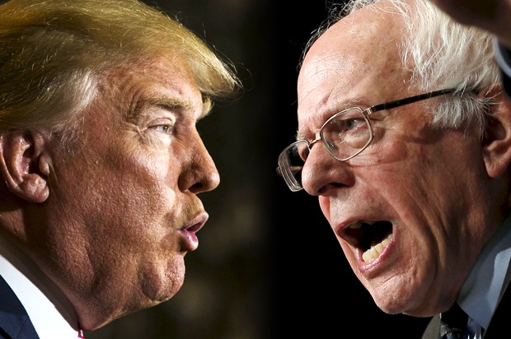
The concept of Populism
a farflung notion (Gerrin 1997): spread out over a very large area
contradictive and incomparable cases of populism (Donald Trump X Bernie Sanders; Brexit X Occupy movement)

Slide 7
Three ways of defining populism in social sciences
1. Ideology
2. Strategy
3. Discoursive style
(Gidron, Bonikowski 2013)

Slide 8
Populism as „thin ideology“
Cas Mudde: The Populist Zeitgeist (2004)
populism as a thin-centered ideology: ideas with limited scope, complexity and ambition
society devided into two antagonistic groups: „the pure people“ vs. „the corrupt elite“
politics as an expression of the general will of the people

Slide 9
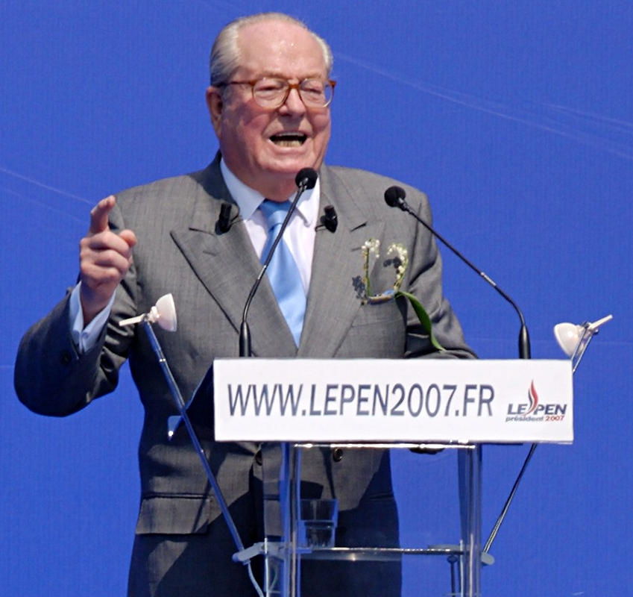
PEOPLE / ELITE
“We are transferring power from Washington DC and giving it back to you, the people … The establishment protected itself, but not the citizens of our country.”
(Donald Trump at his inauguration)
“I will give voice to the people. Because in democracy only the people can be right, and none can be right against them.”
(Jean-Marie Le Pen in 2007)

Slide 10
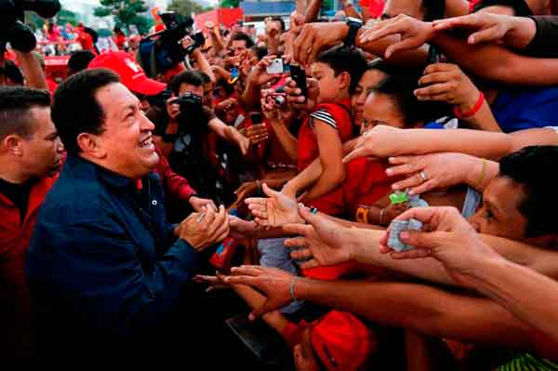
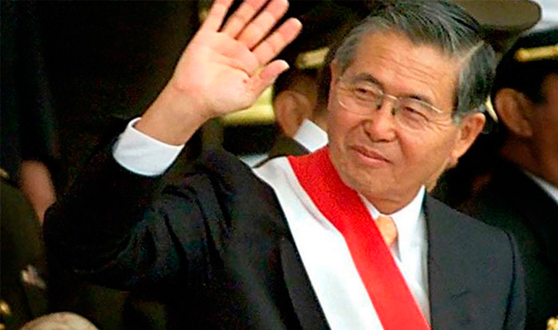
Populists as embodiment of the „true people“
¡Chávez es Pueblo!
(Chávez is the people!)
Fujimori, presidente como usted
(Fujimori, a president like you)

Slide 11
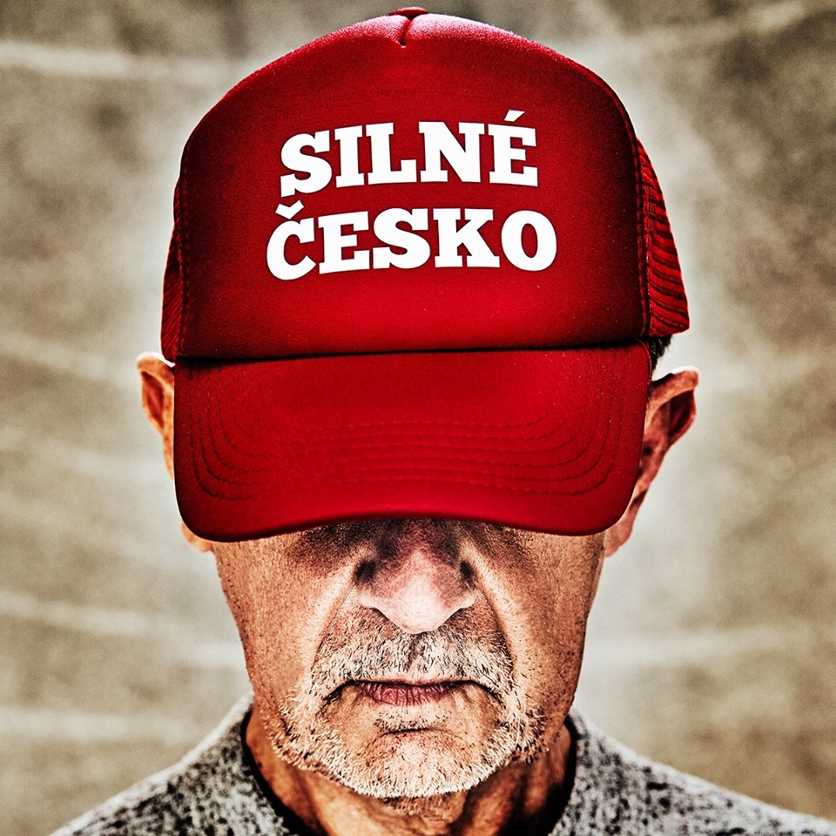
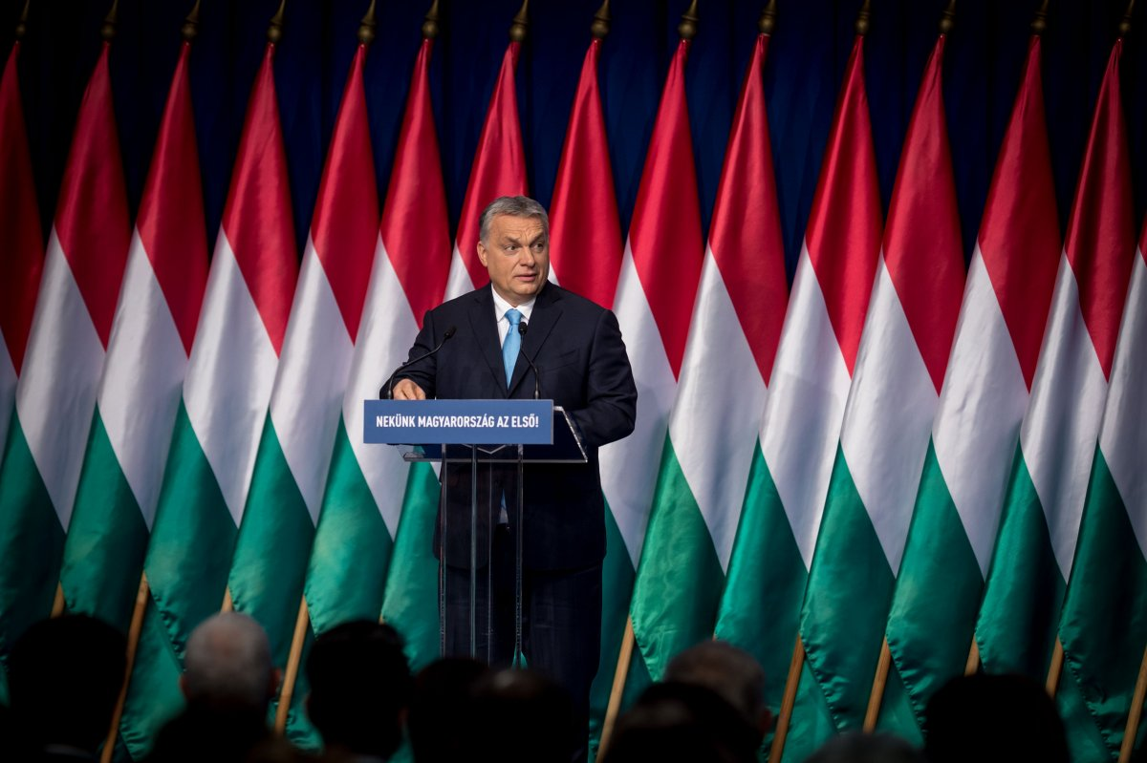
Civilizational X National populism (different content of the term „nation“)
strong economics, progress,
civilization
Hungary as the last bastion against 'Islamisation' of Europe, Christian identity

Slide 12
Populism in CE
Blaming the communist past („mental legacy of communism“)
"a postcommunist man as an individual unwilling to take risk and unfriendly towards fair play and pluralistic values" (Tismaneanu 1996: 514)
totalitarian mentality as a vision of the world exclusively in terms of the friend/enemy distinction (Kohák 1997: 24)
intolerance and hypocrisy, strong etatist (paternalistic) authoritarian rules of behavior, doublethink in public and in private, atomization of society, relative information isolation, a trap of political illusions and resulting unrealistic expectations (Melich 1997)
the communist legacy of depolitization, which can be seen in a lack of patience with politics and in natural tendency to search for easy, radical solutions (Schöpflin 1992: 41)
X the global rise of populism

Slide 13
Populism as a political style
Benjamin Moffitt
„The Global Rise of Populism“
the people / the elite
bad manners
crisis, breakdown, threat
https://www.youtube.com/watch?v=ihQNNcXg7sU
Populism as an effective style -> mainstreaming populism
(populist meaning-making that emerges in the ”mainstream” parties)

Slide 14
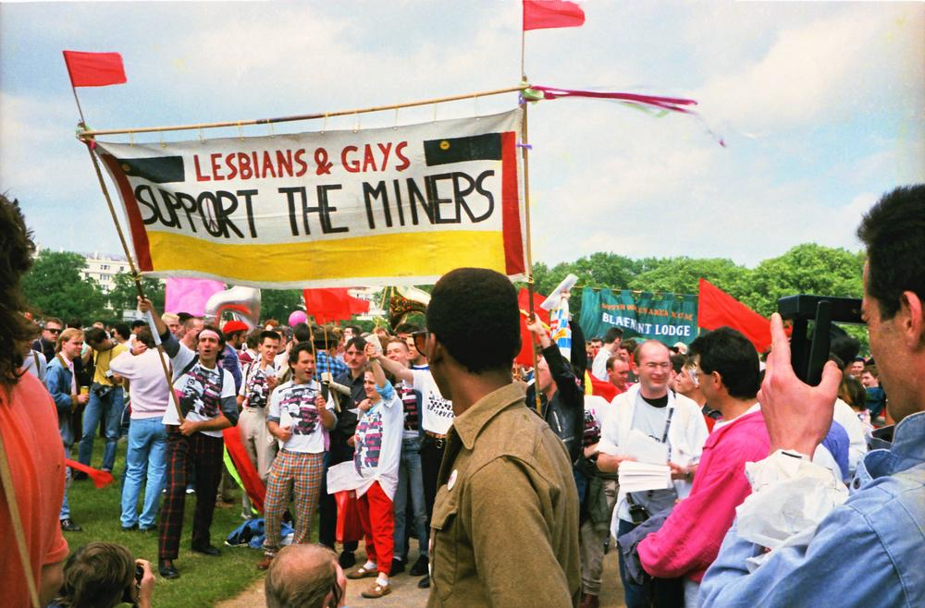
Ernesto Laclau (+ Chantal Mouffe)
populism as a mode of political articulation (Laclau 2005: 153)
all movements are populistic – the question is to what extent
analytical unites: demands
„Populism means putting into question the institutional order by constructing an underdog as an historical agent“ (p. 163)
chain of demands under an „empty signifier“
Notes:
“Laclau and Mouffe (1985, 2000) understand that if we are to pursue a model of agonistic struggle, existing power differences mean that marginalized and disadvantaged groups will need to assemble creative and deeply political strategies to undo the current hegemony. In that context, they advocate what they call ‘chains of equivalence’: movements made up of allied groups seeking broad transformation of existing power relations. The groups in the chain each have their own distinct relation to the existing hegemony, and each group’s experience and interests are irreducible to the others. Each retains their difference. However, they are able to act in concert around an agenda of equivalence. That is, they see themselves as equivalently disadvantaged by existing power relations. ‘Equivalent’ in this case does not mean identical. They are not disadvantaged in precisely the same way, and Laclau and Mouffe explicitly reject the old-style social movements that reduced participants to a single social position (usually class). Each link in the chain remains distinct, but they operate together, in concert

Slide 15
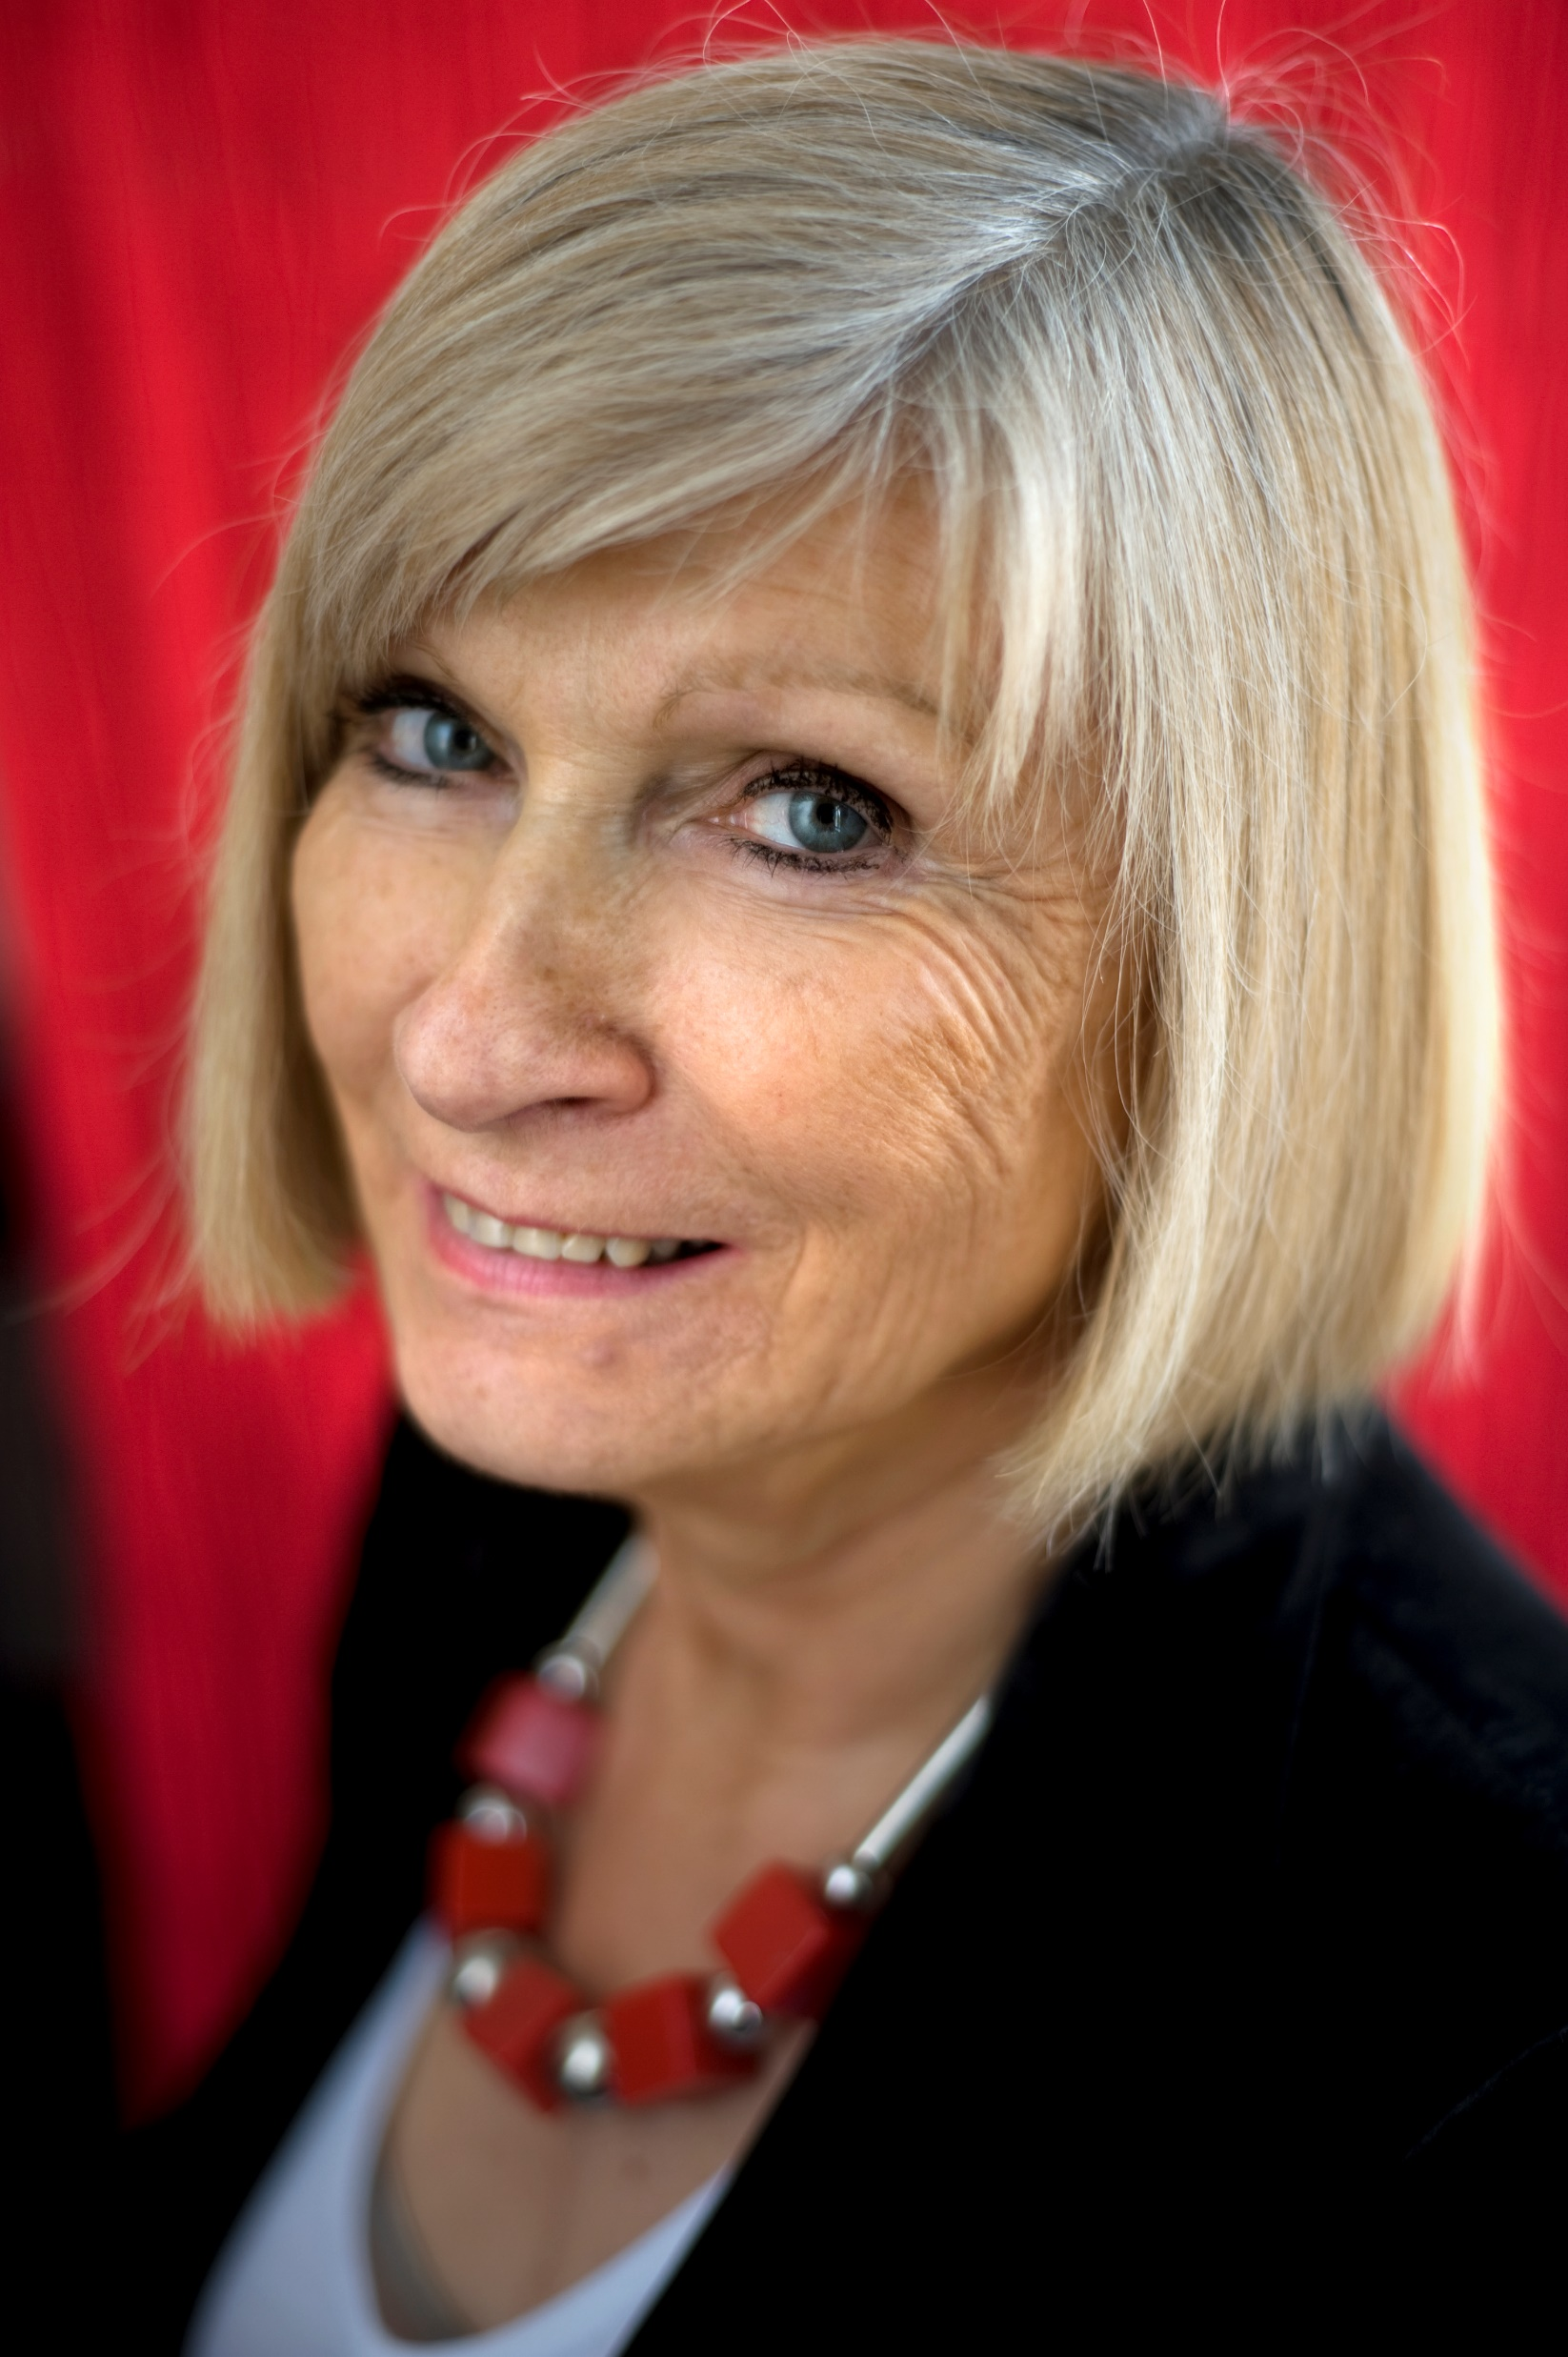
Call for the „good“ populism
populism as the total opposite of liberal and representative democracy (Urbinati 1998: 116)
X
populism ‘can be both a corrective and a threat to democracy’ (Kaltwasser and Mudde 2012: 16)
Mouffe (2018) – left populism
leftwing popular movement that is not based on race or nation can succeed
we should overcome the pejorative connotations of populism

Slide 16
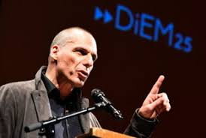
The Case of DiEM25
trans-European movement launched by Yanis Varoufakis and Srećko Horvat in 2016
the main goal: to reform the EU towards deeper democratization
Manifesto:
„The EU will be democratised.
Or it will disintegrate!“

Slide 17
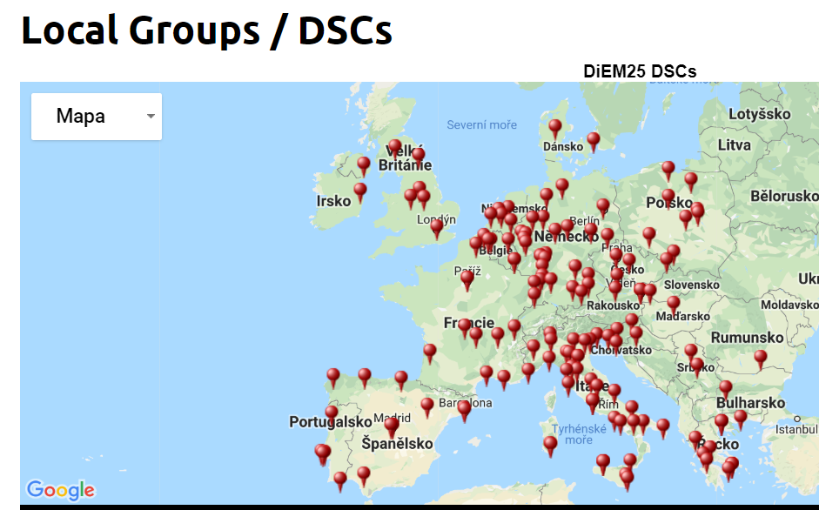

Slide 18
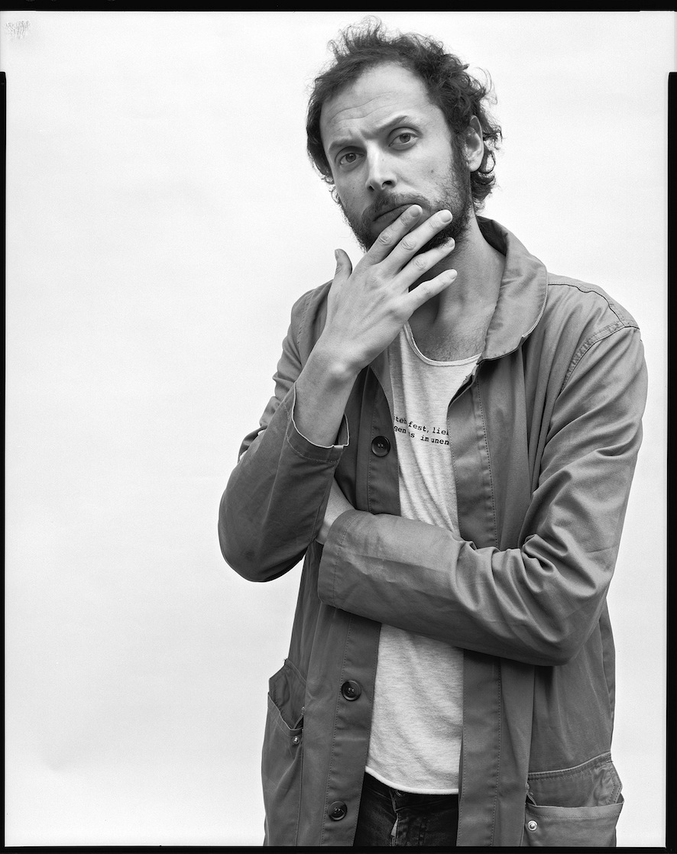
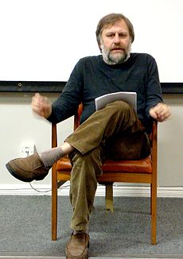
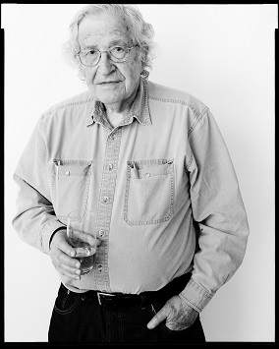
„Europe is desintegrating and losing its soul + problems: public debt, banking, inadequate investment, migration, rising poverty.“
„We, the peoples of Europe, have a duty to regain control over our Europe from unaccountable ‘technocrats’, complicit politicians and shadowy institutions.“

Slide 19
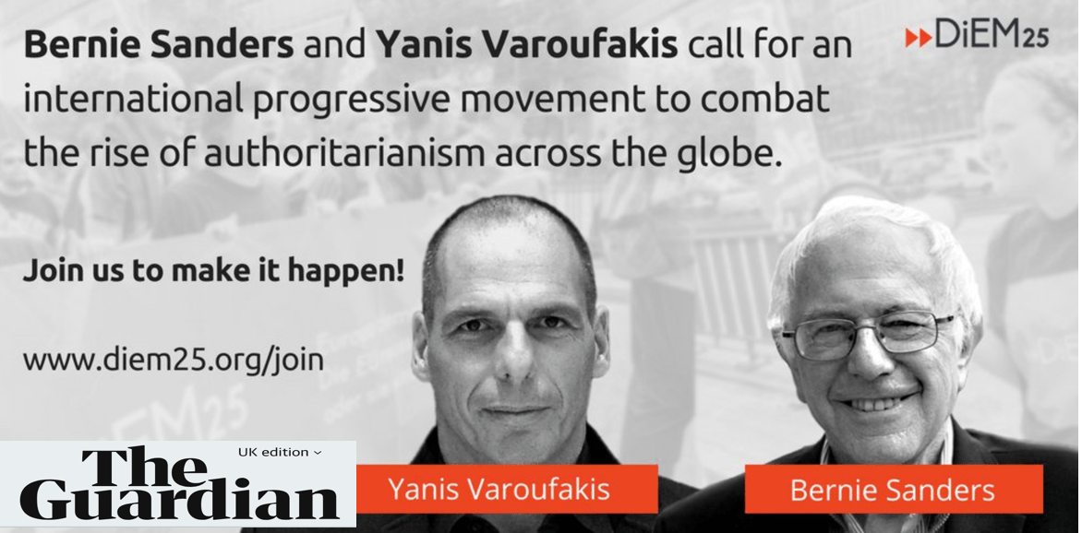
„Simplicity! What the nationalist, nativist Right offer is exactly this: SIMPLICITY. (…) In short, we need to pitch progressive simplicity versus regressive oversimplification.“
Brian Eno & Yanis Varoufakis

Slide 20
Can be populism a corrective for the problems of liberal democracies?

Slide 21
References
Gerring, J. 1997. „Ideology: A Definitional Analysis.“ Political Research Quarterly 50 (4): 957–94.
Gidron, N.; Bonikowski, B. 2013. „Varieties of populism: Literature review and research agenda.“ Working Paper Series of Weatherhead Center for International Affairs. Harvard University.
Kohák, E. 1997. “Consolidating freedom in Central Europe.” Dissent 44 (2): 21-26.
Laclau, E. 2005. On Populist Reason. London: Verso.
Melich, J. S. 1997. “The Post-Communist Mind“: Socio-psychological and Cultural Aspects of the Communist Legacy and the Transformation Processes in Eastern Europe.” Pp. 20-41 in Transition in Central and Eastern Europe, eds. Zeljko Ševic and Glendal Wright. Beograd: YASF-Student Cultural Centre.
Moffitt, B. 2017. „Transnational populism? Representative claims, media and the difficulty of constructing a transnational ‚people‘.” Javnost 24 (4): 409–425.

Slide 22
Moffitt, B. 2016. Global Rise of Populism: Performance, Political Style, and Representation. Stanford University Press.
Mouffe, C. 2018. For a Left Populism. London: Verso.
Mudde, C. 2004 „The Populist Zeitgeist.“ Government and Opposition 39 (4): 542–63.
Mudde, C.; C. R. Kaltwasser (eds.). 2012. Populism in Europe and the Americas. Cambridge: Cambridge University Press.
Schöpflin, G. 1992. „The Problem of Nationalism in the Postcommunist Order.” Pp. 27-41 in Bound to Change: Consolidating Democracy in East Central Europe, ed Peter M. Volten. New York: Institute for East Central Europe.
Tismaneanu, V. 1996. “The Leninist Debris or Waiting for Perón.” East European Politics and Societies 10 (3): 504-535.
Urbinati, N. 1998. „Democracy and Populism.” Constellations 5 (1): 110-124.

