Slide 1
The European commission - review on Sweden and Finland position paper
Charlier F., Hazaryan G., Mainka P., Wiesenthal D
08.04.2019

Slide 2
Uncontrolled migration
“Finland’s objective is to bring the uncontrolled migration in Europe under supervision and direct the migrants towards safer legal routes. There is a need for effective measures in the countries of origin as well as in transit states.”
Yes, but it is an outdated claim.

Slide 3
Huge progress has already been made:
European Migrant Smuggling Centre
Implementation of safe and legal pathways
European Travel Information and Authorization System
FRONTEX reinforcement

Slide 4
1% GNI contribution
“To preserve the current quota of 1% GNI contribution”
Higher contribution = stronger Union and Single Market

Slide 5
Why is a higher contribution needed?
EU budget - too modest
Allows better processing
Only benefits not penalties

Slide 6
Cutting down the cohesion budget
Cannot be an adequate solution in any cases

Slide 7
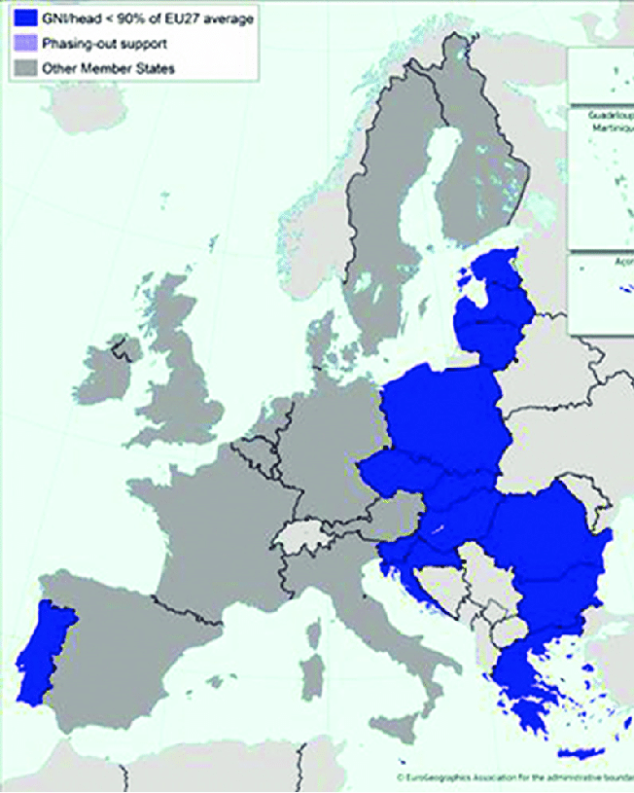
Why do we need this fund?
Reduce disparities across Europe
Ensure the cohesion of the countries
Help to tackle environmental issues
Cohesion and migration topics should not be mixed.

Slide 8
Solidarity argument
“The EU is not a Marshall plan, we want a solidary union, functioning as giving and receiving, not ‘pick and choose’”
Yes, a decision-making system and legal system based on the principle of solidarity is what the European Commission stands for.
It should apply to all countries.

Slide 9
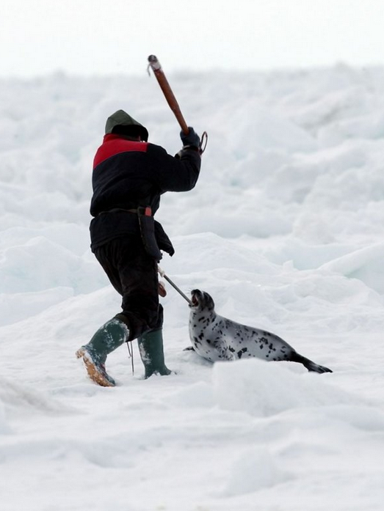
Sweden and Finland should also apply the ‘solidarity principle’:
Environmental solidarity
Sweden opposed legislation preventing Seal hunting
Regulation solidarity
Finland opposed legislation to restrict video sharing platforms and media services

Slide 10
Bibliography:
European Commission, Home affaires - https://ec.europa.eu/home-affairs/sites/homeaffairs/files/what-we-do/policies/european-agenda-migration/20181204_managing-migration-factsheet-8-ebcg_en.pdf
https://ec.europa.eu/home-affairs/sites/homeaffairs/files/what-we-do/policies/european-agenda-migration/20190306_managing-migration-factsheet-step-change-migration-management-border-security-timeline_en.pdf
Future EU budget must be increased to relaunch the Europe from the ground up - https://cor.europa.eu/pt/news/Pages/Future-EU-budget-must-be-increased-.aspx
Votes cast by Finland and Sweden in the Council of Ministers of the EU - https://www.votewatch.eu
EU budget for the future, Volume 1, page 9-10

Slide 11
Thank you for your attention!

