Slide 1
Plan for the following lessons
Previous lecture - Theory
Quick swipe thru Probability theory (just revision)
Walk thru using Aproximate Bayesian Computing
Todays lecture – A little bit of repetetion
Sampling to to work with probability
Simulating data – distributions overview
Examples of model fitting using rethinking package
Next lecture – Hands on
Building basic models and inference in R & Stan interfaces (hopefully)

Slide 2
Introduction to Bayesian data analysis II.
Bartoš František

Slide 3
Quick revision from last time

Slide 4
Probability – simple computations
another die example
Ω = {1, 2, 3, 4, 5, 6}
A = {1, 3, 5} = „event A is odd number“
let‘s have a fair die
(probability of all elementary outcomes is the same)
P(ω₁) = P(ω₂) = … = P(ω₆) = 1/6
What is the probability of event A?
P(A) = P(ω₁) + P(ω₂) + P(ω₃) = 3/6
A
Ω

Slide 5
Probability – simple computations 2
two independent coins (heads = A-side)
Ω = {[heads,heads],
[heads, tails],
[tails, heads],
[tails, tails]}
B₁ = tails on 1st, B₂ = tails on 2nd coin
B = B₁ $∩$B₂ = tails on both coins
let‘s have a fair coin
P(ω_{heads}) = P(ω_{tails}) = 1/2
What is the probability of event B?
P(B) = P(B₁)*P(B₂) = P(ω_{tails}) * P(ω_{tails}) = 1/4
Ω
B

Slide 6
Probability – conditional probability
$$P\left(C | D\right)=\text{"}\text{probability} \text{of} \text{C} \text{given} D\text{" }$$
$\text{= "}\text{probability} \text{of} \text{observing} \text{C} \text{after} \text{D} \text{have} \text{been} \text{observed}\text{" }$
$$P\left(C | D\right)= \frac{P(C ∩D)}{P(D)}=\frac{"probability of C and D"}{"probability of D"}$$
coin and die example – toss and roll
C = tossing head (A-side) with coin
D = rolling 5 or 6 with die
P(C|D) = probability of head (A-side) knowing that 5 or 6 was rolled

Slide 7
Probability – conditional probability
Ω
toss & roll
C = head (A-side)
D = 5 or 6
P(C|D)
P(D|C)
C
D

Slide 8
Probability – conditional probability
$$P\left(C | D\right)= \frac{P(C ∩D)}{P(D)}=\frac{"probability of C and D"}{"probability of D"}$$
P(C) = 1/2
P(D) = 2/6
$P\left(C | D\right)=\frac{P(C ∩D)}{P(D)}=\frac{\frac{1}{2}∗\frac{2}{6}}{\frac{2}{6}}= \frac{1}{2}$

Slide 9
Conditional probability in statistics
data
hypothesis / model parameters
What is probability of our hypothesis after colecting the data?
/ What are the probable model parameters after colecting the data?
conditional probabilities: P(hypothesis|data), P(parameters|data)
NHST answers: Probability of the data given the null hypothesis.

Slide 10
parameters
data
P(data|parameters)
P(parameters|data)

Slide 11
Computing probability using simulations
What are the ods that the most famous serial killers had only so many different signs?

Slide 14
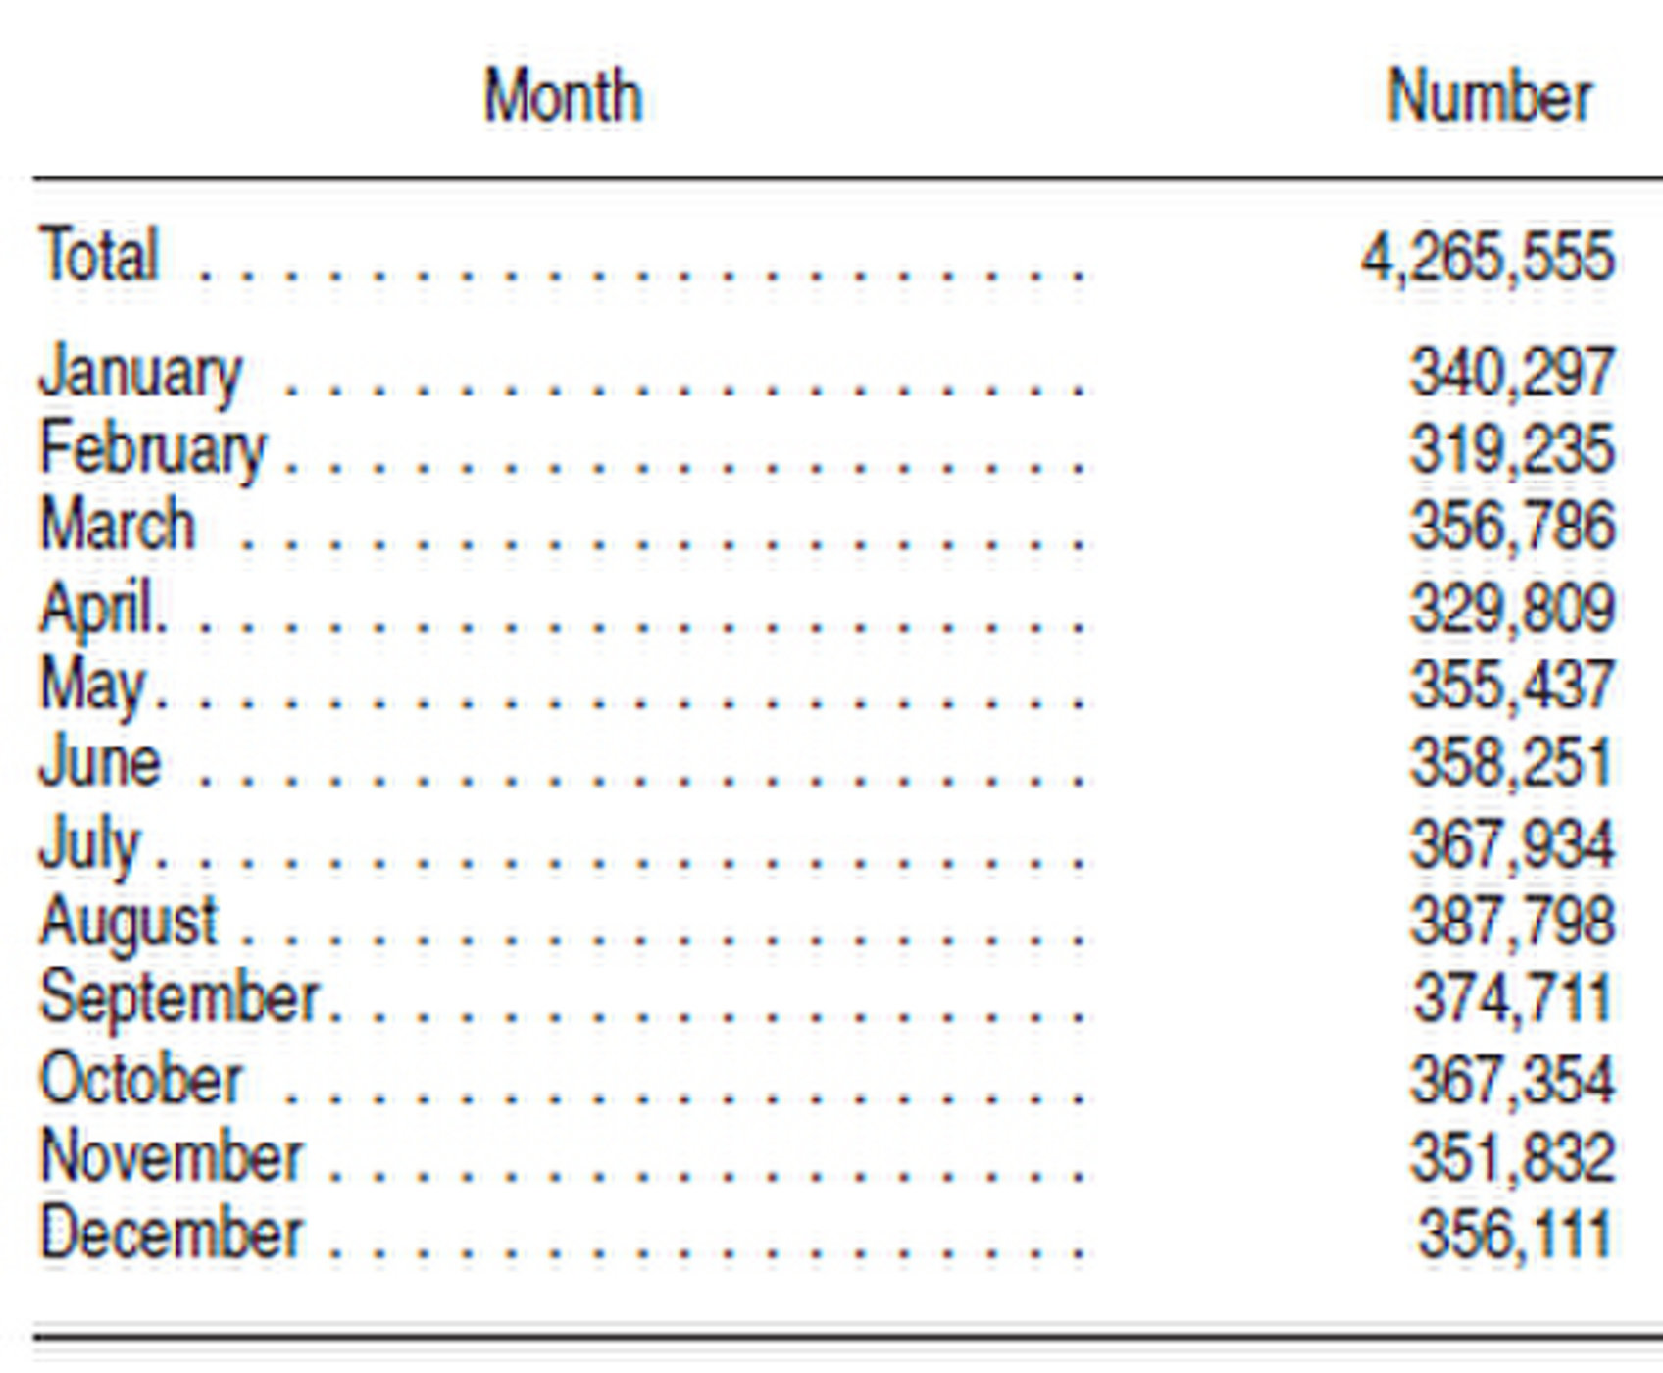
2006, USA birth rate - https://www.livescience.com/32728-baby-month-is-almost-here-.html

Slide 15
https://www.ranker.com/list/serial-killer-zodiac-signs/natalie-hazen

Slide 16
Probability distributions
function which provides probability of occurrence of different events in an experiment
defined by parameters of the functions and sample space
discreate / continuous
bounded / unbounded
univariate / multivariate

Slide 17
The most useful distributions
normal
binomial
beta
gamma
negative binomial
lognormal, skewnormal, t-distribution, Cauchy, poisson, multivariate normal, Dirichtet, von Mises

Slide 18
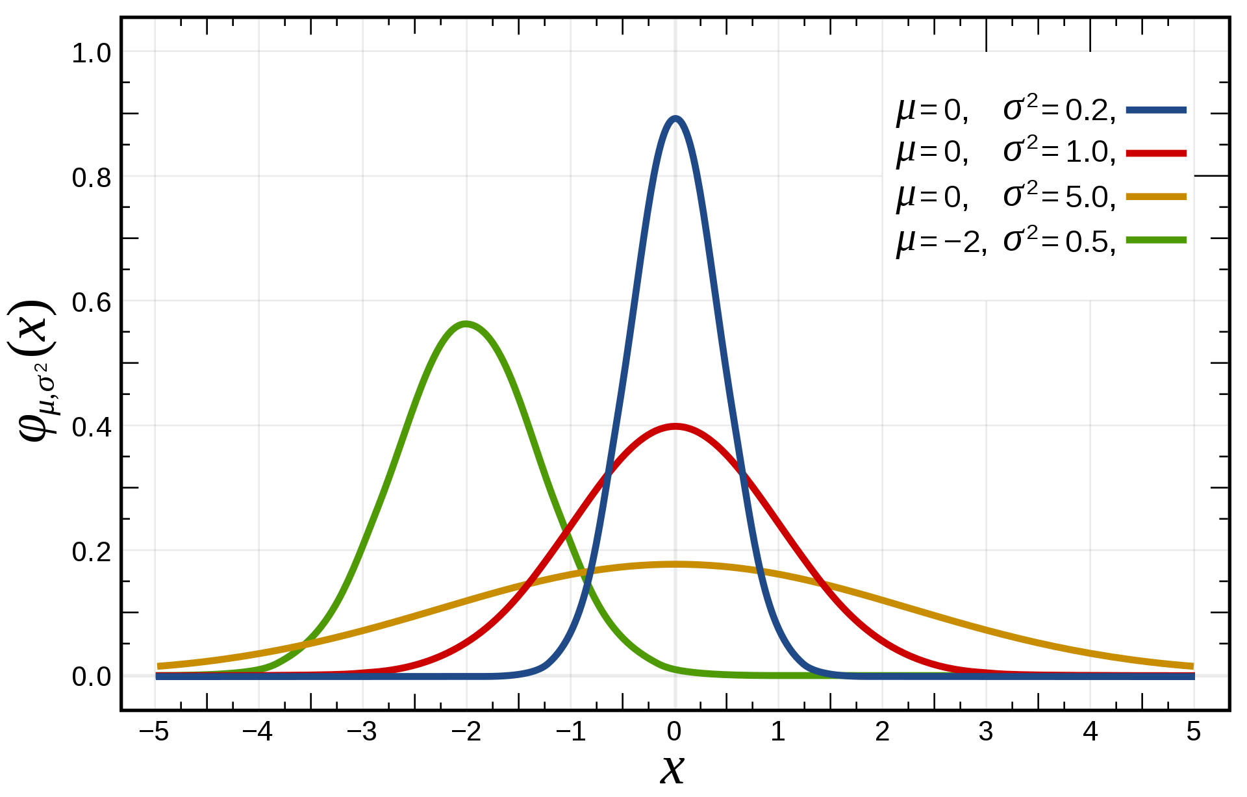
Normal distribution
defined by mean (µ) and variance (σ²) / mean and standard deviation (σ)
normal(µ, σ²)
normal(µ, σ)
assumed to be behind many natural processes

Slide 19
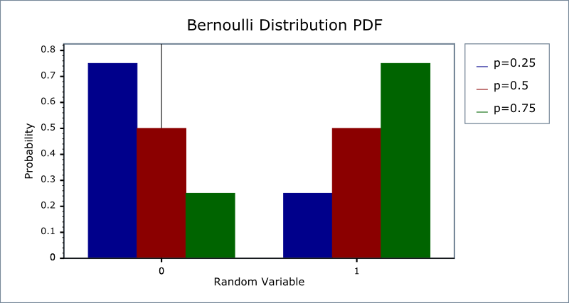
Bernoulli distribution
defined by probability of success (p)
Bernoulli(p)
mean = p
variance = p(1-p)

Slide 20
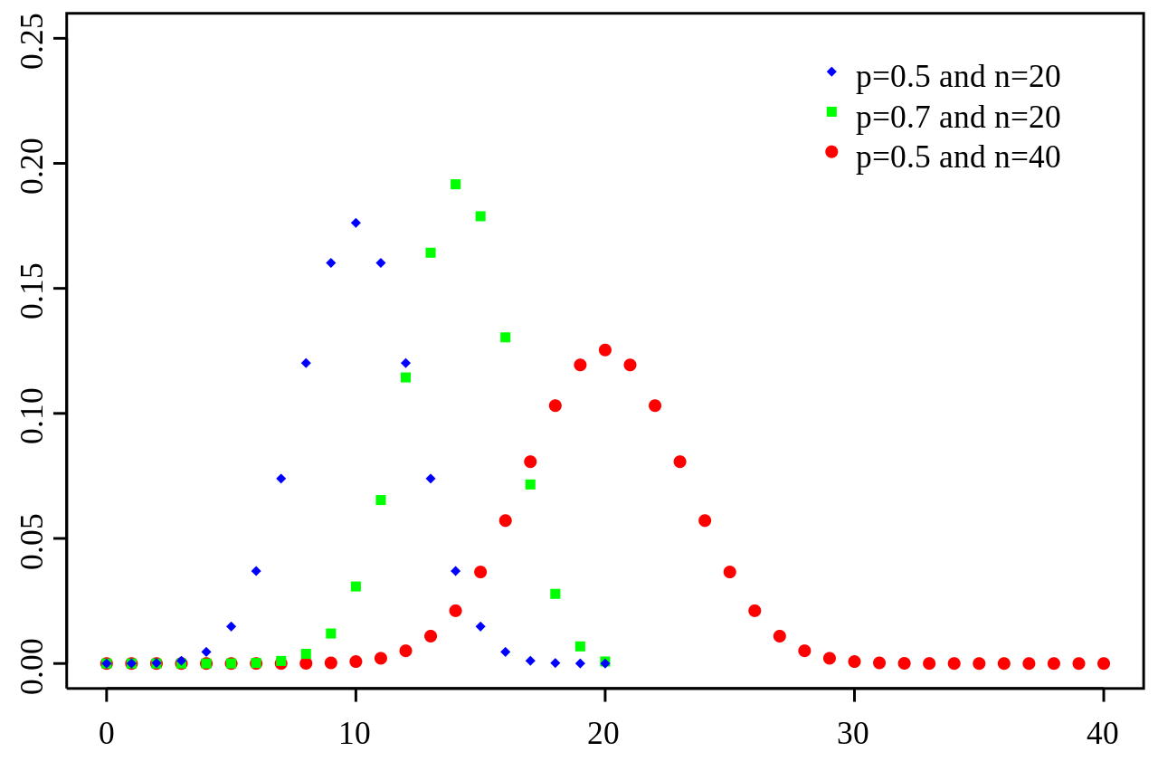
Binomial distribution
defined by number of trials (n) and probability of success (p)
binomial(n,p)
mean = n×p
variance = n×p(1-p)

Slide 21
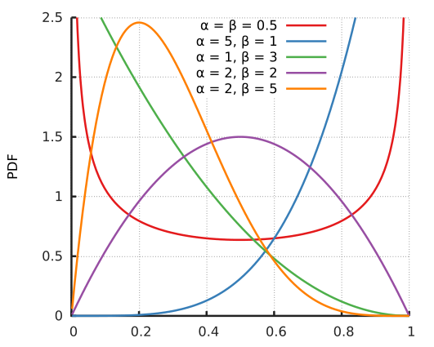
Beta distribution
defined by two shapes parameters (α, β)
beta(α, β)
mean = $\frac{\text{α}}{\text{α}\text{ +} \text{β}}$
variance = $\frac{\text{α}\text{×}\text{β}}{{(\text{α}\text{+}\text{β})}^{2}\text{×}\text{(}\text{α}\text{+}\text{β}+1) }$

Slide 22
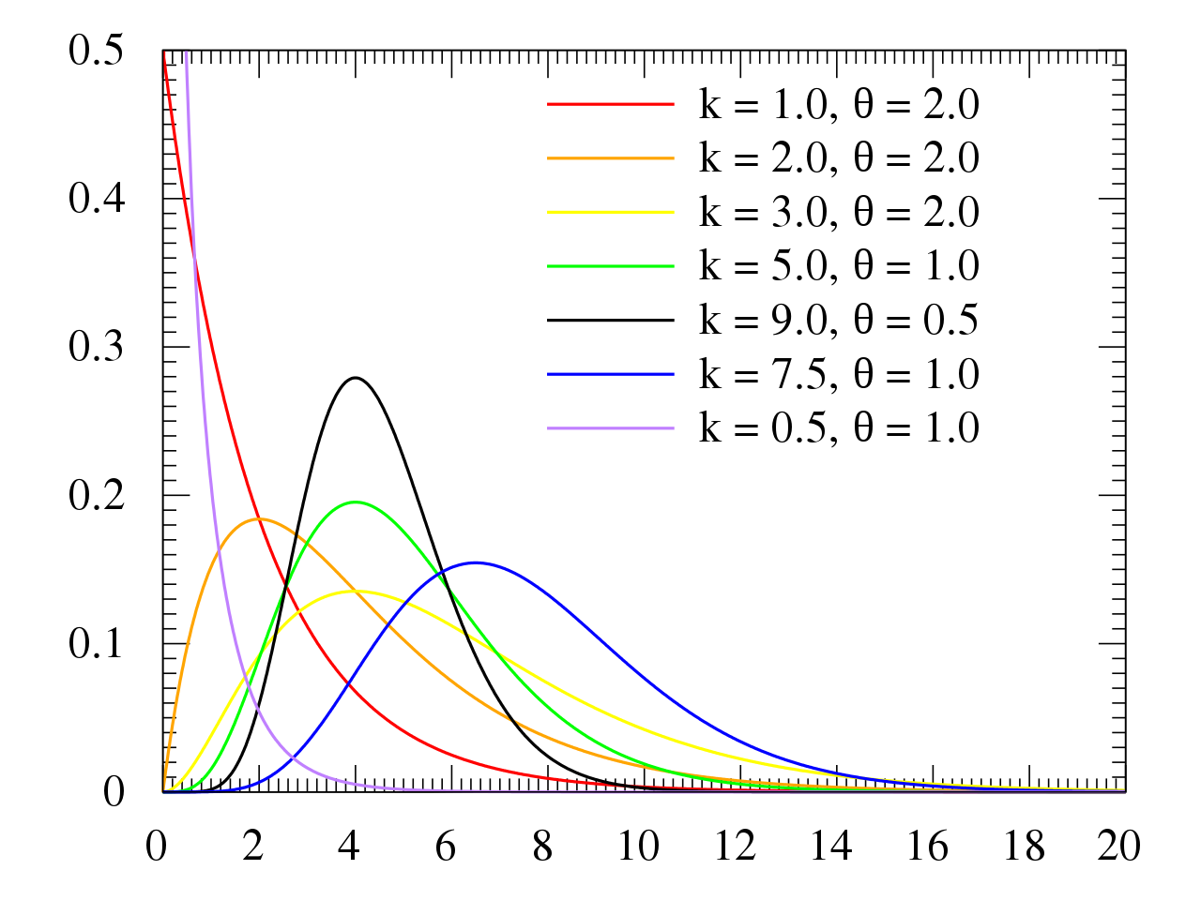
Gamma distribution
defined by shape (k) and scale parameter (θ) / shape and mean (µ) gamma(k,θ) gamma(k,µ)
mean = k$\text{×}$θ or µ
variance = ${\text{k}\text{×}\text{θ}}^{2}$ or $\frac{{\text{µ}}^{2}}{k}$

Slide 23
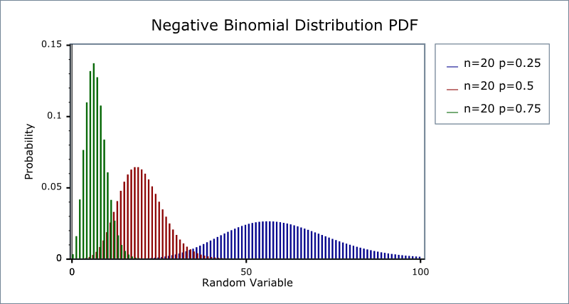
Negative binomial
defined using failures before stop (n) and success probability (p) negative binomial(n,p)
mean = n$\text{×}\text{r}$
variance = $\frac{\text{n}\text{×}\text{r}}{{(1−p)}^{2}}$

Slide 25
Previous lesson example

Slide 26
Study set-up & data
2 conditions
Control Treatment (CT)
Request Treatment (RT) – adding „Do not cheat!“ on the return paper
160 participants (children)
data
overal 123 children reported white (76,9%)
69 children out of 81 reported white (85.4%) in CT
54 children out of 79 reported white (68,8%) in RT

Slide 27
Model
should reflect data generating process or the most important parts of it
binary outcome – white/black side of the coin
binomial distribution
procces which returns number of successes out of n trials, with probability p
number of successes ~ binomial(n, p)
we know: n and number of successes
what are interested in: p

Slide 28
Estimation by ABC
define model & priors for parameters
sample plausible values of parameter p
use model to simulate data for each value of parameter
keep only those parameter values which lead to our observed data

Slide 29
Estimation by MCMC
define model & priors for parameters
run MCMC chains to explore the probability space
collect samples from MCMC chain

Slide 30
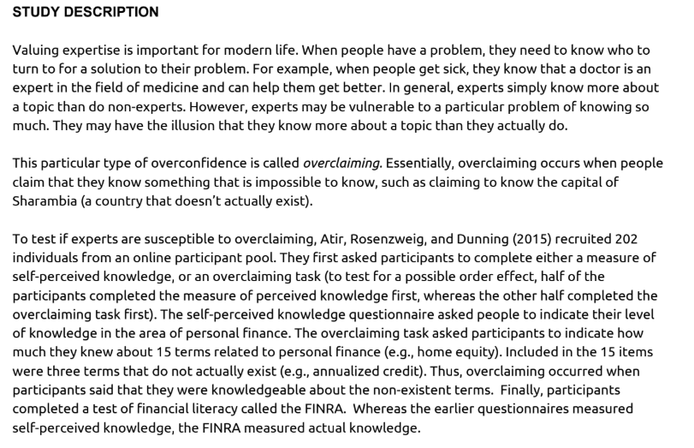
Another example: Do experts overrate the extent of their expertise?

Slide 31
Study set-up & data
2 conditions
Perceived knowledge first/Overclaiming task first
202 participants
measures:
self proclaimed knowledge of personal finance
7 point likert scale (1 = not knowledgeable at all, 7 = very knowledgeable)
overclaiming
rating of knowledge about 15 finance related terms
3 of them didn‘t exist, weightet knowledge claimed on those items
FINRA – financial literacy quiz
5 questions

Slide 32
Step by step analysis

