Slide 1
Diagnosis and treatment of urinary tract infections
The lecture is based on material EAU Guidlines on Urological Infections 2022
http://www.uroweb.org/guidline

Slide 2
Agenda
Classification of UTI based on the location of the bacterial inflammation and associated clinical symptoms
UTI definition and evidence of bacteriuria
Concept of uncomplicated and complicated UTI
General principles of UTI therapy
ABU and ABU therapy
Conclusion

Slide 3
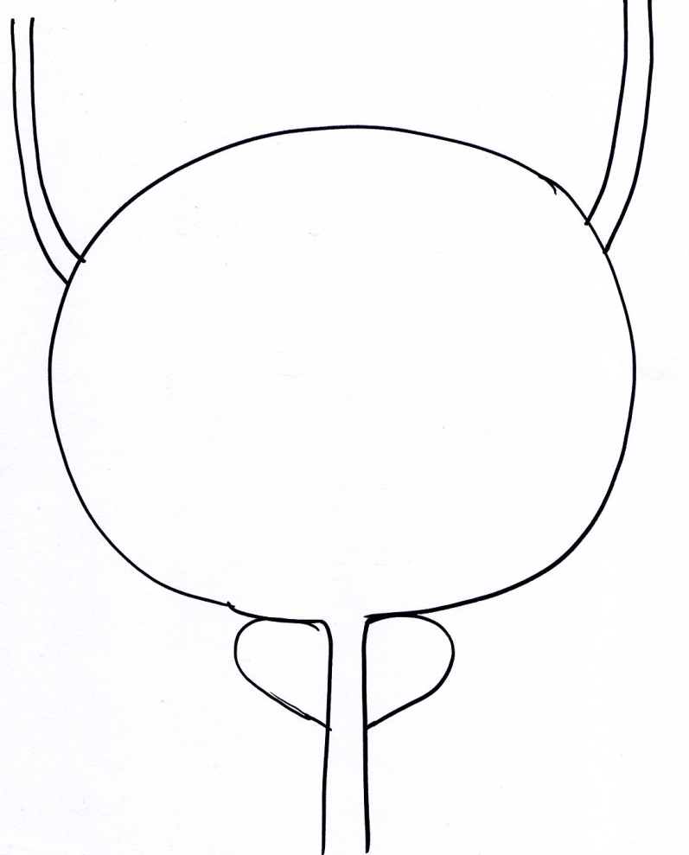
Clinical manifestations of lower urinary tract infection (localizing symptoms)
Bacterial urethritis and cystitis often
occur simultaneously
Urocystitis: cystalgia (pain above the pubic clasp); frequency (frequent urination); urgency (painful urge to urinate);
micro and macrohematuria, body
temperature (BT)↔, CRP↔
Urethritis: stranguria (burning and cutting during urination) , BT↔, CRP↔
Trigonitis: a painful permanent urge
to urination, urinary retention
Secondary VUR (inflammatory damage to the vesico-ureteral junction allows ascending kidney infection): intermittent febrile episodes
Only infection and inflammation of the parenchymatous organs (prostate, kidney) of the urinary tract is associated with high CRP and fever
BT↑↑, CRP ↑↑
Acute prostatitis: perineal pain, coital and postcoital pain,
BT↑↑, CRP ↑↑

Slide 4
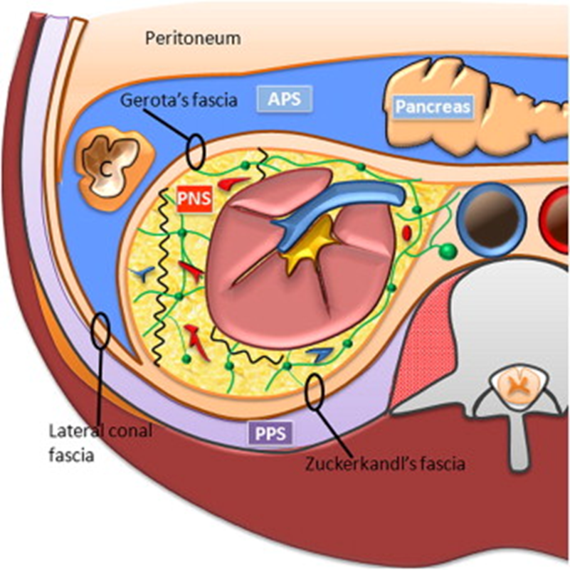
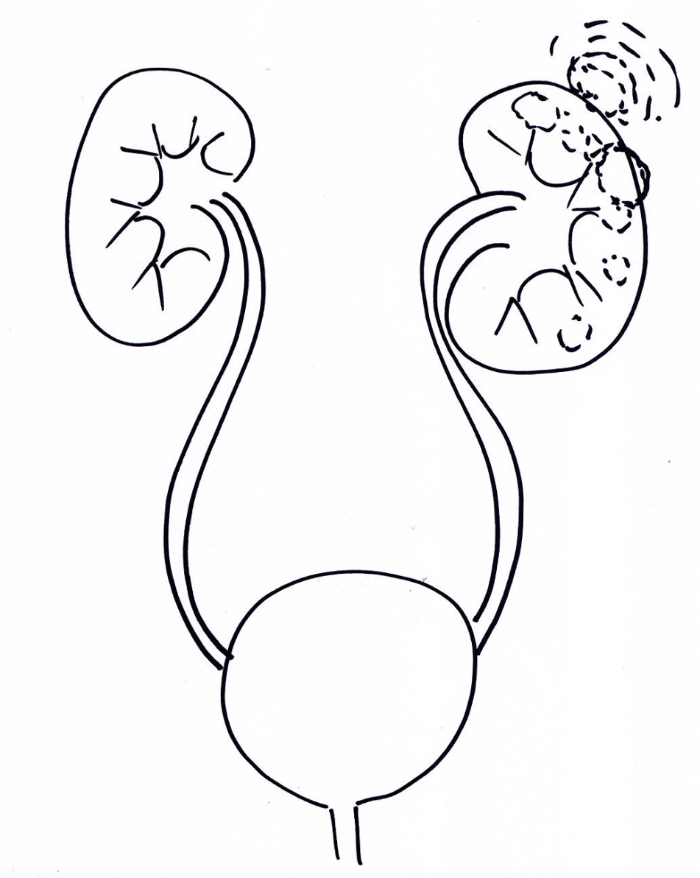
Clinical manifestations of upper urinary tract infection
Ascending PN: nephralgia,
fever , CRP ↑↑↑
Gerot's fascia
Abscessive PN: dominate
symptoms of sepsis, nephralgia
Hematogenous PN abscessing from the beginning: predominate symptoms of sepsis, nephralgia
Perirenal abscess: dominate
symptoms of sepsis,
Nephralgia, loin pain
Pararenal abscess: dominate
symptoms of sepsis
nephralgia, loin pain
Only infection and inflammation of the parenchymatous organs of the urinary tract is associated with high CRP and fever

Slide 5
Difference of clinical and laboratory IMT symptoms in polymorbid seniors
Anorexia, nausea, meteorism, confusion, urinary incontinence
30% of individuals have only symptoms of lower UTI even in pyelonephritis
Patients are only subfebrile even in pyelonephritis /prostatitis
Laboratory signs of inflammation may not be significantly increased (slightly to moderately increased CRP!)
UTI inducing microbial agents is often resistant to antibiotics
Genitourinary syndrome of old women, caused by a hypoestrogenic condition, mimics UTI and the co-present bacteriuria leads (asymptomatic bacterial colonization of the urinary tract) to repeated ATB treatment

Slide 6
Agenda
Classification of UTI based on the location of the bacterial inflammation and associated clinical symptoms
UTI definition and evidence of bacteriuria
Concept of uncomplicated and complicated UTI
General principles of UTI and ABU therapy
Conclusion

Slide 7
UTI definition
Trias
Presence of significant amount of microorganisms in urine
Typical clinical symptomatology
with the exception of atypical symptomatology in seniors
Leukocyturia has a negative predictive value
Absence of leukocyturia excludes the diagnosis of UTI
Presence of leukocyturia does not necessarily confirm UTI

Slide 8
What is significant bacteriuria? (spontaneous micturition / medium stream of urine)
Symptomatic women | >10² coliform bacteria/1 mL urin + leukocyturia >10⁵ every urinary pathogen Any capture of bacteriuria from suprapubic puncture
Symptomatic men | >10³ every urinary pathogen/1 mL
Asymptomatic patients (ABU) | > 10⁵ urinary pathogen in two independent urine samples, one in men

Slide 9
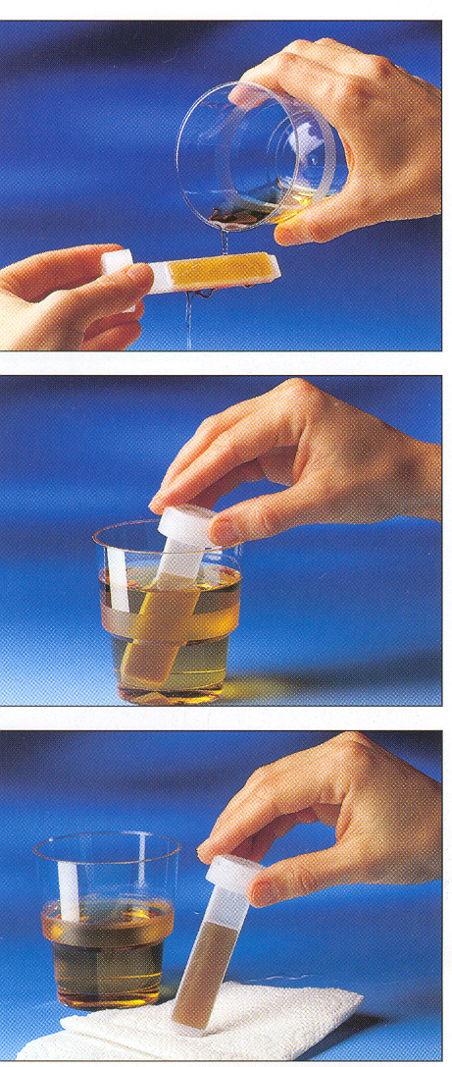
Pre-laboratory diagnostics of UTI enables early treatment and targeted treatment in the at-risk population as well as in an outpatient operation or in a hospital facility without continuous service in a microbiological laboratory!
dippslide
arrangement
1. watering the area with urine on culture medium
1. or immersion in a sterile container
2. allows excess urine
to drain properly

Slide 10
3. putting in the thermostat
for 24 h
Dip slide arrangement:
CLED agar is used to determine the total number of bacteria
MacConky agar supports the growth of G-bacteria
10 pieces~ 17.5€
4. estimation of the
number of bacterial
colonies

Slide 11
Agenda
Classification of UTI based on the location of the bacterial inflammation and associated clinical symptoms
UTI definition and evidence of bacteriuria
Concept of uncomplicated and complicated UTI
General principles of UTI and ABU therapy
Conclusion

Slide 12
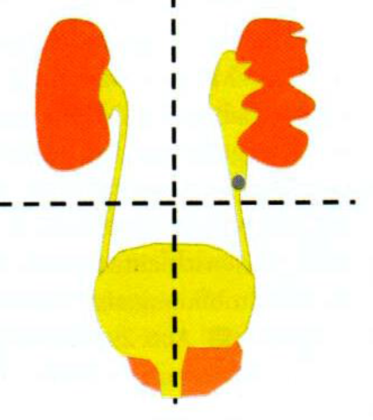
Concept of uncomplicated and complicated UTI
is the key to the correct therapeutic and diagnostic procedure !
PYELONEFRITIS
(upper urinary tract infection)
Urethritis / cystitis / prostatitis
(lower urinary tract infection)
Uncomplicated UTI
episodic or recurrent
UTI in non-pregnant women,
without demonstrable presence
of risk factors for UTI
Complicated UTI
usually recurrent / relapsing
UTI in women, including
pregnant women with risk factors
for UTI and all men regardless of
the presence of risk factors

Slide 13
Concept of uncomplicated and complicated UTI
CYSTITIS
UNCOMPLICATED UTI
PYELONEFRITIS
COMPLICATED UTI
Recurrent UTI
Low risk
Catheter-associated UTI
High risk
UTI in men
Urosepsis

Slide 14
adhesion→→ colonization →→ invasion→→inflammation
ABU = urothelial colonization by bacteria
ABU = absence of UTI symptoms when> 10⁵ pathogens were found in two independent urine samples in women or one in men
ABU
Anti-inflammatory factors
Pro-inflammatory factors

Slide 15
Anatomical changes of the urinary tract Congenital - Urethral stenosis Obstructive-reflux megaureter Bladder diverticulum Urethral valves Acquired defects Urolithiasis Bladder tumors Prostate hyperplasia Urethral stricture - Pregnancy Postoperative changes Post-radiation changes | Functional changes of the urinary tract - Oligo / anuria in RI - Disorders of bladder emptying - Urinary blader detrusor and sphincter dysregulation
 | Comorbidities - Poorly compensated diabetes mellitus with glycosuria - Late complications of liver insufficiency - Late complications of renal insufficiency - Cystic kidney disease
 | Immune disorders - Diseases associated with immune dysregulation - Immunosuppressive therapy - Chemotherapy - Perioperative dysregulation of immunity
Drainage material Nephrostomy Urethral stent Urinary catheter Epicystomic catheter

Slide 16
Gradiet of severity
Smelov V et al.: Improved classification in urinary tract infection: future consideration. European urology supplements 2016; 15:71-80
comprehensive decision strategy
Symptoms
No
symptoms
Local
symptoms:
dysuria
frequency
urgency
Pain/blader
tenderness
General
symptoms:
fever
Flank pain
nausea
vomiting
Systemic
symptoms
SIRS:
Fever
Shivering
Circulatory
failure
Circulatory and organ
failure:
Organ dysfunction
Organ failure
ABU
Cy-1
PN-2
PN-3
Febril UTI
US-4
US-6
Diagnosis
US-5
Examination
Dipstick
MSU culture
as required
Dipstick, MSU culture
renalUSG/CT
Dipstick, MSU /blood culture, abdominal/renal CT IVU, spiral renal CT, abdomen and small pelvis CT
Risk factors
Risk factor assessment acording tu ORENUC
Uncomplicated UTI
Complicated UTI
ATB
tretament
No !
empirical
3-5 d
empirical→
directed 7-14 d
empirical→
directed 7-14 d
Consider combining
2 antibiotics
empirical→
directed 10-14 d
Combine 2 antibiotics!
Surgical treatment
Drainage/surgery as required

Slide 17
Agenda
Classification of UTI based on the location of the bacterial inflammation and associated clinical symptoms
UTI definition and evidence of bacteriuria
Concept of uncomplicated and complicated UTI
General principles of UTI and ABU therapy
Conclusion

Slide 18
General principles of antibacterial drugs choice
Uncomplicated UTI of the lower urinary tract (cystitis): ATBs with sufficient concentration in urine
Complicated UTI of lower urinary tract and parenchymal organs infections (kidney and prostate):
ATBs with a reliable systemic effect and good penetration into the kidney and prostate tissue,
at least initially parenterally, depending on the severity of the infection
Asymptomatic bacteriuria: we do not treat, with some exceptions

Slide 19
Summary of evidence and recommendation for the management of ABU
SUMMARY OF EVIDENCE | LE/ STRENGHT
TREATMENT OF ABU IS NOT BENEFICAL IN THE FOLOWING CONDITIONS :
-Woman without risk factors | 3b
- Patients with well-regulated DM | 1b
-Postmenopausal women | 1a
-Elderly institutionalised patients | 1a
-Patients with dysfunctional and/or reconstructed lower urinary tract | 2b
-Patient with renal transplants | 1a
-Patients prior to arthroplasty surgieries | 1b
TREATMENT OF ABU IS HARMFUL IN PATIENTS WITH RECCURENT UTI | 1b
TREATMENT OF ABU IS BENEFICAL PRIOR UROLOGICAL PROCEDURES BREACHING THE MUCOSA | 1a
TREATMENT OF ABU IN PREGNANT WOMEN WAS FOUND TO BE BENEFICAL BY METAANALYSIS OF THE AVAILABLE EVIDENCE; HOWEVER, MOST STUDIES ARE OLD. A RECENT STUDY REPORTED LOWER RATES OF PN IN LOW –RISK WOMEN | 1a

Slide 20
ACTIVE SUBSTANCE | DOSAGE | DURATION OF TREATMENT
Uncomplicated UTI with localizing symptoms of cystitis: THE TREATMENT OF FIRST CHOICE (empirical therapy)
NITROFURANTOIN | 3-4 x 100 Mg | 7 days
FOSFOMICIN | 1x 3000 Mg | one-time
CEFUROXIM | 2x 500 Mg | 5-7 days
AMOXICILIN-CLAVULANAT | 3x 625 Mg | 5-7 days
TREATMENT OF THE SECOND CHOICE (targeted therapy according to the antibiogram)
COTRIMOXAZOL | 2x 960 Mg | 3 days
FLUOROCHINOLONES Ciprofloxacin Ofloxacin | 2x 500 Mg 2x 200 Mg | 3 days 3 days
The recommended therapy corresponds to the situation of microbial resistance to ATB therapy in the CR!

Slide 21
Uncomplicated UTI with localizing symptoms of PN: THE TREATMENT OF FIRST CHOICE (empirical therapy) ORAL
Cefuroxim Amoxicilin/clavulanat | 2-3x 500 Mg 3x 1 g | 10 - 14 days 10 - 14 days
PARENTERAL
amoxicilin/clavulanat cefuroxin piperacilin/tazobactam ceftadizim cefotaxim | 3x 1,2 g 3x 1,5 g 4x 4,5 g 1x 2g 3x 2 g | 10 - 14 days 10 - 14 days 10 – 14 days 7 – 10 days 7 – 10 days
THE TREATMENT OF SECOND CHOICE (according to antibiogram) ORAL
amoxicilin amoxicilin/clavulanat cortimoxazol ciprofloxacin ofloxacin | 3x 1 – 1,5 g 2 – 3x 1 g 2x 960 Mg 2x 500 - 750 Mg 2x 200 - 400 Mg | 10 – 14 days 10 – 14 days 10 – 14 days 14 days 14 days
PARENTERAL
amoxicilin/clavulanat ceftadizim ( Pseudomonas aeruginosa only) cefepim (Enterobacter cloacae only) imipenem/cilastatin (ESBL strains only) meropenem ( ESBL strains only) | 3x 1,2 g 3x 1 – 2 g 2 – 3x 1 – 2 g 3x 1 g 3x 1 g | 10 - 14 days 7 – 10 days 7 – 10 days 7 – 10 days 7 days
SINGLE –DOSE PARENTERAL TREATMENT
ceftriaxon ertapenem gentamicin amikacin | 1x 2 g 1x 1 g 1x 5 – 7 Mg/kg 1x 15 – 20 Mg/kg | At the beginning of oral treatment At the beginning of oral treatment At the beginning of oral treatment At the beginning of oral treatment
The recommended therapy corresponds to the situation of microbial resistance to ATB therapy in the CR!

Slide 22
Pregnant women: TREATMENT OF CYSTITIS AND ABU
fosfomycin nitrofurantoin cotrimoxazol | Safe throughout pregnancy Contraindicated in the 1st to 3rd trimester Contraindicated in the 1st to 3rd trimester
Pregnant women: TREATMENT OF PYELONEFRITIS
amoxicilin/clavulanat pipericilin/tazobactam ceftriaxon cefepim imipenem meropenem | Effective on enterococci and some G⁻ bacteria Effective on enterococci and some G- bacteria Effective on G-bacteria and some cocci Effective on G-bacteria and some cocci Effective on multi-resistant bacteria Effective on multi-resistant bacteria
Pregnant women: RESERVE THERAPY FOR SEVERE SEPSE
ceftozolam/tazobactam ceftadizim/avibactam
ANTIBIOTICS CONTRAINDICATED THROUGHOUT GRAVIDITY
fluorochinolons gentamicin amikacin

Slide 23
Complicated UTI: FIRST ATBs CHOOSE (empirical therapy)
Piperacilin/tazobactam
3rd generation cephalosporins cefotaxim ceftriaxon ceftadizim | not suitable for the treatment of infection Pseudomonas aeruginosa not suitable for the treatment of infection Pseudomonas aeruginosa reserved for infections Pseudomonas aeruginosa
SECOND ATBs CHOICE (according to the antibiogram)
CARBAPEMS imipenem meropenem | Suitable for gram negative ESBL strains Suitable for gram negative ESBL strains
RESERVE ATBs
ceftozolam/tazobactam ceftadizim/ avibactam | therapy of multidrug-resistant strains in sepsis therapy of multidrug-resistant strains in sepsis

Slide 24
Conclusion
Guidelines and guided empirical therapy (narrowed choice of ATB, early deescalation of ATB therapy, switch IV to PO therapy; monitoring of therapeutic effect; use of consultation with an ATB steward) reduced RR mortality by 35% and adaptation to a narrower spectrum of used ATB by 56%
Davey C et al. Interventions to improve antibiotic prescribing practices for
hospital inpatients. Cochrane Database Syst Rev, 2017. 2: CD003543.

