Slide 1
TUBULOINTERSTITIAL NEHPRITIS /NEPHROPATHY

Slide 2
Definiton
TIN is characterised by structural and functional changes, which are primarily set in renal interstitium and/or renal tubuli. Tubuli are impaired secondary as a consequence of impairment of interstitium and vice versa.

Slide 3
Histological substrate of TIN
Infiltration of intestitium by leukocytes (predominatly by lymfocytes and plasmocytes, in special causes by eosinofiles)
Tubular necrosis in acute TIN and tubular atrophy in chronic TIN
Typical interstitial fibrosis/tubular atrophy in end stage of TIN

Slide 4
Acute TIN pathogenesis
Acute bacterial TIN = acute pyelonephritis: Direct pro-inflammatory action of a bacterial agent in the renal parenchyma in acute pyelonephritis
Acute non-bacterial TIN: is most often caused by an allergic reaction to drugs. Commonly implicated drugs include β-lactam antibiotics, NSAIDs, and proton pump inhibitors. It can also be an allergic reaction to an infectious antigen or plant-derived molecules
The etiopathogenesis of nonbacterial AIN lies in an immunologically mediated mechanism (idiosyncrasy -hypersensitivity) that is triggered by an infectious antigen / drug molecule / molecule of plant origin.

Slide 5
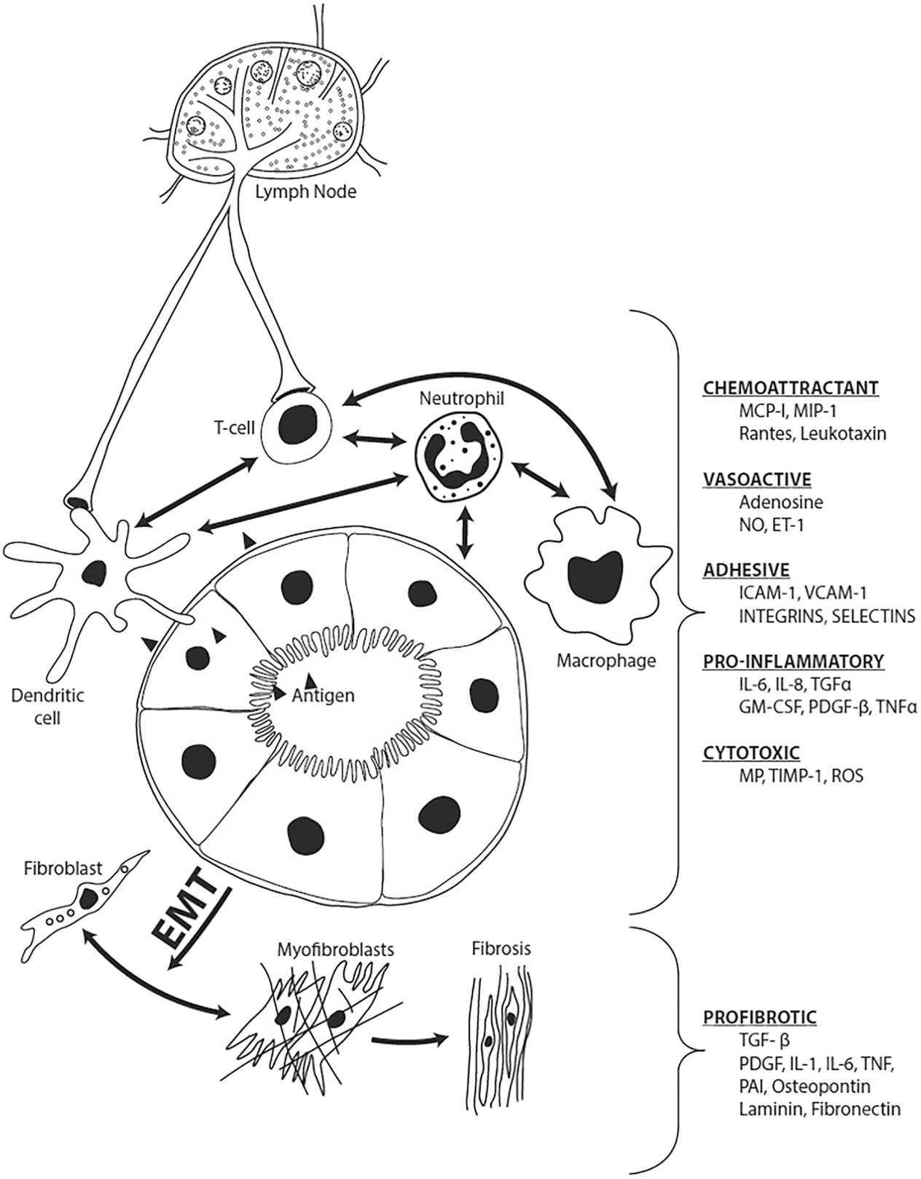
Antigen is formed by the conjugation of a drug/metabolite/infectious agent/plant molecule with a host protein
Antigen processing
Presentation to
local dendritic (DC)
DC activates T cells
Effector phase
Immune response
Unrecognized cause
>>late diagnosis
Profibrogenic phase
Irreversible fibrosis
Epithelial-to-mesenchymal transition
CKD/ESRF
Raghavan R, Shawar S. Mechanisms of Drug-Induced Interstitial Nephritis. Adv Chronic Kidney Dis. 2017 Mar;24(2):64-71.

Slide 6
Chronic TIN pathogenesis
Chronic TIN is from the beginning presented as progressive interstitial fibrosis and tubular cell atrophy. The pathogenesis depends on the triggering factor and is therefore very diverse:
Renal papillar necrosis in analgesic nephropathy
Chronic calcineurin toxicity
Profibrogenic effects of chronic poisoning by heavy metals (lithium, cadmium, lead)
Crystal deposition (hyperoxaluric nephropathy, urate nephropathy, cystine nephropathy, hypercalcemic / hypercalciuric nephropathy)
Progressive fibrotization and tubular cell atrophy in ADTKD
Chronic TIN as an ongoing AIN process
Chronic bacterial focus in the interstitium in reflux and obstructive uropathy
Scarring and fibrotization after acute bacterial inflammation
Profibrogenic phase of AIN

Slide 7
Bacterial
infection
Infection
Medicaments
Metals
Radiotherapy
Analgesic-
antipyretics
CNI
Postinfectious nephropathy
Crystal deposition
ADTKD
plant-derived molecules
Mmolecules inducing
interstitial fibrosis
Inflammation induced by
crystals depozition
Idiosyncrasy
Monogenic AD hereditary
chronic TIN
Hypersensitivity
Cumulative dose independence
Nephrotoxicity-inducing substance
Dependence on cumulative dose and exposure time
Direct action of a bacterial agent in the renal parenchyma
Acute
TIN
Chronic
TIN
IFTA
Chronic obstruction; VUR
Unrecognized dg AIN
transition from acute TIN to chronic TIN
End Stage Kidney
IFTA = interstitial fibrosis-tubular atrophy

Slide 8
Infections as a cause of acute idiosyncrastic TIN
Bacterial infections | Virus infections
streptococci (scarlet fever)ª | Measlesª
Corynebakteria (diphtheriat)ª | Hantavirus
Legionella species | EBV
Leptospira species | CMV
Brucellosis | Polyomavirus
Typhoid | HIV
Syfylis
Yersiniosis
Mocoplasma species
Ricketsioses
Pneumococcus species
Tuberculosis
Toxoplasmosis
a = frequent causes of TIN

Slide 9
Medicaments as a cause of acute idiosyncrastic TIN
Antibiotics, antivirals | Analgetics | NSAIDs | Diuretics | Other
suphonamidesª | paracetamol | derivates of propionic acidª | hydrochlorothiazide/ triamterenª | 5-aminosalycilate acid ª
beta-lactam antibioticsª | metamizoleª | other NSAIDsª | furosemide, torasemide | allopurinolª
methicilinª | phenacetineª |  | ethacrine acid | checkpoint inhibitorsª
rifampicinª |  |  |  | anticonvulsants
penicillins |  |  |  | histaminic H2 receptors antagonists
ciprofloxacin |  |  |  | sulphinpyrazon derivates
cephalosporinsª |  |  |  | contrast agents
COT |  |  |  | streptokinase
gentamicin |  |  |  | prophylthiouracile
erythromycin |  |  |  | phenindione
vankomicin |  |  |  | quinine derivates
tetracyclines
nitrofurantoin
acyclovir
a = frequent causes of TIN

Slide 10
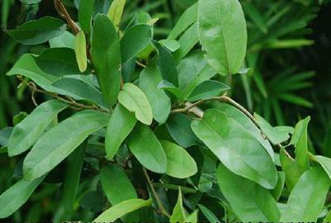
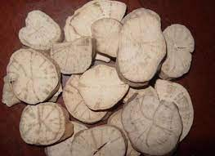
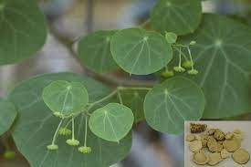
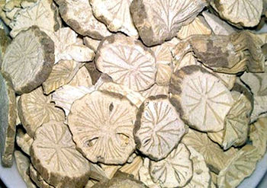
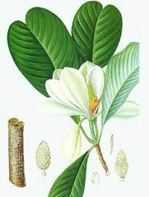
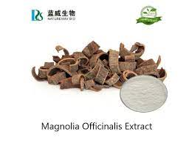
Plant molecules
Aristolochia fangchi
Stephania tetrandra
Aristolochic acid
Magnolia oficinalis
„medicinal „ tea
Chinese herbs nephropathy

Slide 11
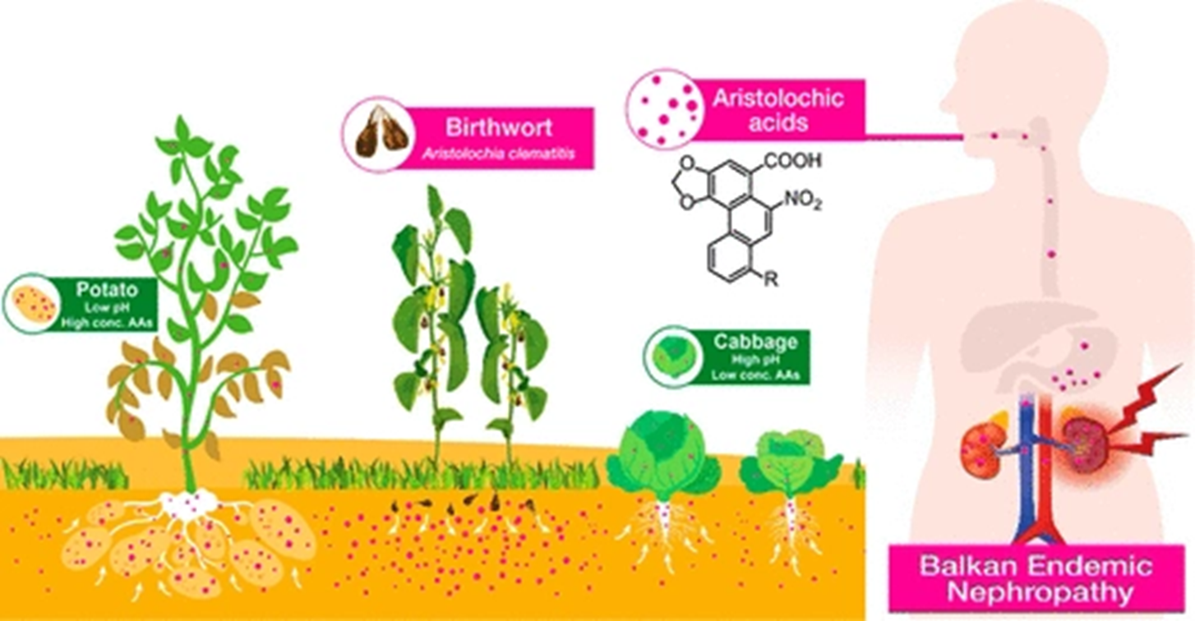
Chan CK, Liu Y, Pavlović NM, Chan W. Etiology of Balkan Endemic Nephropathy: An Up9;31(1date on Aristolochic Acids Exposure Mechanisms. Chem Res Toxicol. 2018 Nov 11):1109-1110.
Vegetables, in particular root vegetables of endemic areas, are extensively contaminated with AAs taken up through root absorption from the AA-tainted soil
There is pH dependence of the n-octanol/water partition coefficient (Kow) of AAs, which resulted in a dramatically higher hydrophobicity-driven plant uptake efficiency of AAs into food crops in endemic areas, characterized by higher acidity levels, compared to non-endemic areas.

Slide 12
Trriger factors of chronic TIN
Idiopathic
CTIN
CTIN induced by
nephrotoxic substances
and medicaments
Secondary CTIN
Analgesic nephropathy
Balkan nephropathy
Chinese herbs nephropathy
Lead nephropathy
Cadmium nephropathy
Lithium nephropathy
Calcineurin inhibitors n.
CTIN induced by
aminoglycosides
CTIN induced by
amphotericin B
Postirradiation CTIN
Postinfectious with anatomical changes of urinary ways
Obstructive nephropathy
Nephrolitiasis
Reflux nephropathy
With crystals deposition:
Hyperoxaluria
Urate nephropathy
Cystine nephropathy
Hypercalciuria nephropathy
asociated with
other nepropathy
Rejection of transplant
Glomerulonephritis
Systemic diseases with
glomerulopathies
Diabetic kidney disease
Vascular nephropathies
Hereditary nephropathies
Myeloma kidney
LCH nephropathy

Slide 13
Clinical course of TIN
Acute TIN: it may be associated with acute renal failure and need for acute hemodialysis
Chronic TIN: progression is slow without significant and special symptomatology. There is disposition to dehydratation caused by salt and watter loss

Slide 14
Laboratory diagnosis of TIN
Impaired structure | Physiological function | Impaired function | Laboratory consequence
Proximal tubule | Malfunction H₂CO3→HCO3⁻ + H₂O→H2CO3 Reabsorption of filterable proteins transport of G, Pi, UA, amino acids Tubular resorption of Na⁺, K⁺, H₂0 | Renal tubular acidosis type II Tubular proteinuria Sec. Fanconi syndrome Osmotic polyuria (+ aqueous nephrogenic DI) | Metabolic hyperchloremic acidosis, urin pH moči >6 Signal proteins: α1mikroglobulinuria, β2mikroglobulinuria Renal glycosuria, phosphateuria, uric aciduria, aminoaciduria EFNa >1%; EFOsm >3,5% UOSM ~POSM (isosthenuria)
Distal tubule | Active secretion of H⁺ Transepithelial voltage gradient Creation of NH3 NH3→NH4⁺ ^{Secretion of NH4} | secretory type of distal RTA I. Voltage dependent RTA RTA type I | Metabolic hyperchloremic acidosis, urin pH moči >6

Slide 15
Laboratory diagnosis of TIN
Impaired structure | Physiological function | Impaired function | Laboratory consequence
Distal nephron | Preservation of volume and electrolyte homeostasis of internal environment | Loss of Na+ and H2O Impairment of K+ tubular transport | EFNa >1% EFOSM >3,5% EFK according to type of impairment ↓ or↑ (in comparision with adequate EFK)
Medulla | Creation of hypertonic urine – waterhousekeeping Creation of PGs | Impairment of concentration ability Decreased creation of PGE2→decrease of aldosteron secretion → Hyporenin - hypoaldosteronism | Inability to increase hyperosmolar urin UOSM >POSM Tendency to hyperkalaemia and hyponatremia

Slide 16
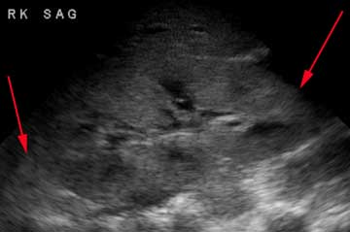
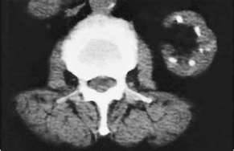
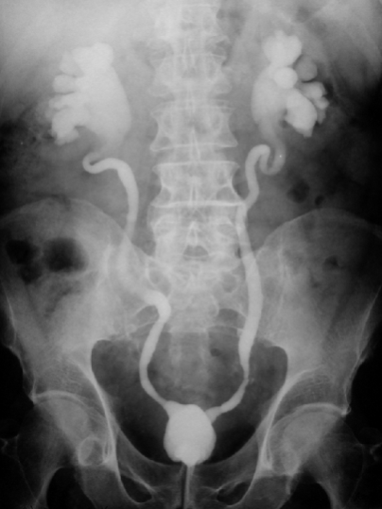
Imaging methods in diagnosis of TIN
AIN: kidneys are rather greater,
hypoechogenic pyramids are prominent
in hyperechogenic renal parenchyma,
index parenchyma : pyelon is increasing
CTIN: the picture is influenced by trigger factor.
For example analgetic nephropathy is characterised
by calcification on papilar line of kidneys,
dilatation of calices, renal pelvis and wraped ureters are typical for reflux nephropathy

Slide 17
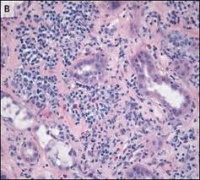
Renal biopsy
Is not indicated in chronic TIN !
RB become reality in some unclear causes of acute renal failure. Interstitial infiltration by monocytes typical for AIN is recognised , but identification of trigger factor is not possible.

Slide 18
Therapy of AIN
To stop the consumption of suspect drug!
Targeted therapy causing infection, if possible!
Symptomatic therapy, including urgent hemodialysis
Therapy of CTIN
The early suspension of the effect of causing factor (exposure to toxic substances, analgesic drugs, etc.).
Symptomatic therapy of complications (sufficient hydration, supplementation of NaCl and KCl and correction of acidosis according to the results of the laboratory examinations
Treatment of complicating urinary tract infection
Timely preparation to renal replacement therapy

