Slide 1
Diabetic kidney disease Kidney disorders in diabetes mellitus

Slide 2
DEFINITION
Diabetic kidney disease is chronic kidney disease in diabetic patients, which is more heterogeneous than previously thought. The largest proportion suffers from proteinuric diabetic glomerulopathy with Kimmelstiel-Wilson lesions
(intercapillary nodular glomerulosclerosis) as the underlying pathology. But reduced glomerular filtration rate in the absence of albuminuria/proteinuria is recognized in an increasing proportion of type 2diabetic patients. Of particular interest is the recognition of vascular lesions in the kidney.
Ritz E, Zeng XX, Rychlík I. Clinical manifestation and natural history of diabetic nephropathy.
Contrib Nephrol. 2011;170:19-27.

Slide 3
Epidemiologic importance
of Diabetic Kidney Disease
Epidemiological data illustrate the burden on health systems
Diabetic kidney impairment
is leadig cause of renal failure

Slide 4
United States Renal Data systém (USRDS). USRDS Annual Report 1, Chapter 1, Accessed March 15,2019

Slide 5
Incidence of patients with DM and with renal replacement therapy program in relative% (source: statistical yearbooks of the Czech Society of Nephrology and official website of the Czech Society of Nephrology: www.nefrol.cz)

Slide 6
2. Outcome of patients with DM on RRT
The best information about outcome is
mortality rate and its comparison with
non-diabetic patient on RRT

Slide 7
Mortality rate and its comparison with non-diabetic patient on RRT
rok | HD (%) |  | PD (%)
 | DM | Non-DM | DM | Non-DM
2012 | 21 | 13 | 26 | 5
2013 | 21 | 15 | 28 | 5
2014 | 20 | 15 | 30 | 6
2015 | 21 | 14 | 37 | 3
2016 | 20 | 14 | 38 | 5
2017 | 22 | 13 | 42 | 4
2018 | 21 | 15 | 24 | 5
2019 | 19 | 15 | 37 | 3
2020 | 26 | 18 | 34 | 7
2021 | 26 | 16 | 32 | 9
PD is not an inferior method
22 vs 15%
33 vs 10%

Slide 8
Life expentacy i patients with early DKD in comparision with DM patients without DKD and pts with early CKD without DM
Wen CP, et al. Kidney Int. 2017;92(2):388-396.

Slide 9
3. Diabetic kidney disease -etiopathogenesis diabetic kidney disease is nephropathy arising from microangioapathic and macroangiopathic complications of diabetes mellitus 3.1. Diabetic glomerulopathy Diabetic glomerulopathy is a microangiopathic complication of DM

Slide 10
DM
Microangiopathy
Euglycemia
Renoprotective therapy!
GBM impairment
Albuminuria/proteinuria
Nephrotic
syndrome
FSGS
IFTA
Diabetic glomerulopathy
End stage renal failure

Slide 11
3. Diabetic kidney disease -etiopathogenesis 3.2 Vascular nephropathy vascular changes in intraparenchymal arteries, main renal arteries and abdominal aorta are the basis of vascular nephropathy

Slide 12
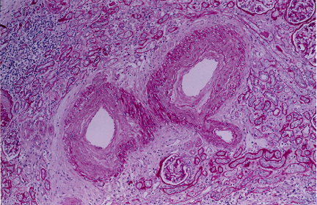
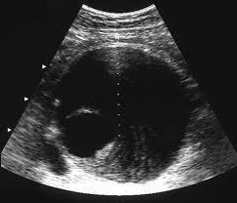
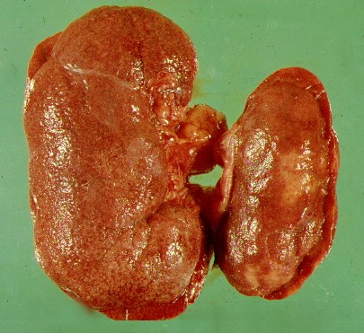
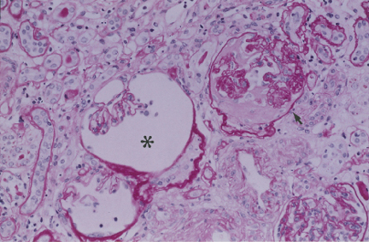
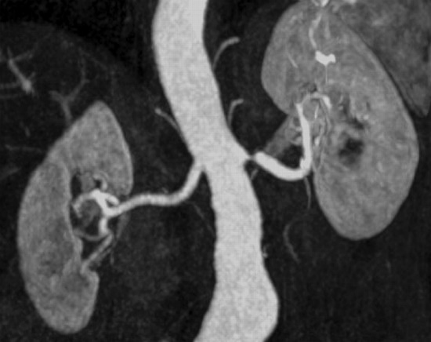
DM
Hypertension therapy
Hyperlipidemia therapy
Macroangiopathy
Hypertension
Vascular nephropathy
Ischemic nephropathy
FSGS
IFTA
End Stage Renal Failure

Slide 13
DM
Microangiopathy
Macroangiopathy
GBM changes
Hypertension
Diabetic Kidney Disease
Diabetic nephroathy is a mix of glomerular
and vascular changes
Albuminuria/proteinuria
Vascular nephropathy
In one individual, both nephropathy or one of them may
be predominant
Ischemic
Nephropathy
Diabetic glomerulopathy
KDOQI: Clinical Practice Guidlines and Clinical Practice Recomendations for Diabetes and Chronic Kidney Diasease (Am J Kidney Dis 2007; 49 (Suppl 2): S12-154
FSGS
IFTA
End Stage Renal Failure

Slide 14
4. Causes of progression to ESRD
The progression of the diabetic kidney disease itself
The result of repeated attacks of acute kidney failure events on underlying diabetic kidney disease
(acute on chronic)

Slide 15
the greater the number of attacks of acute GFR deterioration in the course of DKD, the faster the development of end stage renal failure
GFR
Event of deterioration of GFR
The progression of the diabetic kidney disease itself
Time - years

Slide 16
5. Acute Renal Failure Events causing acute deterioration of GFR on the background of chronic DKD: Kardiorenal syndrom Contrast nephropathy Sepsis >> ATN Acute vasomotor ARF

Slide 17
5.1 Cardio-renal syndrome

Slide 18
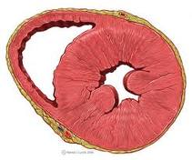
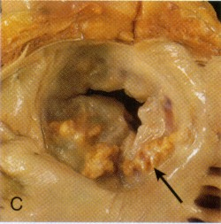
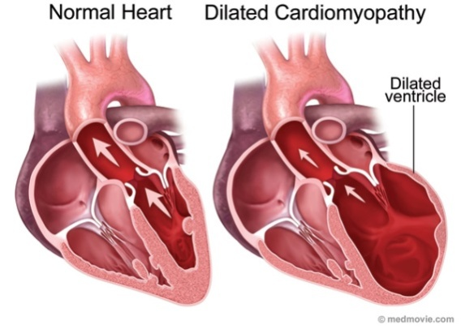
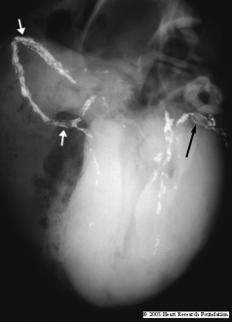
DM
Macroangioapathy
DM
cardiomypathy
Hypertension
Hypertensiv cardiomyopathy
HFpEF
Calcified aortic stenosis
Congestiv heart
disease
Ischemic coronary disease
HFrEF
Mediocalcinosis

Slide 19
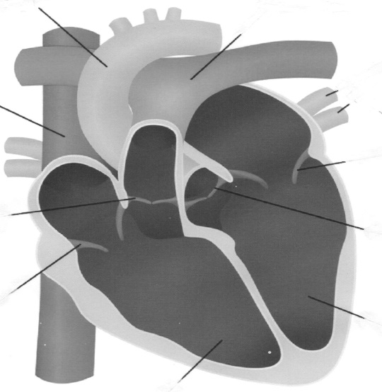
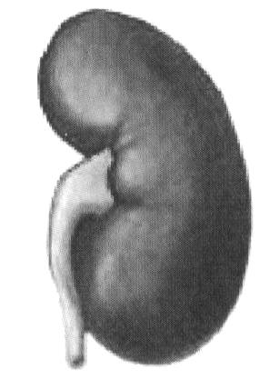
Postcapillary hypertension
Tricuspid insufficiency
Dialatation of the right
atrium and right ventricle
↑CVP
MI
tachyarrhythmia
↑LVEDP
acute left ventricular failure
right ventricular failure (bacward failure)
↓ SV
↓CO
Venous and capillary congestion
Activation RAAS, SNS, vasopresin
vasoconstriction, sodium and water retention
↓ renal
perfusion/ischemia
↑Renal venous/interstitial pressure
↓ GFR

Slide 20
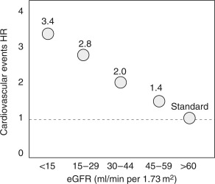
Figure 1
Relationship between glomerular filtration rate (GFR) and the risk for cardiovascular events. Data are adjusted for age, sex, and other Framingham risk factors. HR, hazard rate; eGFR, estimated GFR.
<0.25
0.25-0.49
0.5-0.74
0.75-0.99
1.0
mL/s/1,73m²
Kidney International Supplements 2011 1, 2-5DOI: (10.1038/kisup.2011.4)
Copyright © 2011 International Society of Nephrology Terms and Conditions
Notes:
Relationship between glomerular filtration rate (GFR) and the risk for cardiovascular events. Data are adjusted for age, sex, and other Framingham risk factors. HR, hazard rate; eGFR, estimated GFR.

Slide 21
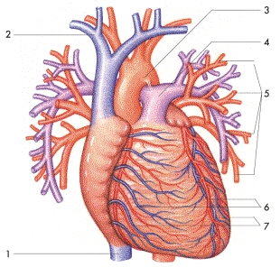
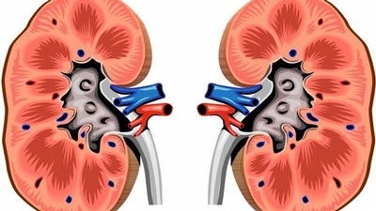
Cardio-renal syndrome
DIABETES MELLITUS
Cardiorenal relationships under conditions of failing heart and kidneys in DM patients produce fatally unfavorable consequences:
Worsening of compensation of one organ causes deterioration in the function of another
Increased morbidity and mortality
Diuretic resistance → earlier initiation of renal replacement therapy
Higher incidence of side effects of commonly used drugs (diuretics, ACEi, sartans, NSAIDs, warfarin)

Slide 22
5.2 Contrast Nephropathy why it is so common in DM patients ?

Slide 23
DM
Macroangiopathy
Atherosclerosis/
arteriosclerosis
Ischemic heart disease
Lower Limbs Ischemia Disease
ARVD
X-ray examination with iodin contrast
Hypertension
CONTRAST NEPHROPATHY
End Stage Renal Failure
Acute renal failure/acute on chronic

Slide 24
5.3 Sepsis why it is so common in DM patients ?

Slide 25
DM
Macroangioapathy
Microangiopathy
Arteriosclerosis/
atherosclerosis
Nephrotic
syndrome
Secondary
immunodefficiency
Urinary retention
<<< polyneuropathy
Nephrotoxic antibiotics
Acute PN
Sepsis
Gangrene
Other bacterial
infection
ATN
End Stage Renal Failure
Acute renal failure/acute on chronic

Slide 26
5.4 Vasomotor Acute Renal Failure and serious Hyperkalemia

Slide 27
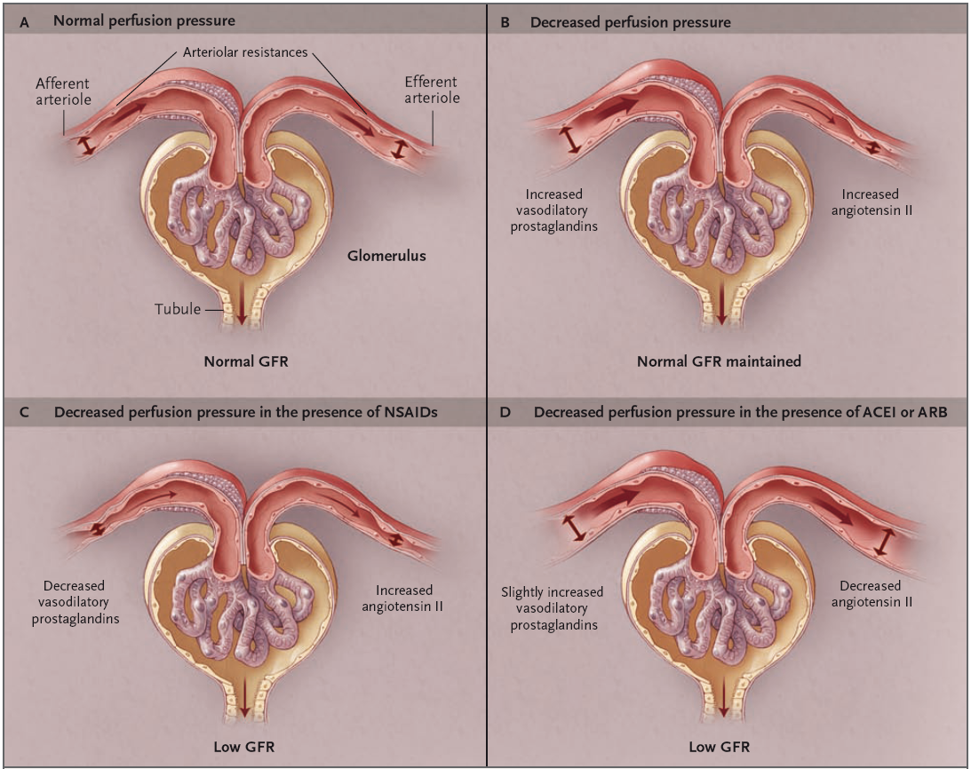
intraglomerular pressure is maintained by an adequate tone of vas afferens and efferens
dilatation of vas afferens and constriction of vas efferens compensates for impairment of glomerular perfusion
ACEi and sartans reduce compensatory vasoconstriction of vas efferens by blocking angiotensin II
NSAIDs block the compensatory role of vasodilating prostaglandins and reduce vasodilation of vas afferents
Abuelo JG. Normotensive ischaemic acute renal failure, NEJM 2007,357,797-805.

Slide 28
HYPORENINAEMIC HYPOALDOSTERONISM
RENIN
MD
ANGIOTENSIN
Na⁺
ALDOSTERON
K⁺
NSAIDs
B CELLS
ACEi/SARTANs/
ALISKIREN
K⁺ TRANSPORT
DISORDER
PGE2
SPIRONOLACTON
AMILORID
HYPERKALEMIA

Slide 29
6. DIAGNOSIS OF DIABETIC KIDNEY DISEASE
6.1 Long-term monitoring GFR and albunuria / proteinuria

Slide 30
The calculated GFR is the best for long-term monitoring od diabetics
Glomerular filtration rate (GFR) is most often determin estimated on bases of the serum creatinine concentration
Chronic Kidney Disease Epidemiology Collaboration equation
CKD-EPI =141 x min(SCr/κ, 1)α x max(SCr /κ, 1)-1.209 x 0.993Age x 1.018 [if female] x
1.159 [if Black]
Glomerular filtration rate (GF) can be estimated based on the serum concentration of cystatin C. The calculation of GFR according to Grubb better respects acute changes in GFR and changes in the G2 and G1 stage.
GF = 1,4115 * cystatin-1,680 * 1,384 (only for a child under 14 years) * 0,948 (for women only)
GFR calculation based on CKD-EPI or Grubb equation can be found on the website (https://www.mdcalc.com/)

Slide 31
Definition and classification of albuminuria/proteinuria
Albuminuria sample
 | 24-hour urin collection (Mg/24-h) | Time limited urin collection (ug/min) | First morning micturition
 |  |  | UALB (Mg/l) | UAlb/UKr (Mg/mmol) (Mg/g)
Normoalbuminuria | <30 | <20 | <20 | >2,5 (3,5*) >20 (300*)
Microalbuminuria | 30-300 | 20-200 | 20-200 | 3,5-35 20-200 (30- 300*)
Overt proteinuria = Macroalbuminurie | >300 | >200 | >200 | >35 >200 (300*)
Nephrotic syndrome | >3 500
* woman

Slide 32
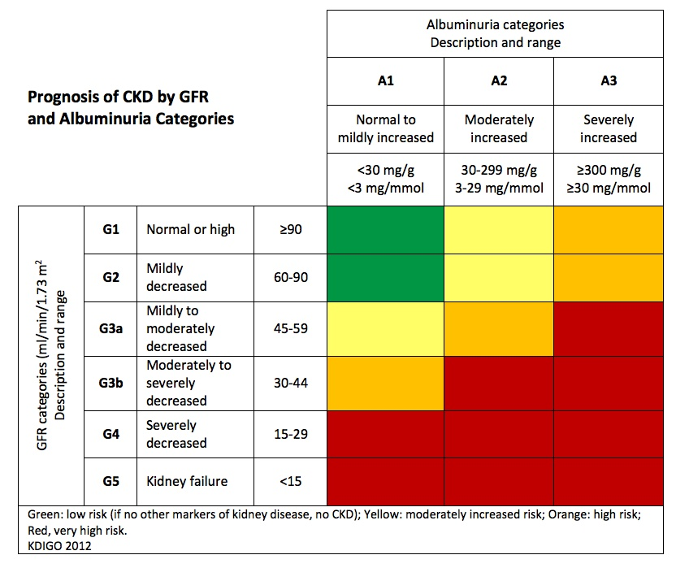
classification and prognosis of the disease is determined based on a combination of GFR and proteinuria

Slide 33
6. DIAGNOSIS OF DIABETIC KIDNEY DISEASE - search for vascular impairment
6.2 - non-invasive estimation of arteriolo / atherosclerotic changes in intraparenchymal arteries
-search for atheroembolic kidney disease in patients with significant atherosclerosis /aneurysm of the abdominal aorta or in patients with dilated left atrium and ventricle and atrial fibrillation
- search for stenosis / occlusion of main - renal arteries in patients with resistant hypertension and flush pulmonary edema

Slide 34
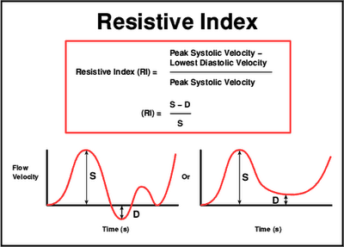
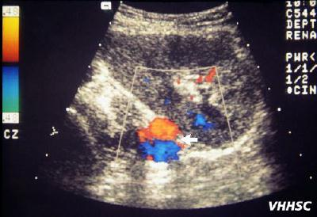
RI >0,70 (marker of renal risk)
Sugiura T , Nephrol Dial Transplant, 2009
RI (association with CV risk)
Parce et al., Am J Kidney Dis, 2010
RI (association with insulin
resistance)
Afsar et al., Metabolism, 2010

Slide 35
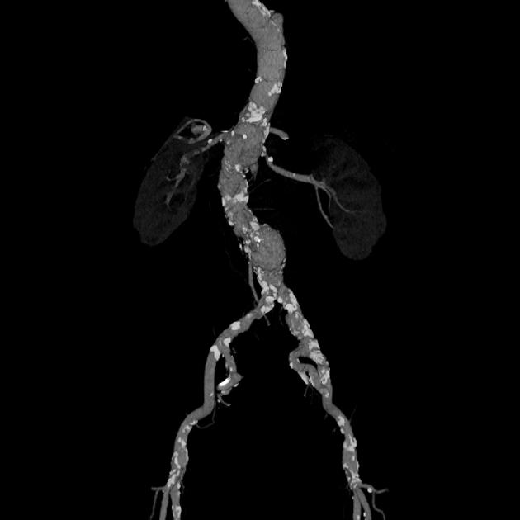
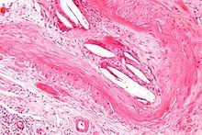
ateosclerotic plaques in the abdominal aorta may be a source of cholesterol embolization into intraparenchymal renal arteries

Slide 36
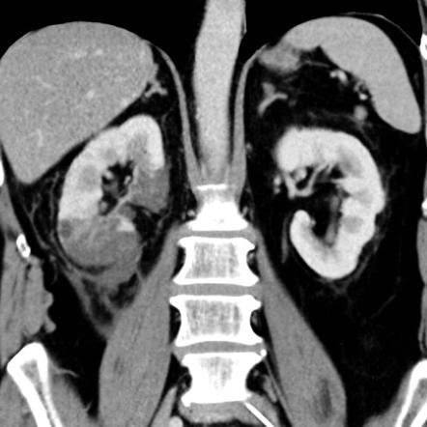
thrombotic abdominal aortic aneurysm may be a source of renal arterial embolism and a cause of renal infarction

Slide 37
Renal artery stenosis / occlusion performed on CT or MRA angiography
MRA

Slide 38
Staging of diabetic kidney disease according to GFR
serves the optimal plan of diagnostic examinations and therapeutic procedures
↑ risk
Damage
↓GF
↓GF
ESRF
Stage 1
Stage 2
Stage 3
Stage 4
Stage 5
GFR
(ml/s/1,73m²)
>1,5
1,49-1
0,99-0,5
0,49-0,20
<0,20
90 mL/min
89-60 mL/min
59-30 mL/min
29-12 mL/min
<12 mL/min
Absence of DKD
Screening of proteinuria
↓ risk of DKD
development
Establisched DKD
Ttreatment of K-V comorbidity
Slowdown progression
Establisched RI
Therapy of specific
RI complication
RRT preparation
ESRD
RRT
Nephrologic consultation
Nephrologic care

Slide 39
7. PREVENTION AND TREATMENT OF ESRF IN DM

Slide 40
Diabetes Amplifies the CKD and CVD Paradigm
People with diabetes and CKD are at high risk for:
losing kidney function, and
experiencing major adverse CV events
End- stage
Progression
Initiation
At increased risk
CKD
CVD
Kidney failure
Heart failure
Therapy
Decreased GFR
CVD events
Albuminuria
DKD
CAD, LVH
Prevention
Diabetes
a relentless trajectory leading to death
hypertension, age, family history
Adapted from NKF KDOQI Guidelines, 2007.
CKD: chronic kidney disease; CVD: cardiovascular disease; GFR: glomerular filtration rate; CAD, coronary artery disease; LVH, left ventricular hypertrophy.
The National Kidney Foundation – Kidney Disease Outcomes Quality Initiative (KDOQI) Clinical practice guidelines and clinical practice recommendations for diabetes and chronic kidney disease. 2007. [Accessed August 2018]. http://kidneyfoundation.cachefly.net/professionals/KDOQI/guideline_diabetes/background.htm#fig4.

Slide 41
Basic principles of therapy of patients with DM
Antiplateled
therapies
Some
patients
SGLT2i
metformin
Most patients
RAASi
Glycemid control
Blood pressure control
Excercise
Lipid management
All patients
Nutrition
Smoking
seccasion

Slide 42
Euglycemia is the target of DM therapy (HbA1c is indicated for monitoring)
Factors guiding decision on individual HbA1c targets
we strive of
we tolerate

Slide 43
Algorithm for selection of antidiabetics for DMT2 patients
lifestyle adjustment
Physical activity
Diet
Weight loss
oral first-line
therapy
METFORMIN
eGFR<45 eGFR <30 /HD
dose reduction termination of
treatment
SGLT2i
eGFR<30 HD
do not start termination
treatment of treatment
+
additive drug therapy
aimed at optimal
glycemic control
GLP-1-R agonist
give preference to these drugs!
patient preferences
comorbidity
eGFR
price
DPP-4 inhibitors
Insulin
Sulfonylurea
derivatives
Thiazolidinediones
including patients
with eGFR
<30 ml / min / 1.73 m2
or on HD
alphaglycosidase inhibitors

Slide 44
Brenner B et al. N Engl J Med 2001; 344:861-860.
Lewis EJ et al. N Engl J Med 2001;344, 851-860.

Slide 45
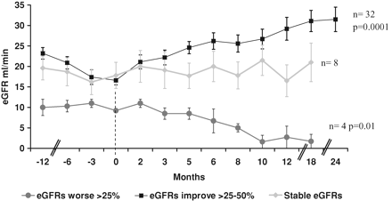
eGFR Changes after discontinuation ofACEi/ARBs in CKD 4 Stage
N=52, Age: 73 ± 1,8 years, eGFR=16 ml/min,
Ahmed: Nephrol Dial Transplant 2009

Slide 46
SGLT 2 inhibitory inhibitors

Slide 47
Early diagnosis
of vascular diseases
Reperfusion
Hypertension
Th
Individualised treatment
of heart failure
Anti-PU Th
Hypertension
PU
Ischemic renal
disease
Cardio-renal
syndrome
Iodin contrast compound
FSGS/
GGS
Interstitial
fibrosis/tubular atrophy
ARF
antibiotics
Negativ vasomotor influence
ESRF
Medicaments/
Medicaments interaction

Slide 48
Conclusions
Diabetic kidney disease is combination of pathological vascular and changes of GBM which lead to glomerular sclerosis, interstitial fibrosis and tubular atrophy
Vascular changes can be dominant in Typ 2 DM patients. Heavy proteinuria may not be present in ESRF
Acute renal failure events increase risk to progression of diabetic kidney disease to ESRF therefore prevention of main risk factors is advisable

Slide 49
Conclusions
Pharmacologic influence of RAAS is suitable for treatment of hypertension and as antiproteinuric (renoprotective) management
Pharmacologic influence of RAAS may be associated with serious side effects (acute vasomotor acute renal failure, hyperkalemia)

Slide 50
Conclusions
SGLT2 inhibitors are promising drugs in DM patients as prevention therapy in patients on high risk of development of RI a HF and as the treatment in patients with cardiorenal syndrome

