Slide 1
INTRODUCTION TO NEPHROLOGY

Slide 2
Agenda
Classification od kidney diseases
Epidemiological significance of chronic nephropathies (CKD)
Renal structure, renal basic unit, renal blood supplay
Renal function
Evaluation of GFR
Importance of GFR assessment for staging and prognosis of chronic nephropathy (CKD)
Evaluation of tubular transport
Emaging methods in nephrology

Slide 3
Nephropathy classification classification aspects
2. renal structure, which is primarily damaged
Nephropathies
Acute
(hours -days)
Chronic
(years)
Nephropathies
Glomerulopathies
Tubulointerstitial
nephropathies
Vascular nephropathies
1. the time period in which
nephropathy develops
3. Is nephropathy the result of primary kidney disease or is it part of another disease ?
Nephropathies
Primary
Secondary
Subacute
(weeks-months)

Slide 4
Primary and secondary nephropathies
Primary: The pathogenetic process takes place primarily in the individual structures of kidney tissue
Secondary: the pathogenetic process in individual kidney tissue structures is caused by another disease: hypertension, diabetes mellitus, neoplasia, sepsis, connective tissue diseases, urological disease (structural and functional disorders of the urinary tract)
Hypertension-related nephropathy and diabetic kidney disease are the most common secondary nephropathies and the most common cause of irreversible renal failure.

Slide 5
A few important notes !
Acute nephropathy can go into a chronic stage
Most primary nephropathies occurs a priori as a chronic form
In the case of secondary nephropathy, the underlying disease should be treated
Causal treatment of primary nephropathies is possible only in some of them
The goal of chronic nephropathy therapy is to slow down the loss of renal function

Slide 6
Agenda
Classification od kidney diseases
Epidemiological significance of chronic nephropathies (CKD)
Renal structure, renal basic unit, renal blood supplay
Renal function
Evaluation of GFR
Importance of GFR assessment for staging and prognosis of chronic nephropathy (CKD)
Evaluation of tubular transport
Emaging methods in nephrology

Slide 7
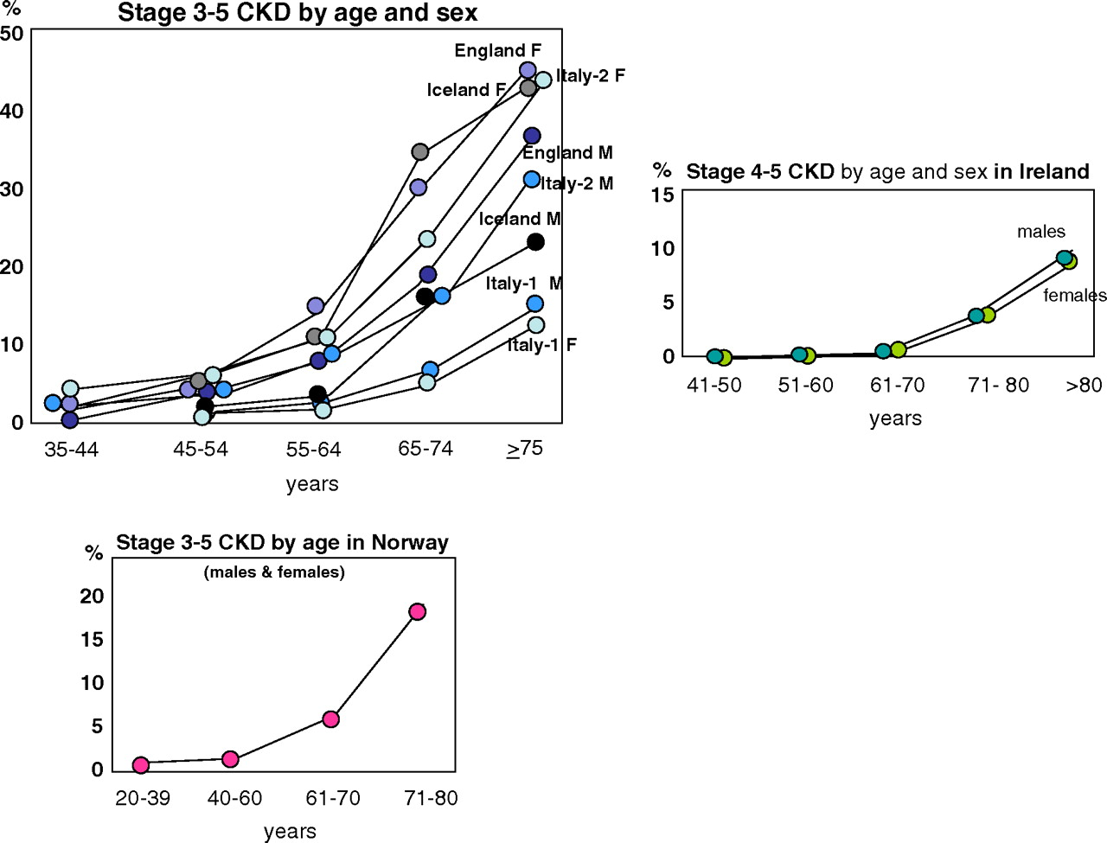
The prevalence of chronic nephropathy increases with age
An increasing prevalence of chronic nephropathies, as shown, can be observed from the age of 60 !

Slide 8
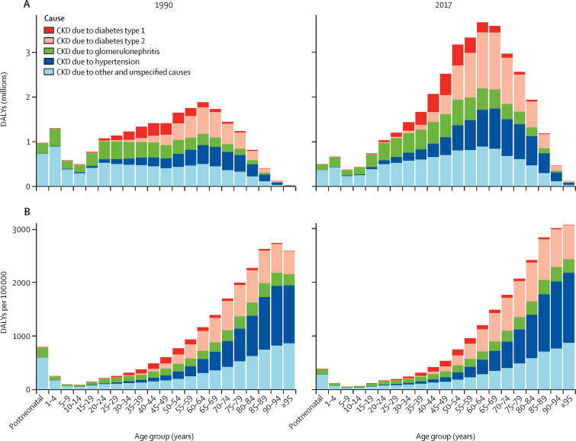
GBD Chronic Kidney Disease Collaboration. Global, regional, and national burden of chronic kidney disease, 1990-2017: a systematic analysis for the Global Burden of Disease Study 2017. Lancet. 2020 Feb 29;395(10225):709-733. doi: 10.1016/S0140-6736(20)30045-3. Epub 2020 Feb 13. PMID: 32061315; PMCID: PMC7049905.
DALY=disability-adjusted life-year
Number (A) and rate (B) of global DALYs for CKD by underlying cause in 1990 and 2017
DALY=disability-adjusted life-year. CKD=chronic kidney disease.

Slide 9
Annual mortality from cardiovascular causes and prevalence of DMT2, hypertension and age> 60 years in patients in the HD program in relative%
(source: statistical yearbooks of the Czech Nephrological Society and official website of the Czech Nephrological Society: www.nefrol.cz
%
Age>60 yars
Hypertension
C-V mortality
Although HD can replace kidney function, the presence of risk factors for K-V diseases and older age is the cause of high mortality from cardiovascular causes.
Notes:
HD sice může nahradit funkci ledvin, ale přítomnost rizikových faktorů K-V chorob a vyšší věk je příčinou jejich vysoké mortality z kardiovaskulárních příčin.

Slide 10
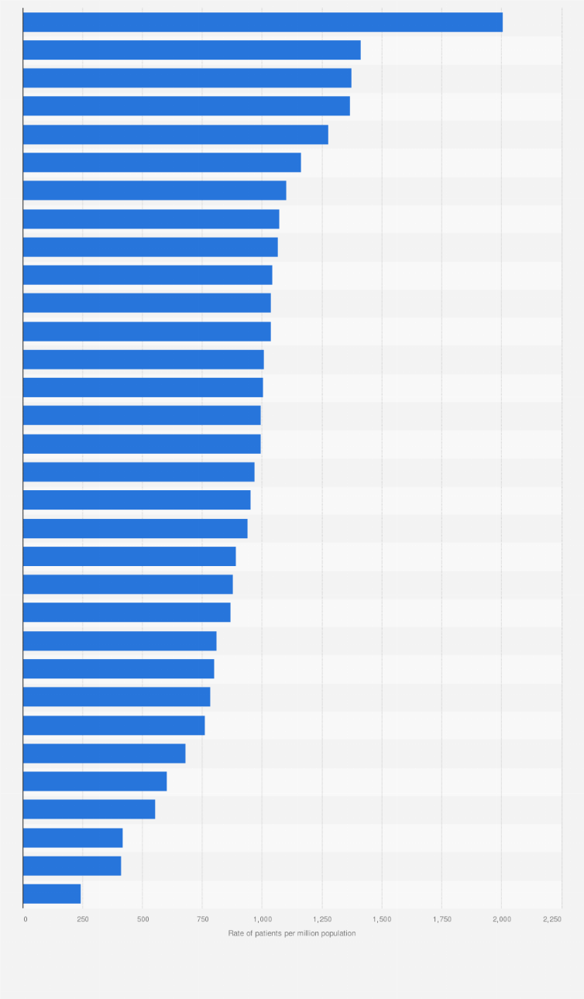
Portugal (2,008 PMP)
Greece
France
Spain
Italy
Romania
Czech Republic (1,101 PMP)
Prevalence of patients (PMP) treated with any form of RRT in 2019
Bosnia and Herzegovina
Slovakia
Albania
Poland
Belarus
Russia
Ukraine (244 PMP)

Slide 11
Agenda
Classification od kidney diseases
Epidemiological significance of chronic nephropathy (CKD)
Renal structure, renal basic unit, renal blood supplay
Renal function
Evaluation of GFR
Importance of GFR assessment for staging and prognosis of chronic nephropathy (CKD)
Evaluation of tubular transport
Emaging methods in nephrology

Slide 12
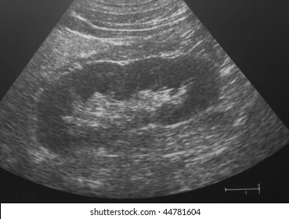
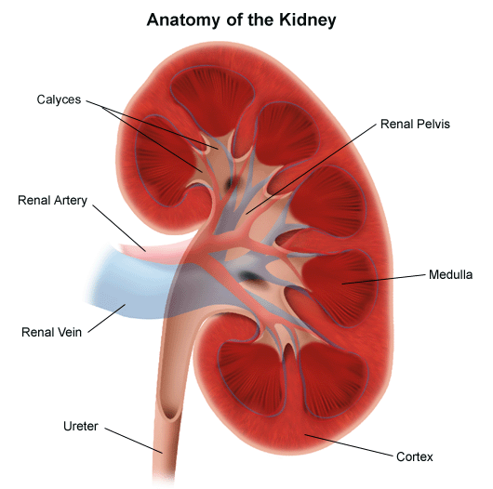
Renal anathomy - clinically important information
longitudinal section
size of renal pelvic calyx
size of the renal pelvis
the renal medulla is a bundle of collecting ducts that open into the renal calyx
collecting ducts drain urine into the calyces and renal pelvis
glomeruli are located in
the renal cortex
parenchymal layer thickness

Slide 13
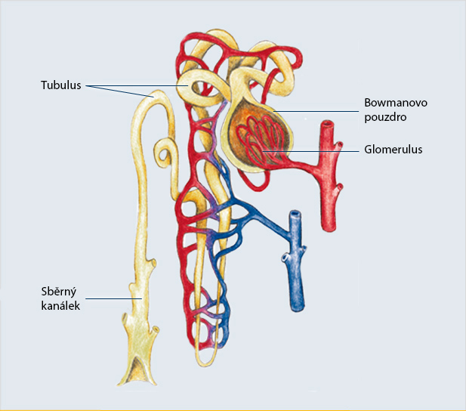
Renal structure
A nephron is the basic structural and functional unit of the kidneys that regulates water and soluble substances in the blood by filtering the blood, reabsorbing what is needed, and excreting the rest as urine. Its function is vital for homeostasis of blood volume, blood pressure, and plasma osmolarity. It is regulated by the neuroendocrine system by hormones such as antidiuretic hormone, aldosterone, and parathyroid hormone.
Basic functional unit= nephron
Bowman´s capsule
There are 1 million nephrons
in each kidney
Collecting
duct
Loop od Henle

Slide 14
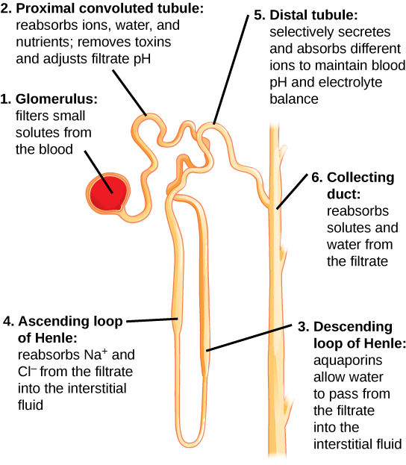
Renal structure

Slide 15
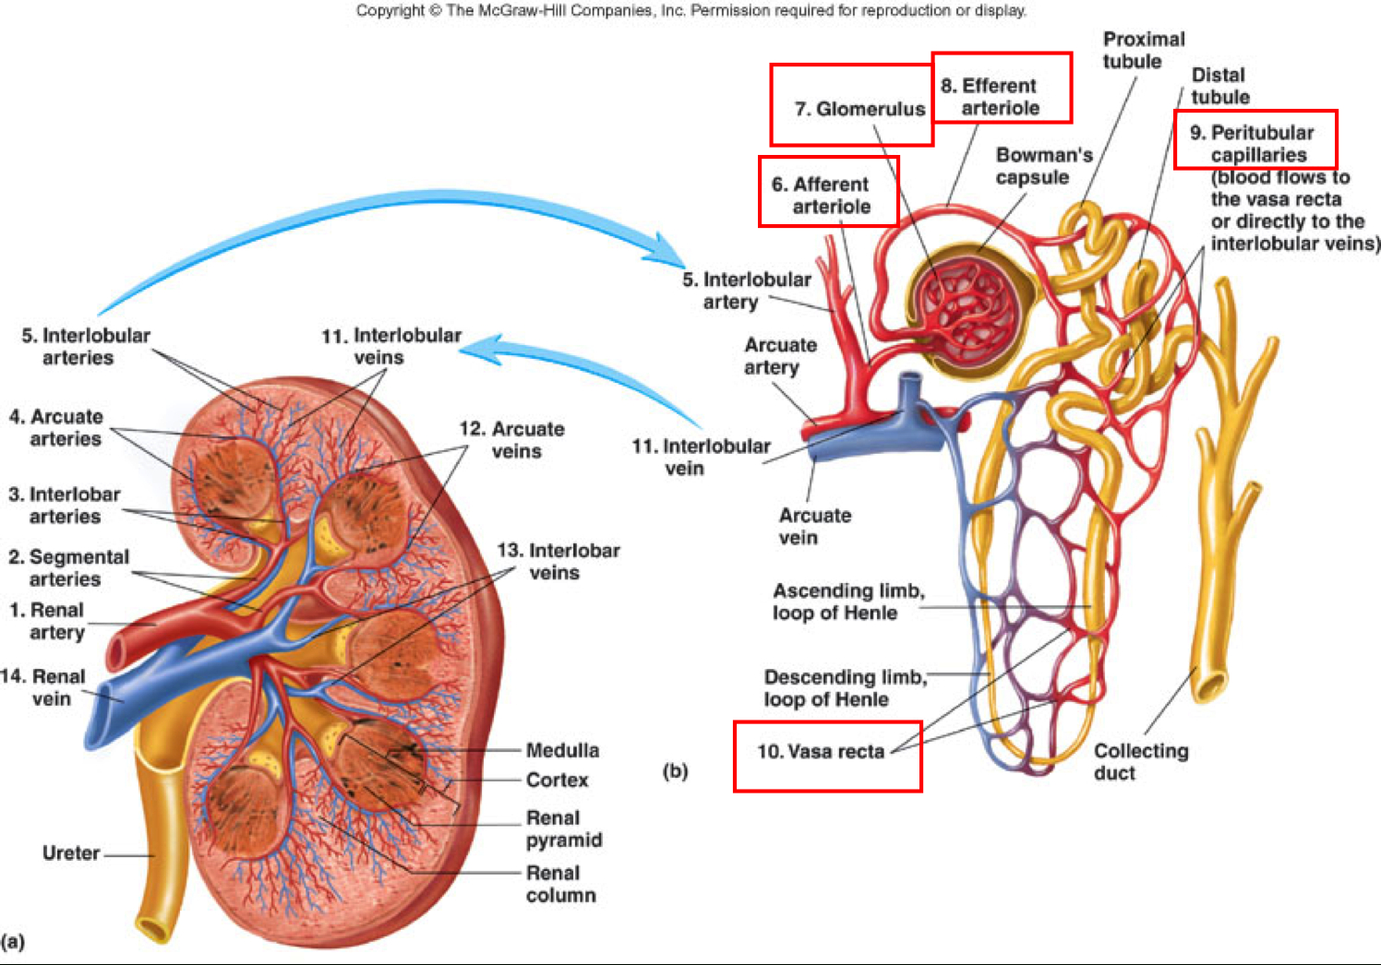
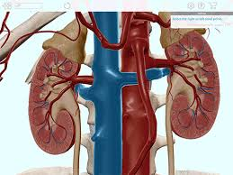
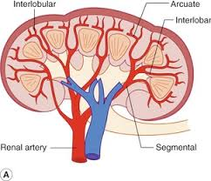
Kidney blood flow
20
represents 20% of the volume of blood that the heart will pump into a large circulation (minute volume!)
Every minute it flows into the kidneys
1 L blood!

Slide 16
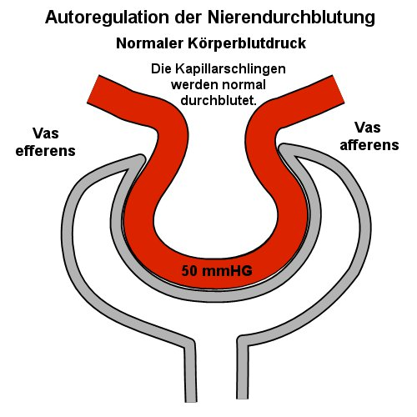
Regulation of blood flow through the glomerulus is responsible for maintenance of intraglomerular pressure
This regulation is controlled by the tubuloglomerular feedback, prostaglandins and the renin-angiotensin-aldosterone system!
Reduction of blood flow to the glomerulus
Increased blood flow to the glomerulus
Vas
afferens
Vas
efferens
Vas
afferens

Slide 17
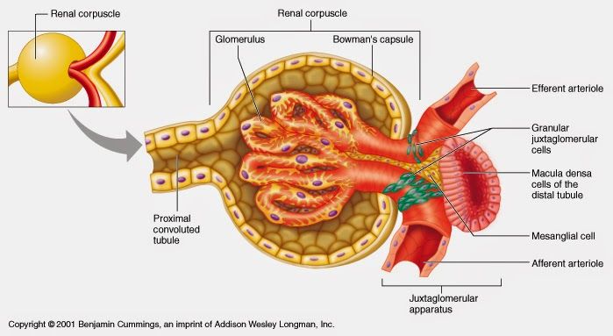
The juxtaglomerular apparatus is responsible for controlling glomerular hemodynamics. MD is a Cl- → Na⁺ concentration sensor
Glomeruli and tubules constantly cooperate and adapt blood flow to the glomerulus in order to maintain sufficient filtration pressure - importance of the juxtaglomerular apparatus

Slide 18
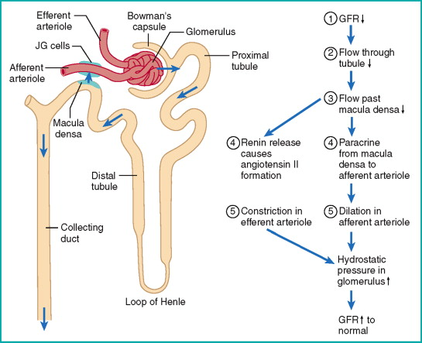
Tbuloglomerular feedback
angiotesin II
nitrogen oxide

Slide 19
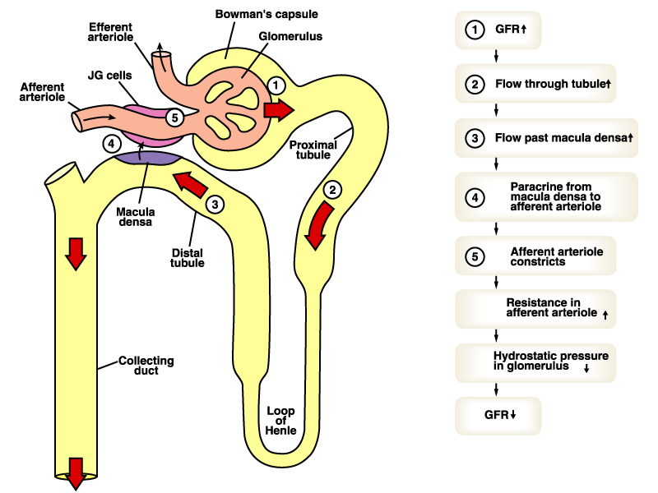
adenosin

Slide 20
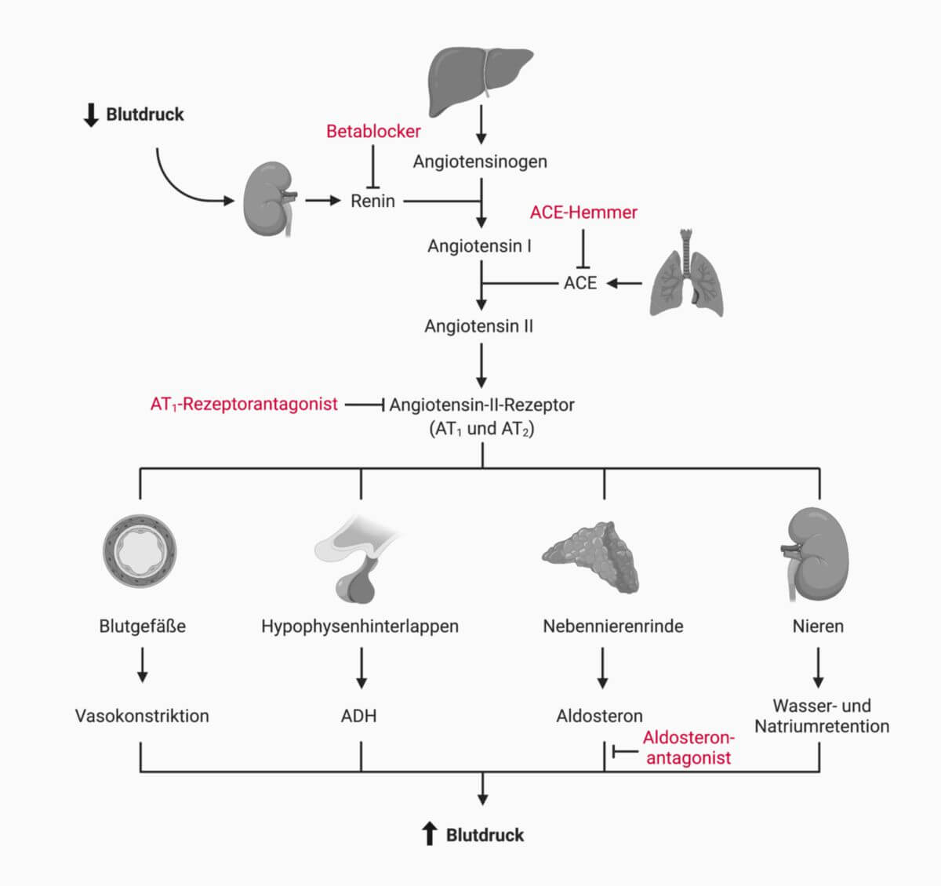
Renin-angiotensin- aldosteron
The liver creates and releases a protein called angiotensinogen. This is then broken up by renin, an enzyme produced in the kidney, to form angiotensin I. This form of the hormone is not known to have any particular biological function in itself but, is an important precursor for angiotensin II.
blood pressure
ACE is a enzyme that cleaves the terminal histidyl-leucine from angiotensin I to form the octapeptide angiotensin II.
blood vessels
posterior pituitary
adrenal cortex
kidneys
vasoconstriction
water and sodium
retention
blood pressure

Slide 21
Renin-angiotensin-aldosteron axis
Aldosteron
ACE
Angiotensin I

Slide 22
Agenda
Classification od kidney diseases
Epidemiological significance of chronic nephropathy (CKD)
Renal structure, renal basic unit, renal blood supplay
Renal function
Evaluation of GFR
Importance of GFR assessment for staging and prognosis of chronic nephropathy (CKD)
Evaluation of tubular transport
Emaging methods in nephrology

Slide 23
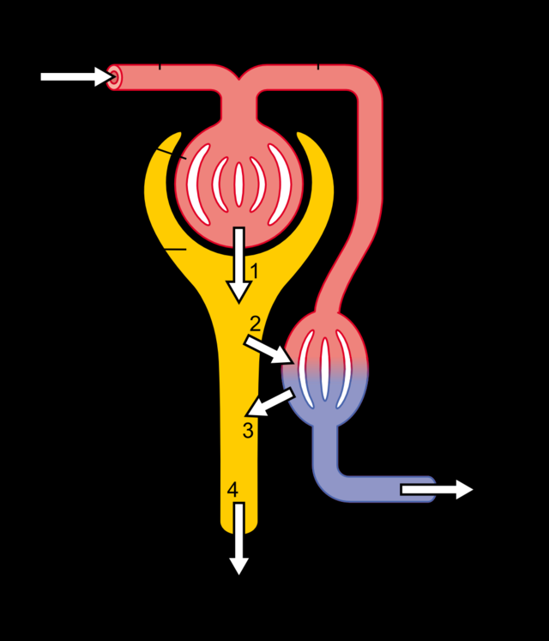
Basic kidney function
1. Glomerular filtration
2. Tubular resorption
3. Tubular resorption
4. Renal excretion

Slide 24
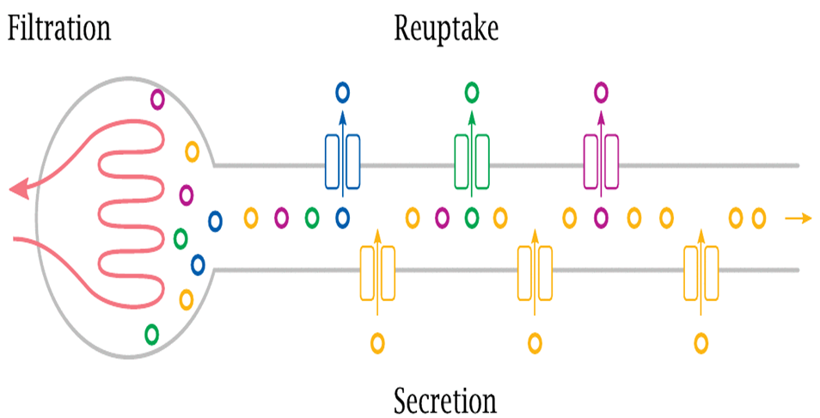
Ensuring physiological conditions of the electrolyte composition of the internal environment and ABB
Glomerular filtration
Tubular transport of water and solutes
Number of functional nephrons
Effective circulating volume
Neuroendocrine regulation
Intraglomerular pressure
Tubuloglomerular feedback
Medicaments
Muscle mass affecting SCr

Slide 25
Agenda
Classification od kidney diseases
Epidemiological significance of chronic nephropathy (CKD)
Renal structure, renal basic unit, renal blood supplay
Renal function
Evaluation of GFR
Importance of GFR assessment for staging and prognosis of chronic nephropathy (CKD)
Evaluation of tubular transport
Emaging methods in nephrology

Slide 26
Glomerular filtration (GFR) = glomerular filtration (GFR) = physiological process of blood ultrafiltrate formation, which is further processed in the renal tubules
GFR cannot be measured directly in humans. GFR is assessed indirectly by the serum concentration of glomerularly filterable endogenous markers, which are mostly eliminated by glomerular filtration or by the urinary / plasma clearance of exogenous
or endogenous molecules.

Slide 27
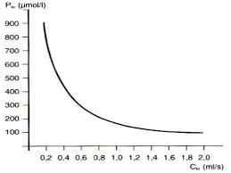
Serum creatinine concentration (SCr) and GFR
Creatinine is a metabolite of the muscle protein creatine, which is about half eaten in food (especially in meat), the remaining 50% is synthesized in the liver. Its creatinine metabolite is released into the bloodstream in a stable amount. It is excreted practically only by the kidneys and, in their physiological function, its serum concentration is relatively constant over 24 hours. However, its value is influenced by the presence of liver disease and / or muscle mass in addition to renal function.
a small decrease in GFR from moderately reduced to significantly reduced GFR represents a large increase in serum creatinine
a large decrease in GFR from normal to slightly decreased GFR represents a small increase in serum creatinine
The relationship between serum creatinine concentration and GFR is expressed by a hyperbolic curve

Slide 28
S_{Cr}

Slide 29
Cystatin C
cystatin C is an endogenous cathepsin protease inhibitor. Its serum concentration does not depend on muscle mass or diet type and is therefore considered to be a more accurate indicator of GFR than serum creatinine. Cystatin C can detect earlier GFR disorders!
Serum levels of cystatin C fluctuate and may be increased in chronic nicotinism, inflammation, obesity or impaired thyroid function and corticosteroid use!

Slide 30
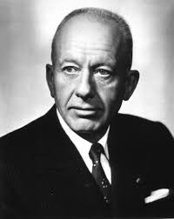
Clearances methods
Homer Smith (1895-1962), USA
postulated clearance methods as suitable for measuring GFR
Renal clearance = volume of blood (plasma) that is purified from a given substance by glomerular filtration per time unit

Slide 31
Clearances methods for measurement of GFR (mGFR) of exogenous substances
method | Strenghts | Limitations
INULIN | Gold standard No side effects | Expensive method Difficult logistics examination
Iothalamat | Inexpensive The long half-life of 125I as a carrier Suitable for research | Tubular secretion →overstates GFR Storage, application and availability 125I Allergy to iodine! Non-radioactive iothalamate requires an expensive assay
Iohexol | Cheap Not radioactive The high sensitivity of the assay allows the application of small doses | Tubular reabsorption and binding to plasma proteins ← underestimation of GFR Allergy to iodine!
EDTA (ethylenediaminetetraacetic acid) | Generally available in the EU Chelated ⁵⁹Cr | Tubular reabsorption ←underestimates GFR Storage, application and availability ⁵⁹Cr
DTPA (diethylenetriaminepentaacetic acid) | Generally available in the USA Chelated ⁹⁹mTc | Storage, application and availability ⁹⁹mTc Short half-life ⁹⁹mTc It requires standardization of ⁹⁹mTc, dissociation and protein binding ← underestimation of GFR

Slide 32
Clearances methods for measuring GFR (mGFR) of endogenous substances
The only method commonly used is creatinine clearance!
U_{Cr} x V (ml/s)
P_{Cr}
The accuracy of this parameter depends on the patient, respectively, the precise 24-hour urine collection
Patient-independent methods for determining GFR were sought !

Slide 33
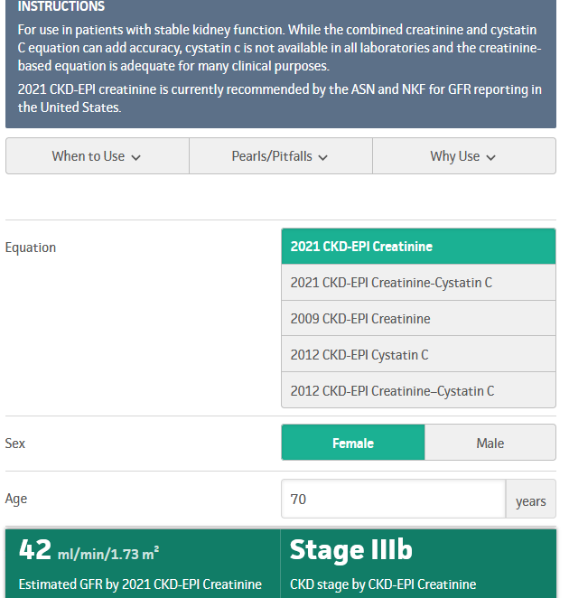
Formulas to estimate GFR (eGFR) based on PCr
Chronic Kidney Disease Epidemiology Collaboration equation
CKD-EPI =141 x min(SCr/κ, 1)α x max(SCr /κ, 1)-1.209 x 0.993Age x 1.018 [if female] x
1.159 [if Black]
www.mdcalc.com
The equation was constructed by examining 12,150 individuals in the EU and the US
(without CKD, with CKD, DM, TX patients, TX potential donors
(Ø GFR 68mL / min / 1.73m2). Data were related to the urinary clearance of iothalamate.

Slide 34
Agenda
Classification od kidney diseases
Epidemiological significance of chronic nephropathy (CKD)
Renal structure, renal basic unit, renal blood supplay
Renal function
Evaluation of GFR
Importance of GFR assessment for staging and prognosis of chronic nephropathy (CKD)
Evaluation of tubular transport
Emaging methods in nephrology

Slide 35
STAGES OF CHRONIC NEPHOPATHY
GFR
(ml/s/1,73m²)
(ml/min/1,73m²)
>1,5
>90
1,49-1
89-60
0,99-0,5
59-30
0,49-0,20
29-12
<0,20
<12
Screening nephropathy
Differential dg of CKD
↓ ↓ Risks of progression
Treatment of complications
Preparation of RRT
RRT
Dg chronic nephropathy
Treatment of comorbidities
Slowing progression

Slide 36
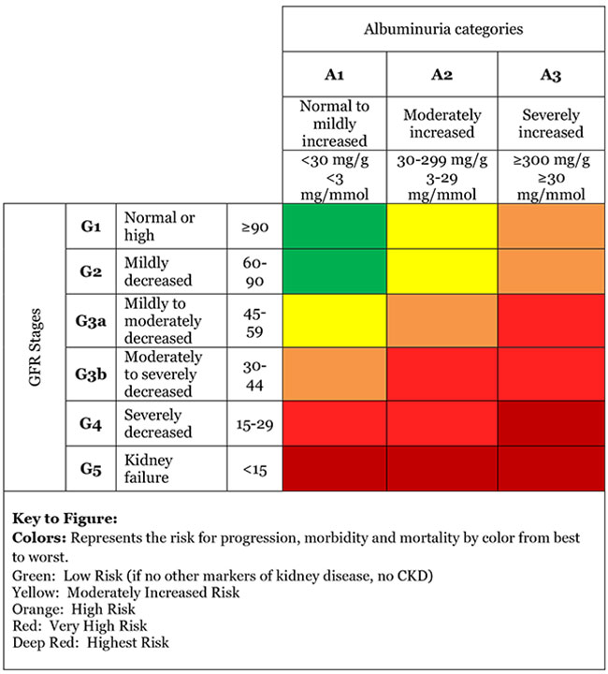
Staging of chronic kidney disease

Slide 37
Agenda
Classification od kidney diseases
Epidemiological significance of chronic nephropathy (CKD)
Renal structure, renal basic unit, renal blood supplay
Renal function
Evaluation of GFR
Importance of GFR assessment for staging and prognosis of chronic nephropathy (CKD)
Evaluation of tubular transport
Imaging methods in nephrology

Slide 38
Ensuring physiological conditions of the electrolyte composition of the internal environment and ABR
GFR
Tubular transport
Nutritional factors
Medicaments
Regulatory mechanisms
Adaptation of residual nephrons
Underlying nephropathy
Extrarenal excretion

Slide 39
Current possibilities of evaluating the intensity of tubular transport of water and individual electrolytes
Example Na⁺
U_{Na+} | Very low values (<20mmol/L) indicate very intense tubular Na⁺ resorption (retention Na⁺?; dilution ?)
dU_{Na+} | High values (>250 mmol/24h) are associated with decreased tubular transport of Na⁺ (salt wasting ?; high salt intake?)
FE_{Na+} | It allows to assess the intensity of tubular Na⁺ transport (classification of abnormal values?)

Slide 40
Calculation of fractional excretion(FE)
FE = Amount of solute excreted in urin x 100
Amount of solute filtered in glomeruli
 | FE_{Na+} (%) | FE_{K+} (%) | FE_{H2O}(%)
Normal value | 0.4-1.2 | 4.0-19 | 1.0-2.0
Maximal value | 20-30 | 150-200 | 20-30

Slide 41
Example of FE calculation
FE _{Na+} = U_{Na+} x S_{Kr} x 100
S _{Na+} U_{Kr}
FE_{H2O} = S_{Kr} x 100
U_{Kr}
Calculation of EF x does not require collection of urine !!!

Slide 42
FE_{Na+} evaluation
FE_{Na+} ABNORMAL VALUES
Changes supporting the preservation of homeostasis of the internal environment
Changes supporting deflection
homeostasis of the internal environment
Compensatory changes
Pathogenic changes

Slide 43
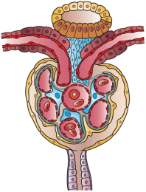
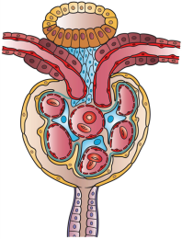
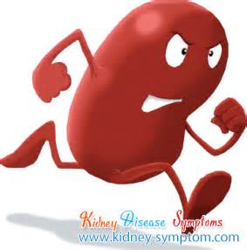
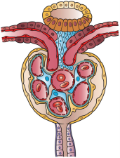
Compensatory changes: adaptive changes of tubular resorption of Na + in residual nephrons
Normal number of nephrons
R.Platt(1952); N.S.Bricker(1960)
S _{Na+} | 140 mmol/L
GFR | 1.5 mL/s
U _{Na+} | 93 mmol/L
dU _{Na+} | 150 mmol/24h
FE _{Na+} | 0.8 %
FE _{H2O} | 1.2%
S _{Na+} | 140 mmol/L
GFR | 0.3 mL/s
U _{Na+} | 68 mmol/L
dU _{Na+} | 150 mmol/24h
FE _{Na+} | 4.1 %
FE _{H2O} | 8.5%
Residual nephrons and its hypertrophy

Slide 44
Pathogenic changes FE_{Na+}
TUBULOPATHIES
(primary or
secondary)
REGULATORY
MECHANISMS DISORDERS
OSMOTIC DIURESIS
Edematous state
Endocrine disorders:
Adrenal inssufficiency
CSWS
Diuretics
Metabolic
disorders
↑S_{OSM}
(DM decomp.)
FE_{Na+} ↑
FE_{Na+} ↓
FE_{Na+} ↑
FE_{Na+} ↑
FE_{Na+} ↑

Slide 45
Agenda
Classification od kidney diseases
Epidemiological significance of chronic nephropathy (CKD)
Renal structure, renal basic unit, renal blood supplay
Renal function
Evaluation of GFR
Importance of GFR assessment for staging and prognosis of chronic nephropathy (CKD)
Evaluation of tubular transport
Imaging methods in nephrology

Slide 46
Imaging methods
USG of kidney, abdominal aorta, renal arteries, bladder, prostate, measurement of post-voiding residual urine and/or bladder capacity, renal CT, CT angiography, CT IVU, spiral CT
Dynamic and static renal scintigraphy
Micturial cystoureterography

Slide 47
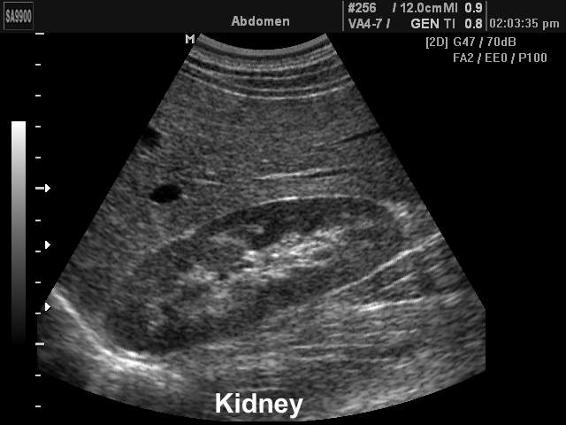
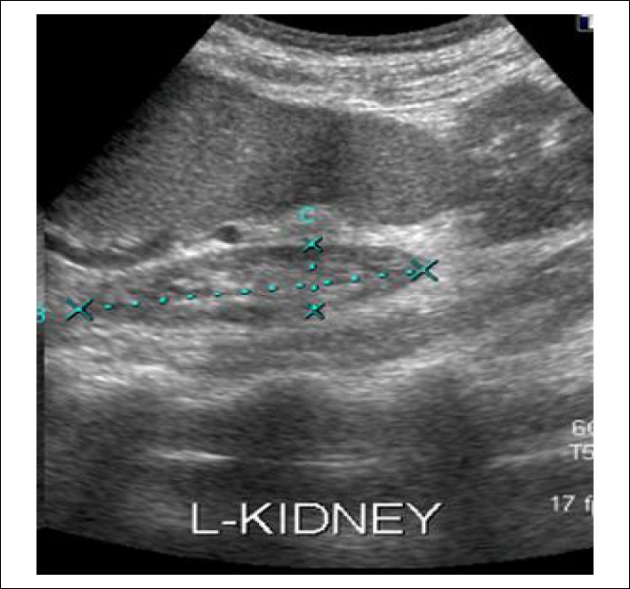
shrunken kidney

Slide 48
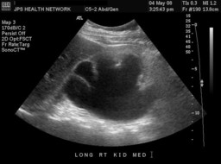
hydronephrosis

Slide 50
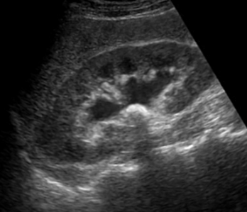
pyelolithiasis

Slide 51
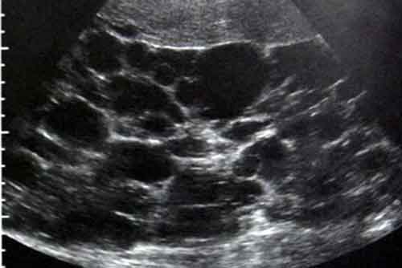

Slide 52
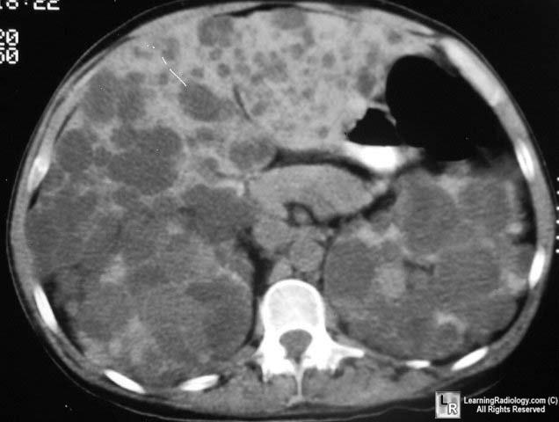

Slide 53
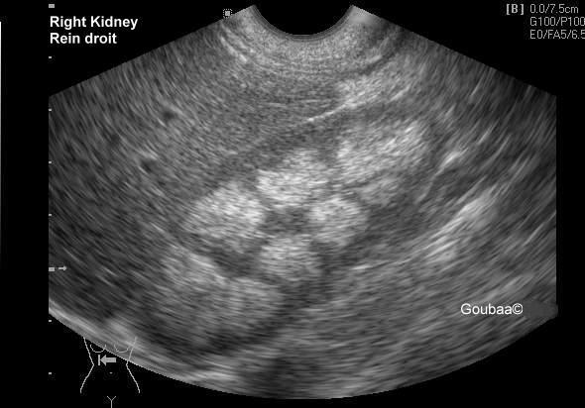
nephrocalcinosis

Slide 54
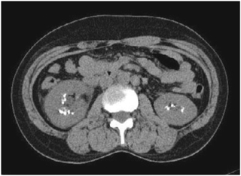

Slide 55
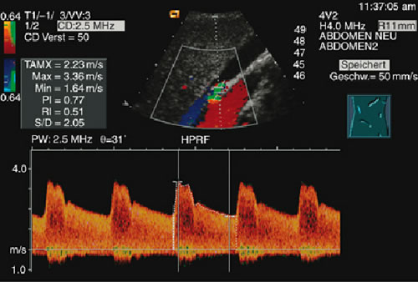
doppler ultrasound
doppler ultrasound

Slide 56
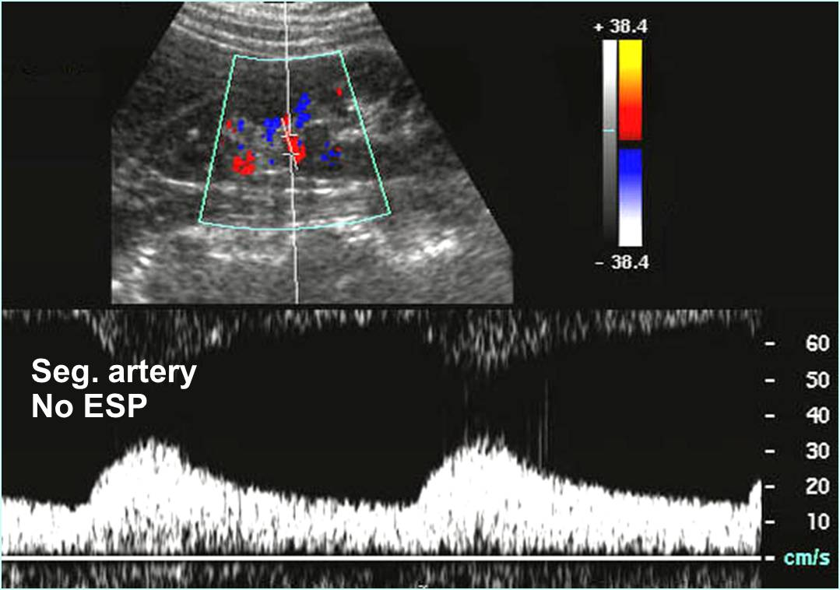

Slide 57
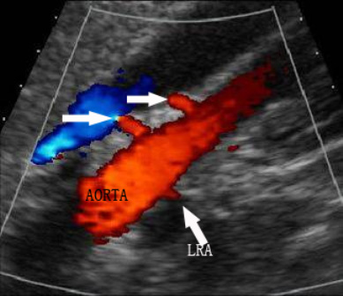

Slide 58
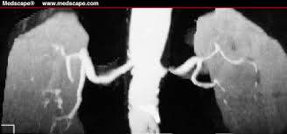
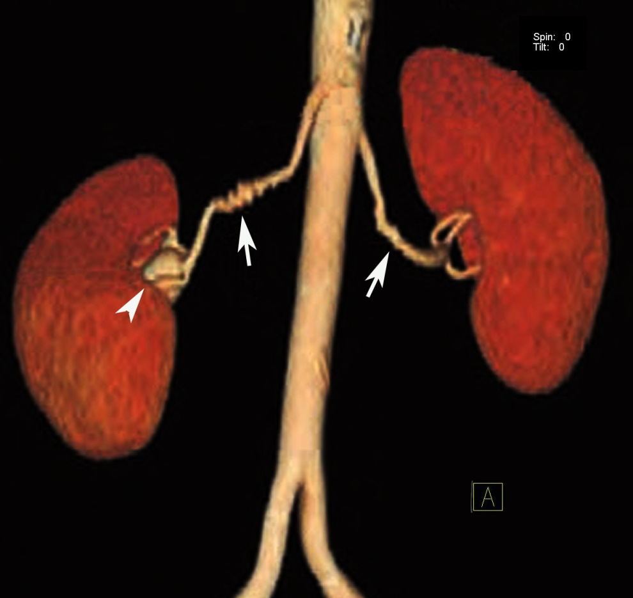
Finromuscular dysplasia
Atheroslerotic stenosis

Slide 59
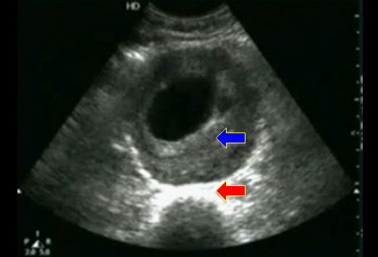
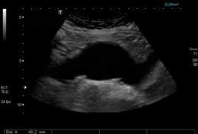

Slide 60
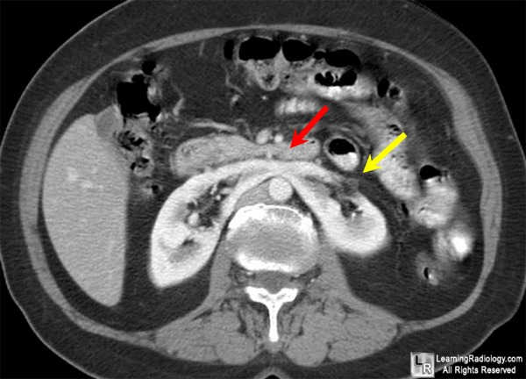
horseshoe kidney

Slide 61
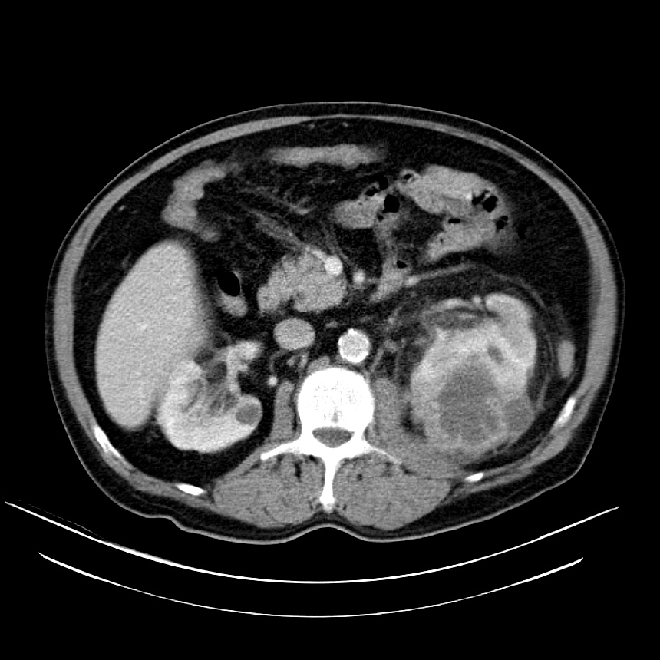

Slide 62
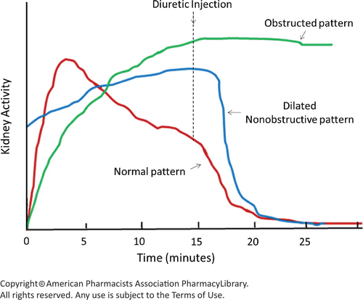
MAG scintigraphy

Slide 63
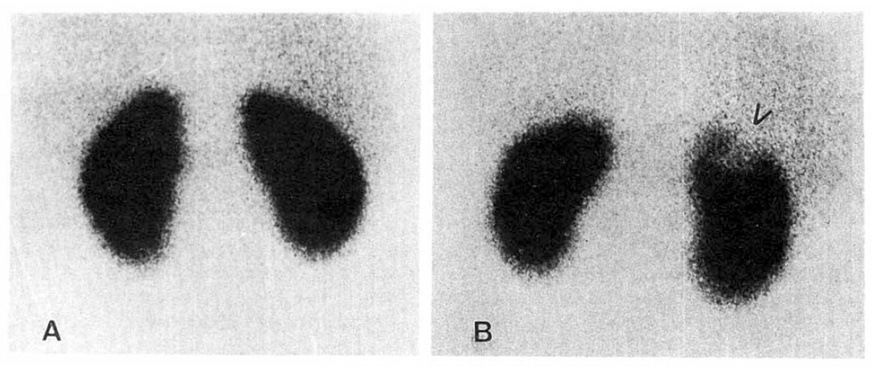
DTPA scintigraphy

