Slide 1
Disorders of water and electrolyte metabolism resulting in Disorders of internal environment homeostasis
Miroslava Horáčková

Slide 2
AGENDA
Basic principles of the physiology of body fluid composition and internal enviroment balance
Disorders of the internal environment associated with normal ECF (extracellular fluid) effective tonicity
Isotonic hypohydration
Third spacing
Isotonic hyperhydration
Disorders of the internal environment associated with abnormal ECF effective tonicity
Free water deficit
Free water excess
Differetial diagnosis of hyponatremia
Disturbances of kalemia

Slide 3
The basic requirements of the physiological composition of the internal environment
Why?
An effective circulating volume (= unmeasurable blood volume in the arterial bed), so also functional blood circulation, allows in stress conditions fight or run away, so survive!!!
The organism can sacrifice isotonicity and isoelectricity in order to maintain isovolemia
Isovolemia is the superior law, because maintaining blood circulation.
Maintanance of :
It is the main determinant of maintaining effective
circulating volume, thus maintaining blood pressure and perfusion of vital organs.
Isovolemia
Isotonicity
Electroneutrality
Is determined by the amount of
osmoles which are able to cause water transport between ICF and ECF
Electroneutrality is a balanced amount of positively and negatively charged solutes in body fluids. Disorders of electroneutrality influence acid - base balance

Slide 4
Composition of the body
Transcelular
compartment
solids ∼ 40%
Na-K-ATPase
Vascular space
<<<<energy supply
Pericardial space
(pericardial effusion)
Pleural space
(pleural effusion)
Peritoneal space
(peritoneal effussion)
Intestinal lumen
(ileus)
Subcutaneous tissue
(edema)
Muscles
(rhadomyolysis)
Skin
(burns)
K+
<<< P_{cap} >>>
Hydraulic
pressure gradient
P_{is}>>>
<<<P_{is}
>>> π_{cap} <<<
Na+
Oncotic
pressure gradient
Concentration
<<<<<< of effective
molecules (Na⁺)
π_{is}<<<
>>>π_{is}
Effective
tonicity
H₂O
≈ 5%
ISC ≈ 15%
ECF
≈ 20% BW
- Na≈ 98%
- K≈2%
ICF
≈ 40% BW
- Na≈ 2-3%
- K≈97-98%

Slide 5
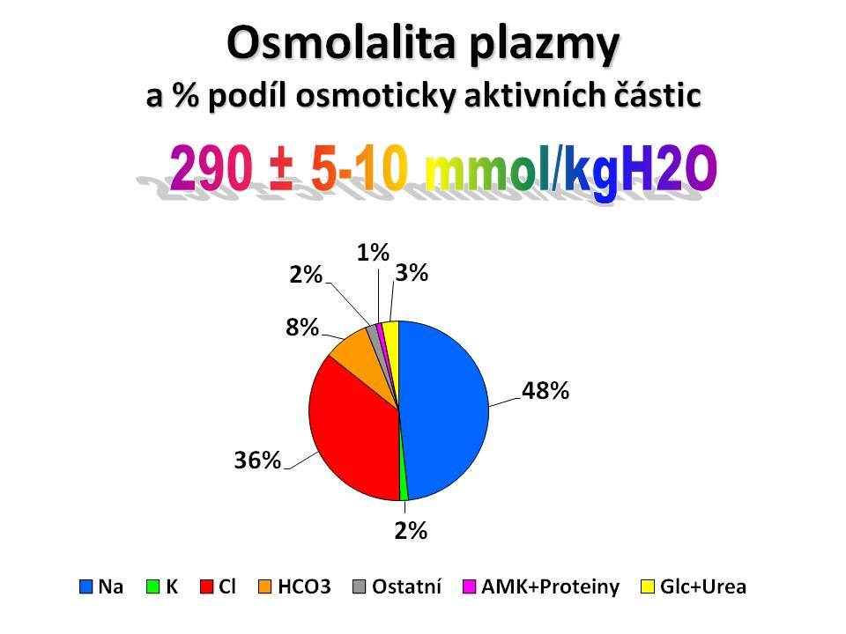
Osmolality- Osmolarity-Tonicity
OSMOLARITY (mmol/L), OSMOLALITY (mmol/Kg)
is the concentration of all solutes regardless of their ability to cause water transport between ICF a ECF
Effective tonicity (mmol/L)
is determined by the amount of
osmoles which are able to cause water
transport between ICF a ECF
Plasma osmolality and percentage portion of osmotic active particles (is measured cryoscopically)
OSMOLES
effective
uneffective
Plasma osmolality
percentage of osmotically active molecules
ENDOGENOUS
EXOGENOUS
ENDOGENOUS
EXOGENOUS
Natrium
Glucose
Manitol
Glycin
Urea
Methanol
Ethanol
Ethylenglycol
other
until complete metabolism of alcohols in the liver, these can play the role of effective osmols

Slide 6
Why is it important to investigate osmolality and calculate effective tonicity!?
Effective tonicity = 2 x (Na⁺ + K⁺) + S_{Gl}
Osmolality = Cryoscopic laboratory measurement of all osmotically active substances in ECF (plasma)
Osmotic gap = difference between measured osmolality and calculated tonicity <10 mosm / Kg.
Effective tonicity determines the transfer of water between ECT and ICT.
When the osmotic gap is >10 mosm/kg, it is necessary to suspect the presence of exogenous effective osmols in ECT !

Slide 7
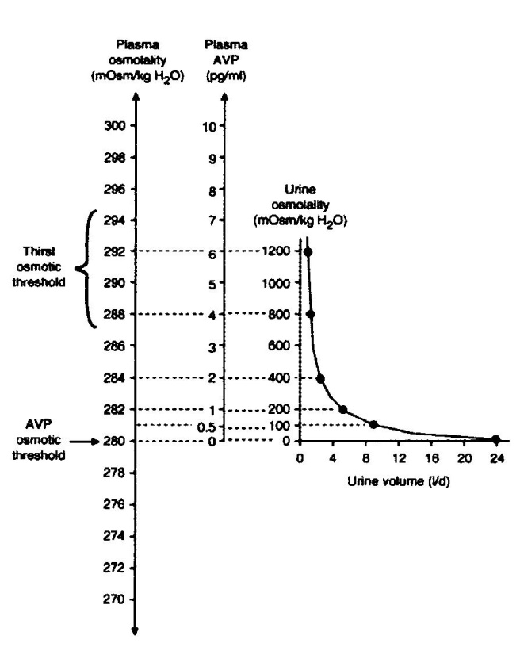
Effective tonicity is controlled by vasopressin (antidiuretic hormone). The main determinant of effective tonicity in ECF is the Na⁺ concentration
Relationship between plasma tonicity ,AVP plasma concentration and urinary osmolality
The osmotic regulation of ADH depends on effective tonicity
At an effective osmolality <280 mOsm / kg H2O
the release of ADH is completely suppressed; and
the Uosm is <100 mOsm / kg H2O
Uosm is a simple laboratory indicator
ADH activity in conditions with hyponatraemia
If in hypotonic hyponatremia
Posm <280 mOsm / kg H2O
Uosm >100 mOsm / kg H2O, this is indicative
for the active role of ADH
Verbalis JG. Disorders of body water homeostasis. Clin Endocrin Metab 2003

Slide 8
The role of ADH in homeostasis of the internal environment
↑Tonicity ECT
↓ECV
↑release from pituitary gland
Ectopic production of ADH
↑ADH activity on aquaporin-2-R
osmoreceptors
baroreceptors
↑ADH
↑↑↑ADH
↑↑↑ADH
Inappropriate ADH elevation
Appropriate ADH elevation

Slide 9
SIAD-inducing drugs
Antidepressants | Anticonvulsants | Antipsychotics | Oncology drugs | other
SSRI | Carbamazepin | Phenothiazides | Vinca-alkaloids | Opiates
Tricyclic | Valproat | Butyrphenones | platinum pharmaceuticals | NSAIDs
MAO inhihibitors | Lamotrigin |  | Ifosfamid | Clofibrat
 |  |  | CFS | Amiodaron
 |  |  | Melfalan | PPI
 |  |  |  | Thiazide diuretics

Slide 10
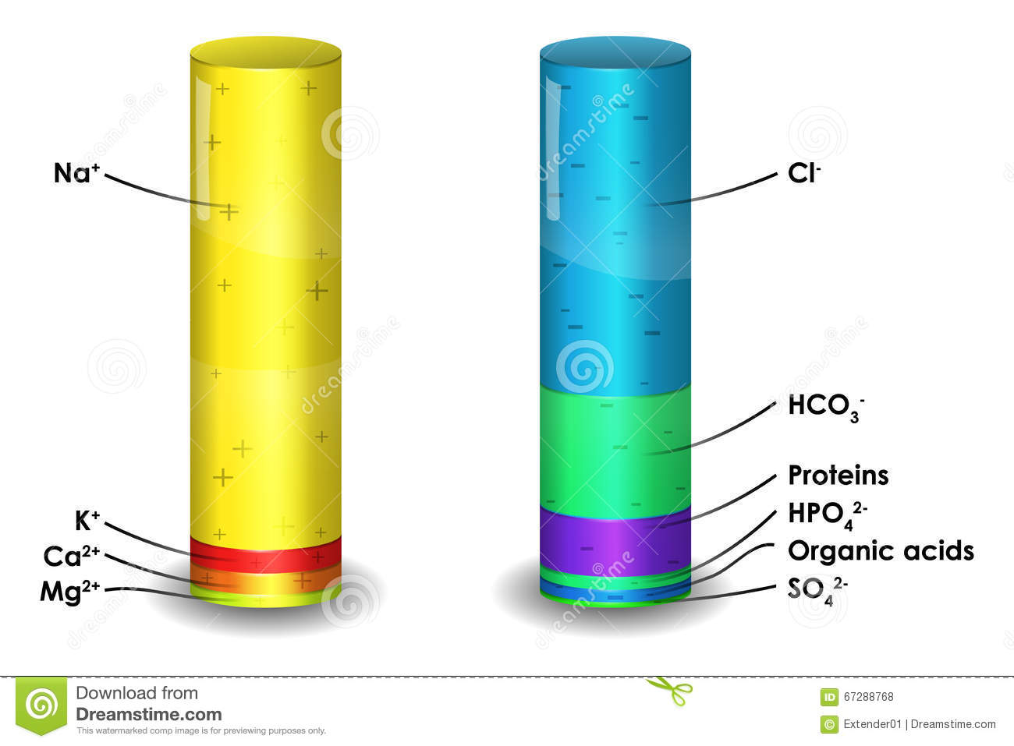
Electroneutrality is a balanced amount of positively and negatively charged solutes in body fluids
Na⁺ + K⁺ + Ca²⁺ + Mg²⁺ + H⁺ = OH⁻ + Cl⁻ + HCO₃⁻ + albumin⁻ + Pi⁻
Disbalance of electrolytes (loss of Cl-) leads to AB disbalance (hypochloremic alcalosis)

Slide 12
AGENDA
Physiology and pathophysiology of body fluid composition
Disorders of the internal environment associated with normal ECF effective tonicity
Isotonic hypohydration
Isotonic hyperhydration
Third spacing
Disorders of the internal environment associated with abnormal ECF effective tonicity
Free water deficit
Free water excess
Differetial diagnosis of hyponatremia
Disturbances of kalemia

Slide 13
Isotonic hypohydration

Slide 14
Isotonic dehydration: deficit of water and solutes in isotonic ratio (ECF volume depletion)
ICF
Plasma and ECF Na⁺ concentration is unchanged
No water transport between
ECF a ICF
Plasma and ECF concentration K⁺ can be changed depending on the cause od dehydratation and acid-base disturbances
Plasma and ECF Cl⁻ concentration depends on causes and consequences of isotonic fluid loss
ABB depends on causes and consequences of isotonic fluid loss
IVC
ICF

Slide 15
Causes of isotonic dehydration
GI losses (vomiting, diarrhea, nasogastric suction, fistula drenage, short bowel)
Renal losses (salt lossing nephropathy, impairment of renal tubular function, primary endocrinologic disorders)
Sequestration of fluid (ileus, burns, peritonitis, pancreatitis)

Slide 16
HCL secretion into the stomach
parietal gastric cell
stomach
ECF
CO₂
+
H₂O
CA
H+
HCO3-
K⁺
Cl-
Cl-
CO2 and H2O in response catalyzed by carboanhydrase (CA) produces H+ and HCO3-. H+ is secreted into the lumen of the stomach by H+/K+ ATPasis and K+ recycles back into the parietal cell. Cl- from ECF enters the parietal cell using the HCO3-/Cl-anion exchange channel. Cl- enters the lumen of the stomach with the help of a Cl-transporter. Created HCO3- is stored for ECF and Cl- enters the gastric lumen, where together with H+ it produces acidic gastric juice. This process is electroneutral for both ICT and ECT environments !

Slide 17
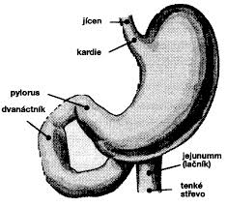
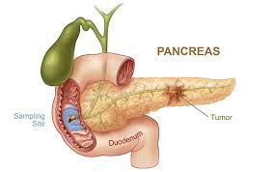
Isotonic dehydration: etiology
GI losses:
vomiting, nasogatric suction
HCl
H⁺ is neutralized by HCO3-
in equimolar ratio (1:1)
Ethiopathogenesis
Primary loss of H⁺ a Cl⁻, retention HCO₃₋ → matabolic alcalosis →renal compensation → ↑NaHCO₃ renal excretion→ Na⁺ loss → activation RAA →
↑ aldosteron → ENAC: ↑Na⁺ tubular resorption and ↑ K⁺ and H⁺ secretion
Isotonic dehydratation + hypochloremia + hypokalemia + metabolic alkalosis

Slide 18
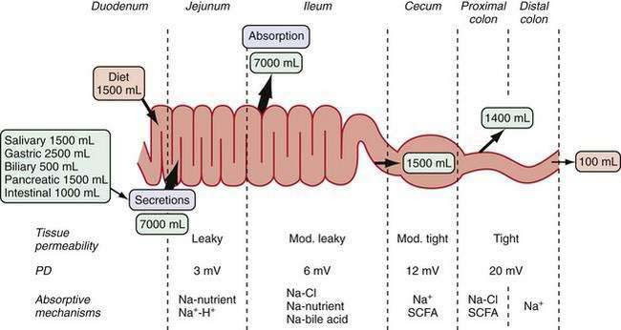

Slide 19
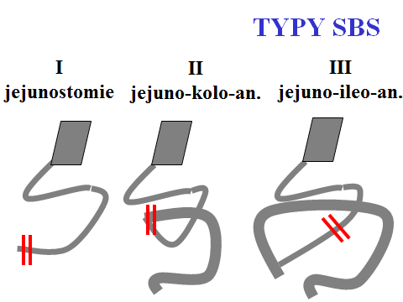
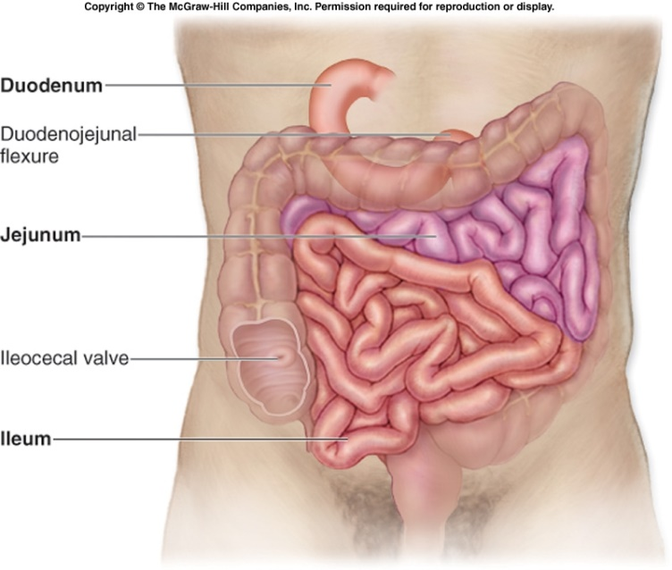
Isotonic dehydration: etiology
GI loss:
small bowel fistula, surgical resection of the small intestine: jejunostomy, ileostomy, ….
small bowel syndrome
jejunostomy
Jejuno-colic an.
jejun-ileo an.
Ethiopathogenesis
Diet containing fatty acids → Diarrhea → primari GI loss of HCO₃₋ acompanied with Na⁺ →activation RAAS →
↑ aldosteron → ENAC: ↑Na+ tubular resorption and ↑ K+ and H+ secretion
Primary GI K⁺ loss
Isotonic dehydratation, hyperchloremic metabolic acidosis, severe hypokalemia

Slide 20
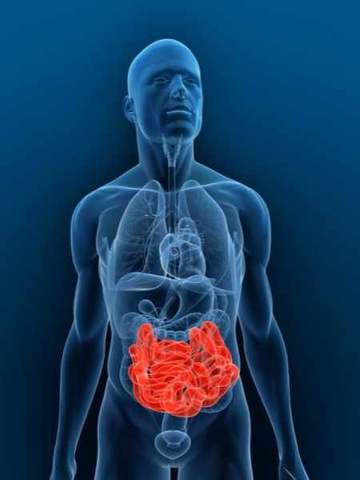
Isotonic dehydration: etiology
GI Loss:
Infection
Diverticulitis
Dysmicrobia
IBD
Ischemia
Malabsorption
Diarrhea
Ethiopathogesis
Diarrhea → primari GI loss of HCO3- acompanied with Na+ →activation RAAS → ↑ aldosteron → ENAC: ↑Na+ tubular resorption and ↑ K+ and H+ secretion
Primary GI K+ loss
Izotonic dehydratation, hyperchloremic metabolic acidosis, hypokalemia

Slide 21
Isotonic dehydration: renal etiology
Urinary loss caused by „salt losing nephropathy“
AIN, Chronic TIN, medullary kidney disease, ADPKD, SLE associated with Sjoegren syndrome, ESRD)
Urinary loss caused by impairment of renal tubular function
Polyuric phase of ATN, post-obstructive natrium polyuria, secondary nephropathies
associated with hyporenin- hypoaldosteronism, diuretics
Urinary loss caused by endocrinological disorders
DM complicated by ketoacidosis: loss of Na⁺ a K⁺ ketoacids salts
CSWS: Hyperproduction natriuretic peptides (brain trauma, brain tumor, subarachnoid hemorrhage, apoplex)
Adrenal insufficiency

Slide 22
Isotonic dehydration (clinical manifestation is not apparent until 3-6 l isotonic fluid has been lost !)
Main symptoms << hypovolemia (↓ ECV→hemodynamic : )
Hypotension (ortostaticá hypotension !)
Invisible filling of jugular vein in horizontal position
↑ HTC, serum protein, albumin, UA, P_{UREA} (trends !)
↓ Central blood pressure
↓ BW (BW befor dehydratation has to be known !)
Symptoms <<< hypohydration
Poor skin turgor
Sunken eyes
Oliguria
Absence of axillary sweat
Muscle cramps
thirst, anorexia
apathy, weaknes, confusion

Slide 23
Differencial diagnosis extrarenal vs renal losses
Extrarenal (GI) loss
Renal loss
↓UNa⁺ < 30 mmol/L
↓EF _{Na+} < 0.4%
↓EF_{Osm} < 2%
EF_{H2O} < 1%
ABB
metabolic acidosis
metabolic alcalosis
U_{K+} > 20 mmol/L
↓EF_{K+}
↑UNa⁺ > 30 mmol/L
↑EF_{Na+} > 1.2%
↑EF _{Osm} > 3.5%
↑EF _{H2O} > 2%
ABB
metabolic acidosis
metabolic alcalosis
↑↓U_{K+}
↓↑EF_{K+}

Slide 24
Therapy od isotonic dehydration
i.v. substitution of isotonic volume
Choice of solute preparation depends on ABB (acidifying solution in pts. with alkalemia; alkalizing solutin in acidemia)
Amount of substituted solution and infusion rate depend on clinical status and underlying diseases

Slide 25
Solute prepations for for therapy
of izotonic dehydratation
 | Na⁺ ^{mmol/l} | Cl⁻ ^{mmol/l} | K⁺ ^{mmol/l} | CH3COO⁻ ACETATE | C6H1107 GLUKONATE | C3H5O3 LAKTATE
Plasmalyte | 140 | 98 | 5 | 27 | 23 | 0
Isolyte | 137 | 110 | 4 | 34 | 0 | 0
Hartmann | 131 | 111 | 5 | 0 | 0 | 29
F1/1 | 154 | 154 | 0 | 0 | 0 | 0
Ringer | 147 | 156 | 4 | 0 | 0 | 0

Slide 26
AGENDA
Physiology and pathophysiology of body fluid composition
Disorders of the internal environment associated with normal ECF effective tonicity
Isotonic hypohydration
Third spacing
Isotonic hyperhydration
Disorders of the internal environment associated with abnormal ECF effective tonicity
Free water deficit
Free water excess
Differetial diagnosis of hyponatremia
Disturbances of kalemia

Slide 27
Third spacing

Slide 28
Isotonic dehydration: sequetration of water and solutes into the transcelular compartment
Plasma and ECF Na⁺ concetration is unchanged
No water transport between
ECF a ICF
etiology
Ileus -intestinal lumen
necrotizing pancreatitis
Sepsis: Subcutaneous tissue (edema)
Muscles (rhabdomyolysis)
Skin (burns)
Na + H₂O

Slide 29
Sequestration of water and solutes into the transcelular compartment (clinical manifestation is not apparent until 2-4 l isotonic fluid has been retained !)
Clinical manifestation
BW gain
Edema
Dyspnea
Tachycardia
Clinical signes of pulmonary congestion

Slide 30
Diagnosis and treatment
Diferencial diagnosis of edematous status
Treatment of underlying disease
The patient is hypovolemic and hyperhydrated
CVVH
artificial lung ventilation

Slide 31
AGENDA
Physiology and pathophysiology of body fluid composition
Disorders of the internal environment associated with normal ECF effective tonicity
Isotonic hypohydration
Third spacing
Isotonic hyperhydration
Disorders of the internal environment associated with abnormal ECF effective tonicity
Free water deficit
Free water excess
Differetial diagnosis of hyponatremia
Disturbances of kalemia

Slide 32
Isotonic hyperhydration

Slide 33
Isotonic hyperhydration : excess of ECF
Plasma and ECF Na⁺ concetration is unchanged
No water transport between ECF a ICF
etiology
Congestive hard failure
Anuric renal failure
Decompensated liver cirhosis
Nephrotic syndrome
Na + H₂O

Slide 34
Isotonic hyperhydration
Clinical manifestation
BW gain
Edema
Dyspnea
Tachycardia
Jugular venous distention
Hepatojugular reflux
Clinical signes of pulmonary congestion

Slide 35
Diagnosis and treatment
Diferencial diagnosis of hyperhydration status
Treatment of underlying disease
Diuretics (renal excretion = refill)
CVVH
Hemodialysis + ultrafiltration

Slide 36
AGENDA
Physiology and pathophysiology of body fluid composition
Disorders of the internal environment associated with normal ECF effective tonicity
Isotonic hypohydration
Third spacing
Isotonic hyperhydration
Disorders of the internal environment associated with abnormal ECF effective tonicity
Free water deficit
Free water excess
Differetial diagnosis of hyponatremia
Disturbances of kalemia

Slide 37
Free water deficit
=
hypertonic dehydration

Slide 38
Hypertonic dehydration : depletion of free water
Plasma and ECF Na⁺ concentration increasis
water is transported into ECF
Plasma and ECF K⁺ concentration remain stable
Plasma and ECF Cl⁻ concentration
increasis
ABB remain stable
H₂O
H₂O
H₂O

Slide 39
Hypertonic dehydration: Pathophysiology
Insufficient oral intake of water (consciousness impairment )
Decreased reactivity of osmoreceptor
in BG in very old patients
= loss of thirst
insufficient home care
Auxiliary factors
Fever
Profuse perspiration
Diabetes insipidus

Slide 40
Hypertonic dehydration Clinical manifestation
Tremulousness
Irritability
Ataxia
Spasticity
Confusion
Seizures
Coma

Slide 41
Hypertonic dehydration Treatment
Intravenous 5% glucose infusion until S_{Na+} has been normalised
Excesively rapid correction is dangerous !
Infusion rate has to be so slow that S_{Na+} decrease das not exceed 0,5 mmol/L per 1 h

Slide 42
AGENDA
Physiology and pathophysiology of body fluid composition
Disorders of the internal environment associated with normal ECF effective tonicity
Isotonic hypohydration
Third spacing
Isotonic hyperhydration
Disorders of the internal environment associated with abnormal ECF effective tonicity
Free water deficit
Free water excess
Differetial diagnosis of hyponatremia
Disturbances of kalemia

Slide 43
Relative free water excess
=
Hypotonic dehydration
=
Depletion hyponatremia

Slide 44
Hypotonic dehydration : depletion of solutes > depletion of water
↓P_{Na+} = ↓↓Na⁺
↓H₂O
ADH
baroreceptors
↓ ECV
Plasma and ECF Na⁺ concentration decreases
water is transported into ICF
Plasma and ECF concentration K⁺ can be changed depending on the cause od dehydratation and acid-base disturbances
Plasma and ECF Cl⁻ concentration depends on causes and consequences of isotonic fluid loss
ABB depends on causes and consequences of isotonic fluid loss
H2O
H2O
Free oral water inatake

Slide 45
Patophysiology
Critical ECF volume depletion → ↑ barroreceptor-induced activation of ADH in order to maintaine isovolemia →the tonicity decreases
Auxiliary factors
Free oral water intake
GI loss of hypotonic fluid
Farmacologic activation of ADH

Slide 46
Hypotonic dehydration Clinical manifestation
Main symptoms (↓ ECF→hemodynamic : )
Hypotension (ortostaticá hypotension !)
Invisible filling of jugular vein in horizontal position
↑ HTC, serum protein, albumin (trends !)
↓ Central blood pressure
↓ BW (BW befor dehydratation has to be known !)
+
HYPONATREMIA

Slide 47
Hypotonic dehydration Treatment
Re-expansion of ECF with isotonic saline
Infusion rate has to be so slow that plasma Na rise das not exceed 10 mmol/L in 24 h (18 mmol/L in 48 h)
Correction of underlyiing disorder
Potassium deficit correction (it contributes to hyponatremia)

Slide 48
Isolated (absolute)
excess of free water
=
Syndrome od inappropriate
antidiuresis
=
Dilution hyponatremia

Slide 49
Euvolemic hyponatremia: absolute excess of free water
↑↑↑ ADH release or activity
↓P_{Na+} = Na⁺
↑H₂O
Plasma and ECF Na⁺ concentration decreases
water is transported into ICF
H2O
H2O

Slide 50
Euvolemic hyponatremia = absolute free water exces – clinical manifestation
Symptoms of brain edema
Severity | Symptom
Moderately severe | Nausea witout vomiting Confusion Headache
Sever | Vomiting Cardiorespiratory distress Abnormal and deep somnolence Seizures Coma (Glasgow Coma Scale ≤ 8)
+
HYPONATREMIA

Slide 51
Euvolemic hyponatremia = absolute free water exces – treatment
Restriction of oral water intake
Infusion of 3% solution NaCl (150 mL/20-30 min)-
in patients with symptoms of brain edema
Correction of underlyiing disorder

Slide 52
AGENDA
Physiology and pathophysiology body fluid composition
Disorders of the internal environment associated with normal ECF effective tonicity
Isotonic hypohydration
Third spacing
Isotonic hyperhydration
Disorders of the internal environment associated with abnormal ECF effective tonicity
Free water deficit
Free water excess
Differetial diagnosis of hyponatremia
Diasturbances of kalemia

Slide 53
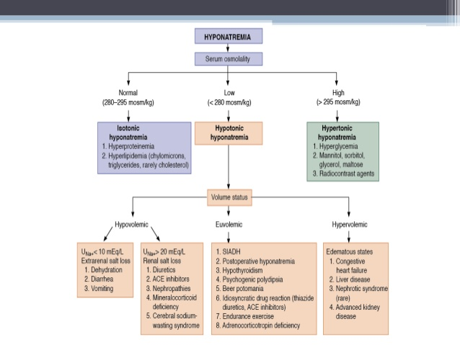
tonicity
Pseudohyponatremia

Slide 54
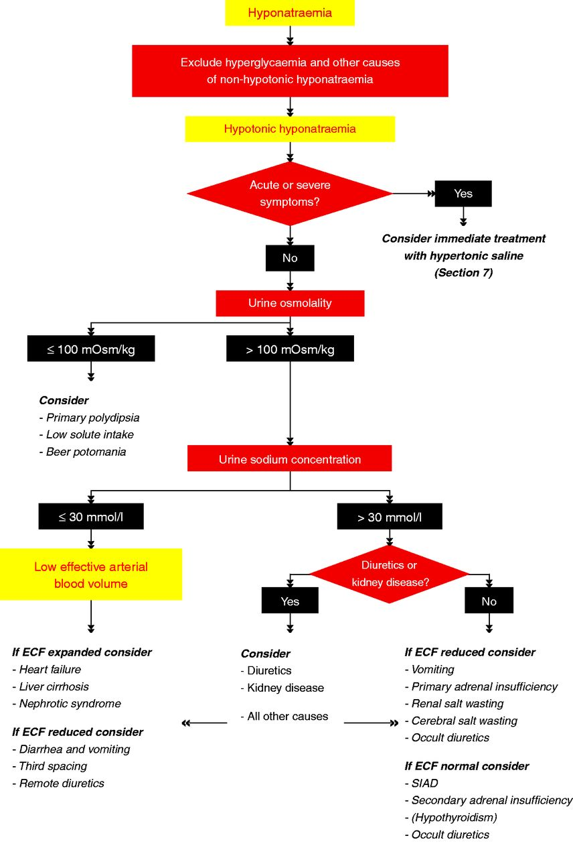
Exclude hypertriglycaemia and
other causes of non- hypotonic hyponatremia
Goce Spasovski et al. Eur J Endocrinol 2014;170:G1-G47
Notes:
Algorithm for the diagnosis of hyponatraemia.

Slide 55
AGENDA
Physiology and pathophysiology body fluid composition
Disorders of the internal environment associated with normal ECF effective tonicity
Isotonic hypohydration
Third spacing
Isotonic hyperhydration
Disorders of the internal environment associated with abnormal ECF effective tonicity
Free water deficit
Free water excess
Differetial diagnosis of hyponatremia
Disturbances of kalemia

Slide 56
Disturbances of kalemia

Slide 57
Internal balance
ECF
ICF
↑pH
pH↓
Kalemia
External balance
Intake
Excretion
GI
Renal

Slide 58
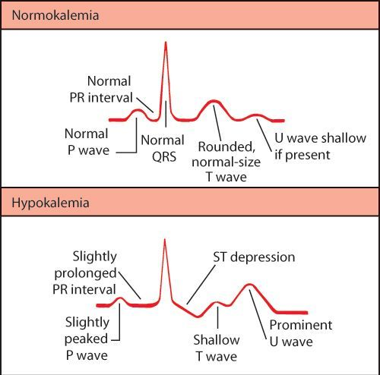
Hypokalemia (P_{K+} < 3.8 mmol/L)
Clinical manifestation (P_{K+} <2.5 mmol/L)
Malaise (nausea)
Fatigue
Neuromuscular disturbances (weakness, hyporeflexia, paresthesia, cramps, restless legs syndrome, paralysis, respiratory failure)
GI symptoms (constipation, ileus, vomiting
Renal abnormalities (urinary concentrating defects, polyuria)
Cardiovascular abnormalities (arrhytmias, ECG changes – T wave flattening, prominent U waves, decreased QRS voltage, ST segment depression)

Slide 59
Hypokalemia
Causes
Transcelular shift in alkalemia, insulin excess, hypothermia, anabolic states
Inadequate intake over prolonged period
Extrarenal losses
Renal losses

Slide 60
Hypokalemia
Treatment
Oral therapy (KCl tablet = 13,5 /27 mmol)
Spironolacton
IV administration
7,45% KCl preparation ( 1 mL = 1 mmol)
Periferal vein: Maximal dose 40 mmol in 1000 mL saline /1 h
Central vein: infusion dispenser 50 mL : 50 mL
7,45 %KCl (1 mL = 1 mmol)

Slide 61
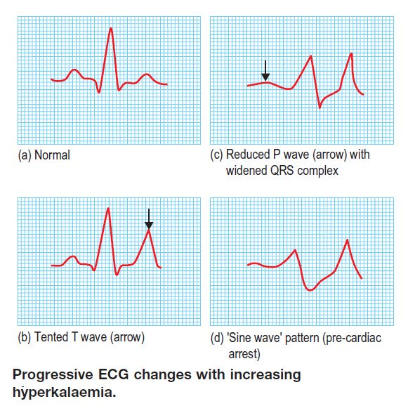
Hyperkalemia (P_{K+} >5,3 mmol/L)
Clinical maifestation (P_{K+} >7,0 mmol/L)
Neuromuscular manifestation: weakness, paresthesias, areflexia, ascending paralysis
Cardiac arrhytmias (bradycardia, asystol, prolongation of A-V conduction, A-V block, ventricular fibrilation

Slide 62
Hyperkalemia
Causes
Redistribution of K+ from ICF to ECF (acidosis, insulin deficiency, hyperglycemia)
Decreased renal excretion
Acute and chronic oliguric failure
Impairment of RAAS (hyporeninemic hypoaldosteronism)
Decreased aldosteron production (secondary to primary adrenal insufficiency)
Impaired response to aldosteron (spironolacton)
Inhibition of tubular secretion (Potassium sparing medicaments- amilorid, triamteren; distal renal tubular acidosis

Slide 63
Hyperkalemia
Treatment
Acute: calcium administration (protect the heart by antagonizing the K+ effect on A-V conduction)
NaHCO3, insulin, glucose (to shift K+ from ECF to the ICF)
Cation exchange resisns
Hemodialysis
Chronic: treatment of underlying disorder

