Slide 1
Elimination methods in nephrology Renal replacement therapy, Renal transplant
Ondřej Pátek

Slide 2
AGENDA
RRT
Epidemiology
Definition of acute and chronic dialysis, specific requirements
Basic physical aspects of HD and PD
Clinical application – technical problems
Access for HD and PD
Complications of HD and PD therapy

Slide 3
RRT (Renal Replacement Therapy)
Hemodialfiltration
HD
Continual methods
PD
Transplant
to 31.12.2018
HD: 6631= 626/PMP
PD: 359 = 34/PMP
TX: 378 = 45/PMP
(47 from living donors, 32 Tx kidney + pankreas/Langerhausen islets, 10 Tx kideny + liver )
RRT

Slide 4
AGENDA
RRT
Epidemiology
Definition of acute and chronic dialysis, specific requirements
Basic physical aspects of HD and PD
Clinical application – technical problems
Access for HD and PD
Complications of HD and PD therapy

Slide 5
Number of patients per 1 milion citizens in HD a PD program
Roky | HD (počet/PMP) | PD (počet/PMP)
2007 | 469 | 39
2008 | 497 | 44
2009 | 505 | 44
2010 | 554 | 47
2011 | 535 | 48
2012 | 550 | 47
2013 | 552 | 49
2014 | 567 | 41
2015 | 591 | 44
2016 | 601 | 41
2017 | 601 | 37
2018 | 626 | 34

Slide 7
25%
5%

Slide 8
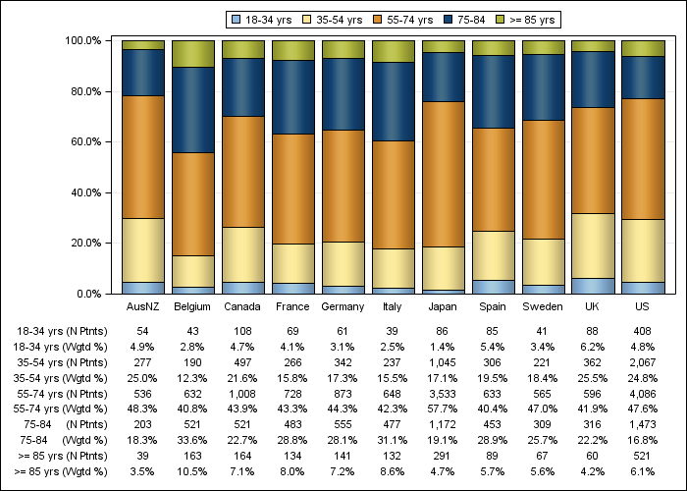
2015
ČR
720
25%
220
5%
22%
44%
30%
37%
35%
40%
24%
35%
31%
26%
23%
DOPPS (Dialysis Otcomes and Practice Patterns Study Program)

Slide 9
K 31.12.2018
51% !!!

Slide 10
Late initiation of RRT in nephrologicaly followed-up patients
Hughes et al. Factors associated with suboptimal initiation of dialysis
despote early nephrologist referral. Nephrol Dial Transplant 2013, 28: 392-397
N=436 (1.1.2009-31.12.2010)
∅ age 67 let, 57% men, 52% DM
Early
N=130 (30%)
Late
N= 306 (70%)
PD
N=80 (61,5%)
HD
N=50 (38,5%)
Nephr.care < 1month (40%)
Nephr.care > 1 year
56%
PD
≈ 3 %
HD
≈ 77%

Slide 11
Late initiation of RRT in patients with nephrological follow-up
Factors
Acute on chronic
30%
Surgeon Long wait time
for vasc. acc.
16%
Refusal of treatement
Refusal of vascular access
30%
Insuficiency of
nephrologic care
8%

Slide 12
Mortality of diabetics and nondiabetics on RRT (since 1.RRT)
rok | HD (%) |  | PD (%)
 | DM | Non-DM | DM | Non-DM
2002 | 27 | 15 | - | -
2003 | 31 | 16 | - | -
2004 | 28 | 21 | 24 | 9
2005 | 27 | 19 | 31 | 10
2006 | 27 | 18 | 25 | 9
2007 | 23 | 15 | 32 | 5
2008 | 23 | 15 | 17 | 6
2009 | 24 | 14 | 28 | 8
2010 | 22 | 14 | 28 | 4
2011 | 23 | 15 | 22 | 6
2012 | 21 | 13 | 26 | 5
2013 | 21 | 15 | 28 | 5
2014 | 20 | 15 | 30 | 6
2015 | 21 | 14 | 37 | 3
2016 | 20 | 14 | 38 | 5
2017 | 22 | 13 | 42 | 4
2018 | 21 | 15 | 24 | 5

Slide 13
Causes of death in PDL (2018)
 | HD N = 1551 | PD N = 25
CVD | 45% | 28%
Infections | 16% | 24%
Malignancy | 7% | 8%
other | 32% | 40%

Slide 14
AGENDA
RRT
Epidemiology
Definition of acute and chronic dialysis, specific requirements
Basic physical aspects of HD and PD
Clinical application – technical problems
Access for HD and PD
Complications of HD and PD therapy

Slide 15
Acute hemodialysis = urgent hemodialysis
Indications:
Hyperhydratation (hypervolemic hypertension, pulm. oedema)
Hyperkalemia not managable by conservative treatment
Anuria not managable by conservative treatment
Uremic syndrome
Acute (urgent) hemodialysis is required by:
some patients with AKI
patients with „Acute on chronic“
„uremics/ESRD from street“

Slide 16
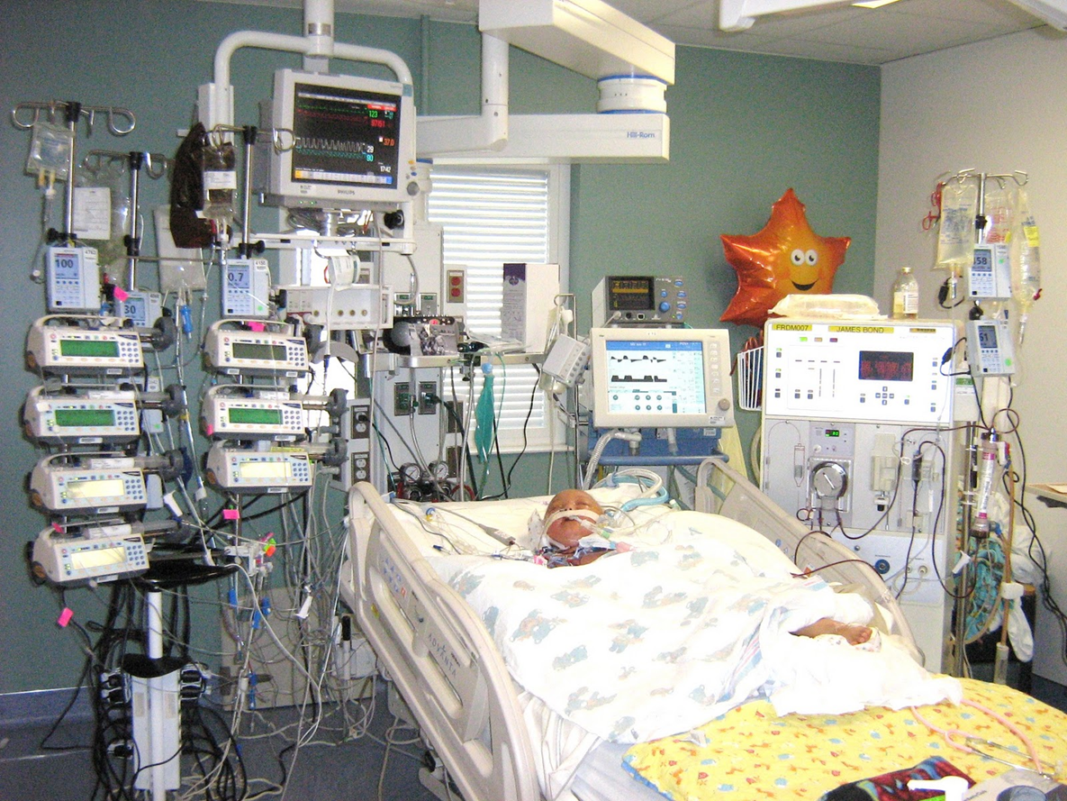

Slide 17
Chronic HD:
Hemodialysis required for chronic
kidney failure
HD in case of planned dialysis treatment (chronic
ambulatory HD of non-complicated ESRD)
2) Planned initiation of HD in prepared
non-complicated ESRD
3) Unschedueled initiation of HD in unprepared ESRD „from street“ in hospital

Slide 18
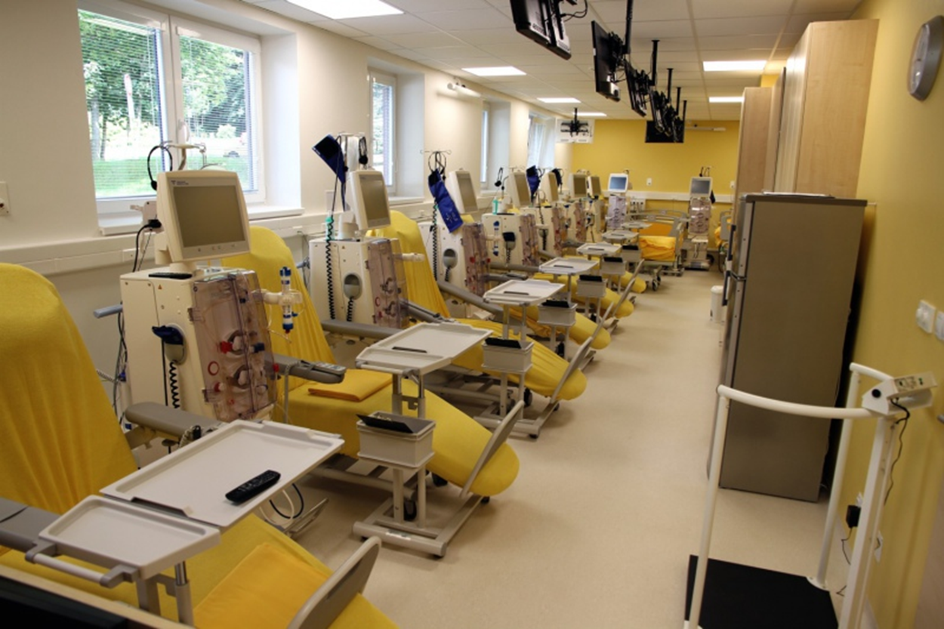

Slide 19
Specific requirements for ambulatory
and hospital HD
Ambul. HD:
1) Maximal therapeutic efect
2) Limitation of side-effects
3) Standard care
Acute HD:
1) Limitation of side-effects
2) Therepeutic eefect
3) Intensive care
4) Availability of consiliary services and complement

Slide 20
AGENDA
RRT
Epidemiology
Definition of acute and chronic dialysis, specific requirements
Basic physical aspects of HD and PD
Clinical application – technical problems
Access for HD and PD
Complications of HD and PD therapy

Slide 21
Dialysis - definition
Dialysis is a process, during which a composition
of one solution changes due to exposure to second
solution, separated by semipermeable membrane
Difusion and ultrafiltration take place.

Slide 22
Hemodialysis and PD
Diffusion
A
B
A
B
t=0
t=equilibrium
Factors influencing diffusion:
1) concentration gradient
2) molecule size
3) Resistance of the membrane

Slide 23
Hemodialysis
Ultrafiltration
A
B
A
B
t=0
t=1
Transport of water through semipermeable membrane is result
of hydrostatic and oncotic pressures. During HD it is
hydrostatic ultrafiltration
Factors onfluencing hydrostatic UF:
1) transmembranous pressure (hydrostatic pressure gradient between
two compartments)
2) ultrafiltration coeficient -Kuf (ml/lhod/mmHg)

Slide 24
Peritoneal dialysis
Osmotic ultrafiltration

Slide 25
AGENDA
RRT
Epidemiology
Definition of acute and chronic dialysis, specific requirements
Basic physical aspects of HD and PD
Clinical application – technical problems
Access for HD and PD
Complications of HD and PD therapy

Slide 26
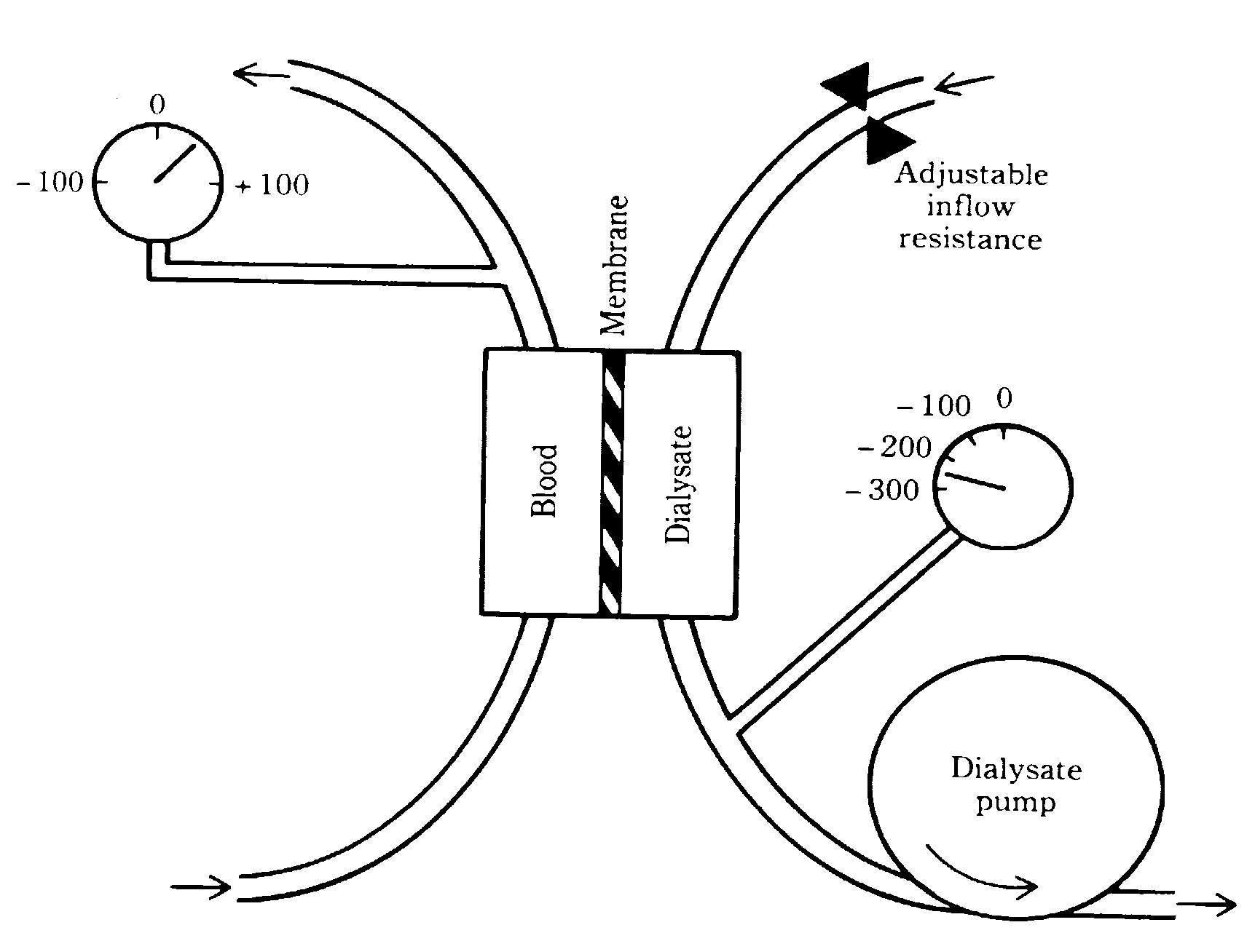
Clinical application of diffusion and UF

Slide 27
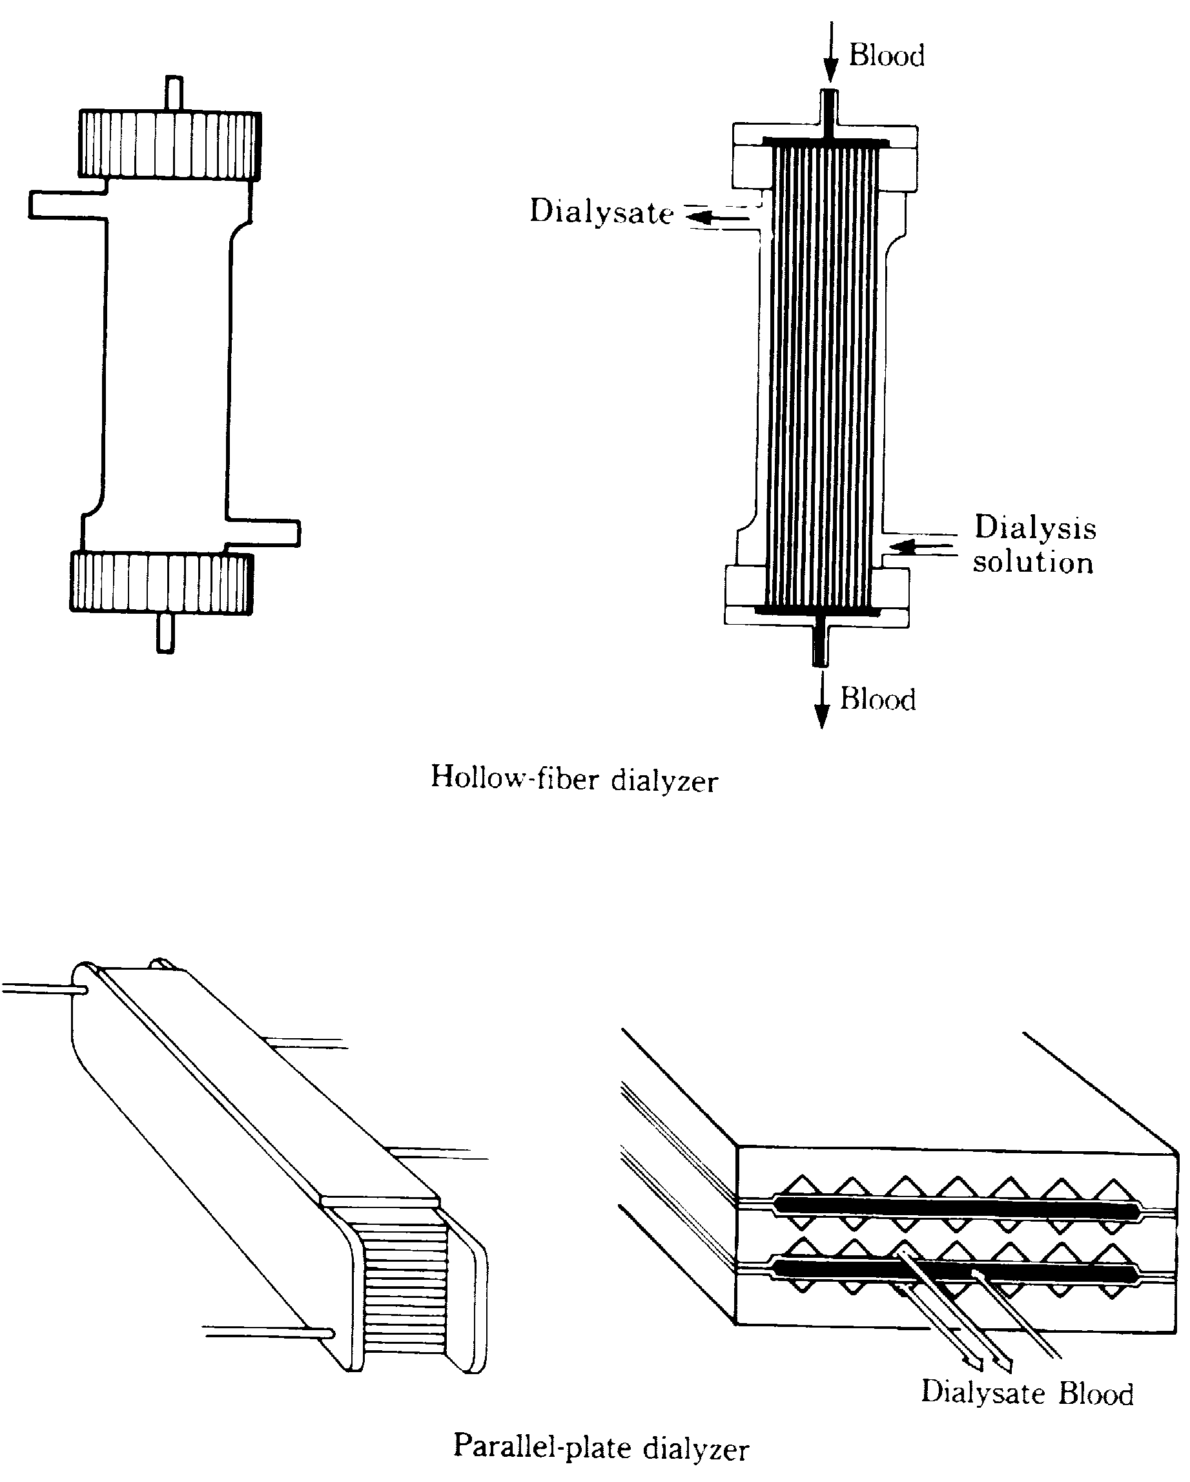
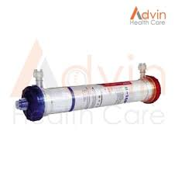
Hemodialysis - technical aspects - design of dialysator

Slide 28
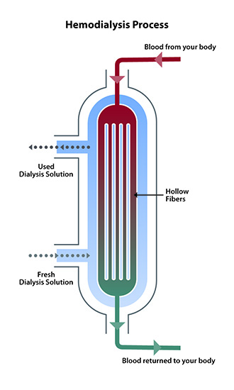

Slide 29
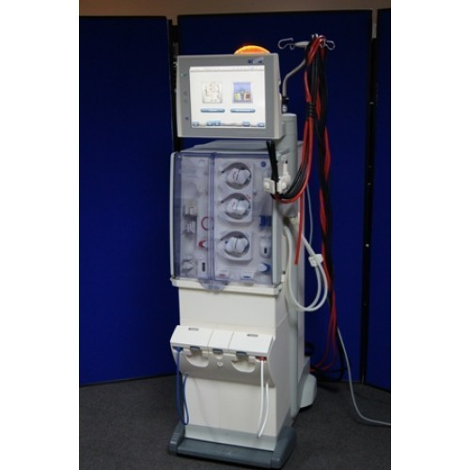
Hemodialysis – technical aspects
Dialysis monitor
1) Blood pump
2) Module for preparation of dialysis solution
3) System of security elements
a) BP monitor
b) monitoring of dialysis circuit

Slide 30
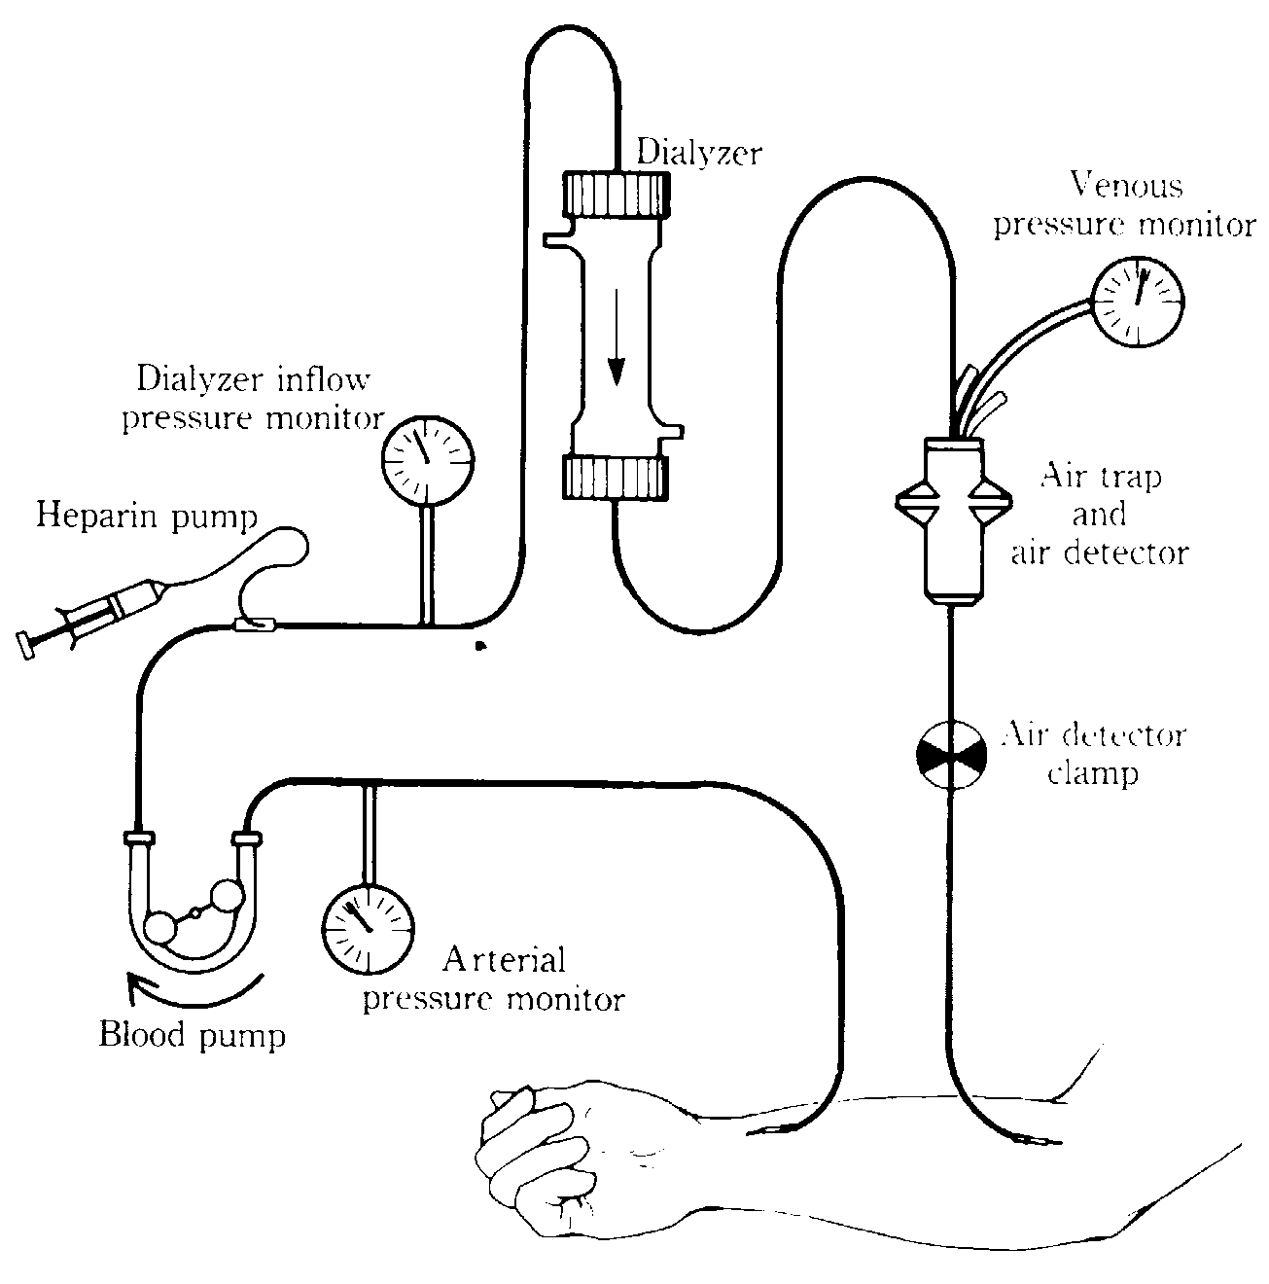
Hemodialysis - technical aspects
System of security measures - monitoring of blood circuit

Slide 31
Hemodialysis – technical aspects
Water for HD
Water adjustment
Needed:
30/l/hod
with flow
500ml/min
Active charcoal:
Cl,Fe,Mn,organ.molec.
60l/hod
water
Special filter:
microparticles 1-10μm
Dialysis monitor
modul water adjustment
Softening
←Ca
Na→
Dial. concentrate
Reverse osmosis
Al, pyrogens,bacteria

Slide 32
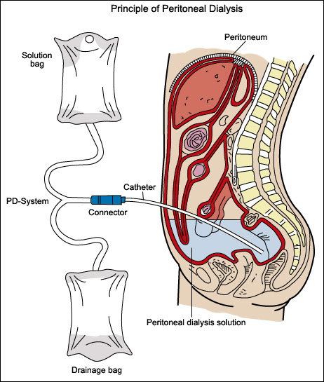
Peritoneal dialysis

Slide 33
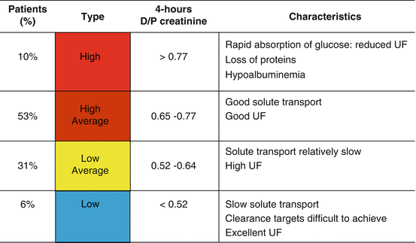
Peritoneal dialysis

Slide 34
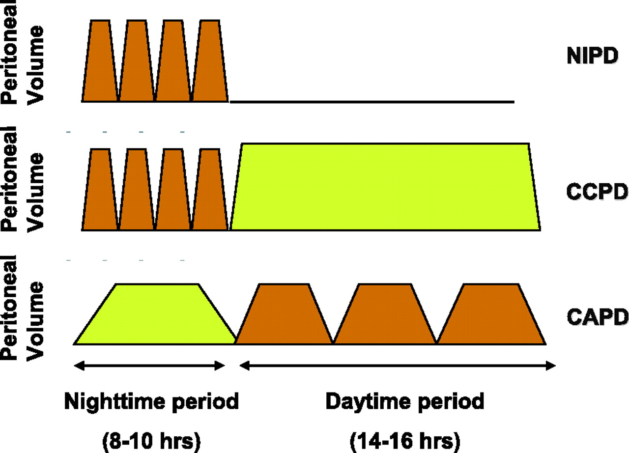
Nocturnal intermitent PD
Continuous cycler-asisted PD
Continuous ambulatory PD

Slide 35
Contraindications for PD
Contraindications to peritoneal dialysis include the following:
Documented type II ultrafiltration failure.
Severe inflammatory bowel disease.
Acute active diverticulitis.
Abdominal abscess.
Active ischemic bowel disease.
Severe active psychotic disorder.
Marked intellectual disability.

Slide 36
Indication for PD
Pacients, that are not indicated or do not want renal transplant
PD is optimal method for bridging until renal transplant
Pacients with CVD
Most seniors
Pacients with side effects of systemic heparinization

Slide 37
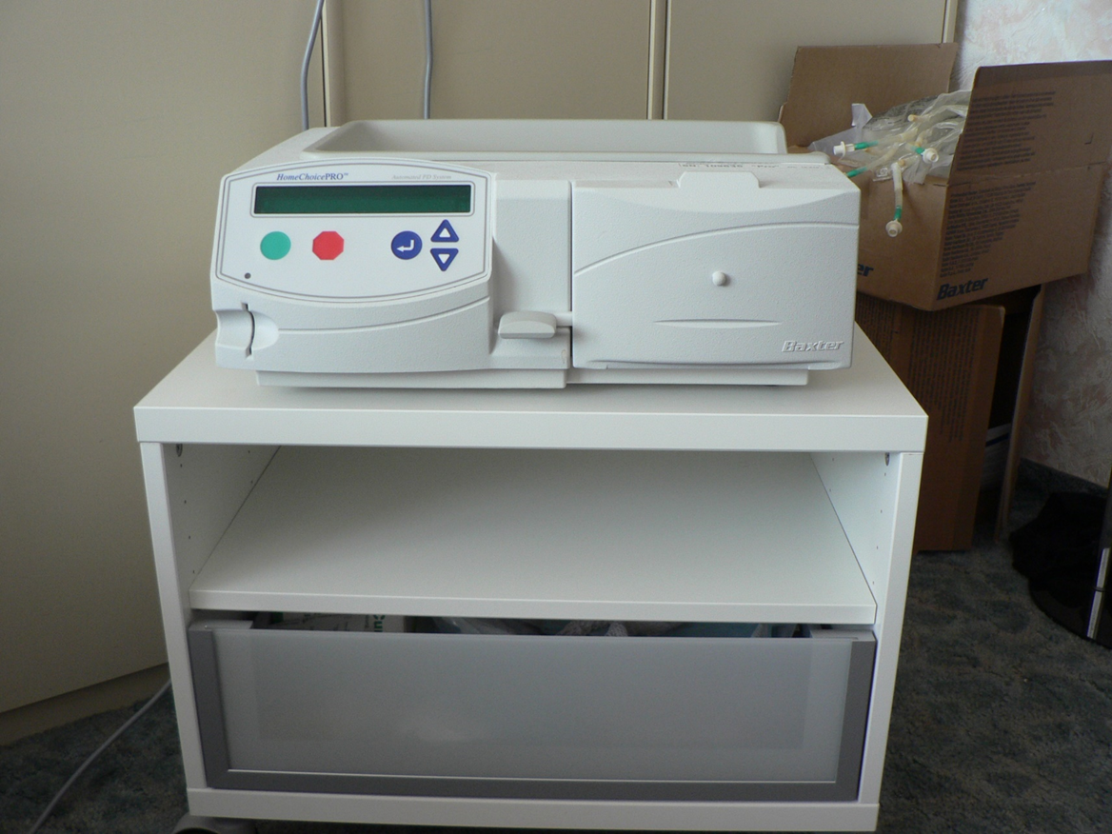
CCPD a NIPD needs equipment for automaticdialysis solution exchange

Slide 38
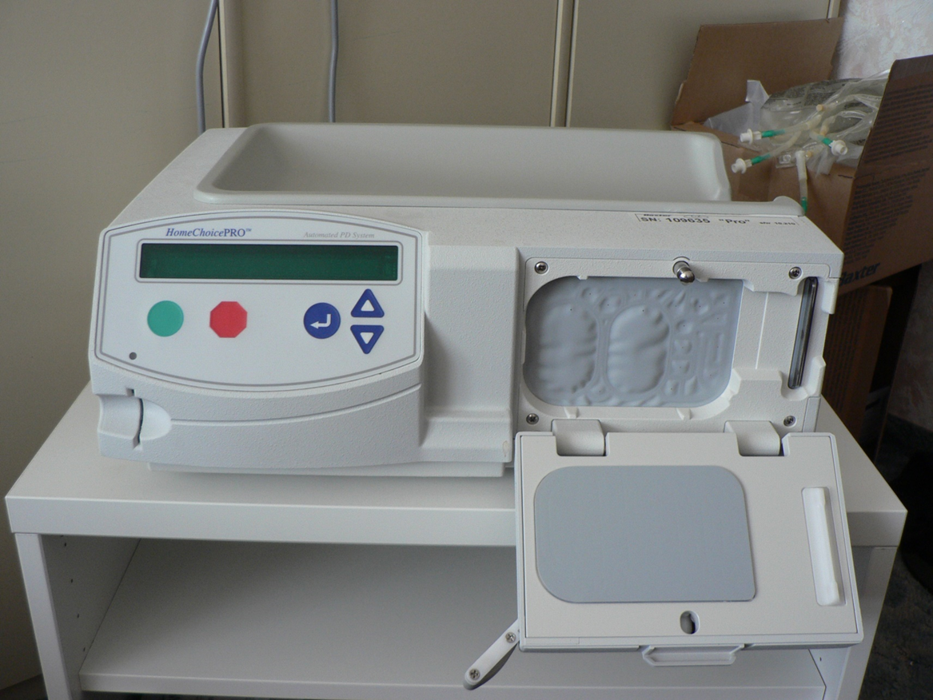

Slide 39
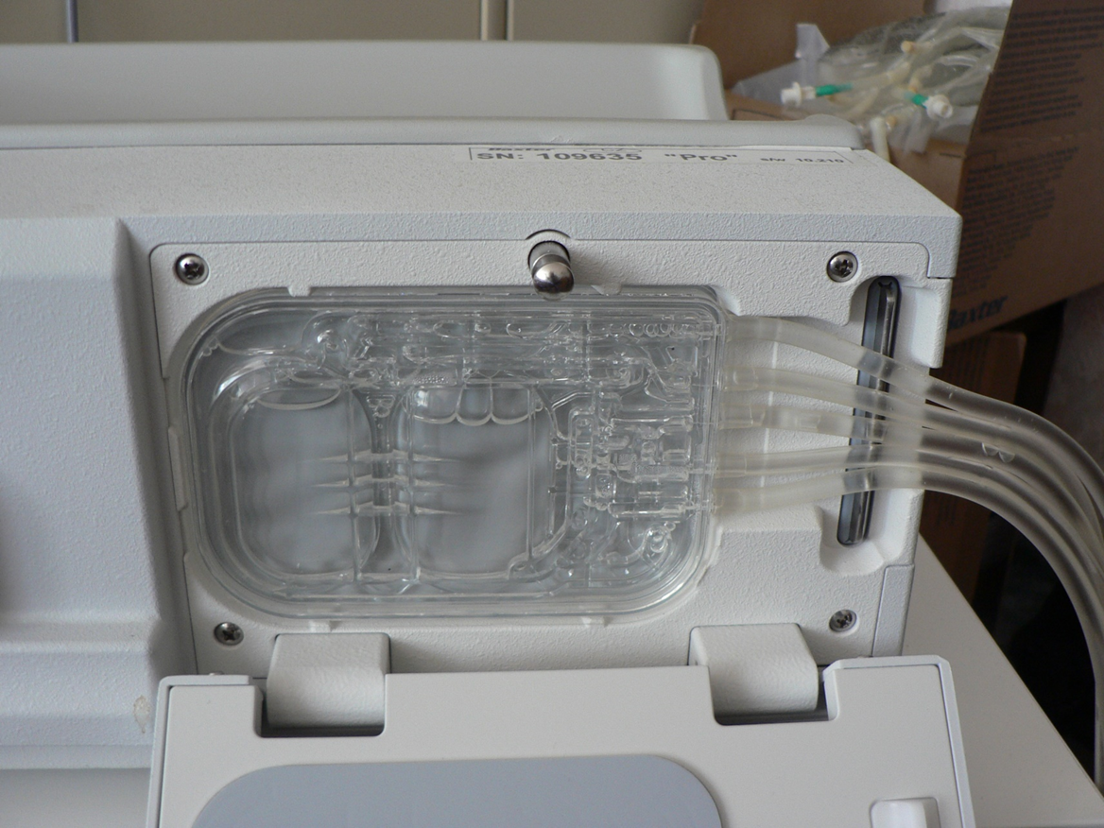

Slide 40
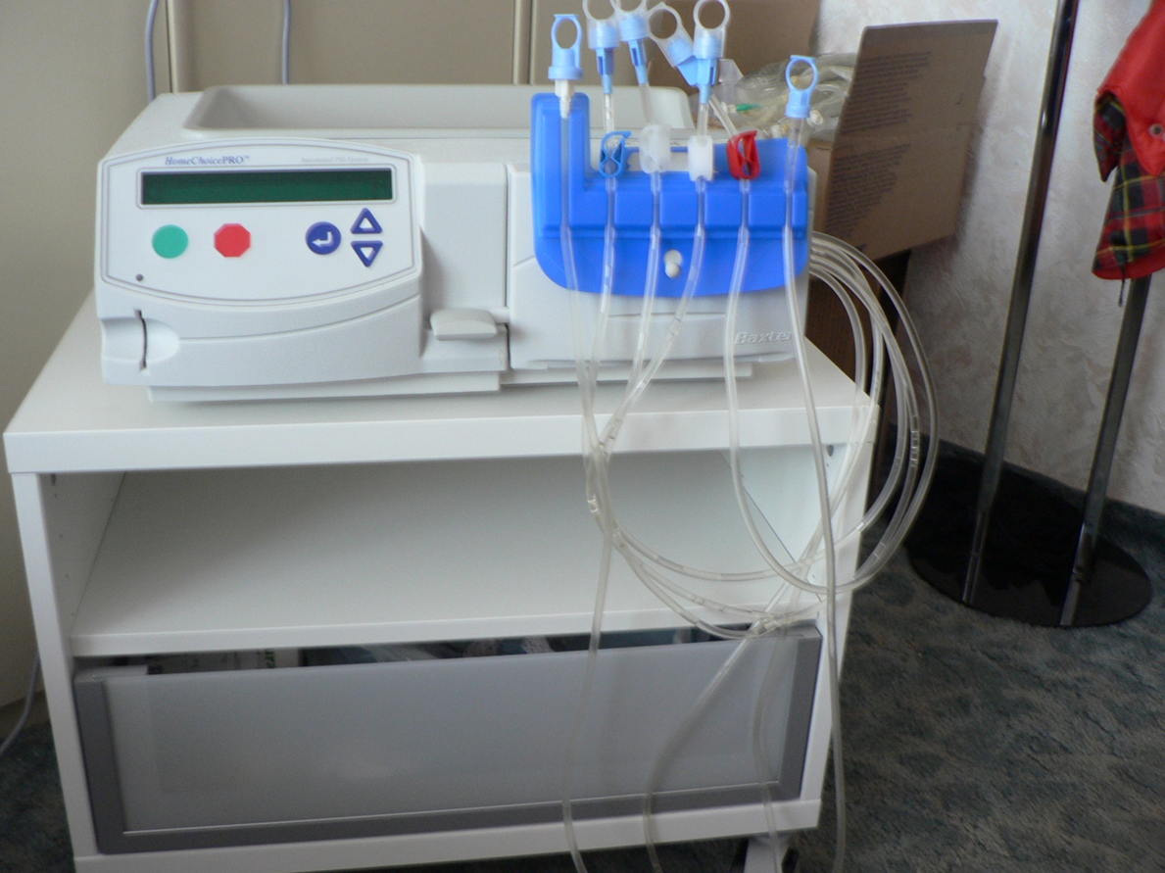

Slide 41
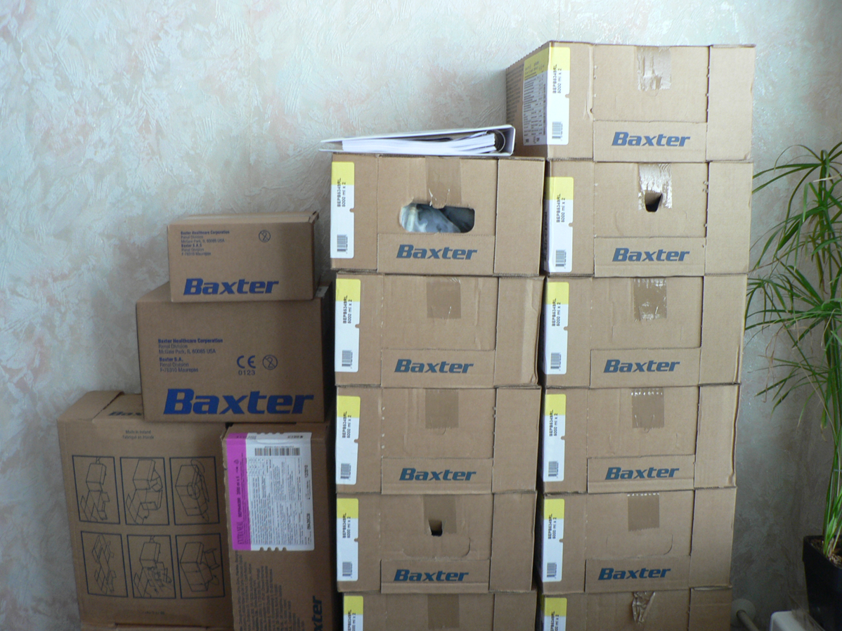

Slide 42
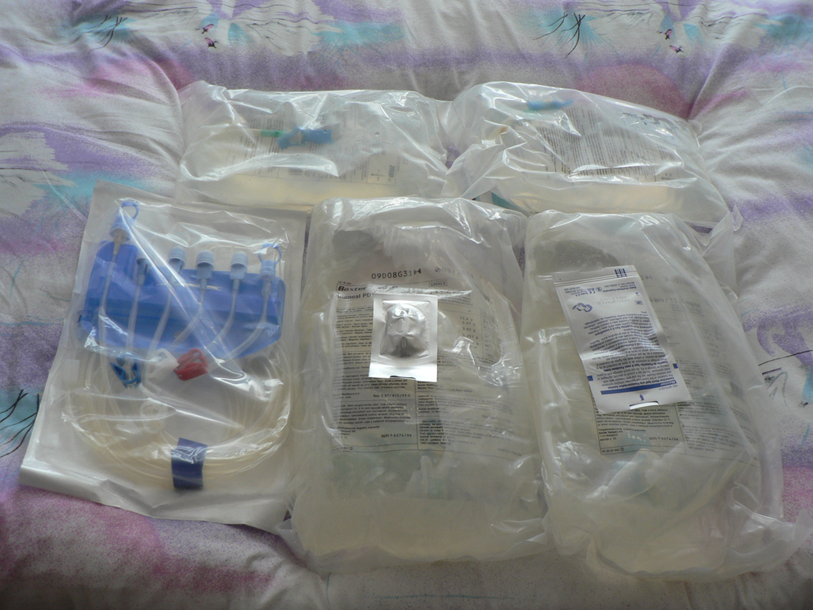

Slide 43
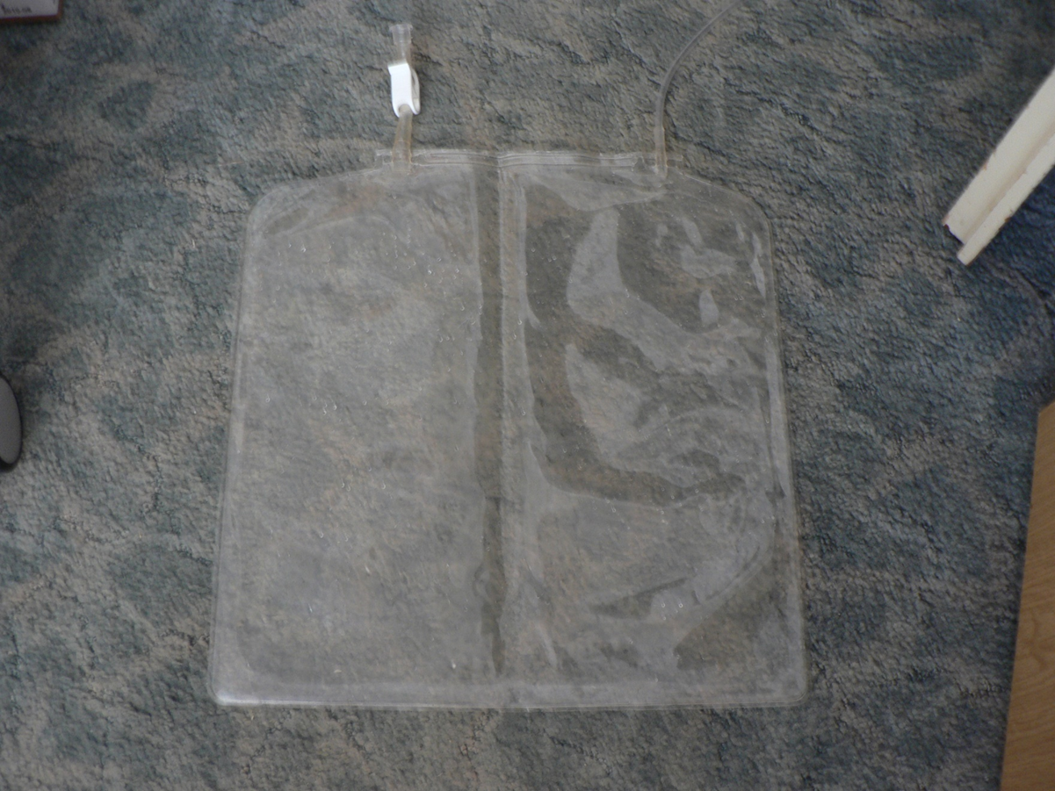

Slide 44
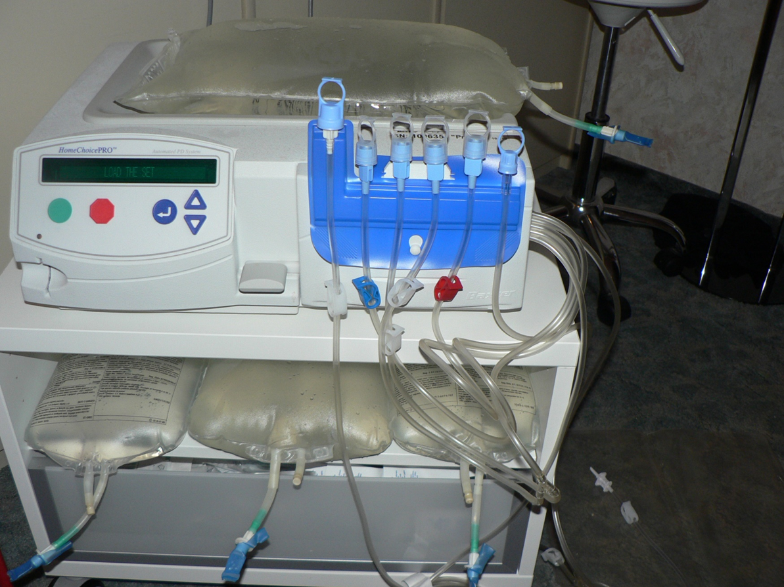

Slide 45
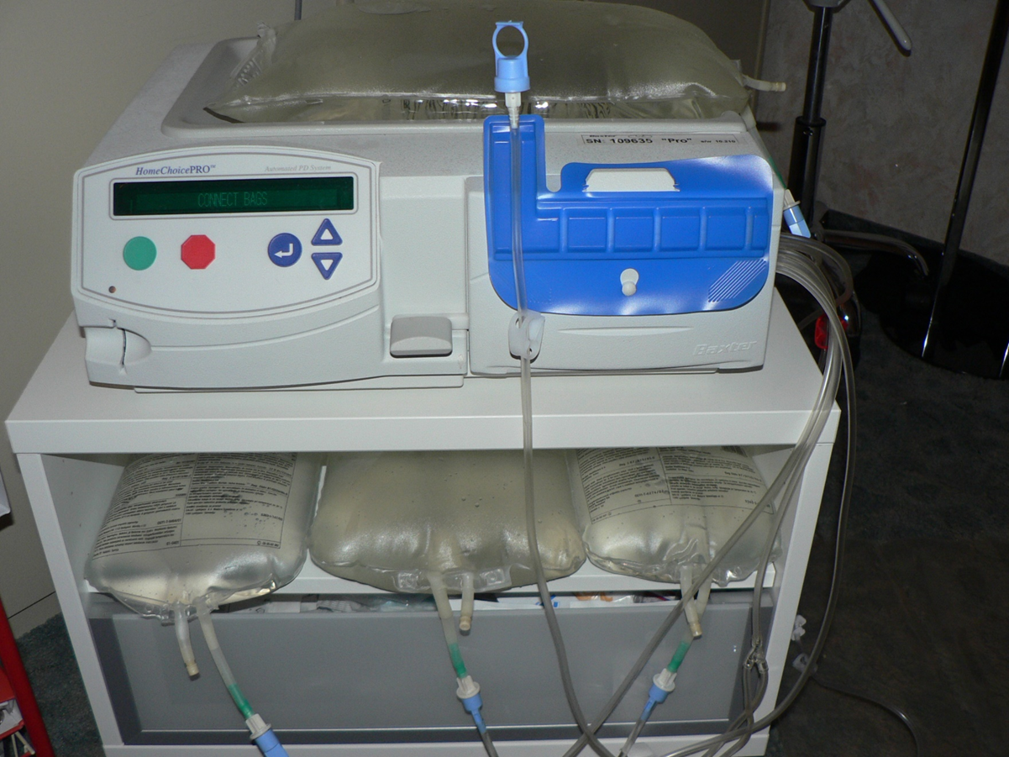

Slide 46
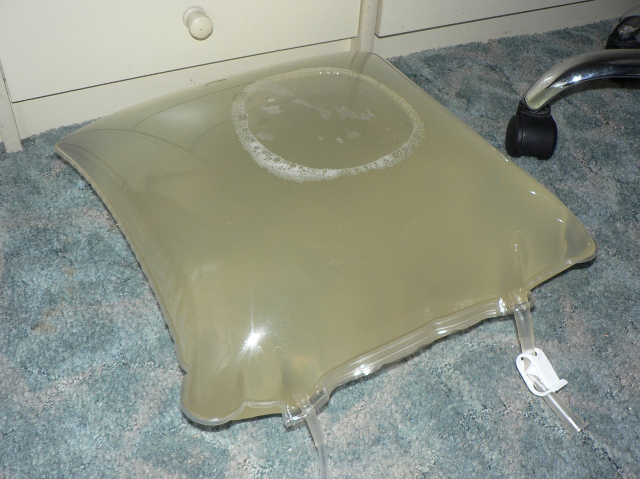

Slide 47
AGENDA
RRT
Epidemiology
Definition of acute and chronic dialysis, specific requirements
Basic physical aspects of HD and PD
Clinical application – technical problems
Access for HD and PD
Complications of HD and PD therapy

Slide 48
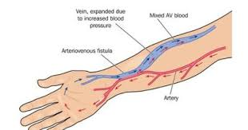
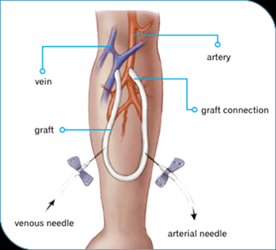
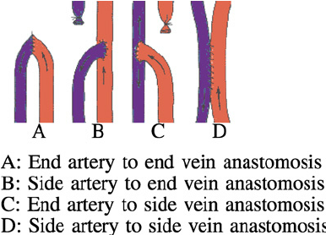
Native A-V shunt
Vascular prothesis

Slide 49
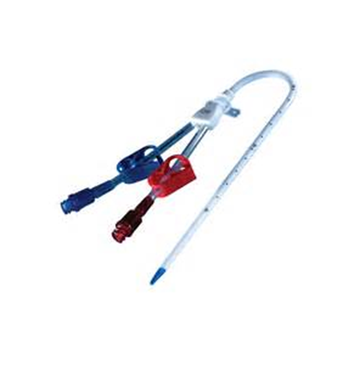
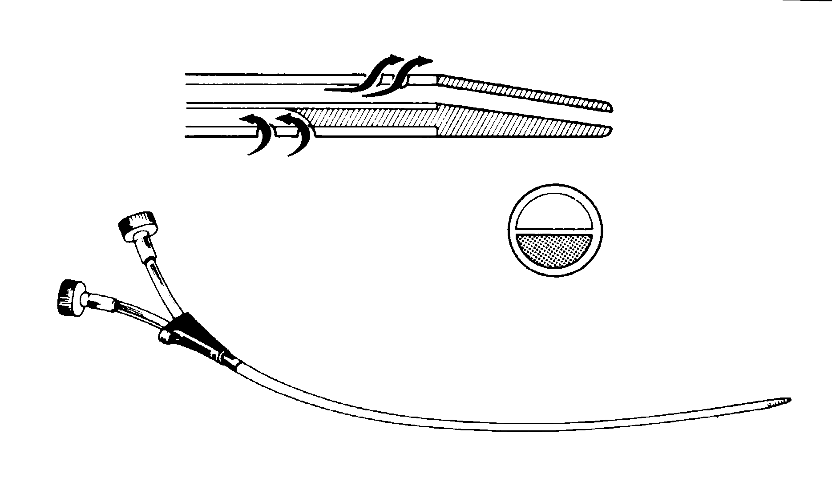
Hemodialysis – clinical aspects
Vascular access
V. jugulairs
V. subclavia
V. femoralis

Slide 50
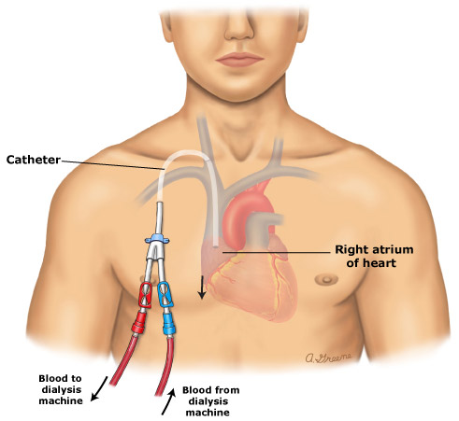
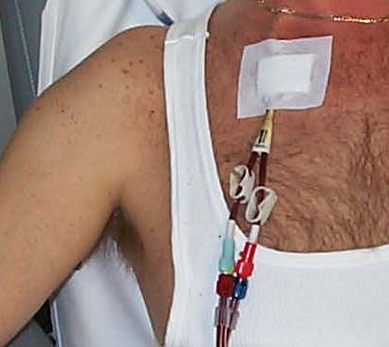

Slide 51
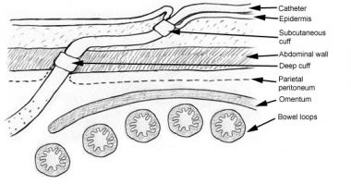

Slide 52
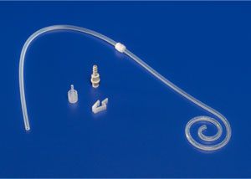
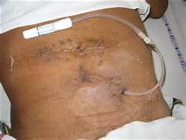
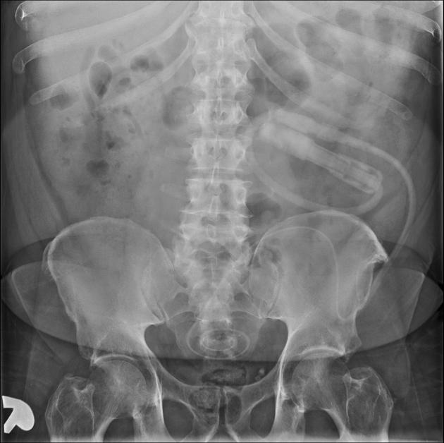
PD catheter

Slide 53
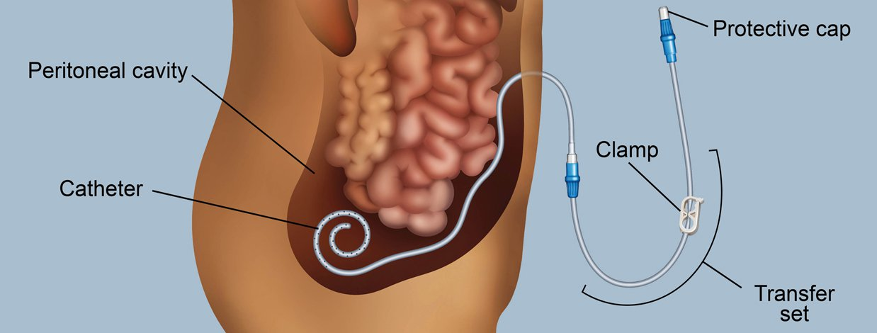

Slide 54
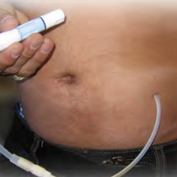
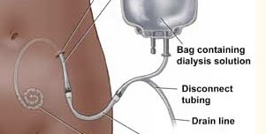

Slide 55
AGENDA
RRT
Epidemiology
Definition of acute and chronic dialysis, specific requirements
Basic physical aspects of HD and PD
Clinical application – technical problems
Access for HD and PD
Complications of HD and PD therapy

Slide 56
Complications during HD
Hypotension
Muscle cramps
Disequilibrium syndrome (urea, Na, K,↓ABR
Fever
Headache
Chest pain
First use syndrome
Arrytmia
Hemorhagic diatesis
Air embolii
Blood clotting in dialysator
Accelerated hypertension

Slide 57
Complications regarding vascular access
Cathether sepsis
Cathether malfunction (thrombosis/stenosis)
Graft infection
Stenosis/thrombosis of an A-V shunt
Aneurysm of A-V phistula
Steel syndrom
Bleeding from A-V phistula
Infection of native A-V phistula

Slide 58
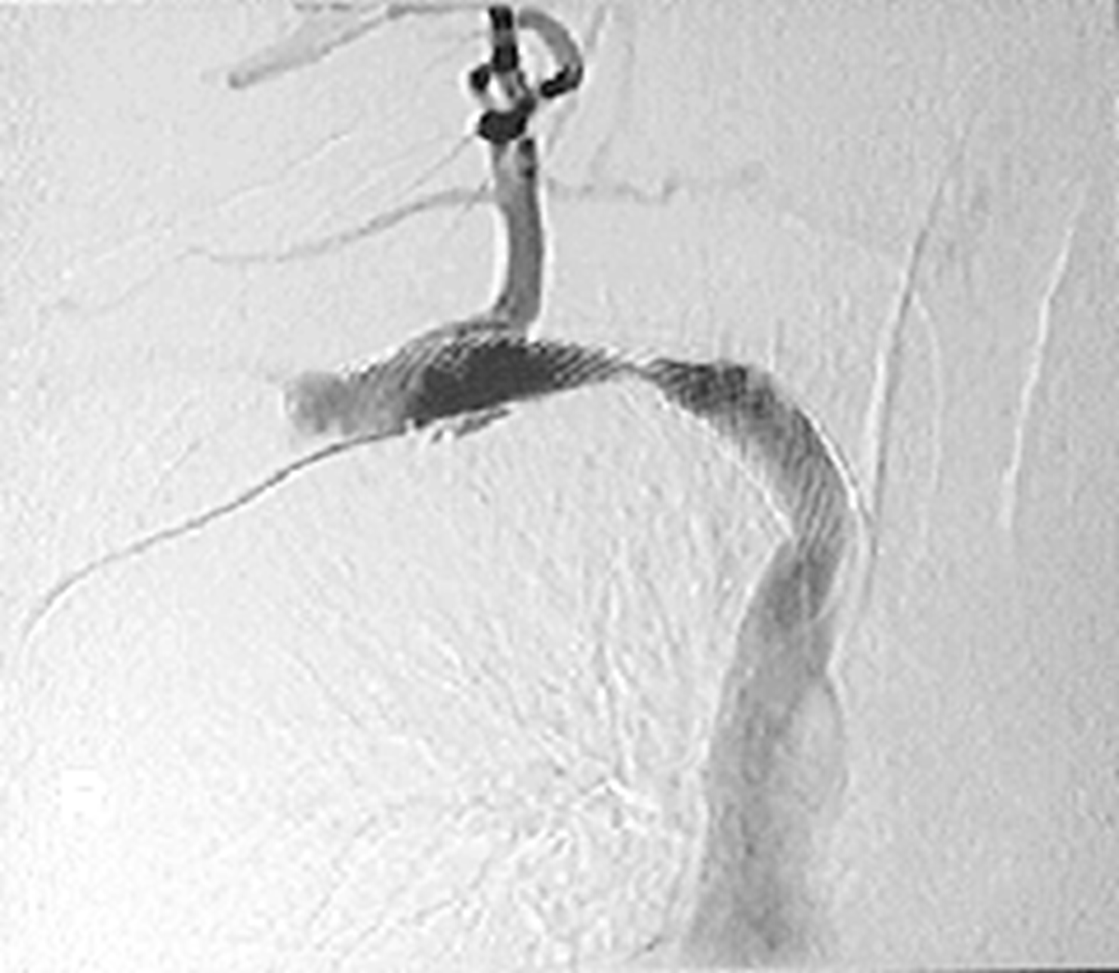

Slide 60
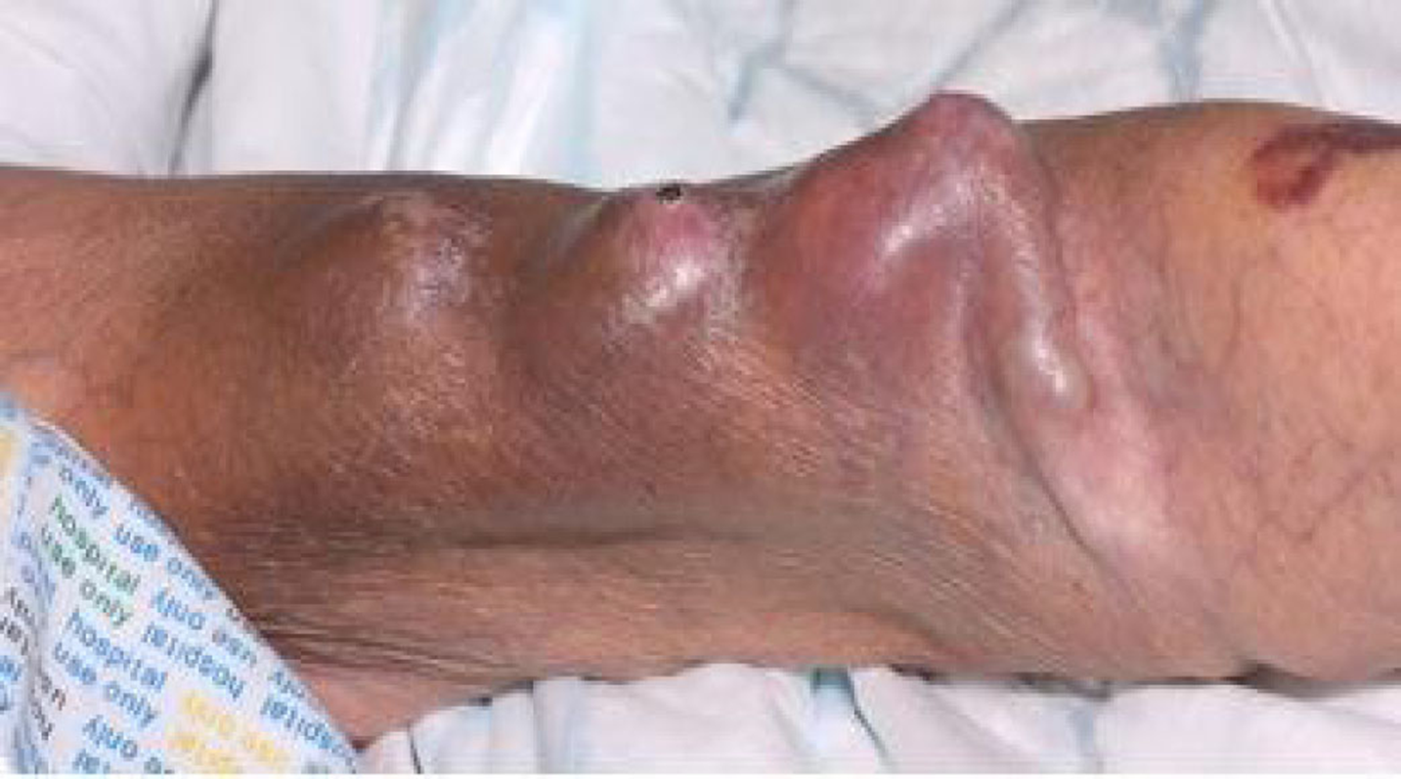

Slide 61
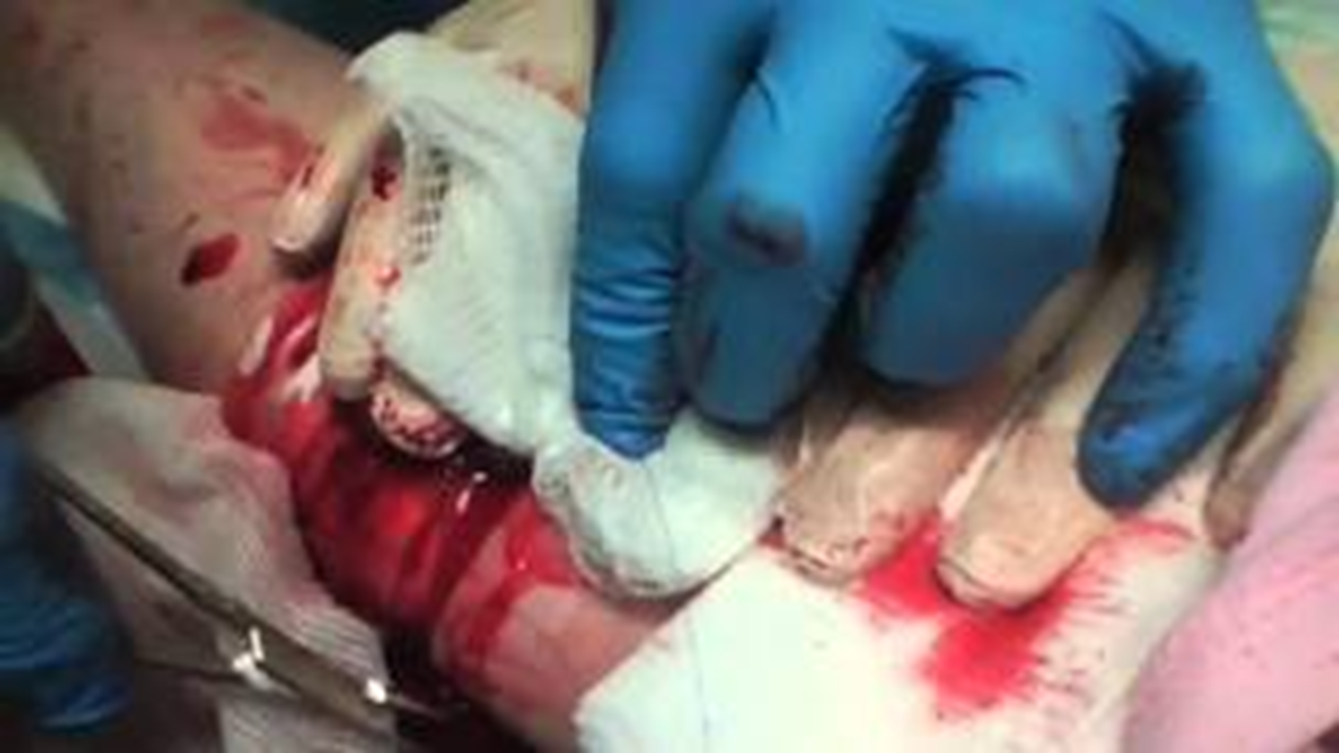

Slide 62
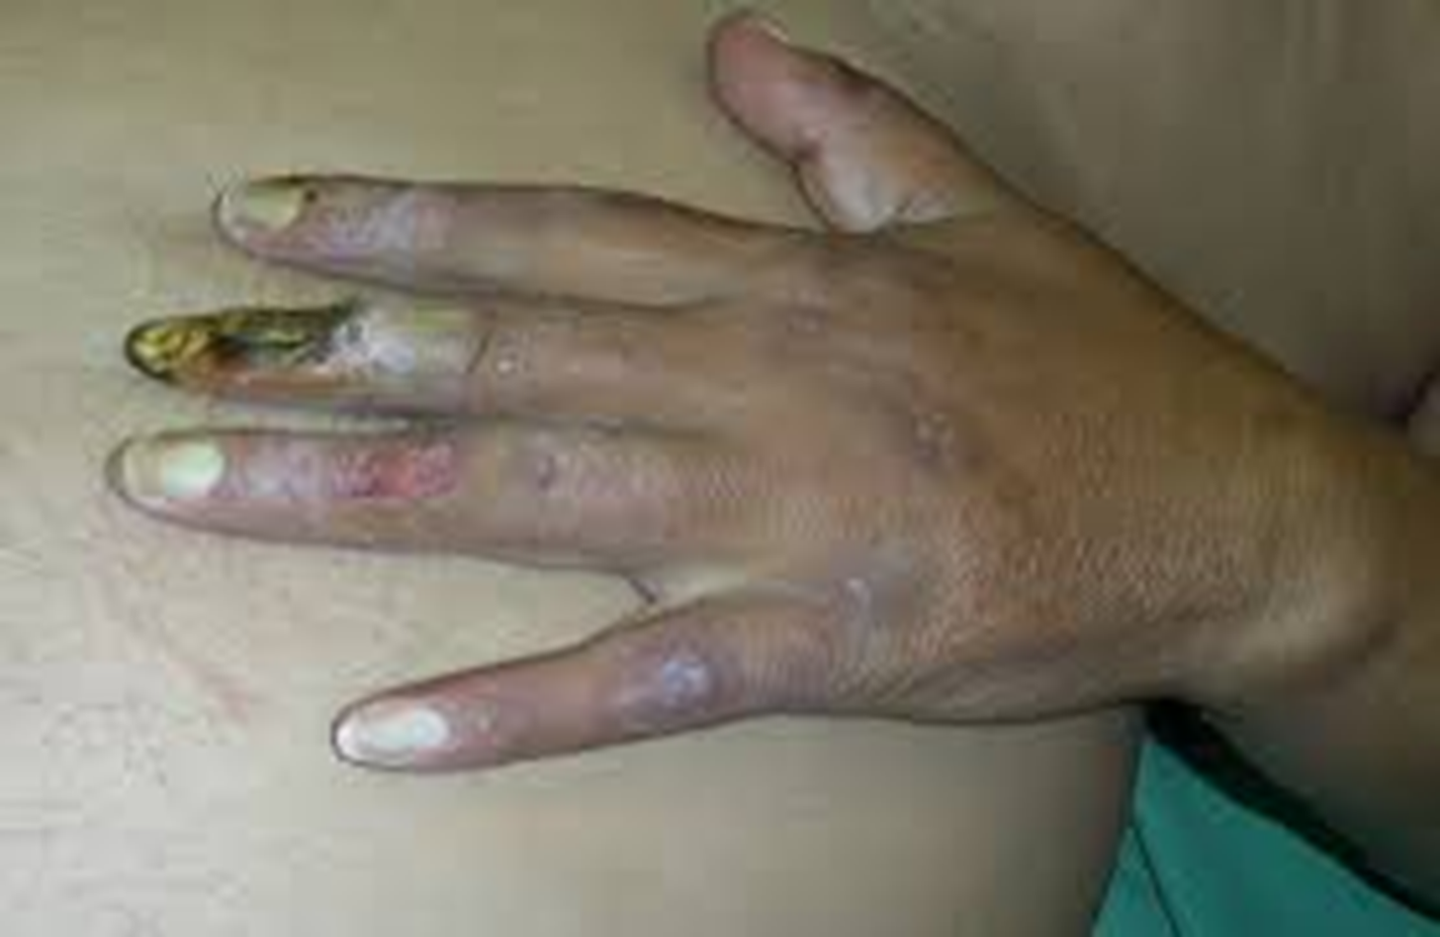

Slide 63
Complications regarding PD
Infectious
Infection of exit site
Infection of tunnel
Dialysis peritonitis
Hospitalisation
Failure of PD
Damage to peritoneal membrane
Noninfectious
Dislocation and malfunction
of PD cathether
Leak of PD fluid
Hernias

Slide 64
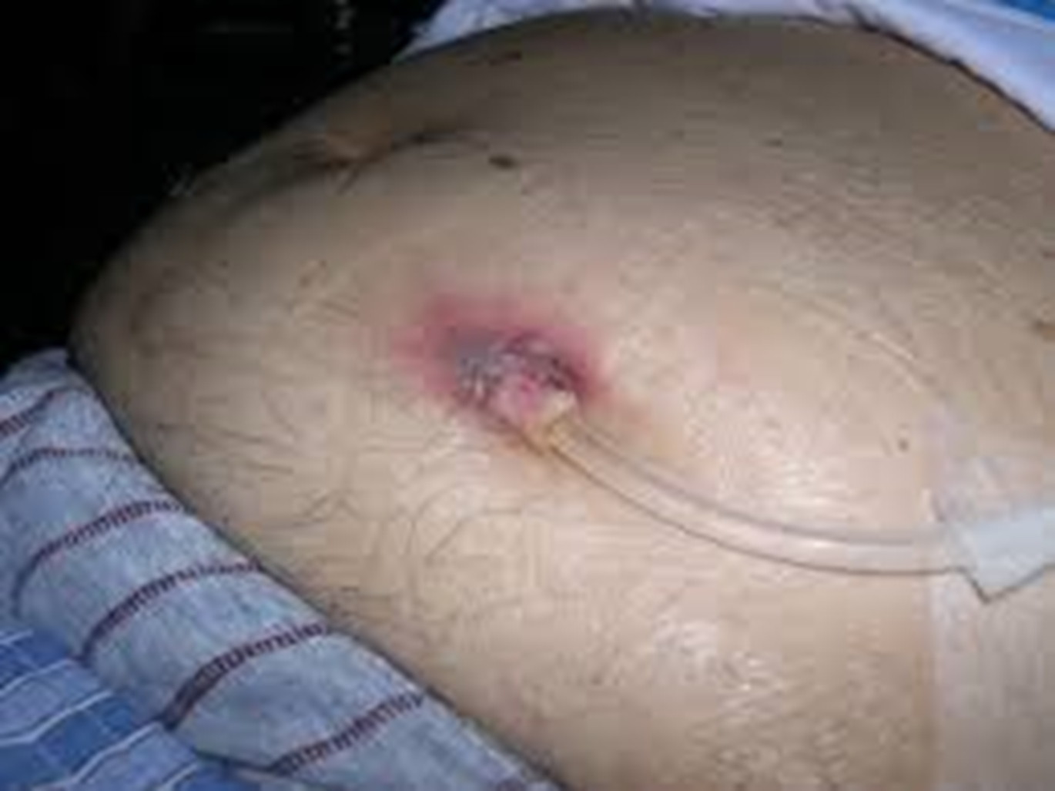

Slide 65
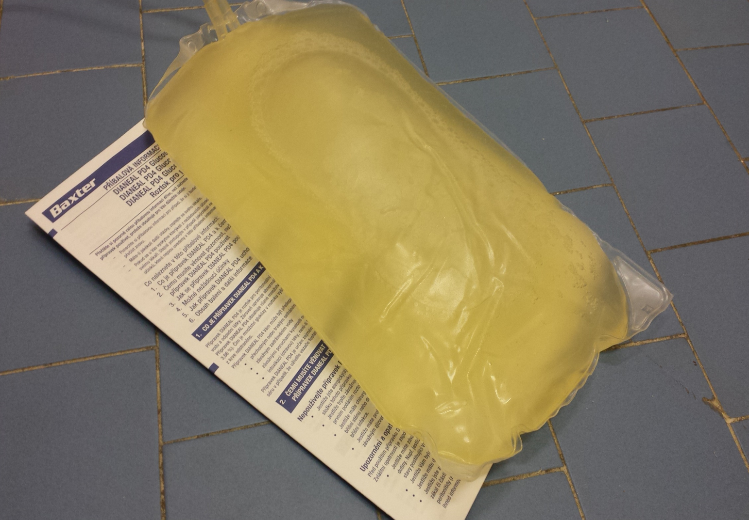

Slide 66
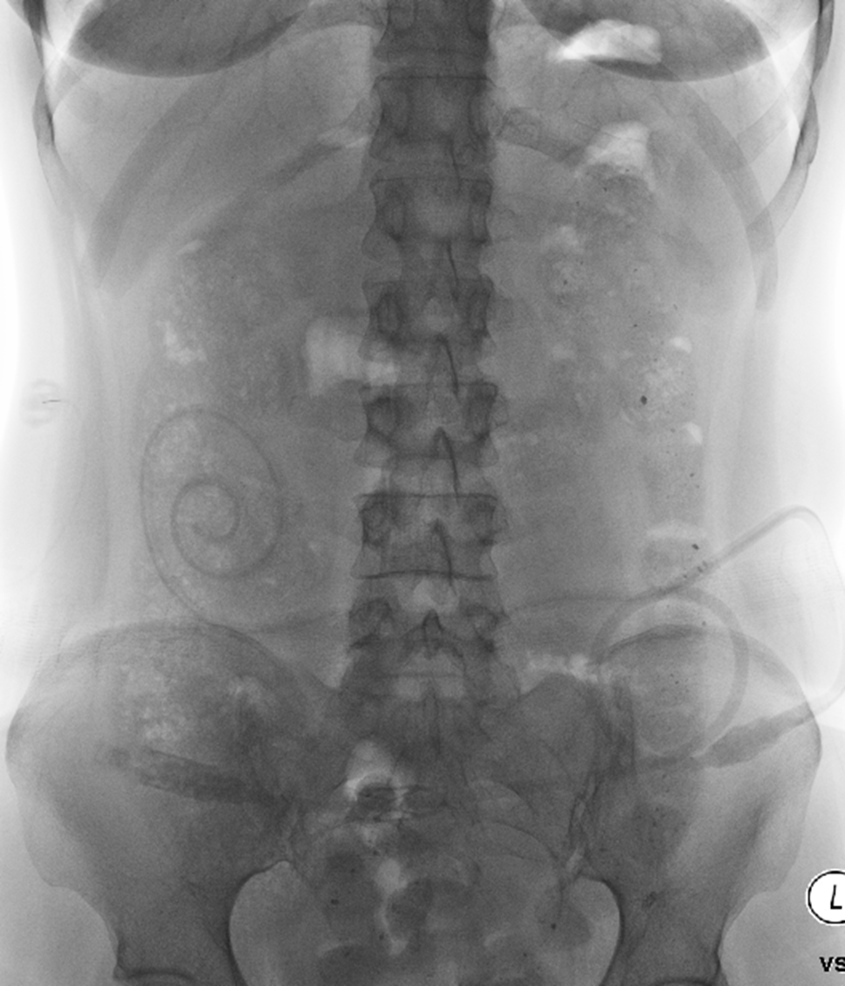

Slide 67
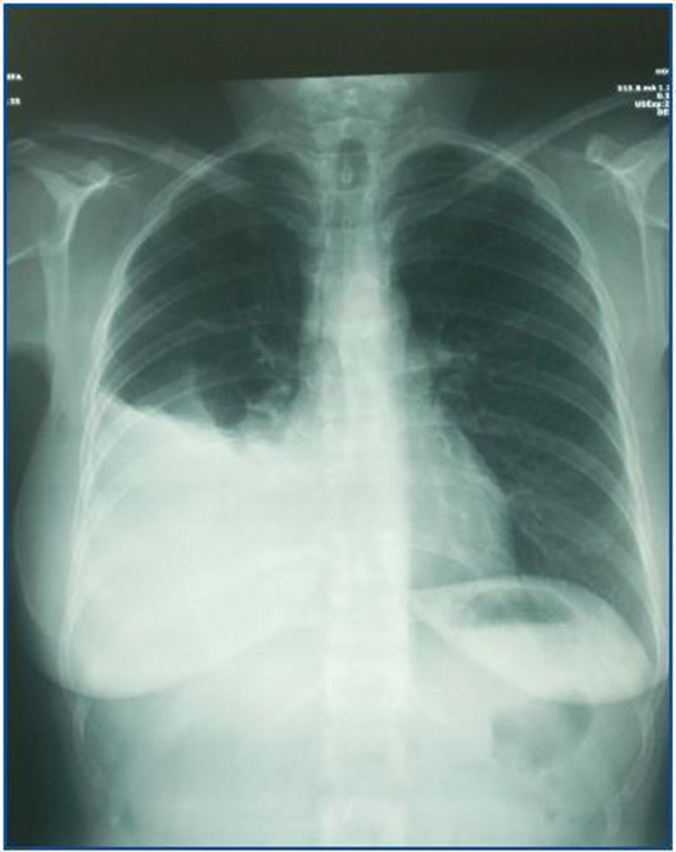

Slide 68
Renal transplant
Indications:
Diabetes
Glomerulonephritis
Polycystic kidney disease
Alport’s disease
Hypertensive nephrosclerosis
Reflux nephropathy
Interstitial nephritis
IgA nephropathy
….
Indications for Pancreatic Transplant
Type I diabetes with advanced nephropathy in an adult
Contraindications for Transplantation
Malignancy within the past two years
Lack of adequate social or family support
Significant non-compliance with medical regimen
Central vascular disease (aortoiliac)
Significant coronary artery disease Severe malnutrition/cachexia

Slide 69
Finally…
Hemofiltration
Hemoperfusion
Plasmapheresis
SLED (Sustained low efficiency dialysis)
Continous methods - CRRT (CVVH, CAVHD…)

