Slide 1
Acute and chronic renal failure

Slide 2
Agenda
Terminology
Renal impairment - classification according to clinical course
Pathogenesis of AKI
Causes of AKI by frequency and estimated risk score
AKI classification according to diagnostic criteria (SKr, GFR, diuresis)
Diagnostics
Therapy
Chronic kidney failure
Stages of chronic nephropathy
Adaptation of residual nephrons with the aim of maintaining the internal environment
Specific complications of RI
Therapy of specific complications of RI

Slide 3
Terminology
Acute kidney failure – (ARF), usually requires urgent replacement of the renal function by hemodialysis
Acute kidney injury does not always mean a condition characterized by acute renal failure!
Acute kidney injury - (AKI), is a newly introduced term to indicate different degrees of glomerular filtration damage
AKI is a potentially reversible process!
Chronic kidney disease - (CKD) is renal impairment and / or glomerular filtration rate (GFR <1 ml / s / 1.73 m²) lasting at least 3 months or more, regardless of the underlying cause. It is usually a progressive process if the underlying cause of damage to renal structures / renal function is not treated/treatable.
Chronic renal insufficiency – (CHRI) is a label for a state in which is the chronic impairment of kidney function accompanied by complications that are not related to underlying nephropathy. The development and severity of these complications depend on the degree of renal impairment.
End stage renal failure - (ESRF) is a definitive renal failure requiring maintenance renal replacement therapy

Slide 4
Agenda
Terminology
Renal impairment - classification according to clinical course
Pathogenesis of AKI
Causes of AKI by frequency and estimated risk score
AKI classification according to diagnostic criteria (SKr, GFR, diuresis)
Diagnostics
Therapy
Chronic kidney failure
Stages of chronic nephropathy
Adaptation of residual nephrons with maintenance goals
Specific complications of RI
Therapy of specific complications of RI

Slide 5
Renal impairment
acute
subacute
chronic
acute on chronic
Sudden (in hours / days) developing renal impairment.
With timely dg it is potentially reversible!
Development of renal impairment progressing in weeks or months. It can be reversible in treatable nephropathy!
Slow development of kidney damage in years. Progression to irreversible failure can be slowed down!
It is one or more attacks of acute AKI on underlying CKD .The number of attacks accelerates the progression to the ESRF!
The classification of renal impairment depends on knowledge of the basal value of renal function! The classification can be refined according to the trend of GFR development during treatment. The rapid reparability of GFR indicates an acute deterioration of GFR.

Slide 6
Agenda
Terminology
Renal impairment - classification according to clinical course
Pathogenesis of AKI
Causes of AKI by frequency and estimated risk score
AKI classification according to diagnostic criteria (SKr, GFR, diuresis)
Diagnostics
Therapy
Chronic kidney failure
Stages of chronic nephropathy
Adaptation of residual nephrons with the aim of maintaining the internal environment
Specific complications of RI
Therapy of specific complications of RI

Slide 7
Pathogenesis of AKI
Pre- renal
Renal
„intrinsic“
Post-renal
Significant EC volume depletion
Reduction of effective circulating volume
Acute renal artery occlusion functionally
or anatomically solitary kidney
4. Nephrotoxic substances and drugs
5. Sepsis
6. Shock circulation - prolonged hypotension
7. Hemolysis, rhabdomyolysis, myeloma
(LCH hyperproduction)
Subvesical obstruction
Obstruction of both ureters
Ureteral obstruction anatomically or functionally solitary kidney
ATN
Acute GN
RPGN
nephropathy associated with TMA
AIN
Acute PN

Slide 8
Ethiology of renal („intrincis“) AKI
Renal AKI
Glomerular
Interstitial
Tubular
Vascular
Acute GN
RPGN
AIN
Acute PN
ATN
Myeloma kidney
Rhabdomyolysis
Hemolysis
TMA
HUS
aHUS

Slide 9
Agenda
Terminology
Renal impairment - classification according to clinical course
Pathogenesis of AKI
Causes of AKI by frequency and estimated risk score
AKI classification according to diagnostic criteria (SKr, GFR, diuresis)
Diagnostics
Therapy
Chronic kidney failure
Stages of chronic nephropathy
Adaptation of residual nephrons with the aim of maintaining the internal environment
Specific complications of RI
Therapy of specific complications of RI

Slide 10
Percentage of AKI causes
Příčina | %
ATN | 45
Pre-renal etiology | 21
Urinary tract obstruction | 10
GN/vasculitis | 4
AIN | 2
Atheroembolism | 1

Slide 11
Risk score for AKI
Most acute kidney injury occurs in the hospital !
Příčina | body
CKD | 2
Chronic liver disease | 2
Heard failure | 2
Hypertension | 2
Ischemic heard disease | 2
pH <7.3 | 3
Exposure to nephrotoxins | 3
Severe infection / sepsis | 2
Anemia | 1
Artificial lung ventilation | 2
Sum> 5 = high risk patient for AKI development in the next 48 hours

Slide 12
Agenda
Terminology
Renal impairment - classification according to clinical course
Pathogenesis of AKI
Causes of AKI by frequency and estimated risk score
AKI classification according to diagnostic criteria (SCr, GFR, diuresis)
Diagnostics
Therapy
Chronic kidney failure
Stages of chronic nephropathy
Adaptation of residual nephrons with the aim of maintaining the internal environment
Specific complications of RI
Therapy of specific complications of RI

Slide 13
Diagnostic criteria for acute renal impairment (AKI)
Parameters | AKIN (Acute Kidney Injury Network)
Grade | S_{Kr} | Diuresis
1 | ↑S_{Cr} ≥ 27 umol/L (0.3 mg/dl) from baseline or ↑S_{Cr} 1.5 ~2 fould from baseline In time period 48 h | < 0.5 mL/kg/h In time period >6 h (35 mL/h>>210 mL/6 h in pts in a patient weighing 70 kg)
2 | ↑ S_{Cr} > 2-3 fould from baseline | < 0.5 mL/kg/h In time period > 12h
3 | ↑S_{Cr} >3 fould or ↑S_{Cr} >44 umol/L (0.5 mg/dl) above chronic value > 354 umol/L (4mg/dl) | <0.3 mL/kg/h In time period 24 h or anuria (20 mL/h >>500mL/24hin pts in a patient weighing 70 kg)

Slide 14
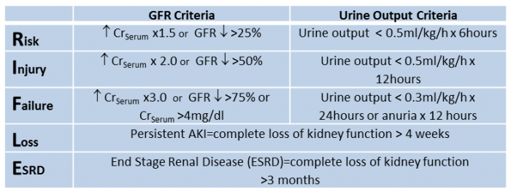
Diagnostic criteria RIFLE

Slide 15
Agenda
Terminology
Renal impairment - classification according to clinical course
Pathogenesis of AKI
Causes of AKI by frequency and estimated risk score
AKI classification according to diagnostic criteria (SKr, GFR, diuresis)
Diagnostics
Therapy
Chronic kidney failure
Stages of chronic nephropathy
Adaptation of residual nephrons with the aim of maintaining the internal environment
Specific complications of RI
Therapy of specific complications of RI

Slide 16
Targeted examinations to distinguish pre-renal AKI / ARF vs ATN and ATN vs ESRF
Pre-renal AKI/ARF
ATN
ESRF
EF_{urea} <30%
EF_{Na} < 0,4%
EF_{osm} < 3.5%
EF_{H2O} <2%
U_{osm} >P_{osm}
Fast ↓ SCr after volume
expansions
EF_{urea} >50%
EF_{Na} >1.2%
EF_{osm} > 3.5%
EF_{H2O} >2%
U_{osm} = P_{osm}
≈ SC_{r} after volume
expansions
EF_{urea} > 50 %
EF_{Na} > 1.2 %
EF_{osm} > 3.5%
EF_{H2O} > 2%
U_{osm} = P_{osm}
≈ SC_{r} after volume
expansions
↑ iPTH
USG image of small kidneys
Anemia

Slide 17
Targeted examinations to distinguish renal AKI
Renal AKI
Glomerular
Interstitial
Tubular
Vascular
Acute GN
RPGN
AIN
Akutní PN
ATN
Myelomová ledvina
Rhabdomyolýza
Hemolýza
TMA
HUS
aHUS
TTP
U_{sediment}/cytology
PU
IgG,IgA,IgM, C3,C4, anti MPO, anti PR3, ANA, anti-dsDNA, ENA, anti-GBM
U_{sediment}, glykosuria
history of drug use !
Serological detection of antibodies against pathognomic infectious agents for AIN
Urin culture
EF_{urea}, EF_{Na}, EF_{osm}, EF_{H2O}
P _{Kappa/Lambda}, 24-h PU, plasma and urin ELFO and iELFO, myoglobin, CK, AST
Hb,trombo, schistocytes
HPG, LD, free Hb, Coombs test (positive)
Hb,trombo, schistocytes
HPG, LD, free Hb,
Coombs test (negative)
Regulators of the alternative pathway of complement activation
(CFH, CFI, MCP)
ADAMTS

Slide 18
Agenda
Terminology
Renal impairment - classification according to clinical course
Pathogenesis of AKI
Causes of AKI by frequency and estimated risk score
AKI classification according to diagnostic criteria (SKr, GFR, diuresis)
Diagnostics
Therapy
Chronic kidney failure
Stages of chronic nephropathy
Adaptation of residual nephrons with maintenance goals
Specific complications of RI
Therapy of specific complications of RI

Slide 19
General principles of AKI therapy
isotonic solution infusion therapy for volume depletion
Therapy of hypervolemia/hyperhydratation by furosemide depends on the patient's responsiveness to this therapy
Correction of severe metabolic acidosis by i.v. bicarbonate applications - as a bridge to hemodialysis
Correction of hematological abnormalities (anemia. trombopenia)
Hyperkalaemia correction
Reduction of oral potassium intake
Use of ion exchangers (potassium binding resins)
Treatment facilitating the entry of potassium into ICT (insulin with glucose)
Urgent hemodialysis or CVVH

Slide 20
Causal therapy
Therapy focused on the cause of AKI is essential!
Renal AKI
Glomerular
Interstitial
Tubular
Vascular
Acute GN
RPGN
AIN
Acute PN
ATN
Myeloma kidney
Rhabdomyolysis
Hemolysis
TMA HUS
aHUS
TTP
0 ← spont. remission
KS + DMARDs
Cyclophosfamide
Mykofenolat-mofetil
Rituximab
volume challenge
alkalizing solutions
AIHA treatment
+
Polyuric phase therapy
>>water and Na⁺ balance
Causal therapy
Ecuzulimab (anti C5)
$500,000 per patient per year
Plasmaferesis + KS +RTX
STOP suspicious
drugs
KS
ATB

Slide 21
Agenda
Terminology
Renal impairment - classification according to clinical course
Pathogenesis of AKI
Causes of AKI by frequency and estimated risk score
AKI classification according to diagnostic criteria (SKr, GFR, diuresis)
Diagnostics
Therapy
Chronic kidney failure
Stages of chronic nephropathy
Adaptation of residual nephrons with maintenance goals
Specific complications of RI
Therapy of specific complications of RI

Slide 22
Chronic renal dysfunction and its consequences
CHRI It is characterized by a gradual decrease in GFR.
The slow decrease in GFR allows the adaptation of residual nephrons.
The homeostasis of the internal environment is maintained if the EF of the individual solutes and water are set to values that correspond to the decrease in GFR, but also to the size of their intake. Metabolic acidosis, changes of electrolyte composition of the internal environment, hyperhydration, hyperkalemia, disorder of phosphate and calcium metabolism and hyperuricemia is a result if the adaptive possibilities are exhausted in the terminal phase RI.
The kidneys are producers of hormones (erythropoietin, calcitriol, renin, prostaglandins) and are the target organ for extrarenally produced hormones (BNP, ADH / vasopressin, FGF23, CLOTHO, parathyroid hormone, aldosterone).
Renal anemia, calcitriol deficiency and secondary hyperparathyroidism are the consequences.
Uremic syndrome is the result of complete depletion of residual nephron compensation in the ESRF phase.

Slide 23
Uremic syndrome= Uremia
Subjective complaints: muscle weakness and fatigue, metallic taste in the mouth, loss of appetite, nausea / vomiting, BW loss, drowsiness and sleep disorders, bone pain, convulsions, paresthesia, skin pruritus, chills
Objective finding
Signs of malnutrition
Straw or gray skin discoloration, bruises
Dyspnoea, hypertension
Foetor uremicus
Increased filling of the jugular veins, signs of pulmonary congestion
Pulmonary / pericardial friction murmur
Laboratory examination
High urea and creatinine, GFR <0.2 ml / s
Anemia
Hyperphosfatemia a hypocalcemia
High PTH

Slide 24
Agenda
Terminology
Renal impairment - classification according to clinical course
Pathogenesis of AKI
Causes of AKI by frequency and estimated risk score
AKI classification according to diagnostic criteria (SKr, GFR, diuresis)
Diagnostics
Therapy
Chronic kidney failure
Stages of chronic nephropathy
Adaptation of residual nephrons with the aim of maintaining the internal environment
Specific complications of RI
Therapy of specific complications of RI

Slide 25
Nehropathy diagnosis
Nephropathy treatment
Treatment of comorbidities
Progression slowdown
Normal function
GFR>1,5 (90) ml/s(min)/1,73m²
Treatment of specific complications of RI
Determination of progression rate
Education about RRT modalities
Impairment
GFR <1,5 (90)
ml/s(min)/1,73m²
Nephropathy screening
Nephropathy diagnosis
Nephropathy treatment
Therapeutic influence of risk
factors
Preparation for RRT
Overt RI
GFR < 1 (60)ml/s(min)/1,73m²
HD
PD
TX
The aim of this classification is to
determine the diagnostic and
treatment procedures to be
performed at a defined level of damage
Preadialysis phase
GFR <0,30ml (18)/s (min)/ 1,73m²
ESRF
GFR < 0,15 (10) ml/s (min)/1,73m2

Slide 26
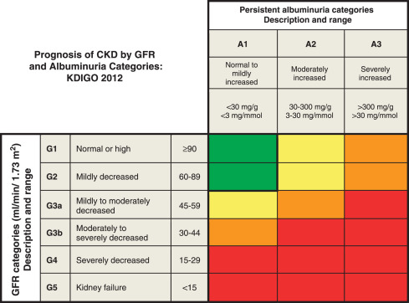

Slide 27
Agenda
Terminology
Renal impairment - classification according to clinical course
Pathogenesis of AKI
Causes of AKI by frequency and estimated risk score
AKI classification according to diagnostic criteria (SKr, GFR, diuresis)
Diagnostics
Therapy
Chronic kidney failure
Stages of chronic nephropathy
Adaptation of residual nephrons with the aim of maintaining the internal environment
Specific complications of RI
Therapy of specific complications of RI

Slide 28
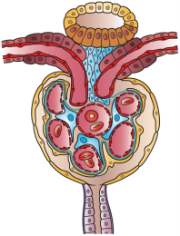
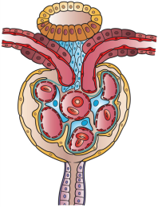
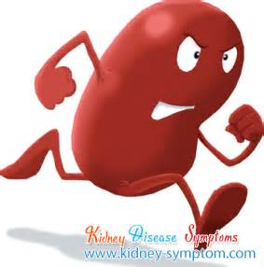
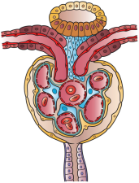
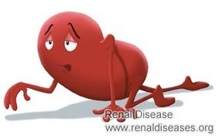
Adaptive changes in tubular Na + resorption in residual nephrons
Normal number of nephrons
R.Platt(1952); N.S.Bricker(1960)
S _{Na+} | 140 mmol/L
GFR | 1.5 mL/s
U _{Na+} | 93 mmol/L
dU _{Na+} | 150 mmol/24h
FE _{Na+} | 0.8 %
FE _{H2O} | 1.2%
S _{Na+} | 140 mmol/L
GFR | 0.3 mL/s
U _{Na+} | 68 mmol/L
dU _{Na+} | 150 mmol/24h
FE _{Na+} | 4.1 %
FE _{H2O} | 8.5%
Residual nephrons and their hypertrophy

Slide 29
Examination of tubular transport
FE_{X} = U_{X} x S_{kr}
S_{X} x U_{kr}
FE_{X} = C_{X} /C_{kr}
EF_{X} < 100% (solutes only tubularly resorbed)
EF_{X} > 100% (solutes intensively secreted)
EF_{X} adequate
The homeostasis of the internal environment can be maintained if the FEs of the individual solutes are set to values that correspond to the decrease in GFR, but also to the size of their intake. The EF value set in this way is called adequate.

Slide 30
Agenda
Terminology
Renal impairment - classification according to clinical course
Pathogenesis of AKI
Causes of AKI by frequency and estimated risk score
AKI classification according to diagnostic criteria (SKr, GFR, diuresis)
Diagnostics
Therapy
Chronic kidney failure
Stages of chronic nephropathy
Adaptation of residual nephrons with the aim of maintaining the internal environment
Specific complications of RI
Therapy of specific complications of RI

Slide 31
Specific complications of RI
Tendency to isotonic dehydration in osmotic diuresis
Tendency to develop severe MAC after minimal insult
Tendency to hyperkalemia before the development of anuria, bacause impaired tubular K⁺ transport in the distal nephron
Early development of phosphate and calcium metabolism disorder accelerating the development of K-V complications
Development of anemia in late stage RI due to erythropoietin deficiency

Slide 32
Definition CKD-MBD
Chronic kidney disease-mineral and bone disorder
Systemic disorder of mineral and bone metabolism based on CKD manifested by one or a combination of the following abnormalities:
Disorder of calcium, phosphorus, PTH and vitamin D metabolism
Bone disorders (bone turnover, mineralization, volume)
Calcification of vascular and other soft tissues

Slide 33
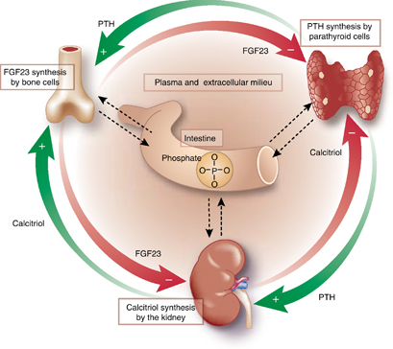
Three feedback loops precisely regulating serum phosphate concentration
RI –GFR <0.10ml/s
(6ml/min)
↓
↑↑↑PTH
↓
↑↑↑Ca + Pi bone releaze
↓
↑↑↑ P_{Ca} + P_{pi}
↓
Terciary HPT
Terciary HPT = PTH adenoma
↓
Renal bone disease
S_{P}: 3.4 to 4.5 mg/dl (1.12 to 1.45 mmol/L)
RI-GFR >0,5 ml/s
(30ml/min):
↑FGF23
↓1,25OHD3
↓
↓ Ca + Pi GIT resorption
↓ Pi resorption in kidney
↓
P_{Pi} ≈normal range
↓P_{Ca}
RI-GFR <0,5 ml/s
↑PTH
↓
↓Pi resorption in kidney
↑Ca + Pi bone releaze
↓
P_{Ca}≈normal range
↑P_{Pi}
↓
Secondary HPT

Slide 34
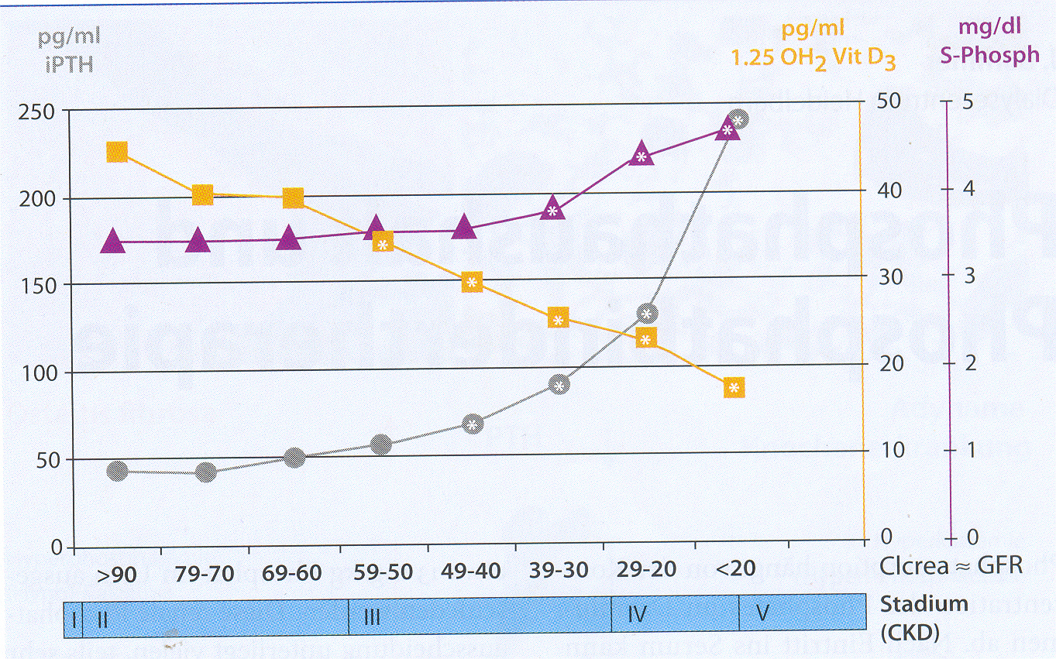
Plasma concentrations of vitamin D, PTH and phosphatemia according to the degree of GFR reduction
FGF23
<1,5
1,3-1,2
1,1-1
0,9-0,8
0,8 - 0,65
0,65-0,5
0,48-0,33
>0,33 ml/s

Slide 35
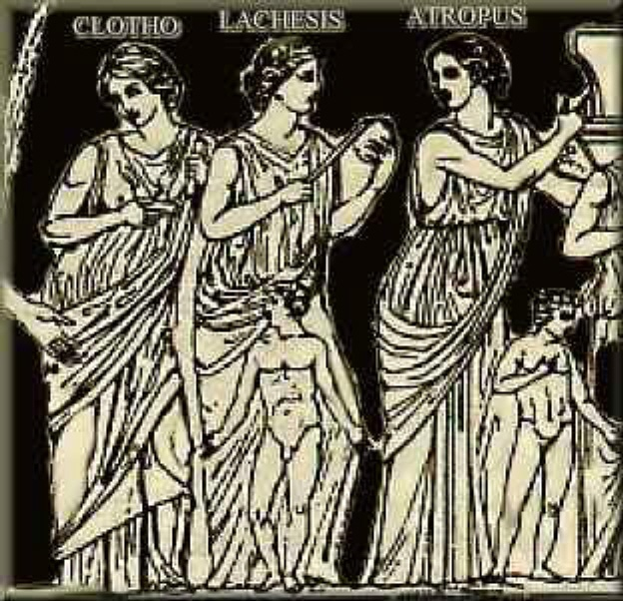
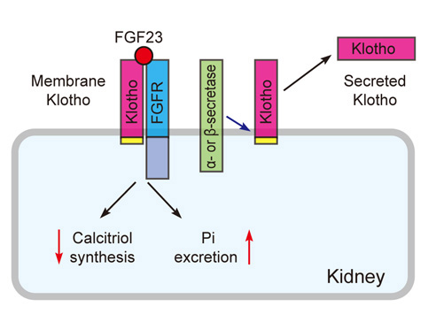
FGF23 function in cooperation with KLOTHO
Clotho is one of the three judges of destiny

Slide 36
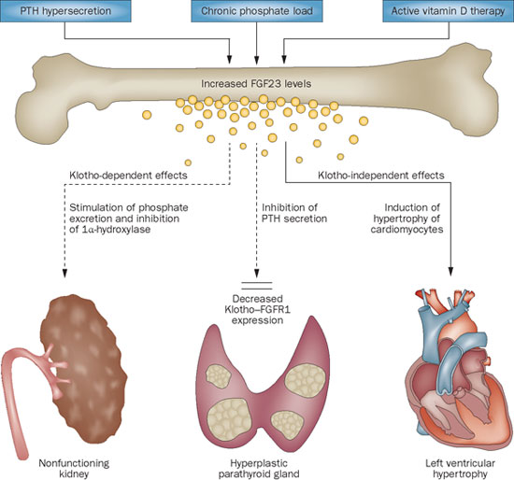
FGF23

Slide 37
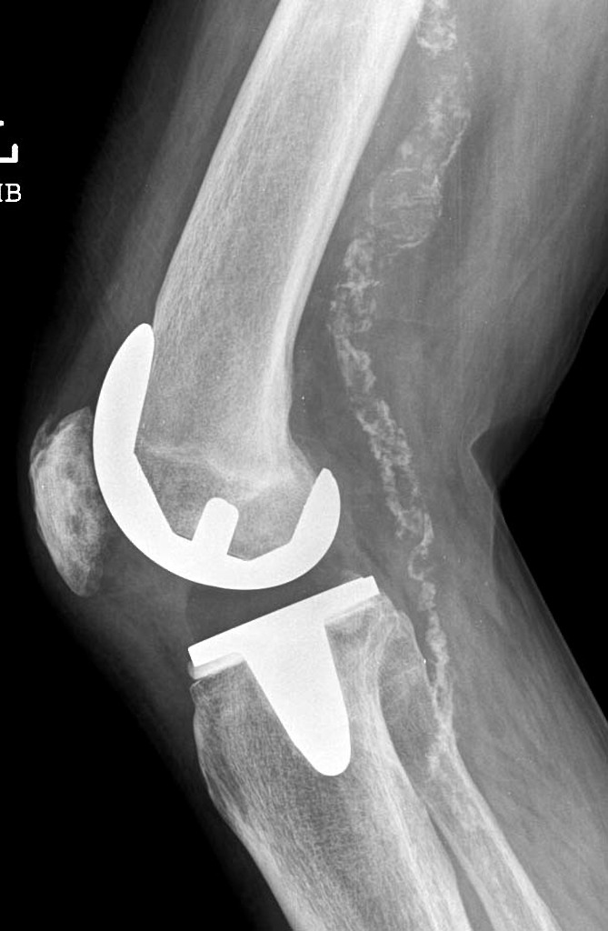
Monckeberg medial calcific sclerosis

Slide 38
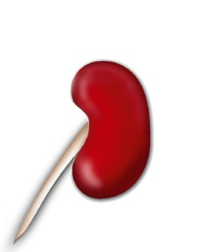
Possibilities of influencing the production and secretion of PTH
TX
Vit. D analogs and derivativets
calcitriol
calcimimetics
CaR
Ca²⁺
VDR
PTH
PTH secretion
PTH creation
Pi
PT cells proliferation
diet, HD, Pi-binders
Slatopolsky E et al. Kidney Int 1999;73:S14–9
Notes:
This slide gives a complete overview of the different mechanisms that lead to excess PTH in patients with CKD and SHPT.
Hypocalcaemic demand is the main driver of the parathyroid glands, but the direct effects of calcitriol and phosphorus act as additional stimuli.

Slide 39
Agenda
Terminology
Renal impairment - classification according to clinical course
Pathogenesis of AKI
Causes of AKI by frequency and estimated risk score
AKI classification according to diagnostic criteria (SKr, GFR, diuresis)
Diagnostics
Therapy
Chronic kidney failure
Stages of chronic nephropathy
Adaptation of residual nephrons with the aim of maintaining the internal environment
Specific complications of RI
Therapy of specific complications of RI

Slide 40
Therapy of specific complications of RI
Volemia control and volume compensation in hypovolemic/dehydrated pts
Correction of ABR disorders
Treatment of Ca-P metabolism disorder by appropriate diet, phosphate binders and calcitriol, early correction of calcidiol deficiency
Differential diagnosis of hyperkalemia in patient in earlier stage of RI
Careful and monitored correction of hypokalaemia
Correction of anemia with erythropoitine with previous correction of hyposideremia

Slide 41
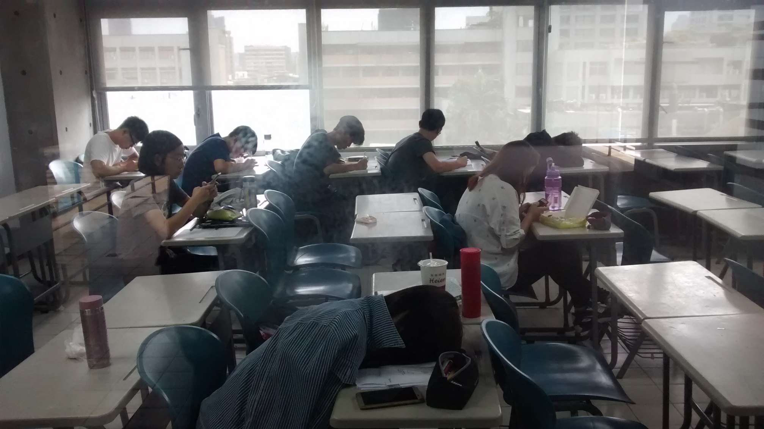
Thank you that our lecture today did not go this way and that you kept your attention!

