Slide 1
Lymphadenopathy
(updated)
Prof.Kateřina Štechová, MD, Ph.D.
katerina.stechova@fnmotol.cz

Slide 2
Introduction
Lymphadenopathy (adenopathy) = disease of the lymph nodes which are abnormal in size and/or consistency
Lymph nodes - the part of the immune system

Slide 3
Introduction
Lymphadenopathy of an inflammatory type (the most common type) is lymphadenitis
Infectious lymphadenitis affecting lymph nodes in the neck (mycobacterial origin) =
scrofula
Lymphangitis

Slide 4
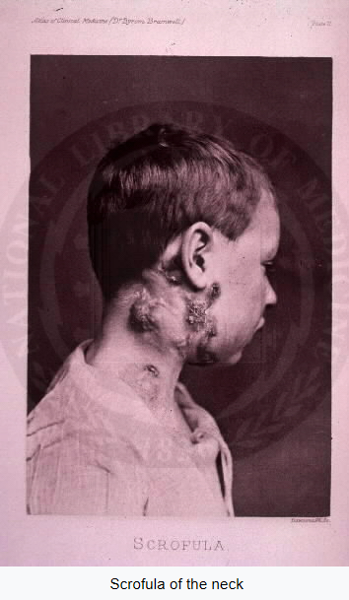

Slide 5
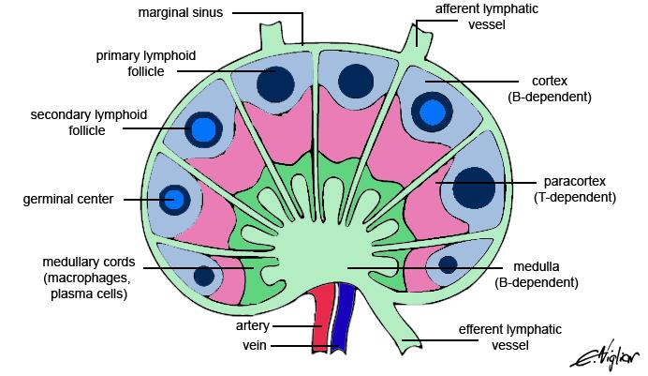
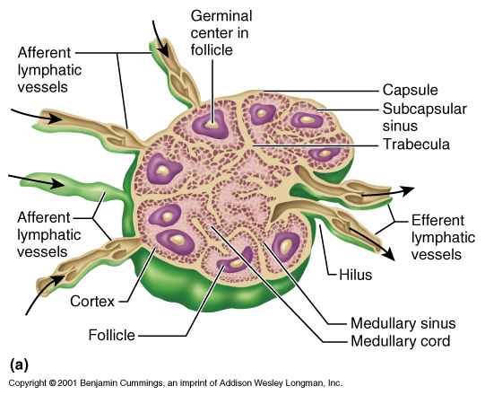
Introduction

Slide 6
Introduction
React to threat
Hyperplastic response that usually resolves within 1 month

Slide 7
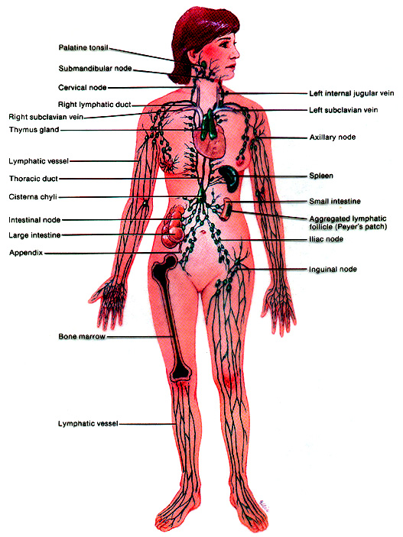
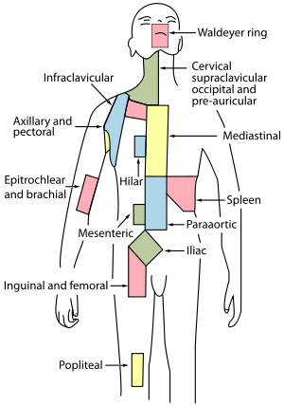
Introduction
Nearly 600
lymph nodes

Slide 8
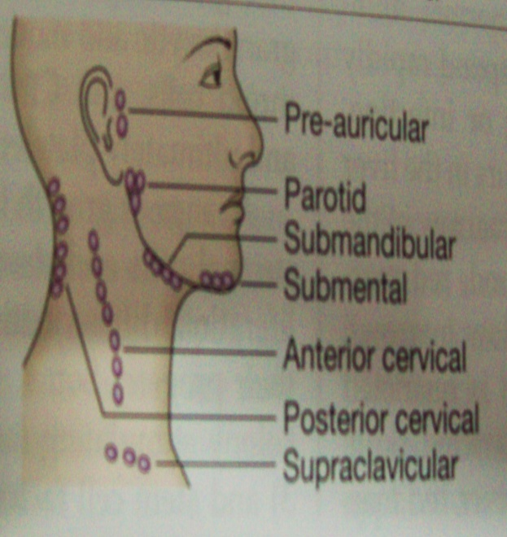
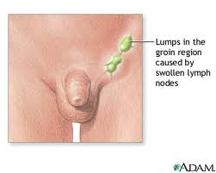
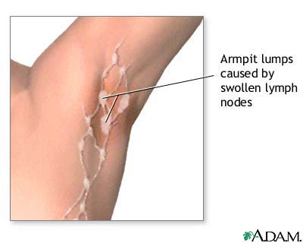
Normally palpable
Submandibular
(Axillary)
Inguinal

Slide 9
Types of LAP (cause)
Benign
Malignant

Slide 10
CHICAGO + region
C - cancers, also metastatic
H – hypersensitivity syndromes: serum sickness, drugs
I – infections
C – connective tissue dis. as SLE…
A – atypical lymphoproliferative dis. as Castleman´s dis., Wegener
G – granulomatous (also infections – mycobacterial but also sarcoidosis)
O - others

Slide 11
Patterns of benign LAP
There are seven distinct patterns of benign lymphadenopathy (but almost always mixture):
Follicular hyperplasia: the most common type of reactive lymphadenopathy
Paracortical hyperplasia/Interfollicular hyperplasia: It is seen in viral infections, skin diseases, and nonspecific reactions

Slide 12
Patterns of benign LAP
Sinus histiocytosis: It is seen in lymph nodes draining limbs, inflammatory lesions, and malignancies.
Nodal extensive necrosis
Nodal granulomatous inflammation
Nodal extensive fibrosis (Connective tissue framework)
Nodal deposition of interstitial substance

Slide 13
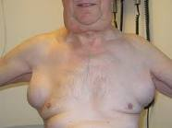
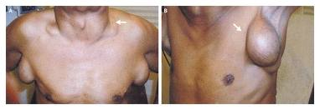
Type according to distribution
GENERALISED

Slide 14
Infections
  HIV
  Toxoplasmosis
  Other - mononucleosis
Neoplasia
  Leukemia
  Hodgkin’s disease
  NHL
Hypersensitivity
Autoimmunity
  Serum sickness
  Drugs – Phenytoin,…
  Vasculitis,lupus,RA
Hyperthyroidism
Lipidoses
Metabolic

Slide 15
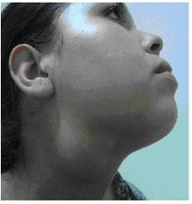
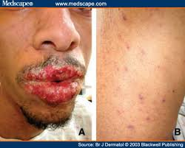
Castleman’s disease
Rare,idiopathic,localised/multicentric,mimic lymphoma/HIV, systemic symptoms,increased risk of malignancies infection
Notes:
Castlemanova choroba
Castlemanova [Káslmenova] nemoc je vzácné onemocnění mízních uzlin. Choroba je spojena se zvýšeným rizikem vzniku některých zhoubných nádorů.
Příčiny: Příčina vzniku nemoci není jasná. Víme, že dochází k nadměrnému zmnožení některých bílých krvinek, které jsou známé jako B-lymfocyty. Mízní uzliny v těle pak jsou těmito lymfocyty obsazovány. Nejčastěji dochází k postižení uzlin krku, hrudníku a břicha. Zmnožené bílé krvinky navíc začínají produkovat řadu sloučenin, které způsobují rozvoj zánětlivého procesu v těle.

Slide 16
LOCALISED (75%)
ANT.AURICULAR
  Viral Conjunctivitis
  Trachoma
  Tularemia
  Sarcoidosis
POST.AURICLAR
  Rubella
  Scalp infection
Notes:
50% of them are detected in the head and neck area

Slide 17
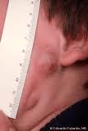
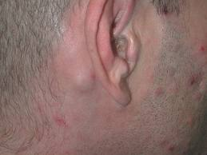
ANT. AURICULAR
POST. AURICULAR

Slide 18
SUB MANDIBULAR
  Buccal cavity infection
  Pharyngitis
  Nasopharyngeal tumour
  Thyroid malignancy
CERVICAL
  Mononucleosis
  Sarcoidosis
  Toxoplasmosis
  Pharyngitis

Slide 19

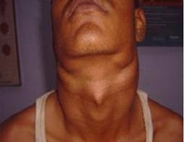
SUBMANDIBULAR
CERVICAL BILAT.

Slide 20
Right supra clavicular
  Pulmonary malignancy
  Mediastinal malignancy
  Esophageal malignancy
Left supra clavicular
(Virchow)
  Intraabdominal malignancy
  Renal ca
  Testicular or ovarian malignancy

Slide 21
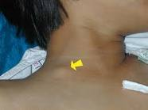
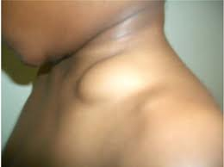
RIGHT SUPRA CLAVICULAR
LEFT SUPRA CLAVICULAR

Slide 22

Axillary
  Ca breast / infection
  Upper extremity infection
Epitrochlear
  Syphilis…Sailor’s handshake
  CLL
  Mononucleosis
  Lymphoma
  Hand infection
Notes:
the "Sailor's Handshake", used in the old days by sailors meeting eager girls on the docks, to subtly discover if they carried syphilis.

Slide 23
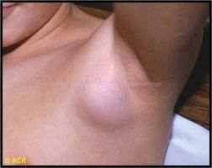
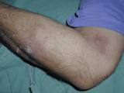
EPITROCHLEAR LYMPHADENOPATHY
AXILLARY LYMPHADENOPATHY

Slide 24
  Syphilis
  Genital herpes
  Lymphogranuloma venereum
  Chancroid
  Lower extremity/local infection
Inguinal
Notes:
Background
Chancroid is a bacterial sexually transmitted disease (STD) caused by infection with Haemophilus ducreyi. It is characterized by painful necrotizing genital ulcers that may be accompanied by inguinal lymphadenopathy. It is a highly contagious but curable disease.

Slide 25
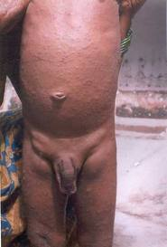
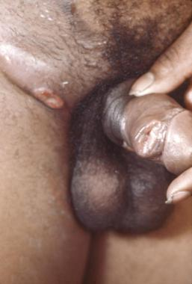
INGUINAL LYMPHADENOPATHY

Slide 26
Hilar(unil)
  Lymphoma
  Bronchogenic ca
  TBC
  Sarcoidosis
Hilar(bil)
  Sarcoidosis
  Fungal(histoplasmosis,coccidiomycosis)
  Lymphoma
  Bronchogenic ca
  TBC

Slide 27
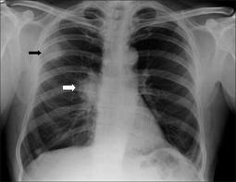
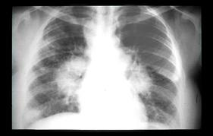
UNILATERAL HILAR LYMPHADENOPATHY
BILATERAL HILAR LYMPHADENOPATHY

Slide 28
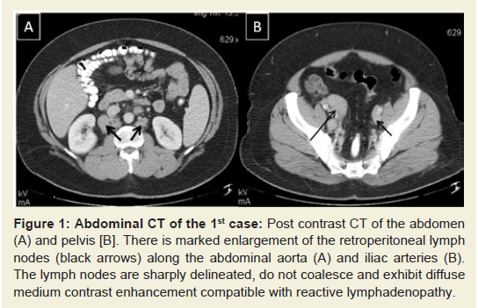
ABDOMINAL
  Adeno ca of gut
  Hodgkin’s dis.
  TBC
  Bladder ca
  Gastric ca

Slide 29
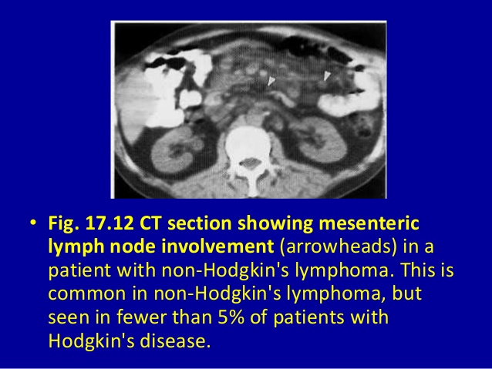

Slide 30
ANY REGION
Cat scratch fever
Hodgkin’s dis.
NHL
Leukemia
Metastatic ca
Sarcoidosis
Granulomatous infection

Slide 31
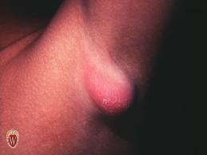
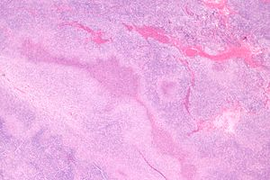
CAT SCRATCH DIS.
Bartonellou henselae,
Incubation period 5-10 days
Notes:
Cat-scratch disease (CSD) is a common and usually benign infectious disease caused by the bacterium Bartonella henselae.^{[2][3]} It is most commonly found in children following a scratch or bite from a cat^{[2]} within about one to two weeks.Cat-scratch disease commonly presents as tender, swollen lymph nodes near the site of the inoculating bite or scratch or on the neck, and is usually limited to one side. This condition is referred to as regional lymphadenopathy and occurs 1–3 weeks after inoculation.^{[4]} Lymphadenopathy in CSD most commonly occurs in the arms, neck, or jaw, but may also occur near the groin or around the ear.^{[2]} A vesicle or an erythematous papule may form at the site of initial infection.^{[2]} Most patients also develop systemic symptoms such as malaise, decreased appetite, and aches.^{[2]} Other associated complaints include headache, chills, muscular pains, joint pains, arthritis, backache, and abdominal pain. It may take 7 to 14 days, or as long as two months, for symptoms to appear. Most cases are benign and self-limiting, but lymphadenopathy may persist for several months after other symptoms disappear.^{[2]} The disease usually resolves spontaneously, with or without treatment, in one month.

Slide 32
History & examination
Size & quality
Is the palpable mass indeed
a lymph node????
Enlarged parotid
Thyroglossal cyst
Abscess
Branchial cyst

Slide 33
Tender.,mobile
Firm,rubbery,nontender
Painless,stonehard,fixed&matted
2.Acute or chronic ??

Slide 34
4.Localized or generalised??
5.Are there associated systemic/localizing symptoms/signs???

Slide 35

Accompanying symptoms
Rec. fever >38.5 C,night sweats,weight loss
LYMPHOMAS
Skin changes, streaking

Slide 36
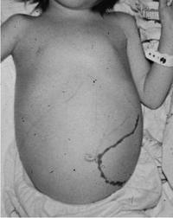
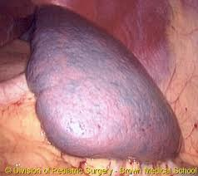
Splenomegaly
Notes:
A recent upper respiratory infection can cause cervical LAP, which is usually self limited.
A triad of moderate to high fever, pharyngitis, and moderately tender lymph node with splenomegaly (>50%) characterizes classic infectious mononucleosis.
Cytomegalovirus, toxoplasmosis, HIV, and human herpes virus type 1 can cause mononucleosis-like syndrome.
The typical symptoms of toxoplasmosis are flu-like symptoms, with a single swollen cervical lymph node.
HIV in the acute phase presents with mononucleosis-like syndrome. Its presentation consists of fever, fatigue, pharyngitis, rash, malaise, arthralgia, and LAP, which appear 2-6 weeks after exposure to the HIV virus.

Slide 37
6.Are there unusual epidemiological clues???
Exposure to cats
Travelling
Exposure to bird droppings
Lacerations during gardening
Exposure to TB
Sexual exposure

Slide 38
Laboratory investigations
1.Complete blood cell count with differential….
Atypical lymphocytosis
Eosinophilia
Pancytopenia

Slide 39
2.Infammation markers
3. Biochemistry

Slide 40
Localised lymphadenopathy
1.US
2.Throat culture
3.Urethral/cervical swabs
4.Blood culture
5.Biopsy
6.Abdominal CT
7.Bone marrow biopsy

Slide 41
Generalised adenopathy
1.Serological tests
2. Immunology
Notes:
AntiCMV IgM or PCR
Anti-HIV (2 weeks „window“) or PCR
IgM toxoplasma antibodies

Slide 42
Hilar adenopathy
1.Mantoux test
3.ACE enzyme determination
4.Bronchoscopy
5.Mediastinoscopy
2.chest X-RAY,CT
Notes:
The angiotensin-converting enzyme (ACE) test is primarily ordered to help diagnose and monitor sarcoidosis.
A tuberculin skin test (also called a Mantoux tuberculin test) is done to see if you have ever been exposed to tuberculosis (TB). The test is done by putting a small amount of TB protein (antigens) under the top layer of skin on your inner forearm. If you have ever been exposed to the TB bacteria (Mycobacterium tuberculosis), your skin will react to the antigens by developing a firm red bump at the site within 2 days.
The TB antigens used in a tuberculin skin test are called purified protein derivative (PPD). A measured amount of PPD in a shot is put under the top layer of skin on your forearm. This is a good test for finding a TB infection. It is often used when symptoms, screening, or testing, such as a chest X-ray, show that a person may have TB.
A tuberculin skin test cannot tell how long you have been infected with TB. It also cannot tell if the infection is latent (inactive) or is active and can be passed to others.

Slide 43
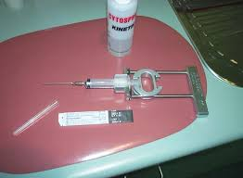
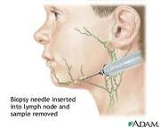
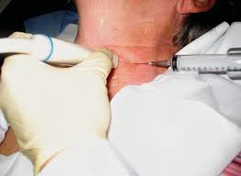
Lymph node biopsy
Most direct approach

Slide 44
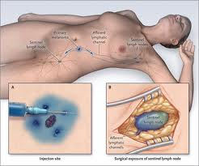
Indications
Approaches & yeild
Excisional biopsy preferred
FNAC
Needle aspiration

Slide 45
Choice of node
Largest node
Avoid inguinal & axillary
Supraclavicular-highest diagnostic yield
Complications
Follow up/empiric treatment

Slide 46
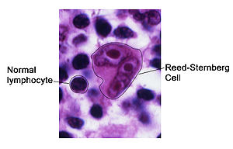
Histopathology
  Certain pathogens cause typical findings.
  Also e.g. Reed-Sternberg cells – Hodgkin´s dis.

Slide 47
Mohseni et al., 2014

Slide 48


Nodes in the area above the left clavicle drain lymph from
ⓘ Start presenting to display the poll results on this slide.

Slide 49
The so-called B symptoms do not include:
ⓘ Start presenting to display the poll results on this slide.

