Slide 1
Diabetes - types, pathogenesis, chronic complications
Prof.Kateřina Štechová, MD, Ph.D.
Dpt. of Internal Medicine ²nd Medical Faculty

Slide 2
Glucose – physiological notes
Glucose as an essential energy source
Gluconeogenesis
„Contraregulatory hormones“
Normal fasting/postprandial glycaemia (below 5,6 resp. 7,8 mmol/l)
Glucose transport into cells – insulin dependent (GLUT4, insulin dependent tissues)/independent

Slide 3
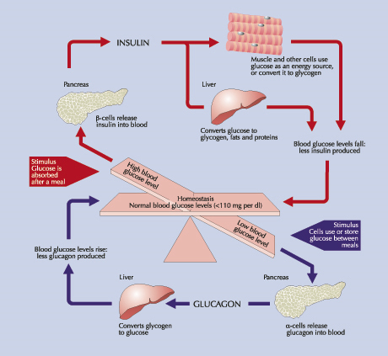

Slide 4
Diabetes definition
Diabetes mellitus (DM) is a group of diseases of multiple aetiology characterized by chronic hyperglycaemia with disturbances of carbohydrate, fat and protein metabolism resulting from defects in insulin secretion, insulin action, or both.
The effects of diabetes mellitus include long–term damage, dysfunction and failure of various organs.

Slide 5
Prediabetes: Impaired glucose tolerance and impaired fasting glucose = „in the grey zone“
People with prediabetes have impaired fasting glucose (IFG) or impaired glucose tolerance (IGT). Some people may have both IFG and IGT.
Progression to diabetes among those with prediabetes is not inevitable. Studies suggest that weight loss and increased physical activity among people with prediabetes prevent or delay diabetes and may return blood glucose levels to normal.
People with prediabetes are already at increased risk for other adverse health outcomes such as heart disease and stroke.

Slide 6
Types of Diabetes
Type 1 Diabetes Mellitus
Type 2 Diabetes Mellitus
Gestational Diabetes
Other specific types:
    MODY (maturity-onset diabetes of youth) = monogenneic
    Secondary Diabetes Mellitus
    …

Slide 7

Diagnosis of Diabetes Mellitus

Slide 8
Diabetes
Diabetes mellitus may present with characteristic symptoms such as thirst, polyuria, blurring of vision, and weight loss.
In its most severe forms, ketoacidosis (DM1 mostly) or a non–ketotic hyperosmolar state (rather DM2) may develop and lead to stupor, coma and, in absence of effective treatment, death.
In DM2 often symptoms are not severe, or may be absent, and consequently hyperglycaemia sufficient to cause pathological and functional changes may be present for a long time before the diagnosis is made.

Slide 9
OGTT
mmol/l (mg/dl) | OK | PREDIABETES | DIABETES
FASTING | <5.6 <101 | ≥5.6 - <7 101-126 | ≥7 >126
POSTPRANDIAL (OGTT – 120 min.) or randomly detected | <7.8 <140 | ≥7.8 - <11.1 140-198 | ≥11.1 ≥200
In lab, venous plasma
These values are not valid for pregnant women
OGGT – 75 g of glucose, conditions

Slide 10
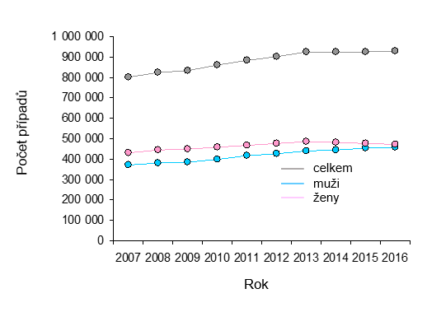
DM prevalence (national data, www.uzis.cz)

Slide 11


Slide 12
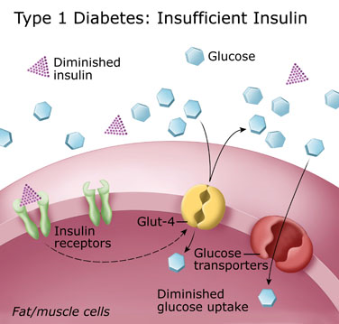
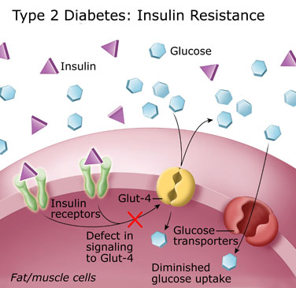

Slide 13
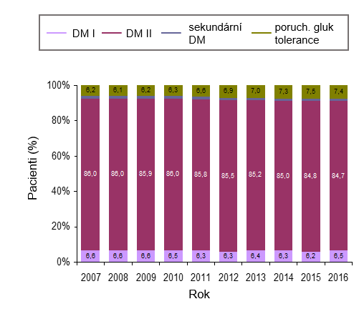
Frequency of DM types, www.uzis.cz

Slide 14
DM1 pathogenesis
Autoimmune disease
+ Other autoimmune diseases
Usually (but not exclusively) in younger age
  LADA
Prior insulin discovery (1921) fatal
Polygeneic multifactorial
- HLA II molecules

Slide 15
DM2 pathogenesis
First – an increase in insulin resistence
Later ↓ insulin secretion (which was first compensatory ↑)
Crucial interconnection with other components of metabolic syndrome
  Obesity

Slide 16


Slide 17

The Economist,
December 13th-19th,
2003
Millions of years
< 30 years

Slide 18


Slide 19
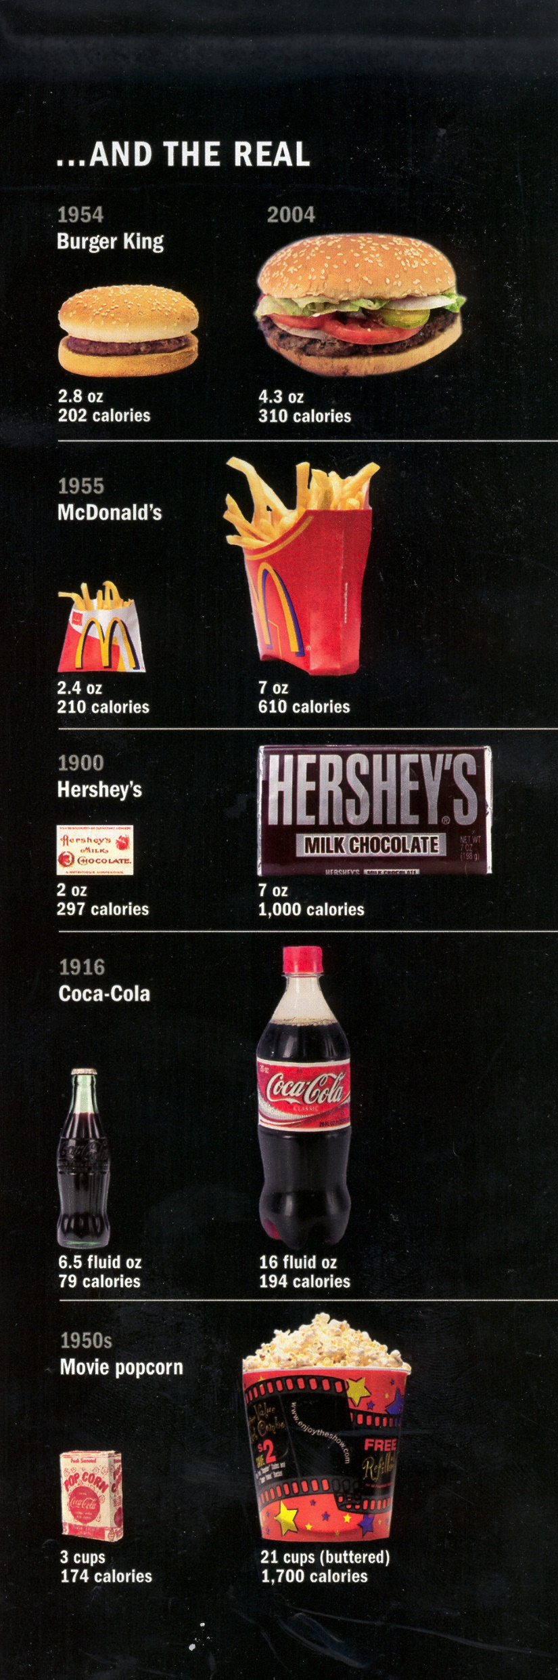

Portion Size: 1950s to 2000

Slide 20
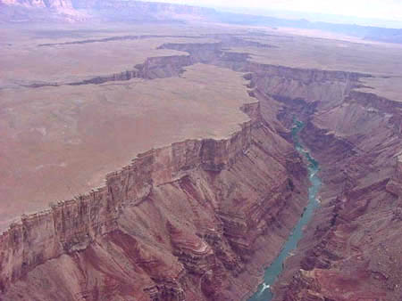
A Growing Divide
Evidence
Behaviour
How can we facilitate translating science to better outcomes?

Slide 21
What else?
Other „specific forms“
  Monogeneic (MODY) – 5% of all cases
    Glucokinase DM (alias MODY 2)
    DM of transcriptional factors
  CFRD, secondary (due to steroids)…
GDM
  Screening in 2 phases

Slide 22
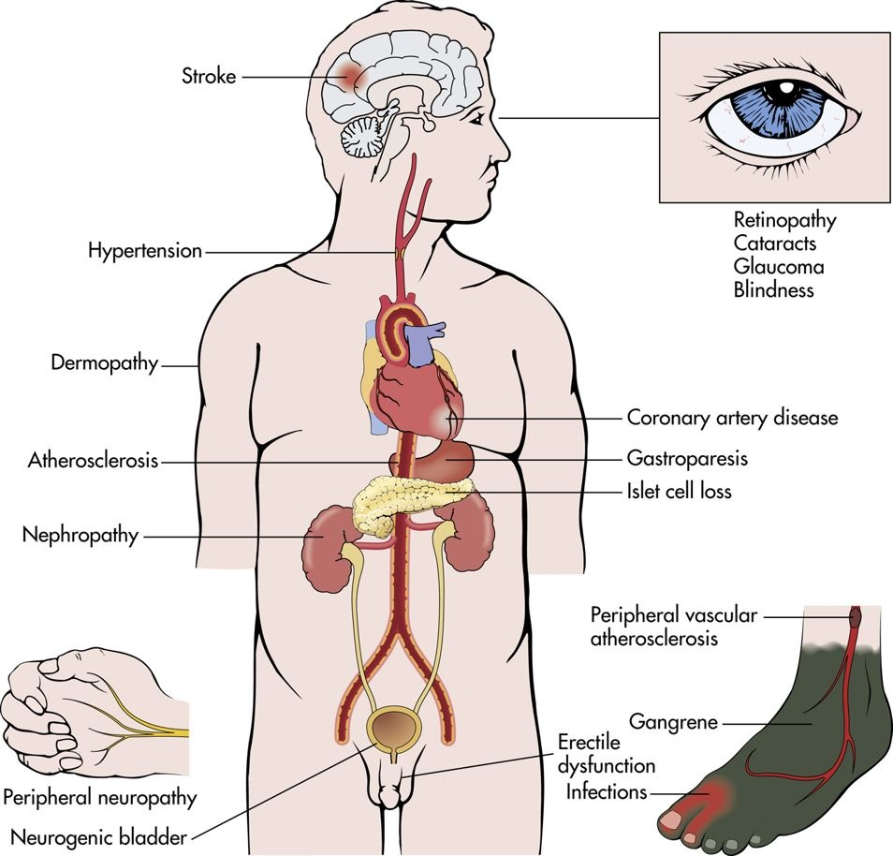
Chronic complications

Slide 23
Mechanisms
Genetic susceptibility
*Repeated acute changes
in cellular metabolism
Hyperglycemia
Tissue damage
**Cumulative long term
changes in stable
macromolecules
Independent accelerating factors
Notes:
* Sorbitol accumulation
↑ NADH/NAD ratio
↓ Myoinositol
early glycation
** Forming advanced glycation end products
Independent accelerating factors:
- HT
- Hyperlipidemia
- Smoking

Slide 24
Mechanisms of Hyperglycaemia Induced Damage
Increased Polyol - sorbitol Pathway flux
Increased AGES formation
Activation of protein kinase C
Increased Hexosamine pathway flux

Slide 25
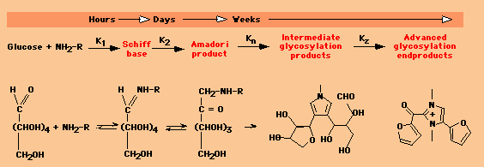
Formation of AGEP

Slide 26
Diabetes Complications
Macro-vascular
Micro-vascular
Stroke
Diabetic eye disease
(retinopathy and cataracts)
Heart disease and hypertension
Renal disease (Kidney)
Peripheral
vascular disease
Neuropathy
Ulcers and amputation
Foot problems

Slide 27
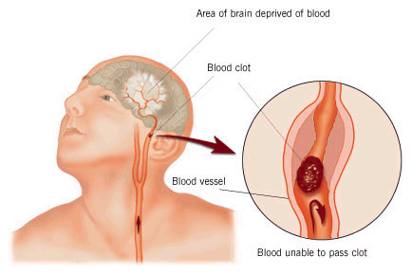
Macro-vascular Complications
Ischemic heart disease
Cerebrovascular disease
Peripheral vascular disease
Diabetic patients have a 2 to 6 times higher risk for
development of these complications than the general population

Slide 28
Risk Factor Clustering in Diabetes
Type 2 Diabetes at Diagnosis:
  50% have hypertension
  30% have dyslipidemia
UKPDS:
  Prospective study
  Newly detected type 2 DM:
    335 with CAD, 8 year follow-up
  Associated with elevated LDL-C, low levels of HDL-C, systolic hypertension
Notes:
This slide illustrates the phenomenon of risk factor clustering in diabetic patients. In terms of patients with type 2 diabetes at diagnosis, 50% have hypertension and 30% have dyslipidemia in addition to their diabetes. In the United Kingdom prospective diabetes study (UKPDS), a prospective study looking at newly detected diabetic patients. Of the patients with newly detected diabetes 335 developed CAD over an 8 year follow-up. Of those patients 30% had high LDL-C, low HDL-c while 50% had systolic hypertension.

Slide 29
Diabetes Complications
Macrovascular
Microvascular
Stroke
Diabetic eye disease
(retinopathy and cataracts)
Heart disease and hypertension
Renal disease (Kidney)
Peripheral
vascular disease
Neuropathy
Ulcers and amputation
Foot problems

Slide 30

Eye Complications
Cataracts
Non enzymatic glycation of lens protein and subsequent cross linking
Sorbitol accumulation could also lead to osmotic swelling of the lens but evidence of involvement in cataract formation is less strong
Glaucoma

Slide 31
Diabetic Retinopathy (DR)
DR is the leading cause of blindness in the working population of the Western world
The prevalence increase with the duration of the disease (few within 5 years, 80 – 100% will have some form of DR after 20 years)

Slide 32
Retinopathy (stages)
Non-proliferative
Starting
Intermediate
Advanced changes
Proliferative
Starting
Highly risky
Maculopathy
Maculopathy is most common in type 2 patients and can cause severe visual loss

Slide 33
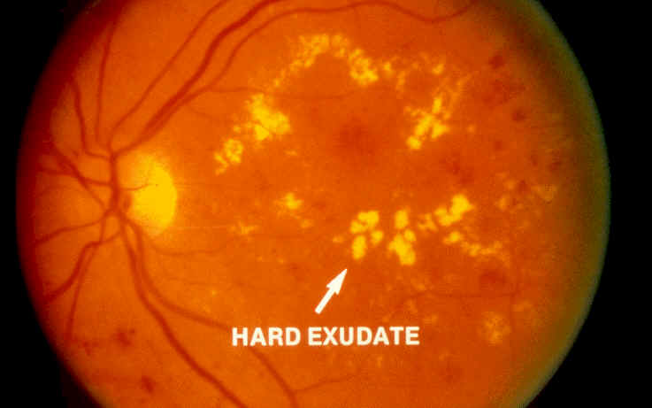
Background Retinopathy
Micro aneurisms
Scattered exudates
Hemorrhages(flame shaped, Dot and Blot)
Cotton wool spots (<5)
Venous dilatations
Background retinopathy

Slide 34
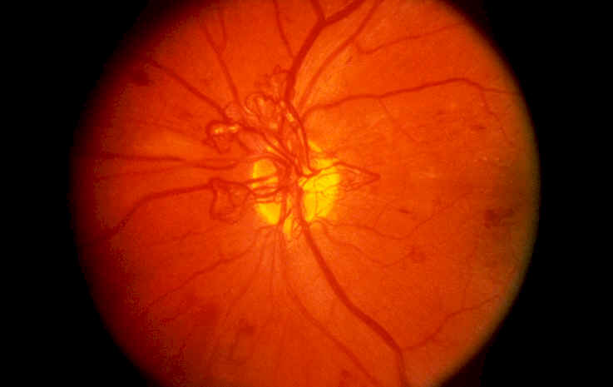
Pre-Proliferative Retinopathy
Rapid increase in amount of micro aneurisms
Multiple hemorrhages
Cotton wool spots (>5)
Venous beading, looping and duplication
Proliferative retinopathy

Slide 35
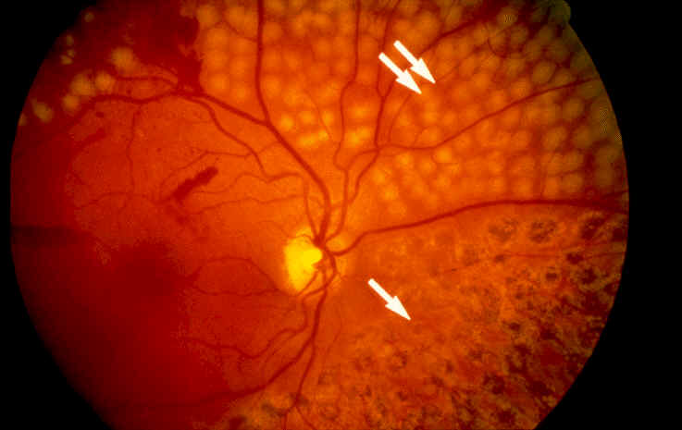
Proliferative Retinopathy
New vessels (on disc, elsewhere)
Fibrous proliferation (on disc, elsewhere)
Hemorrhages (preretinal, vitreous)
Panretinal photo-coagulation

Slide 36
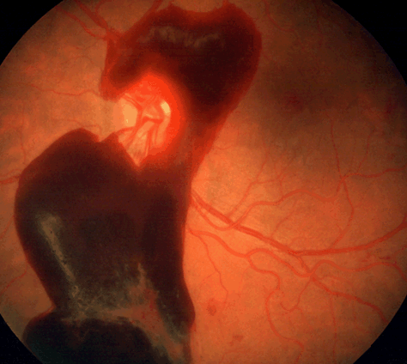
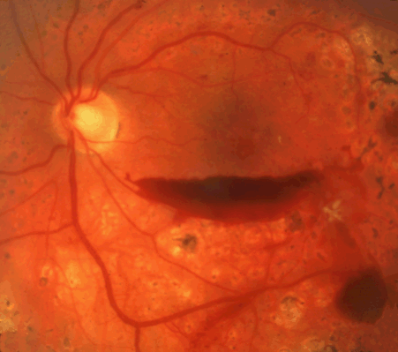
Vitreous Bleeding

Slide 37
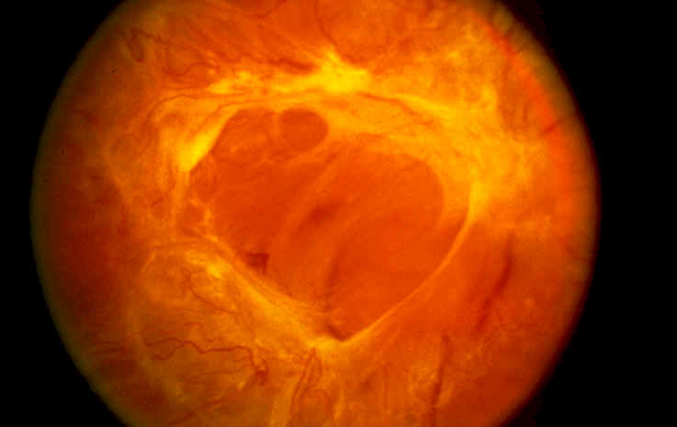
Advanced Diabetic Eye Disease
Retinal detachment with or without retinal tears
Rubeosis iridis
Neovascular glaucoma

Slide 38
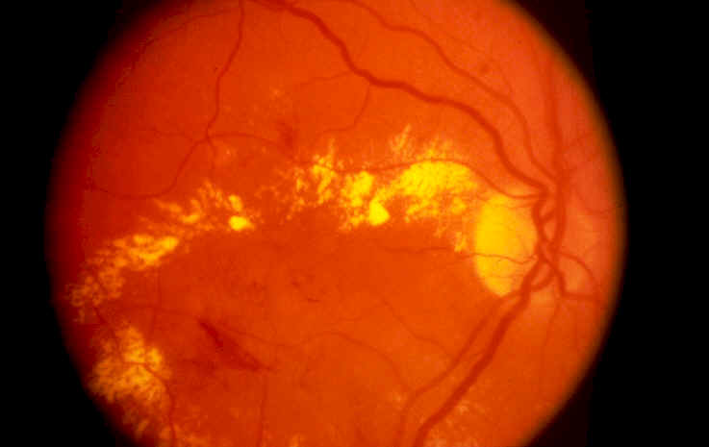
Maculopathy
Macular edema (focal or diffuse)
Ischemic maculopathy
Notes:
Focal and diffuse maculopathy are caused y microvascular leakage, leading to fluid and hard exudates in the area of the macula.
Ischaemic maculopathy is associated with areas of capillary non-perfusion and is difficult to detect. Hard exudates often occur in rings (circinate exudates) around the leaking area.

Slide 39
CDKD, previously diabetic nephropathy (DN)
Diabetes has become the most common cause of end stage renal failure in the US and Europe
About 20 – 30% of patients with diabetes develop evidence of nephropathy
The prevalence of CDKD is higher in Black Americans than in Whites

Slide 40
CDKD
Blood
Endothelial cells
Laminin
xxxxxxxxxxxxxxxxxxxxxxxxxxxxxxxxxxxxxxxxxxxxxxxxxx
Lamina lucida
Collagen type IV
xxxxxxxxxxxxxxxxxxxxxxxxxxxxxxxxxxxxxxxxxxxxxxxxxx
Lamina densa
Podocytes
Urine

Slide 41
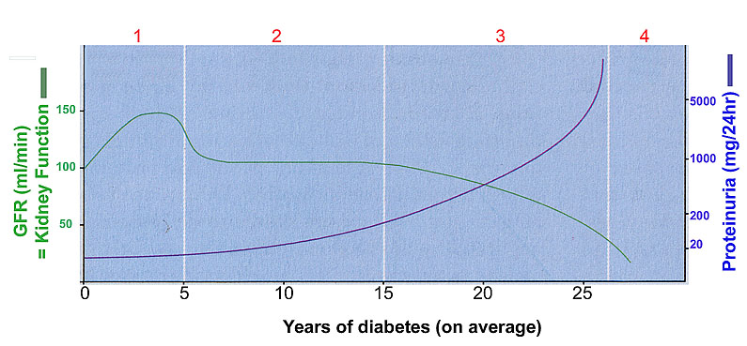
Stages of CDKD
Notes:
Stage 3: Overt diabetic nephropathy
After 15 – 25 years in ±35% of diabetic patients
Pronounced abnormalities of the glomeruli
GFR decline by ±10 ml/min/year
Progressive clinical proteinuria
BP increase by 5 mmHg per year
Nor reversible but progression can be slowed by good glucose control and use of ACE inhibitor
Stage 4: ESRD
Final outcome after 25-30 years
Glomerular closure
GFR < 10 ml/min
Invariably hypertensive
Irreversible

Slide 42
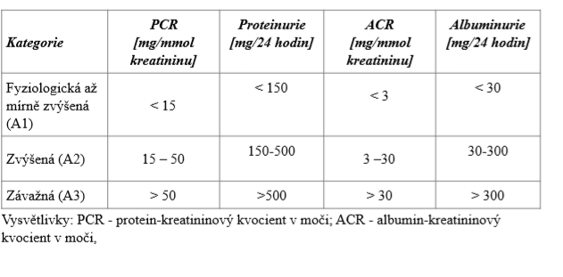
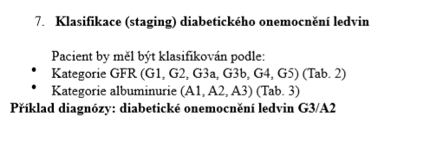
CDKD - classification

Slide 43
Diabetic Neuropathy
Symmetric polyneuropathy
Sensorimotor neuropathy
Autonomic neuropathy
Proximal/distal motor neuropathy
Acute painful (diabetic neuropathic cachexia)
Rapidly reversible changes
Focal and multifocal neuropathy
Mixed forms

Slide 44
Sensorimotor Neuropathy
Patients may be asymptomatic / complain of numbness, paresthesias, allodynia or pain
Feet are mostly affected, hands are seldom affected
In diabetic patients sensory neuropathy usually predominates

Slide 45
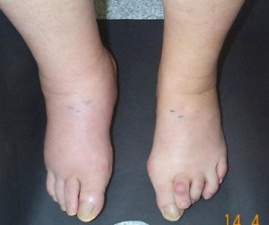
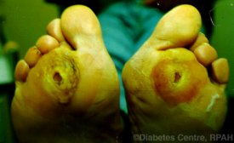
Complications of Sensorimotor neuropathy
Ulceration (painless)
Neuropathic edema
Charcot arthropathy
Callosities

Slide 46
Autonomic Neuropathy
Symptomatic
Postural hypotension
Gastroparesis
Diabetic diarrhea
Neuropathic bladder
Erectile dysfunction
Neuropathic edema
Charcot arthropathy
Gustatatory sweating
Subclinical abnormalities
Abnormal pupillary reflexes
Esophageal dysfunction
Abnormal cardiovascular reflexes
Blunted counter-regulatory responses to hypoglycemia
Increased peripheral blood flow

Slide 47
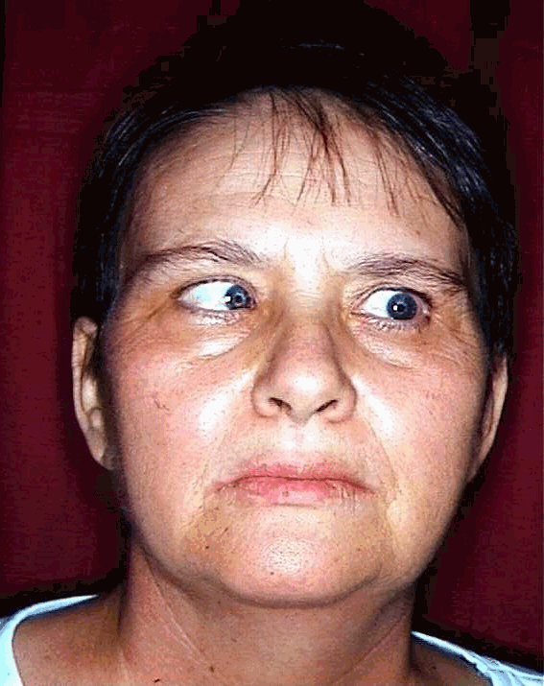
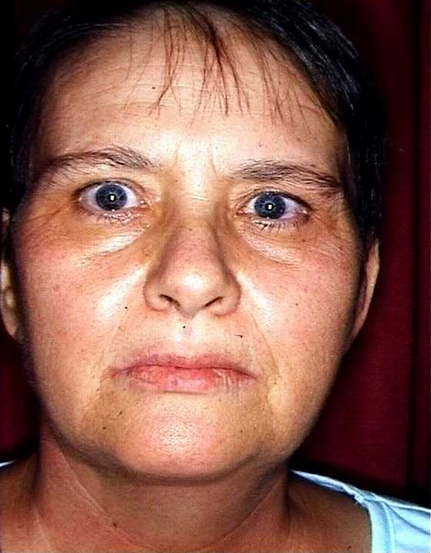
Mononeuropathies
Cranial nerve palsies (most common are n. IV,VI,VII)
Truncal neuropathy (rare)

Slide 48
Entrapment Neuropathies
Carpal tunnel syndrome (median nerve)
Ulnar compression syndrome
Meralgia paresthetica (lat cut nerve to the thigh)
Lat Popliteal nerve compression (drop foot)
All the above are more common in diabetic patients

Slide 49
Proximal Motor Neuropathy
Amyotrophy – most common proximal neuropathy, affects the quadriceps muscles with weakness and atrophy
(synonym: Diabetic Femoral radiculo-neuropathy)

Slide 50
Summary
Diabetic neuropathy is a common complication, and result in significant morbidity
Diabetic neuropathy present in numerous ways
Hyperglycemia is the cause of diabetic neuropathy

Slide 51
Summary (cont.)
Diabetic neuropathy have bad consequences
Diabetic neuropathy can be prevented in only one way
Once diabetic neuropathy is present it can only be managed symptomatically
Early diagnosis and aggressive management can prevent progression

Slide 52
Diabetic foot

Slide 53
Neuropathic
Ischemic

Slide 54

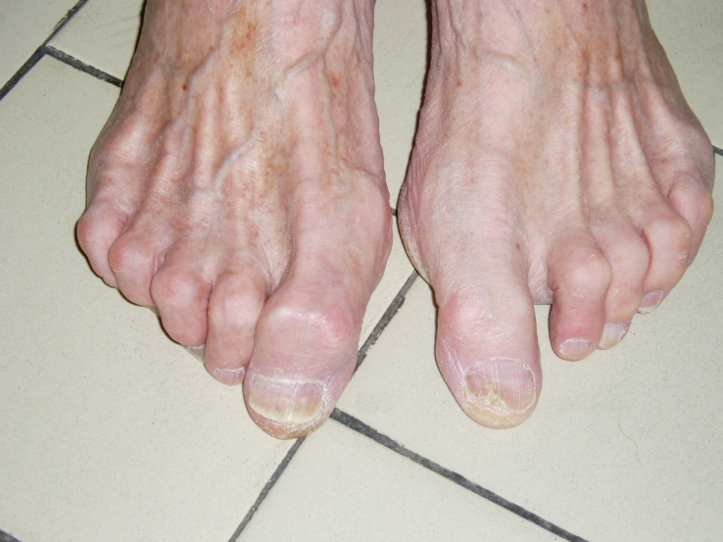
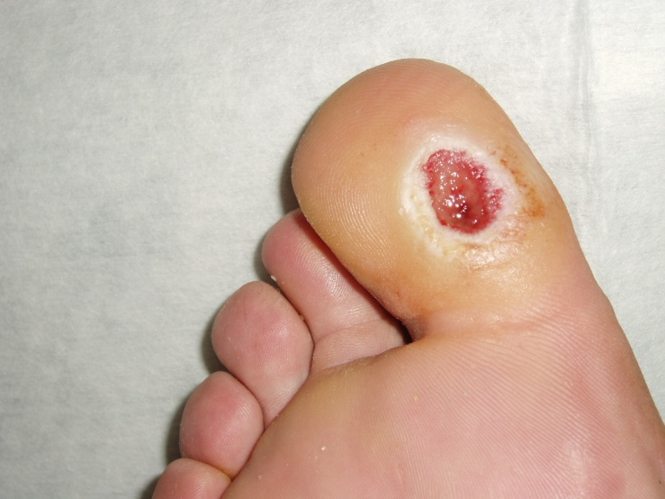
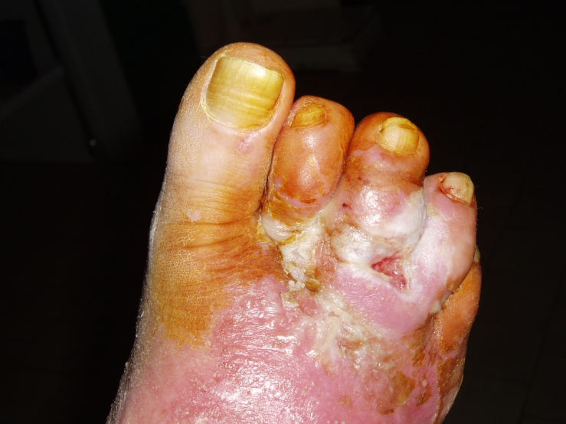
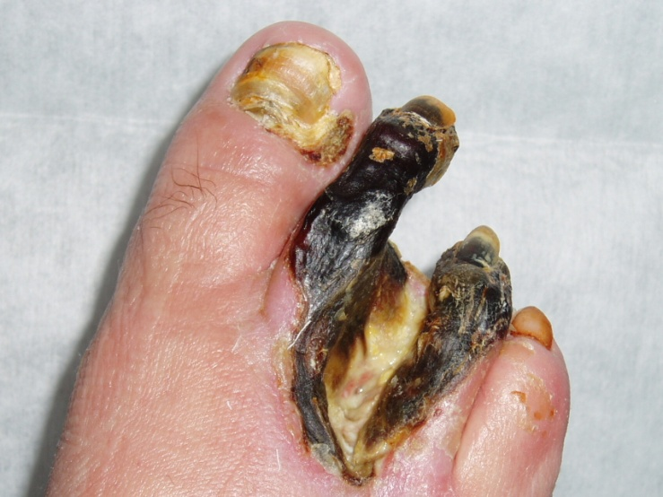
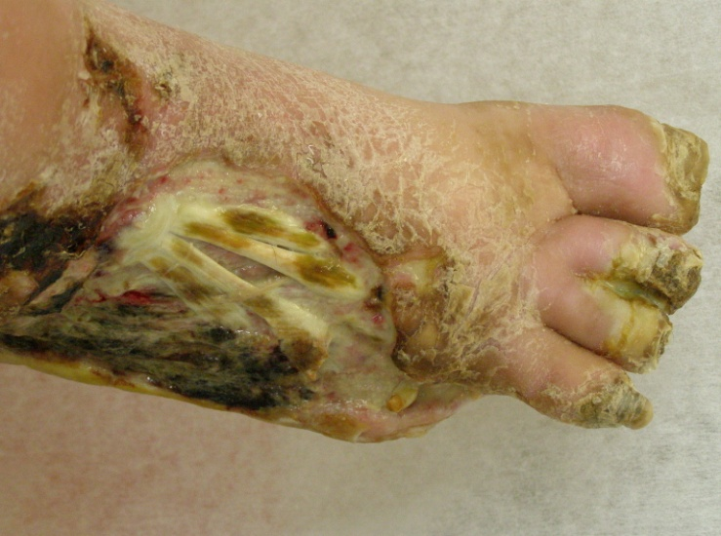
Healthy
Risky
SDF

Slide 55
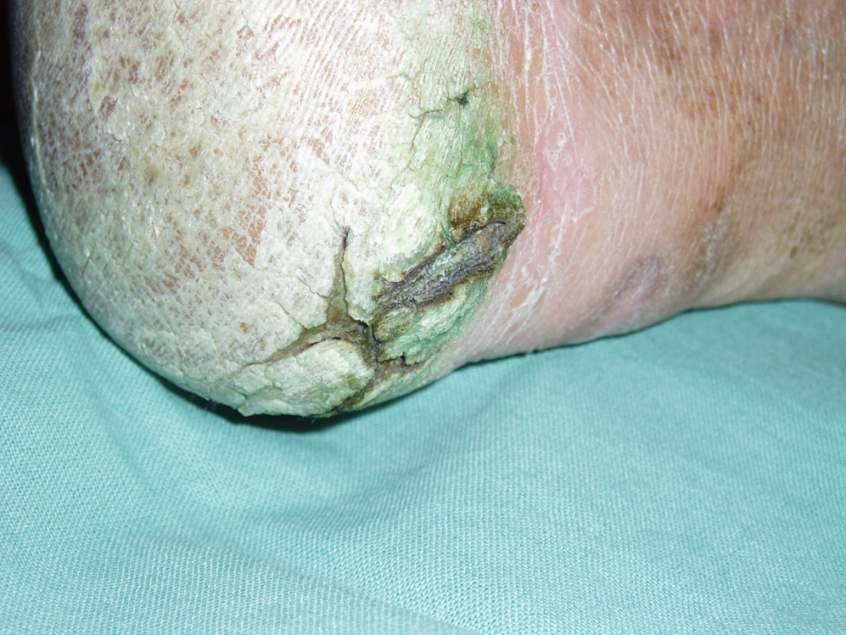
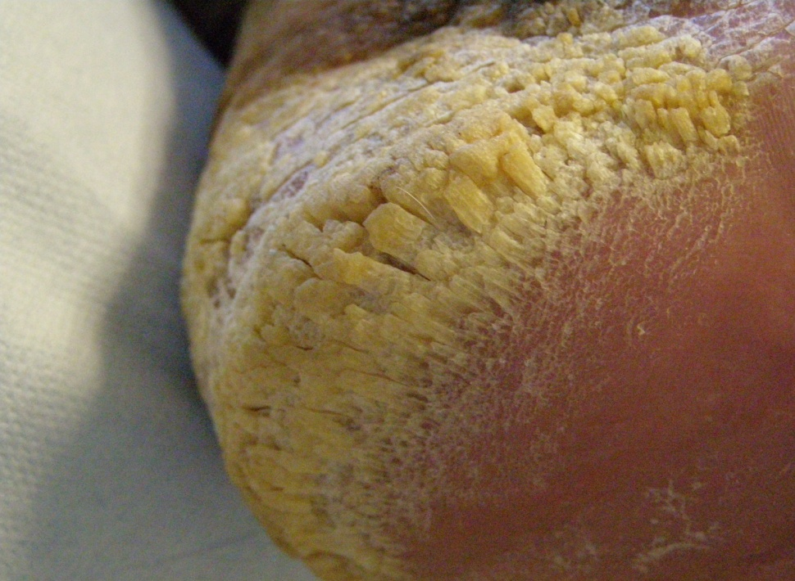

Slide 56
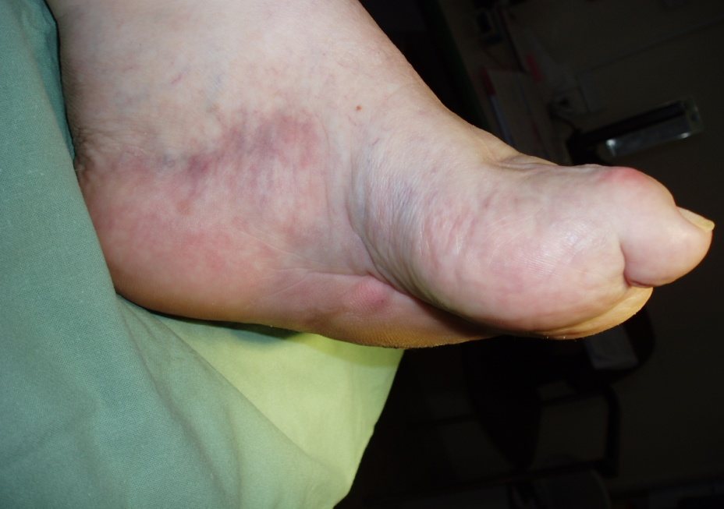
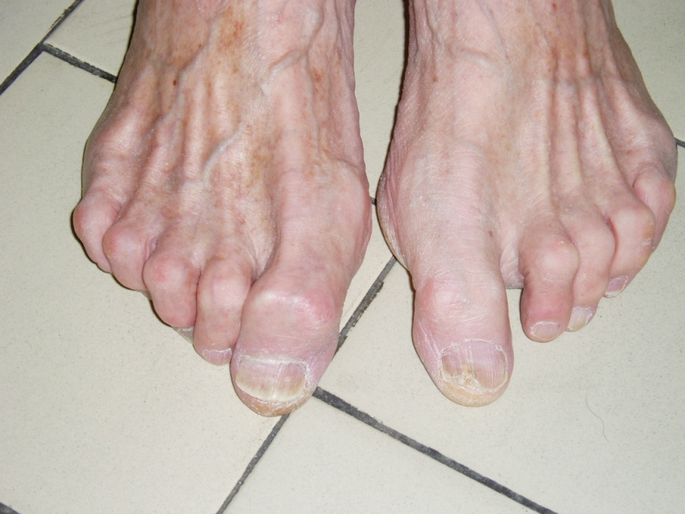
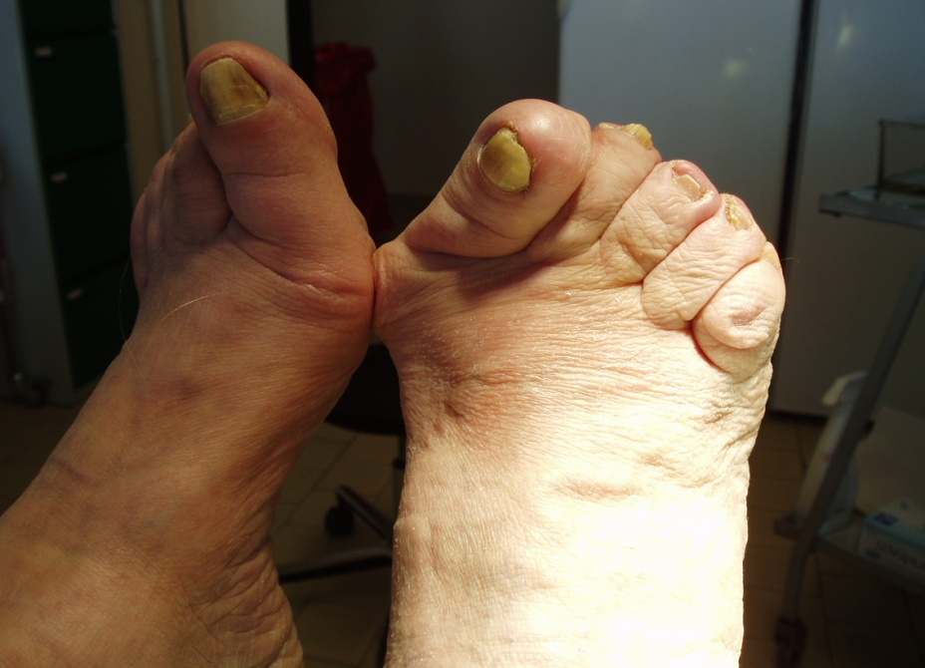

Slide 57
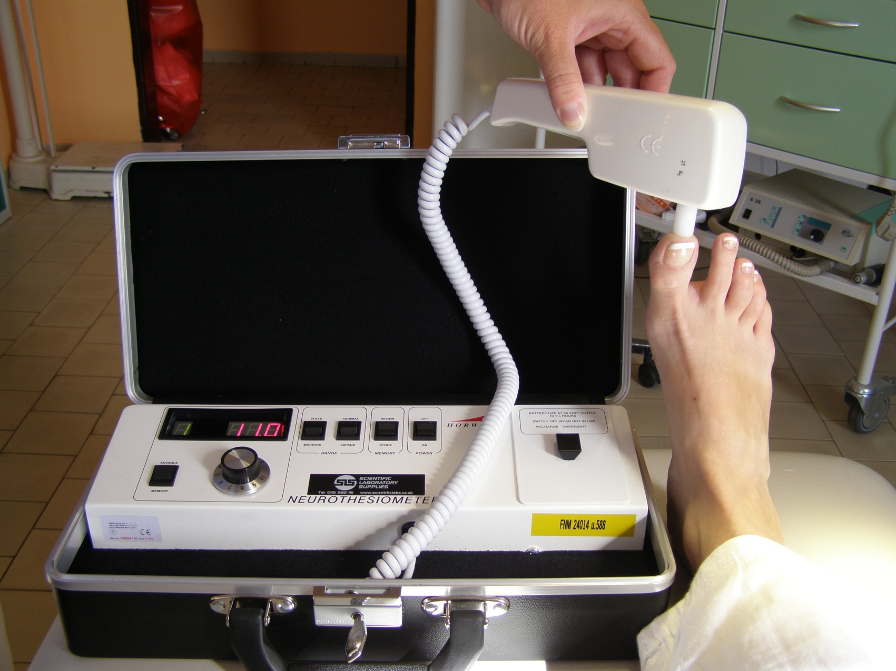
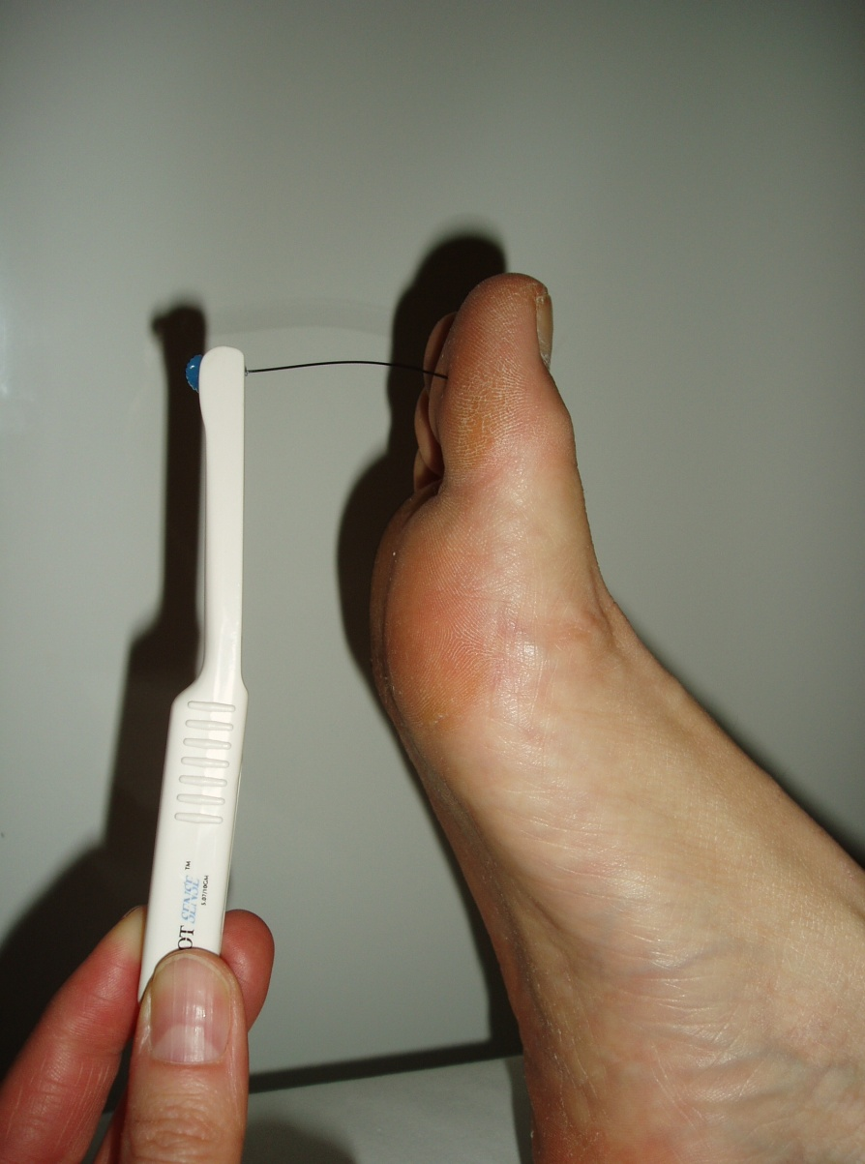
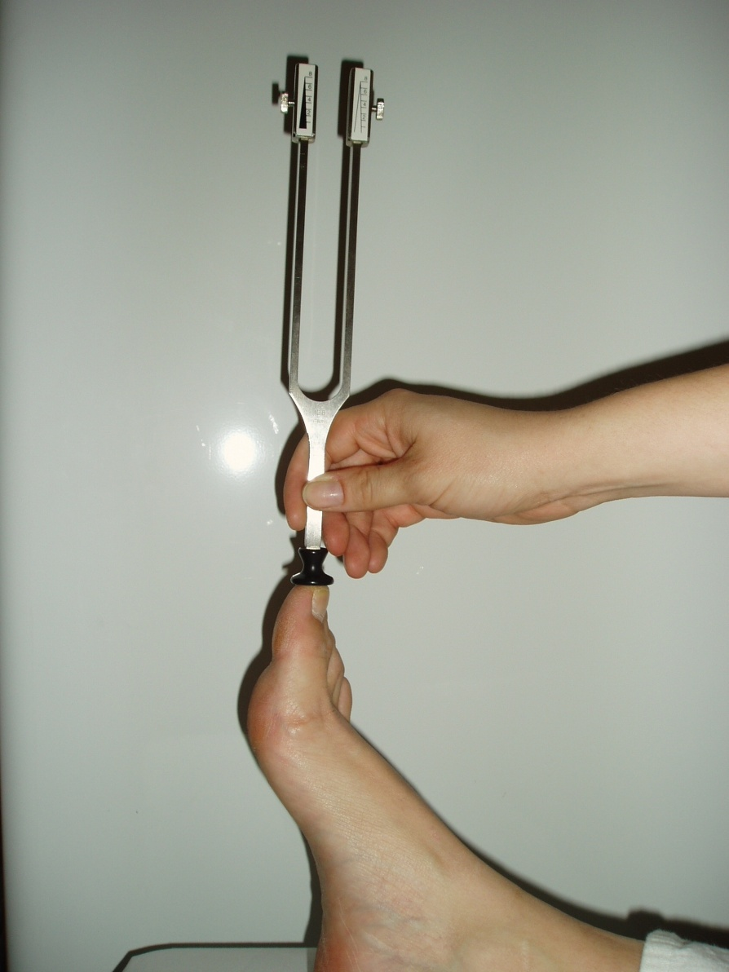

Slide 58
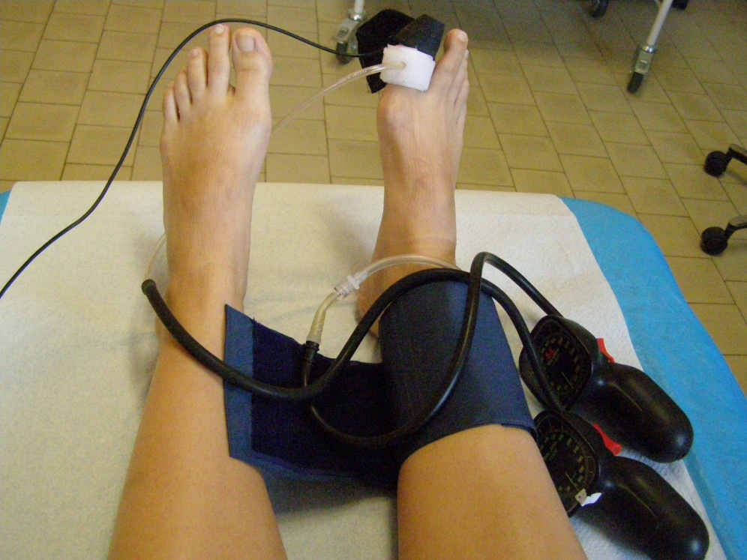
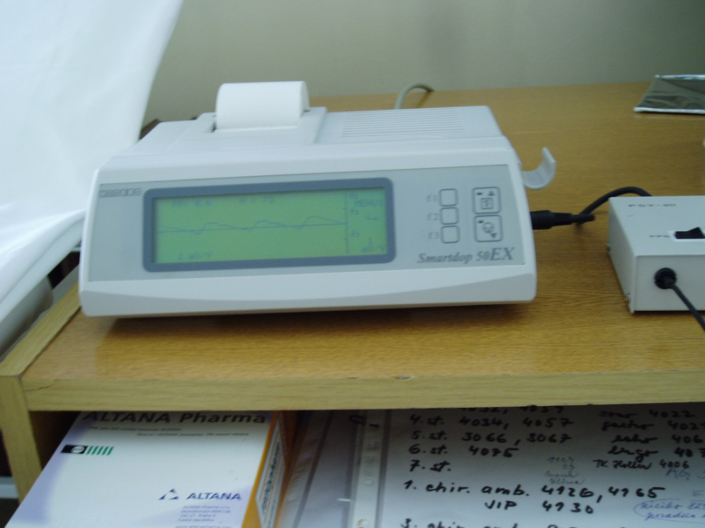
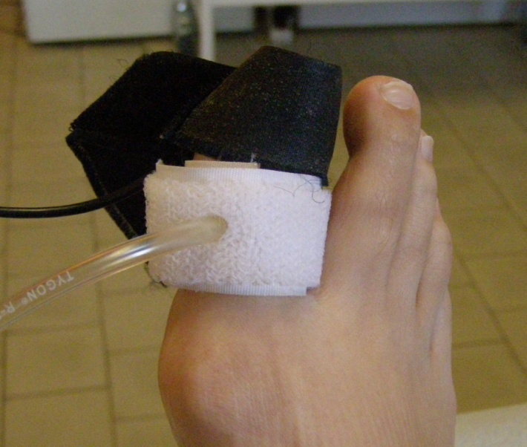

Slide 59
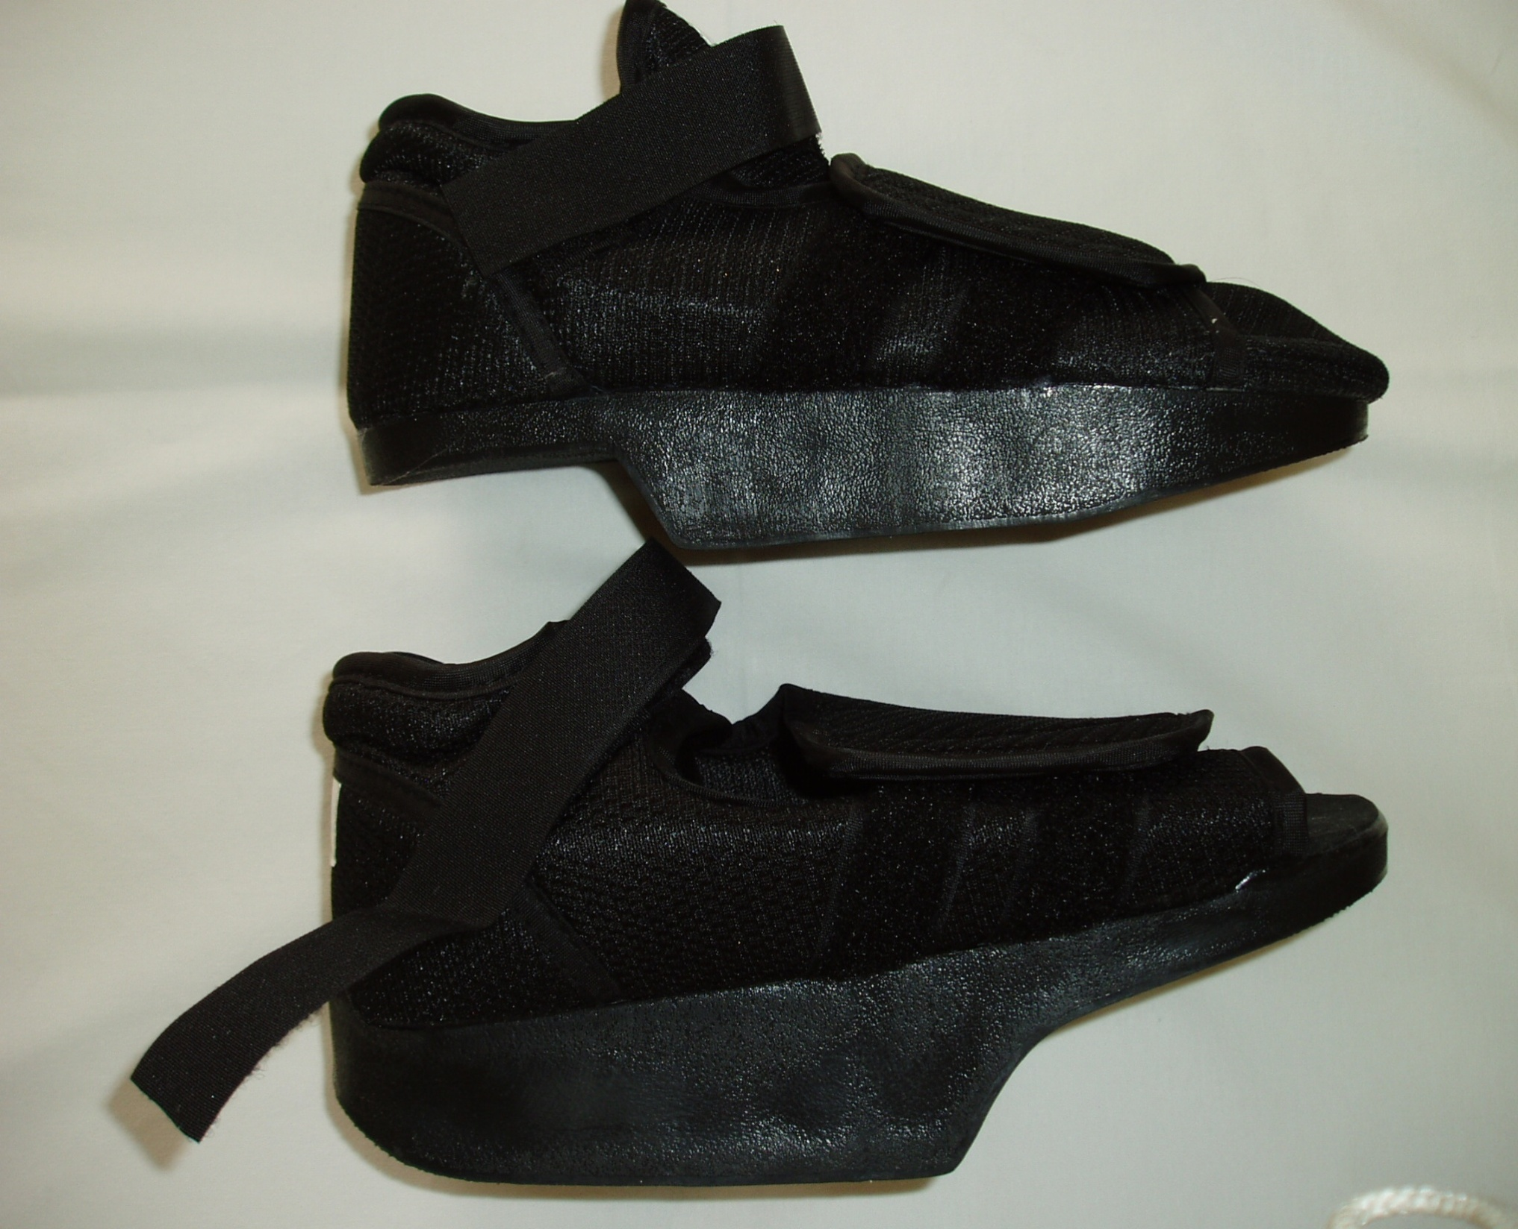

Slide 60
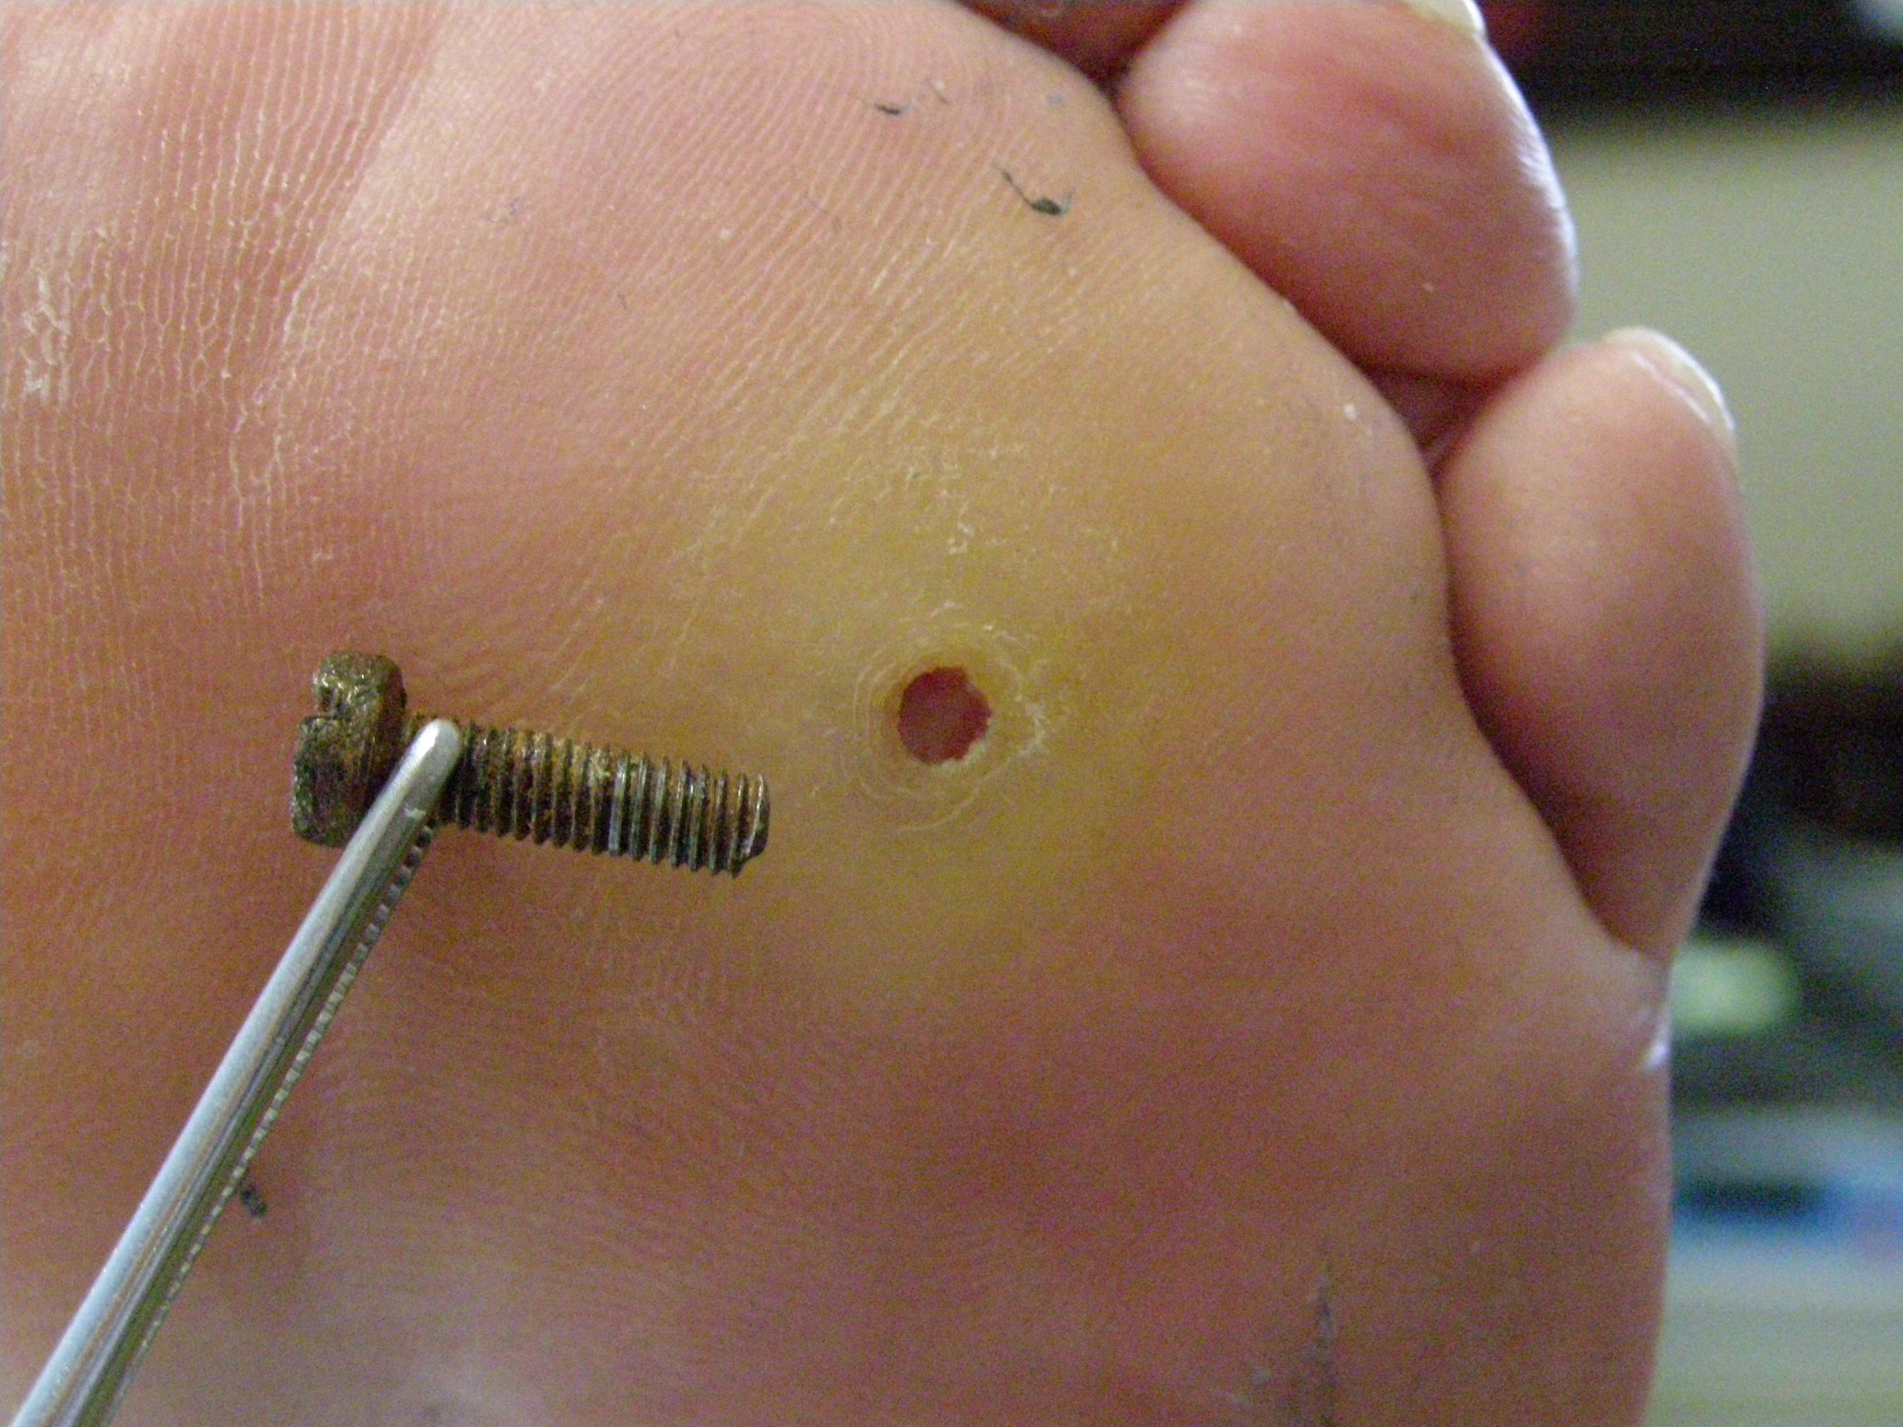
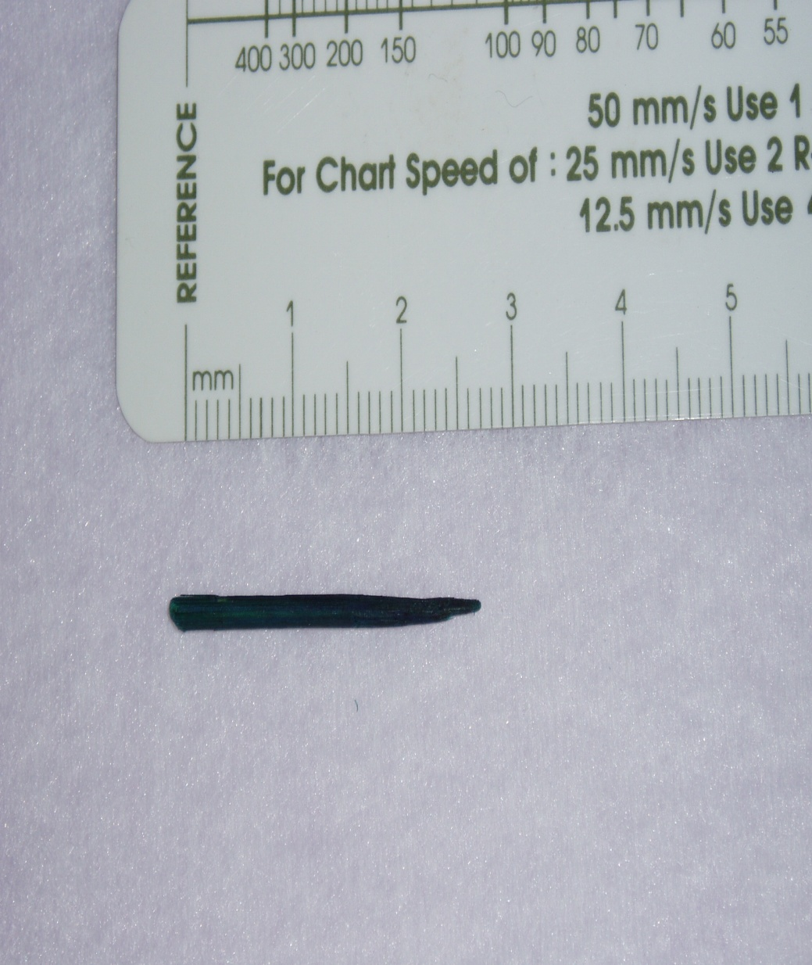
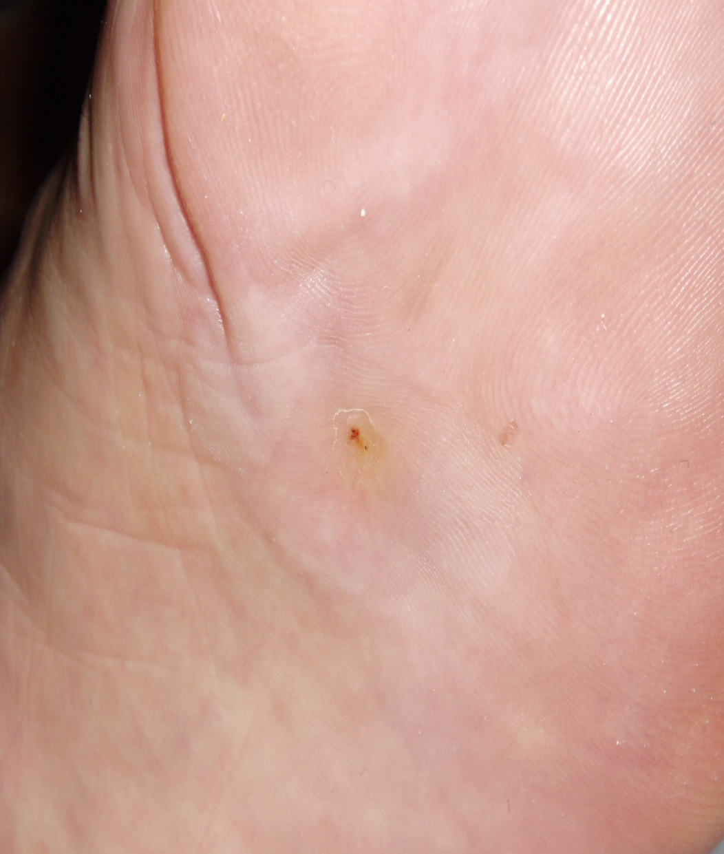

Slide 61

Other complications
Immune system
Psychic problems
…

Slide 62


What is the highest normal fasting blood glucose level?
ⓘ Start presenting to display the poll results on this slide.

Slide 63
It is not among the typical symptoms of the manifestation of diabetes:
ⓘ Start presenting to display the poll results on this slide.

Slide 64
Which of the listed chronic complications of diabetes is not a microvascular complication?
ⓘ Start presenting to display the poll results on this slide.

Slide 65

Notes:
65

