Slide 1


Inflammatory Diseases of Bowel
Jan Šťovíček

Slide 2
Classification of Inflammatory Diseases of Bowel
Location – small intestine, large intestine, rectum
Etiology – specific, non-specific
Involvement – diffuse, segmental
Course of the disease – Acute, subacute, chronic. Remision, relaps.

Slide 3
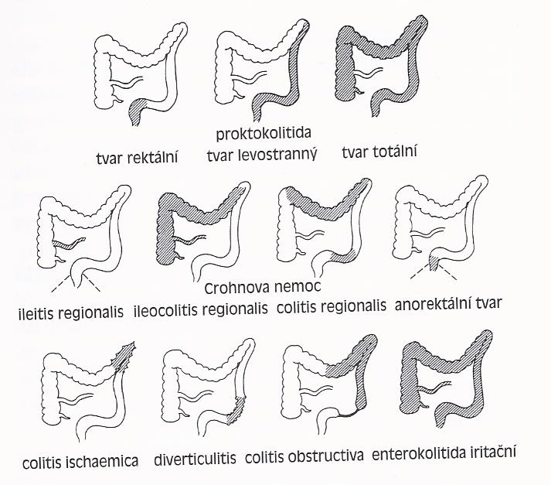
Classification of Inflammatory Diseases of Bowel
According to involvement – difuse, segmental

Slide 4
According to Etiology
Infectious colitis
Inflammatory Bowel Diseases (IBD)
Mikroscopic colitis
  Kolagenous colitis
  Lymfocytic colitis
Alergic colitis
Eozinophilic colitis

Slide 5
According to Etiology II
Endogenous etiology:
  Ischemic colitis
  Diverticulitis
  Linitis plastica
  Neutropennic enterocolitis

Slide 6
According to Etiology III
Exogenic etiology:
  Drugs, food
  Radiation proctitis
Colitis from mechanical reasons:
  Obstructive colitis
  Diversion colitis

Slide 7
Symptoms
Diarhea
Abdominal pain
Weight loss, malnutrition
Fever
Enterorhagia
Anemia
.... Or as complications.

Slide 8
Infectious colitis
Toxigenic strains – enterotoxin leads to secretory diarhea
Cytotoxic strains– cytotoxin
Invasive – pathogens are overcoming mucosal barier and initiating inflammatory reaction.
Adherent – destruction of cytoskeleton of sells

Slide 9
Toxigenic pathogens
Vibrio cholerae
Vibrio sp.
Aeromonas sp.
Plesiomonoas Shigelloides
Escherichia coli (různé kmeny – různé mechanismy: DAEC, EAEC, EHEC, EIEC, ETEC

Slide 10
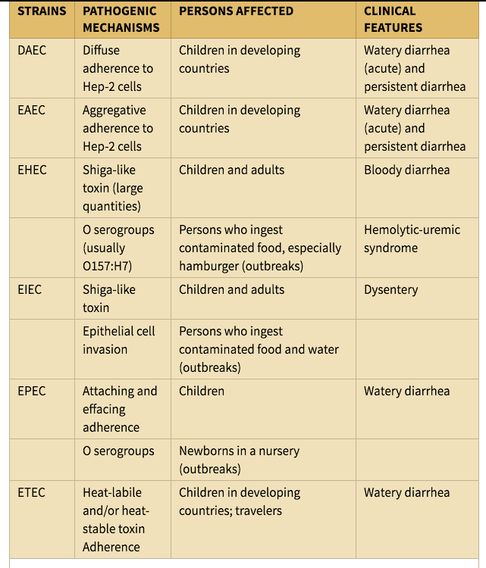

Slide 11
Invasive pathogens
Shigella sp.
Nontyphoidní Salomnellosy
Typhoidní Salmonellosa
Campylobacter Sp.
Yersinia enterocolitica

Slide 12
Viral enterocolitis
Rotavirus
Calicivirus
Adenovirus
Atrovirus
Torovirus

Slide 13
Bacterial Food Poisoning
Staphylococcus aureus
Clostridium perfringens (C.perfringens typ C - enteritis necroticans)
Listeria Sp. (gastrointestinal symptoms in immunocompromise patients)
Bacillus cereus (dyspepsia x diarhea)
Botulismus
Bacillus anthracis

Slide 14
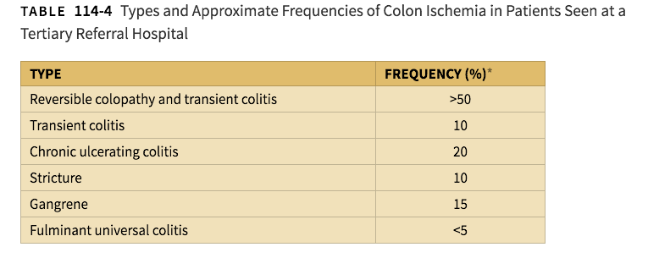
Ischemic colitis

Slide 15
Ischemic colitis
Segmental involvement:
23% lienal flexure
11% c. descendens – c. sigmoideum
8% ceacum, hepatic flexure
8% colon descendens
8% pancolitis

Slide 16
Ischemic colitis
Symptoms:
Diarhea, mucus and/or blood in stool, abdominal pain
Diagnoses:
Irrigography
CT
Coloscopy

Slide 17
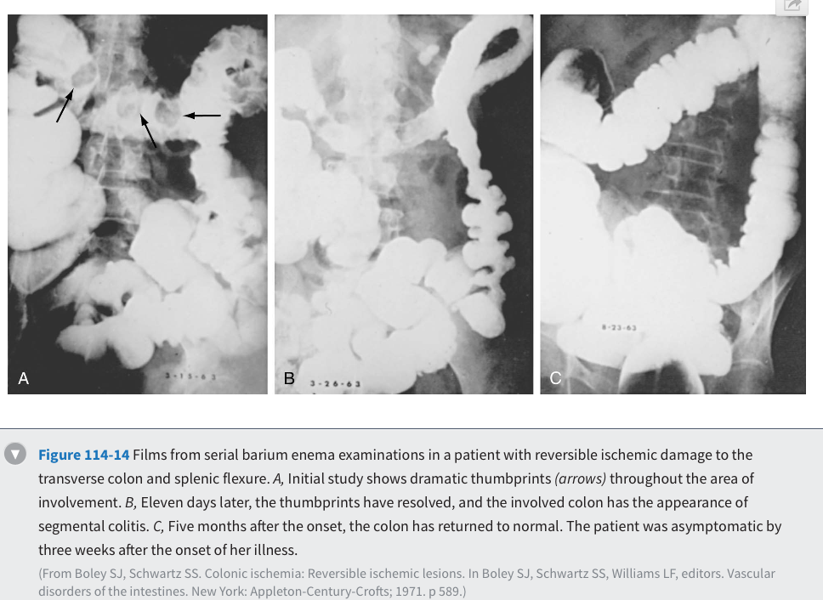

Slide 18
Radiation colitis
Acute:
In first weeks of therapy. Diarhea, pain, enterorhagia
Chronic:
Obliterative endarteritis leading to tissue ischeamia and fibroproductive changes.
Stenoses, ulcers, teleangiectasias

Slide 19
Diverticulosis
Asymtomatic x symptomatic
Incidence: 50. - 60. years 30 % osob, over 70 50%, over 85 66 %
Most symptoms asymptomatic or non-specific symptoms.

Slide 20
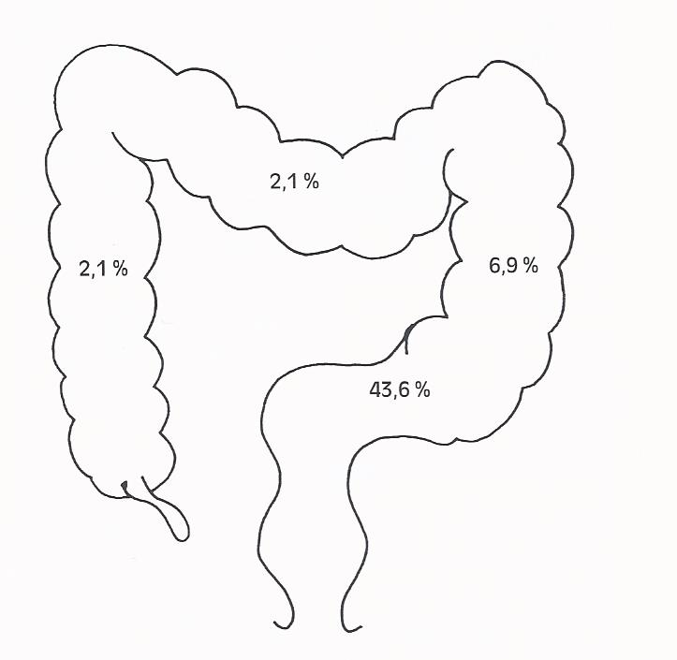
Diverticulitis

Slide 21
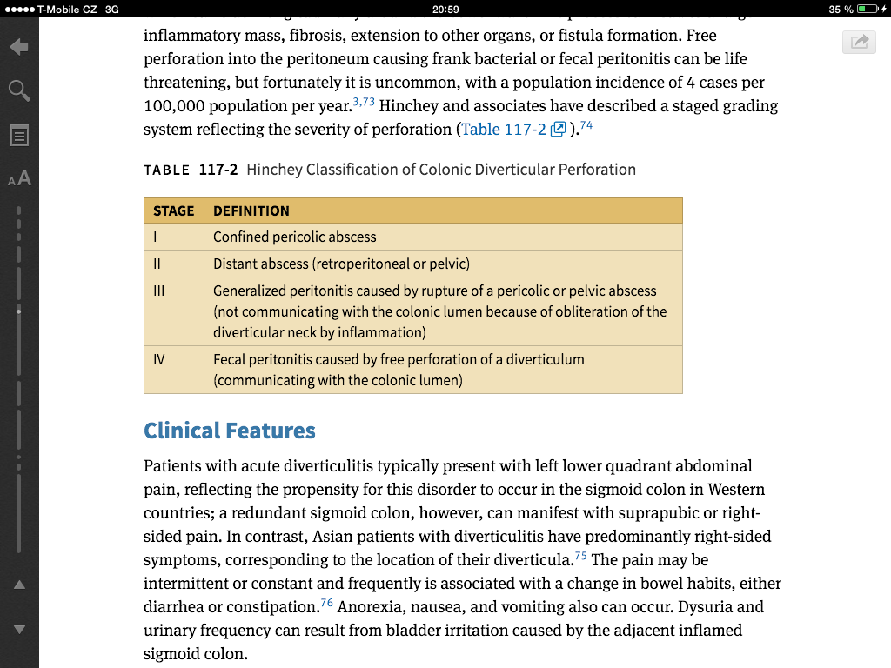
Diverticulitis - complications

Slide 22
Diverticulitis
Irrigography
CT, US
Coloscopy – danger of perforation, better to postpone – 4-6 weeks after the treatment

Slide 23
Inflammatory bowel diseases - IBD

Slide 24
IBD
Crohn disease:
    Chronic, non-specivic inflammation fo small or large bowel or both, segmental or plurisegmental, transmural, granulomatous
Ulcerative colitis:
  Non-specific, just rectum or more – just the large bowel
Gastroenterologie, Mařatka

Slide 25


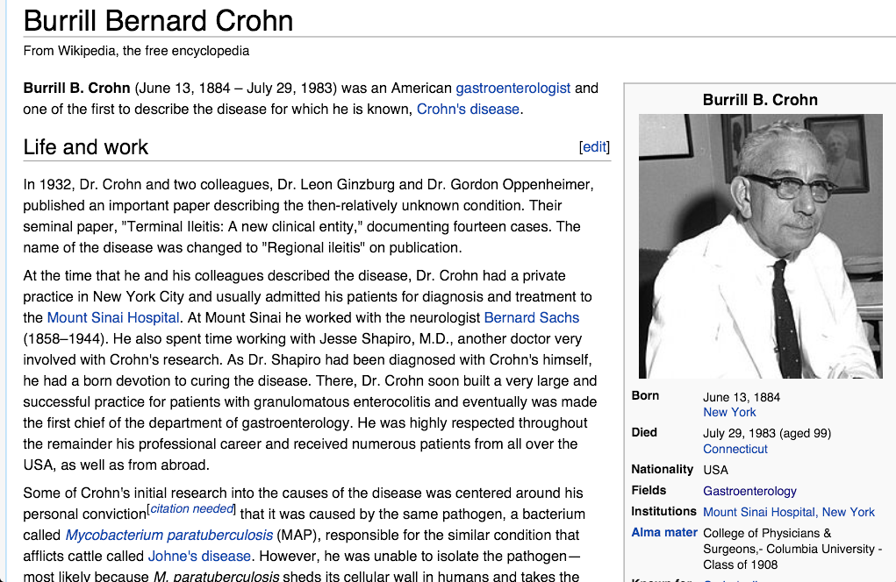
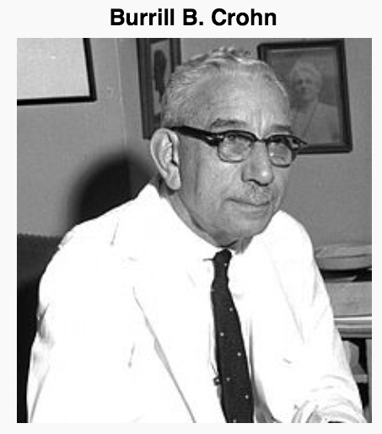
History

Slide 26
Figure 1
Epidemiology
M.Crohn:
Women x men ratio 1,3 : 1
Mostly 15 – 30 yers
Ulcerative colitis:
In any age, mostly 2nd and 3rd decade, second peak 60-70 years.
Women x men ratio 1 : 1
Notes:
The global map of inflammatory bowel disease: red refers to annual incidence greater than 10/105, orange to incidence of 5–10/105, green to incidence less than 4/105, yellow to low incidence that is continuously increasing. Absence of color indicates absence of data.

Slide 27
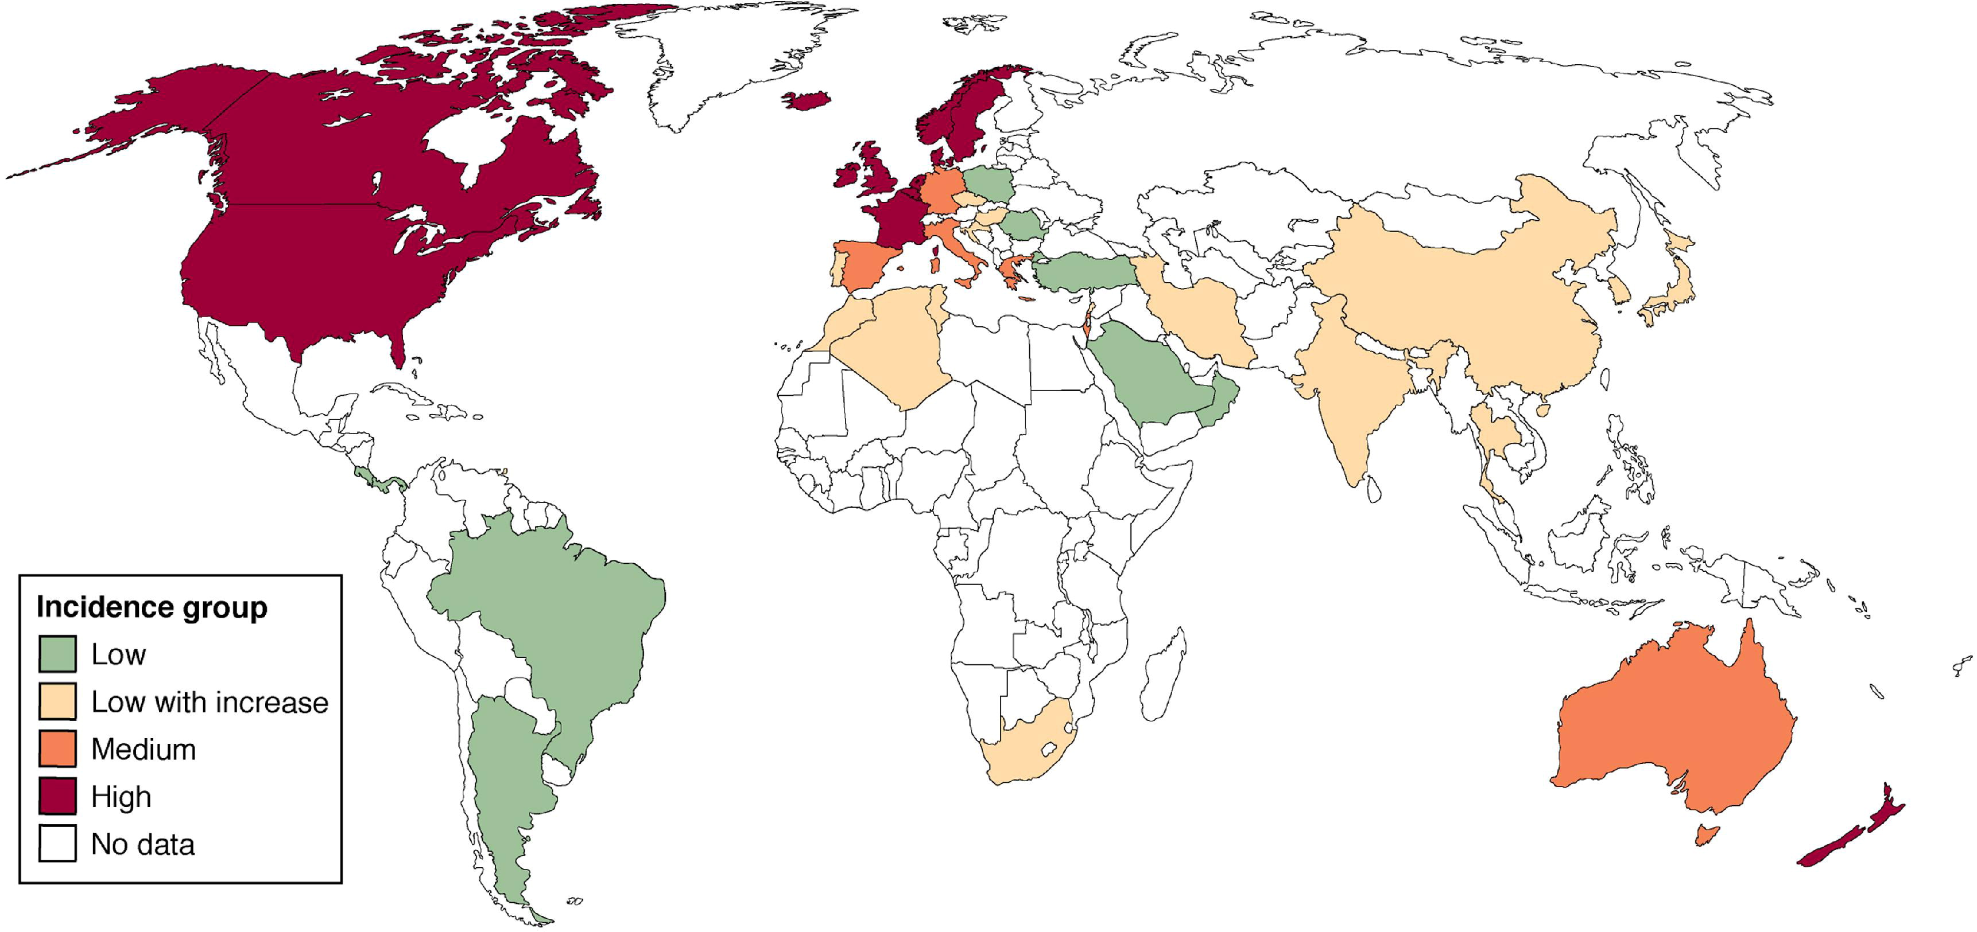

Figure 1
Incidence MC in world
Source: Gastroenterology 2011; 140:1785-1794.e4 (DOI:10.1053/j.gastro.2011.01.055 )
Notes:
The global map of inflammatory bowel disease: red refers to annual incidence greater than 10/105, orange to incidence of 5–10/105, green to incidence less than 4/105, yellow to low incidence that is continuously increasing. Absence of color indicates absence of data.

Slide 28
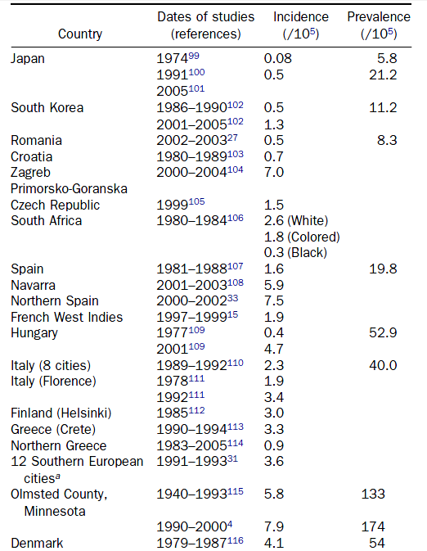
Figure 1
Incidence MC in world
COSNES ET AL, GASTROENTEROLOGY 2011,
Copyright © 2011 AGA Institute Terms and Conditions
Notes:
The global map of inflammatory bowel disease: red refers to annual incidence greater than 10/105, orange to incidence of 5–10/105, green to incidence less than 4/105, yellow to low incidence that is continuously increasing. Absence of color indicates absence of data.

Slide 29
Figure 1
Incidence UC in world
Incidence 1,5 – 20,3 /100 000 / year
Prevalence 31 – 242 / 100 000 / year
Geografic differencies (north x south)
Notes:
The global map of inflammatory bowel disease: red refers to annual incidence greater than 10/105, orange to incidence of 5–10/105, green to incidence less than 4/105, yellow to low incidence that is continuously increasing. Absence of color indicates absence of data.

Slide 30
Etiopatogeneses
Trigger mechanism
Genetic disposition
Environment
Immune reaction
Notes:
Gene

Slide 31
Trigger mechanism
Infection (chlamydia, Listeria monocytogenes, cell-wall–deficient Pseudomonas species, reovirus, … Paramyxovirus, Mycobacterium paratuberculosis)
Comensal microbiota
Notes:
Many infectious agents have been proposed as the cause of Crohn's disease including chlamydia, Listeria monocytogenes, cell-wall–deficient Pseudomonas species, reovirus, and many others. Paramyxovirus (measles virus) has been implicated etiologically in Crohn's disease as a cause of granulomatous vasculitis and microinfarcts of the intestine,[36] but a proposed association between early measles vaccination and Crohn's disease largely has been disproved

Slide 32
Genetic disposition
Risk for relatives - 14 – 15x higher then in general population.
Minimally 30 genes connected with MC
NOD2/CARD15 – 2001 – more found in younger age, ileal location, tendency to stricturing phenotype, 20% - 30% CD patients, penetration less then 1%.

Slide 33
Genes
CHROMOSOME | GENES OR LOCI
1p13 | PTPN22
1p31 | IL23R
1q23 | ITLN1
1q24 | —
1q32 | 3 genes
2q37 | ATG16L1
3p21 | 35 genes
5p13 | —
5q31 | 7 genes
5q33 | IRGM
5q3 | IL12B
6p22 | CDKAL1
6q21 | —
6q27 | CCR6
7p12 | —
8q24 | —
9p24 | JAK2
9q32 | TNFSF15
10p11 | 3 genes
10q21 | ZNF365
10q24 | NKX2-3
11q13 | C11orf30
12q12 | 3 genes
13q14 | 3 genes
16q12 | NOD2
17q21 | 17 genes
17q21 | 4 genes
18p11 | PTPN2
21q21 | —
21q22 | ICOSLG

Slide 34
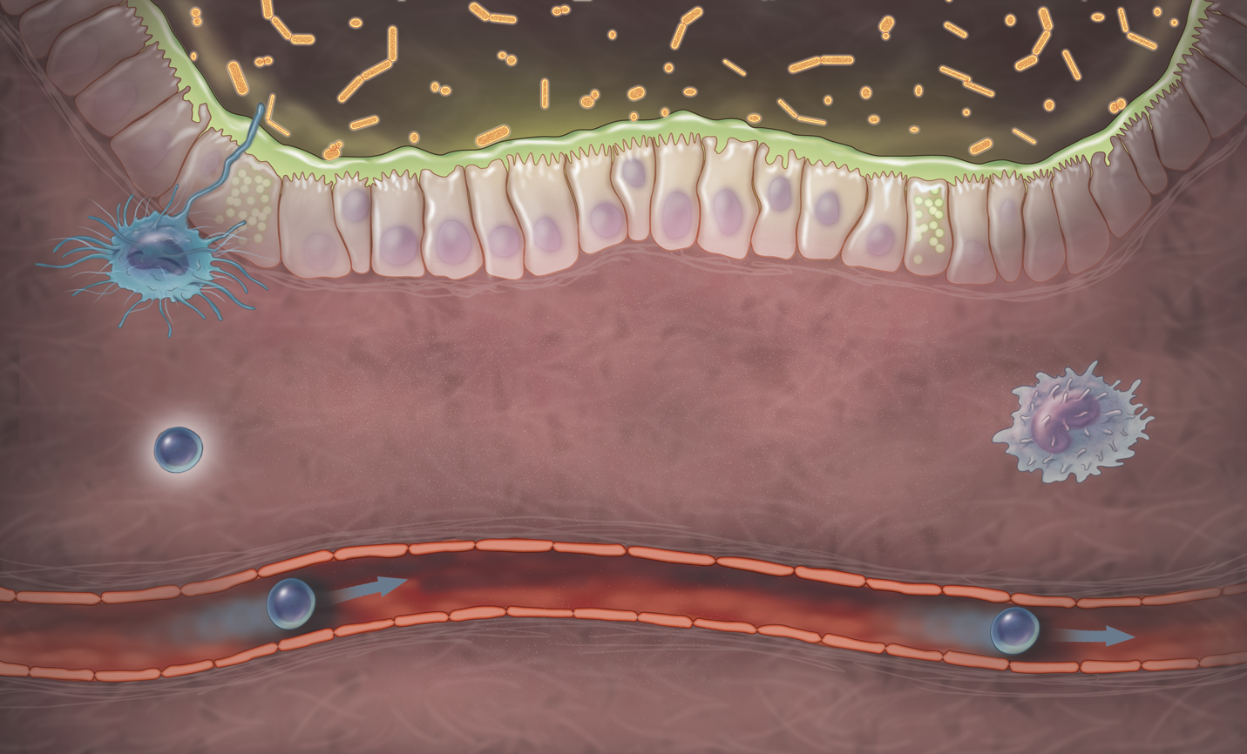
Normal GI tract has a crucial role in immune response
Immunity
Bacteria and dietary antigens within gut lumen
Protective
mucus layer
Epithelium
Tight junctions
between cells
Dendritic cell (antigen presenting cell)
Lamina propria
Lymphocyte
Macrophage
Circulating lymphocyte
GI, gastrointestinal
Corthesy B, et al. J Nutr 2007;137(3 Suppl 2):781S–790S.
Notes:
Key communication point: The gastrointestinal (GI) tract has a key role in regulating normal immune responses.
Discussion points:
1. Regulation of local immunity is an important function of the GI tract.
2. Disruption of regulatory functions may lead to exacerbated immune responses.
Background:
This slide shows the basic elements of the immune system within the GI environment, including presence of antigenic materials in the gut lumen, the ability to identify them (dendritic cells [DC]) and create an immune response (lymphocytes).
Commensal bacteria are an important stimulus for the maturation of local immunity and help maintain a tolerance to intestinal bacteria through continuous stimulation under non-inflammatory conditions.
DC are antigen-presenting cells that process antigen material and present it on the cell surface to the T cells (lymphocytes) of the immune system. In addition, dendrite protrusions may cross the epithelial junctions to ‘sample’ bacteria from the lumen, anchoring between epithelial cells through receptors for the tight junction protein.
At the intestinal epithelial level, microbiota has a positive impact on immune regulatory functions of the gut and may allow beneficial effects through transient colonisation and/or release of bioactive compounds. This translates into reinforcement of the intestinal barrier as well as direct modulation of epithelial cell functions, including cytokine and chemokine release. Although a limited event, translocation of bacteria to the lamina propria may affect innate and adaptive immunity by activating production of cytokines by monocytes/macrophages.
Engulfment of commensal bacteria by DC present microbial antigens to naïve T cells in Peyer’s patches and mesenteric lymph nodes (not shown). This allows an IgA antibody-mediated mucosal response to occur, preventing bacterial overgrowth and spread beyond mesenteric lymph nodes; this is also the process used in oral vaccinations. The same processing pathway plays a critical role in shaping the mucosal immune system towards a non-inflammatory, tolerogenic pattern through the induction of regulatory T cells.
Reference:
1. Corthesy B, Gaskins R, Mercenier A. Cross-talk between probiotic bacteria and the host immune system. J Nutr 2007;137(3):781S–790S.

Slide 35
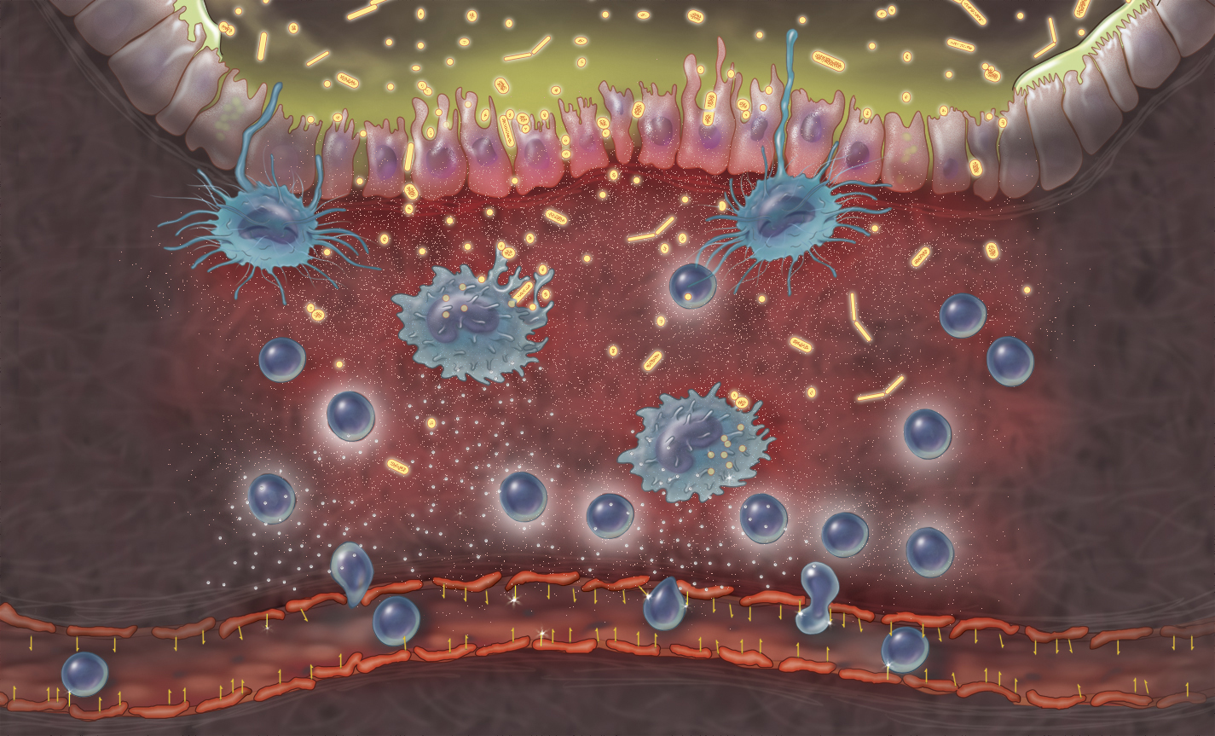
Tissue injury
Tissue injury can lead to disruption of gut physiology and
activation of a localised immune response
Inappropriate and sustained recruitment of inflammatory T cells
Infiltrating lymphocytes
Vascular permeability
1. Lee SC, et al. J Immunol 2000;164(6):3392–3401; 2. Hanauer SB. Inflamm Bowel Dis 2006;12(Suppl 1):S3–S9;
3. Xavier RJ, et al. Nature 2007;448(7152):427–434.
Notes:
Key communication point: Tissue injury can lead to disruption of gut physiology and activation of a localised gut immune response.
Discussion points:
1. Multiple processes are associated with inflammatory response within the GI tract.
Background:
Multiple inflammatory cell types, including neutrophils, macrophages, dendritic cells and lymphocytes, participate in the pathogenesis of IBD, with lymphocytes having a central role in the induction and maintenance of the chronic inflammatory process in the lamina propria.¹
The characteristic inflammatory response begins with an infiltration of neutrophils and macrophages, which then release chemokines and cytokines.² These in turn activate T-helper cells in the gut mucosa, increase the expression of integrin-cellular adhesion molecules on the vasculature walls (with an associated transmigration of lymphocytes³) and exacerbate the dysfunctional immune response.²
Despite expression of adhesion molecules in the vasculature of normal small intestine and colon, the relative area of endothelium-expressing adhesion molecules increases in inflammatory settings. Increased expression is most obvious in sections containing multifocal inflammatory disease.⁴ Infiltration of the GI tract by T lymphocytes is a well documented pathogenic mechanism of IBD, and the molecular mechanisms by which these lymphocytes enter the gut are distinct from those in other peripheral tissues.¹
Slide references
1. Lee SC, Brummet M, Shahabuddin S, et al. Cutaneous injection of human subjects with macrophage inflammatory protein-1 alpha induces significant recruitment of neutrophils and monocytes. J Immunol 2000;164(6):3392–3401.
2. Hanauer SB. Inflammatory bowel disease: epidemiology, pathogenesis, and therapeutic opportunities. Inflamm Bowel Dis 2006;12(Suppl 1):S3–S9.
3. Xavier RJ, Podolsky D. Unravelling the pathogenesis of inflammatory bowel disease. Nature 2007;448(7152):427–434.
Note references
1. Soler D, Chapman T, Yang L-L, et al. The binding specificity and selective antagonism of vedolizumab, an anti-47 integrin therapeutic antibody in development for inflammatory bowel diseases. J Pharmacol Exp Ther 2009;330(3):864–875.
2. Hanauer SB. Inflammatory bowel disease: epidemiology, pathogenesis, and therapeutic opportunities. Inflamm Bowel Dis 2006;12(Suppl 1):S3–S9.
3. Fukatsu K, Kudsk K. Nutrition and gut immunity. Surg Clin North Am 2011;91(4):755–770.
4. Briskin M, Winsor-Hines D, Shyjan A, et al. Human mucosal addressin cell adhesion molecule-1 is preferentially expressed in intestinal tract and associated lymphoid tissue. Am J Pathol 1997;151(1):97–110.

Slide 36
Environment
Geographic distribution
Smoking (UC – non-smokers, CD – smokers)

Slide 37
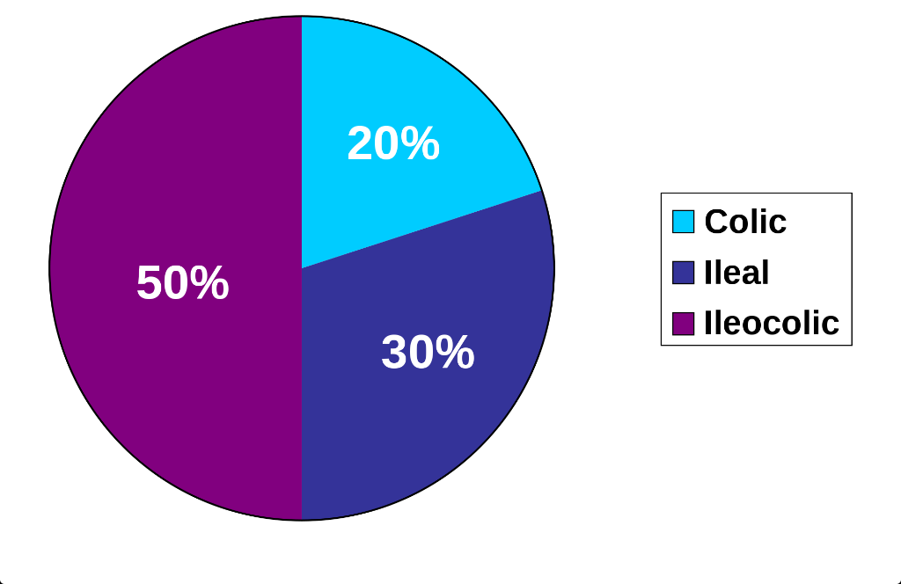
Phenotype of CD
Figure 2
Notes:
Cumulative rate of remaining free of intestinal penetrating or stricturing complications in ileal (left) and colonic (right) CD. Perianal complications were not taken into account. Data were obtained from the studies at St-Antoine hospital that included 1448 patients with ileal disease (L1) and 1129 patients with colonic disease (L2). © Acta Gastro-Enterologica Belgica (Cosnes J, Acta Gastroenterol Belg 2008;71:303–307), reproduced with permission.

Slide 38
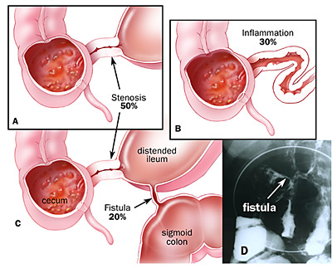
Phenotype of CD
Figure 2
Vídeňská klasifikace
Notes:
Cumulative rate of remaining free of intestinal penetrating or stricturing complications in ileal (left) and colonic (right) CD. Perianal complications were not taken into account. Data were obtained from the studies at St-Antoine hospital that included 1448 patients with ileal disease (L1) and 1129 patients with colonic disease (L2). © Acta Gastro-Enterologica Belgica (Cosnes J, Acta Gastroenterol Belg 2008;71:303–307), reproduced with permission.

Slide 39
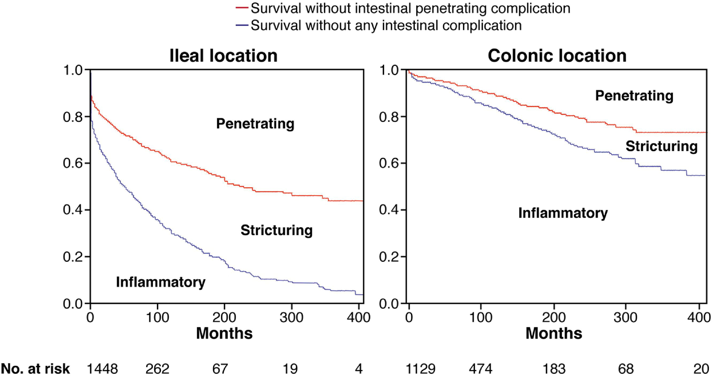
Phenotype of CD
Figure 2
Source: Gastroenterology 2011; 140:1785-1794.e4 (DOI:10.1053/j.gastro.2011.01.055 )
Notes:
Cumulative rate of remaining free of intestinal penetrating or stricturing complications in ileal (left) and colonic (right) CD. Perianal complications were not taken into account. Data were obtained from the studies at St-Antoine hospital that included 1448 patients with ileal disease (L1) and 1129 patients with colonic disease (L2). © Acta Gastro-Enterologica Belgica (Cosnes J, Acta Gastroenterol Belg 2008;71:303–307), reproduced with permission.

Slide 40
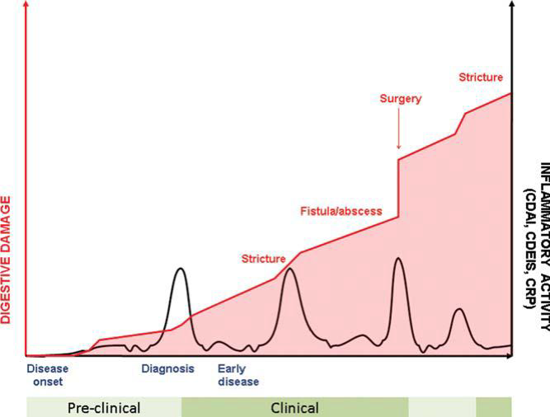
Phenotype of CD
Figure 2
Pariente B. Inflamm Bowel Dis 2011;17:1415
Notes:
Cumulative rate of remaining free of intestinal penetrating or stricturing complications in ileal (left) and colonic (right) CD. Perianal complications were not taken into account. Data were obtained from the studies at St-Antoine hospital that included 1448 patients with ileal disease (L1) and 1129 patients with colonic disease (L2). © Acta Gastro-Enterologica Belgica (Cosnes J, Acta Gastroenterol Belg 2008;71:303–307), reproduced with permission.

Slide 41
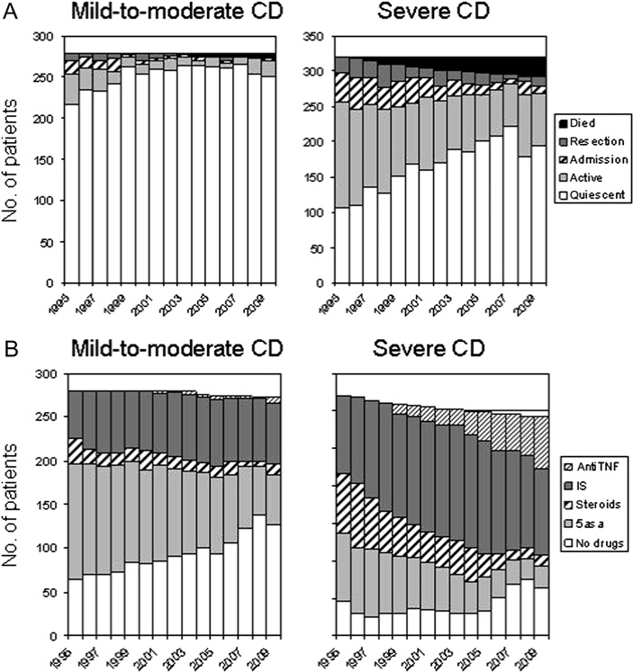
Figure 2
Course of CD - progression?
Cosnes et al., Gut 2012
Notes:
U těžké choroby po 15 letech při stejném procentu imunosupresivní léčby větší procento inaktivních – spontánní vyhasnutí?

Slide 42
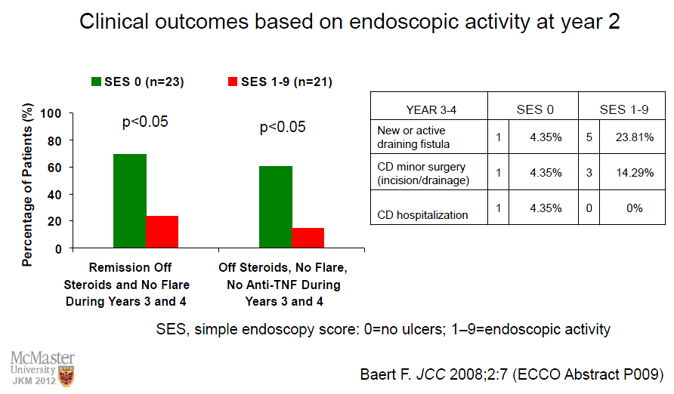
Mucosal healing
Mucosal healing predict the disease course.

Slide 43
Risk Factors of progresive CD
Younger age
Smokers
Rectal involvement
Perianal involvement
Extensive involvement of small bowel
Upper GI tract
Early stenosing/penetrating disease
Deep ulcers in large bowel

Slide 44
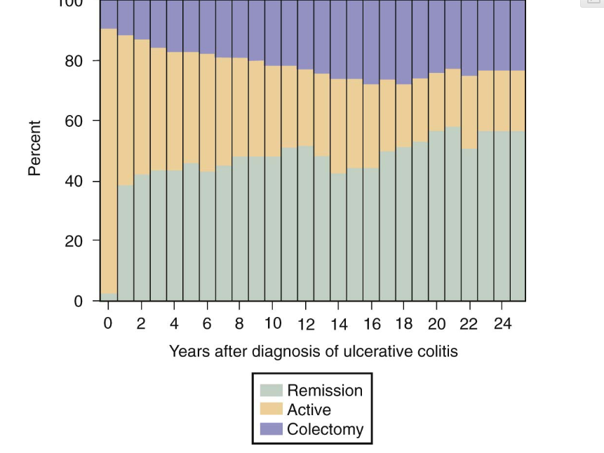
UC – Course of the disease
Notes:
Many infectious agents have been proposed as the cause of Crohn's disease including chlamydia, Listeria monocytogenes, cell-wall–deficient Pseudomonas species, reovirus, and many others. Paramyxovirus (measles virus) has been implicated etiologically in Crohn's disease as a cause of granulomatous vasculitis and microinfarcts of the intestine,[36] but a proposed association between early measles vaccination and Crohn's disease largely has been disproved

Slide 45
Symptoms
Diarhea
Abdominal pain
Weight loss, malnutrition
Fever
Anemia
.... Or as complications.

Slide 46
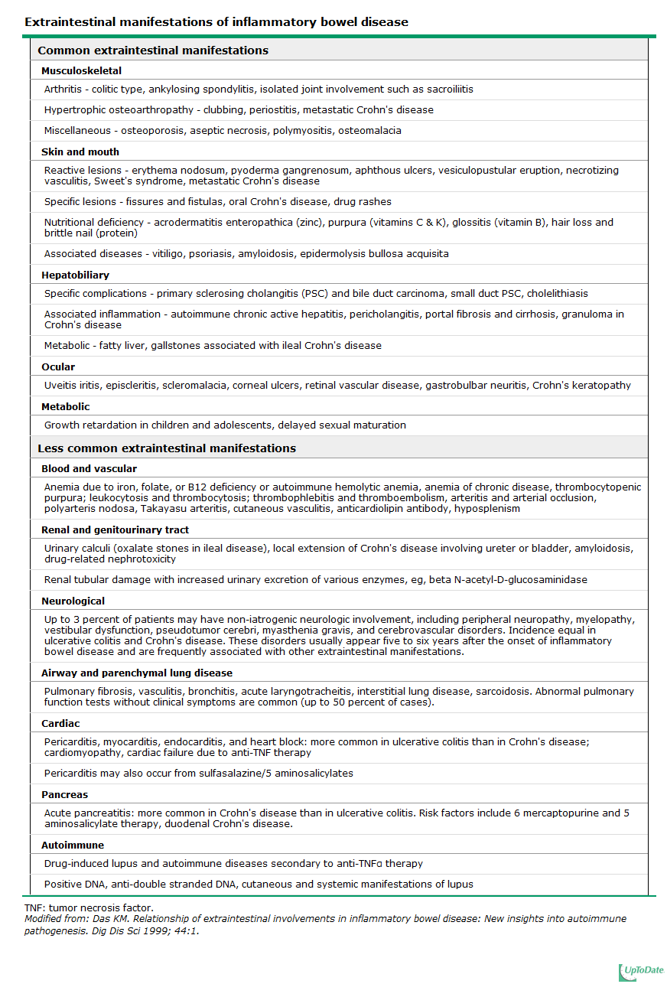
Extraintestinal symptoms

Slide 47
Extraintestinal symptoms

Slide 48
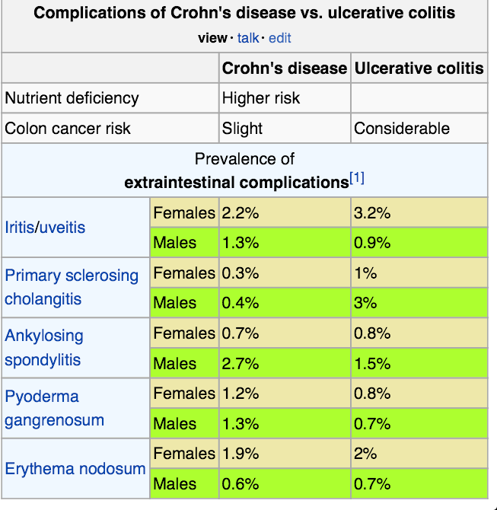
Extraintestinal symptoms

Slide 49
Diagnoses
History
Physical examination
Morfological investigation
Laboratory tests
Diagnostic Conclusion
Doporučené postupy při diagnostice a léčbě IBD, listopad 2001

Slide 50
Morfological Investigation
Coloscopy with biopsie (terminal ileum intubation)
Gastroscopy, enteroscopy, capsule enteroscopy
Radiology – enterography (CT, MR), irrigography, fistulography, MR – pelvic floor, abdominal X-ray, US, CT

Slide 51
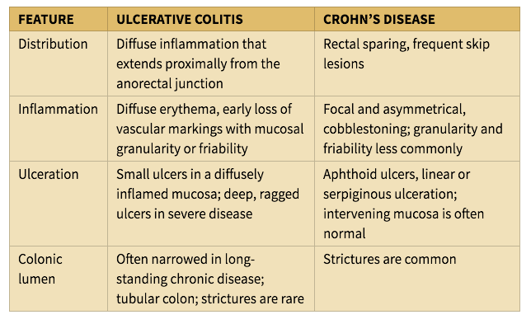
IBD - differencies
  UC i CD colitis could be similar!
Notes:
Many infectious agents have been proposed as the cause of Crohn's disease including chlamydia, Listeria monocytogenes, cell-wall–deficient Pseudomonas species, reovirus, and many others. Paramyxovirus (measles virus) has been implicated etiologically in Crohn's disease as a cause of granulomatous vasculitis and microinfarcts of the intestine,[36] but a proposed association between early measles vaccination and Crohn's disease largely has been disproved

Slide 52
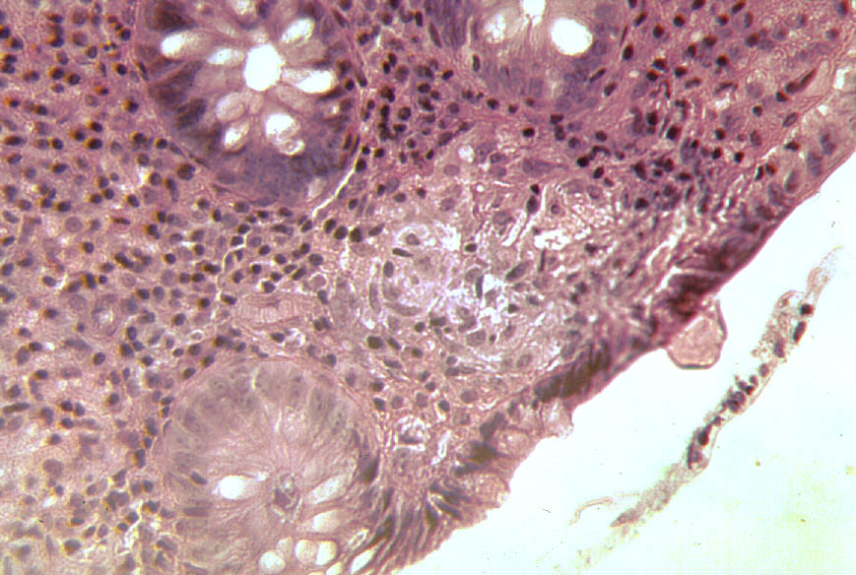
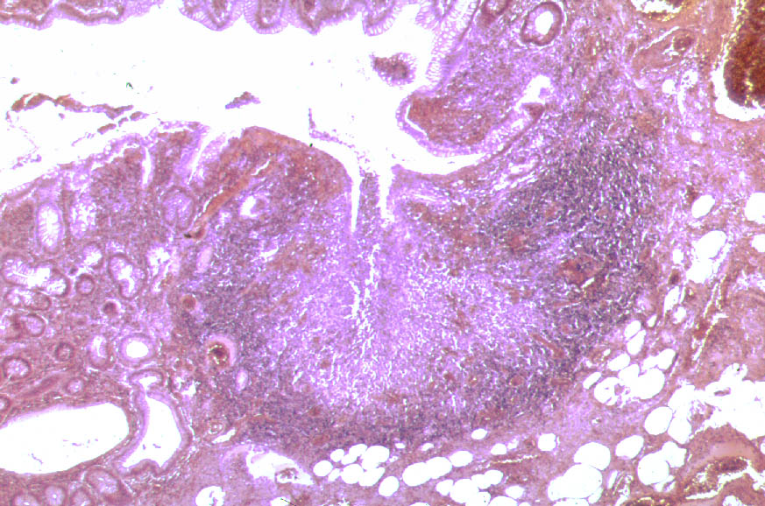
CD - histology
Mikrogranuloma
Aftous ulcer

Slide 53
Lab Tests
To confirm diagnoses
Bakterias, parasites
ASCA, ANCA
2. To evaluate activity of disease
KO, CRP, calprotectin in stool
To evaluate complications
Liver enzymes, prealbumin, protein, cholesterol, iron, urea, creatinin, urine
4. To monitor therapy
Level of infliximab/adalimumab, atibodies against infliximabu/adalimumabu

Slide 54
Stool
Bacterias: Yersinia enterocolitica a pseudotuberculosis, Campylobacter jejuni, Salmonela enteritidis
Parasites
Calprotectin
Notes:
Calprotectin je kalcium vazebný protein s antimikrobiální aktivitou molekulové hmotnosti 36.5 kD složený ze dvou těžkých řetězců a jednoho lehkého řetězce, odvozený především od monocytů a neutrofilů. Calprotectin jako marker stanovený ve stolici vykazuje nižší variabilitu než hemoglobin a je vhodným ukazatelem při diagnostice i monitorování terapie střevních zánětlivých onemocnění - ulcerózní kolitidy a Crohnovy choroby, nebo nekrotizující enterokolitidy u dětí. Stanovení koncentrace ve vzorku stolice s cut-off hodnotou 30 mg/l vykazuje specificitu 97% a senzitivitu 100% pro diferenciální diagnostiku mezi akutní Crohnovou chorobou a syndromem IBS (irritable bowel syndrome). Calprotectin ve stolici je rovněž testován jako marker kolorektálního karcinomu, většina uvedených citací srovnává stanovení calprotectinu s testem FOB, který je běžným screeningovým testem kolorektálních tumorů..

Slide 55
ANCA, ASCA
MORBUS CROHN
ASCA+/pANCA-
ULCEROSNÍ COLITIS
pANCA+/ASCA-

Slide 56
Diagnostic Conclusion
Diagnoses
Location
Disease activity
Complications

Slide 57
IBD therapy
1. Farmacological
Aminosalicylates
Antibiotics
Probiotics
Corticosteroids
Imunosupresives
Biologic therapy
Enteral and parenteral nutrition
Supportive treatment
2. Surgery
3. Experimental therapy
Helmintotherapy
Cytapheresis (granulocytaferéza, leukocytaferéza, lymfocytaferéza)

Slide 58
Convetional and conservative treatment of IBD succesful in 40 - 70% of IBD patients!

Slide 59
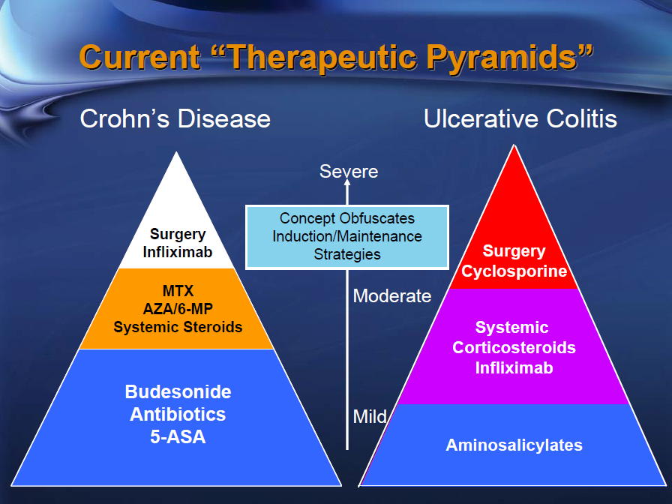
Principals of Therapy

