Slide 1
Chronic hepatitis/hepatopathy Liver cirrhosis
Department of Internal Medicine
Second Faculty of Medicine, Charles University
and Motol University Hospital

Slide 2
Chronic liver disorders
early diagnosis and treatment
to prevent liver fibrosis and cirrhosis

Slide 3
Types of liver diseases sorted by etiology
 | hepatocytes | biliary tree
INFECTIOUS
TOXIC
METABOLIC (impairment of metabolism and/or of transport)
AUTOIMMUNE
TUMOROUS
VASCULAR

Slide 4
The most common chronic hepatopathy
alcoholic liver disorders
NASH
chronic hepatitis C, chronic hepatitis B, B+D
autoimune hepatitis
cholestatic liver disorders
PBC – primary bilary cholangitis
PSC – primary sclerosing cholangitis
Wilson disease
hereditary hemochromatosis
deficit alfa-1 antitrypsinu

Slide 5
AUTOIMMUNE LIVER DISEASE
hepatocytes | biliary tree = cholestatic disorders
autoimmune hepatitis (AIH) typ I, II, III | PBC (primary biliary cholangitis) PSC (primary sclerosing cholangitis) IgG4 associated cholangitis
overlap syndromes AIH/PBC, AIH/PSC, AIH/chronic hepatitis C
Target cells for autoimmune reaction are:
hepatocytes (in AIH)
cholangiocytes of proximal bile ducts (in PBC)
of distal bile ducts (in PSC and IgG4 ass.cholangitis)

Slide 6
Autoimmune hepatitis (AIH)
AIH 4x frequent in F
AIH relatively common in childhood (typ II) and young women
typically: chronic hepatitis (2 % of all chron. hep.)
progressive necro-inflammatory process
→ progression to fibrosis →→ cirrhosis
BUT:
1/3 of cases: acute hepatitis (icterus, ↑↑↑ ALT a AST), also fulminant
it could be also random dg.

Slide 7
Aminotransferases ~ hepatocyte integrity ~ histological activity of hepatic inflammation
AST (up to 0,92 μkat/l)
ALT (up to 0,73 μkat/l)
hepatocyte
cytoplasm
hepatocyte
cytoplasm
mitochondria
skeletal muscle, cardiac muscle
(lung, pancreas, spleen, kidney)

Slide 8
AIH – immunological diagnostis
serum protein ELFO: ↑ Ig (polyclonal)
ANA (anti-nuclear Ab)
ASMA (anti-smooth muscle Ab)
AAA (anti-actin Ab)
SLA (soluble liver antigen Ab)
anti-LKM (anti-liver kidney microsomal antigen 1)
- against proteins of ER in hepatocytes and proxim.tub.
+ in DILI (drug inducer liver injury) and chron. HCV
anti-ASGPR (anti-asialoglykoprotein receptor Ab)
+ in PBC, PSC, and other hepatitis
anti-LC1 (anti-liver cytosol 1 Ab) the most specific – in ?dg
anti-LP (anti-liver pancreatic antigen)

Slide 9
AIH
AIT type I - associace with other AI disease: pernicious anemia, AIHA, autoimmune thyroiditis
AIH type I: + AMA, + ASMA, (pANCA, cANCA, anti-dsDNA)
younger women, tendency to progress to cirrhosis
AIH type II: + anti-LKM
subtype II b: + anti HCV (HCV-RNA)
AIH typ III: + SLA (clinically like typ I)

Slide 10
AIH - histology
1/ characteristic (not pathognomonic – dif. dg. viral or toxic hepatitis) :
in portal tracts:
infiltrate of lymfocytes and plasma cells) (interface hepatitis) → piecemeal necrosis→ bridging necrosis → fibrotisation→→
…grading (inflammation)
…stading (fibrotisation)
bile ducts intact
bile duct

Slide 11
If dg. ? → scoring systems (basis)
+ point:
F, ALP/AST < 1,5
Ig ˃ 2x ULN
autoantibodies
histology:
periportal inflammation (interface hepatitis)
infiltrate of lymfocytes and plasma cells
other AI disease
- point:
M; ALP/AST ˃ 3
alcohol consumption ˃ 60g/d
hepatotoxic drugs
active viral infection
AMA

Slide 12
Therapy of AIH
immunosuppressive drugs
glucocortikoids: prednison 40-60 mg/d – ↓ after the efect of therapy (AST, ALT activity) … 20 mg/d
azathioprine 50-100 mg/d
other immunosuppressants (cyclosporin, tacrolimus, mycofenolate mofetil)
relapsing; HCC is rare
Liver Tx (fulminant AIH, cirrhosis)

Slide 13
AUTOIMMUNE LIVER DISEASE
hepatocytes | biliary tree = cholestatic liver disorders
autoimmune hepatitis (AIH) typ I, II, III IgG4 hepatitis | PBC (primary biliary cholangitis) AIC (autoimmune cholangitis) PSC (primary sclerosing cholangitis) IgG4 associated cholangitis
overlap syndromes AIH/PBC, AIH/PSC, AIH/chronic hepatitis C

Slide 14
Cholestatic liver diseases
chronic cholestasis – more than 6 month
ALP ˃ 1,5x ULN
GGT ˃ 3x ULN

Slide 15
Cholestatic, (obstructive, excretory) liver tests:
ALP (0,6-2,6 μkat/l)
GGT (0,2-0,8 μkat/l)
liver isoenzyme
bone iso.
↑ : childhood (bone growth)
↑ : bone turnover: fractures,
mets, Paget disease
intestinal, placental iso.(pregnancy)
bilirubin: normal: anicteric cholestasis
↑: icteric cholestasis = cholestatic icterus
↑ cholesterol

Slide 16
PBC
Histology staging:
lymphocytic infiltrate (florid ductal lesion) in portal tracts with granulomatous desctruction of portal bile ducts → ductopenia (vanishing bile duct syndrome) → acute and chronic cholestatic changes (bilirubinostasis, …)
portal/periportal inflammation
marginal proliferation of small bile ducts
3. fibrosis (portal→periportal→
cirrhosis →→→ HCC
Clinical features:
pruritus…jaundice
xantomas (retained cholesterol)
steatorhea (vit D deficiency…)

Slide 17
PSC
periductal inflammation and obliterative fibrosis of extrahepatic and intrahepatic bile ducts → segmental stenosis
→ dilation of preserved segments
Histology: „onion skin“ fibrosis

Slide 18
PBC: microscopic bile ducts
v 90-95 % in F
pruritus (anicteric cholestasis)
precedes dg. of PBC
icterus – unfauvorable sign
↑ IgM, +AMA (M2), ev. ANA
abdominal US for dif. dg.
histology in dg.
PSC: macroscopic bile ducts
M:F = 2:1
in 80 % precedes UC (less mC)
icterus, cholangoitídy hnisavé →
secondary biliary cirrhosis and
cholangiocarcinoma (Ca 19-9)
(ANA, ASMA)
ERCP, MRCP
(liver biopsy not dg.)

Slide 19
Therapy of PBC and PSC
UDCA 15 – 20 mg/kg daily, improves/not improves survival
UDCA + glucocorticoid (budesonid)
2nd linie: obeticholic acid (modificated bile acid)
ATB (second. cholangitis), therapeutical ERCP: baloon dilation and stenting
Therapy of pruritus
antihistaminics
bile acid sequestrants – cholestyramine (bounds BA in GIT)
rifampicin (inhibition of E-H circulation: inhibition of BA uptake by hepatocytes)
nasobiliary drainage
Th of osteoporosis (deficiency of vit. A,D,E,K)
Liver Tx

Slide 20
Metabolic liver diseases

Slide 21
Hereditary hemochromatosis
Basic knowledge:
iron metabolism: total body iron content regulated by intestinal absorption (hepcidin and other proteins)
hemochromatosis = heritable (AR), caused by excessive Fe intestinal absorption
hemosiderosis = disorder associated with parenteral Fe administration (repetitive transfusions), ineffective erythropoiesis or with chronic liver disease

Slide 22
Hepcidin
iron regulatory hormone
- secreted by hepatocytes
blockes the expression of ferroportin (Fe efflux chanel on intestinal epitelium and on macrofages)
hepcidin lowers plasma iron → hepcidin deficiency → Fe overload
Bacterial sepsis: IL-6 stimulates sekretion of hepcidin: ↓S-Fe (↓ intest.absorption + retention in macrofages) → ↓ reproduction of bakteria

Slide 23
Other proteins involved in Fe metabolism
e.g. HFE (high Fe), hemojuvelin (HJV), transferrin receptor 2
modulate hepcidin levels

Slide 24
Hereditary hemochromatosis
excessive Fe intestinal absorption
excessive Fe accumulation in the parenchymal cells of various organ:
Fe toxicity (free radical formation, lipid peroxidation) → tissue damage
liver: sideronecrosis of hepatocytes, activation of stellate cells → fibrogenesis → cirrhosis
pancreas: diabetes melllitus (bronze)
skin: hyperpigmentation (↑ melanin)
heart: cardiomyopathy (arrhythmias, heart failure)
joints: artropathy (Fe accumulation in synovial cells)
gonad: atrophy - hypogonadism

Slide 25
Hereditary hemochromatosis- diagnosis
transferin saturation > 50-60 % (n: 16-45 %)
transferin (n: 2,0-3,6 g/l)
feritin (n: 10-290 μg/l) > 1000 μg/l
CAVE: feritin = acute phase reactant
↑ inflammation, mlg.
liver biopsy:
confirm clinical impression + staging (fibrosis)
Fe in dry weight of liver (n: 35μmol/g)
the hepatic iron index: > 1,9
Fe in dry weight/atomic weight of Fe/age

Slide 26
Hereditary hemochromatosis – clinical features
Fe accumulation is life-long
injury caused by Fe is gradual → symptoms
after age of 40 years
M/F = 6/1 (physiological Fe loss in F: menstruation, pregnancy)
fully developed: micronodular ci + DM + skin pigm.
death:
complication of cirrhosis (incl. HCC)
cardiac involvement
Th: regular phlebotomies: 500 ml (250mg Fe) 1-2x weekly to feritin < 50 ng/ml
(chelating agents: desfreroxamin, deferipron, ..)
!!! early diagnosis (20 yo) = normal life expectancy
screening of genetic probands
Notes:
(i.v. desferoxamin, p.o. deferipron či deferasirox)

Slide 27
Hereditary hemochromatosis- genetics
the most common inherited disease in individuals of Northern European ancestry (highest in Celtic origin)
AR; HFE gene (short arm of chromos. 6)
an estimated carrier rate of 1 in 10
frequency homozygosity ~ 1:200-400
but low penetrance
(genetic background does not always lead to disease)
molecular genetic tests→ HFE hemochromatosis
HFE mutation: C282Y (Cys282Tyr), H63D (His63Asp), S65C (Ser65Cys)
- homozygot - compound heterozygot - in 5 % new mutation

Slide 28
Wilson disease
AR, mutations of the ATP7B gene (canalicular copper-transporting ATPase)
Cu absorption and delivery to the liver is normal,
but:
reduced Cu excretion into the bile and impaired incorporation of Cu into ceruloplasmin
→ Cu accumulation in liver → hepatic injury
→ spillover of Cu (non-ceruloplasmin-bound) into the circulation
→ hemolysis
→ accumulation and injury in brain, cornea
=
Clinical features: A/CH liver disease neuropsychiatric changes young women - haemolytic anemia

Slide 29
Wilson disease – liver damage
minor … to ….severe
acute (fulminant ~ massive necrosis) hepatitis
or chronic hepatitis → cirrhosis
fatty change

Slide 30
Wilson disease – clinical features
age of onset (variable) before age 40 years
hepatic involvement
hemolytic anemie (young women)
neuropsychiatric disorders
mild behavioral changes
frank psychosis
Parkinson-like symptoms (Cu in basal ganglia)

Slide 31
Wilson disease – diagnosis
(↓ of serum ceruloplasmin, serum Cu)
↑ urinary Cu excretion (penicillamine test),
liver biopsy
↑ content of Cu in dry liver tissue
staging
family screening: mutation of the ATP7B gene

Slide 32
Wilson disease – therapy
avoid excess in copper-containing foods (mushrooms, nuts, chocolate, dried fruit, liver, shellfish)
↑ excretion of copper in the urine:
p.o. chelators: penicillamine (SE: drug-induced lupus, myasthenia), trientine
↓ absorption of copper from the intestine:
p.o. zinc acetate
in rare (severe neurological) cases:
i.m. dimercaprol

Slide 33
α1-antitrypsin deficiency
α1-AT - serum protease inhibitor (leukocyte elastase):
synthesized byl hepatocytes
AR
risk allele homozygotes (PiZZ): α1-AT level below 10% of normal
in the liver liver hepatocytes - polymerization of structurally defective protein - retention in the ER → ER stress response →activation of caspases → mitochondrial damage > inflammation, fibrosis, PAS+ cytoplasmic globules
systemic effect of α1-antitrypsin deficiency = ↑ protease activity (neutrophil elastase disrupts connective tissue)
- lung emphysematous damage (pulmonary emphysema, COPD) ! smoking
- panniculitis, arterial aneurysms, pancreatitis,

Slide 34
α1-antitrypsin deficiency
Diagnostics:
reduced levels of α1-AT (15% of normal)
genetic testing - Pi allele M, S, Z, null (10% of neonatal hepatitis)
hepatology
-neonatal hepatitis with cholestatic icterus
adulhood: cholestasis, hepatitis, … cirhosis …2-3 % HCC
histology: PAS + globules, cholestasis
Treatment:
- lung-affected (not liver-affected) patients may receive i.v. infusions of alpha-1 antitrypsin
- studies: recombinant and inhaled forms of A1AT

Slide 35
Liver cirrhosis

Slide 36
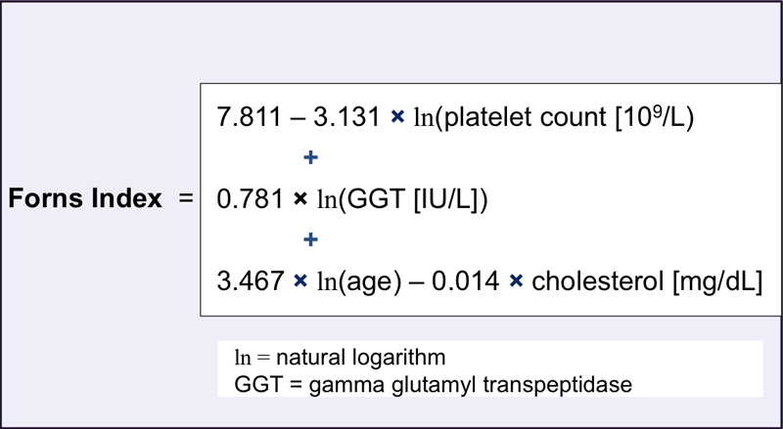
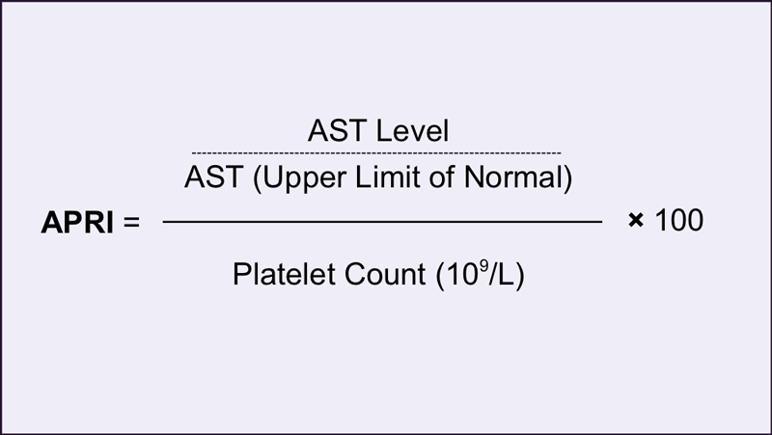
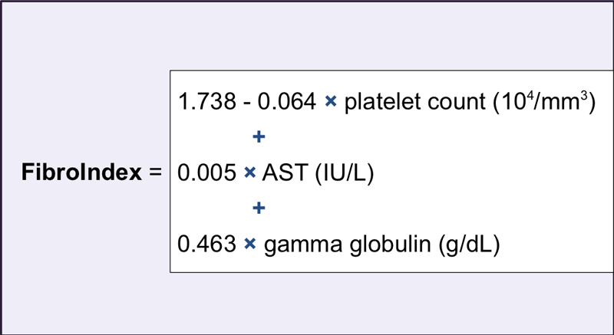
Liver fibrogenesis – clinical issue
It is reversible
Methods of testing of liver fibrosis
products of stellate cells released into the blood:
(hyaluronic acid, alfa-2-microglobulin, collagenous markers, matrix metalloproteinases)
Indexes based on routine lab. tests:
Measurement based on imaging methods: fibroscan, US-/MR- elastography

Slide 37
Complication of liver cirrhosis
Portal hypertension
Liver insufficiency
Variceal hemorrage
Ascites
spontaneous bacterial peritonitis
Hepatorenal syndrome
Hepatopulmonal syndrome
Hepatocelular carcinoma
Infectious complication
Icterus
Liver encephalopathy
Coagulopathy

Slide 38
Spontaneous bacterial peritonitis (SBP)
Bacterial translocation into ascites
Symptomatology: pure
Dg → puncture of ascites:
Neutrofils ˃ 0,25 x 10⁹/l or WBCs ˃ 0,5 x 10⁹/l
and/or + cultivation
Th: cefalosporins 3. gen (G-)
cefotaxim 2,0 g i.v. 2xd at least 5 days (ceftazidim, ceftriaxon)
SBP aquired in hospital (G+ cocci): karbapenems or piperacilin/tazobactam
Secondary prevention after episode of SBP:
norfloxacin 400 mg p.o. 1x d or better: rifamixin 400 mg 3x d
to the vanishing of ascites
to the liver Tx

Slide 39
Hepatorenal syndrome
Functional renal failure in patients with liver cirrhosis and portal HT: vasoconstriction in renal arteries → ↓ GF → retention of water and Na⁺
Type 1 – quickly progredient
During 2 weeks twice incresed S-creatinine (at least 221 μmol/l)
Th: terlipresin, albumin 20% 100-200 ml/d
hemodialysis
Type 2 – „chronic“, associated with refractory ascites and liver insufficiency
Th:
1/ treatment of ascites: paracenthesis + albumin
2/ terlipresin
3/ HD, diuretics ? – however not decrease intravascular volume

Slide 40
Examination in compensated liver cirrhosis – evaluation of risk of decompensation
Define etiology of liver cirrhosis
→ treatment according to the etiology
Gastroscopy
? Presence of varices and primary prophylaxis of bleeding
Ultrasonography: screening of HCC
Non-invasive assesment of liver stiffness
Markers of viral hepatitis A and B
Vaccination for prevention of acute infection

Slide 41
Medications contributing to decompensation of liver cirrhosis
Non-steroidal antiinflammatory drugs
Decrease effect of diuretics, leed to renal vasoconstriction, ↑ risk of hepatorenal syndrome
Vasodilators
Deepen circulatory dysfunction (hyperkinetic circulation) and ↑ risk of hepatorenal syndrome
Non-selective betablockers and carvedilol
Not use when connected with decrease of BP

Slide 42
Liver transplantation - indication
First decompensation
Icterus
New ascites
After variceal bleeding
First signs of liver encephalopathy
Hyponatremia
Hepatorenal or hepatopulmonal syndrome
Acute on chronic liver failure
Child-Pugh B or MELD 14-15 points
Hepatocellular carcinoma (Milan criteria)

Slide 43
Take-home message
Cirrhosis is a heterogeneous and dynamic disease
With appropriate approaches there can be:
Prevention/delay of progression
Regression of cirrhosis to earlier stages
The approach to each stage will be different and depend on the prevailing pathophysiological mechanism(s)
In end-stage liver cirrhosis → timing of liver transplantation

