Slide 1
The public sphere and democracy
28th March 2019

Slide 2
Civil Society VS Public Sphere
What's the difference?

Slide 3
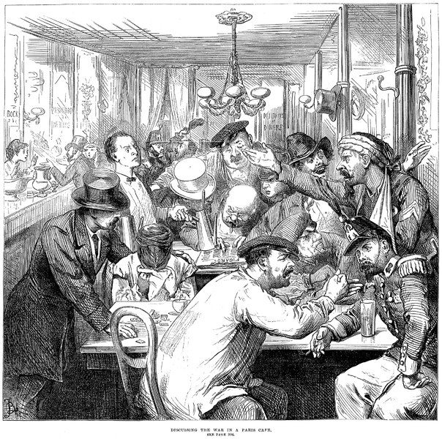
Public sphere
An ideal of a discursive space open to all where unrestricted rational discussion (deliberation) of public matters takes place while status and class differentials are bracketed resulting in formation of considered public opinions (public will) and their critical re-evaluation.
Who participates? Journalists, politicians, lobbyists, advocates, experts, moral enterpreneurs, intellectuals.

Slide 4
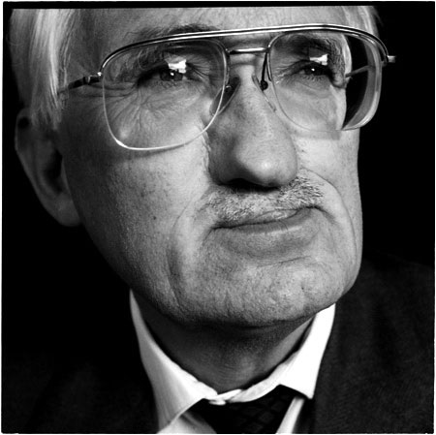
Jürgen Habermas: The Public Sphere
The Structural Transformation of the Public Sphere (1989; German original 1962)
- the ideal type of the bourgeois public sphere (18th century)
Political Communication in Media Society: Does Democracy Still Enjoy an Epistemic Dimension? (2006)
WATCH: https://www.youtube.com/watch?v=R1K46oK3xTU

Slide 5
Habermas (2006): Deliberative Democracy
A discourse-centered concept of democracy, the exchange of arguments as the most suitable procedure for resolving moral-practical questions.
Deliberation is expected to fulfill three functions:
to mobilize and pool relevant issues and required information, and to specify interpretations;
to process such contributions discursively by means of proper arguments for and against;
to generate rationally motivated yes and no attitudes that are expected to determine the outcome of procedurally correct decisions.

Slide 6
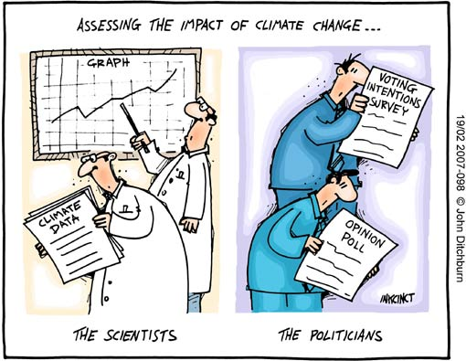
Habermas (2006): Considered Public Opinions
For political elites, considered public opinions set the frame for the range of what the public of citizens would accept as legitimate decisions
For voters, they present plausible alternatives for what counts as a reasonable position on public issues

Slide 7
Michael Neblo: deliberative opinion change
talk matters h. | deliberating groups will come to different decisions
valence h. | unidirectional shifts in opinion rather than polarization
expanded perspective h. | demographic characteristics (age, race, gender) play a smaller role in explaining post-deliberative opinions
filter h. | to filter out publicly unjustifiable influences (racism, dislike)
market-forum h. | a shift from a market frame (“what is it that I prefer?”) to a forum frame (“what is it that we, as a group, should do?”)
proceduralism h. | a move toward what the group decides (the process leading to the group’s decision lends it legitimacy)
Conditional on subjects having enough information to make the process work!

Slide 8
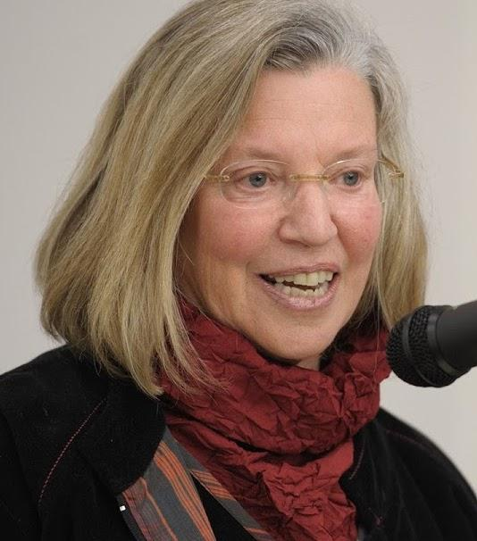
Nancy Fraser: First critique of Habermas (1990)
“It was anything but accessible to everyone. On the contrary, it was the arena, the training ground, and eventually the power base of a stratum of bourgeois men, who were coming to see themselves as a "universal class" and preparing to assert their fitness to govern.”

Slide 9
Nancy Fraser: First critique
Legitimacy
bracketing of social inequalities works to the advantage of the dominant
a plurality of competing public, parallel discursive arenas (subaltern counterpublics)
what will count as a matter of common concern will be decided through discursive contestation, no topics should be ruled off (private x public)
Efficacy
‘weak publics’ of civil society x ‘strong publics’ within the state (translating communicative into administrative power)

Slide 10
MASS MEDIA
What's their effect on the democratic functions of public deliberation?

Slide 11
The power of mass media
to select and process politically relevant content (“gate keeping”, news values) and thus intervene in formation of public opinions
asymmetric actor–audience relation (lack of reciprocity speaker-adressee)
stratification of opportunities to access channels of mediated communication (Koopmans: winners & loosers, a power structure)
Media effect models (Scheufele 2007)
Agenda-setting (changes in the importance attributed to issues)
Priming (changes in the standards people use to make political evaluations)
Framing (changes in how the issue is understood) - inspired by Goffman

Slide 12
Self-regulation of the media system
Requirements (+ causes for existing lacks of legitimacy)
Independence of the media system
incomplete differentiation from the core of the political system
lack of distance between the media and special interest groups (PR)
2. Feedback from a responsive civil society
social deprivation and cultural exclusion of citizens (lack of access)
colonization by market imperatives (political absorbed by entertainment)

Slide 13
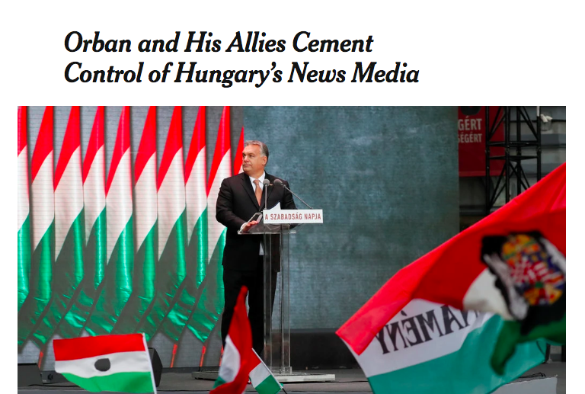
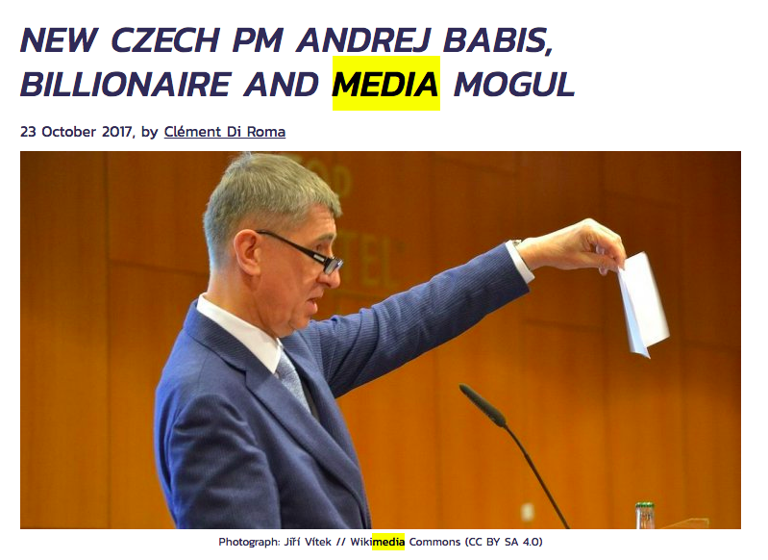
Examples from Central Europe

Slide 14
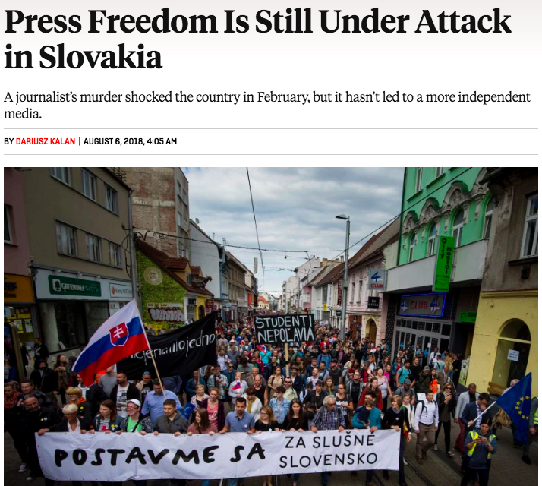
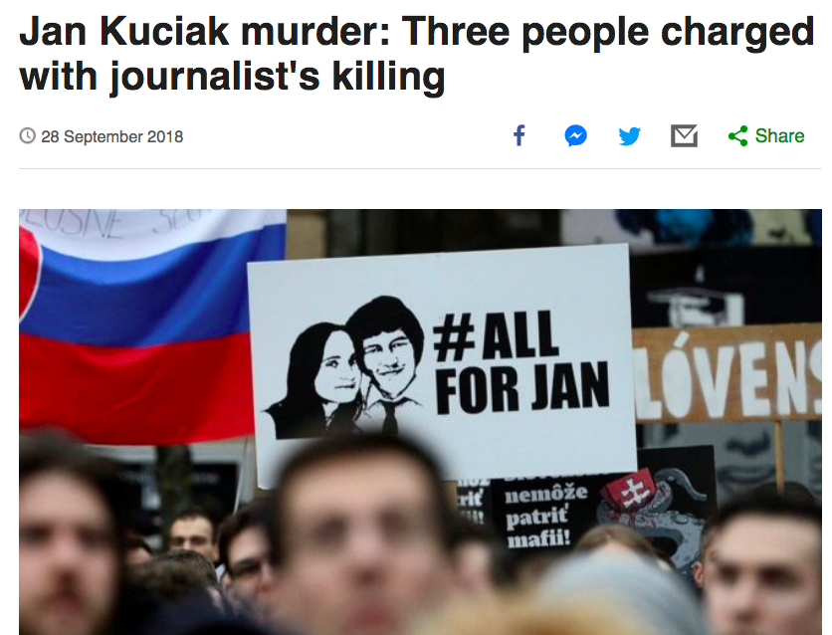
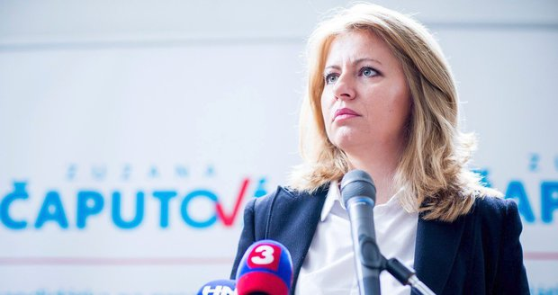

Slide 15
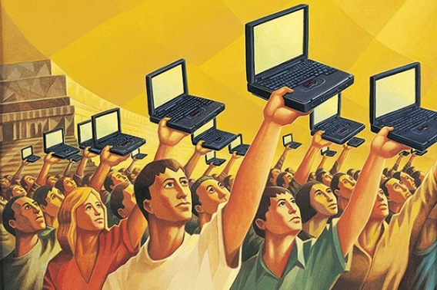
New hope: The Internet Sphere
Expectations (Dahlgren 2005, Papacharissi 2002)
greater accessibility for actors who do not receive attention in other media
stronger representation of perspectives underrepresented in other formats

Slide 16
The Internet Sphere (Gerhards, Schafer 2009)

Slide 17
Problems with the Internet Sphere
search engines advantage established actors (gatekeeping) while making it more difficult for smaller actors and their arguments to appear
large variety of actors and standpoints can be found somewhere in the internet, it is unlikely that the average user will find this content
audience fragmentation, ‘echo chambers’
online communities are rather homogeneous in terms of values and viewpoints, and their participants often hold similar political perspectives
selective exposure: the members of the audience prefer media that provide opinion-reinforcing information and avoid opinion challenges

Slide 18
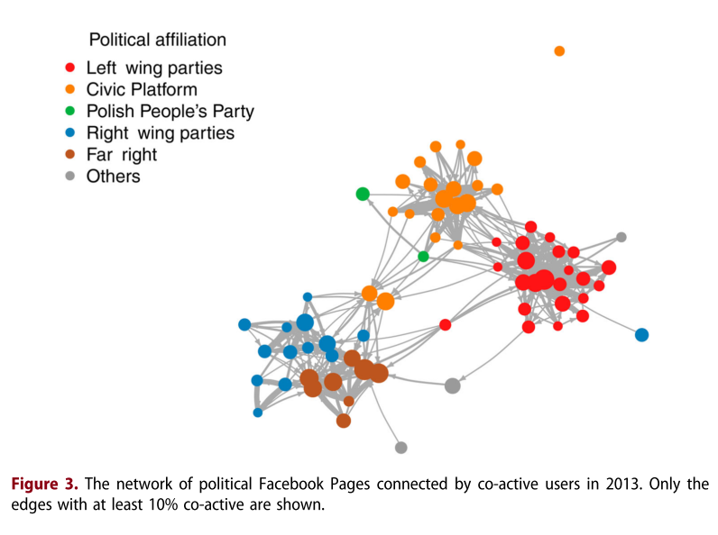
Poland: Echo Chambers (Batorski, Grzywińska 2018)

Slide 19
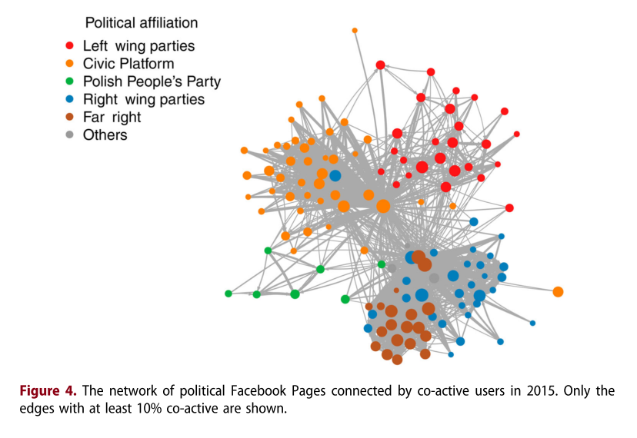
Poland: Echo Chambers (Batorski, Grzywińska 2018)

Slide 20
What's your experience
with public deliberation online?

Slide 21
Nancy Fraser: Second critique of Habermas (2007)
“The public sphere theory has tacitly assumed the frame of a bounded political community with its own territorial state. Only recently it has become possible – and necessary – to rethink public sphere theory in a transnational frame.”

Slide 22
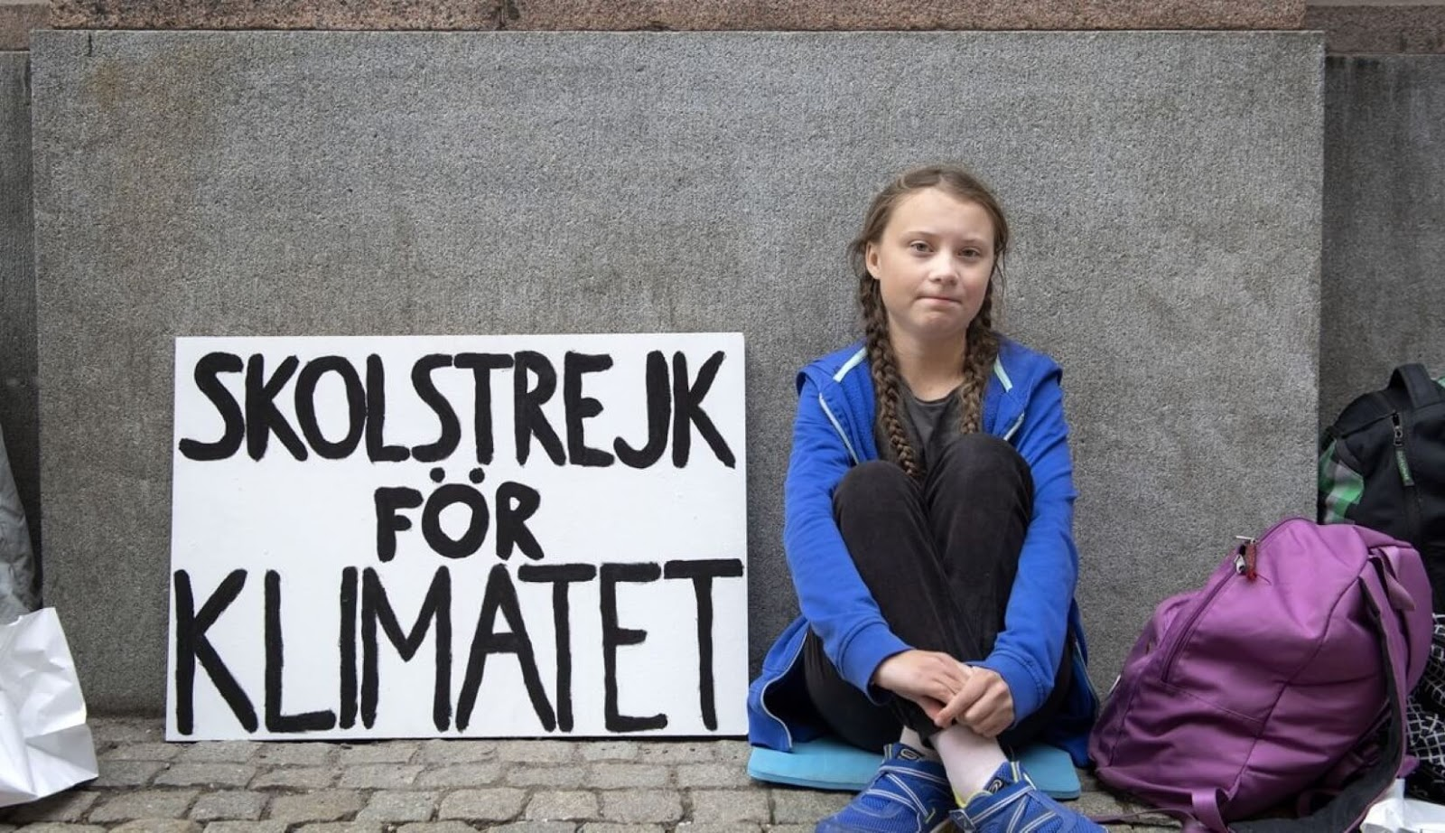
Nancy Fraser: Second critique of Habermas (2007)
trans-territorial problems (global warming or immigration, women’s rights or the terms of trade, unemployment or ‘the war against terrorism’) can neither be located within nor resolved by a nation state
transnational community of risk: public spheres today are not coextensive with political membership (the opinion they generate represents neither the common interest nor the general will of any demos)
de-nationalization of communicative infrastructure: corporate global media, restricted niche media and decentered Internet networks

Slide 23
Nancy Fraser: Second critique of Habermas (2007)
Legitimacy
public opinion is legitimate if and only if it results from a communicative process in which all potentially affected can participate as peers, regardless of political citizenship
Efficacy
the need to construct new addressees for public opinion, in the sense of new, transnational public powers that possess the administrative capacity to solve transnational problems and can be made accountable to new democratic transnational circuits of public opinion

Slide 24
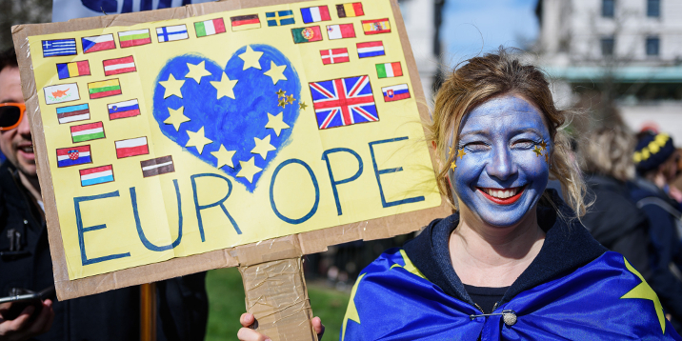
Does the EU have
a public sphere?
Utopist ideal: A common, inclusive European public sphere where political topics of the EU would be jointly discussed irrespective to borders of the nation states.
- mediated by a European media space - EU-wide formation of public opinion - construction of common European identity

Slide 25
Europeanization of National Public Spheres
1. parallelization of national public spheres
interconnectedness, mutual exchanges (Risse, van de Steeg)
same topics, same time and same criteria of relevance (Eder, Kantner)
2. establishment of communicative linkages
issue-specific (Koopmans: policy fields strongly institutionalized at the EU level also more publicly discussed in a Europeanized communication)
situational (Risse: when people debate controversial topics, discursive arenas emerge, the observable Europeanization of public spheres is linked to the growing politicization of EU affairs)
! Europeanized NOT THE SAME AS pro-European

Slide 27
Political Claims Analysis (Koopmans, Statham 1999)
Unit of analysis: political claim
a purposive and public articulation of a political opinion by physical or verbal action (decision, article, letter, interview, protest, petition, strike etc.)
variables: claim-maker; addressee; subject; issue; form; position; scope (local – national – European - supranational)
„A mayor (local claim-maker) sent an official letter (form) to the prime minister (national addressee) and asked him to refuse the relocation mechanism in the EU council (European issue).“

Slide 28
Ruud Koopmans: Winners and losers (2010)
“The transnational flow of public communication offers additional opportunities for those actors that are already dominant on the national level, and it exacerbates rather than compensates for the weak position of civil society actors.”

Slide 29
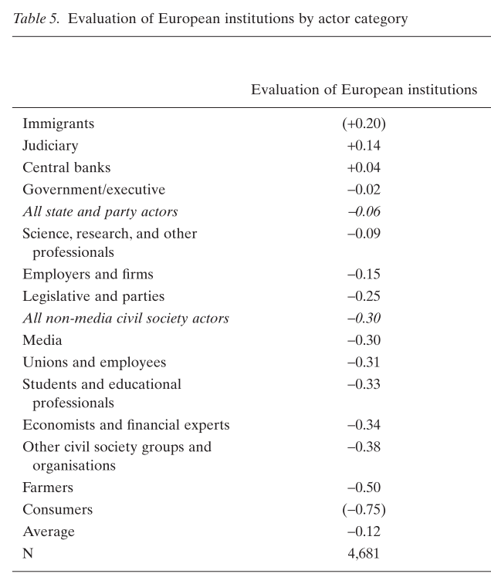
Link to support for EU
Attitude towards Europe reflects the degree to which actors profit from the Europeanization of public debates
Evaluation
EU institutions (-0.12)
national institutions (-0.21)

Slide 30
Czech Think Tanks as Agents of Europeanization
a case study of the Czech debate over Refugee Crisis (4/2015 - 3/2016), a representative sample of 2374 claims from TV broadcasting (all actors)
the Czech think tanks chose the discursive strategy of vertical, bottom-up Europeanization more often than any other actor
the share of claims made by think tanks was marginal, as state executives and politicians dominate the debate
think tanks should be treated as organizations of their own kind since their strategy deviated from that of other civil society organizations who largely stayed on the national level

Slide 31
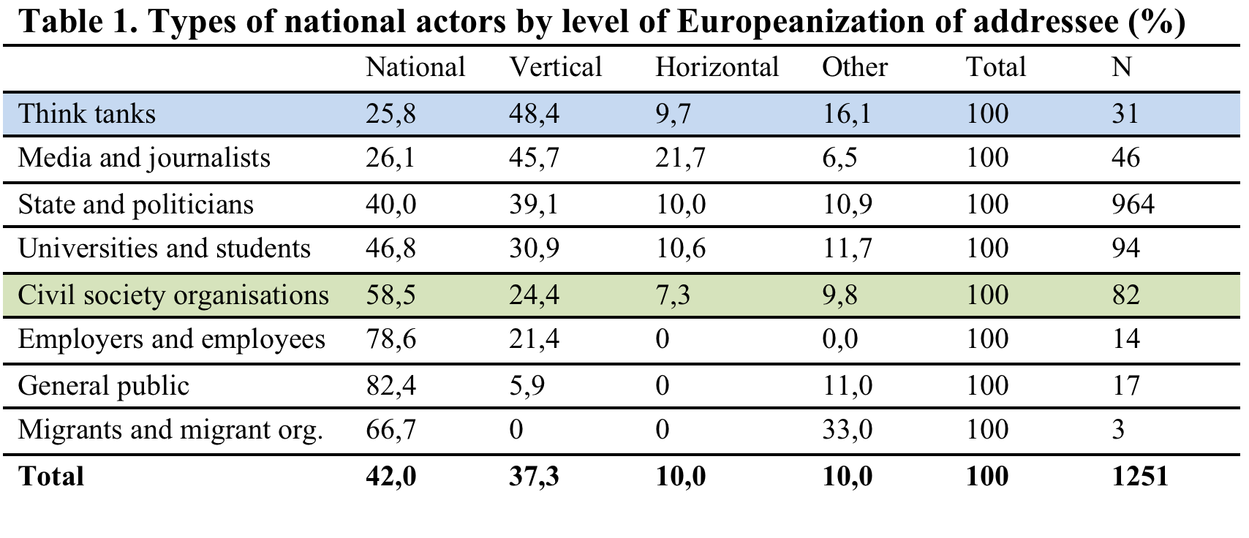

Slide 32
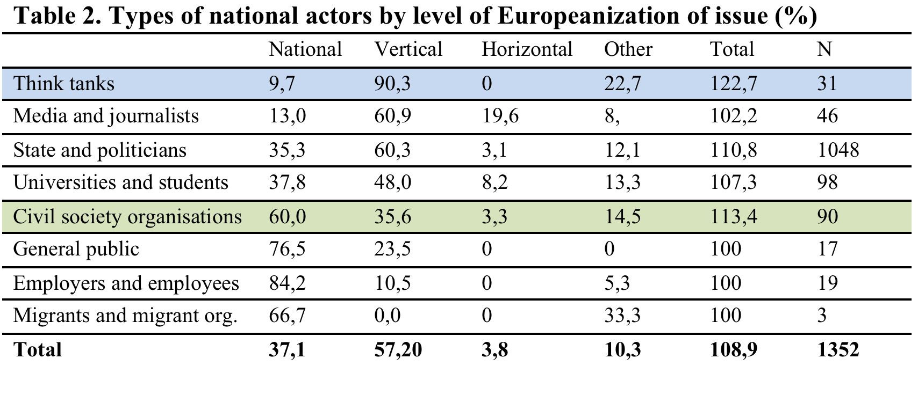

Slide 33
Discussion

