Slide 1
Plan for the following lessons
Today - Theory
Quick swipe thru Probability theory (just revision)
Walk thru using Aproximate Bayesian Computing
Next lecture – Hands on
Building basic models and inference in R & Stan interfaces (hopefully)
Lecture after that – Hands on
Advanced models in Stan

Slide 2
Introduction to Bayesian data analysis
Bartoš František

Slide 3
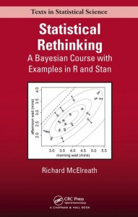
Richard McElreath
http://xcelab.net/rm/statistical-rethinking/

Slide 4
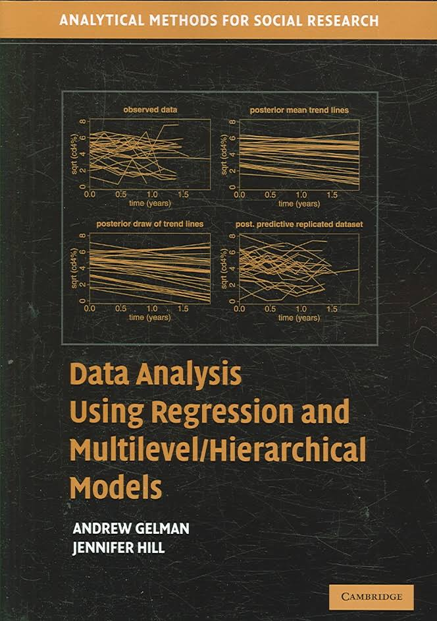
Andrew Gelman
http://www.stat.columbia.edu/~gelman/arm/

Slide 5
Probability – some concepts
Ω = set of all possible outcomes
ω_{i} = elementary outcome i
ω_{i} ∈ Ω
A = event, made up from elementary outcomes
example with die
Ω = {1, 2, 3, 4, 5, 6}
A = {1, 3, 5} = „event A is odd number“
after roll we observe outcome ω_{x} (ie. number 3)
ω_{x} ∈ A „outcome is element of event A => event A occured“

Slide 6
Probability – some properties
P(ω_{i}) = probability of ω_{i}
0 ≤ P(ω_{i}) ≤ 1
ΣP(ω) = 1
P(ø) = 0

Slide 7
Probability – simple computations
another die example
Ω = {1, 2, 3, 4, 5, 6}
A = {1, 3, 5} = „event A is odd number“
let‘s have a fair die
(probability of all elementary outcomes is the same)
P(ω₁) = P(ω₂) = … = P(ω₆) = 1/6
What is the probability of event A?
P(A) = P(ω₁) + P(ω₂) + P(ω₃) = 3/6
A
Ω

Slide 8
Probability – simple computations 2
two independent coins (heads = A-side)
Ω = {[heads,heads],
[heads, tails],
[tails, heads],
[tails, tails]}
B₁ = tails on 1st, B₂ = tails on 2nd coin
B = B₁ $∩$B₂ = tails on both coins
let‘s have a fair coin
P(ω_{heads}) = P(ω_{tails}) = 1/2
What is the probability of event B?
P(B) = P(B₁)*P(B₂) = P(ω_{tails}) * P(ω_{tails}) = 1/4
Ω
B

Slide 9
Probability – conditional probability
$$P\left(C | D\right)=\text{"}\text{probability} \text{of} \text{C} \text{given} D\text{" }$$
$\text{= "}\text{probability} \text{of} \text{observing} \text{C} \text{after} \text{D} \text{have} \text{been} \text{observed}\text{" }$
$$P\left(C | D\right)= \frac{P(C ∩D)}{P(D)}=\frac{"probability of C and D"}{"probability of D"}$$
coin and die example – toss and roll
C = tossing head (A-side) with coin
D = rolling 5 or 6 with die
P(C|D) = probability of head (A-side) knowing that 5 or 6 was rolled

Slide 10
Probability – conditional probability
Ω
toss & roll
C = head (A-side)
D = 5 or 6
P(C|D)
P(D|C)
C
D

Slide 11
Probability – conditional probability
$$P\left(C | D\right)= \frac{P(C ∩D)}{P(D)}=\frac{"probability of C and D"}{"probability of D"}$$
P(C) = 1/2
P(D) = 2/6
$P\left(C | D\right)=\frac{P(C ∩D)}{P(D)}=\frac{\frac{1}{2}∗\frac{2}{6}}{\frac{2}{6}}= \frac{1}{2}$

Slide 12
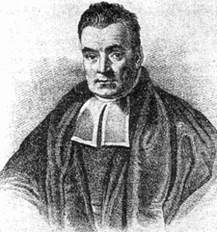
Probability – conditional probability
$P\left(A | B\right)=\frac{P(A ∩ B)}{P(B)}$ $P\left(A ∩ B\right)=P\left(A | B\right)∗P(B)$
$P\left(B | A\right)=\frac{P(A ∩ B)}{P(A)}$ $P\left(A ∩ B\right)=P\left(B | A\right)∗P(A)$
$$P\left(A | B\right)∗P\left(B\right)=P\left(B | A\right)∗P(A)$$
$$P\left(A | B\right)=\frac{P\left(B | A\right)∗P(A) }{P\left(B\right)}$$

Slide 13
Probability – empirical probability
tossing a coin (again)
Ω = {heads, tails}
P(ω_{heads}) = ?
P(ω_{tails}) = 1 - P(ω_{heads})
...

Slide 14
Probability – empirical probability
P(ω_{heads}) = ?
E$P\left(\text{ω}\text{heads}\right)=\frac{|\text{ω}\text{heads}|}{\left|\text{ω}\text{heads}\right|+|\text{ω}\text{tail}\text{s}|}= \frac{"number of heads seen"}{"number of all outcomes"}$
$$\text{E}P\left(\text{ω}\text{heads}\right)= \frac{5}{8}= .625$$

Slide 15
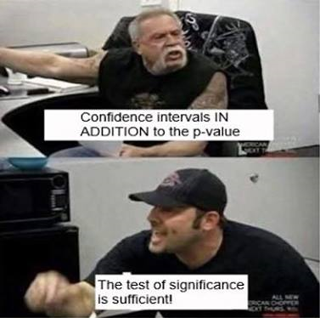

Slide 16
Probability - summary
intuitive (hopefully)
easy to use
add some other pros…

Slide 17
Bayesian data analysis
Using probabilities to represent uncertainty in all parts of a statistical model.
Assesment of the probability of parameters of the statistical model given the data and prior information.
data
generative model
priors

Slide 18
Bayesian data analysis – example

Slide 19
Study set-up & data
2 conditions
Control Treatment (CT)
Request Treatment (RT) – adding „Do not cheat!“ on the return paper
160 participants (children)
data
overal 123 children reported white (76,9%)
69 children out of 81 reported white (85.4%) in CT
54 children out of 79 reported white (68,8%) in RT

Slide 20
Generative model
should reflect data generating process or the most important parts of it
binary outcome – white/black side of the coin
binomial distribution
procces which returns number of successes out of n trials, with probability π
number of successes ~ binomial(n, π)
we know: n and number of successes, what are plausible values of π?

Slide 21
Generative model – binomial distribution
assume that all children were honest
-> π = .5
number of white sides of coins
white sides ~ binomial(n = 160, π = .5)
we can simulate the process in R
rbinom(1, size = 160, prob = .5)
or do it many times and check the distribution white sides assuming that all children were honest
hist(rbinom(100000, size = 160, prob = .5))

Slide 22
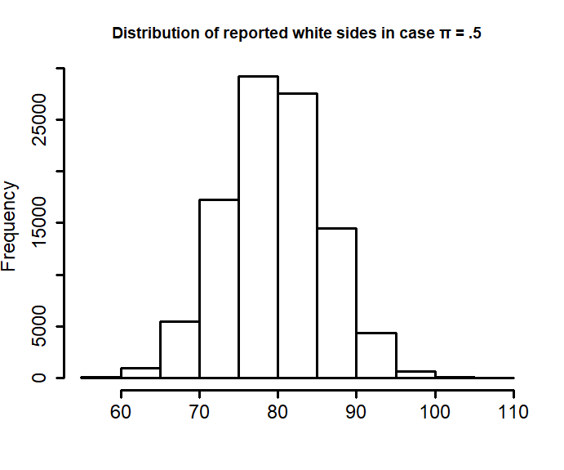

Slide 23
Connection to NHST
p-value = probability of obtaining such or more extreme result given that the null hypothesis is true
if we wanted to test whether π = .5
binom.test(x = 123, n = 160, p = .5)
the p-value can be aproximated using the simulation
sim_data <- rbinom(100000, size = 160, prob = .5)
sum(sim_data >= 123)/100000
… but we are not interested in testing

Slide 24
Estimation by Aproximate Bayesian Computation
white sides ~ binomial(n, π)
CT: white side_{CT} = 69, n_{CT} = 81, π_{CT} = ?
CR: white sides_{CR} = 54, n_{CR} = 79, π_{CR} = ?
the idea:
We can try different values of π and count how many times they have led to our observed data.

Slide 25
Priors
should reflect what we are thinking about possible values of parameters (before seeing the data)
our parameters: π_{CT}, π_{CR}
hard boundaries – lower = 0, upper = 1 – they represent probabilities
shape of distribution- many possible choices reflecting our knowledge about the phenomenon
completely uninformed = uniform distribution on [0,1]
all children are honest = all density at .5
- we do know something most of the time

Slide 26
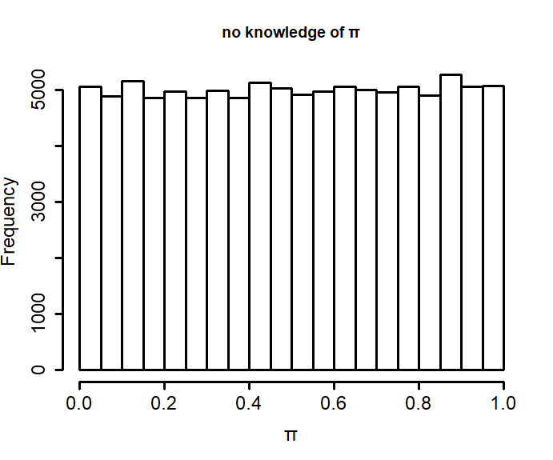
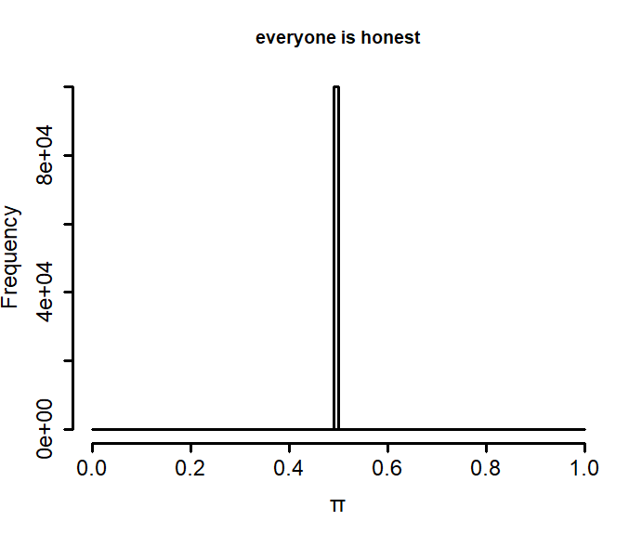
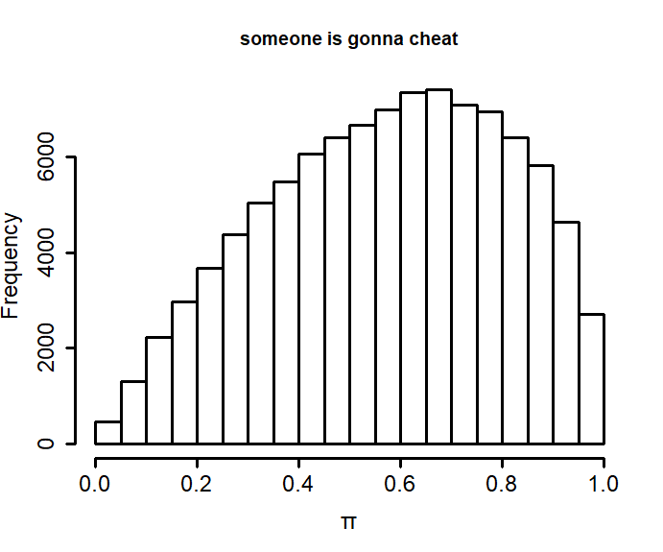
π ~ uniform(0,1)
π = .5
π ~ beta(2, 1.5)

Slide 27
Estimation by Aproximate Bayesian Computation
1) simulate outcome for each value of prior
white side_{CT} ~ binomial(n_{CT}, prior π_{CT})
2) keep those values of prior which led to the same outcome as we observed
π_{CT} = prior π_{CT}[white side_{CT} == white side_{CT}]

Slide 28
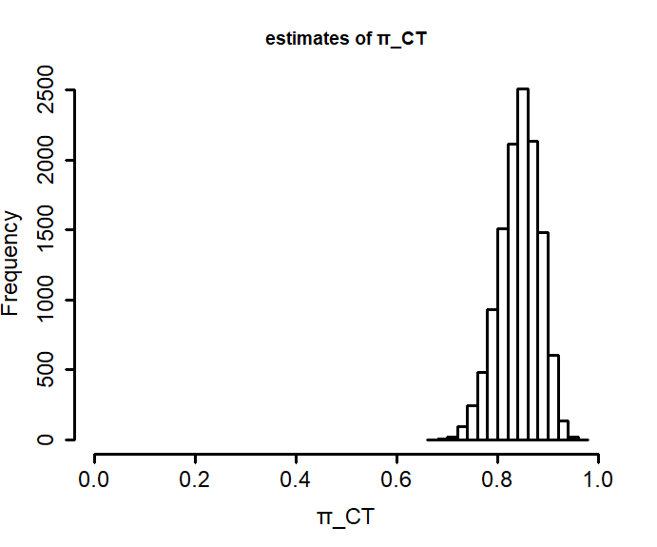
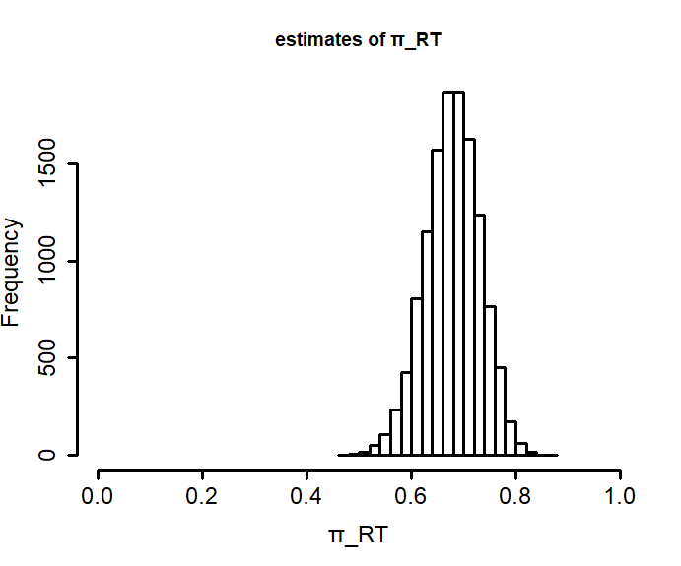
Posterior distribution

Slide 29
Posterior distribution - characteristics
just work with the samples
mean and percentile interval:
mean(π_{CT})
quantiles(π_{CT}, probs = c(0.025, 0.975))
π_{CT} = 0.85, 95% PI [0.76, 0.92]
π_{RT} = 0.68, 95% PI [0.57, 0.78]

Slide 30
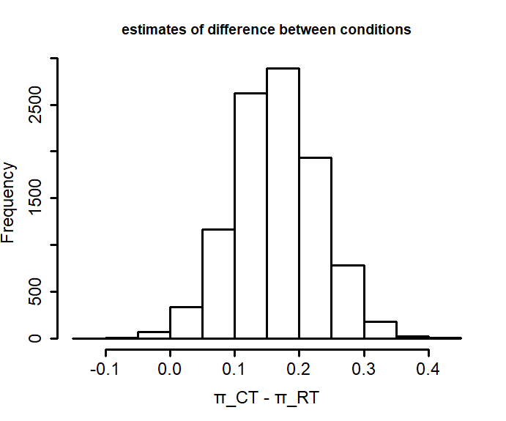
Posterior distribution - computations
keep working with the samples
difference between conditions
π_{diff} = π_{CT} - π_{RT}
mean and percentile interval
mean(π_{diff})
quantiles(π_{diff}, probs = c(0.025, 0.975))
π_{diff} = 0.16, 95% PI [0.03, 0.29]

Slide 31
Posterior distribution – more computations
λ = proportion of cheaters
π_{exp} = expected success rate
$$\text{π} \text{=}\text{λ}\text{ + }\text{(1-}\text{λ}\text{)*}\text{π}\text{exp}$$
$$\text{λ} =\frac{\text{π}\text{ - }\text{π}\text{exp}}{1−\text{π}\text{exp}}$$

Slide 32
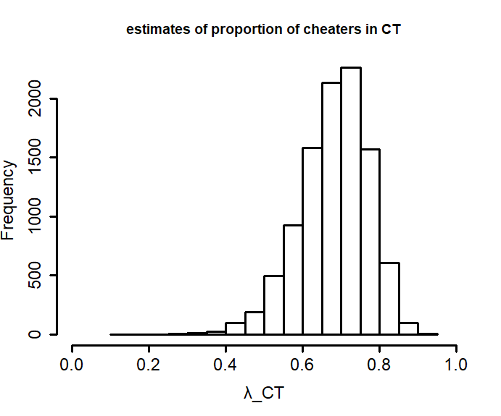
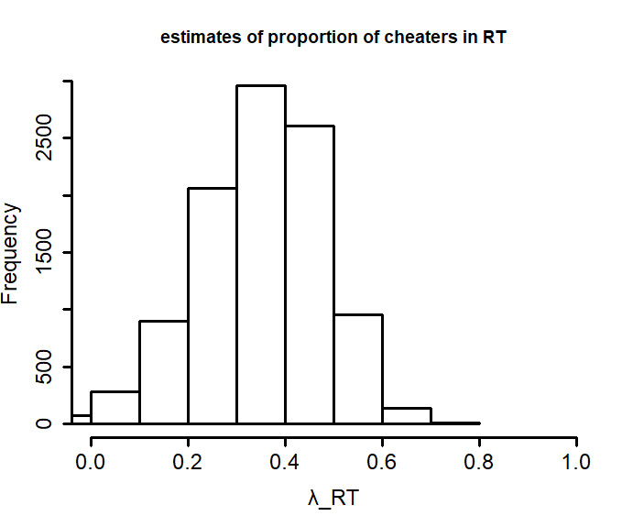

Slide 33
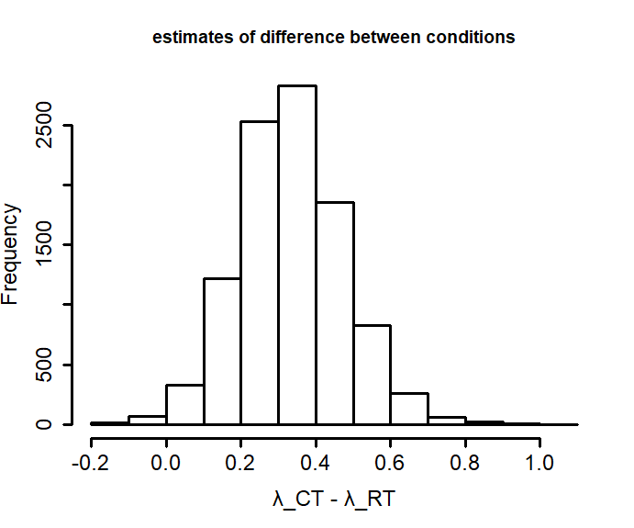
Posterior distribution – more computations
λ_{CT} = 0.68, 95% PI [0.48, 0.82]
λ_{RT} = 0.35, 95% PI [0.07, 0.58]
the difference
λ_{diff} = λ_{CT} – λ_{RT}
λ_{diff} = 0.33, 95% PI [0.07, 0.62]

Slide 34
and so on…

Slide 35
Plan for the following lessons
Today - Theory
Quick swipe thru Probability theory (just revision)
Walk thru using Aproximate Bayesian Computing
Next lecture – Hands on
Building basic models and inference in R & Stan interfaces (hopefully)
Lecture after that – Hands on
Advanced models in Stan

