Slide 1
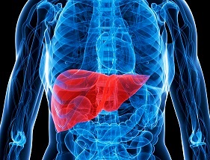
Liver function tests Hyperbilirubinemias

Slide 2
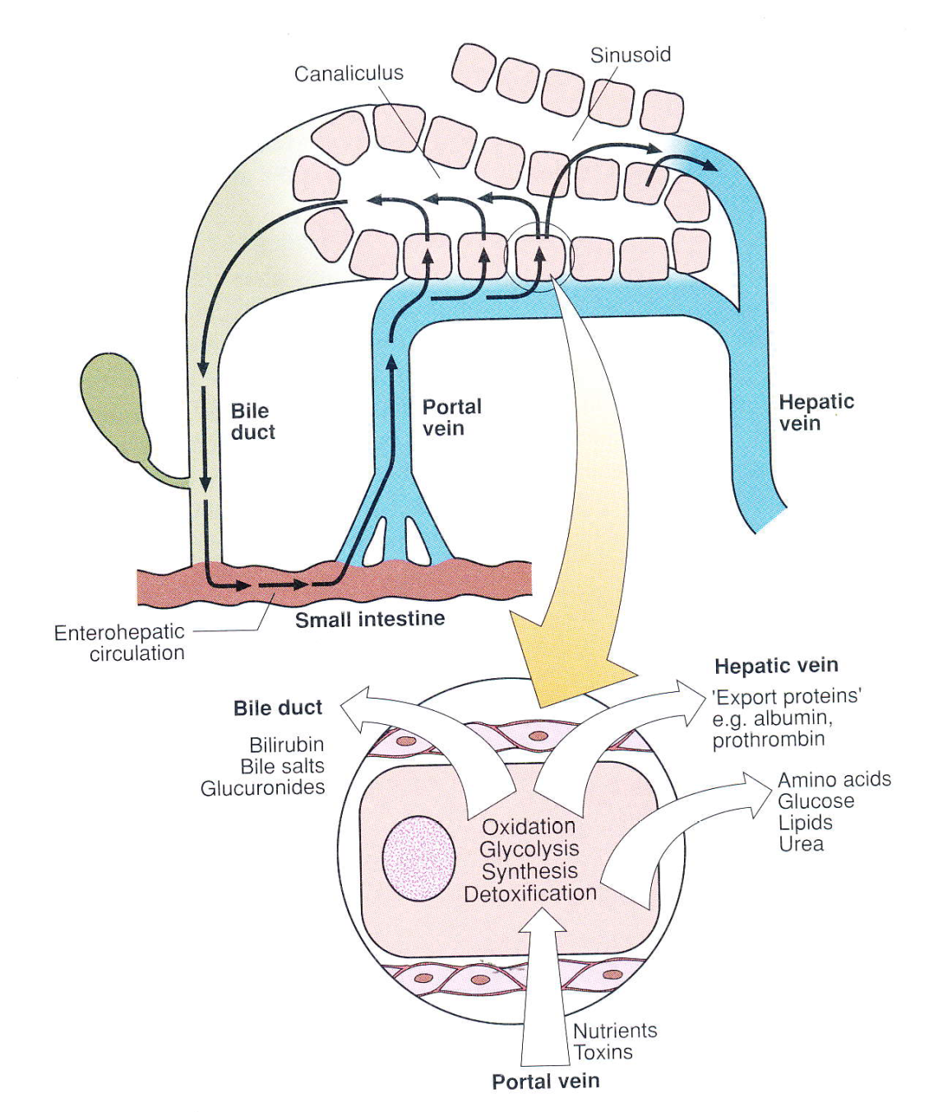
Liver function

Slide 3
Liver function
• energy metabolism
• synthesis
• degradations
• haematopoiesis
• detoxification, excretion
• ureogenesis
• proteins, lipids, carbohydrates
• amino acids, fatty acids, Krebs cycle
• glycolysis, beta oxidation
• synthesis and breakdown of blood cells
• endogenous and exogenous compounds
nutrients and toxins

Slide 4
Liver function tests
• measurements of blood components
• aminotransferases (AST and ALT)
• alkaline phosphatase (ALP)
• gamma glutamyl transferase (GGT)
• bilirubin (BIL)
• albumin (ALB)
• other

Slide 5
Liver injury tests
• sensitive, albeit non-specific index, of acute damage to hepatocytes
ALT
○ liver, cytosol
○ PR: 0.17 – 0.78 μkat/L
AST
○ liver, heart, skeletal muscle, kidney, pancreas
○ 2 isoforms: mitochondrial and cytosolic
○ PR: 0.16 – 0.72 μkat/L
• de Ritis index = AST/ALT, value above 1 => hepatocyte necrosis
• rise activity: hepatitis, toxic liver damage, circulation shock, cirrhosis, drug
overdose, neoplasia, metabolic disorder

Slide 6
Obstruction to bile tract
• increases in alkaline phosphatase activity
ALP
• a few isoforms: bone, gut, liver and placental
• PR: 0.66 – 2.2 μkat/L
• rise activity: cholestasis – rise ALP activity at least twice upper end of PR
primary biliary cirrhosis (PBC) – autoimmune disorder, Ab generation
absces, sec. tumors, cysts, prim. sclerotic cholangitis

Slide 7
Obstruction to bile tract
GGT
• bile duct cells, pancreas, kidney, prostate, heart
• PR: 0.14 – 0.84 μkat/L for men
• PR: 0.14 – 0.68 μkat/L for women
• rise activity: cholestasis, liver tumors, pancreatitis, renal insufficiency
chronic alcoholism
enzyme induction by ingestion of drug (phenytoin) and alcohol

Slide 8
Synthetic function tests
ALBUMIN
• syntesis in liver, about 12-15 g daily
• biological half-life: 19-21 days
• PR: 35 – 53 g/L
• decrease levels: cirrhosis, ascites, nephrotic syndrome, burns
prealbumin
• biological half-life: 2 days
• PR: 0.18 – 0.40 g/L
• better for protheosynthesis estimation

Slide 9
Synthetic function tests
prothrombin time
• measure of activity of certain coagulation factors
• indicator of hepatic synthetic function
• increased time: the earliest indicator of hepatocellular damage
gamma-globulines
• polyclonal gammapathy
• increased levels of IgA, IgM, IgG
alpha-1-fetoprotein (AFP)
• synthesized by fetal liver
• normal adults has very low concentrations <20 μg/L (PR: 0 – 10 μg/L)
• increased levels: hepatocellular carcinoma in 80 – 90% of cases

Slide 10
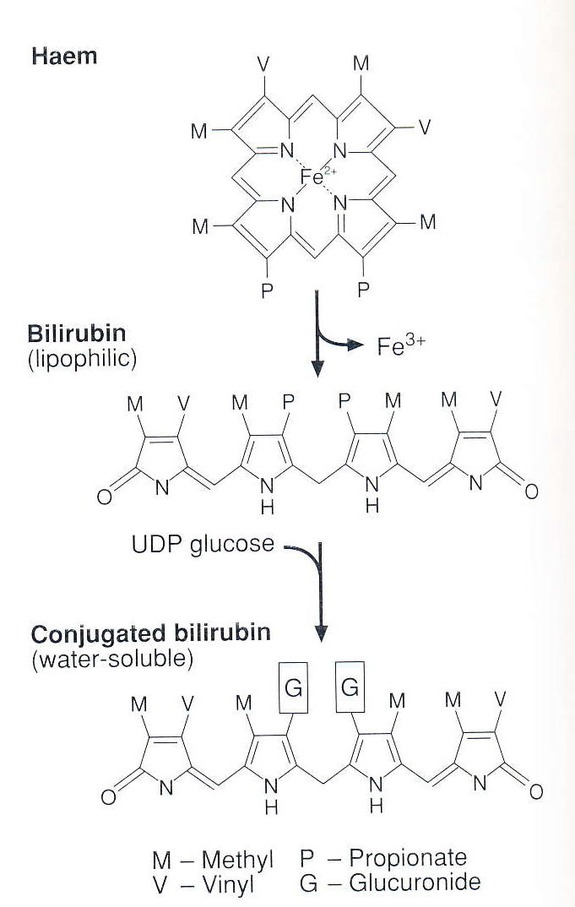
Liver detoxification activity tests
ammonia
• amino acids metabolism product
• ureogenesis disoder marker
• liver failure, inborn metabolic disorders
• PR: 21 – 71 μmol/L for men
• PR: 19 – 63 μmol/L for women
bilirubin
• metabolism:
• about 450 μmol daily
• PR: 2 – 17 μmol/L
derivation → conjugation → excretion
• biliary tract blockage → no bilirubin excretion → rise serum Bil concentraciton → jaundice

Slide 11
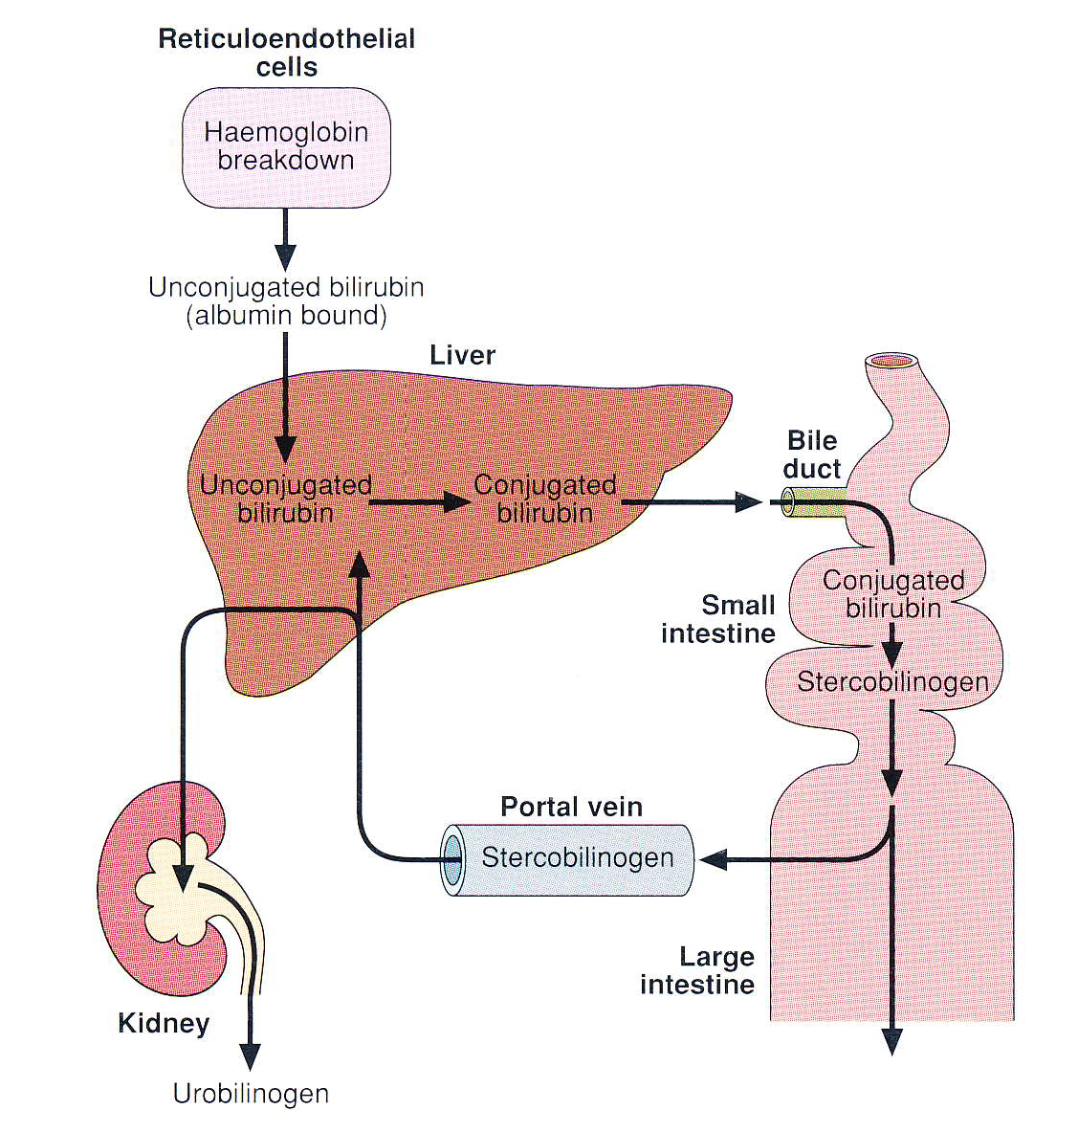
Bilirubin metabolism

Slide 12
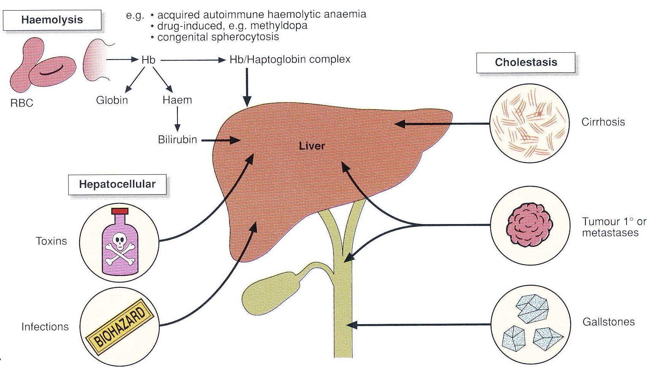
Causes of jaundice

Slide 13
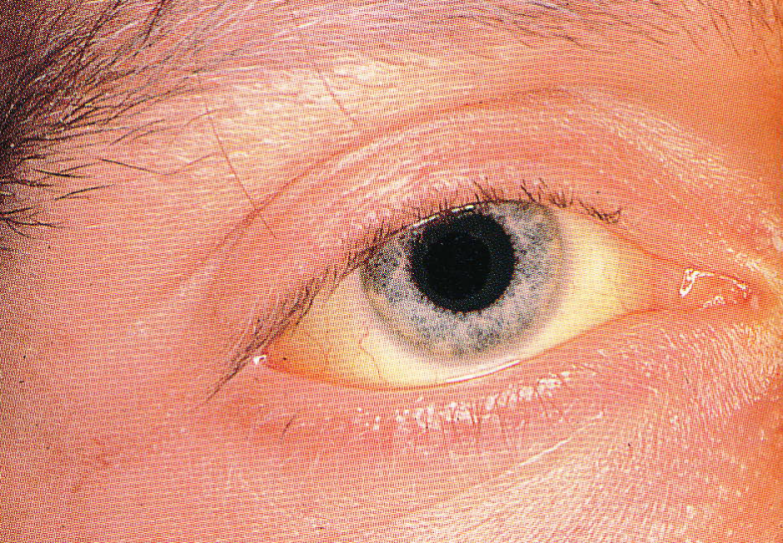
Jaundice
prehepatal (haemolytic)
• haemolysis → increased Bil production
• no Bil in urine
• newborns: careful monitoring: phototherapy (>200 μmol)
exchange transfusion (>300 μmol)
hepatal (hepatocellular)
• liver inability to accept, conjugate and excrete Bil into bile
• rised Bil in serum
• Bil in urine (dark colour)
• hypocholic stool (light colour)
posthepatal (obstructive)
• liver inability to excrete conjugated Bil → back to blood
• rised Bil in serum
• Bil in urine (dark colour), no urobilinogen in urine
• no Bil in bile → acholic stool (light colour)

Slide 14
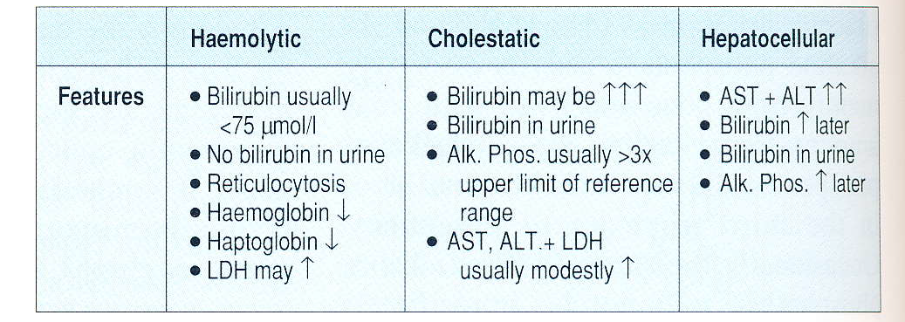
Laboratory differential diagnosis of jaundice

Slide 15
Hyperbilirubinemias
unconjugated
• haemolytic amemia
• morbus haemolyticus neonatorum
• defects of UDP-glucuronyl transferase: Gilbert, Criegler-Najjar
mixed
• hepatocyte damage
• conjugation disorders
• hepatitis
• cirrhosis
conjugated
• obstruction icterus
• obstruction lithiasis
• bile ducts tumors
• Dubin-Johnson, Rotor

Slide 16
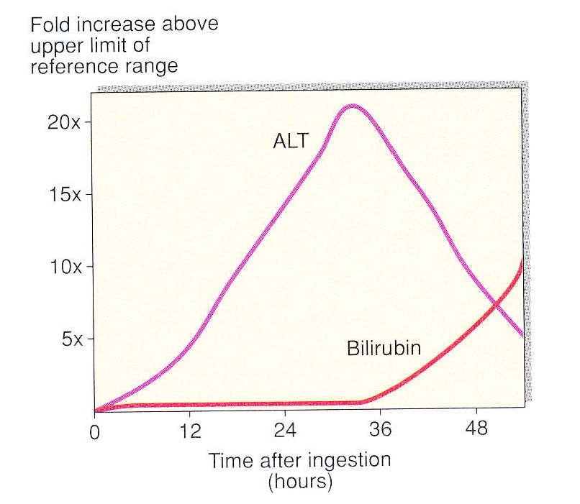
Liver disease
acute liver disease
• poisoning: paracetamol, carbon tetrachloride
mushroom (Amanita phalloides)
anticonvulsant drug (sodium valpoate)
• infection: hepatitis A/B/C
• inadequate perfusion
• may progress to acute hepatic failure
• may lead to chronic hepatic damage

Slide 17
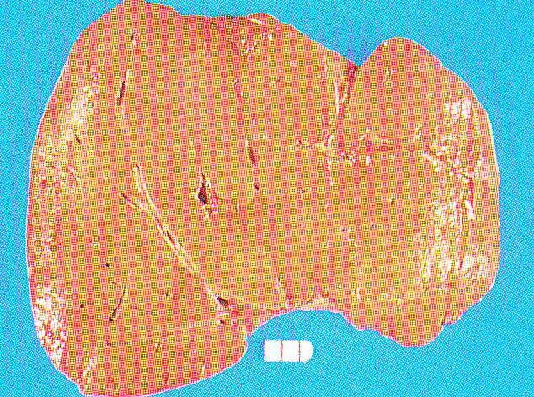
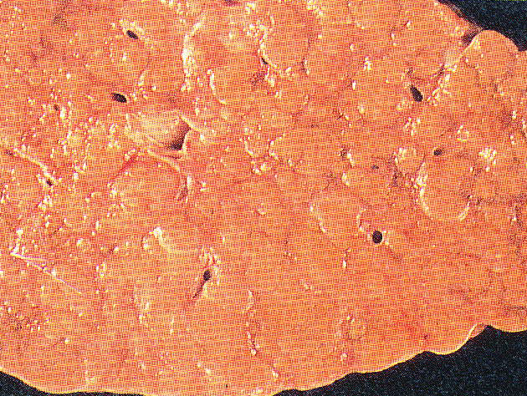
Liver disease
chronic liver disease
• alcoholic fatty liver
• chronic active hepatitis
• primary biliary cirrhosis
• causes of cirrhosis:
○ chronic excess alcohol ingestion
○ viral hepatitis (particularly B)
○ autoimmune diseases

Slide 18
Other tests
choline esterase (CHES)
• decreased activity → problem in protheosysthesis
• PR: 88.7 – 215.3 μkat/L for men
• PR: 71.0 – 187.5 μkat/L for women
• biological half-time: 13 days
transferin
• PR: 1.9 – 3.5 g/L for men
• PR: 1.8 – 4.1 g/L for men
• boilogical half-time: 8 days
PIVKA
• marker of HCC

Slide 19
Other tests
ELF test (Enhanced Liver Fibrosis)
• multivariant index test to provide unique score by measuring
○ hyaluronic acid (HA)
○ procollagen III amino terminal peptide (PIIINP)
○ tissue inhibitor of metalloproteinase 1 (TIMP-1)
• useful for liver fibrosis evaluation for patients with chronic liver disease
• useful for liver fibrosis monitoring in time; before, during, after treatment

Slide 20
Case report No.1
A 65-year-old man came to his GP´s surgery with visible jaundice which he had noticed to be deepening in colour. He had no pain but had noticed some weight loss and that his stool were pale. He was a moderate drinker, and was not on any drug therapy.
His LFTs were:
bilirubin 250 μmol/L
AST 1.45 μkat/L
ALT 1.53 μkat/L
ALP 14.17 μkat/L
What is the differential diagnosis?

Slide 21
Case report No.2
A 49-year-old woman attended her GP with an 8-day history of anorexia, nausea and flu-like symptoms. She had noticed that her urine had been dark in colour over the past 2 days. Physical examination revealed tenderness in the right upper quadrant of the abdomen.
LFTs were as follows:
bilirubin 63 μmol/L
AST 15.60 μkat/L
ALT 45.00 μkat/L
ALP 6.83 μkat/L
GGT 5.20 μkat/L
ALB 42 g/L
What is the differential diagnosis?

