Slide 1
Building a Civil Society
14th March 2019

Slide 2
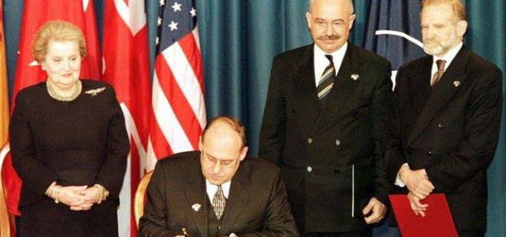
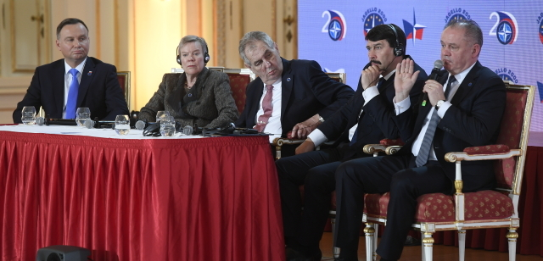
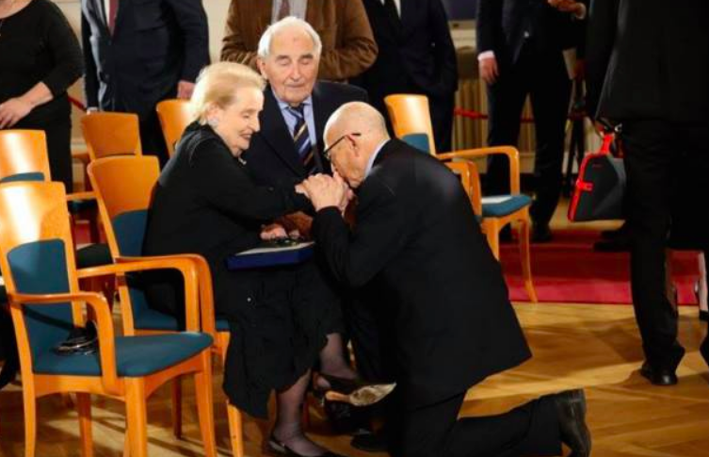
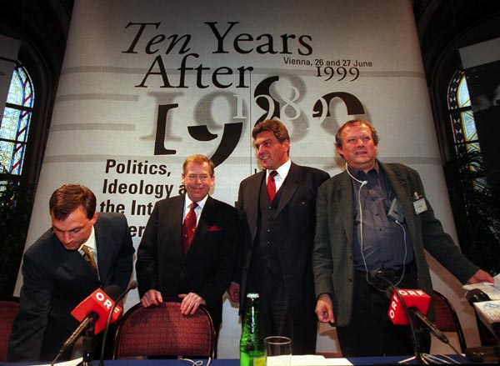
12. 3. 2019: 20 years in NATO celebration

Slide 3
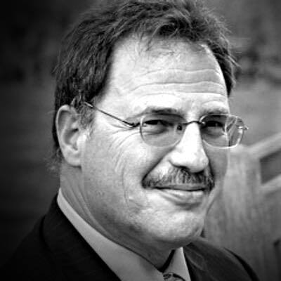
“No phenomenon has more vividly captured the imagination of democratic scholars, observers, and activists alike than "civil society."
What could be more moving than the stories of brave bands of students, writers, artists, pastors, teachers, laborers, and mothers challenging the duplicity, corruption, and brutal domination of authoritarian states?”
Larry Diamond

Slide 4
Definition
State
Market
Private
Civil Society
“Space within which individuals can freely form their associations AND a set of organized groups, whose members deliberate or act collectively to accomplish common goals.” (Ekiert, Kubik 2000)

Slide 5
Types of self-organized associations
Advocacy groups and think tanks
Foundations and funds
Human rights and women org.
Environmental org.
Social and health care org.
Sport, hobby and youth org.
Cultural organizations
Trade unions
Religious organizations and charities
Academia and research institutions
Social movements
Mass media ….?
“CSOs” civil society org. “NGOs” non-governmental org. “NPOs” non-profit org. “VO” voluntary org.

Slide 6
Typology of CSOs
 | Service | Advocacy
Mutual benefit | Sport, recreation Community organizations | Trade unions Professional organizations
Public benefit | Charity Social care Health care | Ecology Human rights protection

Slide 7
Why is civil society
important for democracy?

Slide 8
The Democratic Functions of CS (Diamond 1994)
Limitation of state power (consolidating and maintaining democracy)
Stimulating political participation
“School of democracy” (skills: tolerance, moderation, respect)
Articulation, aggregation and representation of interests
Mitigation of political conflict (interests cross-cut principal polarities)
Recruiting and training new political leaders
Specific democracy institutes (watchdog, human rights, election-monitoring)
Dissemination of information (contradicting the “official story”)
Achievement of economic reform
Strengthening the state: enhancing the accountability, responsiveness, inclusiveness, effectiveness, and hence legitimacy

Slide 9
Communist era associational sector (Skovajsa 2008)
Independent CS | Broader CS
autonomy and independence from the state “parallel polis”, “second society” actively challenging the regime | institutions and organizations controlled by the state passive direct predecessors of today’s CS organizations often also predate the period of communist rule
cells of citizen activism, dissent elite,, social movements and protests, banned cultural and religious org. | trade unions, youth org., sports & hobby org., Catholic church, cultural and academic org.

Slide 10
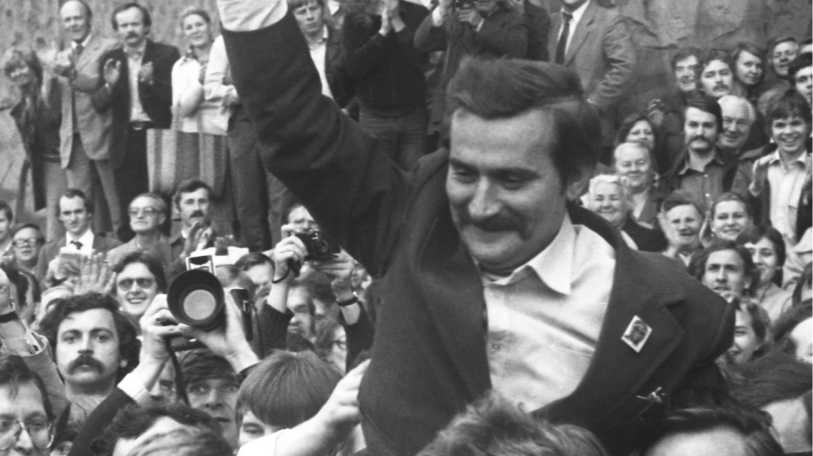
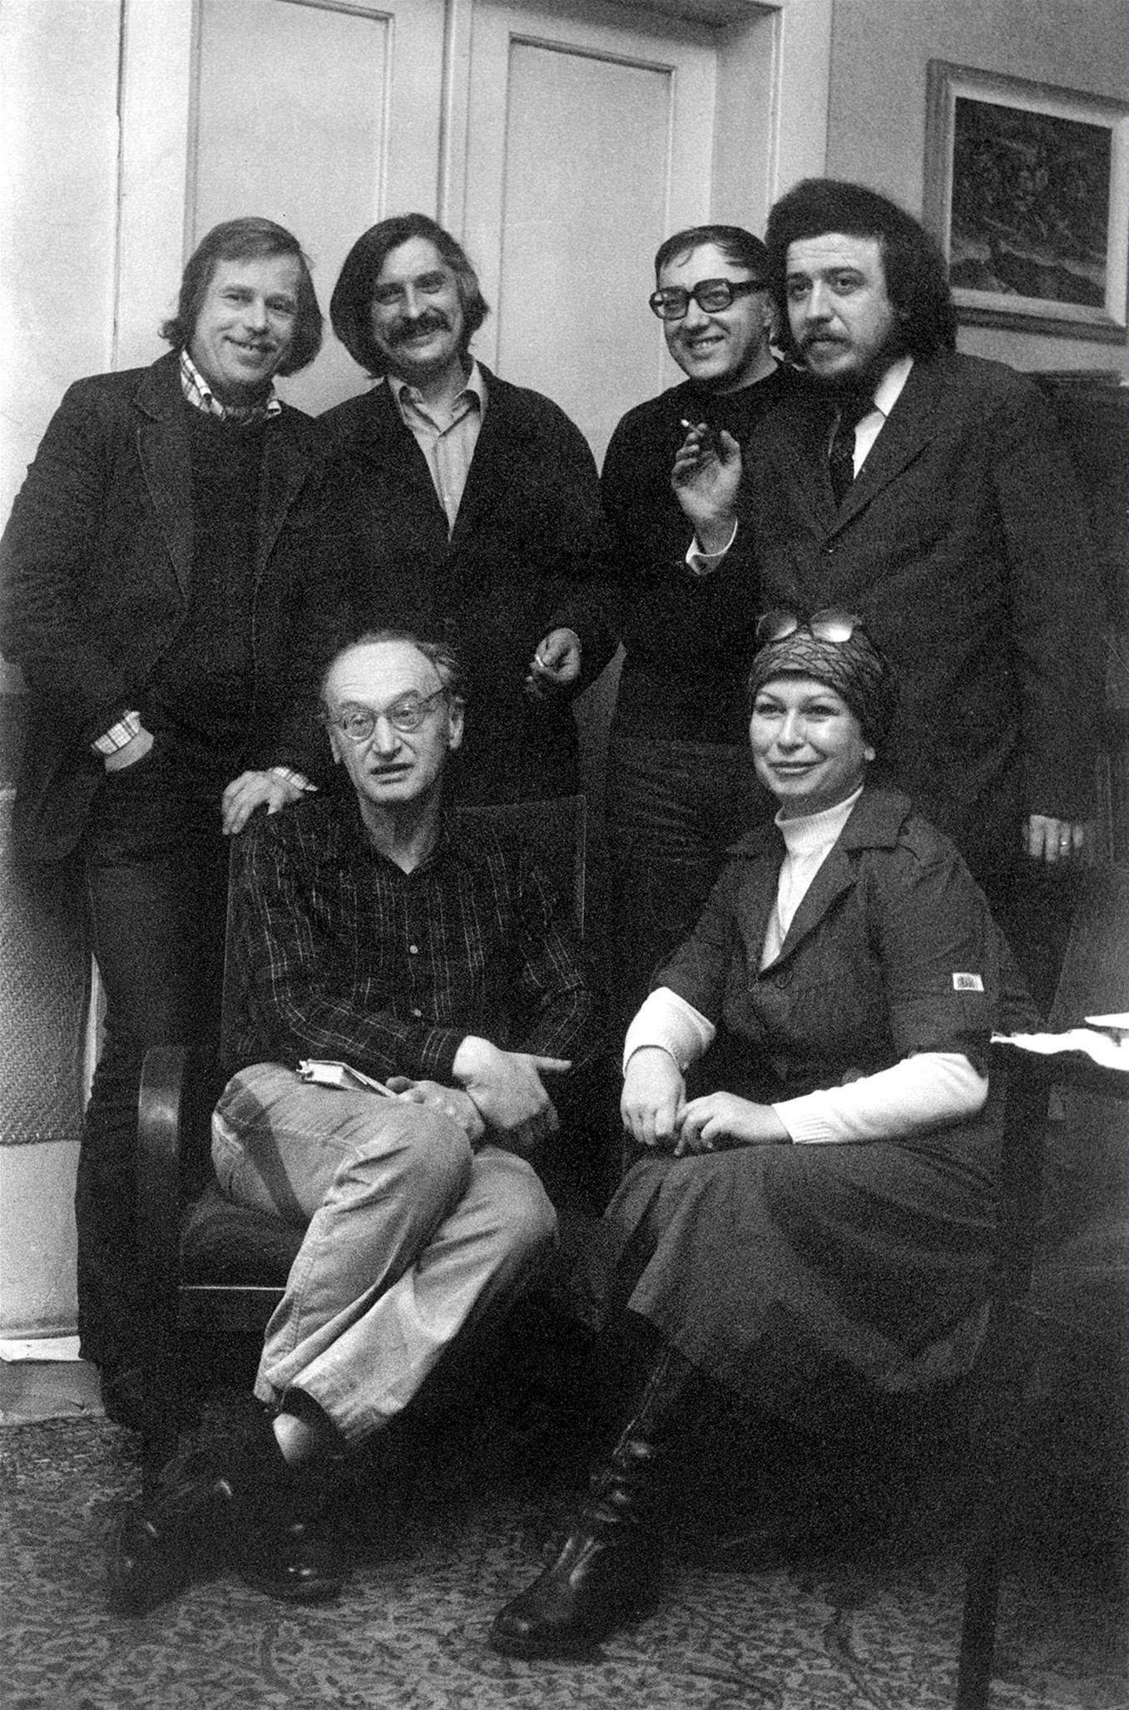
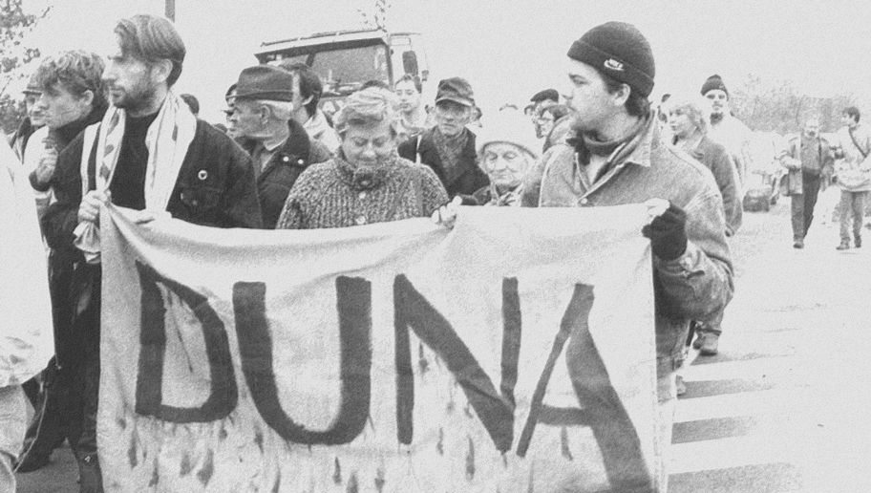
SOLIDARITY
DANUBE
CIRCLE
CHARTA 77
Notes:
CZ: Charta 77 (1977)
petition by artists, demanding recongnition of human rights, 1883 signatures till 1989
PL: Solidarity (1980)
trade union, advocated for workers' rights
HU: The Danube Circle (1984)
environmental movement, a protest body to prevent the construction of the Gabčíkovo – Nagymaros Dams

Slide 11
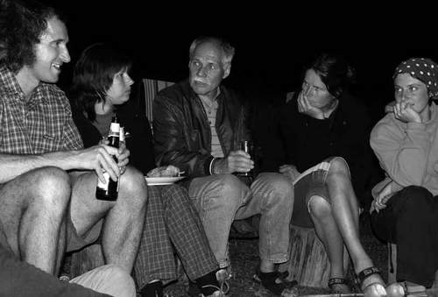
Broader CS: The Ecological Section (Devaux 2010)
“Once the state became too weak to exercise full control over it, this civil society, or important subsets of it, could join the alliance with the antiregime opposition and become a significant force in the process of democratic transition.” Skovajsa (2008)
Bedřich Moldan, co-founder -> “half-dissident”, first minister of environment in 1990

Slide 12
Building a Civil Society
transformation of old associational sector
emergence of a organizations prohibited by the old regime
newly formed organizations (Kubik, 2000: 195)
Processes
legal framework building
resources mobilization
institutionalization and professionalization
Western assistance and funding

Slide 13
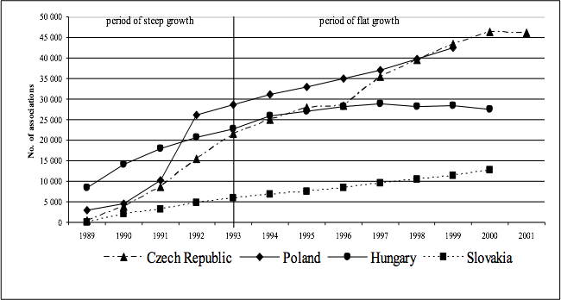
Renaissance of civil society (Mansfeldová et al. 2013)

Slide 14
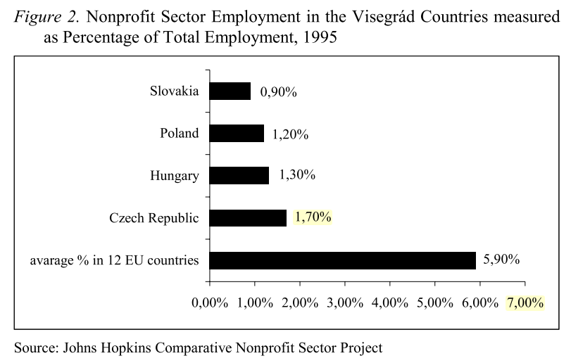

Slide 15
Problems and challenges (Frič 1999, Kuti 1999)
Policy crisis - supportive policy x harmful measures
Identity crisis - lack of coherent sector identity
Sustainability crisis - dependence on foreign funding
Fiscal and economic crises - state reluctant to finance delivery of services
The crises of effectiveness and legitimacy - public distrust towards NGOs
“When the overwhelming majority of NPOs are not able to fulfil their mission for lack of sufficient income, well-trained staff, and satisfactory infrastructure and when some big NPOs are seriously discredited by highly publicized scandals, it can only result in a legitimacy crisis.” (Kuti 1999)

Slide 16
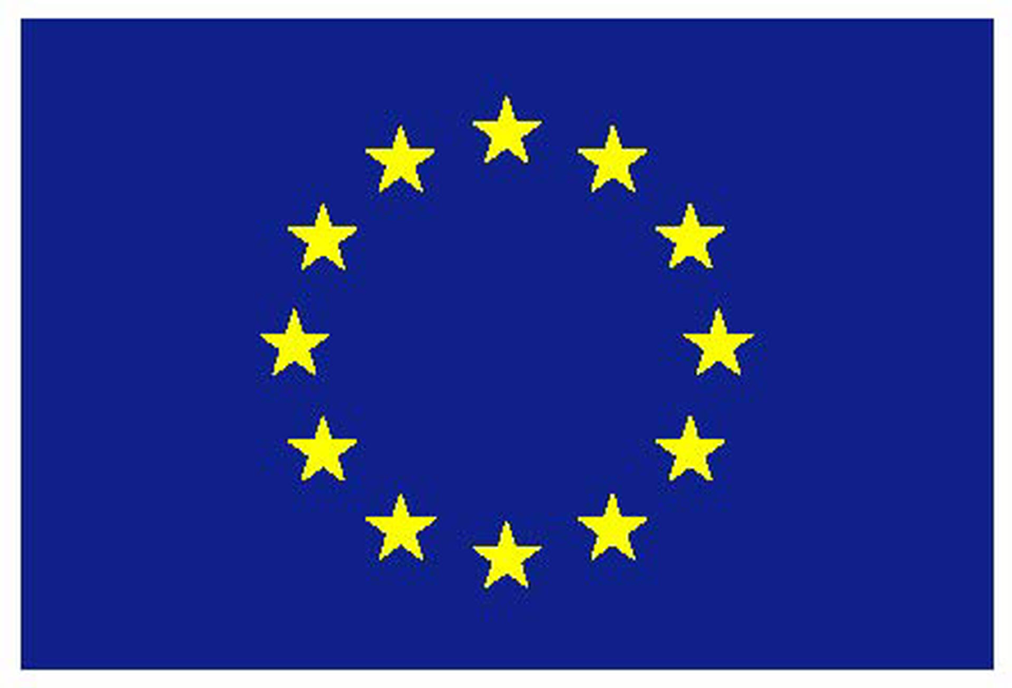
Exporting democracy and foreign funding
Western assistance already during the communist regime
since 1989, American and European state and non-state actors, mainly US-based private foundations, German political foundations
since the end of the 1990s, the European Union (EU) funds - EC/EU program Phare

Slide 17
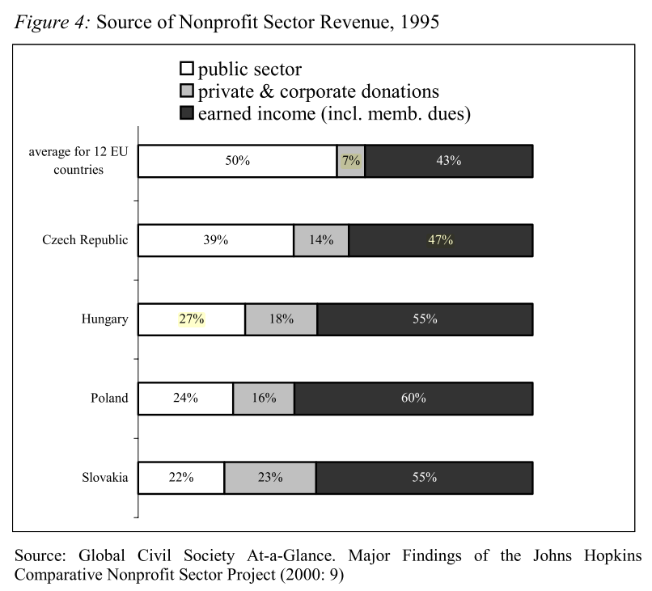

Slide 18
Consequences of foreign funding (Fagan 2005)
NGOs detached from communities
lack of fee-paying members
not connected with local issues
campaigns reflect interests of donors
unaccountable to the societies whose interests they supposedly represent
focus on short-term projects and grant applications, lack of fundraising skills
high competition among the NGOs -> fragmentation and isolation
“The role and function of NGOs is thus ideologically specific: to assist rather than challenge. ... This reality of civil society includes the public only sporadically ... and only to contribute its acclamation.“

Slide 19
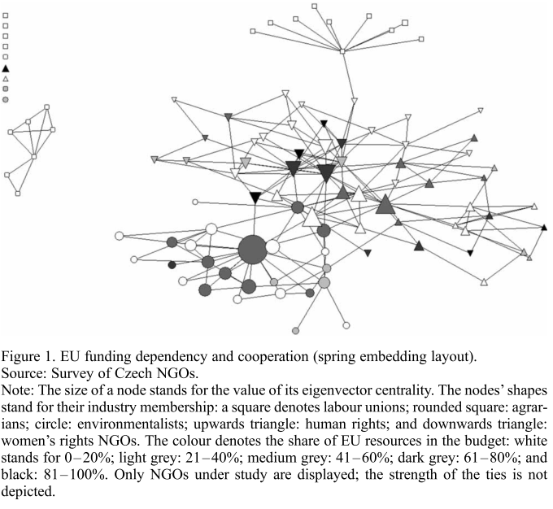
Cooperation thesis (Císař, Navrátil 2015)
EU funding does not hinder willingness to cooperate
increased pressure towards cooperation among recipient organizations

Slide 20
EU pre-accession period (Börzel, Buzogány 2010)
political opportunity structure = “those aspects of the political system that affect the possibilities that challenging groups have to mobilize effectively”
-> affect the possibilities for the civil society to develop / gain more influence
preconditions for success
capacity : state and non-state actors have sufficient resources to engage
culture : an administrative or state culture renders the cooperation with non-state actors an appropriate means to ensure good governance

Slide 21
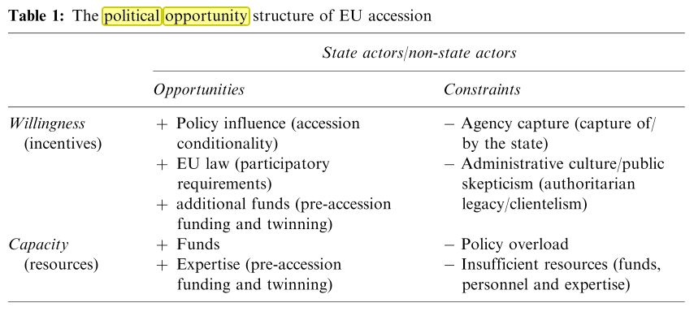

Slide 22
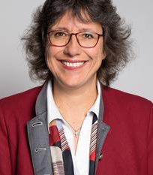
“The new opportunities of accession appear to be distributed among non-state actors according to the St Matthew’s principle – those that already had, got more, but those that did not have, remained empty-handed.”
Tanja Börzel (2010)

