Slide 1
Migration: Basic Questions & Framework
Vilém Semerák, Ph.D.
vilem.semerak@fsv.cuni.cz

Slide 2
Where is this text from?
Give me your tired, your poor,
Your huddled masses yearning to breathe free,
The wretched refuse of your teeming shore.
To spread the light of liberty world-wide for every land.

Slide 3
Topic with a Huge Potential for Conflicts
Security of the target countries
Human rights of the migrants
Rights and convenience of the original inhabitants

Slide 4
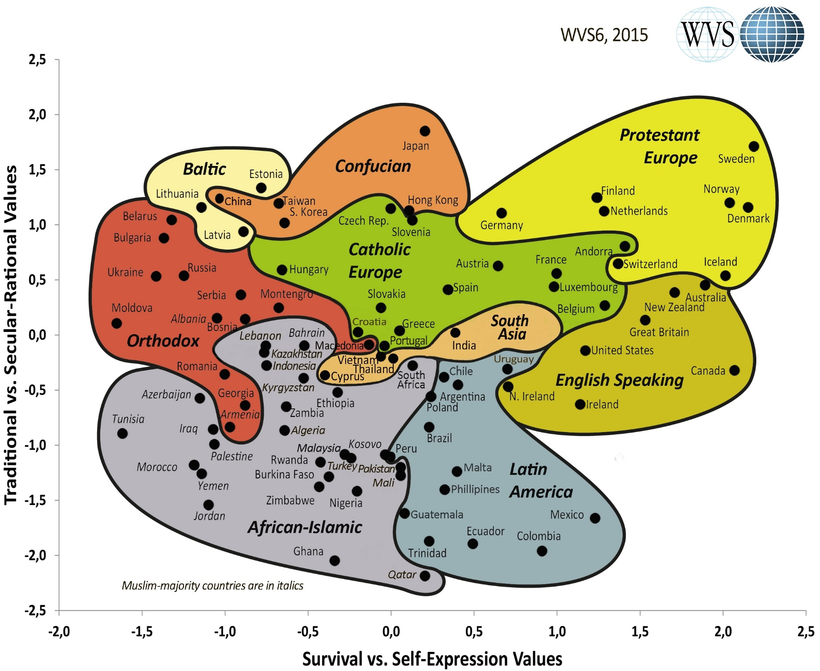
Cultural map - WVS wave 6 (2010-2014)
Source: http://www.worldvaluessurvey.org/WVSContents.jsp

Slide 5
EU and Member States: Competences
Exclusive competence (Art. 3 TFEU)
Customs union, commercial policy, etc.
Shared competence (Art. 4 TFEU)
Internal market
Social policy, limited to the aspects defined in the TFEU
Economic, social and territorial cohesion
Area of freedom, security and justice
Common safety concerns in public health matters, limited to the aspects defined in the TFEU
Development cooperation and humanitarian aid
Competence to support, coordinate or supplement actions of the member states (Art. 6 TFEU)
Civil protection (includes humanitarian aid)
Competence to provide arrangements within which EU member states must coordinate policy (Art. 5 TFEU)

Slide 6
Migration Policy: the Problem
Countries want to regulate migration
Reasons:
Security
Domestic political and economic stability
But they also want to do it without increasing burden for other forms of cross-border traffic
And they want to achieve this while respecting basic standards and human values
Non-democratic countries typically do not experience traditional immigration
Intra-EU dimension: also power struggle between institutions & countries

Slide 7
Topics Shrouded in Many Half-truths and Myths
Implications:
Please, be factual!
Use reliable sources of data and arguments
We need to start discussing the topic systematically
Avoid ad hominem attacks, etc.

Slide 8
Definitions (UN)
Migrant
No formal legal definition of an international migrant
UN documents suggest that an international migrant is someone who changes his or her country of usual residence, irrespective of the reason for migration or legal status.
Generally, a distinction is made between
short-term or temporary migration (movements with a duration between three and 12 months)
long-term or permanent migration (a change of country of residence for a duration of one year or more)
The UN Migration Agency (IOM) defines a migrant as any person who is moving or has moved across an international border or within a State away from his/her habitual place of residence, regardless of (1) the person’s legal status; (2) whether the movement is voluntary or involuntary; (3) what the causes for the movement are; or (4) what the length of the stay is.
United Nations Department of Economic and Social Affairs
https://refugeesmigrants.un.org/definitions

Slide 9
Definitions (UN)
Refugee
Refugees are persons who are outside their country of origin for reasons of feared persecution, conflict, generalized violence, or other circumstances that have seriously disturbed public order and, as a result, require international protection.
The refugee definition can be found in the 1951 Convention and regional refugee instruments, as well as UNHCR’s Statute.
United Nations High Commissioner for Refugees
https://refugeesmigrants.un.org/definitions

Slide 10
If you are not sure about meaning/context:
https://www.iom.int/key-migration-terms

Slide 11
Migration: Numbers
In 2017, the number of migrants reached 258 million,
“only” 173 million in 2000.
Relative to proportion of global population:
3.4% in 2017, compared to 2.8% in 2000 and 2.3% in 1980.
There were approximately 68 million forcibly displaced persons, including over 25 million refugees, 3 million asylum seekers and over 40 million internally displaced persons.
31% of the international migrant stock worldwide reside in Asia, 30% in Europe, 26% in the Americas, 10% in Africa and 3% in Oceania
Precise data are a huge problem!
http://www.un.org/en/sections/issues-depth/migration/index.html

Slide 14
The size of migration flows within and between 15 world regions in 2005 to 2010
Source: http://science.sciencemag.org/content/343/6178/1520.full

Slide 15
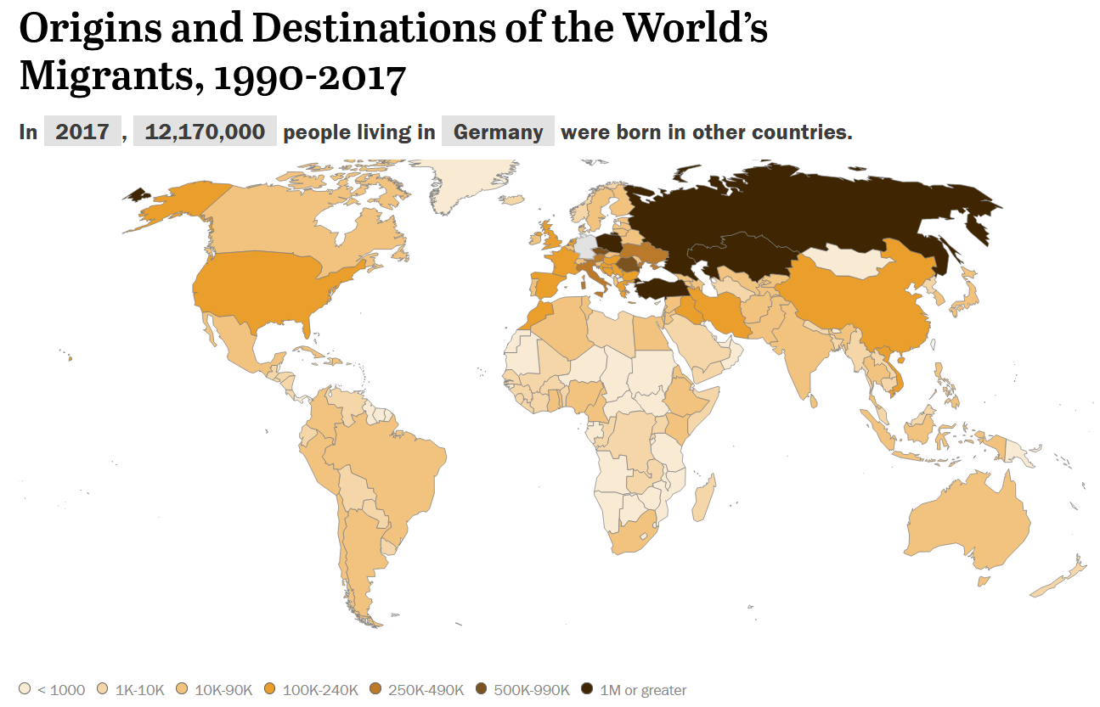

Slide 16
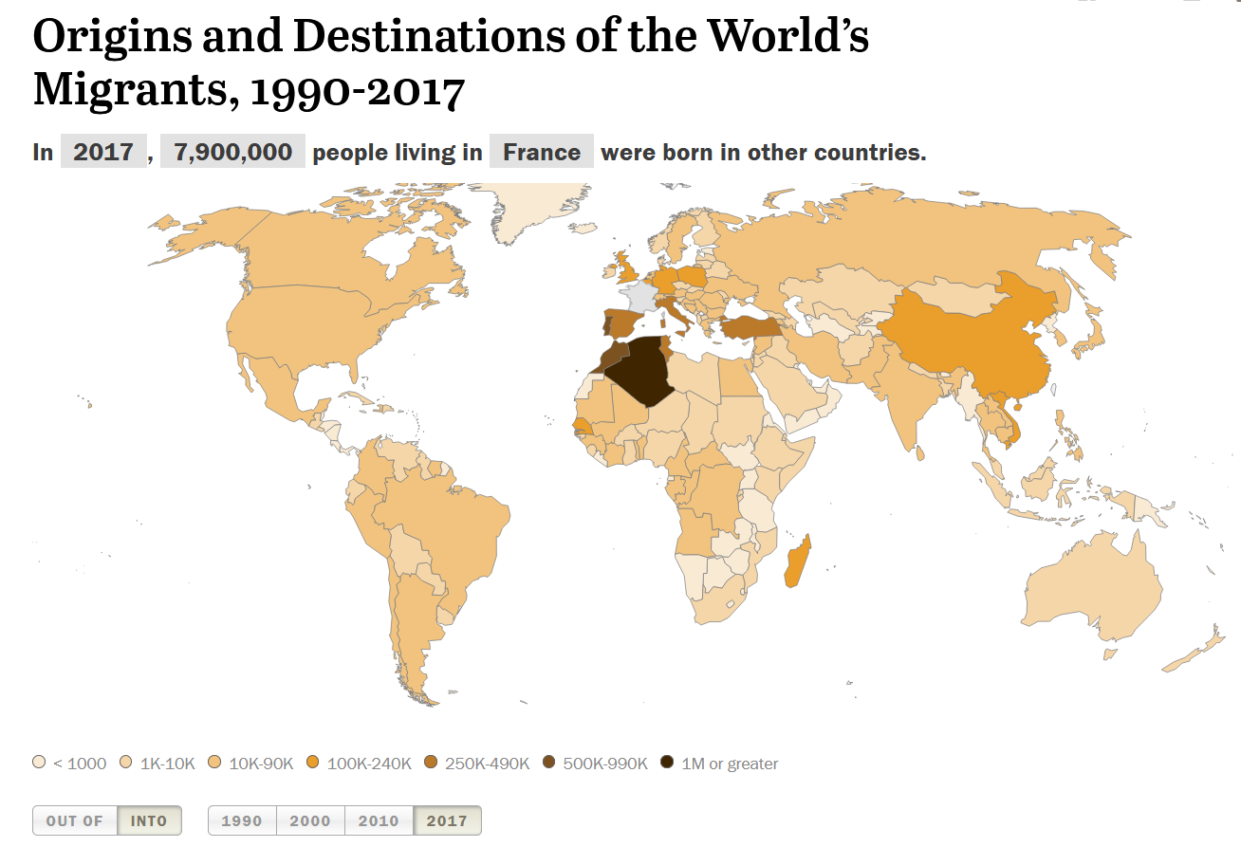

Slide 17
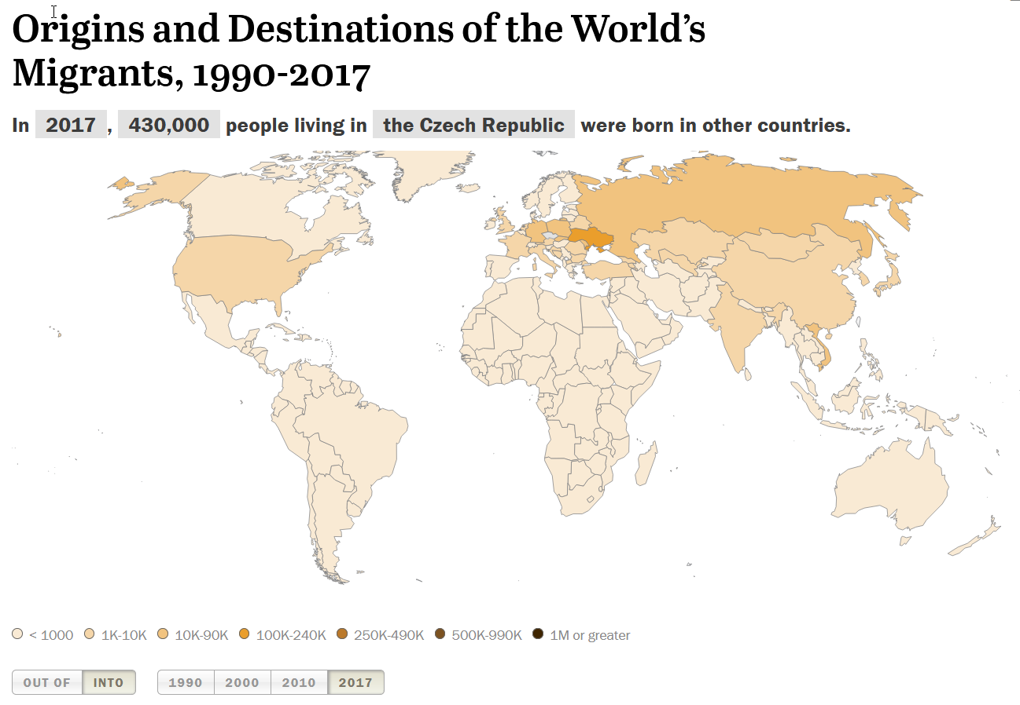
http://www.pewglobal.org/2018/02/28/global-migrant-stocks/?country=CZ&date=2017

Slide 18
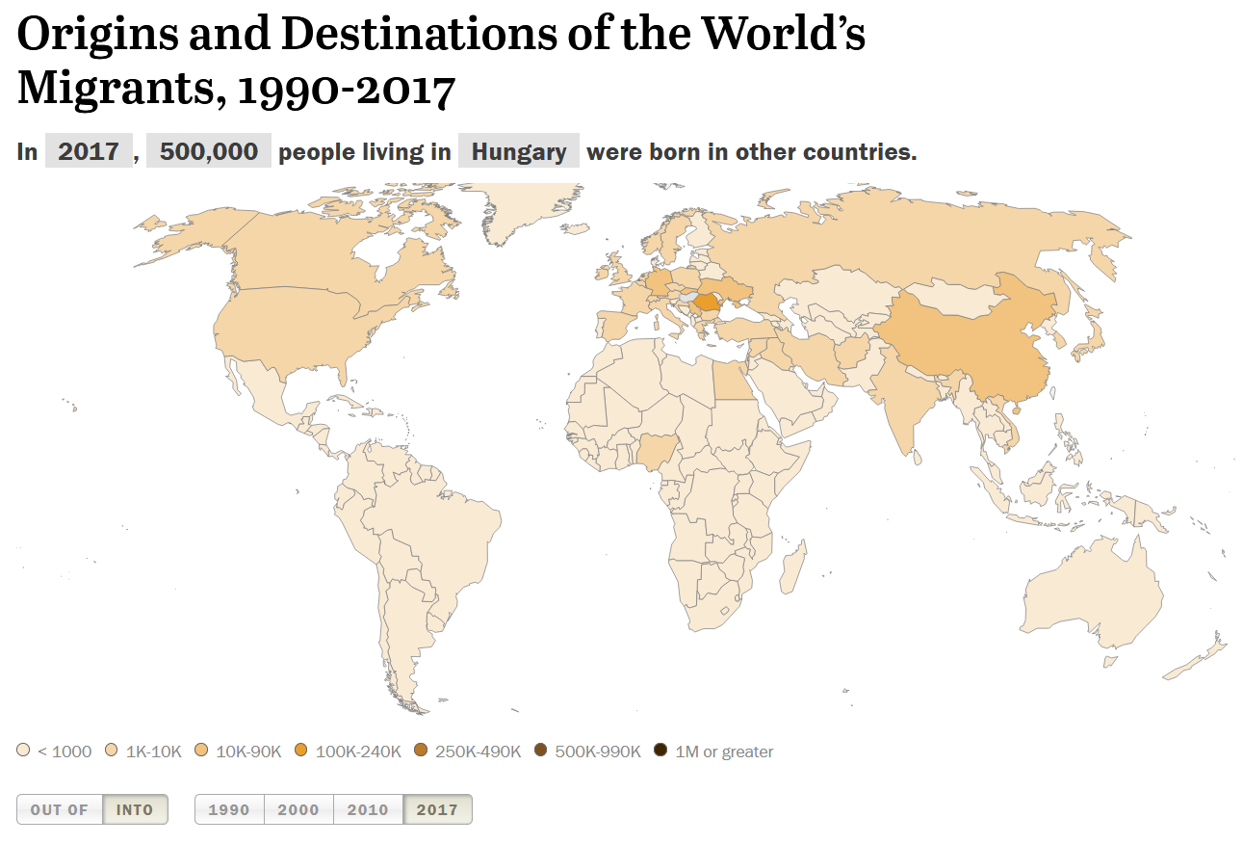
http://www.pewglobal.org/2018/02/28/global-migrant-stocks/?country=HU&date=2017

Slide 19
Basic Framework
International law
EU level National level

Slide 20
The Right of Asylum
Ancient juridical concept
A person persecuted by one's own country may be protected by another sovereign authority, such as another country or a church official
This right was recognized by the Egyptians, the Greeks, and the Hebrews, from whom it was adopted into Western tradition:
René Descartes - the Netherlands
Voltaire - England
Thomas Hobbes - France

Slide 21
Universal Declaration of Human Rights (1948)
Article 13.
(1) Everyone has the right to freedom of movement and residence within the borders of each state.
(2) Everyone has the right to leave any country, including his own, and to return to his country.
Article 14.
(1) Everyone has the right to seek and to enjoy in other countries asylum from persecution.
(2) This right may not be invoked in the case of prosecutions genuinely arising from non-political crimes or from acts contrary to the purposes and principles of the United Nations.
Article 15.
(1) Everyone has the right to a nationality.
(2) No one shall be arbitrarily deprived of his nationality nor denied the right to change his nationality.

Slide 22
Additional Documents
The 1951 Refugee Convention
Ratified​ by 145 State parties
Defines the term ‘refugee’ and outlines the rights of the displaced, as well as the legal obligations of States to protect them.
2016: New York Declaration for Refugees and Migrants
2018: The Global Compact on Refugees
2018: The global compact for safe, orderly and regular migration
The Comprehensive Refugee Response Framework.
Documents with contents available at the moodle site

Slide 23
The Global Compact on Refugees
The Compact was affirmed by the member states of the UN General Assembly on 17 December 2018 in the annual resolution on the work of UNHCR.
The global compact on refugees aims to strengthen the international response to large movements of refugees and protracted refugee situations.
Its four key objectives are to:
Ease the pressures on host countries;
Enhance refugee self-reliance;
Expand access to third-country solutions;
Support conditions in countries of origin for return in safety and dignity.

Slide 24
Migration Compact
The compact:
Aims to mitigate the adverse drivers and structural factors that hinder people from building and maintaining sustainable livelihoods in their countries of origin;
Intends to reduce the risks and vulnerabilities migrants face at different stages of migration by respecting, protecting and fulfilling their human rights and providing them with care and assistance;
Seeks to address the legitimate concerns of states and communities, while recognizing that societies are undergoing demographic, economic, social and environmental changes at different scales that may have implications for and result from migration;
strives to create conducive conditions that enable all migrants to enrich our societies through their human, economic and social capacities, and thus facilitate their contributions to sustainable development at the local, national, regional and global levels.
Source: https://refugeesmigrants.un.org/migration-compact

Slide 25
Global and EU Level: Perspectives
State-centric approaches
Supranational solutions
Reality:
both immigration to and movement within Europe is now governed by a complex amalgam of institutions and processes operating on local, national, European, and international scales;
in short, European migration governance is a paradigm of ‘multilevel governance’ (Hooghe and Marks 2001).

Slide 26
EU Migration Structures
Before 1999 – ad hoc cooperation at intergovernmental level
EU Summit in Tampere (1999): agreed to create a common asylum and migration policy.
2009 Treaty of Lisbon migration policy-making was brought under the ordinary legislative procedure, with ‘co-decision’ between the European Parliament (EP) and the Council, and Qualified Majority Voting (QMV) in the latter.
Migration governance remains an area of shared competence

Slide 27
More details:
Hampshire (2016): European migration governance since the Lisbon treaty: introduction to the special issue.
Provided at Moodle

Slide 28
Differences in Attitudes of EU Countries
Historical aspects
Guilt?
Geographical location
Country of entry?
Demographic factors
Ageing and availability of labour?
Level of development
Richer or new member country?
Timing?

Slide 29
Logic of Migration Flows: Gravity
1885 – Ravenstein (migration)
Gravity models can be used to better assess the impacts of migration policy, for instance, the effects of visa restriction policies on migration flows.
Beine et al.: A practitioners’ guide to gravity models of international migration (available at moodle)

Slide 30
What next?
Next week we will discuss:
Economic models
Migration flows and their sensitivity: gravity model
Economic effects of economic migration
Cultural differences between nations
How much different are we?

Slide 31
References
Hill – chapter 12 Managing Cultural Differences
Pew data on migration - http://www.pewglobal.org/2018/02/28/global-migrant-stocks/?country=HU&date=2017
Universal Declaration of Human Rights
https://refugeesmigrants.un.org/definitions
Hampshire (2016): European migration governance since the Lisbon treaty: introduction to the special issue. JOURNAL OF ETHNIC AND MIGRATION STUDIES, 2016 VOL. 42, NO. 4, 537–553
Global compact for migration - draft

