Slide 1
Social welfare systems in Europe (3)
Walter Lorenz

Slide 2
Decline of the Western post-WW2 Welfare State
1970s Oil crisis, rising unemployment, state budget deficits,
1981 crisis of the welfare state declared: no longer a (profitable) investment in stability and integration in the future of society, but seen as a burden, costs exceeded benefits, therefore cutting back on benefits (declared as “too generous”)
1989: collapse of the Soviet Union, end of Communism in Europe, end of competition between “really existing socialism” in the East and “social market capitalism” in the West.
1990s: Margaret Thatcher / Ronald Reagan: “workfare, not welfare”: welfare benefits conditional on willingness to work; privatisation of public services; “less government”; New Public Management as instrument for cost cutting.
2002: Schröder Chancellor Germany: Hartz Reform: social benefits severely reduced and made conditional on “activation” programmes
Globalisation and the reduction of import taxes enforces competition so that firms have an incentive to move to low-wage, low social contribution countries to cut production costs, leading to higher unemployment in countries with good welfare insurance systems;
International competition under unequal workers’ rights conditions forces the reduction of welfare benefit structures and causes de-regulation with more precarious working conditions (less job security, less benefits, more temporary jobs (“the working poor”)

Slide 3
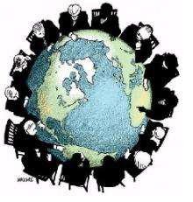
Neo-liberalism
Neo-liberalism is a largely unregulated capitalist system with a set of economic policies that limits restrictions on manufacturing, reduces barriers to commerce, reduces tariffs, and free trade that came up to develop a nation's economy.
It is essentially about making trade between nations easier.
It is about freer movement of goods, resources and enterprises to maximize profits and efficiency.

Slide 4
neo-liberalism
emphasis on liberating private enterprise from government restrictions even at high social costs | Rule of the market
Reducing expenditure on public services like education and health | Cutting public expenditure
limits government regulation on anything that protects safety of jobs, promotes profit incentive | Deregulation
selling state-owned enterprises, services and goods to investors who operate them privately | Privatisation
pressurizes the poorest to find own solutions for their lack of education, health and social security; puts the responsibility for their failure on themselves and blames them for their lack of effort. | Removing the concept of the community or public good

Slide 5
From welfare state to the “social investment state”
Expenditure on welfare is not decreasing but continues to expand despite political calls for reductions – why?
Le Grand (1990: 344) analyses the development in expenditure for various categories and concludes that “trends in expenditure seem to have followed trends in needs.” The explanation he offers is the middle class-thesis, i.e. that areas that are of interest to the middle class developed the most. Governments cannot afford to deprive those who have gained from the welfare state most of continuing support (see ageing population: longevity is the result of better welfare, pensioners are important voters).
However, support is shifted from public to private providers (benefiting again the middle class most): “welfare mix”: private firms and the voluntary sector-
“the activating state” (instead of the “providing state”); shift from supporting the interests of workers to supporting the interests of employers. (“Post-industrial society”)
Welfare as investment that has to “pay off” in terms of higher productivity and competitiveness: personalizing / individualizing social service attention

Slide 6
Social policy patterns in some post-communist countries
The Czech Republic represents the model for gradualist transformation that respects traditional institutions and social goals.
Estonia’s is that of shock therapy, both in the economic and social realms.
Poland, opted to modernize its economy, leaving social matters to fend for themselves, as it were. In fact, Poland has not been carrying out social reforms to their conclusion, as there has not been sufficient determination.

Slide 7
Effects of 1989 on post-communist welfare
„shock therapy“ to facilitate a rapid change of the economic principles towards capitalism: private property, economic freedom, privatisation: „transformation poverty“, high unemployment, low skills levels;
Welfare protection targeted on elderly citizens and low-skilled people; promotion of „entrepreneurship“ (find your own solutions)
Strong influence by international organisations (World Bank, WTO, EU)
Slow construction of social dialogue (democratic trade unions)
Dramatic shifts in demography: trends towards ageing population increased by massive emigration of younger people to industrial centres abroad
Increasing costs in health care due to „modern treatment“ methods

Slide 8
Impact of EU membership on CEE countries
Health and safety at work regulations
Employment rights (Employment Rights Charter)
Gender equality policies
Combat poverty and social inclusion
Harmonisation of education systems (Bologna process)
Student mobility (Erasmus)
Structural funds, Cohesion fund

Slide 9
EU trends in welfare after enlargement to former communist countries
Impact of EU social policies only through the „Open Method of Coordination“ (OM): implementation largely of the principle of subsidiarity
Private industry enlisted in social assistance forms („Corporate Social Responsibility)“ instead of reliance on the state
European Social Fund and other programmes give incentives to non-governmental welfare organisations to become active andmore independent from the state

Slide 10
Shared characteristics of CEE member states of EU (Transition Economies) STANISŁAWA GOLINOWSKASource: Polish Sociological Review, 2009, No. 166 (2009), pp. 273-296
High dynamic of demographic changes
Bigger labour market problems (unemployment, emigration)
Difficulties in keeping „welfare promises“ stemming from former regime in areas of pensions, disability, health protection
Encouraging individual responsibility and initiative, using expert advice without becoming authoritarian
Vulnerability of non-governmental organisations to mis-management and corruption
High education aspirations of young generation
Growing problems of social exclusion
Low trust in formal institutions

Slide 11
Demographic challenges
Changes in family structure: e.g. UK Twenty years ago, nearly 80 percent of women with children were in married couples; today the figure is just barely over 50 percent. The proportion of lone mothers has risen to nearly 30 percent,
Ageing population:

Slide 12
Life expectancy in Europe for those born 2017

Slide 13
Percentage of population over 65

Slide 14
% increase in >65 population from 2006-2016

Slide 15
Old age dependency ratio (65+/15-64)

Slide 16
EU population age / sex

Slide 17
Distribution of EU immigrant population by residence country, 2014, %

Slide 19
Economic changes:
Economic globalisation, combined with EU policies, emphasises competitiveness, free market principles
Restricts autonomous social policy making by nation states
Results: growing discrepancy between rich and poor (“poverty gap”: “The poverty gap is the ratio by which the mean income of the poor falls below the poverty line. The poverty line is defined as half the median household income of the total population. The poverty gap helps refine the poverty rate by providing an indication of the poverty level in a country. This indicator is measured for the total population, as well as for people aged 18-65 years and people over 65.“

Slide 20
Poverty gap according to OECD 2015

Slide 21
Poverty rate

Slide 24
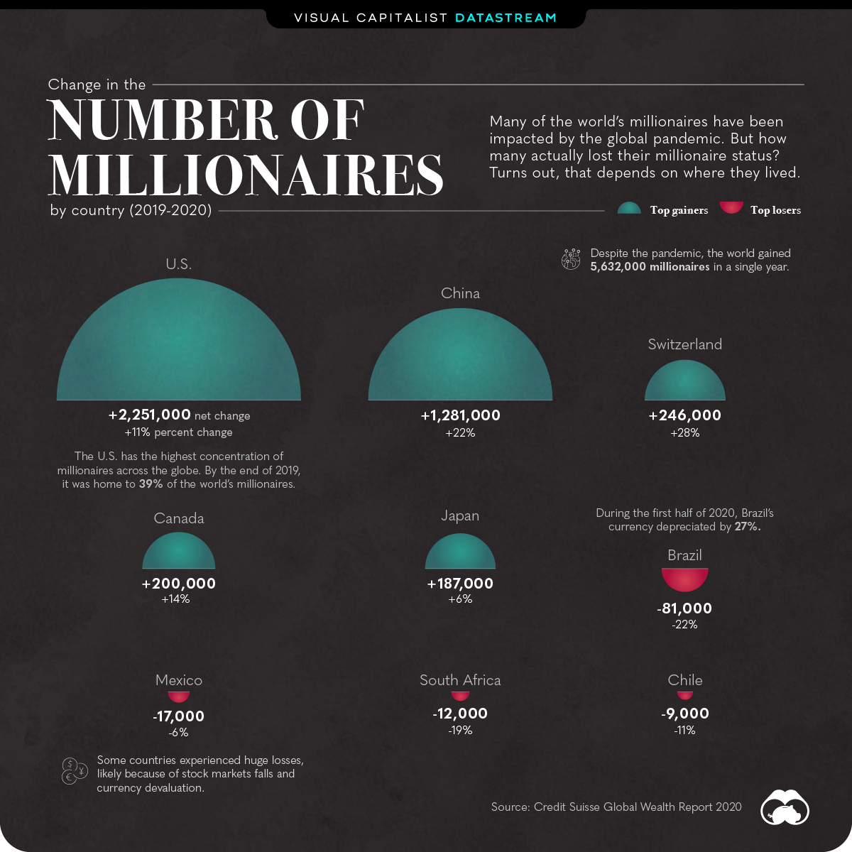

Slide 25
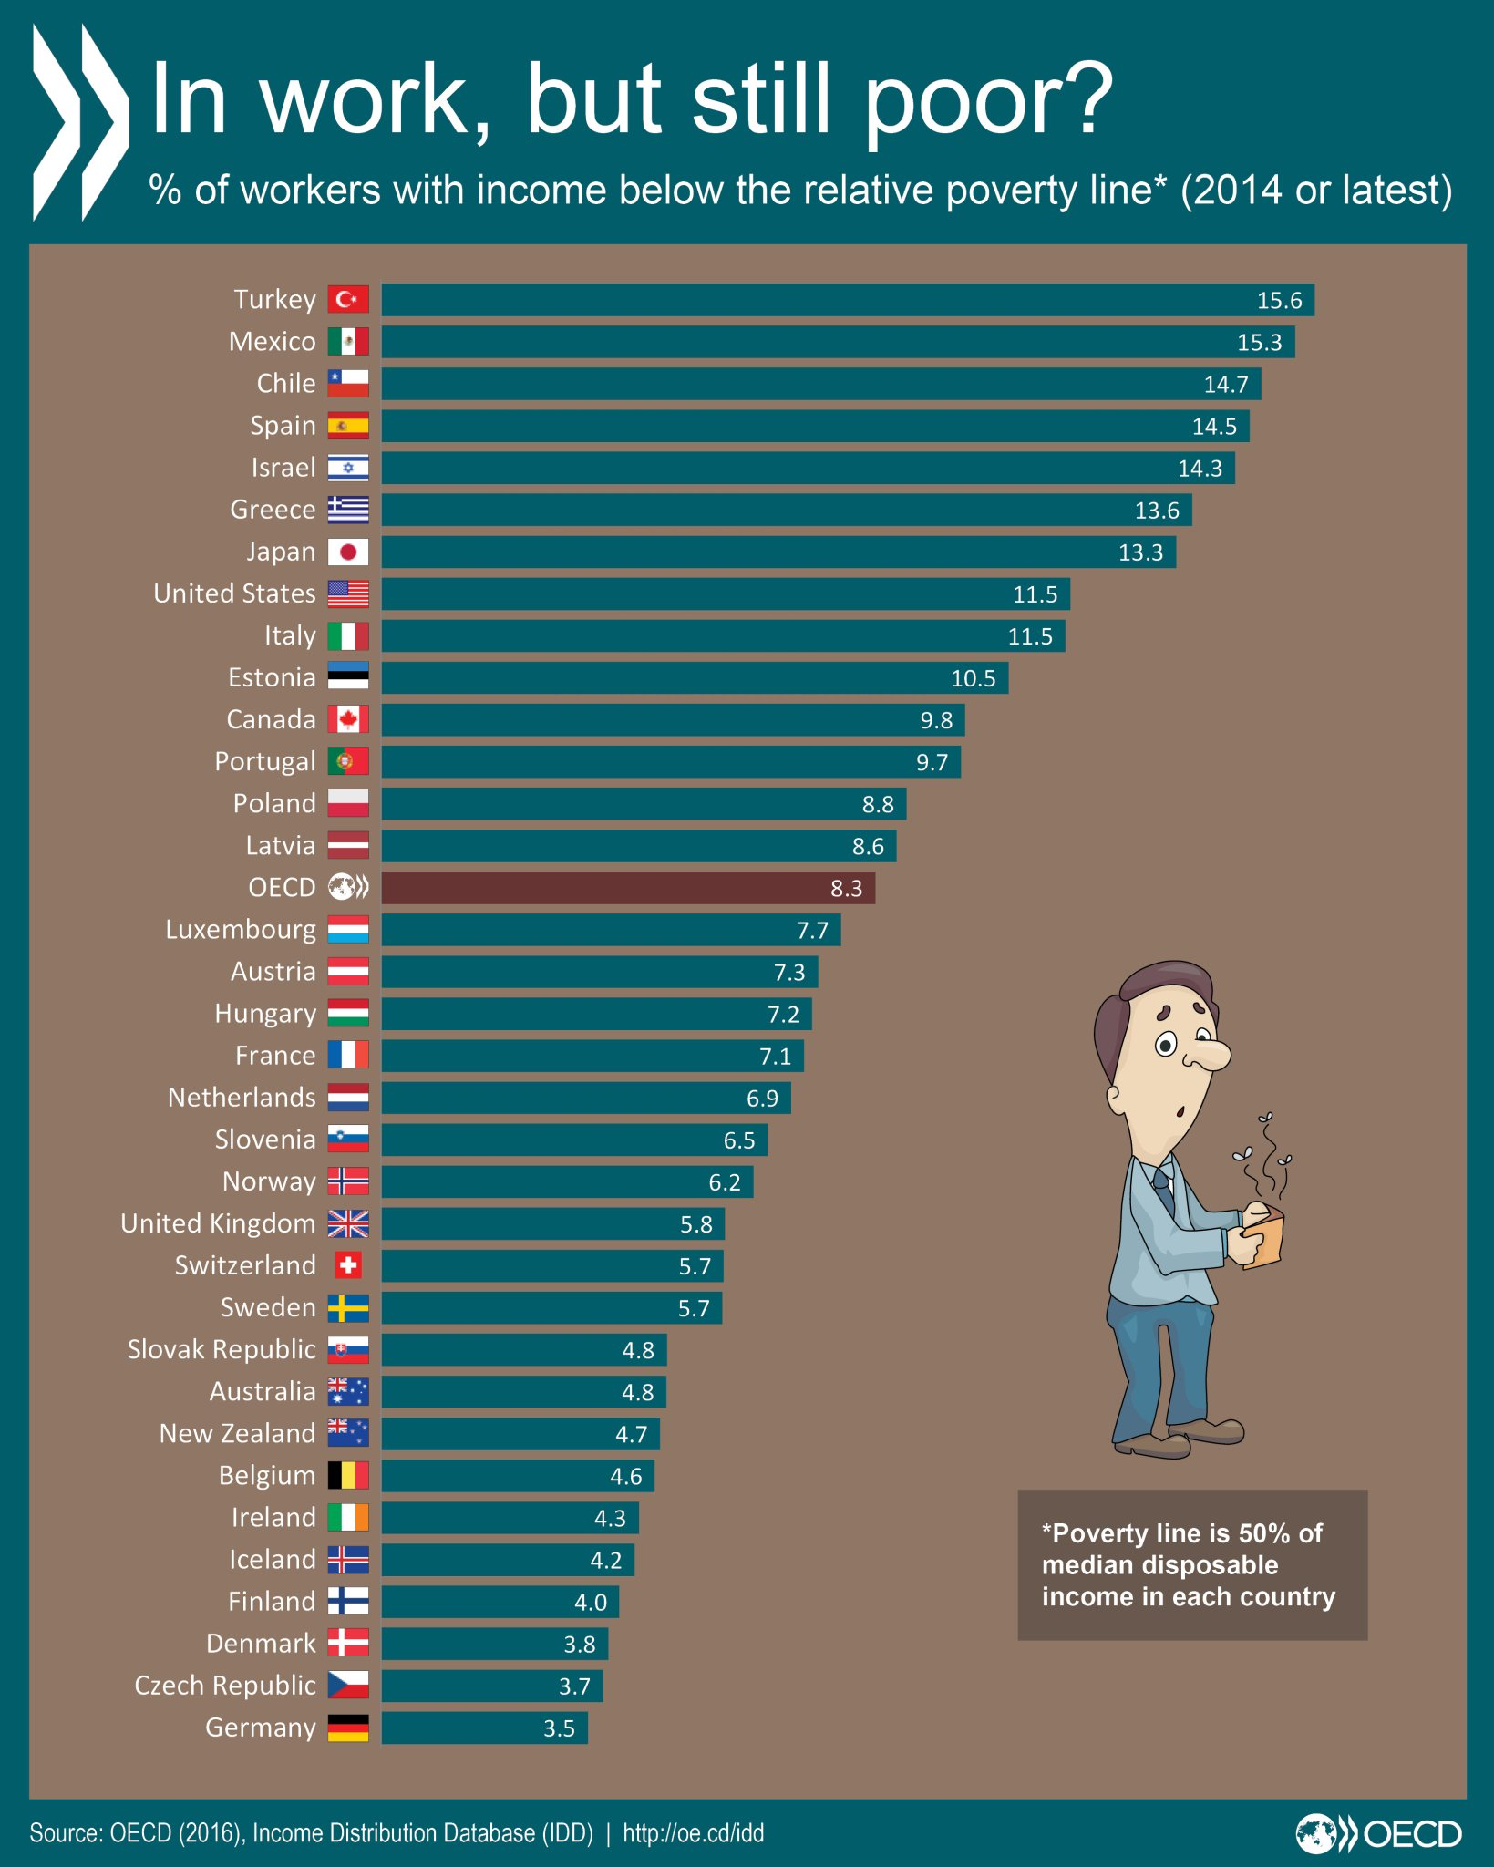

Slide 26
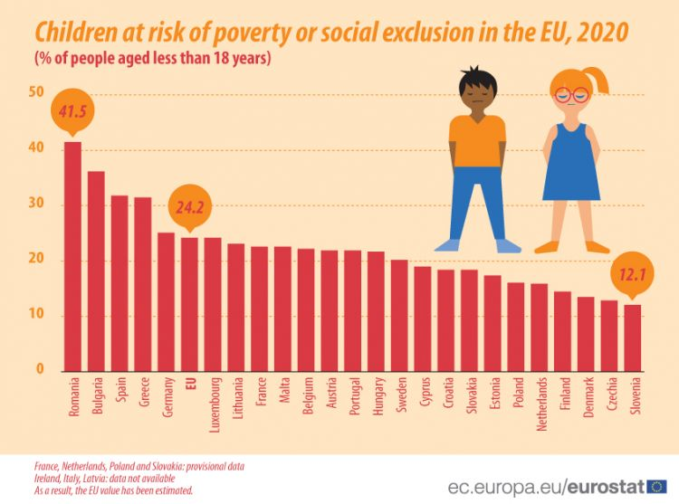

Slide 33
Legislation producing different care regimes:
Family leave policies grant parents the right to take time off for caregiving, especially when children are below school-age, and they replace some or all wages during parents’ time off. Short-term paid leaves also contribute to gender equality in the labor market by facilitating continuous maternal employment and reducing wage penalties associated with motherhood.
working time regulations can free up parents’ caring time – for both fathers and mothers – by limiting normal employment hours to, say, fewer than 40 per week and by guaranteeing a minimum number of days for annual vacations. Some feminist scholars have concluded, furthermore, that shortening working time may be the most promising tool for achieving a gender-egalitarian redistribution of domestic labor.
public provisions for early childhood education and care further strengthen maternal employment by providing alternatives to full-time maternal caregiving and high-quality early education and care can also enhance child well-being. Public financing and delivery – rather than a market-based system – alleviates the economic burden of childcare costs, especially for low-income families, and raises the wages of the caregiving workforce as well.

Slide 34
Leave in weeks, maternity=paid, parental paid or unpaid

Slide 36
demography (life expectancy, drop in fertility, migration)
economic globalisation (competition, precarious contracts, reduced labour force)
liberalisation politics (reduction of spending, management and privatisation

Slide 37
demography (life expectancy, drop in fertility, migration)
economic globalisation (competition, precarious contracts, reduced labour force)
liberalisation politics (reduction of spending, management and privatisation

Slide 38
demography (life expectancy, drop in fertility, migration)
economic globalisation (competition, precarious contracts, reduced labour force)
liberalisation politics (reduction of spending, management and privatisation

Slide 39
demography (life expectancy, drop in fertility, migration)
economic globalisation (competition, precarious contracts, reduced labour force)
liberalisation politics (reduction of spending, management and privatisation
welfare

Slide 40
Dependence on foreign workforce

Slide 41
Is there still such a thing as the‘European social model’? Bilbao‐Ubillos, Javier. "" International Journal of Social Welfare 25, no. 2 (2016): 110-25
Social protection systems differ according to:
(i) the economic capability of systems, estimated by percapita income;
(ii) the socio-demographic characteristics of the populations, which basically give rise to specific situations of risk and necessity for which public sector decision makers choose to provide cover;
(iii) country-specific political, institutional and culturalelements that reflect a bond of entitlement between citizens whose level is determined by successive legislation and decisions adopted in the past.

Slide 42
(cont.d) – CEE countries cannot fully adopt welfare levels and models of other EU countries
the absence of social policy criteria in the Community acquis (= the accumulated legislation, legal acts and court decisions which constitute the bodyof European Union law): no harmonization of social protection (CEE economy is “competitive” because of lower social conditions of workers)
high public expenditure cannot be covered by higher taxation without creating disincentives for enterprise
financial crisis of 2008 forced further spending cuts where public expenditure would be necessary
the most plausible chance of any convergence between Western and Eastern EU countries regarding the ESM seems to lie in the deterioration of the situation in Western countries, that is, in a downward convergence

Slide 43
The Social Divide and the Populist Vote. A Challenge for the Welfare State
The social divide has been on the rise in Europe over the past decades. High and rising inequality harms our societies and hampers social cohesion. It can explain the populist revolt illustrated by the election of Donald Trump, the victory of Brexit, and the electoral success of the French Front National. As expressed by Michael Sandel (2017), this revolt resulted from the failure of elites to grasp the discontent roiling politics in democracies around the world. (It) marked the rejection of a technocratic approach to politics incapable of understanding the resentments of voters who feel the economy and the culture have left them behind.
The socio-economic divide is not only about juxtaposing ‘the rich’ and ‘the poor’ in terms of wages or incomes. The phenomenon is a complex web involving accumulated wealth or debts, but it also has to do with health status, quality of jobs, education, and perception of social mobility, and migration threat. This complexity constitutes a huge test for the welfare state whose toolbox is not prepared to cope with these problems. Adapting our policy instruments to deal with the social divide is one of the most serious challenges faced by modern welfare states
Pestieau, P., & Lefebvre, M. (2018-08-30). Introduction. In The Welfare State in Europe: Economic and Social Perspectives. : Oxford University Press.

Slide 44
