Slide 1
Social welfare systems in Europe (2)
Walter Lorenz

Slide 2
European welfare developments before World War II
Largely responses to crises (war-effects, pandemic!, unemployment, poverty, class division): uneven development, political compromises.
In post-Habsburg countries, the social institutions created were directed at mitigating needs of people who were in particularly difficult situations. Law on social care passed in Poland in 1923 endured until 1990, typical for Central and Eastern European countries (Zalewski 2005). Social assistance was based on the local authorities' cooperation with local civic organisations responsible for the fate of the poorest people. In Poland mainly religious organisations (Caritas), benefits predominantly in kind: food, accommodation, fuel in winter …
Reliance on “container institutions” (asylums for poor, disabled, mentally ill, orphaned people)

Slide 3
History of Soviet welfare measures 1917-1992
Utopian era (post 1017 revolution): Lenin promises comprehensive social security measures (income maintenance) – cannot be kept because of economic difficulties
Realism: 1920s – limited protection for skilled workers, investment in health and education, concentrated on urban areas (solidarity of workers)
Industrial emphasis (1928): unemployment benefits abolished by Stalin, work a civil duty, doctors mainly attached to hospitals (control of “real illness”); investment in education (future labour force) housing, disability, pensions neglected.
1950s Khrushchev reaffirms original social policy commitments: equality, public housing, workers’ access to higher education, old-age pensions doubled.
Constant threat: only economic growth can guarantee the realisation of the plans – state is forced to become practically a capitalist entrepreneur (workers do not receive the full benefit of the surplus they produce).
Social policy is used to support the economy primarily, not the needs of the population.

Slide 4
Renewed support for public welfare after World War II in Western Europe – motives:
Reward for returning soldiers (“a country fit for heroes”, Britain) – war bonus
Anti-fascism, anti-Nazism bonus: promoting a voluntary commitment to the nation, de-centralised organisation
Anti-communism (Cold War bonus): The West has to look after citizens better than the East; German model: Social Market Economy
Trend towards “de-commodification” : everybody should be able to benefit from support irrespective of personal financial resources – social class equality bonus

Slide 5
Principle of “De-commodification” (Esping-Andersen)
“De-commodification occurs when a service is rendered as a matter of right, and when a person can maintain a livelihood without reliance on the market. De-commodification strengthens the worker and weakens the absolute authority of the employer.”
- Which social services today are de-commodified and to what extent?

Slide 6
Fundamental, contrasting notions of welfare
 | Socialist welfare | Marketised welfare
Core principles | Equality: „to each according to their needs“ | Liberty: „to each according to their abilities / efforts“
Anthropology | Humans are inseparable of community (the collective creates individuals) | Humans are free agents making rational choices in their own interest, individuals choose groups
Provider of main support | „the collective“ (the state) | The individual (as entrepreneur)
Process | Social planning (collective targets) | Market as efficient distributor of goods according to demand
Dangers | Loss of freedom, state control | Deep social divisions

Slide 7
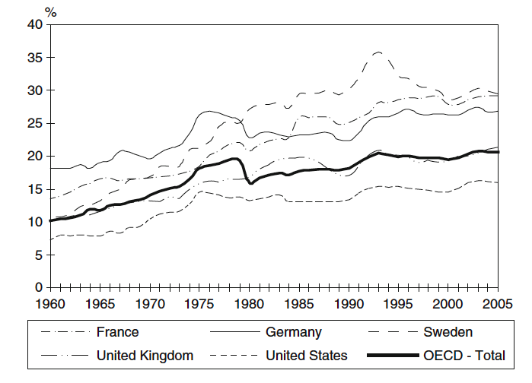
Social expenditure in % of GDP

Slide 8
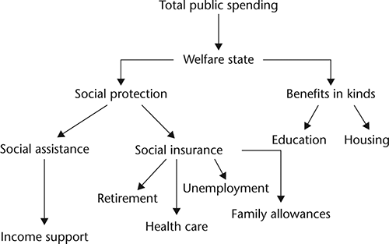

Slide 9
Main welfare concerns in the first decades after World War II
secure growth,
full (male) employment,
predictable welfare needs (education, health, pensions, housing)
homogenous societies,
dominance of class over identity-politics ad
national political-economic independence

Slide 10
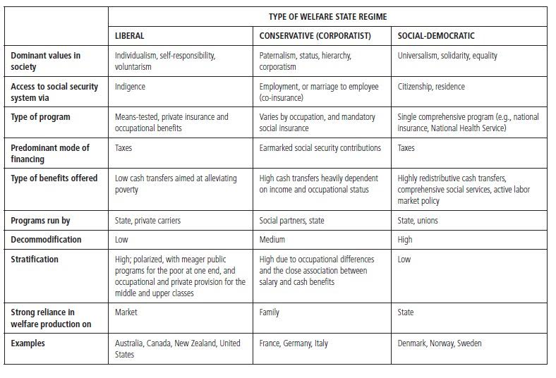

Slide 11
How many of those bonuses are still valid today after 1989?
War – a long time past
Fascism and Nazism – not seen as an issue of social policy
Cold War – „resolved“ after 1989
Class differences – stimulus for individual effort (activation)

Slide 12
Did this result in a European Social Model (ESM)?
Busch,Hermann, Hinrichs, and Schulten (2013) six policy objectives:
policy aimed at full employment;
wage policy: wage increases that reflect productivity growth; European minimum wages
social security systems: pension, healthcare and family policy, unemployment benefit;
participation rights: co-determination in firms, social dialogue
strong public sector to stabilising the level of employment;
incorporation of a social progress clause into the EU Treaty that gives basic social rights priority over marketfreedoms

Slide 13
Limits to EU making social policies
The principle of subsidiarity determines when the EU is competent to legislate, and contributes to decisions being taken as closely as possible to the citizen (article 5 of the Treaty on European Union).
This means: social policy remains largely the responsibility of the single member state and the EU can only determine “framework conditions” and compensatory programmes (European Social Fund, European Regional Fund …)

Slide 14
subsidiarity
The Union can therefore only act in a policy area if:
the action forms part of the competences conferred upon the EU by the Treaties (principle of conferral);
in the context of competences shared with Member States, the European level is most relevant in order to meet the objectives set by the Treaties (principle of subsidiarity);
the content and form of the action does not exceed what is necessary to achieve the objectives set by the Treaties (principle of proportionality).

Slide 15
EU social objectives
Article 2 of the Treaty on European Union states that the Union’s aim is to promote the well-being of its peoples and beside a “highly competitive social market economy” it aims at “full employment and social progress”.
It also states “It shall combat social exclusion and discrimination, and shall promote social justice and protection, equality between women and men, solidarity between generations and protection of the rights of the child”.

Slide 16
EU social policy initiatives
1994 White Paper European Social Policy: a WayForward for the Union - shared values: democracy and individual rights, free collective bargaining, the market economy, equal opportu-nities for all, social welfare and solidarity
2000 European Council at Nice confirms principles
2000 Lisbon Strategy – making EU "the most competitive and dynamic knowledge-based economy in the world capable of sustainable economic growth with more and better jobs and greater social cohesion" by 2010
cont.d

Slide 17
2001 Communication on Employment and SocialPolicies: a Framework for Investing in Quality
2005 European Values in a Globalised World:‘unity and diversity in shaping economic and social policies’
Overview of regional integration policy:
https://ec.europa.eu/regional_policy/en/policy/what/history/

Slide 18
EU Instruments with social implications
European Social Fund (ESF): main instrument for supporting jobs, helping people get better jobs and ensuring fairer job opportunities for all EU citizens. It works by investing in Europe’s human capital – its workers, its young people and all those seeking a job. ESF financing of EUR 10 billion a year is improving job prospects for millions of Europeans, in particular those who find it difficult to get work
view: https://ec.europa.eu/esf/videos_include.jsp?mode=1&videoId=2521&vl=en&langId=en

Slide 19
European Regional Development Fund (ERDF):
'thematic concentration’ on key priority areas:
Innovation and research;
The digital agenda;
Support for small and medium-sized enterprises (SMEs);
The low-carbon economy.

Slide 20
Cohesion Fund: set up in 1994, provides funding for environmental and trans-European network projects in the Member States whose gross national income per capita is less than 90% of the EU average.
The Just Transition Fund is a new instrument of the Cohesion Policy 2021-2027, as the first pillar of the Just Transition Mechanism in the context of the European Green Deal aiming at achieving the EU climate-neutrality by 2050.
REACT-EU is a legislative proposal to repair the social and economic damage caused by the COVID-19 pandemic, and to prepare for a green, digital and resilient recovery. REACT-EU seeks to mobilise an additional EUR 58 billion for the structural funds in the 2020-2022 period, and to increase flexibility in cohesion policy spending

Slide 21
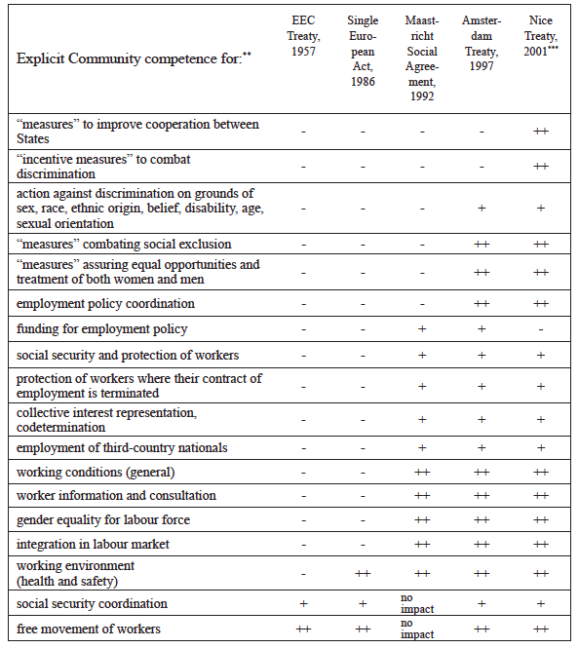

Slide 22
In 2007 the European Globalisation Adjustment Fund (EGF) started with a budget of some 500 million euro a year. Its aim is to help workers made redundant as a result of changing global trade patterns to find another job as quickly as possible.
In the EU budget for 2006 some 9.9 percent went to the policy area “Employment and social affairs”. It was the third largest policy area after “Agriculture and rural development” (45.2 percent) and “Regional policy” (23.8 percent).
Some commentators have thus concluded that, “contrary to popular belief, the level of financial resources deployed by the EC by way of redistributive social policy is considerable” (Falkner 2006). However, like most of EU social policy, ESF expenditures are also subordinated to economic objectives: employment, the workforce, competitiveness, growth. Thus, the ESF is also an instrument for economic efficiency rather than for redistribution (social justice).
(Stanisława Golinowska, Maciej Żukowski, in Diversity and Commonality in European Social Policies: The Forging of a European Social Model, 2009, p. 303)

Slide 23
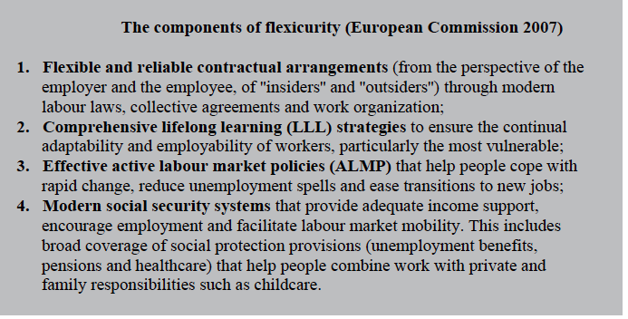

Slide 24
The ‘economisation of social policy’ in the EU
While social policy responsibilities in the EU remain largely national responsibility, the creeping (or rampant) privatisation of social and health services in member states brings those areas more and more under the influence of EU competition law:
“Problems are emerging as a consequence of marketization and the partial privatization of social policy. For example, obligatory pension funds (like those in Poland) are part of the obligatory and universal pension systems, and thus of social policy, with national competence. On the other hand, they are managed by private financial institutions operating on the financial market, with strong EU rules on competition and basic freedoms.
One conflict between the national competence in social policy and EU competence in competition and the freedom of services may also concern other parts of social policy, such as health care – especially in the case of the competition between health care providers.
Thus, the deepening of economic integration has consequences for social policy. This influence of the EU on the social policies of member states may be described as the “Europeanization” (in the EU sense) of social policy “by the back door” – through progress in economic integration, without a clear strengthening of EU competencies in social policy”
(Stanisława Golinowska, Maciej Żukowski, 2009, p. 315)

Slide 25
Lisbon Strategy
Finally, coordination of social policies was decided by the Member States in the European Council in March 2000, when the Lisbon Strategy was launched. One of its aims was to modernise the European social model, to invest in people and to combat social exclusion by using the Open Method of Coordination (OMC). It seems that, at its origins, the Lisbon Strategy was an attempt ‘to put social priorities on a similar level as economic policies’ (Goetschy 2014), even if economic governance was dominant in the Treaties.
Lisbon Treaty signed 2008

Slide 26
Priority of economic over social policy – Lisbon Treaty
‘1. The Member States shall coordinate their economic policies within the Union (…). 2. The Union shall take measures to ensure coordination of the employment policies of the Member States (…). 3. The Union may take initiatives to ensure coordination of Member States’ social policies’. The way the three paragraphs are formulated shows a hierarchy, which gives priority to economic policies over employment policies and especially over social policies.

Slide 27
EU response to national debt crisis 2008 „Excessive Deficit Procedure“ (all except Estonia, Luxembourg and Sweden.)
In Greece and Cyprus, all welfare sectors have been affected. The economic crisis and austerity policies have had a catastrophic impact on people’s income and on poverty.
The social protection system has been dismantled and families reappear as the only existing safety net
In Portugal, provision of public services, especially in healthcare and education, has been cut down. Structural reforms regarding labour market flexibility were imposed.

Slide 28
EU social policies and the Financial Crisis of 2008
“The crisis showed the strengthening of an already existing tension between the economic integration and the social dimension. On the one hand, the EU aims towards more convergence in welfare issues and social policies and supports especially the new Member States; but on the other hand it only has few instruments of rather weak nature at its disposal. The Member States have to act under crisis-driven constraints, especially those subjects to a macroeconomic adjustment programme (ECB, EC and IMF) and/or subject to an excessive deficit procedure. As a result, the differences inside the EU and between the Member States are increasing tremendously”.
Kerschen, N., & Sweeney, M. (2016). Chances and Limits of the European Social Integration BT - Challenges to European Welfare Systems (K. Schubert, P. de Villota, & J. Kuhlmann, eds.). https://doi.org/10.1007/978-3-319-07680-5_36

Slide 29
EU policies correspond to the 2nd ‘disembedding’ of social relations since 1980s
Nation state monopoly position in defining social integration conditions is being challenged at both supra- and sub-national level
Demographic changes linked to economic pressures create added mobility
Social relationships become temporary (growth in singles households)
Privatisation of social responsibilities

