Slide 1
Social welfare systems in Europe
Walter Lorenz

Slide 2
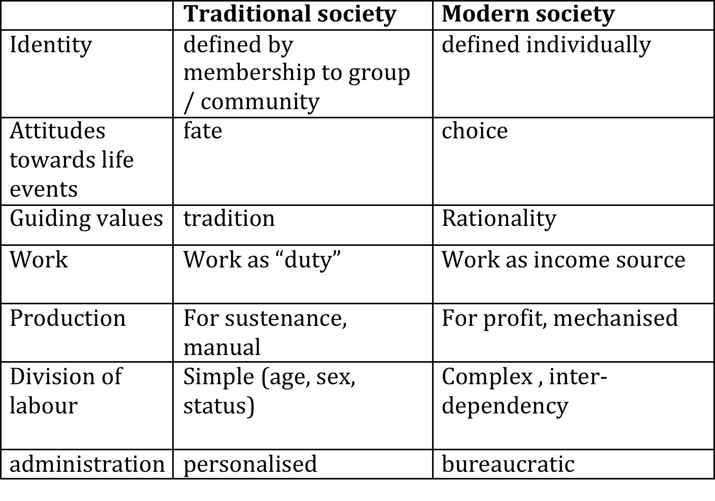
The need for social policies in modernity

Slide 3
Humans need community – which is not provided “naturally”
biological necessity (humans are creatures with a prolonged dependency on others after birth)
psychological necessity (specifically human abilities such as language, security, sense of self, only develop in interaction with others)
economic necessity (relative self-sufficiency can only be achieved in groups; division of labour even in ‘primitive’ societies between food gathering or hunting, food preparation, care work, cultural achievements ..)
social necessity (roles, patterns of behaviour, expectations, lines of authority) ‘learned’ in community

Slide 4
Importance of „capital“ in modern societies
Pierre Bourdieu: capital can be understood as a form of fuel which enables agents to reproduce their position within the social field and represents the immanent structure of the social world. Depending on the field where it functions, capital can manifest itself in three radical forms: economic, cultural, and social capital.
economic capital: individual material assets which can be directly and easily convertible into money
Cultural capital: a form of capital that is “convertible, in certain conditions, into economic capital and maybe institutionalized in the form of educational qualifications”
social capital: the network of social relations which increases the ability of an actor to advance her/his interests

Slide 5
The political challenge of modernity: capitalism creates the unequal distribution of all forms of capital
For the middle classes financial capital (property, ownership of the means of production) ensured also the acquisition of human capital (servants, labourers) so that they were free to accumulate social capital: leisure time in clubs, hobbies, trade fairs, commercial partners… political parties.
For the working classes this means not only less financial capital but also restrictions on social capital

Slide 6
central question: who is now responsible for solving social problems?
individuals – in which case they need to be made aware of their responsibility, probably through deterrents (threat of the workhouse)
volunteers (the churches, humanitarian projects, philanthropy) by helping ‘informally’
public organisations – police, institutions (schools, hospitals, asylums), social workers.

Slide 7
 |  | State
Civil society (community) |  |  |  | Private sphere (individuals, market)

Slide 8
What makes you belong to a nation state?
Having passport?
Being able to vote?
Being protected by the law against unfair treatment?
Enjoying public services?
Feeling the state is looking after my health and social needs when I have no other resources?
Which of these measures are being provided by the European Union?

Slide 9
The wider meaning of „welfare“ in modern societies
Well-being is not just the absence of „suffering“ (which would be of interest only in crisis situations or for people in „marginal“ positions through illness, poverty, social conditions, delinquency …) - BUT
Well-being describes essential elements of social existence
Freedom from threats (physical, mental security)
Access to basic resources (food, shelter, education)
Legal integrity (protection against unfair and unjust treatment)
The right to belong to social units (family, community, associations, nation state)

Slide 10
„citizenship“ as the guarantee of being fully recognised as a person, „the right to belong“
T.H. Marshall’s Theory of stages of the development of citizenship:
Civil citizenship (1700s): the rights necessary for individual freedom, like personal liberty, freedom of speech, right to own property, freedom of thought / religion etc. The institutions most directly associated with civil rights are the courts of justice.
Political citizenship (1800s): the right to participate in the exercise of political power (active and passive vote, founding and joining parties)
Social citizenship (1900s): the right to be publicly recognised as equally vulnerable and hence “worthy of protection” by public institutions and in law (pensions, health and education as a right, regulated labour)

Slide 11
Welfare therefore becomes a political issue (even where it is provided mainly privately)
At issue are basic values that constitute the foundations of the creation of modern societies:
The demand for equality (rights, participation, democracy, legitimation)
The demand for personal freedom (freedom to „be oneself“, free from interference by others, free to have one‘s own opinion, to live according to one‘s own principles). See Corona Crisis responses
However, both principles cannot be satisfied by the efforts of the individual alone nor by the delegation to the state: the principles are potentially in conflict with each other but also converge towards the necessity to constantly negotiate between them

Slide 12
Necessity to move towards social citizenship:
Democracy and participation are at risk of becoming meaningless if the state (the collective) either does not care for the everyday concerns of citizens or dominates their lives so totally (authoritarianism) that they cannot enjoy any margin of self-determination and freedom
Providing social protection (welfare) is essential for the political legitimation of the state and for the integration of society
People who are left without protection „fall out“ of society, have no interest in democratic processes („dangerous mob“, source of unrest, anarchy, disobedience, have nothing to lose)

Slide 13
Norbert Elias: „civilizing processes“
to be a citizen not only means having basic civil liberties, political power and civic responsibilities, but also living a ‘civilized’ life. And what civilized means (i.e., the norms and standards defining how the individual should live and act as a full member of the political community) has gradually been incorporated in the definition of citizenship.
And in later phases of social existence, this enriched idea of citizenship has fed back into what a given society views as wellbeing and deprivation (Townsend, 1979), which in turn, had a significant impact on welfare institutions, too. (rising expectations!)
Welfare is a dynamic process, not a static state

Slide 14
Discussion
What can the state provide that no other institution or level of society independent of the state can provide? (list activities)
What are the dangers associated with an over-reliance on the state?
What services can civil society organisations provide best and why? (examples and reasons)
What are the limitations to your knowledge of „what is best for myself“ and how does this affect your sense of freedom (give examples)

Slide 15
Correspondence citizenship to ‘welfare regimes’
Libertarian (United Kingdom)
‘residual’ welfare: Freedom, personal responsibility State only ‘last resource’ in situations of need, people should make their private care and security arrangements

Slide 16
Correspondence to ‘welfare regimes’
Libertarian (United Kingdom) | Social democratic (Nordic Countries)
‘residual’ welfare: Freedom, personal responsibility State only ‘last resource’ in situations of need, people should make their private care and security arrangements | Entitlements: equal rights for citizens State should provide good quality services for everybody irrespective of their income, social provisions according to need not according to ability to pay

Slide 17
Correspondence to ‘welfare regimes’
Libertarian (United Kingdom) | Social democratic (Nordic Countries) | Civic republican (Germany)
‘residual’ welfare: Freedom, personal responsibility State only ‘last resource’ in situations of need, people should make their private care and security arrangements | Entitlements: equal rights for citizens State should provide good quality services for everybody irrespective of their income, social provisions according to need not according to ability to pay | Bismarckian subsidiarity (emphasis on civil society organisations like church or philanthropy, state only coordinates

Slide 18
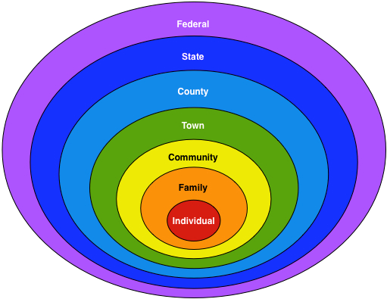
subsidiarity

Slide 19
Whose problem is it?
practice | Individuals should take care and make personal provisions
instrument | Savings or private insurance, market
Political ideology | Liberalism Example: United Kingdom
principle | Freedom

Slide 20
Whose problem is it?
practice | Individuals should take care and make personal provisions | The collective (the state) should protect its citizens who in turn show their loyalty
instrument | Savings or private insurance, market | State insurance and public social services
Political ideology | Liberalism Example: United Kingdom | Social democracy Example: Nordic Countries
principle | Freedom | equality

Slide 21
Whose problem is it?
practice | Individuals should take care and make personal provisions | The collective (the state) should protect its citizens who in turn show their loyalty | Civil society should should respect traditional values and forms of helping
instrument | Savings or private insurance, market | State insurance and public social services | Family and established aid organisations (churches, Red Cross, Philanthropy)
Political ideology | Liberalism Example: United Kingdom | Social democracy Example: Nordic Countries | Conservatism Example: Germany (Bismarck)
principle | Freedom | equality | duty

Slide 22
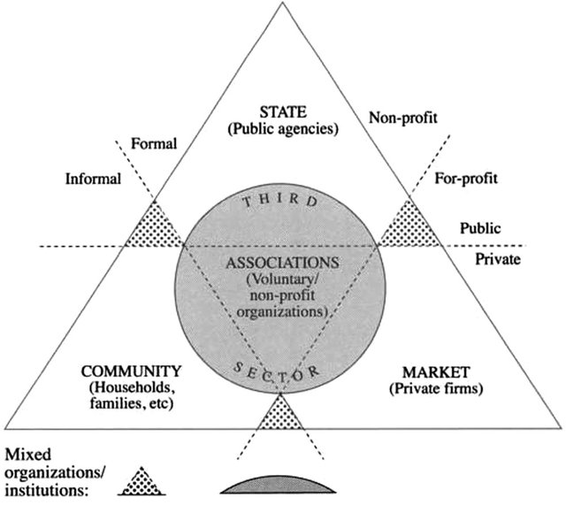
Welfare mix

Slide 23
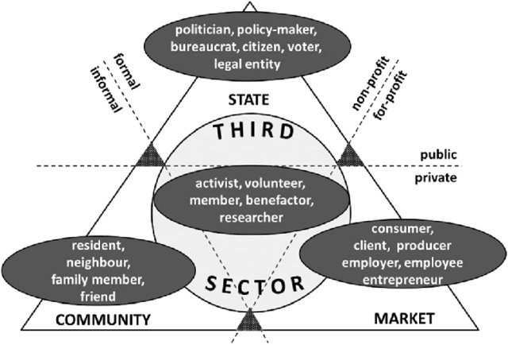
actors

Slide 24
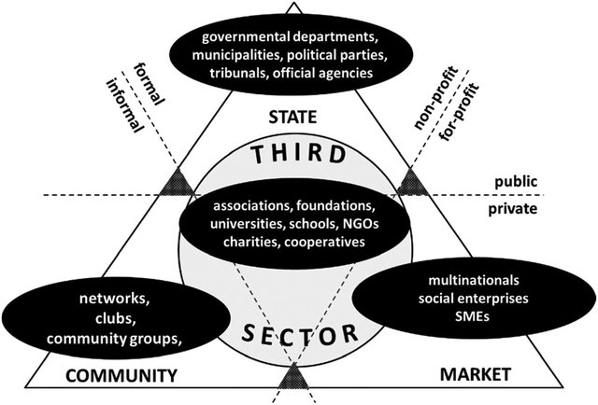
organiations

