Slide 1
Visual art –
Posters

Slide 2
What is a poster?
a form of visual art which typically has two values :
1) it informs i.e. it carries textual information
2) it caries visual information - the visual information is especially important as it conveys a lot about the time in which it was produced and also about the author
BUT: Posters may consist exclusively of images, or images and text., in rare cases it may consist entirely of textual graphics.
The interaction in the graphic expression between picture and text is the unique characteristic of the poster, they can accentuate each other or they can contrast

Slide 3
Purpose:
The poster’s job is to inform, to spread some information
the poster must compete with the fact that the viewer is often in motion, at a distance, or perhaps distracted by the context in which the poster has been hung
It must grab attention fast and make an instant impression, and the picture is by far the fastest method
Attract, surprise, shock, and remind are central precepts in the rhetoric of posters
originally it was connected with advertising
The idea was to display an artistically elevated quality in the advertising in order to more effectively communicate a message and thus sell the product

Slide 4
Types of posters
may be divided from several points of view into the following types:
(1) Fine Art Posters
(2) Reproductions of Famous Paintings
(3) Political Posters
according to the content: cultural (theatrical, film, club poster) political, social, advertising etc.

Slide 5
Evolution of poster arts
The evolution and development of poster art-linked to technical advances in printmaking i.e. lithography
Jules Cheret French printmaker invented "three stone lithographic process" in the 1860s
began purely as a means to sell products and theatrical entertainment- advertisement for famous performance, meant a new conception of art as being of service to advertising and then developed into an independent work of art
Cheret was the first artist to make his fine art career in the medium of poster advertising
introduced the feminine image as an advertising ploy- Chéret's laughing and provocative feminine figures "chérettes"
published a book Masters of the Poster, to promote the best poster designers

Slide 6
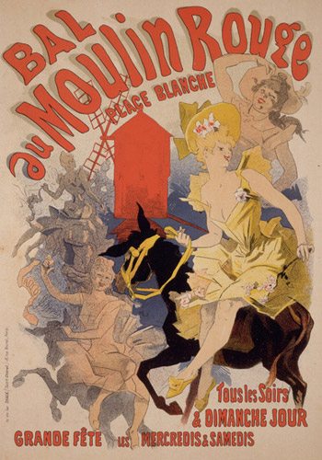
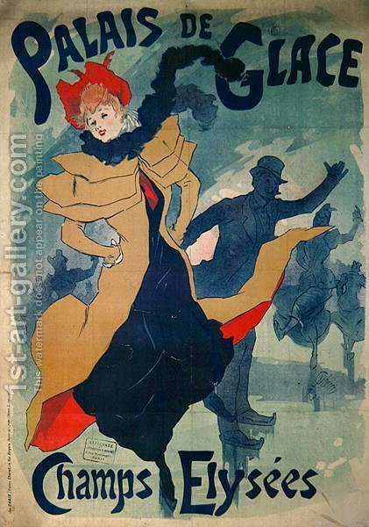

Slide 7
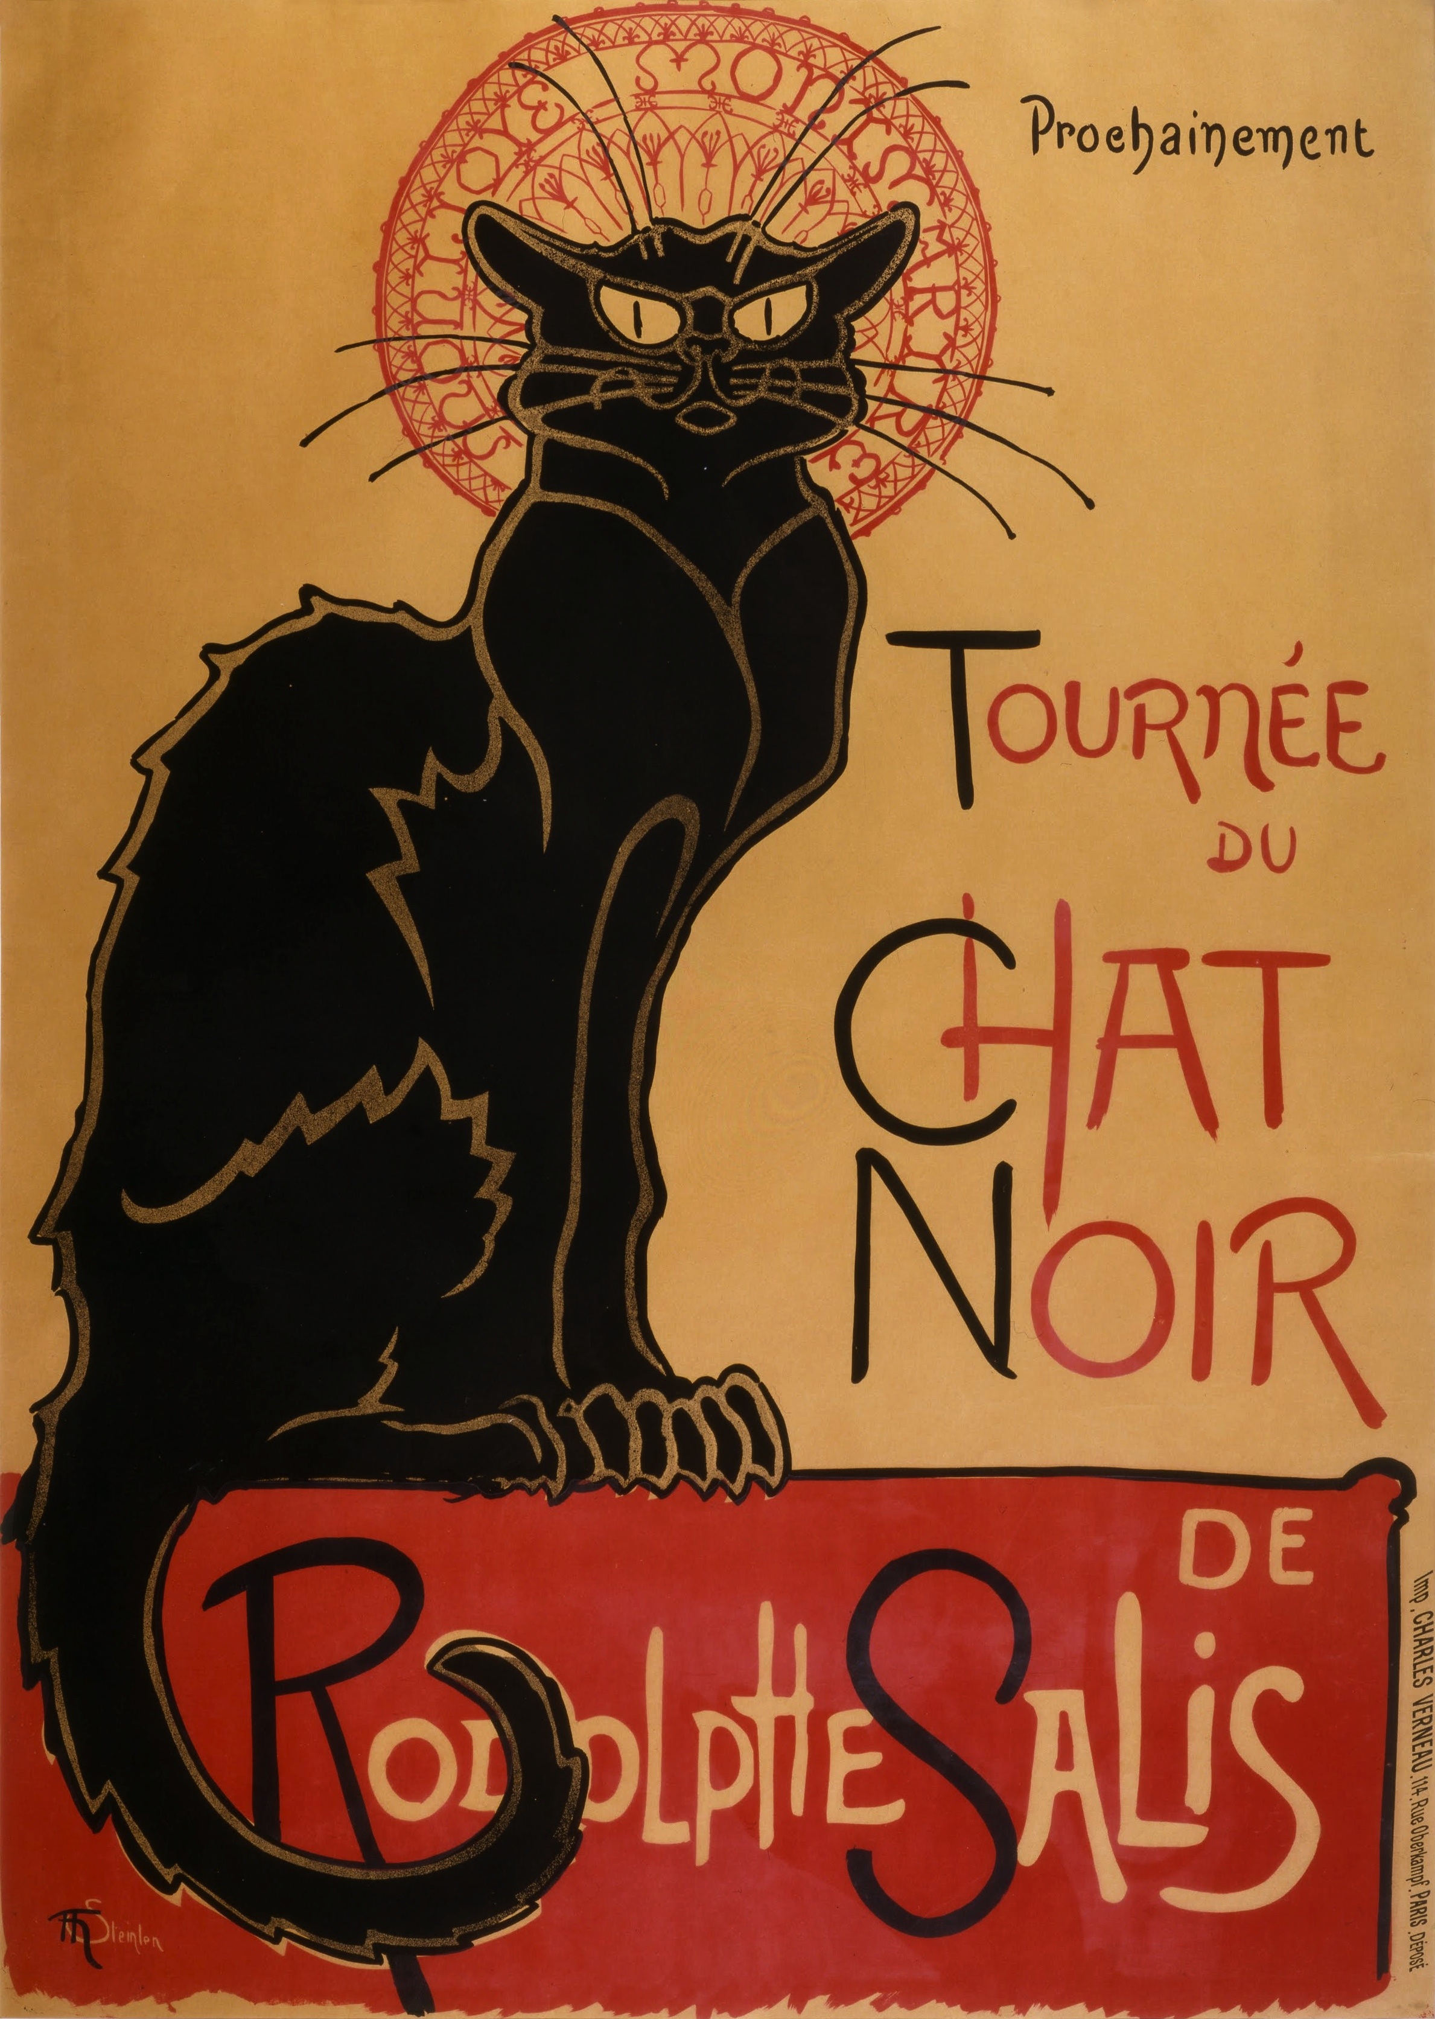
By 1880 poster art form became the principal means of mass communication in european metropolises
attracting a number of other top designers:
- Theophile Steinlen responsible for the immortal poster "Cabaret Du Chat Noir„
-Toulouse-Lautrec-creator of numerous theatrical masterpieces
subject matter featured: Parisian night life, notably the theatres, music halls and cabarets of the city

Slide 8
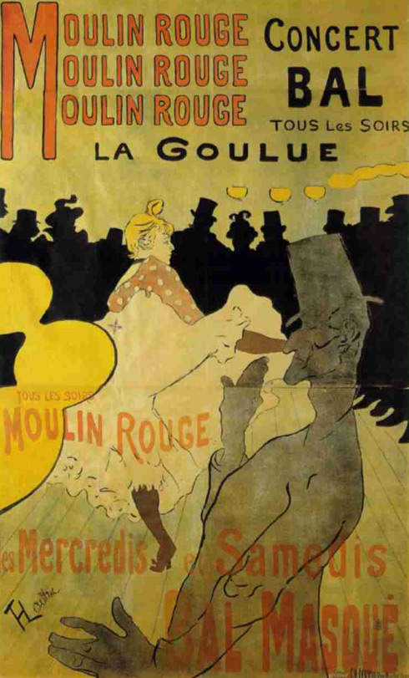
Henri Toulouse-Lautrec, Moulin Rouge - La Goulue, 1891

Slide 9
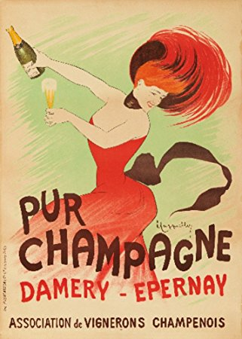
Leonetto Cappiello
Pur Champagne, 1902

Slide 10
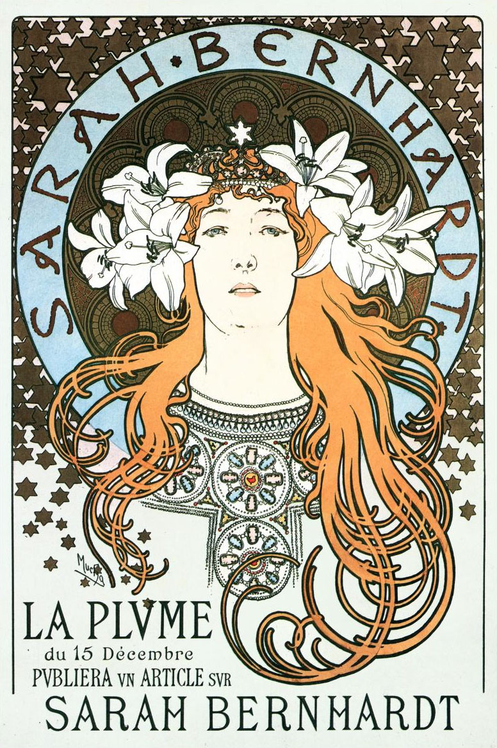
Art Noveau (1890-1900s)
Poster art greatly stimulated during the 1890s with the emergence of the style
ornamental, decorative style of art
flowing, curvilinear shapes, and drawing inspiration from Byzantine icons and the Celtic Art
Aubrey Beardsley -the English illustrator a master of this style
art nouveau attracted other artists, including Alphonse Mucha: in fact, one of the first Art Nouveau masterpieces was his Sarah Bernhardt poster (1894)

Slide 11
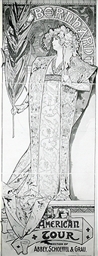
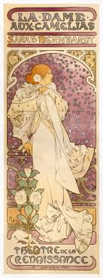
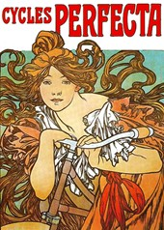

Slide 12
Art Deco - 1920s
Poster Art During the Inter-War Years
Art Nouveau was seen as old-fashioned and irrelevant when compared to the new age dominated by Science and great technological development
the new technological reality was better represented by modern art movements such as Cubism, Futurism, Expressionism and others from which the movement drew inspiration
simpler more function style
key features: dynamism, power and speed, sleek geometrical forms, and strong, even striking, colours
switched from curvilinear shapes to rectilinear and geometric imagery, in order to sharpen the advertising message

Slide 13
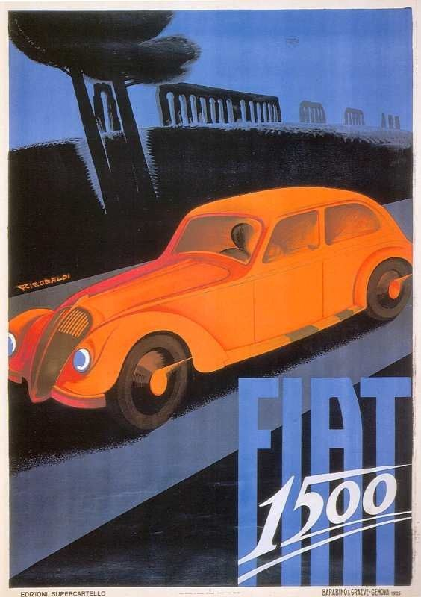
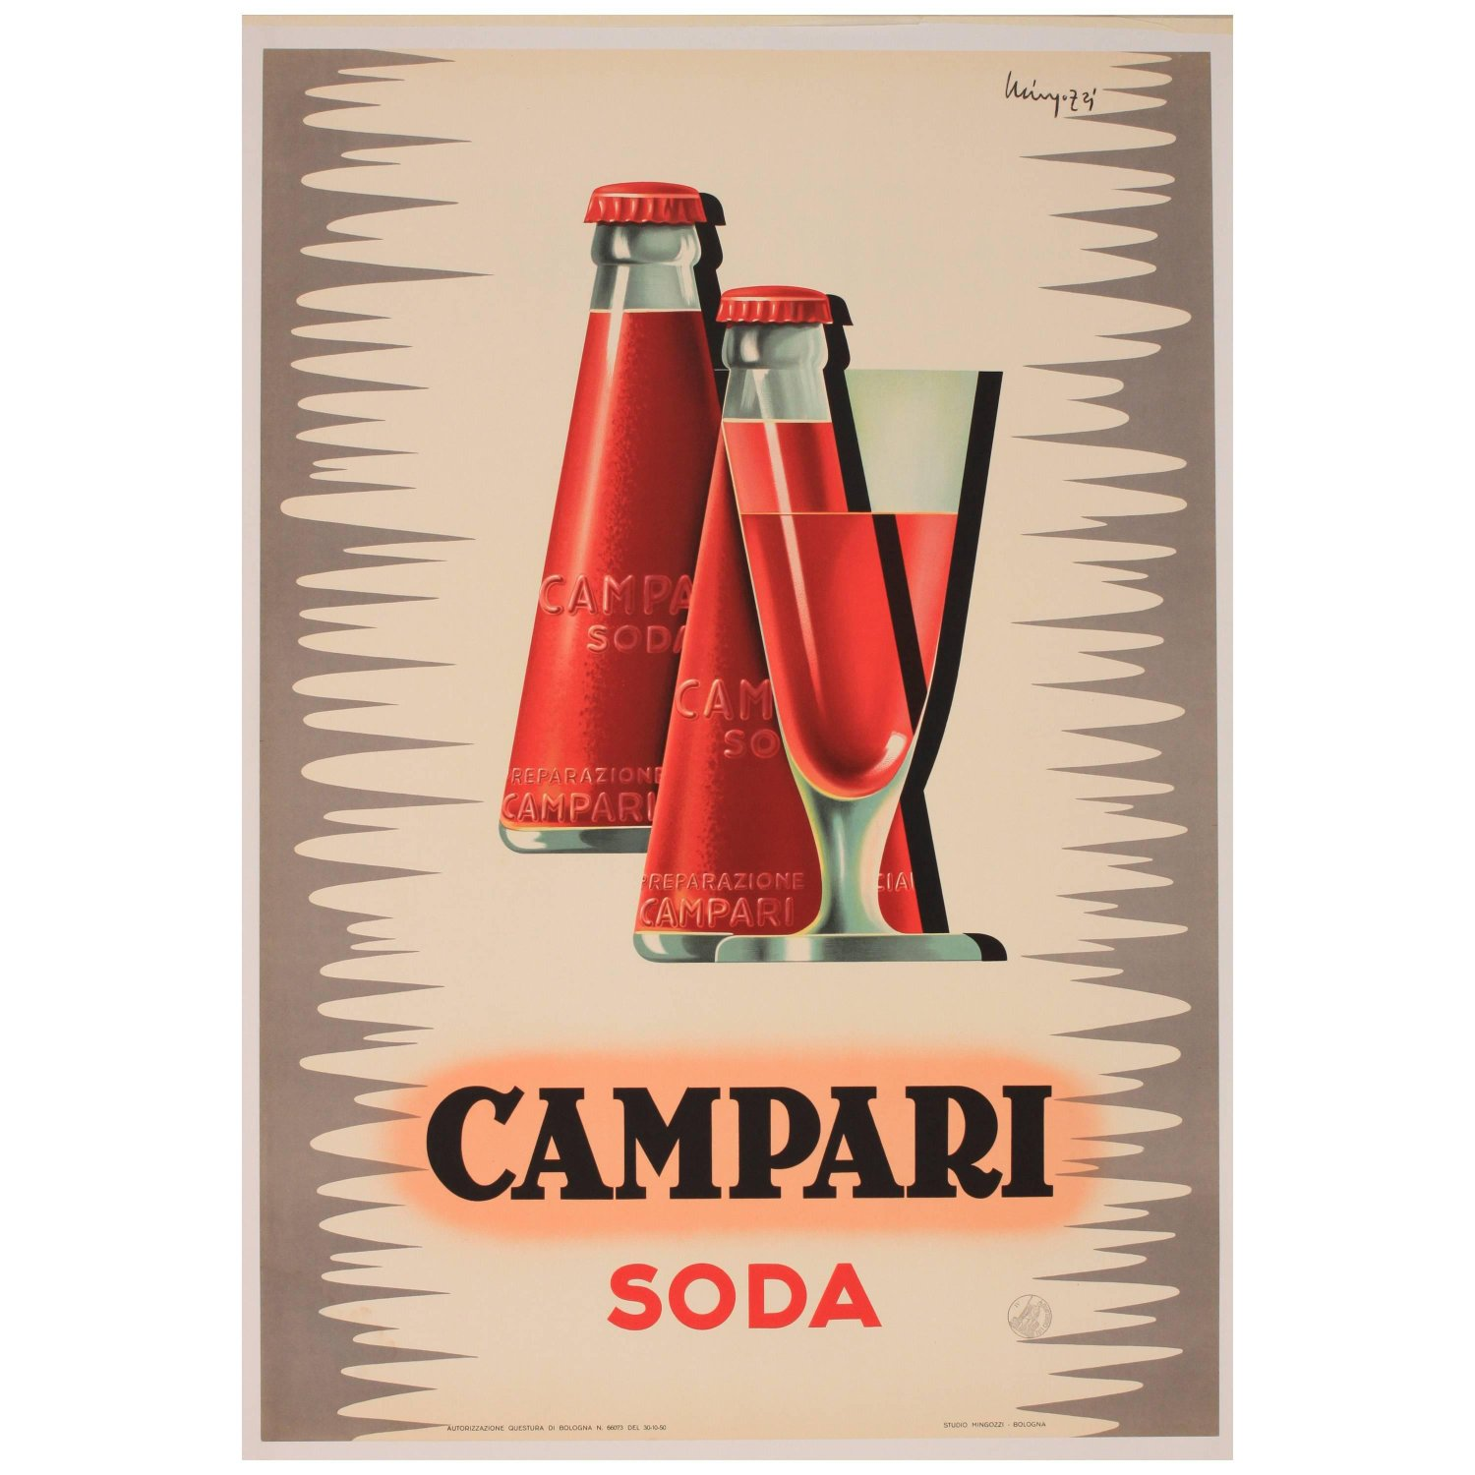

Slide 14
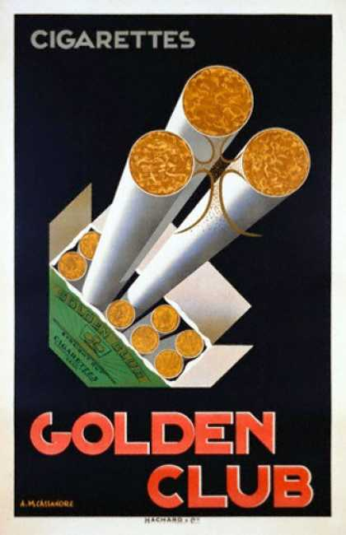

Slide 15
WORLD WARS PERIOD
Political poster was born
WWI - POSTER USED AS A PROPAGANDA TOOL
poster's accessibility and impact made it the most important means of mass communication
the poster into the most important medium of political imagery
it helped:
- increase morale
-recruit soldiers
-defame the enemy
-boost patriotism
-support for the war
designed to influence public opinion through the use of stereotyped images and motifs
control over visual arts– only artists who complied with the REGIME’ S guidelines, were allowed to practice their art

Slide 16
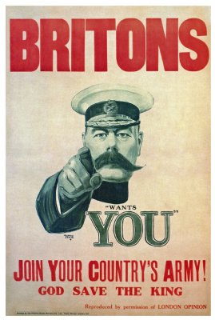
World War Propaganda
World War I Recruitment poster-designed by Alfred Leete
The Lord Kitchener -a legend within the British army was given the task of recruiting a large army to fight Germany
-This propaganda poster was published on the front cover of the hugely influential London Opinion magazine on 5 September 1914
The poster led to an immense recruiting success for the British army

Slide 17
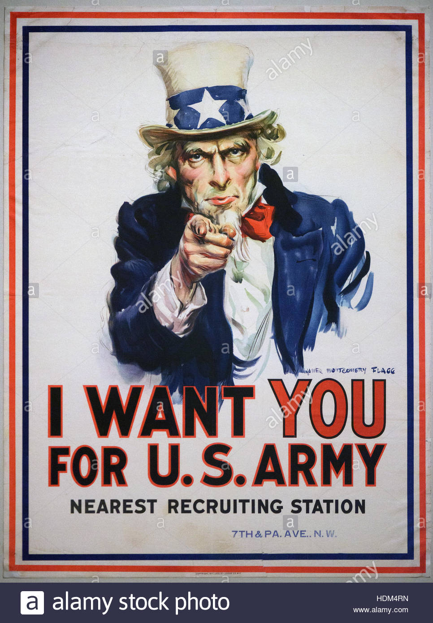
In America- famous army recruiting poster 1917
- James Montgomery Flagg army recruiting poster depicting Uncle Sam Uncle Sam, a personification of the US state (also same initials), pointing directly at the viewer

Slide 18
Nazi Poster art
During the 1930s and early 40s
anti-semitic campaigns
to denigrate Jews
recruit SS volunteers
promote anti-semitic films and exhibitions
scare the population
Nazi street propaganda - Hans Schweitzer - poster promoting the anti-Semitic film, "The Eternal Jew".
STEREOTIPICAL IMAGES: hook-nosed Jew and the vigorous blonde Aryan

Slide 19
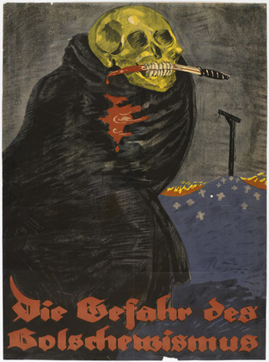
The Danger of Bolshevism (Die Gefahr des Bolschewismus) Rudi Feld (1919)
Death figure reflected a common fear in the aftermath of World War I in Germany—that the 1917 Bolshevik revolution in Russia might be replicated in Germany

Slide 20
"The Eternal Jew"
The film was intended to depict the
Jews as dangerous aggressors who
had to be exterminated. It argued that killing Jews is not a crime, but a
necessity, akin to killing rats to preserve health and cleanliness.

Slide 21
Socialist Realism style posters(c.1920-80)
Posters in a realist style, which contains a socialist message„
political art" - aesthetic considerations always took second place to the political message
matters like composition, size/position of figures, colour, tone, perspective were political issues to be decided by the cultural authorities
posters were a critical means of influencing and controlling mass audience -illiterate workers and peasants – simple images
SUBJECTS:
heroic idealization of the working man was its leitmotif, its pictures were characterized by an easily understood form of realism, painted in bold colours
completion of large-scale projects, like power stations, steel mills, and the like.
inspire them with admiration for hard working citizens trying to build a communist society

Slide 22
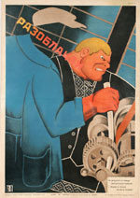
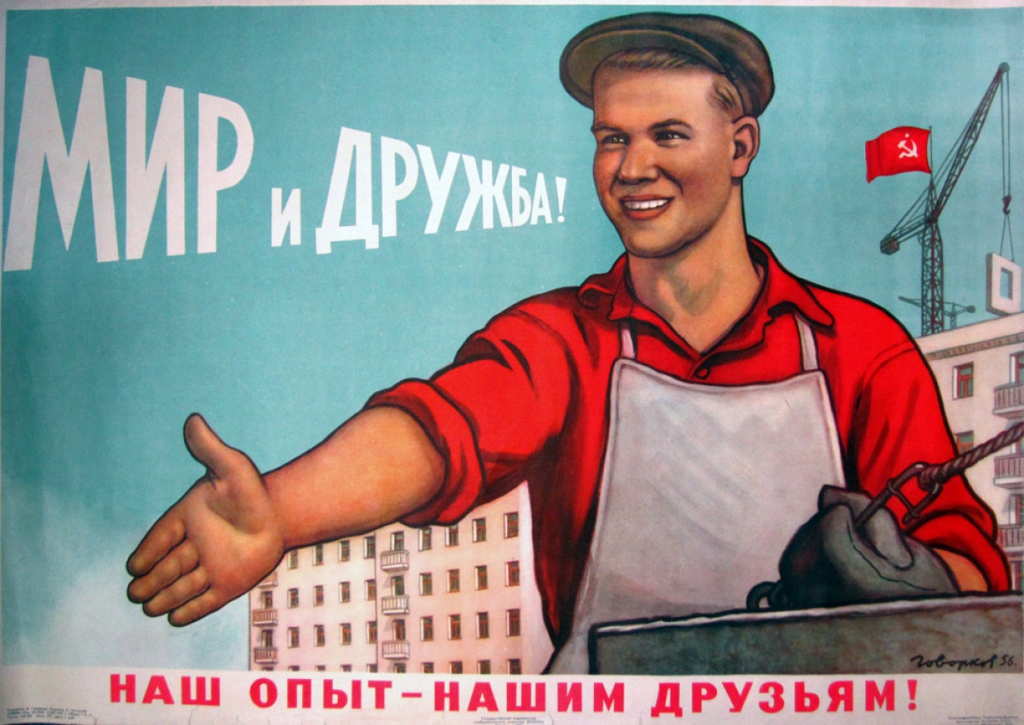
Unmask Him! (1930)
Socialist realist poster warns workers to be on the lookout for wreckers and
saboteurs in factories.

Slide 23
Poster Art After World War II
decline in Poster Advertising
taken over by photography, radio and later television
late 1960s- sudden revival- the pop art and the counterculture movements of the mid-1960 led to the rise of the a new (if brief) visual style, the psychedelic poster, Influenced by a combination of rock music and hallucinogenic drugs
- the movement was strongest in San Francisco and New York
Wes Wilson
Milton Glaser- poster for Bob Dylan's 1967 'Greatest Hits' album.

Slide 24
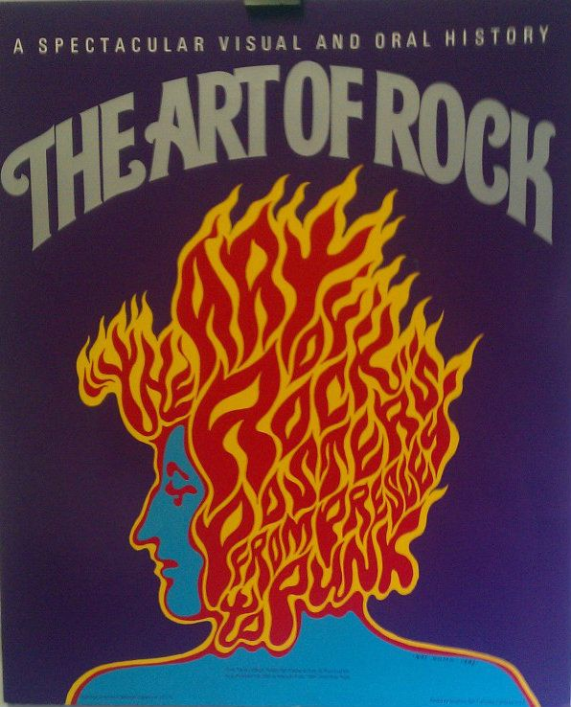
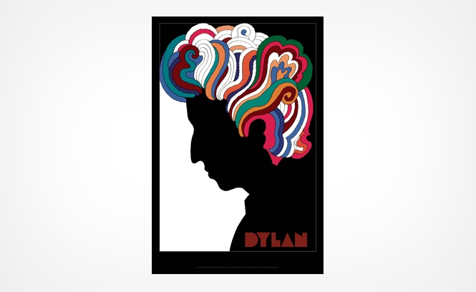

Slide 25
Poster Art Today
replicating famous works of art remains popular - it is possible to buy a reproduction of almost any major painting (like The Mona Lisa)
advertising posters have lost their appeal for commercial companies
A classical poster has been transformed- billboard, megaboard- digitalized images

Slide 26
Literature used:
Jiří Eliška,Vizuální komunikace Grafický design, http://www.jirieliska.cz/fileadmin/user_upload/knihy/Grafick%C3%BD%20desicn03.pdf
Josef muller Brockmann a Shizuko muller Brockmann, History of Poster, http://www.visual-arts-cork.com/poster-art-history.htm
Jitka Vysealová, Psychologie reklamy, Praha: 4 vyd., Grada Publishing, 2012
Richard Hollis, Stručná historie grafického designu, Praha: Rubato, 2014
Development of the Poster, http://www.designishistory.com/1850/posters/
History of posters, http://www.all-art.org/history661_posters.html

Slide 27
Thank you for your
attention

