Slide 1
Basics in Molecular Modelling of Drugs
Zvýšení kvality vzdělávání na UK a jeho relevance pro potřeby trhu práce-ESF
Reg. č. CZ.02.2.69/0.0/0.0/16_015/0002362
Projekt je financován z programu OP VVV
Pharmacy – 4th section of study, 2nd Lecture
Specialization: Pharmaceutical Chemistry
Marta Kučerová
Topics: Drug Targets. Protein structure, nucleic acid structure. Importance of particular amino acids for tertiary protein structure and for reaction catalysis, types of interactions, receptors theory. Rational approaches to drug design and development. Interaction between drugs and receptors, inter-molecular forces, hydrogen bond.

Slide 2
Drug targets
macromolecules in cell membrane or within cell
proteins
  enzymes
  receptors
  transport proteins in cell membrane
  structural proteins (exceptional target is tubulin)
nucleic acid
  DNA
  RNA
lipids (lipid bilayer may be influenced by antifungal agents, antibiotics etc.)
carbohydrates
binding site enables the interaction with low-molecular drug
Patrick GL: An Introduction to Medicinal Chemistry, Oxford University Press, New York 2009, 4th Ed.
Notes:
Other targets:
Biosynthetic building blocks
Biosynthetic processes – chain terminators
Protein-protein interactions

Slide 3
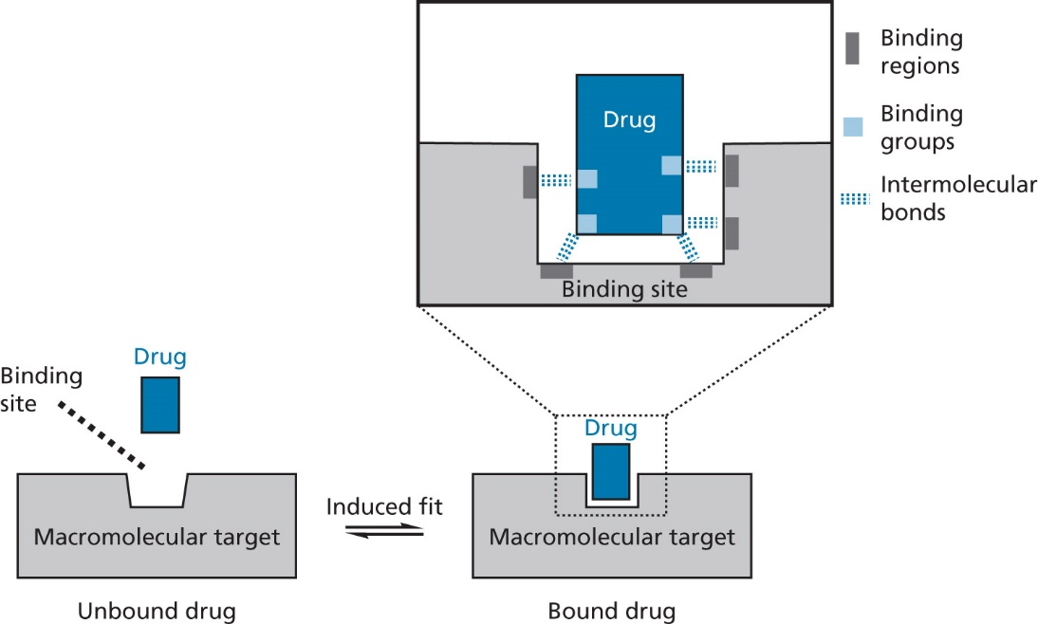
Binding of a drug to the target
importance of binding group and molecule skeleton of the drug as well of the target (binding regions)
Fig. 1.4. The equilibrium of a drug being bound and unbound to its target
Patrick GL: An Introduction to Medicinal Chemistry, Oxford University Press, New York 2009, 4th Ed.

Slide 4
Types of interactions (drug-target)
intermolecular non-covalent bonds
  electrostatic or ionic bonds
  dipole-dipole interactions
  hydrogen bond
  halogen bond
  van der Waals interactions
  hydrophobic interactions
  the more interactions, the stronger binding force
covalent bond (200–400 kJ.mol⁻¹, length 1.0–1.5 Å)
Patrick GL: An Introduction to Medicinal Chemistry, Oxford University Press, New York 2009, 4th Ed.
Notes:
Lemke: covalent bond 50-150 kcal/mol, alkylating or phosphorylating drugs

Slide 5
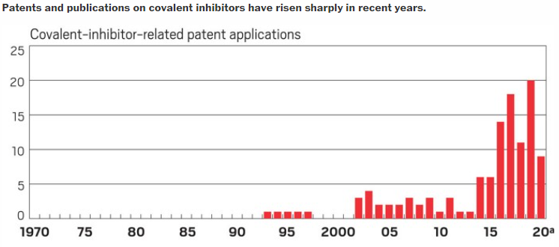
Covalent bond in drug design
from TABOO to TRENDY
history milestones
  1899 – Aspirin
  1928 – benzylpenicillin
  1989 – omeprazol
  1996 – phosphomycin
  1997 – clopidogrel
  2003 – bortezomib
  2009 – saxagliptin
  2013 – ibrutinib
  2018 – dacomitinib
  2019 – voxelotor
in 2020: 35 drugs registered by FDA
https://cen.acs.org/pharmaceuticals/drug-discovery/Covalent-drugs-fringe-field-fashionable/98/i43
Notes:
Možno doplnit
Molecules | Free Full-Text | Theory and Applications of Covalent Docking in Drug Discovery: Merits and Pitfalls (mdpi.com)

Slide 6
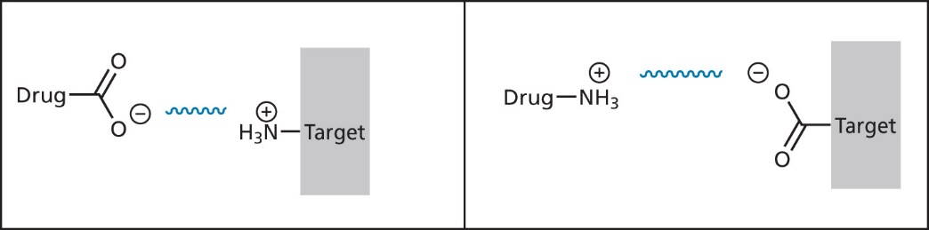
Electrostatic or ionic bonds
strongest intermolecular bonds (20–40 kJ.mol⁻¹) between groups having an opposite charges
  inversely proportional to the distance between the two charged atoms
  depending on the nature of environment: stronger in hydrophobic than in hydrophilic environment
Fig. 1.5. Electrostatic (ionic) interactions between a drug and the binding site
Patrick GL: An Introduction to Medicinal Chemistry, Oxford University Press, New York 2009, 4th Ed.
Notes:
Lemke: ionic bond 5–10 kcal/mol

Slide 7
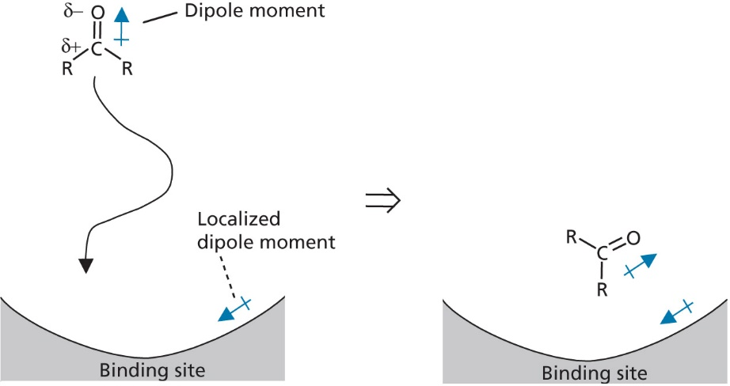
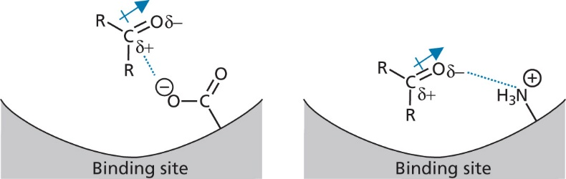
Dipole-dipole and ion-dipole interactions
weak form of electrostatic Interactions between permanent dipole moments resulting from different electronegativities of the atoms, e.g., ketone
dipole moments in drug and dipole moment in target can interact, as well interaction between ion and dipole can proceed
Fig. 1.15 Dipole-dipole interactions between a drug
and a binding site
Fig. 1.16 Ion-dipole interactions between a drug
and a binding site
Patrick GL: An Introduction to Medicinal Chemistry, Oxford University Press, New York 2009, 4th Ed.

Slide 8
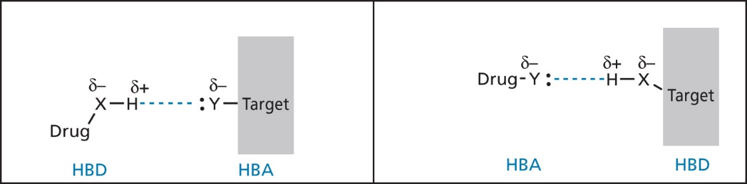
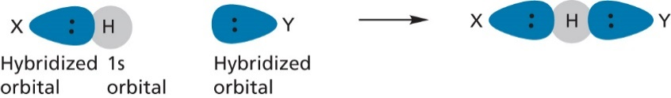
Hydrogen bond (HB)
= strong dipole-dipole interaction between
an electron-deficient hydrogen (H bound to an electronegative atom X) = hydrogen bond donor (HBD)
an electron-rich heteroatom Y (with a lone pair of electron, e.g., O or N) = hydrogen bond acceptor (HBA)
weak form of electrostatic interaction because of partial charges, but overlapping of orbitals occurs
strength: 16–60 kJ.mol⁻¹ in dependence on the angle X-H-Y (130–180° stronger, 90° weaker)
length 1.5–2.2 Å
Fig. 1.6 Hydrogen bonding shown by a dashed line between a drug and a binding site
(X, Y = oxygen o nitrogen; BHD = hydrogen bond donor, HBA = hydrogen bond acceptor)
Fig. 1.7 Orbital overlap in a hydrogen bond
Patrick GL: An Introduction to Medicinal Chemistry, Oxford University Press, New York 2009, 4th Ed.; Lemke TL et al.: Foye´s Principles of Medicinal Chemistry, Lippincot William and Wilkins, Baltimore 2013, 7th Ed.
Notes:
Lemke: 2–5 kcal/mol
Bissantz 0,26–0,32 nm

Slide 9
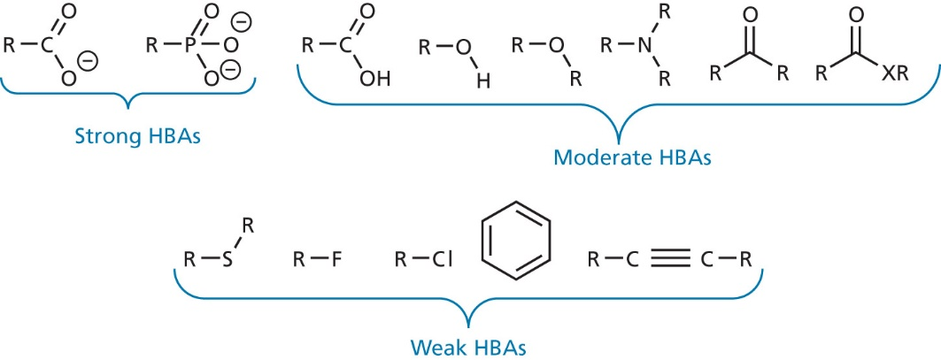
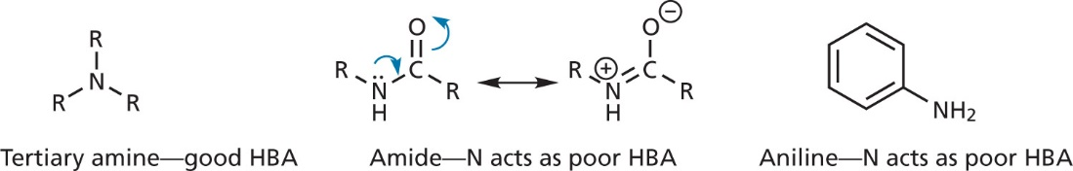
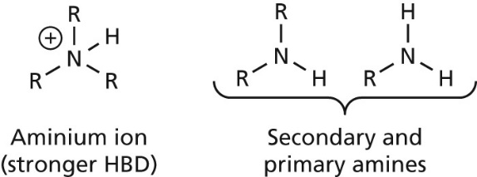
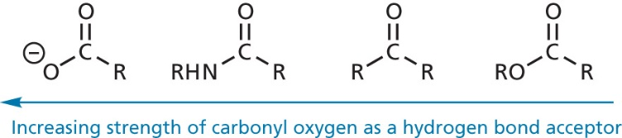
Functional groups in hydrogen bonding
some groups can act as HBA as well as HBD, e.g., OH, NH₂ = hydrogen bond flip-flop
HBA has to be electronegative and have lone pair of electron (nitrogen has one, oxygen has two → can form two HB)
Fig. 1.11 Comparison of different nitrogen-containing functional groups
as hydrogen bond acceptors (HBAs)
Fig. 1.10 Relative strengths of hydrogen bond acceptors (HBAs)
Fig. 1.12 Comparison of carbonyl oxygen as hydrogen bond acceptors.
Fig. 1.13 Comparison of hydrogen bond donors (HBDs)
Patrick GL: An Introduction to Medicinal Chemistry, Oxford University Press, New York 2009, 4th Ed.

Slide 10
Hydrogen bond
acceptor strength decreases in order:
  amides/sulfoxides/pyridines/N-methylimidazoles
  ketones
  esters/alcohols
  sulfones/sulfonamides/ethers
responsible for:
  intermolecular interactions
    e.g., between water molecules results in high boiling point
  intramolecular interactions
    partly responsible for the secondary, tertiary and quarternary structure of proteins and nucleic acids
Davis A., Ward S. E.: Handbook of Medicinal Chemistry, Royal Society of Chemistry, Cambridge 2015; Lemke TL et al.: Foye´s Principles of Medicinal Chemistry, Lippincot William and Wilkins, Baltimore 2013, 7th Ed.

Slide 11
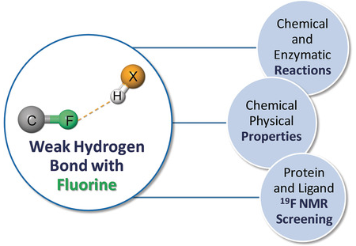
Fluorine as a Hydrogen-Bond Acceptor
hydrogen bonds involving fluorine: C−F⋅⋅⋅H−X HBs (where X=O or N) may be formed in the presence of high concentrations of hydrogen-bond donors and in the absence of strong hydrogen-bond acceptors, as well as in protein pockets shielded from the solvent. These results could have important implications for enzymatic and chemical reactions involving fluorine
in experiment: the strengths of HB formation for the fluorinated moieties appended to the same molecule decrease in the order: CH₂F > CHF₂ > CF₃
https://www.chemistryviews.org/details/ezine/9256861/Fluorine_as_a_Hydrogen-Bond_Acceptor/

Slide 12
Halogen bond C-X….O
halogen bonding is the non-covalent interaction occurring between the region of positive electrostatic potential of a covalently bonded halogen atom and an electron-rich atom (or group of atoms) that acts as a Lewis base
halogen bond acceptor: O, S, N, aromatic π-electron systems
halogen bond donor: the strength of the interaction increases in going from chlorine to bromine to iodine
  halogen acts as surrogate halogen bond donor due to „sigma-hole“ at the end of bond between the aromatic carbon and the halogen, which creates a partial positive charge on the halogen for on-axis interactions (bond angle approx. 140–180 °)
  sigma-hole = a small, positively charged area at the tip of the C–X bond extension
Patrick GL: An Introduction to Medicinal Chemistry, Oxford University Press, New York 2009, 4th Ed.; Clark T. et al.: J. Mol. Model. 2007, 13, 291; Parisini E. et al.: Chem. Soc. Rev., 2011, 40, 2267
Notes:
Bissantz 0,29–0,35 nm

Slide 13
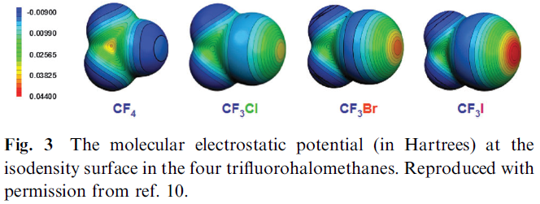
Halogen bond: C-X….O
the partial negative charge is not evenly distributed around the halogen atom; rather, it forms an equatorial belt around it, coaxial with the C–X bond, that leaves a region of positive electrostatic potential localized at the tip of the C–X bond extension
frequently observed
used in drug design and crystal engineering
occurs between aromatic chlorine, bromine and iodine substituent in aromatic rings with EWG and carbonyl oxygen from the protein backbone, Asn, Gln, Asp or Glu side chain
Patrick GL: An Introduction to Medicinal Chemistry, Oxford University Press, New York 2009, 4th Ed.; Clark T. et al.: J. Mol. Model. 2007, 13, 291; Parisini E. et al.: Chem. Soc. Rev., 2011, 40, 2267
Notes:
EWG = electron-withdrawing group
Not fluorine
the existence of σ-holes depend very much on the environments of the respective halogen atoms in the molecules. Thus, halogen bonding by CF3Cl, CF3Br and CF3I is greatly enhanced by the three electron-withdrawing fluorines. In their absence, CH3Cl does not even have a σ-hole and those on the bromine and iodine in CH3Br and CH3I are much weaker
Halogen bonding involves iodine, bromine and sometimes chlorine, typically substituted in molecular environments that are electron-withdrawing

Slide 14
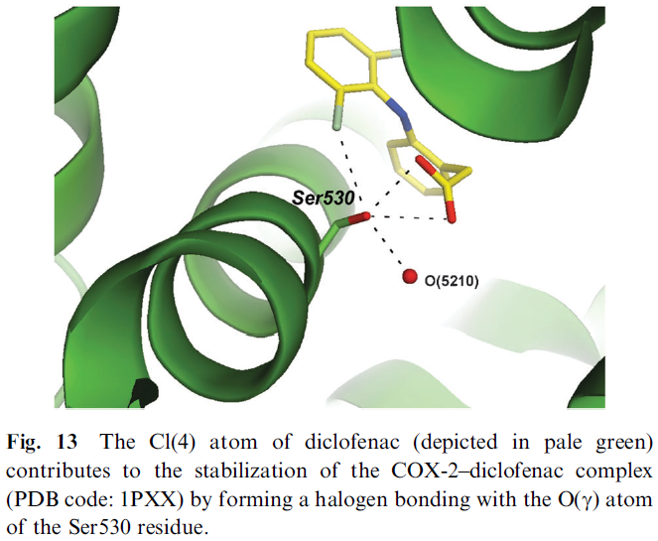
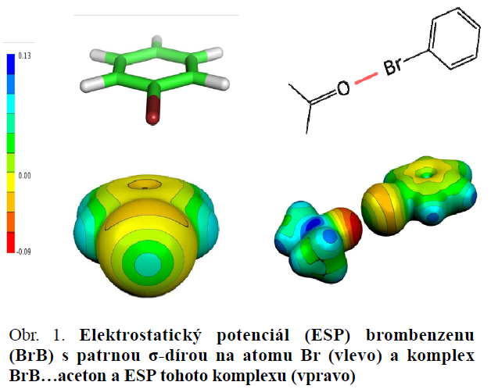
Fig. Electrostatic potential (ESP) of bromobenzene (BrB) with a visible sigma hole on the Br atom (left) and the complex BrB ... acetone and ESP of this complex (right)
Hobza P.: Chem. Listy 2016, 110, 371-375; Parisini E. et al.: Chem. Soc. Rev., 2011, 40, 2267

Slide 15
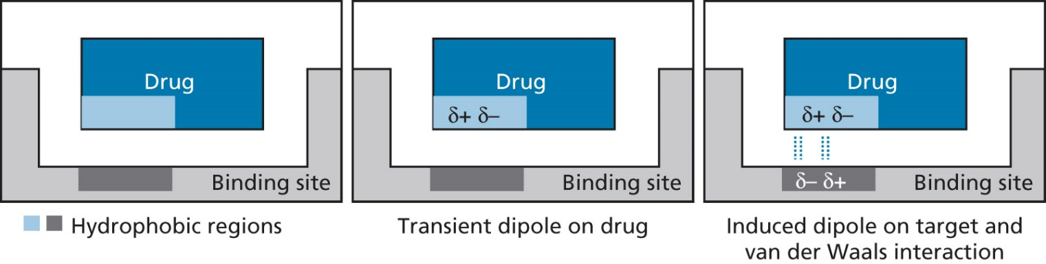
Van der Waals interactions (Londons forces)
very weak interactions between hydrophobic region of different molecules (carbon skeleton or aliphatic substituents)
strength: 2–4 kJ.mol⁻¹
high and low electron densities in neutral, non-polar regions can lead to temporary/transient dipoles, which can induce dipole in neighbouring molecule
Fig. 1.14 Van der Waals interactions between hydrophobic regions of a drug and a binding site
Patrick GL: An Introduction to Medicinal Chemistry, Oxford University Press, New York 2009, 4th Ed.
Notes:
Lemke: 0.5–1 kcal/mol
London dispersion forces between "instantaneously induced dipoles“

Slide 16
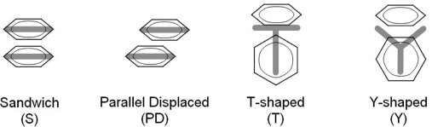
π-π interactions
Headen TF et al.: J. Am. Chem. Soc. 2010, 132, 5735
Notes:
Bissantz 0,33–0,42 nm

Slide 17
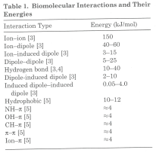
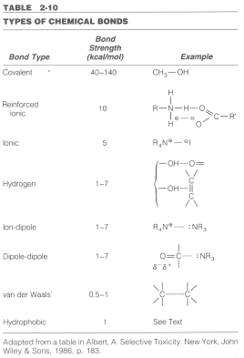
Energy of interactions
importance increases
covalent (disulfidic bond)
ionic, electrostatic
hydrophobic and H-bonds
energy increases
Delgado J. N., Remers W. A.: Wilson and Gisvold's textbook of organic medicinal and pharmaceutical chemistry, 10th Ed.,
Lippincott – Raven Philadephia (USA) 1998
Notes:
Tabulka z Burgera

Slide 18
Other aspects of binding drug-target
repulsive interactions
  e.g., two charged groups of identical charge are repelled
solvation with water molecules in organisms
  interaction of a drug and target is effective in case, that binding energy is greater than energy required to desolvate both the drug and binding site
  water does not solvate non-polar of hydrophobic regions of a drug or its target and the water molecules form more ordered layers of water next to the non-polar surface (negative entropy). In case hydrophobic region of a drug interacts with hydrophobic region of a target, entropy increases and binding energy (0.1–0.2 kJ.mol⁻¹) can be gained
  desolvation energy results in an energy penalty
Patrick GL: An Introduction to Medicinal Chemistry, Oxford University Press, New York 2009, 4th Ed.

Slide 19
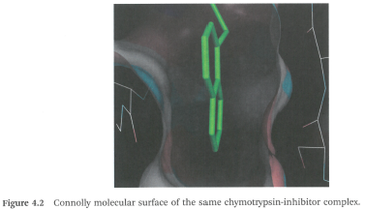
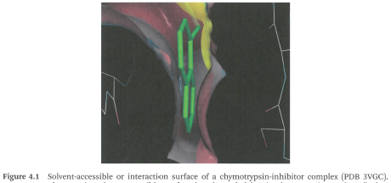
Solvation of the binding site
van der Waals (vdW) surface
solvent-accessible surface (interaction surface)
  1.4 Å beyond the vdW surface (1.4 Å = radius of water molecule)
Davis A., Ward S. E.: Handbook of Medicinal Chemistry, Royal Society of Chemistry, Cambridge 2015

Slide 20
Gibbs Free Energy of Binding
ΔG = ΔH - T ΔS
ΔG = -2.3 RT log K = -1.4 log K
small changes in binding energy cause exponential changes in binding affinity
prediction is complicated
  method for affinity prediction: free energy perturbation (FEP)
Davis A., Ward S. E.: Handbook of Medicinal Chemistry, Royal Society of Chemistry, Cambridge 2015
Notes:
X-ray crystal structure provides information about structure, but computational chemistry provides info about the binding enthalpies or free energies
Concept of drug discovery programs: hydrophobic interactions as HB are driven by entropy, polar interactions (HB) are due to enthalpy BUT it may be adverse
Best-in-class drugs may have enthalpy-driven rather than entropy-driven binding
R is the gas constant with a value of 8.314 J K-1mol-1.

Slide 21
What Drives Binding?
gas-phase: non-covalent association driven by polar and electrostatic interactions
water phase: hydrophobic interactions drive protein folding and intermolecular interactions
  water solvates the ligand and the active site, but some water molecules are easier to be displaced and some are tightly bound
  question for compound design: include the water molecule into interaction or displace it?
high quality co-crystal structures and computational analysis conclude that most ligands bind in one of their preferred low-energy conformations if not their minimum energy conformation
Davis A., Ward S. E.: Handbook of Medicinal Chemistry, Royal Society of Chemistry, Cambridge 2015

Slide 22
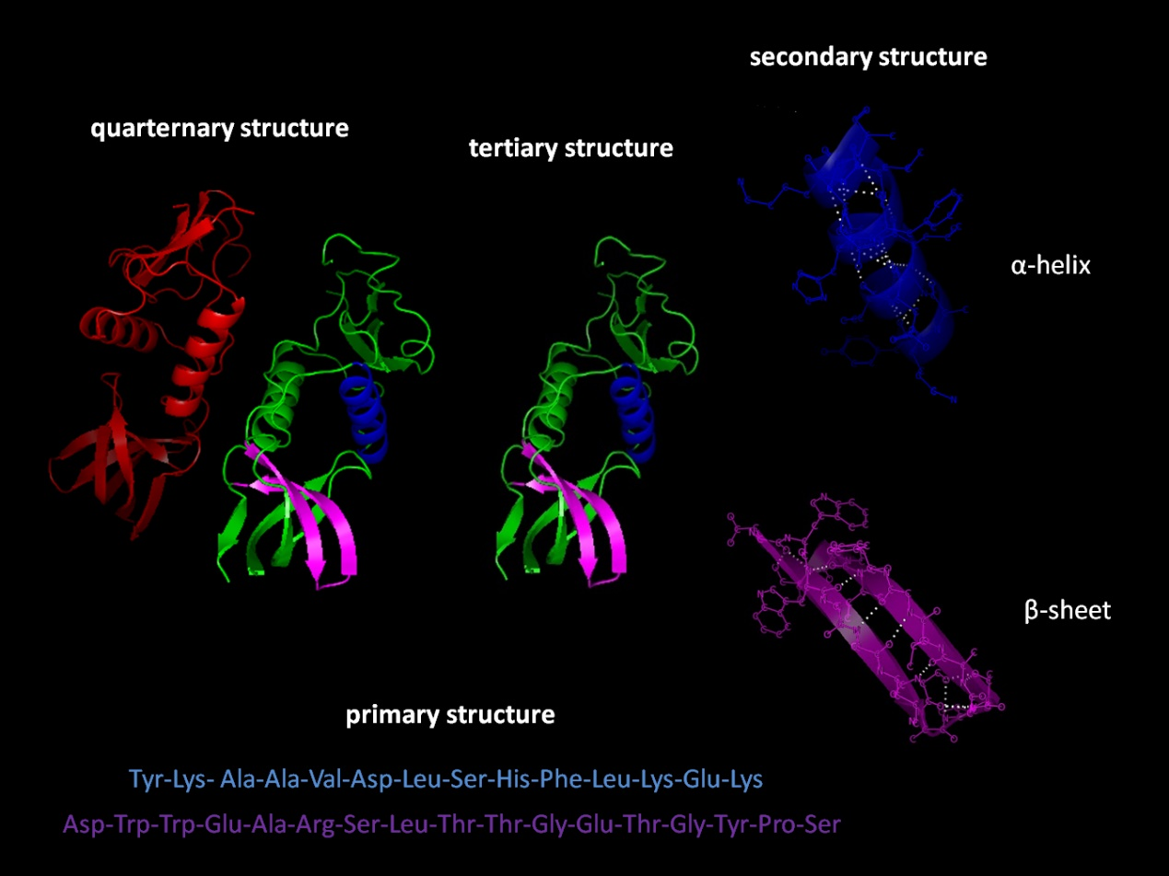
Protein structure
primary → secondary → structural motifs → structural domains →
tertiary → (quarternary)
https://upload.wikimedia.org/wikipedia/commons/0/05/Protein_structure.png

Slide 23
Protein structure
Primary = linear sequence of amino acids, covalent bonds
Secondary = local 3D arrangement of aa chain, based on short-range non-covalent interactions
Tertiary = overall 3D fold of a single polypeptide chain, long-range non-covalent interactions; disulfide bonds
Quaternary = 3D arrangement of multiple subunits (chains), only in case protein contains more than one chain

Slide 24
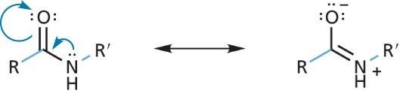
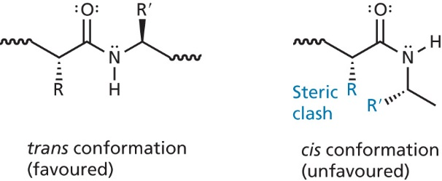
Peptide bond
partial delocalization on nitrogen lone pair → CN bond has partially character of double bond, which implicates:
  peptide bond is planar
  cis vs trans pseudoisomerism
  In common proteins trans : cis ratio is approx. 1000:1.
  cis-Pro similar energy to trans-Pro
Fig. 2.3 The planar peptide bond
(bond rotation allowed for coloured bond only)
Fig. 2.4 Trans and cis conformations of the peptide bond
Notes:
cis/trans peptide bonds in molecular modelling software
role of cis amino acids in proteins, active sites

Slide 25
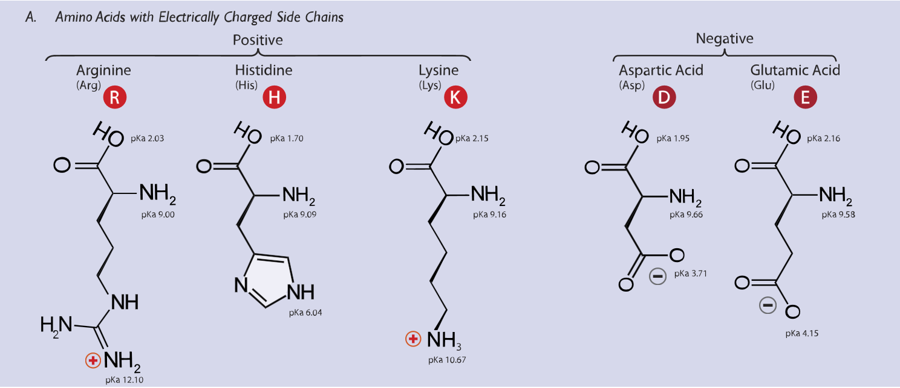
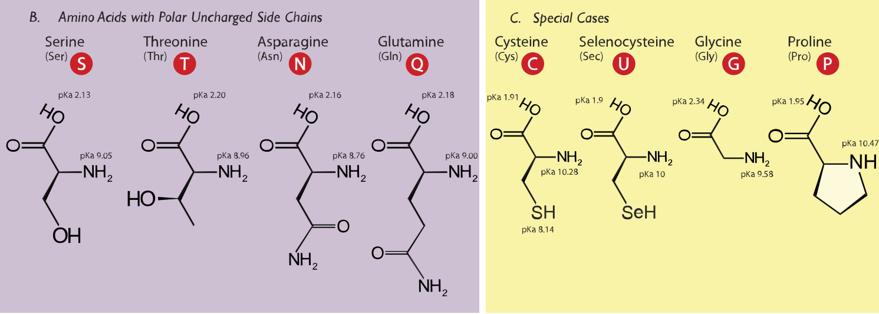
Amino acids
Polar and charged (at physiologically relevant pH) side chain
Polar and uncharged (at physiologically relevant pH) side chain

Slide 26
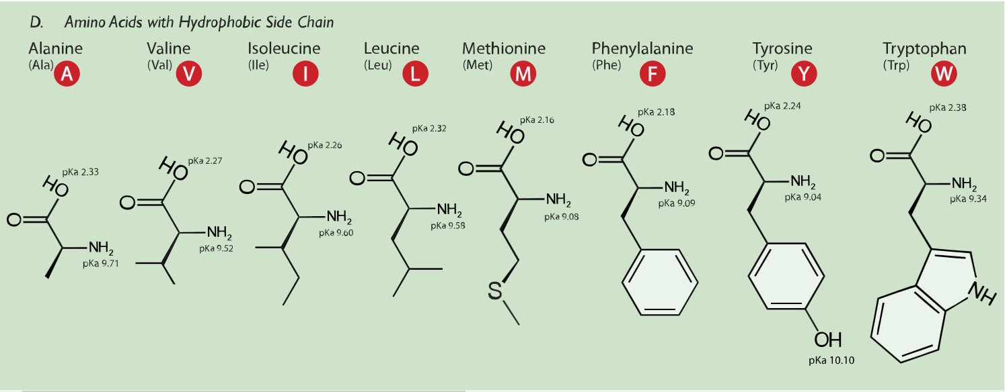
Amino acids
Aromatic side chain
Lipophilic side chain

Slide 27
Secondary structure
α-helix
β-(pleated)-sheet
Turn/Loop – change the direction of running polypeptide
Coil = disordered flexible region in a protein's secondary structure
Notes:
Loops that have only 4 or 5 amino acid residues are called turns when they have internal hydrogen bonds.

Slide 28
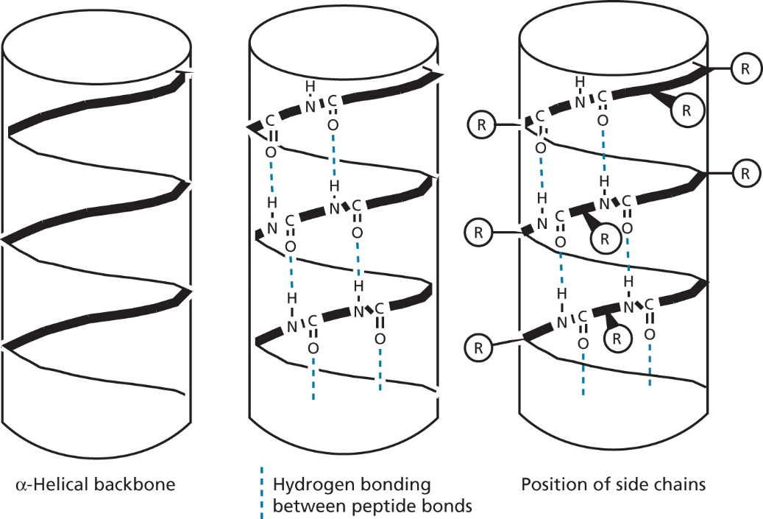
Secondary structure
α-helix
the most common and abundant type
H-bonds between individual „loops“
H-bond parallel to the main direction of the chain
much less frequent helices:
3(10)-helix
Fig. 2.5 The α-helix for proteins showing intramolecular hydrogen bonds
and the position of residues
Notes:
3(10)-helix arranged in a right-handed helical structure. Each amino acid corresponds to a 120° turn in the helix (i.e., the helix has three residues per turn)
π-helix right-handed helical structure. Each amino acid corresponds to an 87° turn in the helix (i.e., the helix has 4.1 residues per turn)

Slide 29
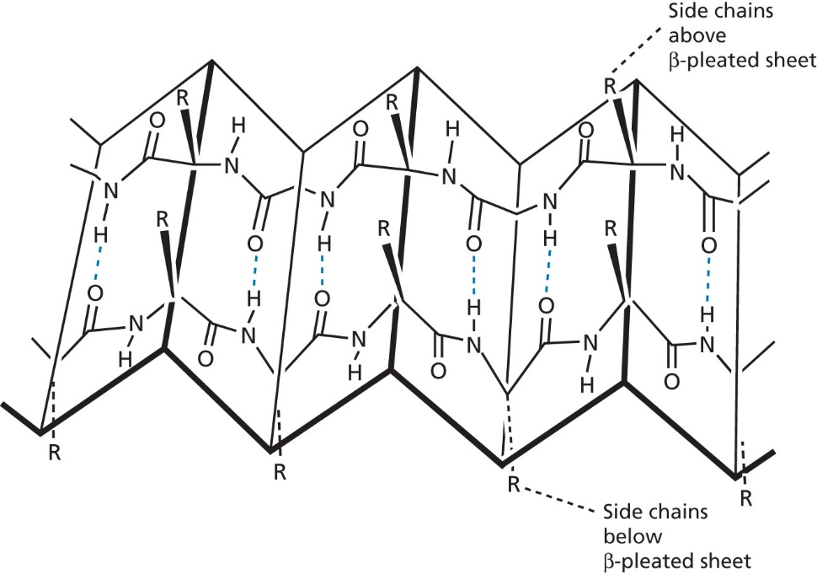
Secondary structure
β-pleated sheet
H-bonds between individual „chains“
H-bonds approx. at right angle to the overall direction of the chain
side chains above and below the sheet
parallel vs antiparallel
Fig. 2.6 The β-sheet (antiparallel arrangement)

Slide 30
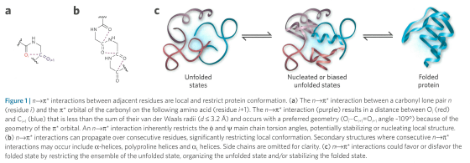
Protein folding
unfolded vs folded state
interactions stabilizing secondary structure
  hydrogen bonds (HB) between amides
  n→π* interactions = interaction between lone pair of oxygen (n) in carbonyl and the empty electrophilic π* orbital in carbonyl carbon
Zondlo NJ.: Nature Chem. Biol. 2010, 6 (8), 567-568; Bartlett G. Nature Chem. Biol. 2010, 6 (8), 615-620

Slide 31

Supersecondary structure = structural motifs
Simple combinations of a few secondary structure elements with a specific geometric arrangement
functional and structural specificity
helix -turn-helix
helix -loop-helix
Beta hairpin
Greek key
Notes:
β-hairpin, in which two antiparallel strands are linked by a short loop of two to five residues, of which one is frequently a glycine or a proline, both of which can assume the dihedral-angle conformations required for a tight turn or a β-bulge loop.
Greek key motif = four adjacent antiparallel strands

Slide 32
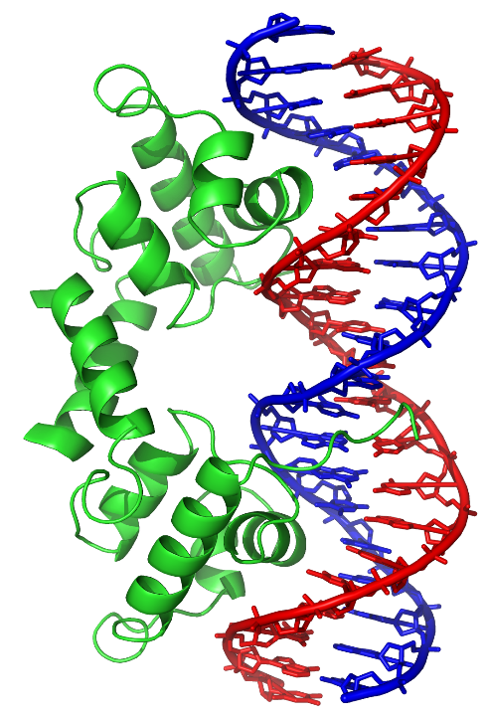
Structural motifs – examples
DNA-binding
H-L-H

Slide 33
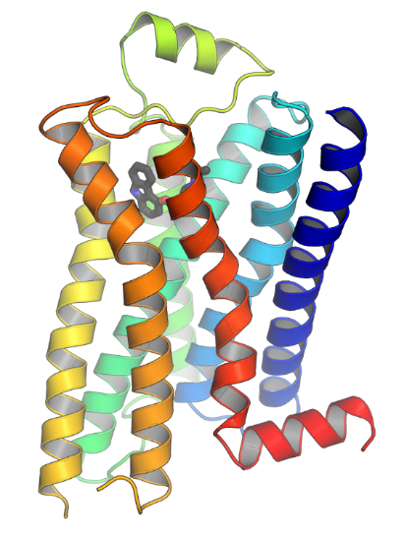
Structural domains
fundamental structural unit of tertiary structure
(part of) polypeptide chain that can independently fold into a stable tertiary structure
built from combinations of secondary structural elements and motifs
units of function
Division:
α Domains – several helices connected by loops
β Domains – antiparallel sheets
α/β domains – alternating α-helices and β-strands
α+β domains – separated groups of α helices and groups of β-strands
human beta-2 adrenergic receptor
pdb: 1gzm
Notes:
α + β proteins - beta sheets are mainly antiparallel
α / β proteins - beta sheets are

Slide 34
α-domains
β-domains
4-helix bundle
up-and-down sheets,
barrel

Slide 35
α/β-domain structures
TIM barrel
Rossmann fold
α/β horseshoe fold,
Leu-rich repeat domain
Notes:
TIM barrel - a conserved protein fold consisting of eight α-helices and eight parallel β-strands
The Rossmann fold is a protein structural motif found in proteins that bind nucleotides, such as enzyme cofactors FAD, NAD⁺, and NADP⁺. The structure is composed of up to seven mostly parallel beta strands. The first two strands are connected by an α- helix. The structures of segments between additional strands vary greatly and may include structures such as short helical segments and coils.
The motif is named for Michael Rossmann, who first pointed out that this is a frequently occurring motif in nucleotide binding proteins, such as dehydrogenases.
Leucine-rich repeat domain - horseshoe shape with an interior parallel beta sheet and an exterior array of helices. One face of the beta sheet and one side of the helix array are exposed to solvent and are therefore dominated by hydrophilic residues. The region between the helices and sheets is the protein's hydrophobic core and is tightly sterically packed with leucine residues.

Slide 36

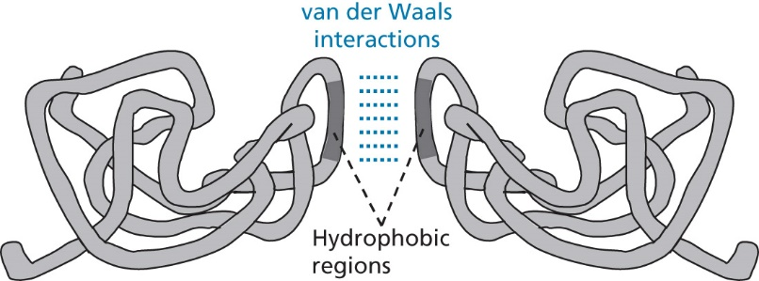
Quarternary structure
peptides containing several polypeptide subunits
Fig. 2.17 Quaternary structure involving two protein subunits

Slide 37
Enzymes as drug targets
active site of an enzyme
  groove, hollow or gully
  more lipophilic than the surface
  comparing different organisms, several important aa in the active binding site are the same in one type of enzyme
  role of aa in the active site
    binding
    catalytic
Patrick GL: An Introduction to Medicinal Chemistry, Oxford University Press, New York 2017, 6th Ed.

Slide 38
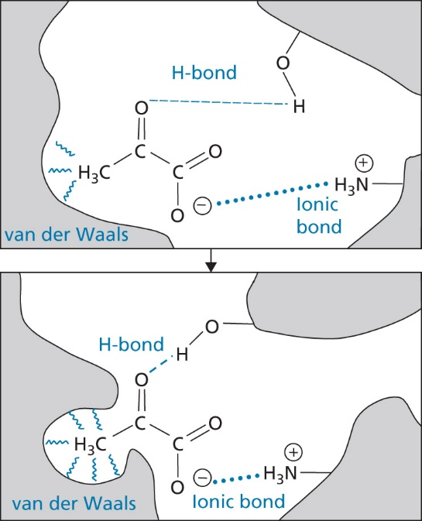
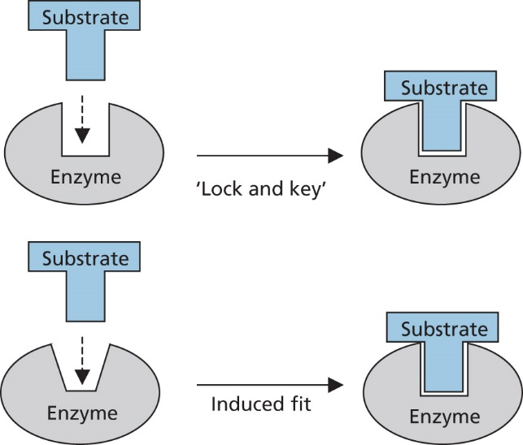
The catalytic role of enzymes – binding interactions
Fischer’s lock and key hypothesis vs Koshland´s theory (1958) of induced fit
Induced fit means that all enzymes undergo conformational changes induced by substrate binding
Fig. 3.17 The „lock and key“ and „induced fit“
hypotheses for substrate-enzyme binding
Fig. 3.8 Example of an induced fit
Patrick GL: An Introduction to Medicinal Chemistry, Oxford University Press, New York 2009, 4th Ed.; Koshland, D.E., Jr. Angew. Chem. Int. Ed. Engl. 1995, 33: 2375
Notes:
Enzyme changes the its shape to move the important aa residues closer to the substrate
It explains wide range of substrates for some enzymes

Slide 39
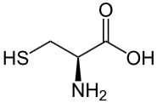
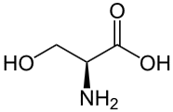
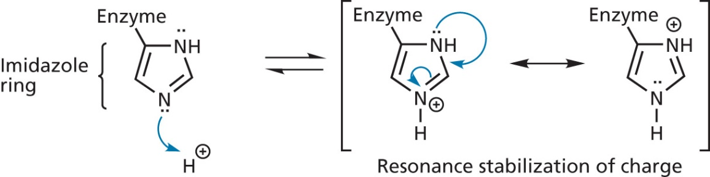
Aa – specific functions
Acid-base catalysing residues
Nucleophilic residues
His
  weak base that can exist at physiological pH both in protonized and deprotonized form
Glu, Tyr
  proton source
Asp, Asn
  both proton donors and acceptors
Cys, Ser
  possess lone electron pair
  often react with nucleophilic centre (electron-deficient C) to form covalent bond
Lys
  if present in a hydrophobic pocket then it is non-protonated
Fig. 3.9 Histidine acting as a weak base
Patrick GL: An Introduction to Medicinal Chemistry, Oxford University Press, New York 2009, 4th Ed.

Slide 40
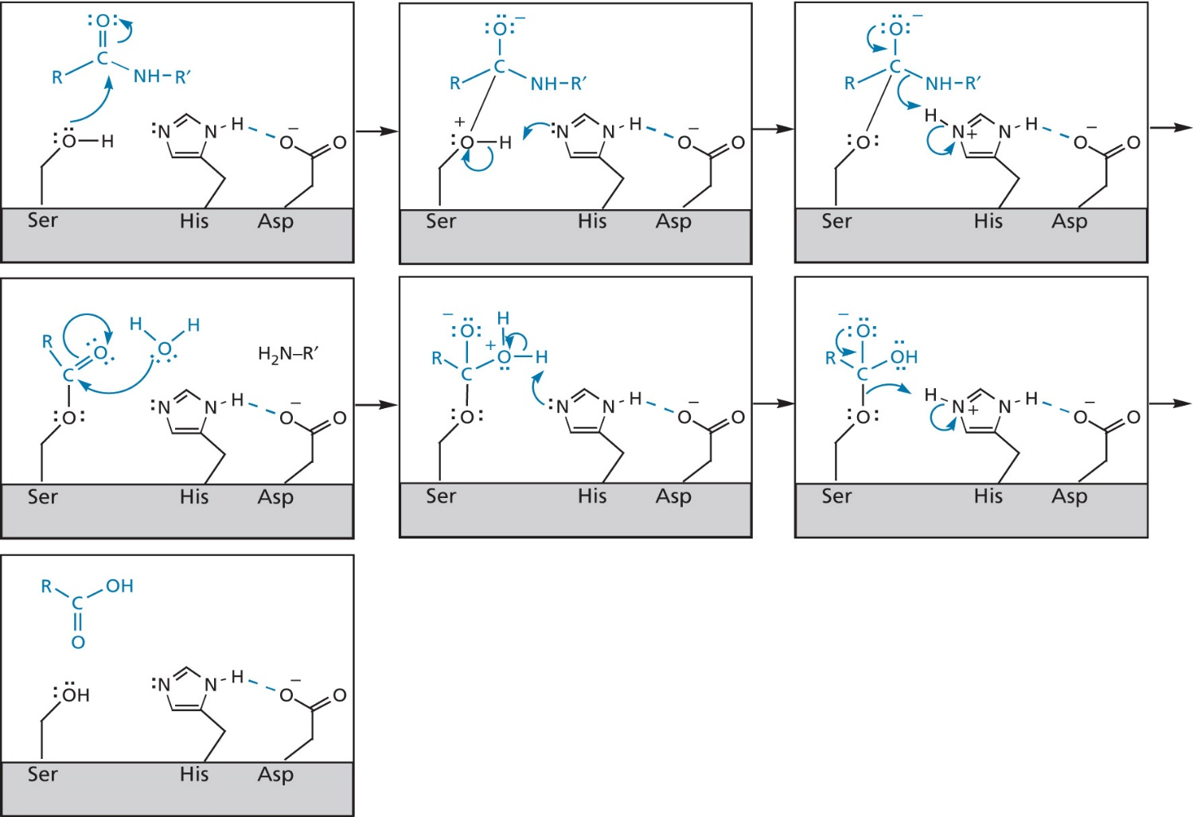
Enzymes – mechanism of catalysis
catalytic triad
example of chymotrypsin – cleavage of peptide bond
Fig. 3.9 Hydrolysis of peptide bonds catalysed by the enzyme chymotrypsin
Patrick GL: An Introduction to Medicinal Chemistry, Oxford University Press, New York 2009, 4th Ed.
Notes:
catalytic triad often present in the active site of hydrolases and transferases

Slide 41
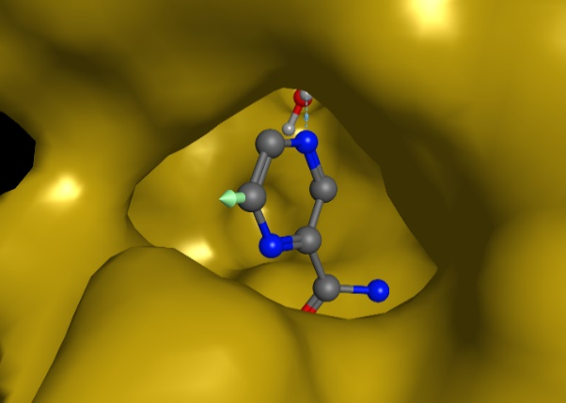
Cofactors
metal ions
  necessary for metalloenzymes
  Fe²⁺, Mn²⁺, Cu²⁺, Zn²⁺
small organic molecules = coenzymes
  if coenzyme bound covalently = prosthetic groups
  coenzymes derived from water-soluble vitamins
  role in redox reactions
    NADH, NADPH – reducing agents
    NAD⁺, NADP⁺ – catalyze dehydrogenation
  FAD, FMN
Patrick GL: An Introduction to Medicinal Chemistry, Oxford University Press, New York 2017, 6th Ed.
Notes:
Fe2+ in CYP – necessary for oxidation and reduction reactions
Zinc metalloproteases, eg. ACE, matrix metalloproteinases, histon-deacetylase
NADPH exclusively for reductive biosynthesis, NADH for ATP generation

Slide 42
Enzymes – mechanism of catalysis
example of nicotinamidase/pyrazinamidase PncA – hydrolysis of amide

Slide 43
Enzymes
regulation of enzymes
  internal control – stimulation/inhibition (e.g., by rising level of a product)
  external control – by chemical messenger from outside the cell (phosphorylation of enzyme involved)
  allosteric binding site for binding agents controlling the activity → it causes an induced fit in the active site and alters the shape of the enzyme
isoenzymes = isozymes
  enzymes with quarternary structure can differ in combination of polypeptide subunits in different tissues
  they differ in their primary structure, substrate specificity and tissue distribution
Patrick GL: An Introduction to Medicinal Chemistry, Oxford University Press, New York 2017, 6th Ed.
Notes:
Allosteric site convenient for agents structurally different from the substrate and the agents do not have to compete with the substrate to regulate the enzyme

Slide 44
DNA – Structure
primary
  deoxyadenosine, deoxyguanosine, deoxythymidine, deoxycytidine connected through phosphate groups linking 3'- and 5'-hydroxyls
secondary
  pairing of bases (A with T via 2 HBs and G with C via 3 HBs)
  hydrophobic interaction (vdW) between the faces of heterocyclic rings
  polar sugar-phosphate backbone can have polar interactions with water
  double helix ⇒ major and minor groove
tertiary
  coiled into a 3D shape, process supercoiling catalyzed by topoisomerases (topo I cleaves one strand, topo II cleaves both strands, topo IV – bacterial target)
Patrick GL: An Introduction to Medicinal Chemistry, Oxford University Press, New York 2009, 4th Ed.

Slide 45
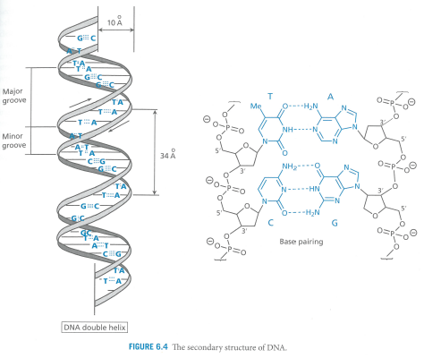
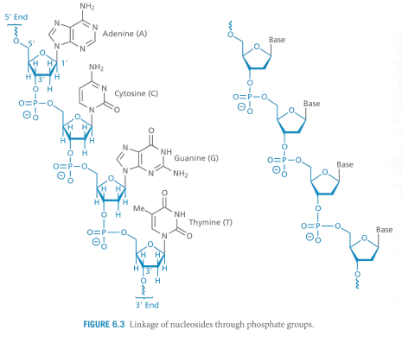
DNA – Structure
Patrick GL: An Introduction to Medicinal Chemistry, Oxford University Press, New York 2009, 4th Ed.

Slide 46
DNA – Function
replication
  copying of genetic information, each parent DNA chain acts as template for a new daughter DNA
triplet coding
  set of three nucleotides codes for one amino acid
  transcription
Patrick GL: An Introduction to Medicinal Chemistry, Oxford University Press, New York 2009, 4th Ed.

Slide 47
RNA – Structure and Function
primary
  the same as that of DNA, but ribose is the sugar and uracil replaces thymine... some other bases in minority
secondary
  more varied – not doubled, also regions with helical secondary structure
function: protein synthesis = translation (RNA is the „middle man“ between DNA and protein)
  mRNA – carries the code from nucleus to endoplasmic reticulum after transcription
  rRNA – the main component of ribosomes in ER, mammalian ribosome has 60S and 40S subunit, whereas bacterial 50S and 30S subunit
  tRNA – links the triplet code on mRNA to a specific amino acid, it has an anticodon complementary to a specific triplet and corresponding to a specific amino acid
Patrick GL: An Introduction to Medicinal Chemistry, Oxford University Press, New York 2009, 4th Ed.

Slide 48
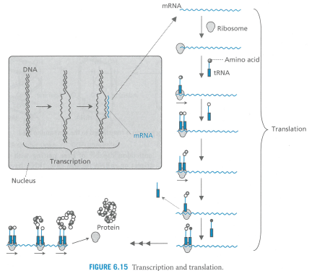
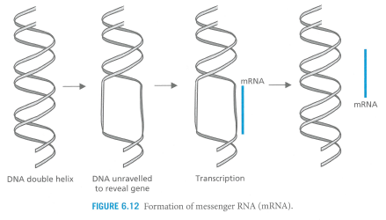
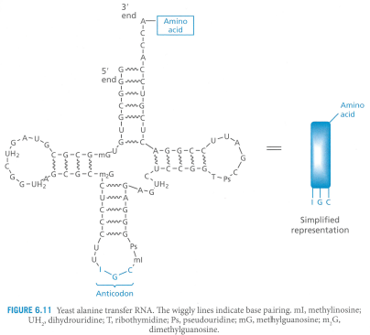
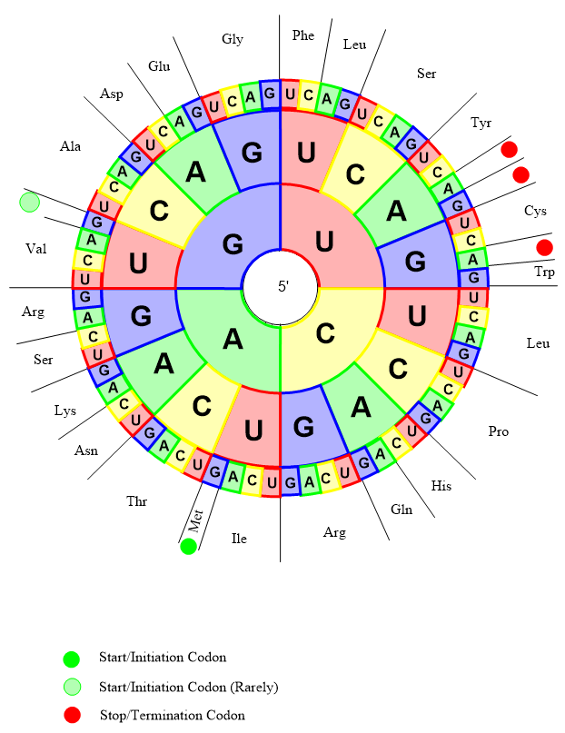
RNA – Structure and Function
Patrick GL: An Introduction to Medicinal Chemistry, Oxford University Press, New York 2009, 4th Ed., ChemDraw samples – codon triplets

Slide 49
Nucleic Acids as Drug Targets
drugs interacting with DNA
  intercalating drugs
  topoisomerase poisons (non-intercalating)
  alkylating/metallating agents
  chain cutters (e.g., calicheamycin)
  chain terminators (nucleosides analogues after fosforylation in vivo)
drugs interacting with RNA
  agents that bind to ribosomes
  antisense therapy
Patrick GL: An Introduction to Medicinal Chemistry, Oxford University Press, New York 2009, 4th Ed.

Slide 50
Receptor-Ligand Interaction/Binding Assays
Labeled ligand-binding assays
  Fluorescent ligand binding assays
  Radioligand binding assays
  Bioluminescent binding assays using nanoluciferase
Label-free ligand binding assays
  Surface plasmon resonance (SPR)
  Plasmon-waveguide resonance (PWR)
  SPR imaging for affinity-based biosensors
  Nanofluidic fluorescence microscopy (NFM)
  Whispering gallery microresonator (WGM)
  Resonant waveguide grating (RWG)
  Biolayer Interferometry Biosensor (BIB)
Structure-based ligand binding assays
  Nuclear magnetic resonance (NMR)
  X-ray crystallography
Thermodynamic binding assays
  Thermal denaturation assays (TDA = TSA)
  Isothermal titration calorimetry (ITC)
Whole cell ligand-binding assays
  Surface acoustic wave (SAW) biosensor
  RWG biosensor
Yakimchuk K.: MATER METHODS 2011;1:199
Notes:
Ligand binding assay – Wikipedia
https://www.labome.com/method/Receptor-Ligand-Binding-Assays.html
Receptor Binding Techniques - Frey - 1997 - Current Protocols in Neuroscience - Wiley Online Library
A powerful tool for drug discovery - European Pharmaceutical Review
Techniky nerozlišují agonisty/antagonisty! (Lemke)
HSQC - heteronuclear single quantum coherence or heteronuclear single quantum correlation (protein NMR)
WAC weak affinity chromatography

Slide 51
Receptor-Ligand Interaction/Binding Assays
X-ray crystallography is the only technique that provides detailed atomic resolution binding mode data in standard applications, while quantitative affinity data can be provided by isothermal titration calorimetry (ITC), surface plasmon resonance (SPR), and NMR spectroscopy
X-ray crystallography and ITC are low throughput techniques, while SPR and thermal shift are higher throughput
Stauch B. H.: PhD. Thesis 2013, University of Cambridge

Slide 52
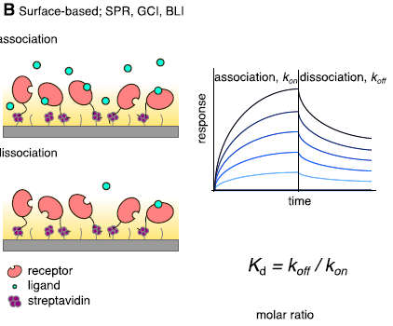
Surface plasmon resonance (SPR)
optical-based method to measure the change in the refractive index near a sensor surface
  proteins are immobilized on a metal coated surface and ligands flow past. When a ligand binds to the protein, it causes changes in the refractivity/reflectivity properties of the metal that are related to the mass of the ligand and the mass of the protein that can be detected by an optical device.
measuring real-time quantification of protein–ligand binding kinetics and affinities
Stauch B. H.: PhD. Thesis 2013, University of Cambridge
Du X. et al. Int. J. Mol. Sci. 2016, 17, 144;
Sandoval P. J. et al.: Plant Physiol. 2020, 182, 1697
Notes:
More sensitive than ITC

Slide 53
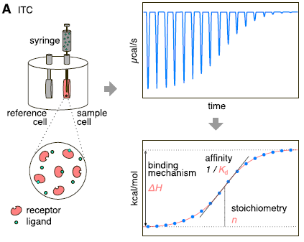
Isothermal titration calorimetry (ITC)
measurement of heat release upon ligand binding – the only approach to measure directly the heat exchange during complex formation at a constant temperature, and has become the gold standard in determining the forces that drive the binding process or stabilize the intermolecular Interactions
technique of choice for precise determination of binding constants, and the only widely used biophysical technique that is able to deconvolute the contributions of enthalpy and entropy to ligand binding. The relative contributions of enthalpy and entropy can provide with insights into the relative importance of polar and hydrophobic interactions, respectively
typical ITC experiment contains three steps: (i) a ligand is titrated into a solution containing the bio-macromolecule (e.g., protein) of interest; (ii) the heat released or absorbed that is associated with a binding event is measured; and (iii) the primary ITC data is processed and fitted to obtain the binding constant (Kb), Gibbs free energy of binding (DG), binding enthalpy (DH) and entropy (DS), and the stoichiometry (n) of the binding event. Moreover, when ITC experiments are performer at varying temperatures, the heat capacity change (DCp) of a binding reaction can be obtained
Stauch B. H.: PhD. Thesis 2013, University of Cambridge
Du X. et al. Int. J. Mol. Sci. 2016, 17, 144
Sandoval P. J. et al.: Plant Physiol. 2020, 182, 1697
Notes:
DU 2016
However, the calorimetric techniques, including the differential scanning calorimetry (DSC) and the ITC, provide quantitative thermodynamic data that can be used to study the complex stability and to elucidate the binding driving forces. DSC can measure the enthalpy and the heat capacity of thermal denaturation and as thus provides a way to estimate the stability of protein–ligand complexes..

Slide 54
Thermal shift assay (TSA)
small molecule ligands typically bind to proteins in a well-defined, folded state, thereby stabilizing this folded state by increasing its heat capacity
in TSA the protein unfolding temperature is determined in the presence and absence of a ligand by optical means, as folded and unfolded proteins have different fluorescent properties. In the case of ligand binding, an increase in unfolding temperature can be measured
Stauch B. H.: PhD. Thesis 2013, University of Cambridge

Slide 55
Homework – see the video http://pdb101.rcsb.org/learn/videos/what-is-a-protein-video
Projekt
„Zvýšení kvality vzdělávání na UK a jeho relevance pro potřeby trhu práce-ESF
Reg. č. CZ.02.2.69/0.0/0.0/16_015/0002362“, je financován z programu OP VVV

