Slide 1
Basics in Molecular Modelling of Drugs
Zvýšení kvality vzdělávání na UK a jeho relevance pro potřeby trhu práce-ESF
Reg. č. CZ.02.2.69/0.0/0.0/16_015/0002362
Projekt je financován z programu OP VVV
Pharmacy – 4th section of study
Specialization: Pharmaceutical Chemistry
1st Lecture
Marta Kučerová
Notes:
kap. Computers in Med. Chem. Patrick str. 354
https://smarts.plus/about

Slide 2

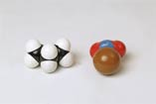
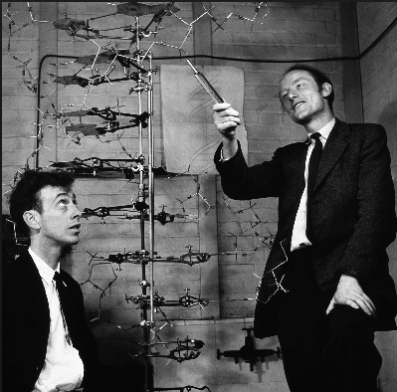
Molecular Models
Dreiding models
Stuart-Briegleb or CPK models
Watson and Crick model of DNA
1970s – first virtual Dreiding models
Höltje, H.-D. et al.: Molecular Modeling – Basic Principles and Applications, Wiley-VCH, Weinheim 2008, 3rd Ed.
Notes:
Corey-Pauling-Koltun

Slide 3
Computational Chemistry - IUPAC definition
Computational chemistry is a discipline using mathematical methods for the calculation of molecular properties or for the simulation of molecular behavior
it also includes, e.g., synthesis planning, database searching, combinatorial library manipulation
computer-assisted drug design = CADD (computer-aided drug design)
computer-assisted molecular design = CAMD
  computer-assisted drug design involves all computer-assisted techniques used to discover, design and optimize biologically active compounds with a putative use as drugs (CADD)/compounds with desired structure and properties (CAMD)
Patrick GL: An Introduction to Medicinal Chemistry, Oxford University Press, New York 2009, 4th Ed.
Notes:
Solomon K. A.: molecular modelling and drug design, MJP Publisher, Chennai 2008
CADD can be used in evaluation of efficiency, stability (chemical, metabolic), solubility (absorption, distribution), synthetic viability (bio-, chemo-), novelty (patentability)

Slide 4
Data Science/ Computational chemoinformatics molecular design
Data integration
Data curation and annotation
Data analysis
Data visualization
Comparative modelling
Molecular docking
Virtual screening
PH4-modelling
MD simulations/normal mode analysis
Bioactivity profiling
Predictive modelling/machine learning
Zdrazil B.: Lecture (EUROPIN Summer school on Drug Design, 15-20, September 2019, Vienna)

Slide 5
Computers in Medicinal Chemistry
molecular and quantum mechanics
drawing chemical structure
3D structures
energy minimization
molecular properties
conformational analysis
Patrick GL: An Introduction in Medicinal Chemistry, Oxford University Press, New York 2009, 4th Ed.

Slide 6
Historical Milestones in Computational Chemistry I
1926 Erwin Schrödinger develops the „wave equation“ that mathematically describes the distribution of an electron through space (energy operator = Hamiltonian H)
1928 Robert S. Mulliken develops a „molecular orbital“ theory where electrons are assigned to orbitals across an entire molecule
1929 John Lennard-Jones introduces the linear combination of atomic orbitals approximation for the calculation of molecular orbitals
1930 Fritz London explains van der Waals forces as due to the interacting fluctuating dipole moments between molecules
1938 Charles A. Coulson makes the first accurate calculation of a molecular orbital wavefunction for the hydrogen molecule
1950 Derek Barton lays down the foundation of Conformational Analysis in a study of steroid chemistry
1956 the first ab initio Hartree-Fock calculations on diatomic molecules
1961 W.A. Hendrickson publishes the first use of a computer for force field calculations in a study of ring conformations
1965 Egon Wiberg employs Steepest Descent algorithm for geometry optimisation with a molecular mechanics (MM)
1965 the molecular structure drawing program ORTEP developed at Oak Ridge National Laboratory
1970 Gaussian70 made freely available via the Quantum Chemistry Program Exchange (QCPE)
1970 the term „Computational Chemistry“ first used to describe the new scientific discipline
1973 Cambridge Crystallographic Data Centre makes its 3D structure files widely available
1973 N. L. Allinger describes the modelling of hydrocarbons with a new force field, MM1
1975 the first molecular dynamic simulation of a protein is published by A. Warshel and M. Levitt
Davis A., Ward S. E.: Handbook of Medicinal Chemistry, Royal Society of Chemistry, Cambridge 2015
Notes:
N. Allinger developed computer code and used computers to optimize the structure of molecules using such classical, empirical potentials in a set of molecular mechanics methods called MM1, MM2 and so on. In these methods the energy of the system was minimized to obtain the structure of the studied system. The MM-methods were primarily used for systems built from organic molecules

Slide 7
Historical Milestones in Computational Chemistry II
1982 P. J. Kuntz and co-workers lay down the foundations for the DOCK algorithm, the starting point for a multitude of researchers in the area of virtual screening
1985 GRID is published by Peter Goodford. A computational procedure for determining energetically favourable binding sites on biologically important macromolecules
1987 the Concord automatic 3D structure generation program was developed
1993 zanamivir is discovered with the assistance of GRID in one of the first examples of protein structure-based drug design (SBDD)
1998 Nobel prize awarded to John Pople and Walter Kohn for development of computational chemistry in quantum chemistry (Gaussian 70)
2010 the first millisecond simulation of a protein is performed using Anton = a computer designed specifically for high-speed molecular dynamics
2017 simulation of subatomic particles of LiH, BeH₂ by IBM on a quantum computer (seven qubit processor)
2017 Nobel prize awarded to J. Dubochet, J. Frank, and R. Henderson for developing cryo-electron microscopy for the high-resolution structure determination of biomolecules in solution
2019 Arute F et al. (Nature 2019, 574, 505) Quantum supremacy using a programmable superconducting processor
2019 Novartis and Microsoft announce collaboration to transform medicine with artificial intelligence
2022 Google's DeepMind AI predicts 3D structure of nearly every protein known to science
Davis A., Ward S. E.: Handbook of Medicinal Chemistry, Royal Society of Chemistry, Cambridge 2015; https://www.ibm.com/blogs/research/2017/09/quantum-molecule/ ; https://news.microsoft.com/2019/10/01/novartis-and-microsoft-announce-collaboration-to-transform-medicine-with-artificial-intelligence/; https://www.pharmaceutical-technology.com/deal-news/novartis-microsoft-ai-alliance/ ; https://www.cnet.com/science/biology/googles-deepmind-ai-predicts-3d-structure-of-nearly-every-protein-known-to-science/
Notes:
Google's sister company, DeepMind used AlphaFold (AI systém)

Slide 8
Searching for a New Drug
Drug Discovery
  choosing a disease → choosing a target → identifying a bioassay
  finding a hit = molecule, typically with a potency of 100 nM–5 µM at the drug target
  process from hit to a „lead“ (compound) „H2L“
Drug Design (rational drug design) = the application of all techniques leading to the discovery of new chemical entities (NCE) with specific properties required for the intended application (IUPAC definition)
  structure-activity relationships (SAR)
  identification of pharmacophore
  drug optimization
Drug Development = getting drug, i.e. candidate to the market
  preclinical trials (ADMET, PK and PD)
  clinical trials
  patenting and regulatory affairs
Patrick GL: An Introduction to Medicinal Chemistry, Oxford University Press, New York 2009, 4th Ed.; Schwardt O. et al.: Drug Discovery Today. Front. Med. Chem. 2005, 2, 533-543; Hughes JP et al.: Brit. J. Pharmacol. 2011, 162, 1239
Notes:
Solomon K. A.: molecular modelling and drug design, MJP Publisher, Chennai 2008
Hits are chemical compounds that produce biological activity thought to a represent therapeutic potential, but have some „to-be-improved“/ undesirable properties
Targets: 3500 enzymes, 2000 G-protein coupled receptors, 1000 ion channels, >150 nuclear hormone receptors
Drug discovery process: Target identification-target validation-lead discovery (HTS: 10⁵ chemical compounds)-lead optimization (in terms of potency, selectivity, fysico-chem. properties)-assays

Slide 9
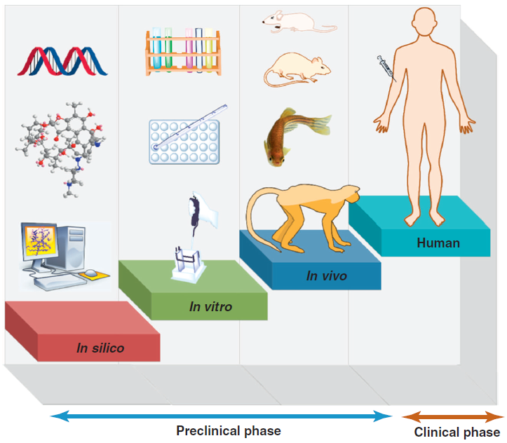
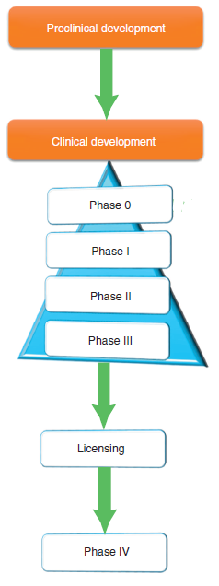
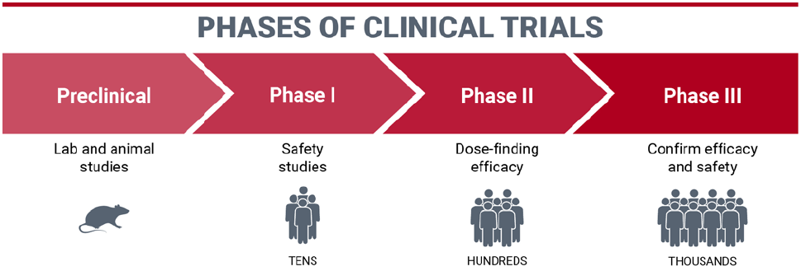
SAFETY FIRST: Assessing drugs early can preclude regulatory and health issues, C&EN Brandlab 2023
Notes:
Davis A., Ward S. E.: Handbook of Medicinal Chemistry, Royal Society of Chemistry, Cambridge 2015
Medicinal chemistry is the most expensive part of pre-clinical research

Slide 10
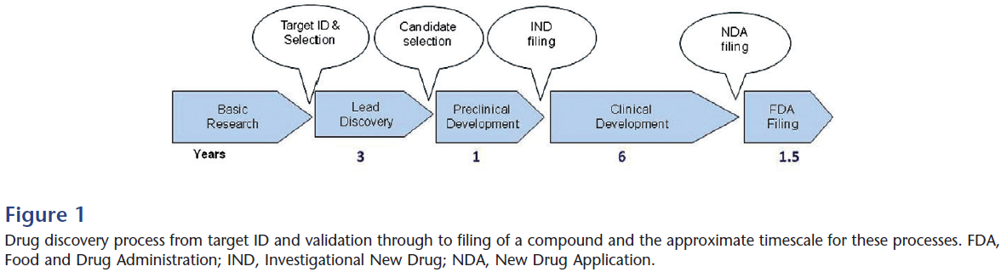
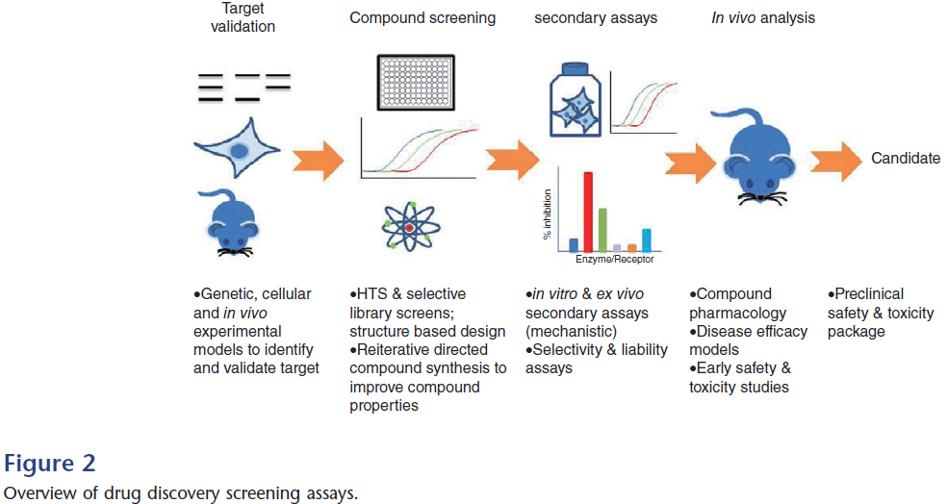
Hughes JP et al.: Brit. J. Pharmacol. 2011, 162, 1239
Notes:
Hughes JP et al.: Brit. J. Pharmacol. 2011, 162, 1239
200000-10⁶ hits – 100s of molecules in lead optimization – 1-2 candidate molecules
https://www.fda.gov/drugs/types-applications/investigational-new-drug-ind-application

Slide 11
Methodologies for Lead Identifying
High Throughput Screening (HTS)
  screening of nature extracts, corporate compound collections and combinatorial libraries
  hit (selection)
In Silico screening = virtual screening
  computational docking to 3D-structure of the target by using numerous computational filters
Screening by NMR
Ligand-Observed Screening
Target-Observed Screening
Schwardt O. et al.: Drug Discovery Today. Front. Med. Chem. 2005, 2, 533-543

Slide 12
Compound Libraries
screening collections ~ 10⁶ compounds
large virtual libraries
  10¹² individual compounds
  10¹⁴ combinatorial chemistry compounds
  10¹⁸ de novo compounds reassembled from fragments
chemical space: 10⁶³ of drug-like compounds
Abraham D. J., Rotella D. P.: Burger´s Medicinal Chemistry, Drug Discovery and Development – Discovering Lead Molecules (Volume 2), Wiley, New Jersey 2010
Hessler G.: Lecture (EUROPIN Summer school on Drug Design, 15-20, September 2019, Vienna)

Slide 13
Schwardt O. et al.: Front. Med. Chem. 2005, 2, 533-543

Slide 14
Molecular Modelling – IUPAC definition
molecular modelling is the investigation of molecular structures and properties using computational chemistry and graphical visualization techniques in order to provide a plausible three-dimensional representation under a given set of circumstances
computer-assisted molecular modelling (CAMM)
  Computer-assisted molecular modelling is the investigation of molecular structures and properties using computational chemistry and graphical visualization techniques.
Notes:
molfile
A molfile is a table containing atom type, connectivity and a more or less arbitrary 2D or 3D information about a molecule. Well-known file formats include the MOLfile used by MDL Information Systems Inc. (e.g., in the database MACCS), the MOL2 file used by Tripos Associates (e.g., in the modelling package SYBYL), or the CSSR format.

Slide 15
Molecular Mechanics vs Quantum Mechanics
Born-Oppenheimer approximation: mass difference between nuclei and electrons is sufficient, so that their motion can be considered separately
a proton is 1836 times heavier than an electron
QUANTUM MECHANICS (QM) – focused on the electronic state of the molecule given a fixed position for the nuclei
MOLECULAR MECHANICS (MM) – focused on the nuclear coordinates of a molecule in its ground electronic state
Davis A., Ward S. E.: Handbook of Medicinal Chemistry, Royal Society of Chemistry, Cambridge 2015
Notes:
Max Born
Robert Oppenheimer

Slide 16
IUPAC definitions of QM and MM
quantum mechanical methods
  ab initio, syn. non-empirical quantum mechanical methods are methods of quantum mechanical calculations independent of any experiment other than the determination of fundamental constants. The methods are based on the use of the full Schrödinger equation to treat all the electrons of a chemical system. In practice, approximations are necessary to restrict the complexity of the electronic wave function and to make its calculation possible
  semi-empirical quantum mechanical methods are methods which use parameters derived from experimental data to simplify computations. The simplification may occur at various levels: simplification of the Hamiltonian (e.g., as in the Extended Huckel method), approximate evaluation of certain molecular integrals (see, for example, Zero differential overlap approximation), simplification of the wave function (for example, use of a Pi (π) electron approximation as in Pariser–Parr–Pople method), etc.
molecular mechanics calculation, syn. force-field calculation (IUPAC definition) is an empirical calculational method intended to give estimates of structures and energies for conformations of molecules. The method is based on the assumption of 'natural' bond lengths and angles, deviation from which leads to strain, and the existence of torsional interactions and attractive and/or repulsive van der Waals and dipolar forces between non-bonded atoms. The method is also called '(empirical) force-field calculations'.

Slide 17
Quantum Mechanics (QM, A. Einstein)
key concept is the wave function denoted as ψ (see wave-particle duality)
ψ completely describes the properties of a quantum mechanical system and has a value at every point in space
important result of QM: localisation of electron density can be computed
Hartree-Fock method – each electron is considered to move in a static field of all other electrons
semi-empirical quantum mechanics: MNDO (Modified Neglect of Differential Overlap)
Density Functional Theory (DFT) – directly calculates the electron density distribution and the total electronic energy
Davis A., Ward S. E.: Handbook of Medicinal Chemistry, Royal Society of Chemistry, Cambridge 2015

Slide 18
Application of MM vs QM
Molecular mechanic
Quantum mechanics
is limited to molecules containing thousands of atoms
suitable for the following operations or calculations
  energy minimization
  identifying stable conformations
  energy calculations for specific conformations
  generating different conformations
  studying molecular motion
ab initio calculations are limited to molecules containing tens of atoms
semiempirical calculations to molecules containing hundreds of atoms
suitable for the following operations or calculations
  molecular orbital energies and coefficients
  heat of formation for specific conformations
  partial atomic charges calculated from molecular orbital coefficients
  electrostatic potentials
  dipole moments
  transition state geometries and energies
  bond dissociation energies
Patrick GL: An Introduction to Medicinal Chemistry, Oxford University Press, New York 2017, 6th Ed.

Slide 19
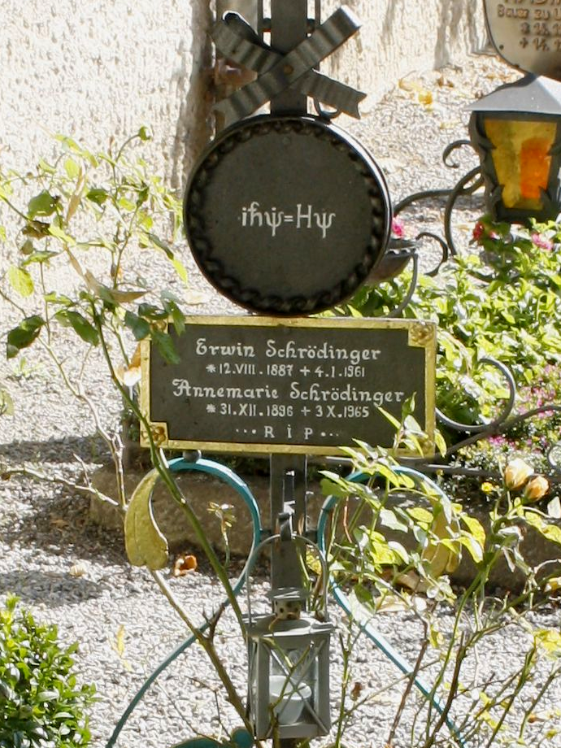
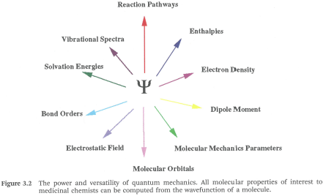
https://en.wikipedia.org/wiki/Schr%C3%B6dinger_equation
Davis A., Ward S. E.: Handbook of Medicinal Chemistry, Royal Society of Chemistry, Cambridge 2015

Slide 20
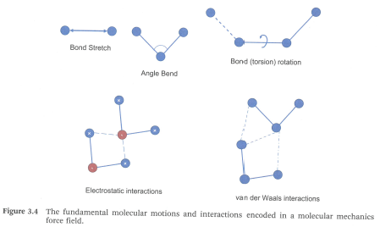
Molecular Mechanics (MM)
this technique originated with the vibrational spectroscopic community
energy of the molecules is defined in terms of the nuclear positions, i.e. electron are not studied and are assumed to adopt an optimal distribution around the nuclei
the energy of the molecule in MM has contributions from bond-stretches, angle stretches, out of plane bending and torsional energies with additional terms to describe non-bonded terms for van der Waals and electrostatic interactions
Davis A., Ward S. E.: Handbook of Medicinal Chemistry, Royal Society of Chemistry, Cambridge 2015
Notes:
“ball and spring” model where atoms are treated as hard spheres and bonds are described by equations similar to those from Hooke’s law.

Slide 21
Terms in MM
bond-stretch of two bonded atoms (harmonic=symmetrical potential)
  Hook's Law (the extension is proportional to the force)
angle stretches – energy associated by deformation of a bond angle (harmonic potential)
torsional energies – describes how the energy changes as a bond rotates
composite function = non-bonded interaction between atoms
  6-12 Lennard-Jones potential for van der Waals energies
  simple Coulomb charge potential modified by dielectric constant of the environment (1 for vacuum, 78.4 for water and 2 for interior of a protein)
Davis A., Ward S. E.: Handbook of Medicinal Chemistry, Royal Society of Chemistry, Cambridge 2015

Slide 22
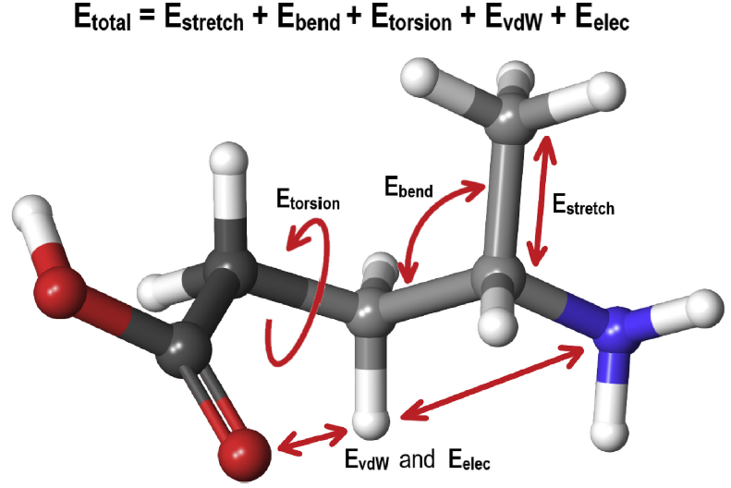
Force Field
defined by a combination of the mathematical energy function and a set of required parameters
method MM1
  introduced by N. L. Allinger for hydrocarbons
  and many others
applications in drug discovery
  conformational analysis
  protein-ligand interaction – force field as scoring function is set up of four components
    protein-ligand hydrogen bond energy (external H-bond)
    protein-ligand van der Waals (vdW) energy (external vdW)
    ligand internal vdW energy (internal vdW)
    ligand torsional strain energy (internal torsion)
Davis A., Ward S. E.: Handbook of Medicinal Chemistry, Royal Society of Chemistry, Cambridge 2015;
Brown N.: In Silico Medicinal Chemistry, Royal Society of Chemistry, Cambridge 2016;
Lewis-Atwell T. et al.: Tetrahedron 2021, 79, 131865

Slide 23
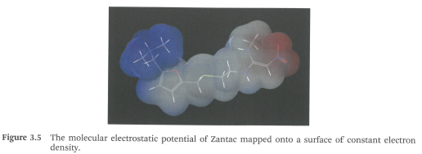
Electronic Distribution and Electrostatic Isopotentials
Coulombic terms – Partial Charges
QM
  Mulliken Method
  Gasteiger-Marsili Method
MM
valence bond model (the molecular electrostatic potential = MEP of ranitidin mapped onto a surface of constant electron density.
Davis A., Ward S. E.: Handbook of Medicinal Chemistry, Royal Society of Chemistry, Cambridge 2015

Slide 24
Structure-Based Drug Design (SBDD)
structure-based design (IUPAC definition) is a design strategy for new chemical entities (NCE) based on the three-dimensional (3D) structure of the target obtained by X-ray or nuclear magnetic resonance (NMR) studies, or from protein homology models
most familiar application of computational chemistry
1976 first structure-based design published by Bedell et al. (allosteric binding to haemoglobin)
Davis A., Ward S. E.: Handbook of Medicinal Chemistry, Royal Society of Chemistry, Cambridge 2015
Notes:
Can be splitted into virtual screening and de novo approaches

Slide 25
Protein Structure Determination at the Atomic Level
x-ray crystallography/high-throughput x-ray crystallography
  very versatile especially in case of globular proteins
  proteins must be expressed, purified, characterized and crystallized
  X-ray crystal structures for most non-membrane proteins can be routinely accessible with sufficiently high resolution (≤2.5 Å, i.e., 0.25 nm)
  a well-supported project can deliver co-crystal structures within two weeks
nuclear magnetic resonance (NMR)
  in solution phase
  up to 30 kDa proteins
  is synergic with X-ray
  neutron diffraction
  higher resolution than NMR, allows direct observation of hydrogen positions in structures
  larger crystals necessary
  cryo-electron microscopy (cryo-EM)
    typically applied to proteins that are multimeric and/or membrane protein complexes with a molecular weight of over 50 kDa
  computional methods – homology modelling
  approximate model of a protein in case of high sequence homology to a known protein structure
Schwardt O. et al.: Drug Discovery Today. Front. Med. Chem. 2005, 2, 533-543; Abraham D. J., Rotella D. P.: Burger´s Medicinal Chemistry, Drug Discovery and Development – Discovering Lead Molecules (Volume 2), Wiley, New Jersey 2010; Davis A., Ward S. E.: Handbook of Medicinal Chemistry, Royal Society of Chemistry, Cambridge 2015; gene-drug-approach-white-paper-wp0023.pdf (thermofisher.com)
Notes:
Burger:
resolution=is a statement of the accuracy in data collection, not a measure of the accuracy in refinement
resolution in crystalography= a width of window we use to analyze the crystal
Cryo-EM - preparation of vitrified cryo-EM specimens, which facilitates rapid plunge-freezing of holey carbon grids in liquid ethane after application and blotting of the protein solution. This achieves embedding of proteins in a thin layer of non-crystalline ice preserving their native state in solution. records movies that represent 2D projection images of the target of interest and are subsequently used for computational 3D image reconstruction. After data collection, 3D reconstruction involves orienting and averaging hundreds of thousands of 2D images of isolated particles to calculate a high-resolution map of the protein.

Slide 26

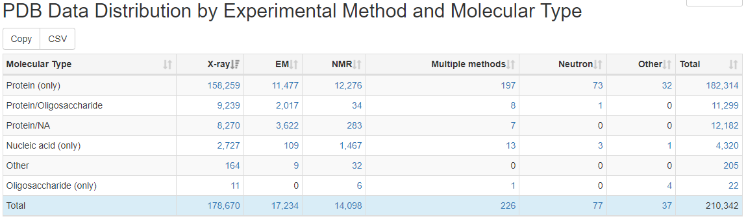
Protein Data Bank (PDB)
www.rcsb.org
publicly available structures
crystallographic system to obtain crystals, co-crystals
Notes:
http://www.rcsb.org/stats/summary

Slide 27
Structure-Based Drug Design (SBDD)
= virtual design in order to
select a compound from possible molecules which could be synthesized as a part of a lead optimisation program
discover leads in an existing collection of molecules
Davis A., Ward S. E.: Handbook of Medicinal Chemistry, Royal Society of Chemistry, Cambridge 2015

Slide 28
Steps of Structure-Based Drug Design (SBDD)
molecular docking = computational methods that predict the 3D structure of a protein-ligand complex, i.e., method for generation of plausible poses of the ligand and protein
  pose = ligand's orientation in the binding site
scoring = selecting the correct binding mode and conformation for a single molecule and correctly ranking molecules against each other
  prediction of free energy of protein-ligand binding (binding affinity)
  small changes in binding energy can cause exponential changes in binding affinity
systematic or random (stochastic) approach
Abraham D. J., Rotella D. P.: Burger´s Medicinal Chemistry, Drug Discovery and Development – Discovering Lead Molecules (Volume 2), Wiley, New Jersey 2010
Davis A., Ward S. E.: Handbook of Medicinal Chemistry, Royal Society of Chemistry, Cambridge 2015

Slide 29
Molecular Dynamics
molecular dynamics in drug design (IUPAC definition) is a simulation procedure consisting of the computation of the motion of atoms in a molecule or of individual atoms or molecules in solids, liquids and gases, according to Newton's laws of motion. The forces acting on the atoms, required to simulate their motions, are generally calculated using molecular mechanics force fields.
simulations are able to model time-dependent behaviour
first published method for simulation: Monte Carlo technique
Davis A., Ward S. E.: Handbook of Medicinal Chemistry, Royal Society of Chemistry, Cambridge 2015
Notes:
Force-field for MD: GROMOS, CHARMM, AMBER

Slide 30
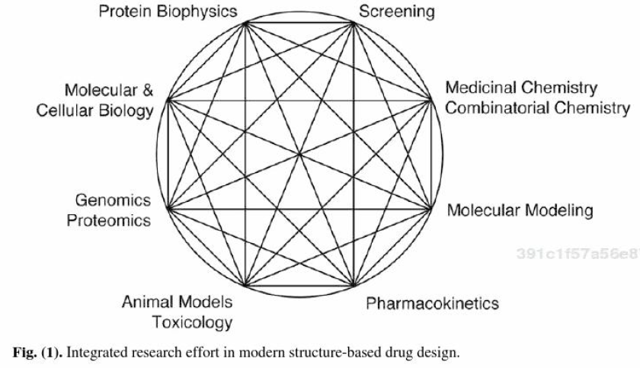
SBDD is used during
hit identification (high throughput virtual screening = HTVS)
hit-to-lead optimization
late-stage optimization (concerns PK, TOX, solubility)
Davis A., Ward S. E.: Handbook of Medicinal Chemistry, Royal Society of Chemistry, Cambridge 2015; Schwardt O. et al.: Front. Med. Chem. 2005, 2, 533-543

Slide 31
Ligand-Based Drug Design (LBDD)
Ligand-Based Virtual Screening (LBVS)
encompasses all techniques to computationally screen for novel compounds using ligand information only without including any information of the target structure
approaches
  compound similarity
  pharmacophore screening
  machine learning (QSAR models)
Abraham D. J., Rotella D. P.: Burger´s Medicinal Chemistry, Drug Discovery and Development – Discovering Lead Molecules (Volume 2), Wiley, New Jersey 2010

Slide 32
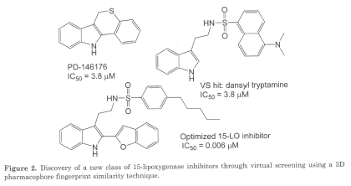
Compound Similarity
assumption: similar compounds exhibit similar biological activity
similarity in
  structural terms (fingerprints, structural keys: hydrophobic or aromatic moieties, ionizable groups)
  property terms (descriptors: calcd. logP, MW, number of rotatable bonds, HBA/HBD, pK_{a} etc.)
Abraham D. J., Rotella D. P.: Burger´s Medicinal Chemistry, Drug Discovery and Development – Discovering Lead Molecules (Volume 2), Wiley, New Jersey 2010

Slide 33
Pharmacophore Screening
1894 Emil Fischer characterized the binding of compounds to proteins with lock & key hypothesis
Paul Ehrlich – 1st definition of pharmacophore: “a molecular framework that carries (phoros) the essential features responsible for a drug's (pharmacon) biological activity“
Peter Gund modification: “a set of structural features in a molecule that is recognized at a receptor site and is responsible for that molecule's biological activity”
Abraham D. J., Rotella D. P.: Burger´s Medicinal Chemistry, Drug Discovery and Development – Discovering Lead Molecules (Volume 2), Wiley, New Jersey 2010

Slide 34

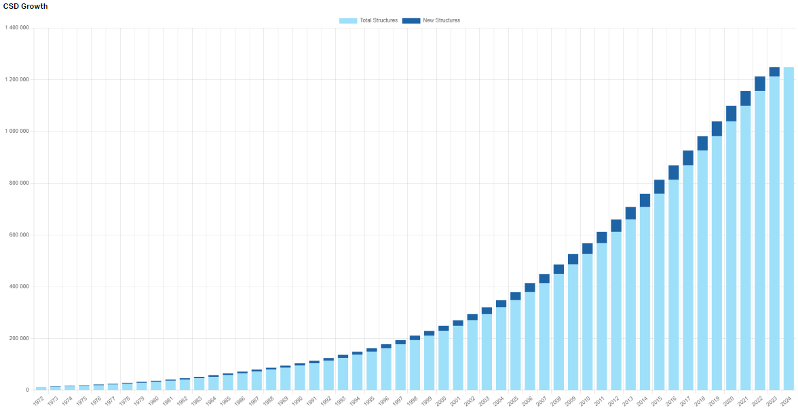
Cambridge Structural Database (CSD)
http://www.ccdc.cam.ac.uk/solutions/csd-system/components/csd/
primary source of 3D experimental structures of organic molecules
Notes:
https://www.ccdc.cam.ac.uk/CCDCStats/

Slide 35
Databases of Organic Compounds
free available
  ZINC Database http://zinc.docking.org/
  National Cancer Institute Database
  Chemspider (20 million compounds)
vendor
  eMolecules (10 mil commercially available compounds)
virtual databases
databases use
  SMILES codes
  molecular descriptors
Notes:
program for generating 3D structure databases from 2D structure databases: CONCORD, CORINA

Slide 36
Ligand-Based
3D Pharmacophore Generation I
used in case, that protein structure can not be obtained and there is a set of known active compounds binding in a similar way to the protein
3 steps of pharmacophore mapping
  identifying common binding elements (responsible for biological activity)
  generating potential conformations of active compounds
  measuring distances between binding pharmacophore elements in each conformations
Abraham D. J., Rotella D. P.: Burger´s Medicinal Chemistry, Drug Discovery and Development – Discovering Lead Molecules (Volume 2), Wiley, New Jersey 2010

Slide 37
Ligand-Based
3D Pharmacophore Generation II
software: HipHop, HypoGen, PHASE, MOE, Disco, Gasp, Flo, APEX
  use algorithms trained with a set molecules that are ranked with a scoring function
common pharmacophore features
  HBD/HBA
  negative/positive charges, ionizable centres
  surface accessible hydrophobic regions (aliphatic, aromatic, nonspecific)
  flexibility
Abraham D. J., Rotella D. P.: Burger´s Medicinal Chemistry, Drug Discovery and Development – Discovering Lead Molecules (Volume 2), Wiley, New Jersey 2010

Slide 38
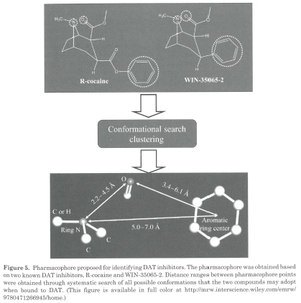
Pharmacophore Screening – example
Abraham D. J., Rotella D. P.: Burger´s Medicinal Chemistry, Drug Discovery and Development – Discovering Lead Molecules (Volume 2), Wiley, New Jersey 2010
Notes:
DAT = dopamine transporters

Slide 39
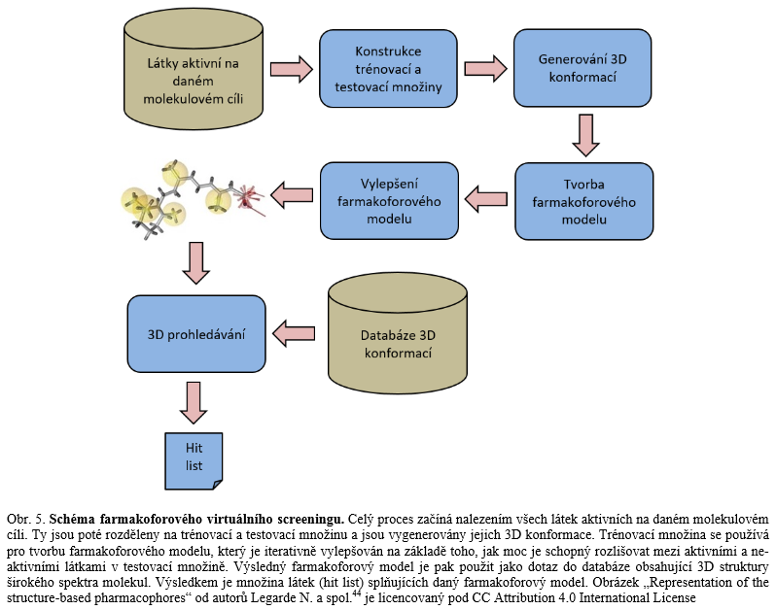
Svozil D. : Chem. listy 2017, 11, 738

Slide 40
QSAR Models
quantification of biological activity
1D-QSAR – relationship between activity and physicochemical properties, e.g. MW, logP, pK_{a}
2D-QSAR – additionally structural patterns and connectivity
3D-QSAR – describes electrostatic and steric properties in 3D
4D-QSAR – computes with more conformations of ligand
5D-QSAR – adds induced-fit models to 4D-QSAR
6D-QSAR – adds solvation models to 5D-QSAR
Polanski J.: Curr. Med. Chem. 2009, 16, 3243-3257; Kučera T. : Mil. Med. Sci. Lett. 2016, 85 (2), 75-79

Slide 41
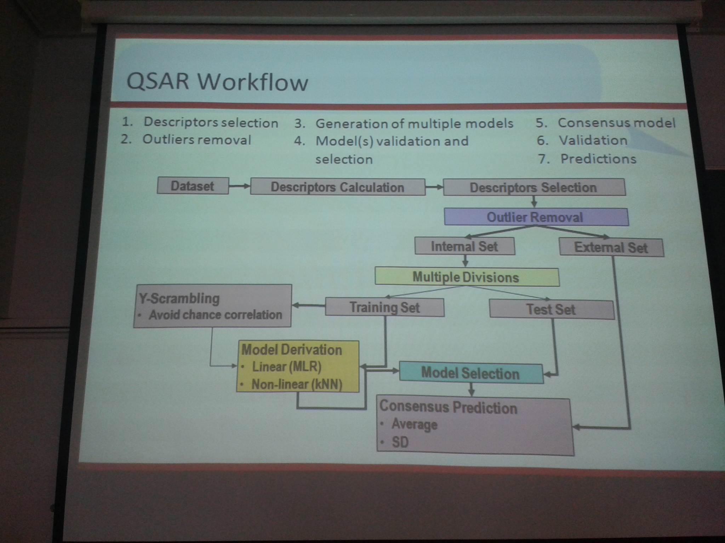

Slide 42
Fragment-Based Lead Discovery (FBLD)
history: 1996 the very first publication on FBLD (Abott)
screening of fragment library, usually by biophysical method
combination of information about fragments with other hits from virtual or experimental screening of conventional libraries and from literature
validation of binding of the various hits and structure determined by X-ray, NMR etc.
Davis A., Ward S. E.: Handbook of Medicinal Chemistry, Royal Society of Chemistry, Cambridge 2015

Slide 43
Fragment
is small (low MW)
need methods for fragment evolution
Fragment-based ligand design
  for most targets, fragment screening provides choice in the number and diversity of chemical starting points
  the chemist has a small start points, this gives opportunities for developing highly efficient, lower molecular weight lead with the possibility to optimise the required drug-like properties
  enables identifying novel scaffolds and binding motifs
Davis A., Ward S. E.: Handbook of Medicinal Chemistry, Royal Society of Chemistry, Cambridge 2015

Slide 44
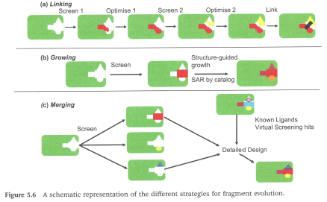
Fragment Evolution
Davis A., Ward S. E.: Handbook of Medicinal Chemistry, Royal Society of Chemistry, Cambridge 2015

Slide 45
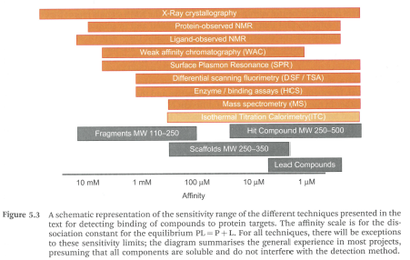
Fragment Screening Approaches
Davis A., Ward S. E.: Handbook of Medicinal Chemistry, Royal Society of Chemistry, Cambridge 2015

Slide 46
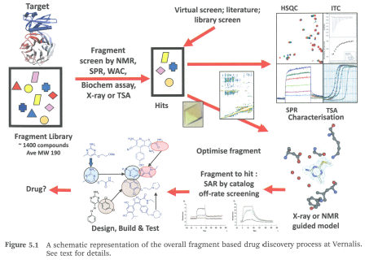
Davis A., Ward S. E.: Handbook of Medicinal Chemistry, Royal Society of Chemistry, Cambridge 2015
Notes:
HSQC - heteronuclear single quantum coherence or heteronuclear single quantum correlation (protein NMR)
SPR – surface plasmon resonance
TSA – thermal shift assay
ITC isothermal titration calorimetry
WAC weak affinity chromatography

Slide 47
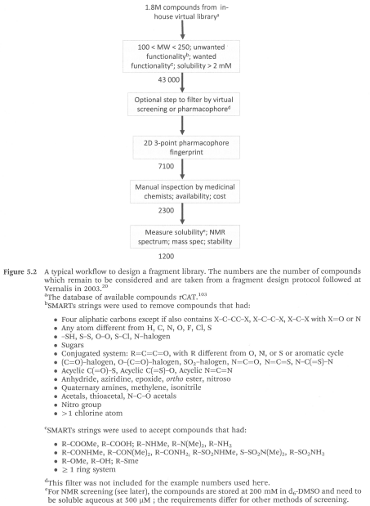
Fragment Library
commercially available compounds
corporate libraries
filters
  MW
  toxicity
  reactivity
  solubility etc.
Davis A., Ward S. E.: Handbook of Medicinal Chemistry, Royal Society of Chemistry, Cambridge 2015

Slide 48
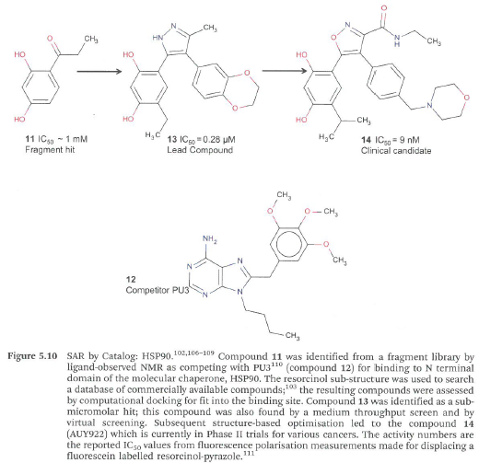
Davis A., Ward S. E.: Handbook of Medicinal Chemistry, Royal Society of Chemistry, Cambridge 2015

Slide 49
Conformation
history: Barton related the reactivity of subst. cyclohexane to equatorial or axial orientation of the ring substituents
each rotatable bond is systematically rotated via a fixed amount whilst the bond lengths and angles are kept constant
  small molecule with 3 rotational bonds → 1728 conformations
  molecule with 6 rotational bonds → 2.9 million conformations
  molecule with 7 rotational bonds → 36 million conformations
the objective is to discover all the accessible conformations, which will lie at energy minima
the calculation can produce a map of potential energy surface for a molecule
Davis A., Ward S. E.: Handbook of Medicinal Chemistry, Royal Society of Chemistry, Cambridge 2015

Slide 50
Conformation
Conformation calculations
Experimental determination of conformation
conformational sampling (resulting conformational sample ‘‘ensemble’’ will be representative of the system as a whole)
  systematic Search Method
  random Searches (Cartesian random search or torsional random search)
  Metropolis Monte Carlo Methods
  genetic Algorithm and Evolutionary Algorithm
  model Building Methods (fragment-based building)
  molecular Dynamics
  distance geometry
  neural Networks
conformation optimization (simulated annealing)
conformational analysis
  similarity measures
  cluster analysis
X-ray Diffraction
electron Diffraction
Raman Spectroscopy,
ultraViolet Spectroscopy
infraRed Spectroscopy
NMR Spectroscopy
microwave Spectroscopy
photoelectron Spectroscopy
supersonic Molecular Jet Spectroscopy
optical Rotatory Dispersion and CD measurements.
Uthuppan J et al.: Int. J. Pharm. Sci. Res. 2012, 2013; Vol. 4(1): 34-41
Notes:
Monte Carlo: The most stable conformation is used as starting origin for next phase where temperature is set at lower temperature.
Mol. Dyn.: the atoms of molecule are given an initial velocity and are then allowed to evolve in time according to the laws of Newtonian mechanics to provide a trajectory that defines how the positions and velocities of theparticles of the system vary with time. MD treats the atoms within the molecules as moving spheres. After 10⁻¹⁵ sec of movement, determination of the position and velocity of each atom in structure is used for the estimation of the forces by utilizing the values of bond lengths, bond angles. Generation of different conformations is carried out by program by “Heating” of molecule
simulated annealing It is derived by analogy with the process of crystallization; slow cooling produces stable crystalline forms corresponding to global minimum, whereas rapid freezing may lead to the formation of metastable form corresponding to local minimum.

Slide 51
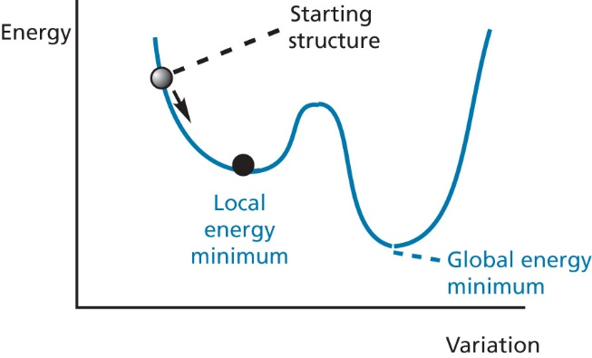
Local and Global Energy Minima
Methods of conformational analysis
  systematic search procedures
  Monte Carlo methods (serendipity)
  molecular dynamics
Patrick GL: An Introduction to Medicinal Chemistry, Oxford University Press, New York 2009, 4th Ed.; Höltje, H.-D. et al.: Molecular Modeling – Basic Principles and Applications, Wiley-VCH, Weinheim 2008, 3rd Ed.

Slide 52
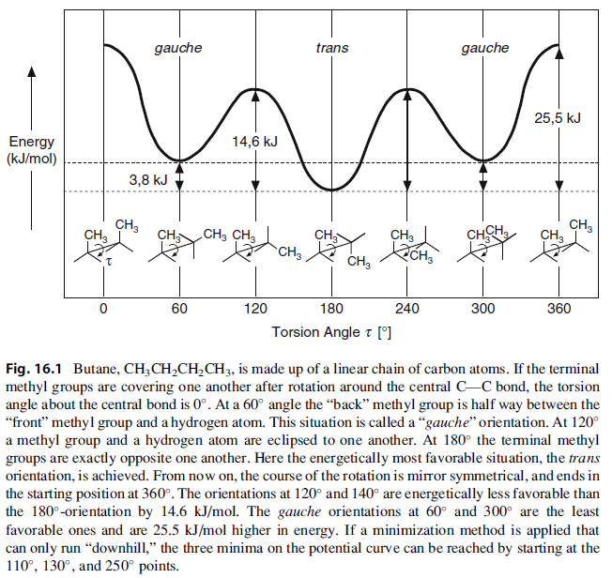
Butane conformations
Klebe G.: Drug design – methodology, concepts and mode-of action, Springer-Verlag Berlin Heidelberg 2013

Slide 53
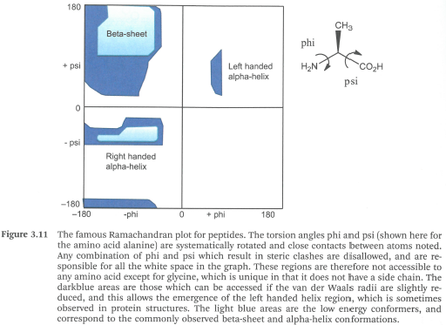
Ramachandran Plot (ϥ, ψ plot)
Davis A., Ward S. E.: Handbook of Medicinal Chemistry, Royal Society of Chemistry, Cambridge 2015

Slide 54
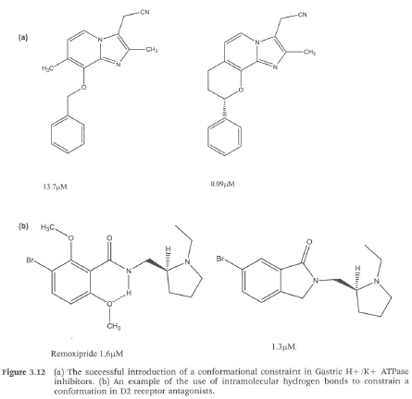
Examples of Conformational Constraints
conformational constraints are a familiar tactic in small molecule drug discovery
Davis A., Ward S. E.: Handbook of Medicinal Chemistry, Royal Society of Chemistry, Cambridge 2015

Slide 55
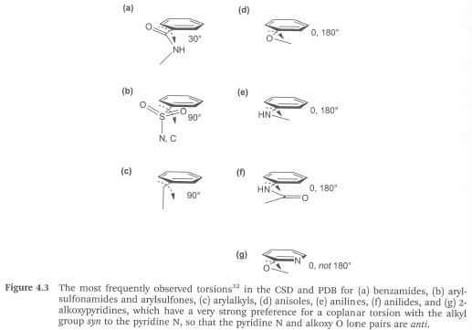
Preferred Conformations in Linkers between Aryls
Davis A., Ward S. E.: Handbook of Medicinal Chemistry, Royal Society of Chemistry, Cambridge 2015

Slide 56
To sum up the methods…
 |  | Target (enzyme/receptor)
 |  | unknown | known
Compounds (inhibitor/ligand) | unknown | Similarity search Rational screening | De novo design
 | known | Ligand-based drug design | Structure-based drug design
Solomon K. A.: Molecular modelling and drug design, MJP Publisher, Chennai 2008

Slide 57
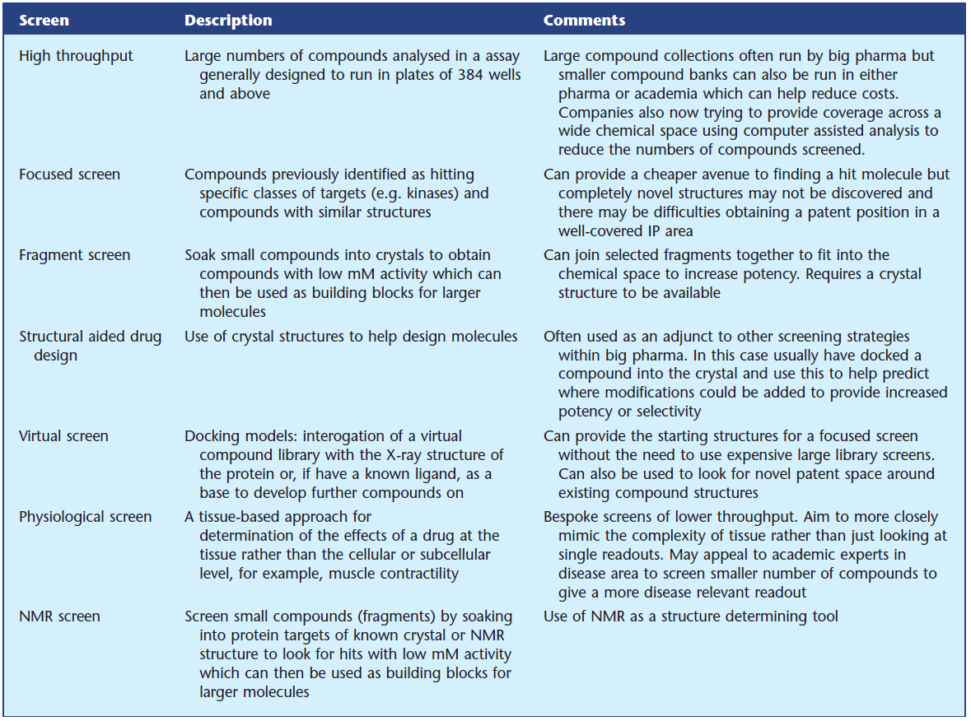
Notes:
Hughes JP et al.: Brit. J. Pharmacol. 2011, 162, 1239

Slide 58
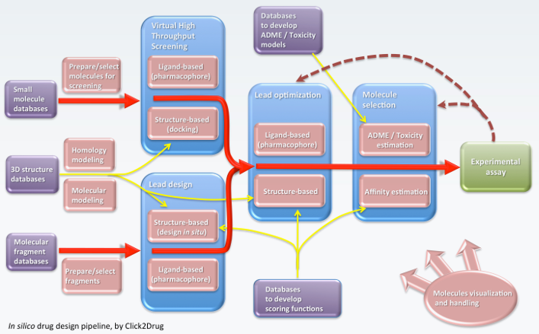
www.click2drug.com

Slide 59
Institutions Concerned with Computational Molecular Modelling in Czech Republic https://www.elixir-czech.cz/ www.ceitec.cz http://www.uochb.cz https://fch.upol.cz/vyzkum/
Projekt
„Zvýšení kvality vzdělávání na UK a jeho relevance pro potřeby trhu práce-ESF
Reg. č. CZ.02.2.69/0.0/0.0/16_015/0002362“, je financován z programu OP VVV

