Slide 1
Basics of Molecular Modelling of Drugs
Zvýšení kvality vzdělávání na UK a jeho relevance pro potřeby trhu práce-ESF
Reg. č. CZ.02.2.69/0.0/0.0/16_015/0002362
Projekt je financován z programu OP VVV
Pharmacy – 4th section of study
Specialization: Pharmaceutical Chemistry
7th Lecture
Topic: case studies

Slide 2
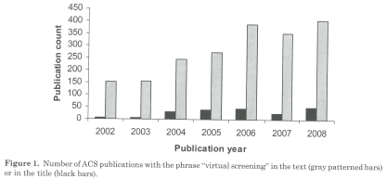
Introduction
??? proclamation: drugs can be designed using molecular modelling alone (i.e., de novo design) ???
up-to-date de novo design has been effective in designing new lead compounds, but further drug optimization with the aid of structure-based drug design has always been necessary to develop a clinically useful drug
molecular modelling is one of the powerful tools in hands of pharmaceutical chemists
design process considers both the pharmacodynamic and pharmacokinetic properties of the compound produced
Patrick GL: An Introduction to Medicinal Chemistry, Oxford University Press, New York 2009, 4th Ed.
Abraham D. J., Rotella D. P.: Burger´s Medicinal Chemistry, Drug Discovery and Development – Discovering Lead Molecules (Volume 2), Wiley, New Jersey 2010

Slide 3
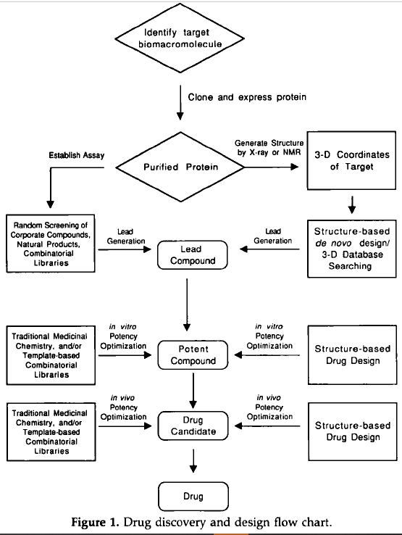
Typical workflow in DD
collaborative venture among scientists from a variety of disciplines including computational chemistry, synthetic organic chemistry, medicinal chemistry, molecular biology, X-ray crystallography, and NMR spectroscopy
Bohacek RS et al.: Med. Res. Rev. 1996, 16 (1), 3-50.

Slide 4
Applications of in silico methods in Med. Chem.
Target Identification & Validation
ligandability
druggability, e.g., SiteMap software from Schrödinger − Druggability score (Dscore)
Hit Generation
Hits-to-Leads
analogue by catalogue
Lead Optimization
Clinical Evaluation
property and structural filters after HTS
interactive data exploration= data mining using e.g., free In-house explorative data analysis DataWarrior by Actelion Pharmaceuticals
similarity clustering/grouping the hit list based on the chemical structure (scaffold analysis using e.g., Scaffold Tree method or free Scaffold-Hunter software)
cellular assay, animal models of the disease
oral absorption, metabolic clearence
virtual combinatorial libraries – both methods complementary
toxicity assays, off-target (selectivity), anti-target
methods: QSAR, Matched Molecular Pair Analysis (MMPA) – Bioisosteric replacement
Brown N.: In Silico Medicinal Chemistry, Royal Society of Chemistry, Cambridge 2016

Slide 5
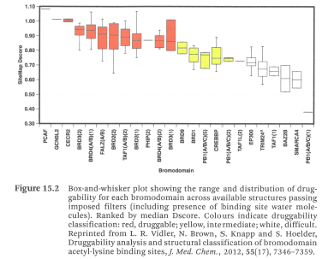
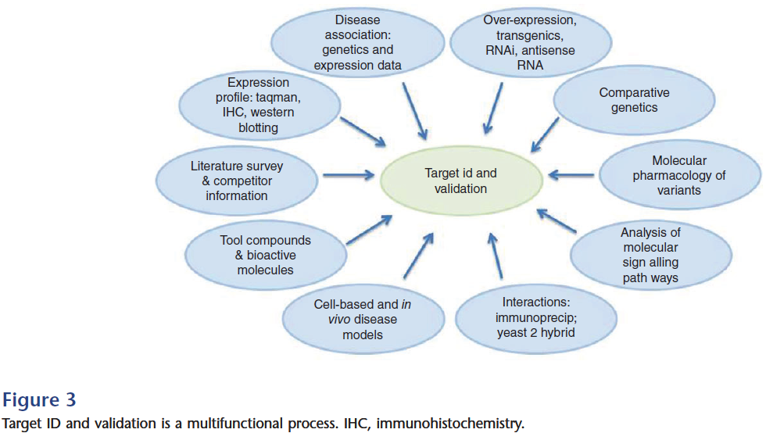
Druggability of the target
Therapeutic Target Database (TTD)
(idrblab.net)
Hughes JP et al.: Brit. J. Pharmacol. 2011, 162, 1239; Brown N.: In Silico Medicinal Chemistry, Royal Society of Chemistry, Cambridge 2016
Notes:
bromodomains as targets in both human cancer and multiple sclerosis

Slide 6
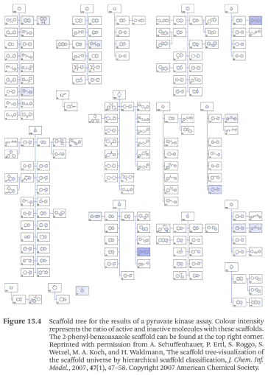
Evaluation of ligands
clustering based on similarity in
molecular property descriptors (MW, ClogP, TPSA, HBD/HBA)
topological descriptors (topological indeces and molecular fingerprints, (e.g., Tanimoto index)
topographical descriptors (scaffold)
IC₅₀ versus Ligand Efficiency (LE) – most commonly defined as the ratio of the affinity of a ligand divided by the number of heavy (non-hydrogen) atoms in the molecule (LE = ΔG/[number of heavy atoms])
e.g., saquinavir (LE = 0.25) is much larger and less potent than darunavir (LE = 0.40)
Reynolds CH.: Future Med. Chem. (2015) 7(11), 1363
Brown N.: In Silico Medicinal Chemistry, Royal Society of Chemistry, Cambridge 2016
Notes:
2D-Structure Similarity Searching
Several similarity coefficients such as Euclidean, Tversky, and Dice, although the most widely used is the Tanimoto index (Ti), which consists of the ratio of the number of features shared by two molecules to the total number of features
Ligand Efficiency LE (at http://www.openmolecules.org/properties/properties.html#le)
The ligand efficiency is a measure for the activity normalized by the number of non-H atoms. More precisely, it is the relative free binding energy in kcal/mol per non-H atom, calculated from an IC₅₀ value. Especially in early project stages prioritizing compounds based on their ligand efficiency values is a much more favorable approach compared to judging from plain activities alone: "For the purposes of HTS follow-up, we recommend considering optimizing the hits or leads with the highest ligand efficiencies rather than the most potent..." (Ref.: A. L. Hopkins et al., Drug Disc. Today, 9 (2004), pp. 430-431).

Slide 7
Virtual methods in development of drugs
SBDD (began almost forty years ago…)
neuraminidase inhibitors: zanamivir, oseltamivir
renin inhibitor: aliskiren
carbonic anhydrase glaucoma drug: dorzolamide
many HIV protease inhibitors
HCV protease inhibitors: telaprevir, boceprevir, simeprevir
kinase inhibitors: imatinib, nilotinib, gefitinib, verumafenib
dihydrofolate reductase inhibitor: methotrexate
pharmacophore models
tirofiban (the very first drug in this approach)
Davis A., Ward S. E.: Handbook of Medicinal Chemistry, Royal Society of Chemistry, Cambridge 2015; Abraham D. J., Rotella D. P.: Burger´s Medicinal Chemistry, Drug Discovery and Development – Discovering Lead Molecules (Volume 2), Wiley, New Jersey 2010; Chem. Listy 2016, 110- 575-580; Bisht N et al: Int. J. Pharm. Sci. Res. 2017, 8, 1405-1415

Slide 8
Design of ACE inhibitors using SBDD with a similar protein: captopril (Squibb) and enalapril (Merck & Co.)
ACE = membrane-bound enzyme from group of zinc metalloproteinases and catalyses hydrolysis of a dipeptide from the decapeptide angiotensin I to give octapeptide angiotensin II (vasoconstrictor)
design of ACE inhibitors was helped by studying the structure and mechanism of carboxypeptidase from group of zinc metalloproteinases (cleaves one amino acid, inhibited by L-benzylsuccinic acid)
Fig. CS2.2 Reaction catalysed by angiotensin-converting enzyme (ACE)
Fig. CS2.3 Hydrolysis of terminal amino acid
from a peptide chain by the carboxypeptidase enzyme.
The assymetric centre of L-benzylsuccinic acid has the R configuration.
Patrick GL: An Introduction to Medicinal Chemistry, Oxford University Press, New York 2009, 4th Ed.

Slide 9
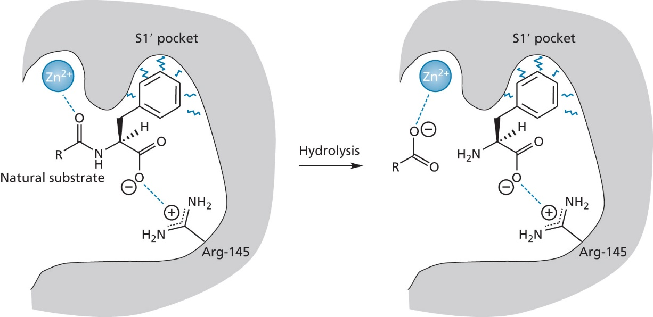
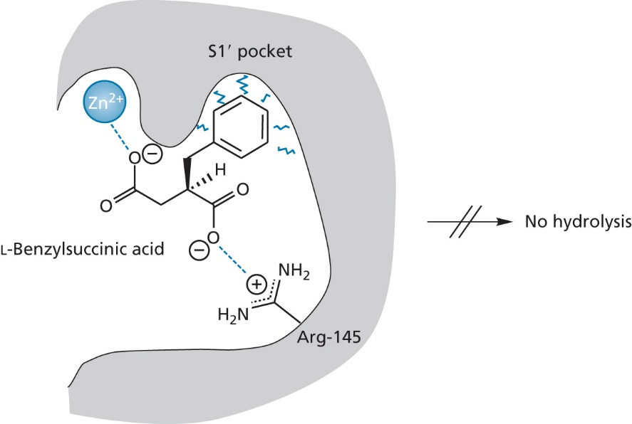
Design of ACE inhibitors using SBDD with a similar protein: captopril (Squibb) and enalapril (Merck & Co.)
active site of carboxypeptidase contains Arg-145 and zinc ion
Fig. 2.4 Binding site interaction for a substrate bound
to the active site of carboxypeptidase
Fig. 2.5 Inhibition by L-benzylsuccinic acid (the R-enantiomer)
Patrick GL: An Introduction to Medicinal Chemistry, Oxford University Press, New York 2009, 4th Ed.
Notes:
terminal carboxylic acid ionically bound to the arginine unit, while the carbonyl group of the terminal peptide bond is bound to the zinc ion (polarizes the carbonyl group). hydrophobic pocket S1 can accept the side chain of the terminal amino acid, especially aromatic amino acids at the C-terminus, e.g., Phe

Slide 10
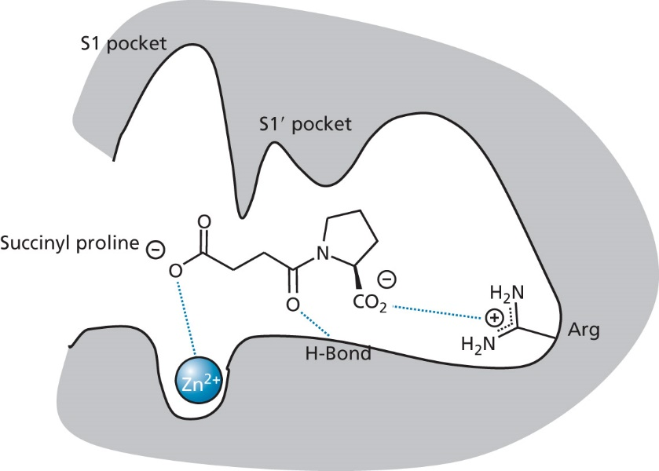
Design of ACE inhibitors using SBDD with a similar protein: captopril (Squibb) and enalapril (Merck & Co.)
ACE splits dipeptide → succinyl-substituted amino acid
no selectivity was known, therefore peptides inhibiting ACE were studied, e.g., nonapeptide teprotide (Botrops jararaca) and other venom peptides
assumption of S1 pocket and extension strategy
Fig. CS2.5 Angiotensin-converting enzyme (ACE) inhibitors
Fig. CS2.6 Binding interaction for succinylproline
in the active site of ACE
Fig. CS2.7 Development of captopril
Patrick GL: An Introduction to Medicinal Chemistry, Oxford University Press, New York 2009, 4th Ed.
Notes:
Křovinář žararaka (zmije z čeledi chřestýšovitých, J. Amer.)
S-enantiomer of captopril is 100-fold more active

Slide 11
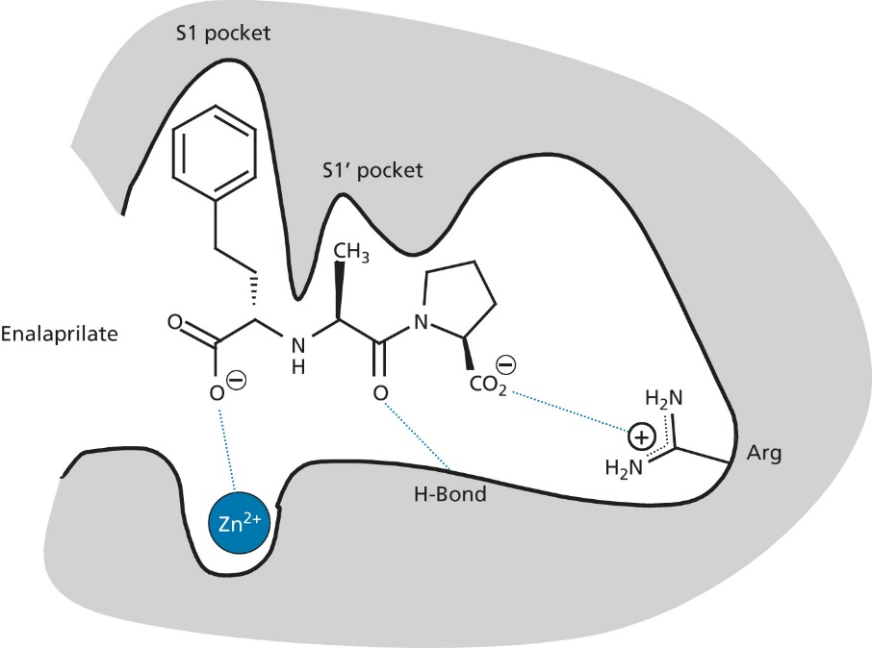
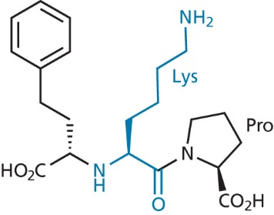
Design of ACE inhibitors
Fig. CS2.9 Enalaprilate (introduced in 1980)
Fig. CS2.8 Development of enalaprilate
(S,S,S)-diasteromer was found to be 700-times more active than (R,S,S)-diastereomer
Fig. CS2.10 Lisinopril (introduced in 1984)
2003 – X-ray of complex with ACE (Lys instead of Ala)
Patrick GL: An Introduction to Medicinal Chemistry, Oxford University Press, New York 2009, 4th Ed.

Slide 12
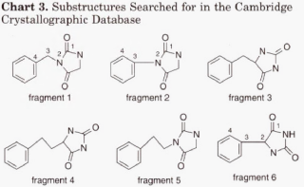
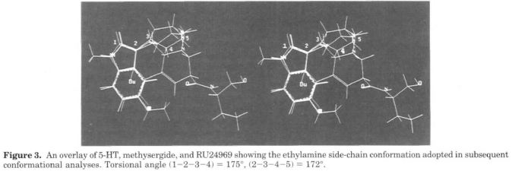
Discovery of zolmitriptan by Wellcome research lab. SBDD of 5-substituted tryptamines at 5-HT_{1D}
Glen R.C. et al.: J. Med. Chem. 1995, 38, 3566-3580
Notes:
developing highly selective 5-HT_{1D} agonists with the objectives of obtaining novel compounds with excellent potency, high oral bioavailability, a plasma half-life of greater than 2 h, and low CNS penetration
Structures were retrieved for fragments 1—3 and 6. Fragments retrieved for fragment 4 were constrained by additional ring systems and were therefore not representative of available conformers. No examples of fragment 5 were found.
Abstract: Structural modifications of N- and C-linked (principally hydantoin) analogues at the 5-position were synthesized and their pharmacological activities were utilized to deduce significant steric and electrostatic requirements of the 5-HT_{1D} and 5-HT_{2A} receptor subtypes. Conformations of the active molecules were computed which, when overlaid, suggested a pharmacophore hypothesis which was consistent with the affinity and selectivity measured at 5-HT_{1D} and 5-HT_{2A} receptors. This pharmacophore is composed of a protonated amine site, an aromatic site, a hydrophobic pocket, and two hydrogen-bonding sites. A “selectivity site” was also identified which, if occupied, induced selectivity for 5-HT_{1D} over 5-HT_{2A} in this series of molecules. The development and use of the pharmacophore models in compound design is described. In addition, the physicochemical constraints of molecular size and hydrophobicity required for efficient oral absorption are discussed. Utilizing the pharmacophore model in conjunction with the physicochemical constraints of molecular size and logD_{pH7.4} led to the discovery of zolmitriptan = lab code 311C90 (in article comp. 6), a new selective 5-HT_{1D} agonist with good oral absorption and potential use in the treatment of migraine.

Slide 13
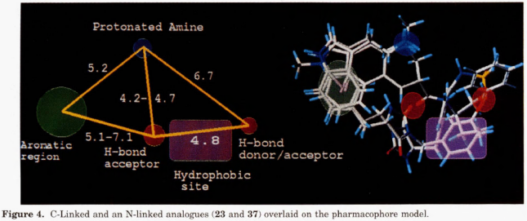
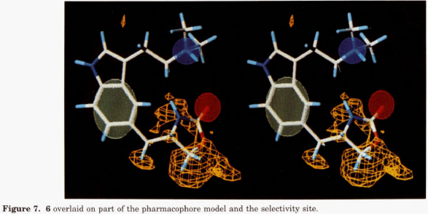
Discovery of zolmitriptan by Wellcome research lab. SBDD of 5-substituted tryptamines at 5-HT_{1D}
Glen R.C. et al.: J. Med. Chem. 1995, 38, 3566-3580
Notes:
„The receptor pharmacology of zolmitriptan was assessed using appropriate functional and radioligand binding assays (Table 8). The compound is a potent partial agonist at the 5-HT_{1D} receptor in the rabbit saphenous vein (RbSV) (ptAsol = 6.8; intrinsic activity = 0.77, cf. 5-HT) and shows high affinity at the 5-HT_{1D} binding sites in homogenates of calf caudate nucleus. 6 demonstrates at least 30-fold selectivity over other monoamine receptors and binding sites including 5-HT receptor subtypes. The compound is basic with a measured pK_{A} for the amine of 9.64. The free base is stable, nonhygroscopic, and soluble in aqueous solution at a neutral pH of >20 mg/mL. 6 is currently undergoing clinical evaluation for the treatment of migraine.“

Slide 14
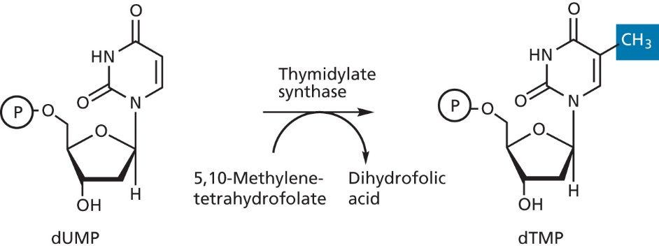
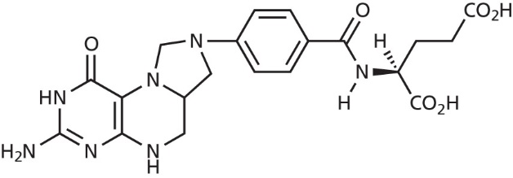
Design of a thymidylate synthase inhibitor
de novo drug design & structure-based drug design in development of antitumor agents
thymidylate synthase catalyses the methylation of dUMP to dTMP using 5,10-methylenetetrahydrofolate as a coenzyme
Fig. CS5.2 5,10-methylenetetrahydrofolate
Fig. CS5.1 Reaction catalyses by thymidylate synthase
Patrick GL: An Introduction to Medicinal Chemistry, Oxford University Press, New York 2009, 4th Ed.

Slide 15
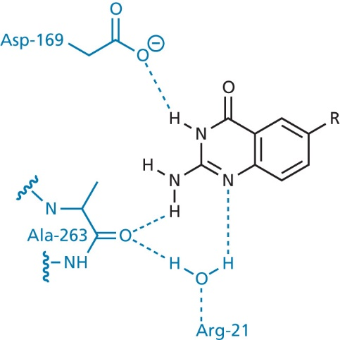
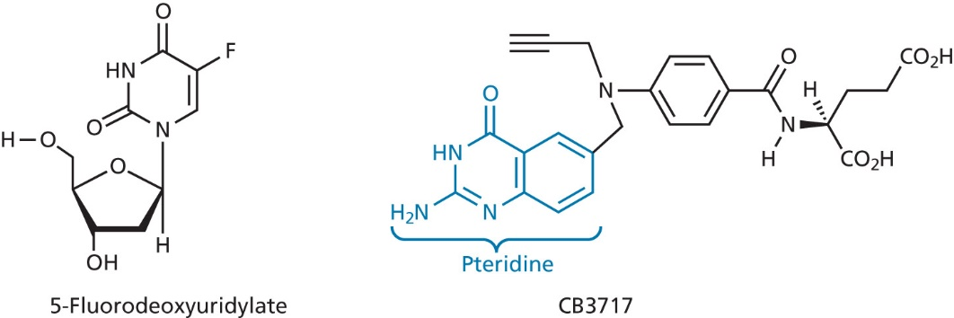
Design of a thymidylate synthase inhibitor
bacterial enzyme from E. coli (could be supplied in large amount) was crystallized with the known inhibitors 5-fluorodeoxyuridylate and CB3717
ligand was deleted from the active site and hydrophobic regions were measured
Fig. CS5.3 Inhibitors of thymidylate synthase
Fig. CS5.4. Binding interactions holding
a pteridine moiety in the active site
Patrick GL: An Introduction to Medicinal Chemistry, Oxford University Press, New York 2009, 4th Ed.

Slide 16
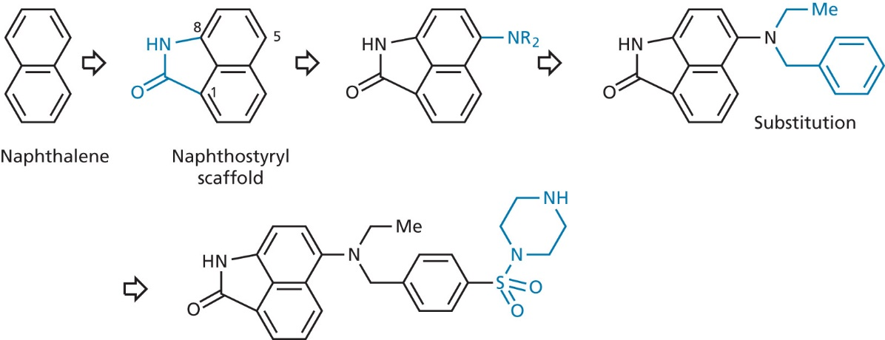
Design of a thymidylate synthase inhibitor
naphtalene scaffold was chosen for hydrophobic part and cyclic amide for HB interaction
Fig. CS5.5 Design of an enzyme inhibitor by de novo methods
Fig. CS5.6 Intended versus actual interactions of the inhibitor
with the active site
Patrick GL: An Introduction to Medicinal Chemistry, Oxford University Press, New York 2009, 4th Ed.
Notes:
carbon means assymetric centre that´s why nitrogen
benzyl suggested by modelling instead of cofactor
sulfonylpiperazine added for water solubility, this part molecule can stay solvated which lowers energy penalty

Slide 17
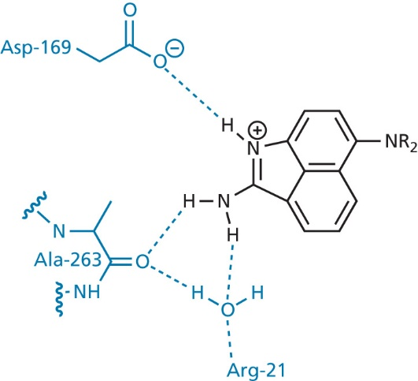
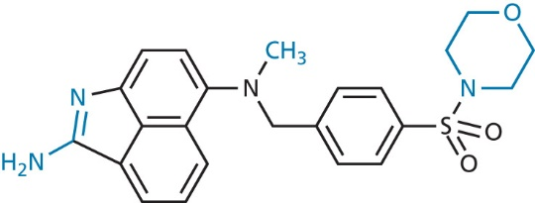
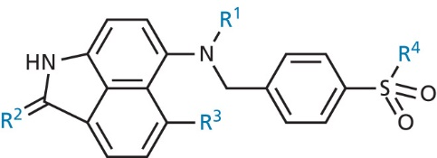
Design of a thymidylate synthase inhibitor
optimization – docking of proposed structures overlaying the lead
compounds passed the test were synthesized and tested (41 compd.)
the result was a lead compound inhibiting bacterial as well human enzyme
Fig. CS5.7 Variable positions (in colour)
R¹ = CH₂CH₂OH, CH₃
R² = NH₂
R³ = Cl, CH₃ (beneficial for bact. enzyme)
R⁴ = morpholine
Fig. CS8.8 Binding interactions of the modified
inhibitor with the active site
Fig. CS5.9 Modified inhibitor put forward
for clinical trial
(500 times more active than original amide)
Patrick GL: An Introduction to Medicinal Chemistry, Oxford University Press, New York 2009, 4th Ed.
Notes:
Computational studies (induced fit) were carried out on bacterial enzyme, fortunately the activity on human enzyme was higher

Slide 18
Design of ritonavir and lopinavir (Abott Pharmaceuticals)
C2 symmetry of protease active site → symmetric inhibitors
might have better selectivity
might be better recognized by viral proteases than by human ones
symmetrical binding might be stronger
analysis of molecular modelling was favourable, but after synthesis it inhibited enzyme weakly and it was inactive against the virus in vitro
Fig. 20.24 De novo design of a symmetrical lead compound acting as an inhibitor
Patrick GL: An Introduction to Medicinal Chemistry, Oxford University Press, New York 2009, 4th Ed.
Notes:
Binding subsites S1-S4 and S1´- S4´

Slide 19
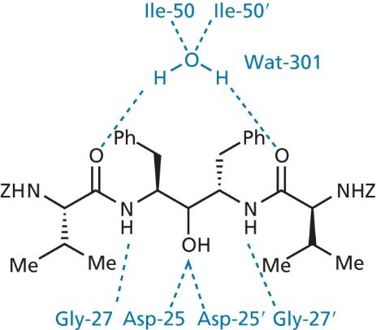
Design of ritonavir and lopinavir (Abott Pharmaceuticals)
extension of the lead molecule: valine added with protected N-groups
X-ray of co-crystal
de novo design + SBDD
Fig. 20.26 Binding interactions between the backbone
of A 74704 and the active site of recombinant HIV protease
Fig. 20.25 Development of A 74704 (Z = PhCH₂OCO)
Fig. 20.27 De novo design of a symmetrical diol inhibitor
Patrick GL: An Introduction to Medicinal Chemistry, Oxford University Press, New York 2009, 4th Ed.

Slide 20
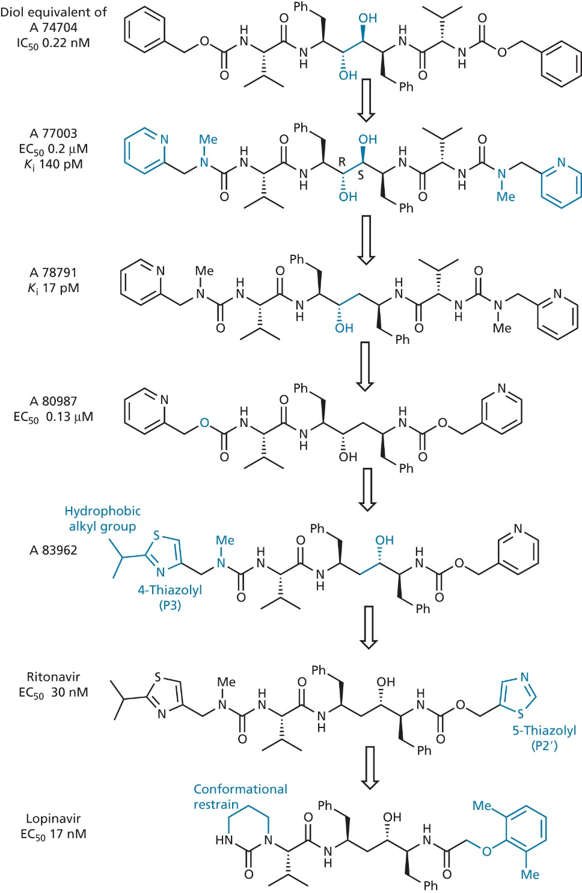
development of
ritonavir and lopinavir
Patrick GL: An Introduction to Medicinal Chemistry, Oxford University Press, New York 2009, 4th Ed.
Notes:
Diol equivalent of A 74704 had 10fold better level of activity, poorly water solubility
Terminal portion of molecule exposed to solvation according to X-ray (pyridine, urea added)
A77003 entered clinical trials as intravenous antiviral agent – modelling studies showed two possible binding modes (each –OH binds aspartate, one –OH binds to both asp)+X-ray –the latter mode confirmed, (R)-OH convenient, S-OH removed due to energy penalty
Then study on mol. size, aqueous solubility and hydrogen bonding – urea better for solubility and bioavailability, but carbamate better for potency and plasma half-life
A80987 retained activity, improved oral bioavailability, but short plasma halftime and strongly bond to plasma proteins, metabolic studied revealed both N-pyridines oxidized metabolites – firstly steric shielding, adding EWG, bioisostere ring replacement, thiazolyl decreased activity – methyl urea reintroduced, alkylation of thiazolyl and altering position of –OH led to potency increase
HB between thiazolyl N and Asp-30 – the other pyridine replaced – therap. plasma levels lasting 24 h after oral administration
When ritonavir used on own, in resistant strains of virus a mutation concerning val-82 to ala, thr, phe proceeds, according X-ray there is a hydrophobic interaction between isopropyl on the thiazolyl and isopro of val-82
In lopinavir cyclic urea

Slide 21
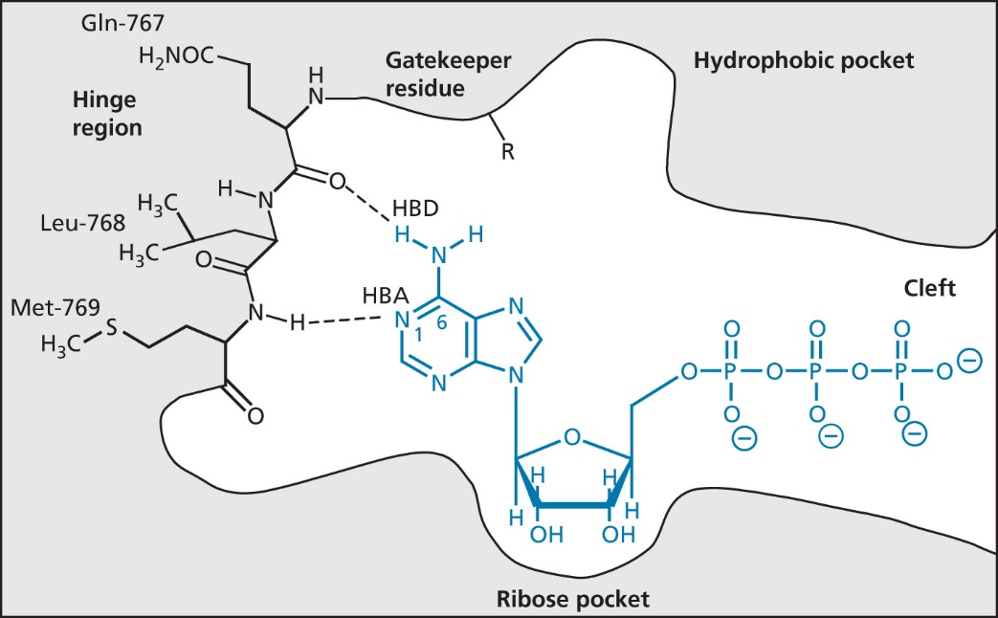
Design of kinase inhibitors of the epidermal growth factor receptor (EGFR)
protein kinases – phosphorylate amino acids using ATP
tyrosine kinases
serine-threonine kinases
histidine kinases
kinase inhibitors
Type I – inhibits active conformation
by binding to the active site
all clinical important inhibitors mimic adenine of ATP
gefitinib, erlotinib, SU11248, seliciclib
Type II – stabilizes the inactive
conformation of the enzyme
imatinib, lapatinib, sorafenib, vatalanib
Fig. 21.46 Binding of ATP to the kinase active site of the
epidermal growth factor
Patrick GL: An Introduction to Medicinal Chemistry, Oxford University Press, New York 2009, 4th Ed.

Slide 22
Design of kinase inhibitors of the epidermal growth factor receptor (EGFR)
EGF-R is a membrane-bound tyr-kinase receptor having an extracellular binding site for EGF and an intracellular kinase active site
first clinic kinase inhibitor – gefitinib (AstraZeneca, 2002) = 4-anilinoquinazoline
SAR known: secondary amine, EDG at positions 6 and 7 and a small lipophilic substituent on the aromatic ring
Fig. 21.47 Structure and binding interactions of gefitinib (Iressa)
Fig. 21.48 Design of metabolically stable analogue of structure I
Patrick GL: An Introduction to Medicinal Chemistry, Oxford University Press, New York 2009, 4th Ed.
Fig. 21.49 Inhibitors of EGFR kinase
Notes:
I-potent inhibitor, but in vivo metabolized
Cl is a bioisostere of CH3 (similar size and lipophilicity)
IV less active in vitro, but more active in vivo
Morpholine enhances water solubility, basic N can be protonated and form salts
Addition of water soluble handle is a common feature in many kinase inhibitors, it is a water-exposed region, which avoids water penalty
Molecular modelling study carried to investigate the binding, model constructed from a knowledge of the structures of similar active site (met769, Thr-830), aniline of gefitinib occupies the normally vacant hydrophobic pocket
AISLP: Iressa (i Tarceva) je indikována k léčbě dospělých pacientů s lokálně pokročilým nebo metastazujícím nemalobuněčným karcinomem plic (NSCLC) s aktivačními mutacemi EGFR-TK

Slide 23
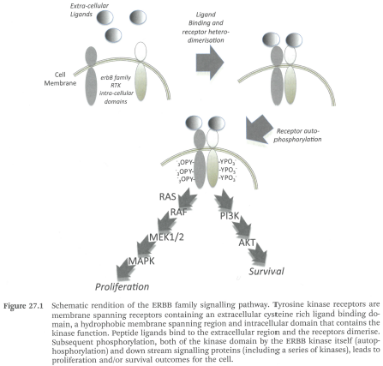
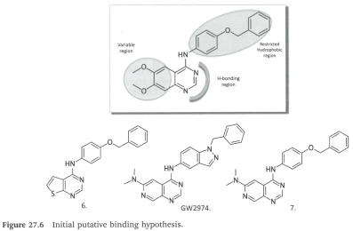
Discovery and development of lapatinib (TYKERB, Glaxo, 2007)
kinome = protein kinase target family, ERBB2 receptor tyrosine kinase identified in 1980's as a cancer target
project focused on inhibition both EGFR and ERBB2 signalling
in company library: staurosporines and PD153035
indazol GW2974 showed marked activity a selectivity, reached pre-clinical stage, but there were problems with dose and metabolism
restricted hydrophobic region
variable
region
H-bonding region
Davis A., Ward S. E.: Handbook of Medicinal Chemistry, Royal Society of Chemistry, Cambridge 2015
Notes:
4557W tested in different xenograft models (breast, gastric cancer)

Slide 24
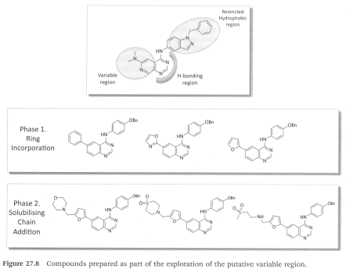
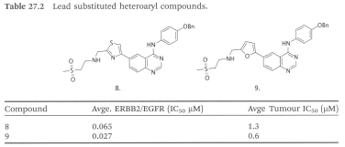
Discovery and development of lapatinib
important SAR observed for amine containing side chain linked through a 6-furyl quinazoline (furyl orientation)
there was no crystal structure of EGFR
Davis A., Ward S. E.: Handbook of Medicinal Chemistry, Royal Society of Chemistry, Cambridge 2015

Slide 25
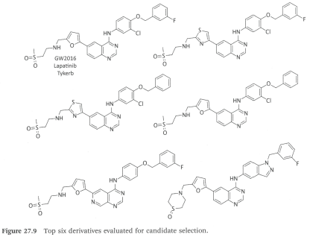
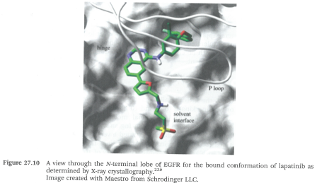
Discovery and development of lapatinib
after project evaluation: better bio-assays, dual inhibitor requested
lapatinib IC₅₀ = 9 nM (ERBB2) and 10 nM (EGFR)
first clinical trials in 2001
Davis A., Ward S. E.: Handbook of Medicinal Chemistry, Royal Society of Chemistry, Cambridge 2015
Notes:
AISLP: Tyverb je indikován k léčbě dospělých pacientů s karcinomem prsu, jejichž nádory ve zvýšené míře exprimují HER2 (ErbB2)

Slide 26
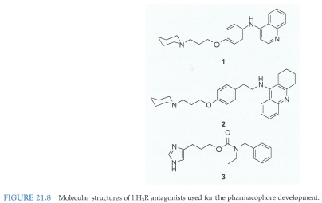
Pharmacophore-based screening in search for novel histamine H₃-receptor antagonists
human H₃-receptor (hH3R) was a GPCR with no 3D structure, there was only a crystal structure for H₁-receptor
hH3R modulates the release of various neurotransmitters in CNS and PNS, therefore it might be a target in therapy of various diseases
ligands of hH3R (compd. 1-3) are known → protonable nitrogen atom in aromatic or saturated ring and an aromatic system separated by a certain distance, polar moiety in spacer
Wermuth, C. G. Et al.: The Practice of Medicinal Chemistry, 4th Ed., Elsevier Oxford 2015

Slide 27
Pharmacophore-based screening in search for novel histamine H₃-receptor antagonists
a dataset of 418 ligands with known affinities from an assay used for docking study with a homology model of hH3R → results explained the interactions, but the docking study was not enough discriminating between active and inactive antagonists
pharmacophore model based on ligand 1 itself was too loose, it was constrained with vdW volume and excluded volume, then still 316 compounds from the dataset as hits
Wermuth, C. G. Et al.: The Practice of Medicinal Chemistry, 4th Ed., Elsevier Oxford 2015

Slide 28
Pharmacophore-based screening in search for novel histamine H₃-receptor antagonists
using of filters in Maybridge Database (59 000 compds.) and World Drug Index (48 000 compds.)
creation of pharmacophore models of compounds 2 and 3 with similar features → combining of the models (2688 compds. from databases)
using leave-one-out filter (LOO) – leaving out one pharmacophore feature reduced the number of hits from databases to 320
after docking, 7 compds. selected for testing
guided by cluster analysis of 7 compds. and similarity search using fingerprint system → advantages of pharmacophore model versus docking:
better limitation of compounds
lower similarity, which means NOVELTY
Wermuth, C. G. Et al.: The Practice of Medicinal Chemistry, 4th Ed., Elsevier Oxford 2015

Slide 29
Homology modelling – workflow
Template search
explore the region of interest
global similarity
local similarity
similarity in function
Template-target (sequence alignment)
Model building and assessment
Model refinement
Model validation

Slide 30
A case study for protein modelling: the nuclear hormone receptor CAR as an example for comparative modelling and the analysis of protein-ligand complexes
Nuclear hormone receptors (NHRs)
48 nuclear receptors found in humans
act as ligand-activated transcription factors and regulated gene transcription
involved in development, differentiation, homeostasis and reproduction
bind as homo- (Type I) or heterodimers (Type II) to DNA
inactive NR are bound to co-repressor, activation requires co-activator
known 3D structure of DNA binding domain (DBD) and ligand binding domain (LBD, mainly hydrophobic binding pocket) of the receptors
function of endogenous ligand is unknown ⇒ designated as orphan receptors
Höltje, H.-D. et al.: Molecular Modeling – Basic Principles and Applications, Wiley-VCH, Weinheim 2008, 3rd Ed.

Slide 31
A case study for protein modelling: the nuclear hormone receptor CAR as an example for comparative modelling and the analysis of protein-ligand complexes
constitutive androstane receptor (CAR)
activation involves agonist binding, which leads to nuclear translocation and heterodimerization with another NR (RXR)
regulates the expression of metabolizing enzymes upon xenobiotic stress
comparative modelling of CAR
only few ligands of CAR known
vitamin D receptor (VDR) and pregnane X receptor (PXR) from the same NR subfamily selected for template structures – they showed 40–50% sequence identity within the LBD according to X-ray and their homology models were constructed, the model showed 37% sequence identity, but the model superimposed with crystal structures showed large deviations as well molecular dynamic (MD, 5ns) of the models
CAR model based on two template structures generated by manually selecting the coordinates from VDR and PXR
Höltje, H.-D. et al.: Molecular Modeling – Basic Principles and Applications, Wiley-VCH, Weinheim 2008, 3rd Ed.

Slide 32
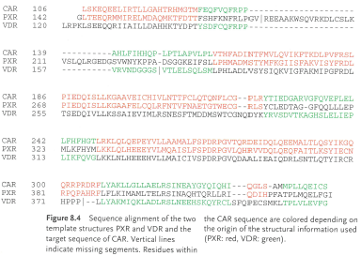
A case study for protein modelling: the nuclear hormone receptor CAR as an example for comparative modelling and the analysis of protein-ligand complexes
multiple sequence alignment of CAR with VDR and PXR was carried using CLUSTAW
homology modelling of CAR using Homology module within INSIGHT II, program SCWRL used for side-chain conformation modelling
another CAR model with co-activator was generated based on crystal structure of PXR with co-activator (SRC-1)
Höltje, H.-D. et al.: Molecular Modeling – Basic Principles and Applications, Wiley-VCH, Weinheim 2008, 3rd Ed.
Notes:
SRC-1 = steroid receptor coactivator-1

Slide 33
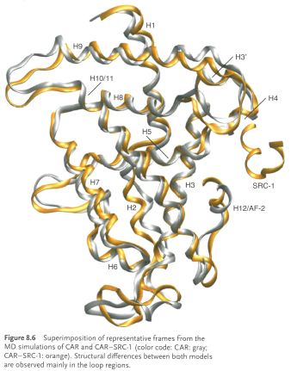
A case study for protein modelling: the nuclear hormone receptor CAR as an example for comparative modelling and the analysis of protein-ligand complexes
CAR models refined by minimization and subsequent MD simulation using GROMACS software (GROMOS96 force field convenient for proteins in aqueous environment), further MD studies ⇒ Ramachandran plot checked
coactivator binding studied, mutant modelling study
Höltje, H.-D. et al.: Molecular Modeling – Basic Principles and Applications, Wiley-VCH, Weinheim 2008, 3rd Ed.

Slide 34
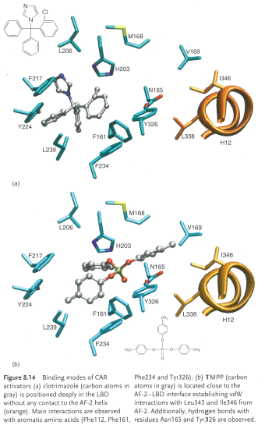
A case study for protein modelling: the nuclear hormone receptor CAR as an example for comparative modelling and the analysis of protein-ligand complexes
modelling of CAR-ligand complexes
docking of a ligand (known activators clotrimazol and tri-p-methylphenylphosphate=TMPP) into CAR-coactivator homology model using docking program GOLD (genetic algorithm, 30 docking poses, GoldScore function)
MD simulation (2.5 ns)
flexible regions detected, pocket can expand up to 80%
Höltje, H.-D. et al.: Molecular Modeling – Basic Principles and Applications, Wiley-VCH, Weinheim 2008, 3rd Ed.
Notes:
pocket hydrophobic, diverse ligands
flexibility compared to complex of RXR-hyperforin

Slide 35
A case study for protein modelling: the nuclear hormone receptor CAR as an example for comparative modelling and the analysis of protein-ligand complexes
X-ray structures of hum. and mouse CAR were later reported (superimposition with homology model 3.4–3.8 Å, 1.8 Å when deviation region (AA 139–153) excluded
constitutive androstane receptor activators are regarded as potential therapeutics in cholestasis and neonatal jaundice
virtual screening for CAR agonists with
LeadQuest database (Tripos Inc., St. Louis, USA) with 85 000 molecules
steroids and compounds violating Ro5 excluded, after filtration: 9 700 compounds
after docking in GOLD 66 compounds, plus 30 supplied
17 compounds activated CAR
3 compounds activating receptor 5-8fold (N-substituted and N,N-disubstituted sulfonamides and thiazolidin-4-one derivatives
Höltje, H.-D. et al.: Molecular Modeling – Basic Principles and Applications, Wiley-VCH, Weinheim 2008, 3rd Ed.

Slide 36
SBDD of nitric oxide synthase's (NOS) inhibitors
NOS catalyzes conversion of Arg to citrulline and NO (signalling and cytotoxic agent) and the enzyme has three similar isoforms
constitutive: neuronal nNOS and endothelial eNOS
inducible: iNOS (inflammation)
inhibitors contain a basic amidine mimicking the arg-guanidinium interacting with Glu-377
program of AstraZeneca on iNOS inhibitors: 70 co-crystal structures of quinazolines, aminopyridines or bicyclic thienoxazepines
Gln-263 provided a valuable source of selectivity, this residue common for all isoforms can move depending on the ligand and induce movement up to 20 Å away, selective inhibitors open a new pocket = „Gln pocket“
in literature, weak non-basic inhibitors described
Davis A., Ward S. E.: Handbook of Medicinal Chemistry, Royal Society of Chemistry, Cambridge 2015
Notes:
Constitutively expressed NOS play role in GI motility, memory, vascular tone

Slide 37
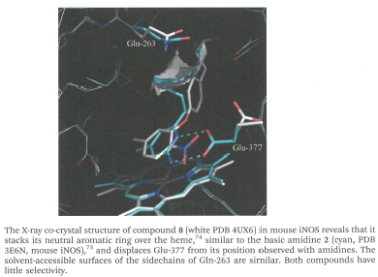
SBDD of nitric oxide synthase's (NOS) inhibitors
Davis A., Ward S. E.: Handbook of Medicinal Chemistry, Royal Society of Chemistry, Cambridge 2015
Notes:
str. 113 obr. 4.9, 4.10,

Slide 38
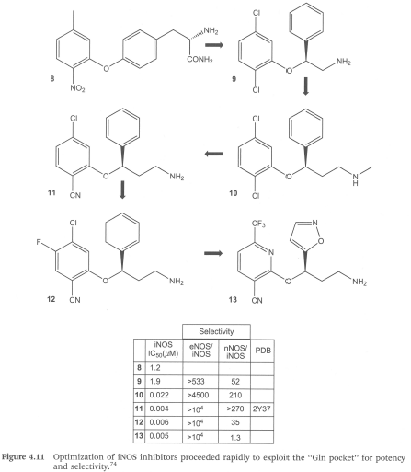
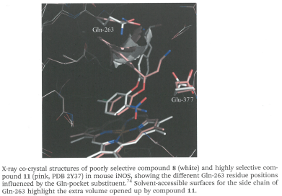
SBDD of nitric oxide synthase's (NOS) inhibitors
structure design: neutral heme binder, displacing Glu, reaching for the arginine's amino acid binding site initially with a zwitterion, building into a Glu pocket for selectivity, and then replacing the zwitterionic AA with a basic group to improve cell permeability
Davis A., Ward S. E.: Handbook of Medicinal
Chemistry, RSC, Cambridge 2015

Slide 39
Fragment-based drug design Vemurafenib (Zelboraf®)
1st approved drug from FBDD
is a selective B-Raf enzyme inhibitor developed by Plexxikon (now part of Daiichi-Sankyo) and Genentech for the treatment of metastatic melanoma
causes programmed cell death in melanoma cell lines, it interrupts the B-Raf/MEK step on the B-Raf/MEK/ERK pathway − if the B-Raf has the common V600E mutation
Davis A., Ward S. E.: Handbook of Medicinal Chemistry, Royal Society of Chemistry, Cambridge 2015; Wermuth, C. G. Et al.: The Practice of Medicinal Chemistry, 4th Ed., Elsevier Oxford 2015

Slide 40
Fragment-based drug design Vemurafenib (Zelboraf®)
selected library of 20 000 scaffolds with MW 150–300 Da screened at 200 μM against well-known kinases
azaindole 29 identified using co-crystal structure having multiple binding, then compd. 30 as next fragment with single binding mode
it led to discovery of compds PLX 4720 and PLX 4032 (vemurafenib)
Wermuth, C. G. Et al.: The Practice of Medicinal Chemistry, 4th Ed., Elsevier Oxford 2015

Slide 41
SBDD of aleglitazar
peroxisome proliferator activated receptors (PPARs) exist in 3 isoforms: PPAR-α, PPAR-δ (called also PPAR-β) and PPAR-γ
they are ligand-dependent transcription factors and belong to superfamily of nuclear hormone receptors (NHRs)
PPAR-α highly expressed in tissues with high rates of mitochondrial fatty acid oxidation (liver, heart, muscle, kidney and cells of arterial wall) and it is activated by fibrates, fatty acids and eicosanoids, 15d-PGJ2 and oxidized fatty acids
PPAR-δ found in most tissues, no physiological relevant ligand
PPAR-γ found in adipose tissues, activated by fatty acids and plays a pivotal role in insulin sensitivity, adipogenesis and placental function
the program of Boehringer-Mannheim on retinoids/rexinoids, from 1997 Roche Basel (acquisition), development of PPAR α/γ co-agonist for treatment of DM2 started in 2000
Davis A., Ward S. E.: Handbook of Medicinal Chemistry, Royal Society of Chemistry, Cambridge 2015

Slide 42
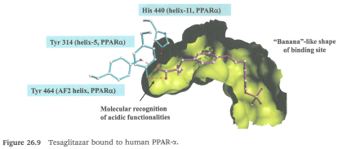
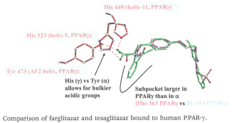
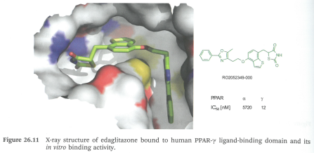
SBDD of aleglitazar
competitors had active compounds – rosiglitazone (GSK), pioglitazone (Takeda/Eli Lilly), tesaglitazar (AstraZeneca, later stopped – adverse effects)
information concerning interaction in the binding site had been published
-COOH forms three HBs to His 440, Tyr 314 and Tyr 464
farglitazar is the strongest γ-binder, later adverse effects found
benzothiophene linker inspired by edaglitazone
after two week of project, aleglitazar was synthesized
Davis A., Ward S. E.: Handbook of Medicinal Chemistry, RSC, Cambridge 2015

Slide 43
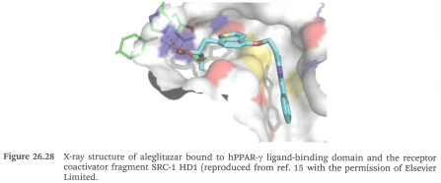
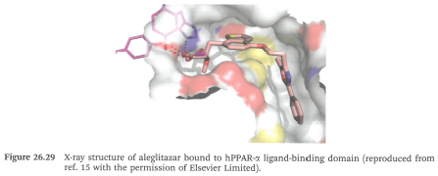
SBDD of aleglitazar
SAR
PPAR-γ affinity increased with size and lipophilicity of the side-chain
PPAR-α affinity increased with methoxy and ethoxy in the side-chain, according to modelling, bulky side-chains did not fit into the small sub-pocket
substitution of phenyl on oxazol brought nothing
stereoselective synthesis elaborated, it forms polymorph A and B
after 8 months from project start, aleglitazar was established
Davis A., Ward S. E.: Handbook of Medicinal Chemistry, Royal Society of Chemistry, Cambridge 2015
Notes:
muraglitazar in use

Slide 44
Neuraminidase inhibitors: oseltamivir (TAMIFLU) and zanamivir (RELENZA)
one of the earliest application of SBDD
first-in-class drug zanamivir (inhal.) developed by GlaxoSmithKline (approved in 1999) and oseltamivir (p.o.) by Gilead Sciences (licenced to Roche)
neuraminidase (exo-α-sialidase) inhibitors against influenza A and B used for treatment and prevention
rational drug design utilizing available X-ray crystal structures of sialic acid analogues bound to the active site of influenza virus neuraminidase
Von Itzenstein R.: Nat. Rev. 2007, 6, 967

Slide 45
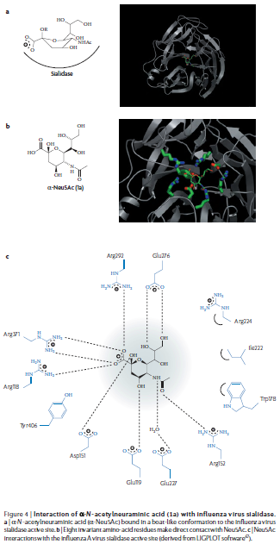
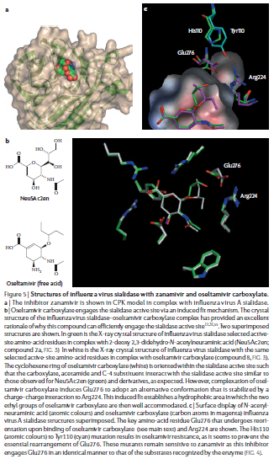
Von Itzenstein R.: Nat. Rev. 2007, 6, 967

Slide 46
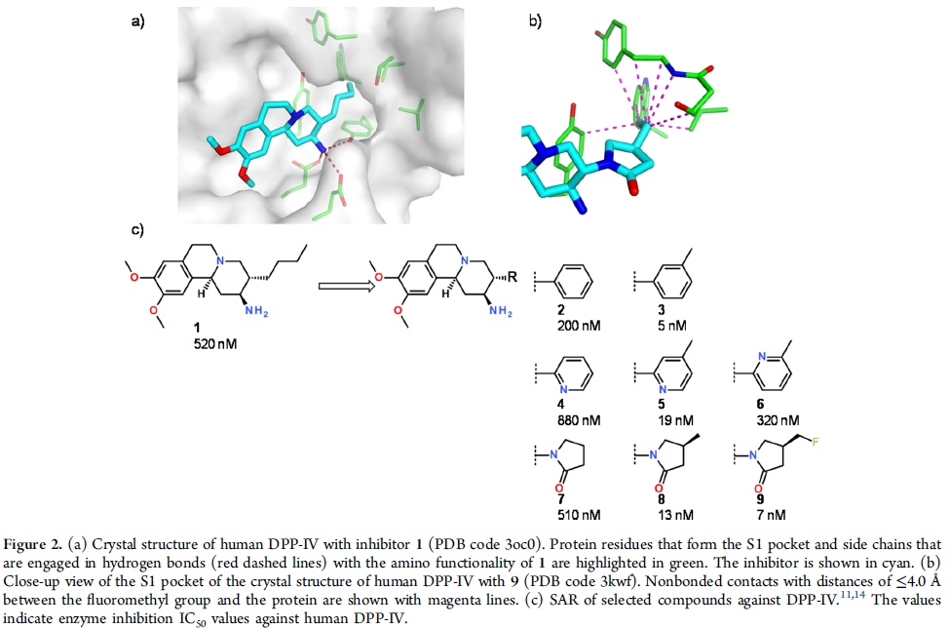
Molecular design in case studies of Roche DPP-IV inhibitors
Dipeptidyl peptidase IV inhibitors in treatment of DM2
in-house HTS campaign identified 2-aminobenzo[a]quinolizine hit
chem. modifications
co-crystal structure → rigidification of n-butyl
virtual screening and molecular design → subst. lactam
overlayment of DPP-IV inhibitors → additional space in aromatic position
compd. 8 and 9 drug-like (balancing polarity), compd. 9 selected for clinical development (carmegliptin)
Kuhn B. et al.: J. Med. Chem. 2016, 59, 4087

Slide 47
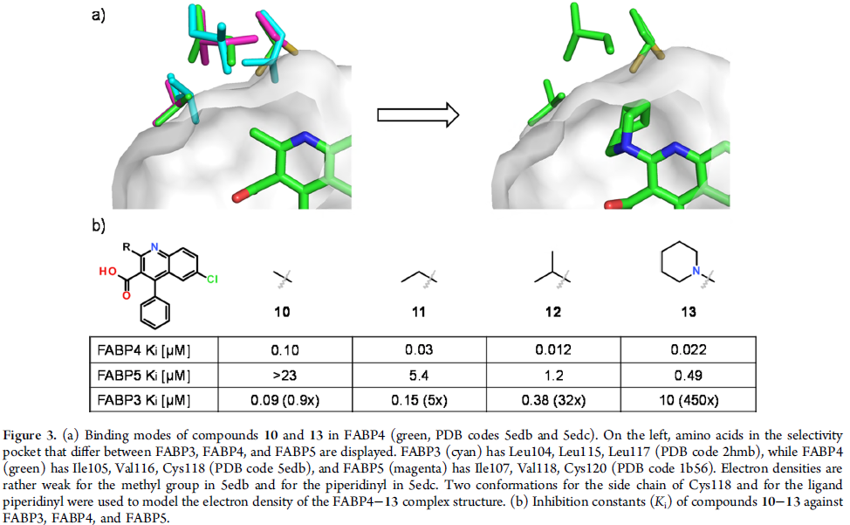
Molecular design in case studies of Roche Fatty acid binding protein 4/5
FABP4 and FABP5 = cytosolic FA binding proteins as potential diabetes and atherosclerosis targets
screen of Roche library (1200 compd.) yielded quinoline with activity on FABP4
binding interactions of co-crystal revealed a sequence of 3 side chains: Ile, Val, Cys in FABP 4 and 5, where as in FABP3 there are three leucins → steric clash (antitarget, isoform selectivity)
Kuhn B. et al.: J. Med. Chem. 2016, 59, 4087

Slide 48
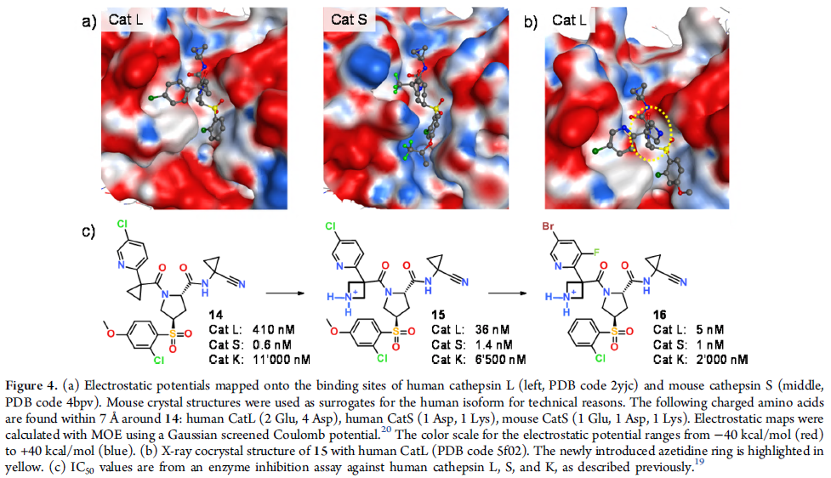
Molecular design in case studies of Roche Cathepsin S/L
dual inhibition of CatS and CatL is potential strategy to combat glomerular diseases of the kidney
former project on selective CatS inhibitors showed covalent binding of subst. pyrrolidine via nitrile group to cys, chloro pyridine occupies S2 and S3 pocket
cathepsins binding sites differ in their electrostatic potentials (CatL negative surface, CatS balanced)
balancing the interaction with binding site as well solvent – exposed ligand groups
Kuhn B. et al.: J. Med. Chem. 2016, 59, 4087

Slide 49
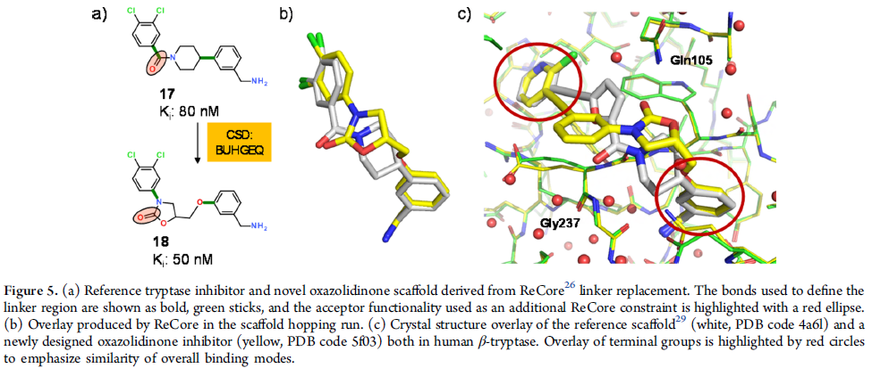
Molecular design in case studies of Roche β-Tryptase
is a heparin-stabilized tetrameric serine protease expressed in mast cell with role in airway inflammatory and allergic responses
inhibitor series from Sanofi-Aventis contained benzylamine in S1 pocket, piperidine amide scaffold linker and various subst. aryl rings in S4 pocket
co-crystal structure revealed interaction with Asp207 in S1 pocket
search for a better linker via scaffold hopping
Kuhn B. et al.: J. Med. Chem. 2016, 59, 4087

Slide 50
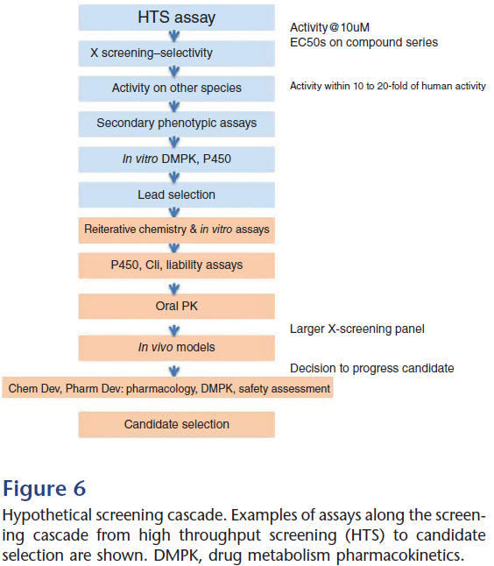
Important properties of drug candidates
Hughes JP et al.: Brit. J. Pharmacol. 2011, 162, 1239

Slide 51
Conclusion
Current small molecule drug discovery
filling of lipophilic pockets to gain affinity or selectivity
addition of polar substituents
scaffold hopping
transfer of SAR
conformation analysis
molecular overlays
Other methods:
Ffragment-based drug design
design of protein-protein interaction inhibitors
allosteric modulators
…
J. Med. Chem. 2016, 59, 4087

Slide 52
Target fishing
has increasingly become a key approach for polypharmacology, drug repurposing, and the identification of new drug targets
Galati S. et al.: Molecules 2021, 26, 5124

Slide 53
Projekt
„Zvýšení kvality vzdělávání na UK a jeho relevance pro potřeby trhu práce-ESF
Reg. č. CZ.02.2.69/0.0/0.0/16_015/0002362“, je financován z programu OP VVV
S. Henderson et al.: Education in Chemistry, Vol 48, No. 6 (November 2011)
Notes:
https://edu.rsc.org/feature/teaching-chemistry-in-3d-using-crystal-structure-data/2020239.article

