Slide 1
Basics of Molecular Modelling of Drugs
Pharmacy – 4th section of study
Specialization: Pharmaceutical Chemistry
5th Lecture
Topic: Pharmacophore models, Molecular fingerprints

Slide 2
Pharmacophore-based searching

Slide 3
3D Pharmacophore
3D pharmacophore represents the relative position of important binding groups in space and disregards the molecular skeleton that holds them there
3D chemical databases (e.g. CSD) can be used for searching the structures, that could adopt the stable conformation containing the required pharmacophore
Patrick GL: An Introduction to Medicinal Chemistry, Oxford University Press, New York 2009, 4th Ed.

Slide 4
Methods for 3D Pharmacophore Identification
Analysis of ligand-receptor complexes
DIRECT METHOD
X-ray crystallography
SBDD
Crystal structure of target-ligand complex can be downloaded and studied to identify the bonding interactions by measuring distances between likely binding groups in the drug and complementary binding groups in the binding site.

Slide 5
Methods for 3D Pharmacophore Identification
Study of possible binding site without knowledge of ligand
INDIRECT METHOD
SBDD
Flexible alignment of active compounds
INDIRECT METHOD
LBDD
3D pharmacophore can be identified from structure of a range of active compounds, they can be overlaid to find important binding groups

Slide 6
Pharmacophore annotations
Atom annotations are located directly on an atom of a molecule, such as "H-bond donor" or "cation" and typically indicate a function related to protein-ligand binding.
Centroid Annotations are located at the geometric center of a subset of the atoms of a molecule. For example, an aromatic ring annotation will typically be located at the centroid of the atoms of the ring. Centroid annotations can also be used to indicate hydrophobic regions.
Projected Annotations are (typically) located along implicit lone pair directions or implicit hydrogen directions and are used to annotate the location of possible hydrogen bond partners, metal ligation partners, or possible R-group atom locations.

Slide 7
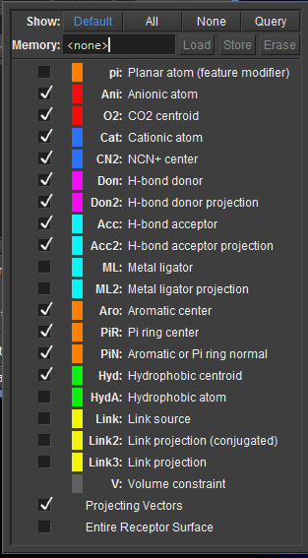
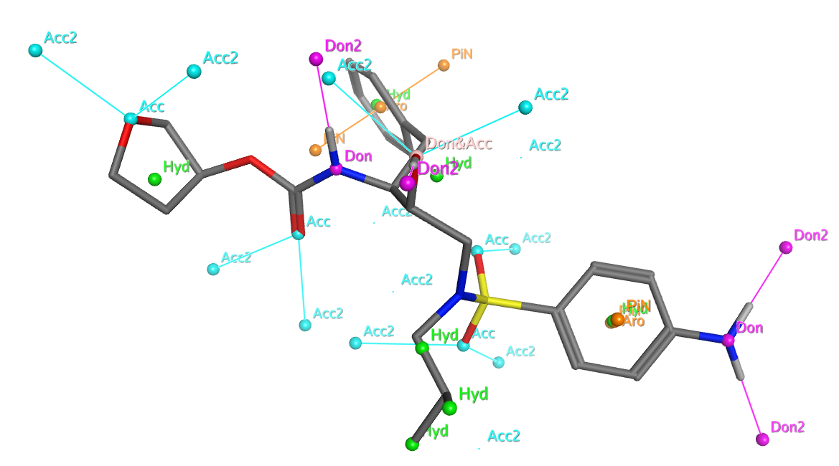
Pharmacophore annotations
Annotation points

Slide 8
Pharmacophore annotations
H-Bond Donors/Acceptors and Metal Ligators
Don annotates an H-bond donor heavy atom.
Don2 annotates projected locations of potential H-bond acceptors (HA).
Acc annotates an H-bond acceptor heavy atom.
Acc2 annotates projected locations of potential H-bond donors (HA).
ML annotates a metal ligator heavy atom.
ML2 annotates projected locations of potential ligated metals.
Notes:
HA = heavy atom

Slide 9
Pharmacophore from ligand-receptor complex(es)
direct method
the most accurate
COMPLICATIONS
ligands of different structural class might have different binding modes
receptor flexibility

Slide 10
Pharmacophore from ligand-target complex(es)
3D structure of the ligand-target complex is known
Define pharmacophore based on observed interactions
Define VOLUME (excluded, occupied, ligand shape) features
Evaluate the model (actives should fit, inactive should not)
Prepare the complex –analyse the binding site

Slide 11
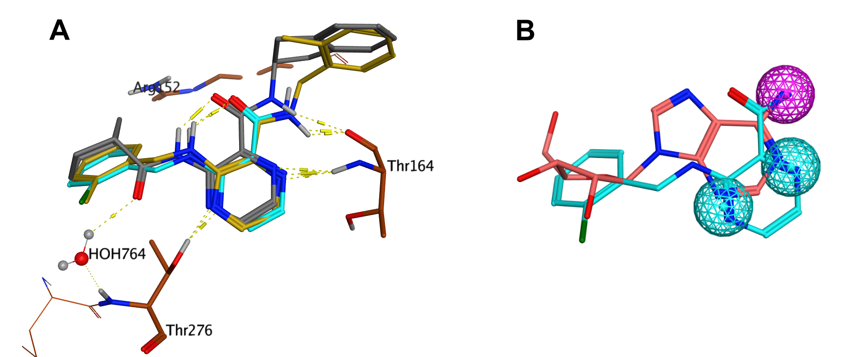
Analysis of the ligand-receptor interactions
Inhibitors/substrates of hProRS: A – Interactions with the adenine binding site. B – defined pharmacophore features.

Slide 12
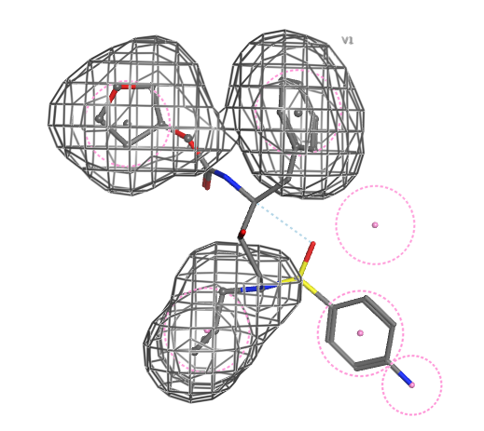
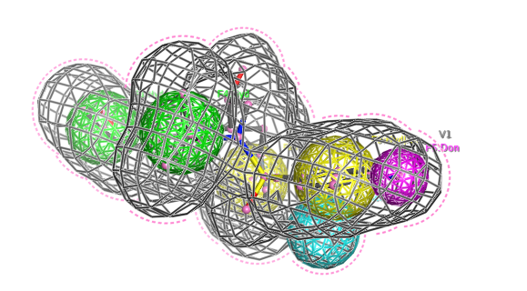
Volumes
excluded volume
ligand shape
occupied volume
Notes:
- demo in MOE

Slide 13
Pharmacophore model from the active site
3D structure of target (receptor) is known - (no ligand in the binding site)
Define pharmacophore features of the site
Define EXCLUDED VOLUME features
Evaluate the model (actives should fit, inactive should not)
Identify the binding site

Slide 14
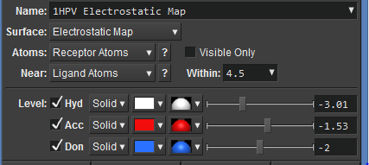
Pharmacophore model from the active site
molecular surface – shape of the cavity

Slide 15
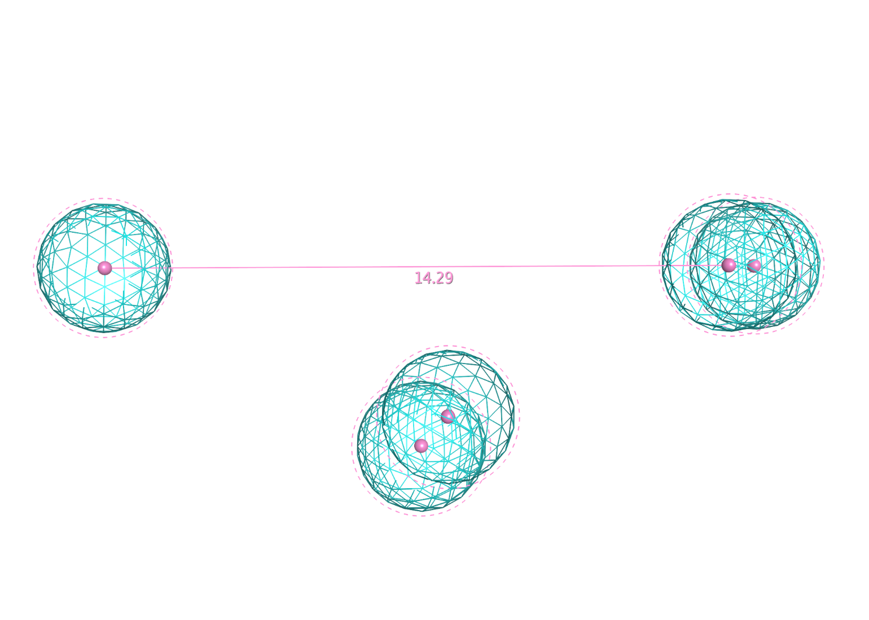
Pharmacophore model from the active site
HB Acc

Slide 16
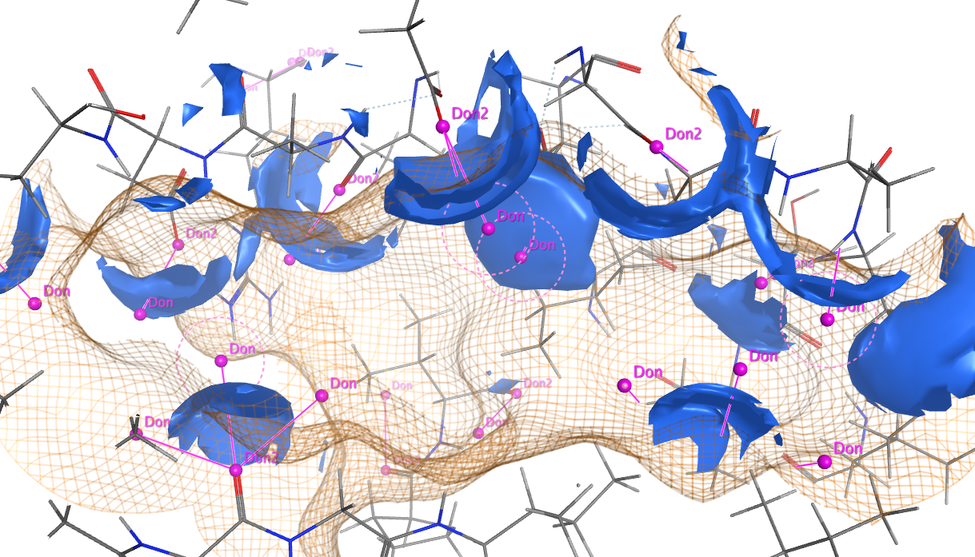
Pharmacophore model from the active site
HB Don

Slide 17
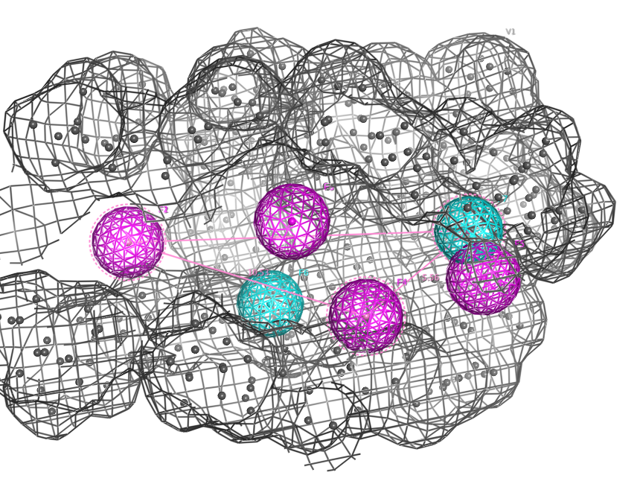
Pharmacophore model from the active site
Final pharmacophore model with volume constraint

Slide 18
Pharmacophore model from active ligands
structure of the target (receptor) is not known
Flexible alignment of active molecules
Determine common features in actives
Select features to include in pharmacophore - several models suggested
Map potential features (annotations) to individual ligands
Evaluate the model (actives should fit, inactives should not)

Slide 19
Methods of Superposition: atom-by-atom superposition
least-squares technique for superpositioning of corresponding atom positions is the most widely used (rmsd value), inadequate for a set of dissimilar molecules
active analogue approach utilizes a systematic search algorithm for calculating a representative number of sterically and energetically allowed conformations for congeneric molecules, resulting distances between pharmacophoric groups for one molecule are compared with all the sets of all other molecules
inclusion of a rigid or semi-rigid molecule for each series of flexible molecule is a big advantage
rapid pairwise comparison of dissimilar molecules (SEAL program) – similarity score is calculated from summation over all possible atom pairs between two molecules (originally vdW radii, but physicochemical properties can be also included)
FLEXs program - uses a flexible superpositioning on the basis of combinatorial matching procedure, pairs of molecules are aligned – one is considered rigid, the other flexible, the program tries to decompose the flexible structure into relatively rigid portions, suitable for screening of large databases
other software: DISCO, RECEPS, AUTFIT
Höltje, H.-D. et al.: Molecular Modeling – Basic Principles and Applications, Wiley-VCH, Weinheim 2008, 3rd Ed.

Slide 20
Methods of Superposition: Superposition of Molecular Fields
molecules recognize each other by characteristic properties on or outside their vdW volume
for this purpose, molecule is located in a 3D grid and each grid point is loaded with a certain characteristic property measure (charge distribution, hydrophobic potential, size of the volume)
one molecule with conformation limits is chosen as template and all trial molecule grids are manipulated to by rotation and translation to find the best fit of the grid values
time-consuming → other field properties used: electrostatic field, Lennard-Jones potential
suitable for dissimilar compounds
Höltje, H.-D. et al.: Molecular Modeling – Basic Principles and Applications, Wiley-VCH, Weinheim 2008, 3rd Ed.

Slide 21
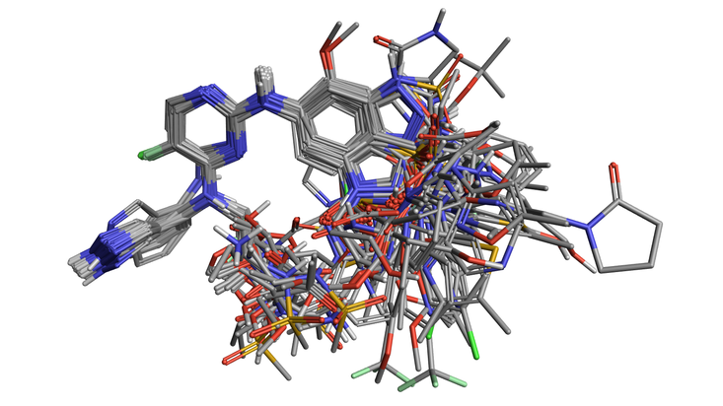
Superposition – flexible alignment
Compare congeneric and diverse active ligands to understand SAR and build models and pharmacophores (cresset-group.com)

Slide 22
Pharmacophore model from active ligands
An example of a pharmacophore model of the benzodiazepine binding site on the GABA_{A} receptor. White sticks represent the carbon atoms of the benzodiazepine diazepam, while green represents carbon atoms of the nonbenzodiazepine CGS-9896.

Slide 23
Select annotation points to become pharmacophore features

Slide 24
Pharmacophore model from active ligands
PROBLEMS
important feature of the binding site might be missed (because it was not present in any of the known active ligands)
excessive features included in the pharmacophore
it is not known, which conformation of the active molecule binds to the binding site
to minimize the risks
use structurally diverse active molecules

Slide 25
Automatic Identification of Pharmacophores
software program can identify potential binding centres: HBD, HBA, aromatic rings, acidic groups, basic groups… hydrophobic centres (hydrocarbon skeleton, i.e. ˃ 3C)
four triangles identified
generation of different conformations and for each conformation a set a of pharmacophore triangles is defined
Fig. 17.16 Pharmacophore ID in dopamine
Patrick GL: An Introduction to Medicinal Chemistry, Oxford University Press, New York 2009, 4th Ed.

Slide 26
Automatic Identification of Pharmacophores
it is advisable to start with the most active and most rigid compound
Fig. 17.27 Test structures
Fig. 17.28 Pharmacophore plot
Patrick GL: An Introduction to Medicinal Chemistry, Oxford University Press, New York 2009, 4th Ed.

Slide 27
Similarity searching using MOLECULAR FINGERPRINTS

Slide 28
Molecular Descriptors
molecular property descriptors
MW, ClogP, TPSA (topological polar surface area), HBD/HBA
topological descriptors
topological indexes
Wiener, Randić, Petitjean, Zagreb
molecular fingerprints
Knowledge-based fingerprints = Structure-key fingerprints
Information-based fingerprints = Hash-key fingerprints
topographical descriptors
Brown N.: In Silico Medicinal Chemistry, Royal Society of Chemistry, Cambridge 2016
Notes:
unbiased information content
no association with conformers
use graph-theoretic representations of molecular structures

Slide 29
Molecular Fingerprints
defined as the transformation of a molecular graph into a string of variables, most often binary variables
originally developed to rapidly speed-up accurate screen-out of chemical structures
fingerprints = a vector of Binary, categorical, integer or real-valued data that can be applied as a mask screen, a complexity measure of to calculate similarities between objects
knowledge-based fingerprints encodes a known molecular structure moiety (based on explicitly defined dictionary of molecular keys or substructures), may be partly biased
information-based fingerprints uses substructure enumeration techniques to encode typically linear of circular fragments from molecular structure
Brown N.: In Silico Medicinal Chemistry, Royal Society of Chemistry, Cambridge 2016

Slide 30
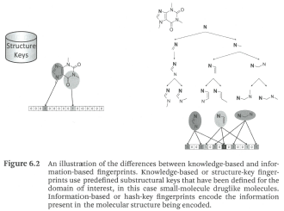
Knowledge-based fingerprints vs. information-based fingerprints
Information-based fingerprints
=
Hash-Key fingerprints
Knowledge-based fingerprints
=
Structure-key fingerprints
Brown N.: In Silico Medicinal Chemistry, Royal Society of Chemistry, Cambridge 2016

Slide 31
Information-Based Fingerprints = Hash Key Fingerprints
coding the molecular graph structure into a fingerprint more similar to a mathematical graph-vector transform
originally designed for screen-out of molecule when conducting a substructure search
Fingal fingerprints
algorithm of „Daylight Chemical Information Systems“ for de novo design including frequency of molecular features, geometry of the molecule
Morgan fingerprints
have a long history in cheminformatics, elaborated by Henry Morgan who worked for Chem. Abstr.
Morgan algorithm is a method to canonicalise a molecular structure such that the linear atom ordering is always the same for that particular structure
circular fingerprint originally for rapid search in chem. databases
Brown N.: In Silico Medicinal Chemistry, Royal Society of Chemistry, Cambridge 2016

Slide 32
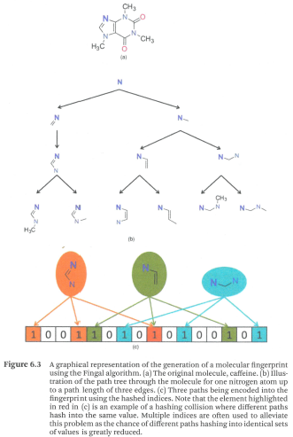
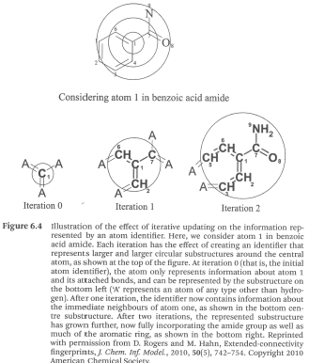
Fingal fingerprints
Morgan fingerprints
Brown N.: In Silico Medicinal Chemistry, Royal Society of Chemistry, Cambridge 2016

Slide 33
Tanimoto coefficient (index) - TI
the most widely used metrics to compare fingerprints of two compounds
Identical fingerprints TI = 1
Practically similar compounds in the drug design applications have similarity of their fingerprints of TI > 0.65

Slide 34
Ligand-Based Topological Pharmacophores
are the most used topological descriptors type for bioisosteric replacement and scaffold hopping, they attempt to characterise potential 3D pharmacophore representations using atomic abstractions and through-graph distances as a surrogate for through-space distances
first ligand-base topological pharmacophore published was Similog descriptor (includes HBA/HBD, bulkiness, electro positivity)
another was Chemically Advanced Search (CATS) fingerprint, developed for scaffold hopping

