Slide 1
EFA and network analysis

Slide 2
Research in personality
cross-sectional data
many variables (items) from multiple subjects
-> EFA to identify latent variables
latent variables can be seen as causes:
items ‘‘I like to go to parties’’ and ‘‘I have many friends’’ are viewed as being causally dependent on a latent variable extraversion
or simply as a common elements

Slide 3
EFA / PCA
exploratory factor analysis / principal component analysis
diff? in EFA we are looking for latent variables, in PCA we are replacing variables with fewer components
extraction method
criterions for number of factors/components selection
parallel analysis (Ledesma, Valero-Mora, 2007), eigen > 1, scree, plot, total var explained
rotation method
orthogonal or oblique
Notes:
Ledesma, R.D.; Valero-Mora, P. (2007). "Determining the Number of Factors to Retain in EFA: An easy-to-use computer program for carrying out Parallel Analysis". Practical Assessment Research & Evaluation. 12 (2): 1–11.

Slide 4
An alternative perspective:
„The structural covariation in personality scales results from direct interactions between the variables measured through personality items.
For instance, one may suppose that people who like to go to parties gain more friends because they meet more people, and people who have more friends get invited to good parties more often.
In this way, one can achieve an explanation of the relevant pattern of covariation without having to posit latent variables.“

Slide 5
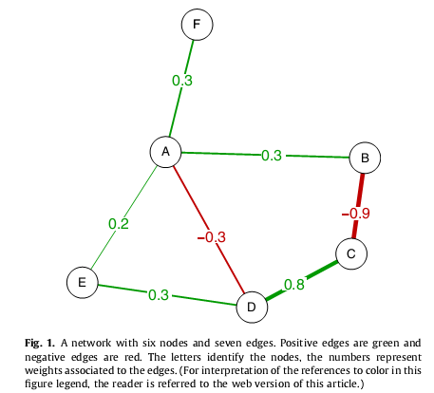
„A network is...
...an abstract model composed of a set of nodes, a set of edges, links or ties that connect the nodes, together with information concerning the nature of the nodes and links“

Slide 6
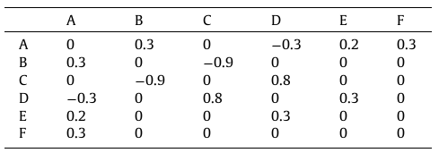
network information in a form of a table:

Slide 7
correlation network
partial-correlation network
adaptive LASSO network
(lasso = least absolute shrinkage and selection operator)

Slide 8
centrality
how important a node is
degree – number of connections
strength – sum of absolute values of coefficients
for weighted networks
closeness – inverse of distances
local clustering
number of connections among the neighbors of a focal node over the maximum possible number of such connections
how the node is redundant
global clustering (transitivity)
property of the whole network

