Slide 1
Basics in Molecular Modelling of Drugs
Pharmacy – 4th section of study
Specialization: Pharmaceutical Chemistry
3rd Lecture
Topics: Chemical information systems and databases. Biological information systems and databases. Crystallographic databases. Critical evaluation of quality of 3D protein structures (Ramachandran plot). In silico prediction of 3D protein structures. Homolog models and their usage. Data mining from publically available sources.
Notes:
https://www.rcsb.org/docs/general-help/computed-structure-models-and-rcsborg
https://edu.rsc.org/feature/teaching-chemistry-in-3d-using-crystal-structure-data/2020239.article
https://pdb101.rcsb.org/learn/guide-to-understanding-pdb-data/computed-structure-models
https://edu.rsc.org/feature/teaching-chemistry-in-3d-using-crystal-structure-data/2020239.article
https://www.sciencedirect.com/science/article/pii/S0079646817300243
Quantum-Machine.org: Datasets
Binding Database Home (bindingdb.org)
The XFEL Protein Crystallography: Developments and Perspectives - PMC (nih.gov) https://www.ncbi.nlm.nih.gov/pmc/articles/PMC6678726/
QCM-D | Measurements | Biolin Scientific

Slide 2
Chemical information systems
cheminformatics is the application of computational tools to solve discovery chemistry problems such as facile exploration of structural and chemical or biological data, library design, and virtual screening
such an application requires a chemical information system with the following key functions
  effective storage of structures and data
  accurate retrieval of structures based upon matching specific search criteria
  calculation of structure-derived data such as physical properties and 3D-conformation
  execution of in silico chemistry operations such as combinatorial library enumeration
http://www.daylight.com/

Slide 3
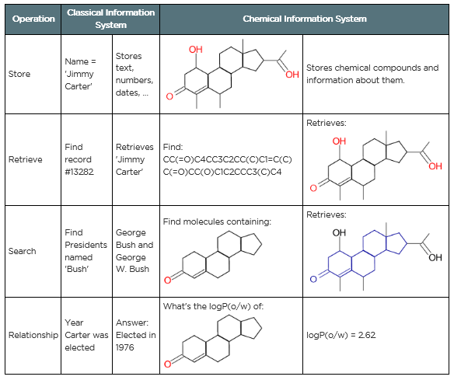
Chemical informatics = Cheminformatics
Cheminformatics is a cross between Computer Science and Chemistry: the process of storing and retrieving information about chemical compounds.
Information Systems are concerned with storing, retrieving, and searching for information, and with storing relationships between bits of data. For example:
https://www.emolecules.com/

Slide 4
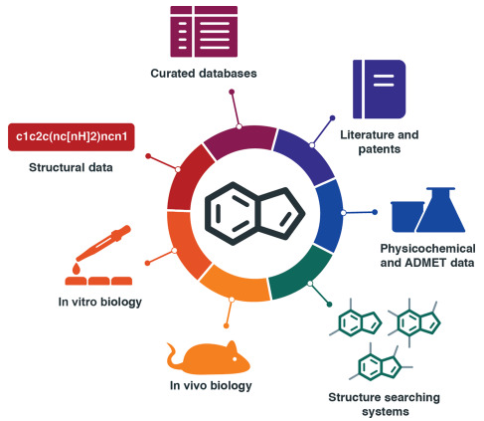
Overview of the common data types of relevance in chemistry databases: chemical structures, calculated and measured chemical properties, biological data, ADMET data and provenance references
https://doi.org/10.1016/bs.pmch.2017.12.003

Slide 5
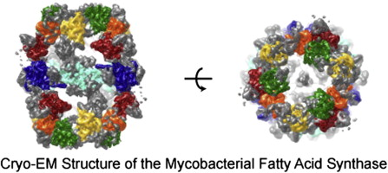
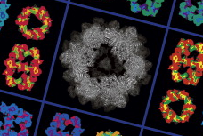
Methods of structure determination
solid state molecules
  X-ray
  neutron diffraction
gas-phase molecules
  microwave spectroscopy
  electron diffraction
proteins
  X-ray
  NMR
  cryo electron microscopy (cryo-EM)
Hinchliffe A.: Molecular Modelling for Beginners, Jonh Wiley & Sons, Chichester (UK), 2008; Boehringer, D.; Ban, N.; Leibundgut, M. J. Mol. Biol. 2013, 425, 841-849.
Notes:
www.rcsb.org
Primarily, the scientist has some kind of experimental data about the structure of the molecule. For X-ray crystallography, this is the X-ray diffraction pattern. For NMR spectroscopy, it is information on the local conformation and distance between atoms that are close to one another. In electron microscopy, it is an image of the overall shape of the molecule.

Slide 6
Small molecules
defining the relative positions of the atoms in space using Cartesian coordinates
methods for generating 3D molecular structures
  use of X-ray crystallographic databases
  compilation from fragment libraries with standard geometries
  2D to 3D conversion using automated approaches
Höltje. H.-D. et al.: Molecular Modeling: Basic Principles and Applications, Wiley VCH, Weinheim, 2008

Slide 7
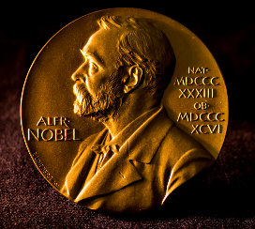
X-ray crystallography
25 × Nobel prize
principle: scattering of the X-rays by the electron cloud around an atom
problem: localization of hydrogen atoms, as they have just one electron
following points should be clarified before starting to work with an X-ray structure
  whether the atom types are correct
  whether the bond lengths and bond angles are reasonable
  whether the bond orders are correct
  in case of chiral molecules, whether the data correspond to the correct enantiomer
molecular data file contains all molecule details including organization, extension name and format
crystalline state geometry of a molecule is influenced by crystal packing sources and the solid-state structure corresponds to only one of many conformations
Höltje. H.-D. et al.: Molecular Modeling: Basic Principles and Applications, Wiley VCH, Weinheim, 2008

Slide 8
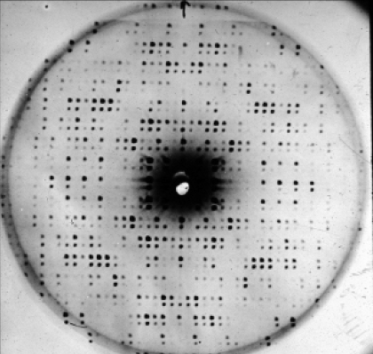
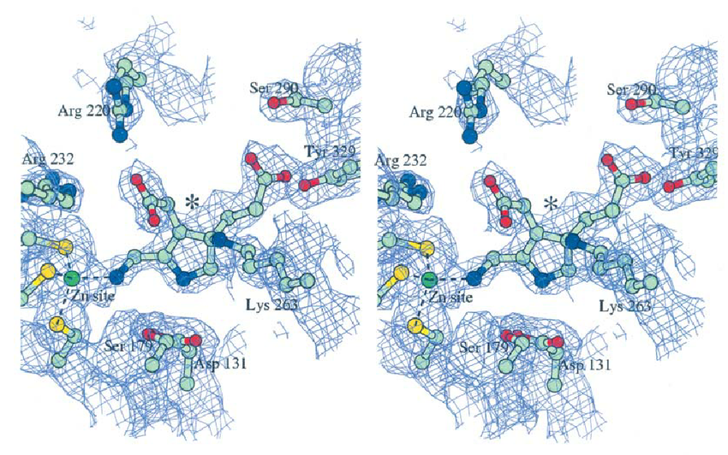
X-ray diffraction pattern
electron density map with fitted AA residues

Slide 9
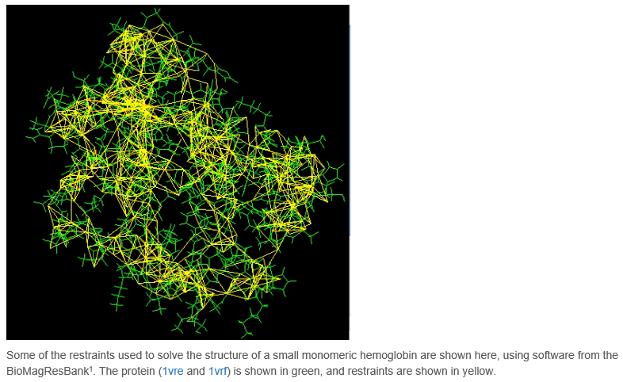
NMR spectroscopy
the technique is currently limited to small or medium proteins, since large proteins present problems with overlapping peaks in the NMR spectra
a major advantage of NMR spectroscopy is that it provides information on proteins in solution, as opposed to those locked in a crystal or bound to a microscope grid, and thus, NMR spectroscopy is the premier method for studying the atomic structures of flexible proteins
www.rcsb.org

Slide 10
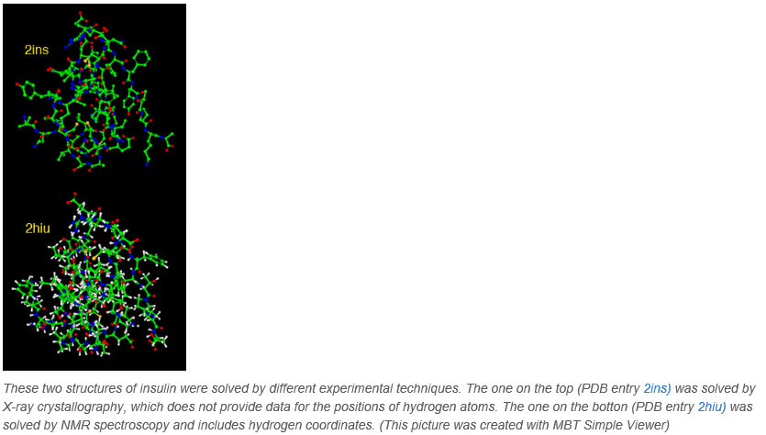
Where are the hydrogens?
www.rcsb.org

Slide 11
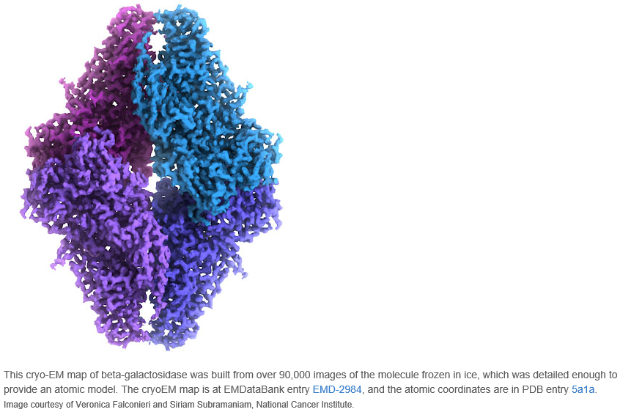
3D Electron Microscopy (3DEM)
involves imaging of many thousands of different single particles preserved in a thin layer of non-crystalline ice (cryo-EM). Provided these views show the molecule in myriad different orientations, a computational approach akin to that used for computerized axial tomography or CAT scans in medicine will yield a 3D mass density map
Movie https://pdb101.rcsb.org/learn/guide-to-understanding-pdb-data/methods-for-determining-structure
www.rcsb.org

Slide 12
Conversion of 2D structural data to 3D form for small molecules
software programs save structural data in a file
acceptable standard file formats:
  Molfile format and extended SD format (structural-data) developed by MDL (Molecular Design Limited) in 1980s
  SMILES (Simplified Molecular Input Line Entry System) developed by David Weininger in 1986
  Tripos Mol2 format
  PDB file format – for macromolecules
3D structure generators (programs): CONCORD, CORINA, Omega
Höltje. H.-D. et al.: Molecular Modeling: Basic Principles and Applications, Wiley VCH, Weinheim, 2008

Slide 13
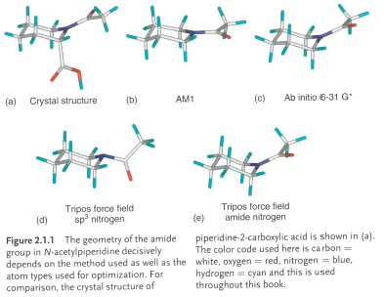
Fragment libraries
common building method in case there are no X-ray data available
construction of molecules from pre-existing fragment libraries
fragment pool contains entries with optimized standard geometries, therefore during construction of 3D structures only torsion angles need to be cleared
Höltje. H.-D. et al.: Molecular Modeling: Basic Principles and Applications, Wiley VCH, Weinheim, 2008

Slide 14
Prediction of 3D structure of proteins
= Computed Structure Models (CSMs)
Template-based modelling = homology modelling
Template-free modelling
https://pdb101.rcsb.org/learn/guide-to-understanding-pdb-data/computed-structure-models

Slide 15
Homology modelling
= comparative modelling or template-based modelling
constructing an atomic-resolution model of the target protein from its amino acid sequence and an experimental 3D structure of a related homologous protein (the template)
proteins with similar amino acid sequences (more than ~30% sequence identity) are known to fold into similar structures
central principle: the sequence of amino acid residues in a protein chain determines its functional 3D shape
Amino sequence identity Target vs template | Expected RMSD from real structure
70% | 1–2 Å
25% | 2–4 Å
this RMSD implies only to matched backbone atoms; not for side-chains; not for regions without template or low similarity
https://pdb101.rcsb.org/learn/guide-to-understanding-pdb-data/computed-structure-models

Slide 16
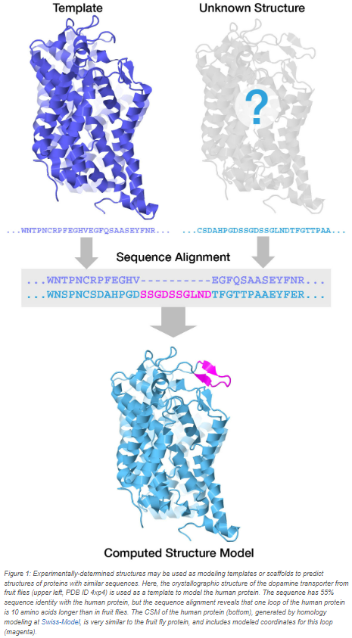
Homology modelling - workflow
template selection (one or multiple)
target-template alignment
model construction
  generation of 3D coordinates based on 3D structure of template
  ab initio modelling of loops, turns and other areas without reliable template
model quality assessment
automated WEB services for protein homology modelling:
  SWISS-MODEL
  Phyre²
https://pdb101.rcsb.org/learn/guide-to-understanding-pdb-data/computed-structure-models

Slide 17
Template-free modelling
local features of the structure are matched to build these models
multiple sequence alignments can be used to identify evolutionarily conserved protein families. Access to vast amounts of sequencing and experimentally determined structural data show that in conserved protein families, amino acids that are in close proximity in 3D may be mutated so that their locations are exchanged but the interactions and physical distance between them is preserved. These correlated mutations or covariations can provide distance constraints and guide prediction of intramolecular contacts. Additionally, fragment matches and local secondary structure predictions can be included in template-free structure prediction. While advances in genome sequencing have given us access to vast amounts of protein sequence data needed for this approach, access to machine learning approaches has made such computations feasible
ab initio modeling or prediction of protein structure using just amino acid sequences and physics-based software tools (e.g., RoseTTAFold using deep learning) is currently only possible for small polypeptide chains
AlphaFold
  Artificial intelligence (AI) system developed by DeepMind predicts 3D structures of small globular proteins from its amino acid sequence with accuracy comparable to that of low-resolution experimental methods
  AlphaFold2 generates computed structure models of proteins in a stepwise fashion. First, the sequence of the protein to be modeled is used to generate a multiple sequence alignment. Thereafter, an iterative process interrogates the multiple sequence alignment, refines the predicted 3D contacts within the polypeptide chain. Additional AI/ML processes then predict the 3D structure by breaking an initial protein model into individual amino acids and computationally recombining them in a way that is consistent with the predicted contacts. In the final model, a confidence score called “predicted local distance difference test” (pLDDT) is computed for each amino acid residue to estimate how well the method has converged - i.e., how well the predicted structure agrees with multiple sequence alignment data and PDB structure information
https://pdb101.rcsb.org/learn/guide-to-understanding-pdb-data/computed-structure-models
https://www.nature.com/articles/d41586-024-03708-4

Slide 18
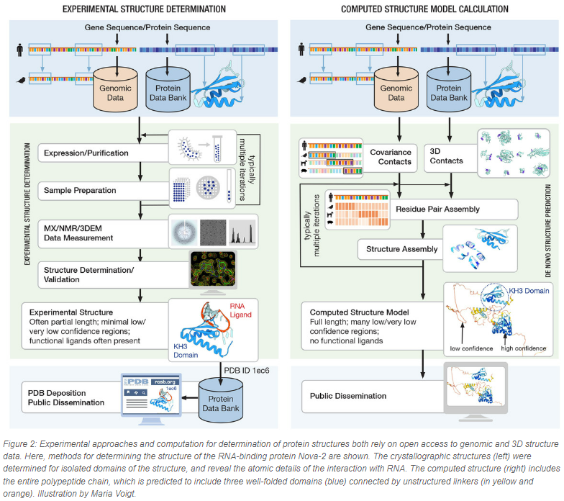
https://pdb101.rcsb.org/learn/guide-to-understanding-pdb-data/computed-structure-models

Slide 19


Cambridge structural (crystallographic) database
the world’s largest database of small-molecule organic and metal-organic crystal structure data
50 years ago at University in Cambridge, Olga Kennard began the collection of crystal structures of molecules resulting in the creation of one of the world’s first numeric scientific databases
released by Cambridge Crystallographic Data Centre
  CCDS Inc. in USA
https://www.ccdc.cam.ac.uk/
https://www.ccdc.cam.ac.uk/Community/educationalresources/
Höltje. H.-D. et al.: Molecular Modeling: Basic Principles and Applications, Wiley VCH, Weinheim, 2008; Hinchliffe A.: Molecular Modelling for Beginners, Jonh Wiley & Sons, Chichester (UK), 2008; https://www.ccdc.cam.ac.uk/
Notes:
Small molecule = upto 1000 atoms including H

Slide 20
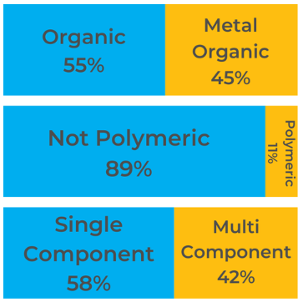
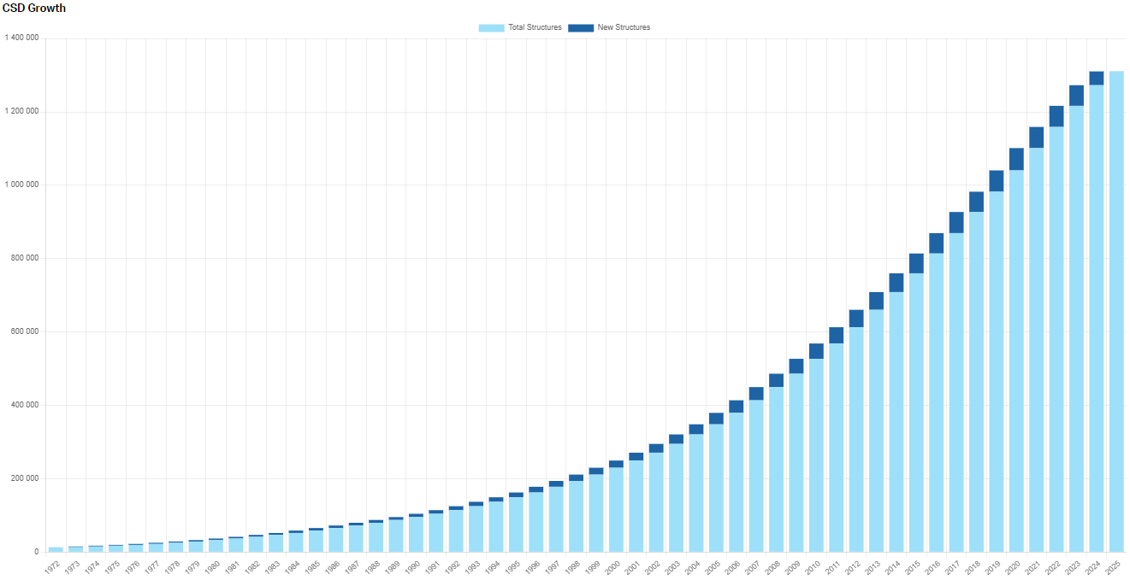
  over 1.25M of entries of experimentally derived (X-ray and neutron diffraction analyses) atomic coordinates for organic and inorganic compound up to size of about 500 atoms, i.e., file containing 3D structural information readable by molecular modelling packages
  ‘small molecules’
  every entry contains
    bibliographic data
    connectivity data
    molecular geometry
  downloadable in CIF format
  (crystallographic information file)
Höltje. H.-D. et al.: Molecular Modeling: Basic Principles and Applications, Wiley VCH, Weinheim, 2008; https://www.ccdc.cam.ac.uk/
Notes:
https://www.ccdc.cam.ac.uk/solutions/csd-system/Components/CSD/
https://www.ccdc.cam.ac.uk/solutions/about-the-csd/csd-statistics/

Slide 21
CSD Subsets
CCDC’s Desktop software required (for academic Mercury software is free)
Current CSD subsets
  Best Representative Lists
  CSD Drug Subsets
  CSD MOF Subsets
  Teaching Subset
  ADPs Available (anisotropic displacement parameter)
  CSD Pesticides
  Electron Diffraction Subset
  High Pressure Subset
  Hydrate Subset
  Minimal Disorder Subset
  Polymorphic Subset
  Significant Disorder Subset
https://www.ccdc.cam.ac.uk/solutions/about-the-csd/csd-subsets/#current-subsets

Slide 22
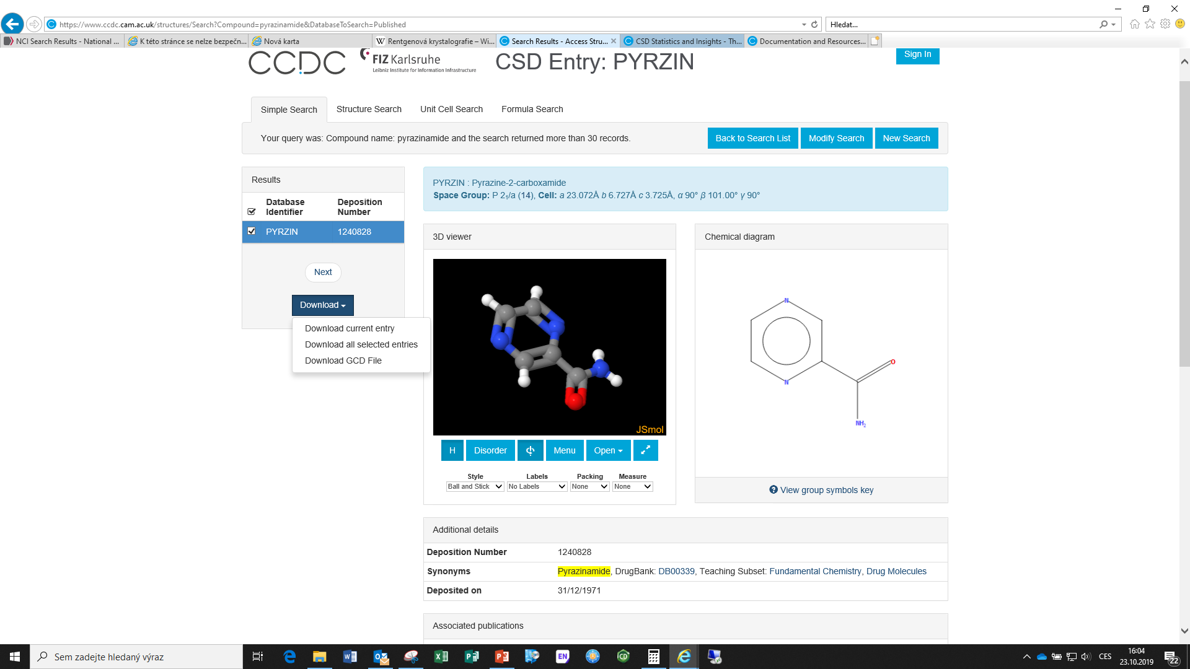

Slide 23

ZINC database
originally designed for target based virtual screening (docking)
a free database of commercially-available compounds for virtual screening. ZINC contains over 230 million purchasable compounds in ready-to-dock, 3D formats. ZINC also contains over 750 million purchasable compounds you can search for analogs in under a minute
it is available in subsets for general screening as well as target-, chemotype- and vendor-focused subsets
provided by the University of California San Francisco (UCSF)
previous versions: ZINC12, ZINC15
ZINC is free for everyone to use and download at
  https://zinc.docking.org/
Höltje. H.-D. et al.: Molecular Modeling,: Basic Principles and Applications, Wiley VCH, Weinheim, 2008

Slide 24
ZINC Database
subsets = pre-selected sets of compounds based on their properties:
  availability: in-stock; on-demand; wait-ok
  bioactive and drugs: FDA, world-not-fda, investigational-only, in trials, in cells
  biogenic: endogenous; metabolites, natural-products
  reactivity: reactive; reactive-ok; clean
tranches – filtration of compounds based on logP and MW (and other properties (such as drug-likeness, reactivity, availability)

Slide 25
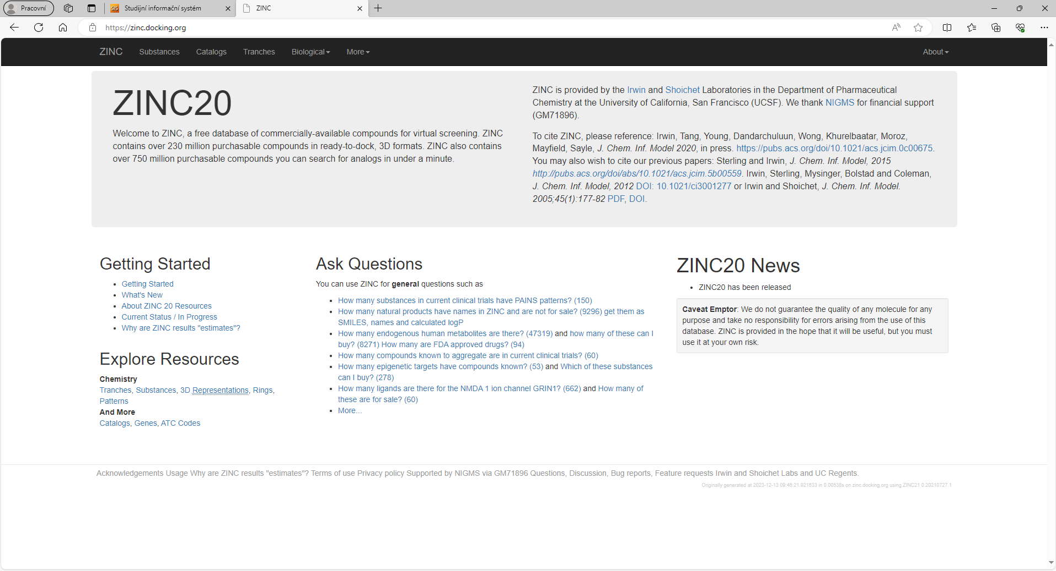
Notes:
Compounds, subsets, download smiles, 3D conversion
Tranches – jsou i 3D

Slide 26

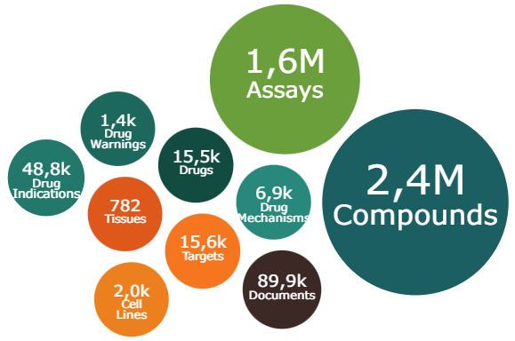
ChEMBL
provided by European Bioinformatics Institute (EBI), which is part of the European Molecular Biology Laboratory (EMBL), an international, innovative and interdisciplinary research organisation funded by 28 member states https://www.ebi.ac.uk/chembl/
ChEMBL is a manually curated database of bioactive molecules with drug-like properties. It brings together chemical, bioactivity and genomic data to aid the translation of genomic information into effective new drugs.
Notes:
With 28 member states, laboratories at six sites across Europe and thousands of scientists and engineers working together, the European Molecular Biology Laboratory (EMBL) is a powerhouse of biological expertise. EMBL is an intergovernmental organisation, headquartered in Heidelberg, and was founded in 1974 with the mission of promoting molecular biology research in Europe, training young scientists, and developing new technologies.
EMBL currently employs more than 1800 people in Barcelona, ​​Grenoble, Hamburg, Heidelberg, EMBL-EBI Hinxton (near Cambridge), and Rome.

Slide 27
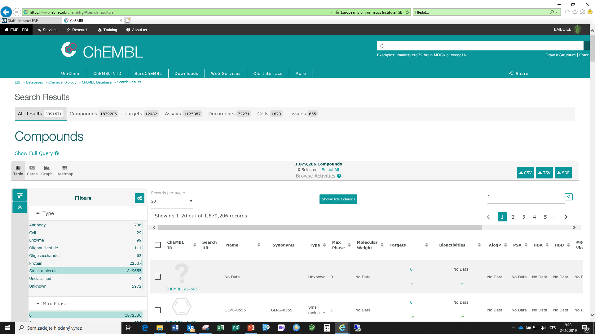
Notes:
Přes koláč. Graf se otevřou sloučeniny, download v XLS, převést na CSV a 3D konversion

Slide 28
DrugBank online
DrugBank Online is a comprehensive, free-to-access, online database containing information on drugs and drug targets. As both a bioinformatics and a cheminformatics resource, we combine detailed drug (i.e., chemical, pharmacological and pharmaceutical) data with comprehensive drug target (i.e., sequence, structure, and pathway) information.
contains 16,574 drug entries including 2,761 approved small molecule drugs, 1,612 approved biologics (proteins, peptides, vaccines, and allergenics), 135 nutraceuticals and over 6,723 experimental (discovery-phase) drugs. Additionally, 5,304 non-redundant protein (i.e. drug target/enzyme/transporter/carrier) sequences are linked to these drug entries
each entry contains more than 200 data fields with half of the information being devoted to drug/chemical data and the other half devoted to drug target or protein data
https://go.drugbank.com/
Notes:
started in 2006 in Dr. David Wishart’s lab at the University of Alberta. It began as a project to help academic researchers get detailed structured information about drugs. In 2011 it became a part of The Metabolomics Innovation Center (TMIC). The project continued to grow in scope and popularity and was spun out into OMx Personal Health Analytics Inc in 2015.
The DrugBank database is a blended bioinformatics and cheminformatics resource that combines detailed drug (i.e. chemical, pharmacological and pharmaceutical) data with comprehensive drug target (i.e. sequence, structure, and pathway) information. The database contains over 7,800 drug entries including nearly 2,200 FDA-approved small molecule drugs, 340 FDA-approved biotech (protein/peptide) drugs, 93 nutraceuticals and >5,000 experimental drugs. DrugBank also contains extensive SNP-drug data that is useful for pharmacogenomics studies.

Slide 29
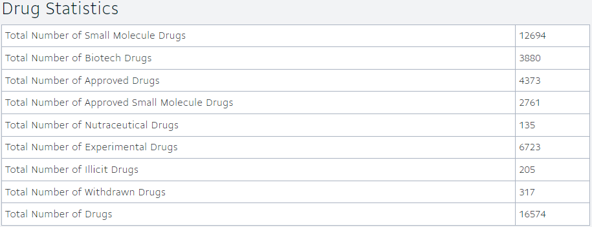
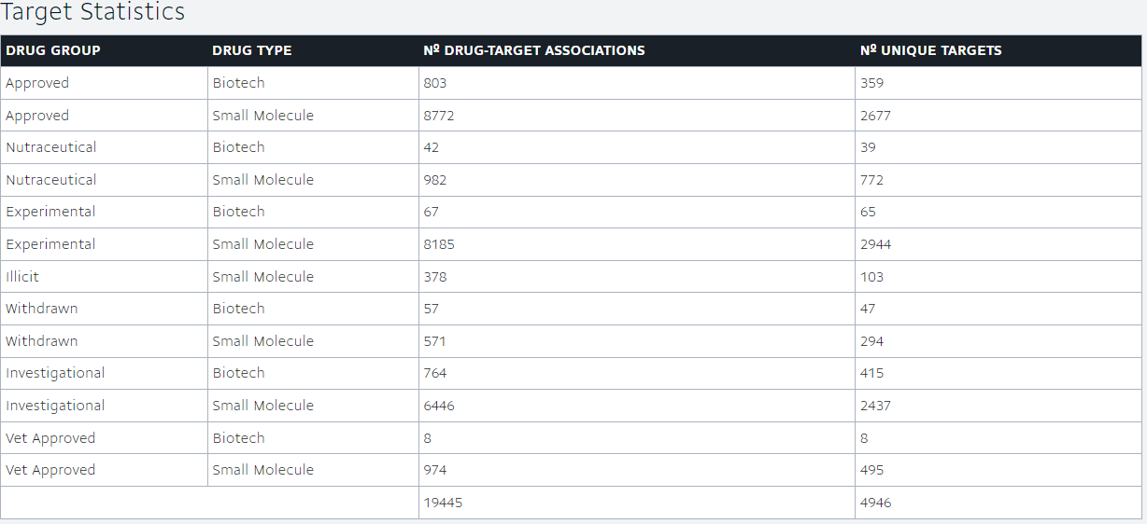

Slide 30
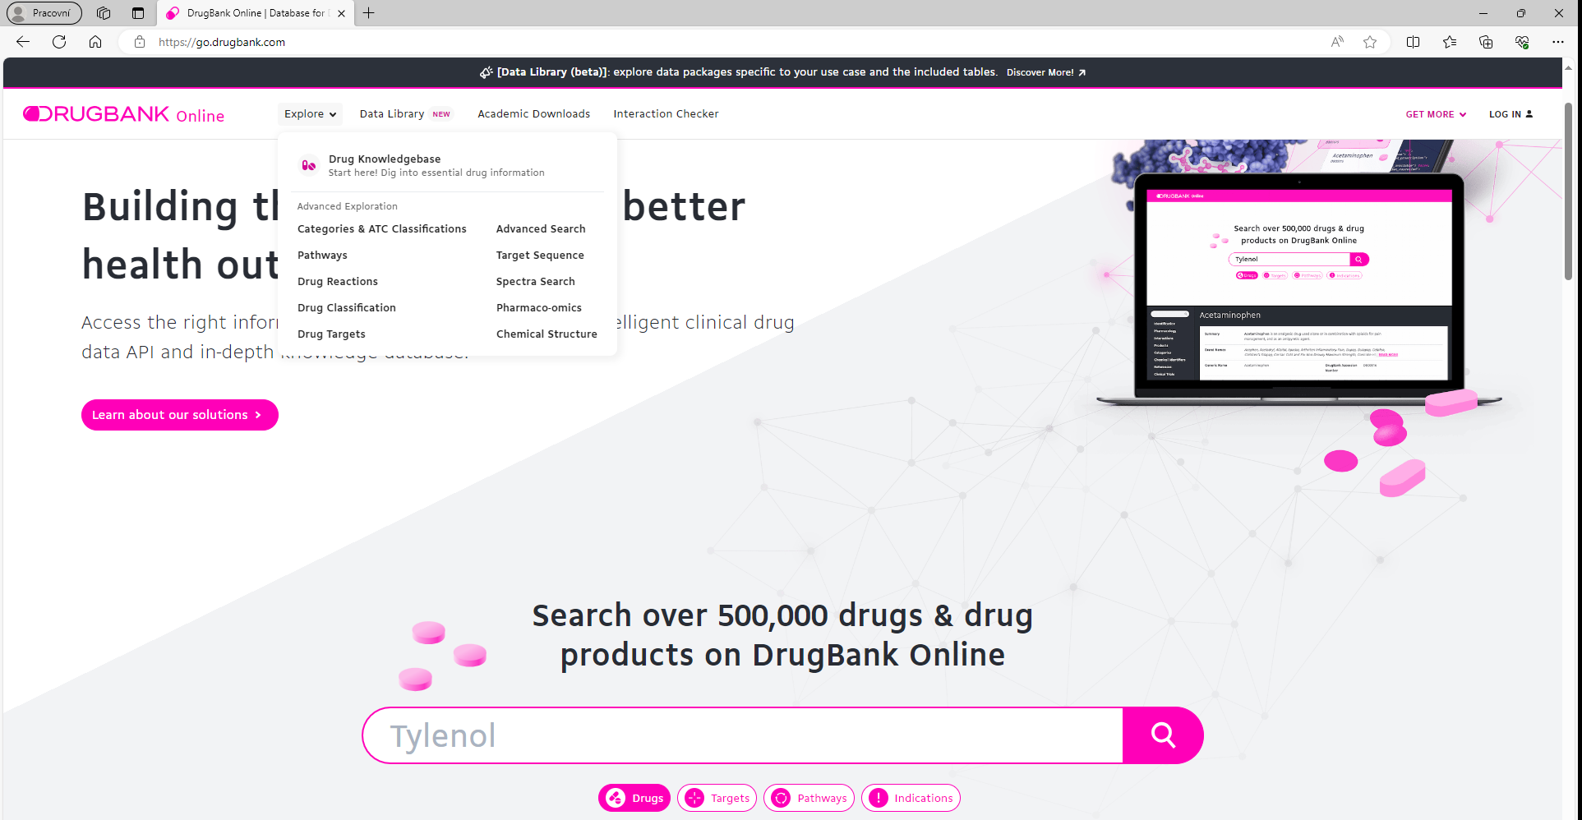

Slide 31

Enamine
Screening hits & HTS
  run HTS directly at Enamine or have your copy from ever-expanding collection of 4 million compounds
Fragments
  206 034 fragment compounds including 7 360 covalent binders
Real compounds
  REadily AccessibLe through validated parallel synthesis
  the largest enumerated database of synthetically feasible molecules
  reach out to new Chemical space breaking the availability bias: 38B Molecules
New buiding blocks
  the world‘s largest collection of building blocks in stock: 259,380
ADME/T & in-vivo PK
  a broad test panel to support lead discovery; integrated projects of a-la-carte service
https://enamine.net/
Notes:
Enamine Ltd was founded in 1991 with the advent of high throughput screening in early drug discovery. The driving force of the company’s development was rapidly increasing demand for new chemical compounds. In over 15 years Enamine has become a global provider of Screening Compounds, Building Blocks, and Fragments for supporting a wide range of research programs conducted by pharmaceutical and biotech companies, drug discovery centers, academic institutions and other research organizations worldwide.
Over the years, the company has developed a comprehensive set of R&D services to meet the ever increasing needs of the customers. Enamine supports complex medicinal chemistry programs offering the following chemical services: custom synthesis, compound library design, hit follow up support, support for lead optimization.
To complement chemical services, Enamine is investing heavily in expanding its biology services, which now include a wide range of reliable bioanalytical services, molecular screening programs and other biological studies.
The company is committed to providing Life Science industries with a one-stop-shop solution for a wide spectrum of research needs. In order to deliver on this ambitious statement, the company is constantly expanding its team of highly skilled chemists, biologists, and engineers, which now is above 500 people.
The Enamine headquarters occupy the space of 5 acres in Kyiv, Ukraine with multiple buildings for chemical and analytical labs, compound stock facilities, operations and business departments. The company has several stock facilities in the USA and Europe and it works through authorized representatives in Asian region.

Slide 32
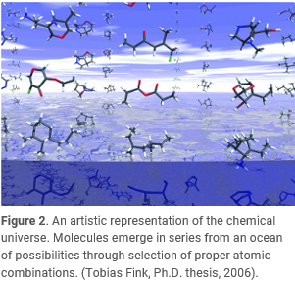
GDB Databases
Prof. Reymond Research Group, University of Bern
GDB stands for “Generated DataBase”, which is a list of all small organic molecules that would be possible following simple rules of chemical stability and synthetic feasibility
  GDB-11, which lists 26.4 million molecules consisting of up to 11 atoms of carbons, nitrogen, oxygen, and fluorine
  extended the enumeration to GDB-13 containing almost one billion molecules of up to 13 atoms
  GDB-17 containing 166.4 billion molecules up to 17 atoms
All the molecules are stored in dearomatized, canonized SMILES format and compressed at http://gdb.unibe.ch/

Slide 33
Exploring the chemical space
10⁸
https://doi.org/10.1016/j.drudis.2019.02.013
Notes:
MASSIV, Merck AcceSSIble InVentory

Slide 34


Chemspider
ChemSpider is a free chemical structure database providing fast access to over 100 million structures, properties, and associated information
owned by Royal Society of Chemistry
search by name, chemical structure or specific properties
http://www.chemspider.com/

Slide 35
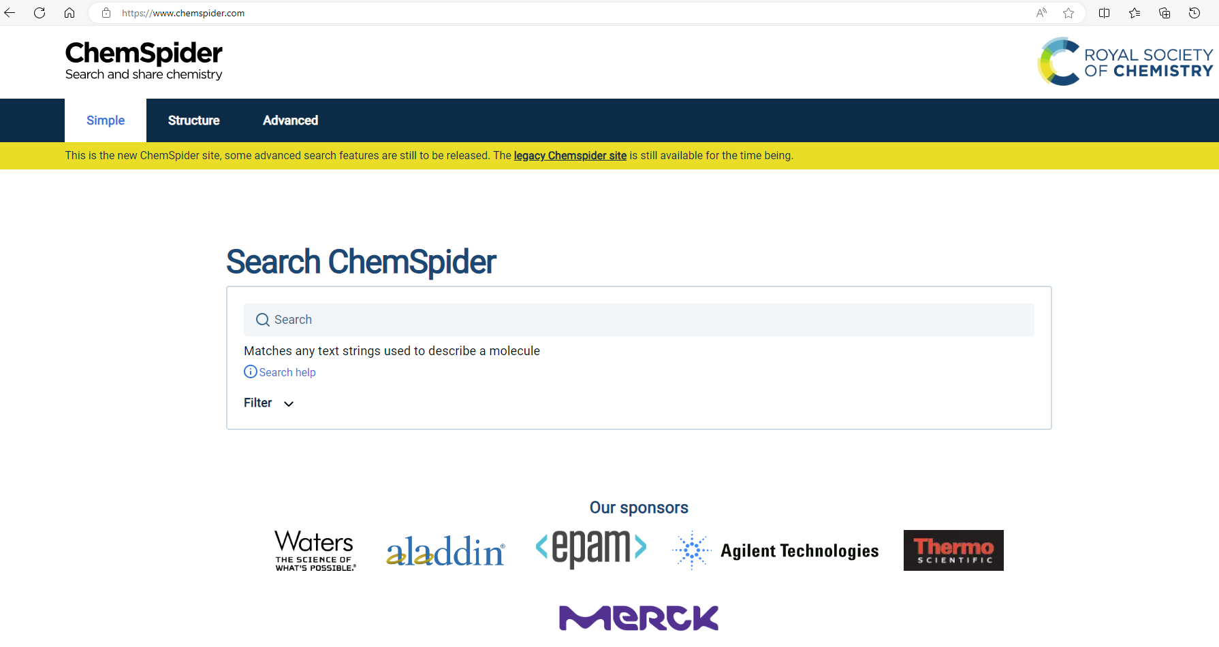

Slide 36


PubChem
PubChem is an open chemistry database at the National Institutes of Health (NIH)
mostly contains small molecules, but also larger molecules such as nucleotides, carbohydrates, lipids, peptides, and chemically-modified macromolecules. We collect information on chemical structures, identifiers, chemical and physical properties, biological activities, patents, health, safety, toxicity data, and many others
collection of freely accessible chemical information. Search chemicals by name, molecular formula, structure, and other identifiers. Find chemical and physical properties, biological activities, safety and toxicity information, patents, literature citations and more
https://pubchem.ncbi.nlm.nih.gov/
https://www.ncbi.nlm.nih.gov/pubmed/

Slide 37
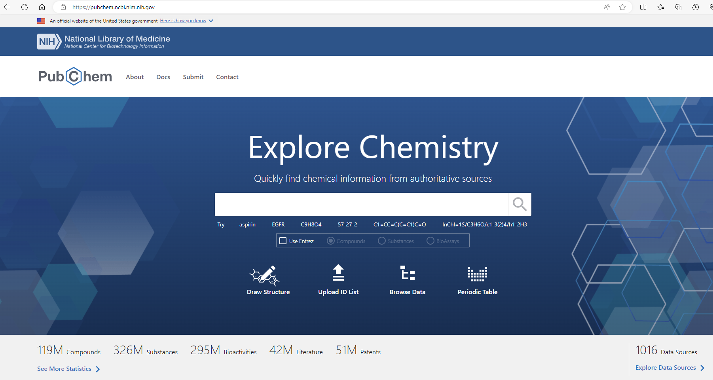

Slide 38
Other Small Molecule Databases
National Cancer Institute Open Database
  https://cactus.nci.nih.gov/download/nci/
eMolecules database
  https://www.emolecules.com/
Binding DB
  https://www.bindingdb.org/bind/aboutus.jsp
Höltje. H.-D. et al.: Molecular Modeling: Basic Principles and Applications, Wiley VCH, Weinheim, 2008

Slide 39

Brookhaven Protein Data Bank (PDB)
operated by the Research Collaboratory for Structural Bioinformatics (RCSB) is the single worldwide repository for processing and distribution (for free) of 3D biological macromolecular structural data
the most important deposit of 3D structures of biological macromolecules (most often proteins)
www.rcsb.org
each structure is represented by a four-character alpha-numeric identifier
the PDB file format (.pdb) includes bibliographic data, connectivity data and Cartesian coordinates of proteins, nucleic acid and other macromolecules
Notes:
RCSB PDB (RCSB.org) is the US data center for the global Protein Data Bank (PDB) archive of 3D structure data for large biological molecules (proteins, DNA, and RNA) essential for research and education in fundamental biology, health, energy, and biotechnology.
The Protein Data Bank (PDB) was established as the 1st open access digital data resource in all of biology and medicine (Historical Timeline). It is today a leading global resource for experimental data central to scientific discovery.
Through an internet information portal and downloadable data archive, PDB provides access to 3D structure data for the molecules of life, found in all organisms on the planet.
Knowing the 3D structure of a biological macromolecule is essential for understanding its role in human and animal health and disease, its function in plants and food and energy production, and its importance to other topics related to global prosperity and sustainability.
The enormous wealth of 3D structure data stored in the PDB has underpinned significant advances in our understanding of protein architecture, culminating in recent breakthroughs in protein structure prediction accelerated by artificial intelligence approaches and deep or machine learning methods.
RCSB PDB (Research Collaboratory for Structural Bioinformatics PDB) operates the US data center for the global PDB archive, and makes PDB data available at no charge to all data consumers without limitations on usage (Policies).
The Vision of the RCSB PDB is to expand the frontiers of fundamental biology, biomedicine, energy sciences, and biotechnology through open and sustainable access to the 3D structure, function, and evolution of biological macromolecules contained in the Protein Data Bank (PDB) archive.
Recognized experts in fields, including but not limited to, structural biology, cell and molecular biology, computational biology, information technology, and education serve as advisors to the RCSB PDB.

Slide 40
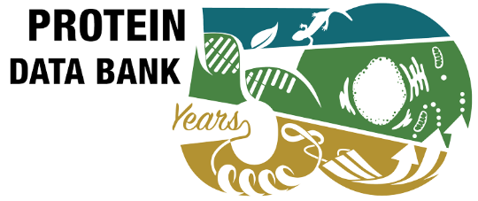
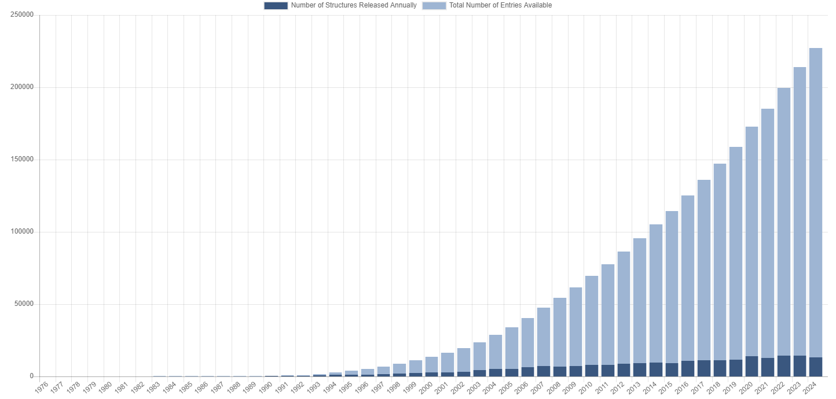
PDB Statistics: Overall Growth of
Released Structures Per Year
the PDB was established in 1971 at Brookhaven National Laboratory
in 2024: 227,344 structures
Notes:
https://www.rcsb.org/stats/growth/growth-released-structures
https://www.rcsb.org/pages/pdb50
The PDB was established in 1971 at Brookhaven National Laboratory under the leadership of Walter Hamilton and originally contained 7 structures

Slide 41
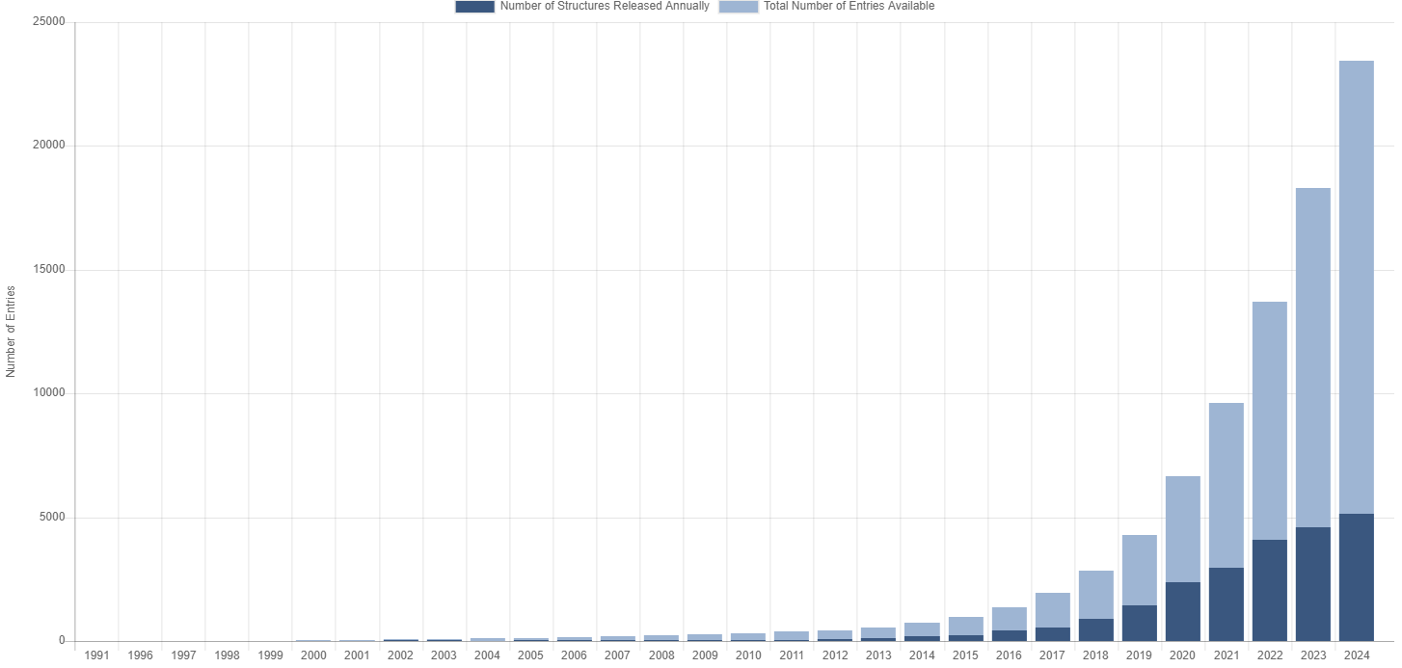
PDB Statistics: Growth of Structures from 3DEM Experiments Released per Year

Slide 42
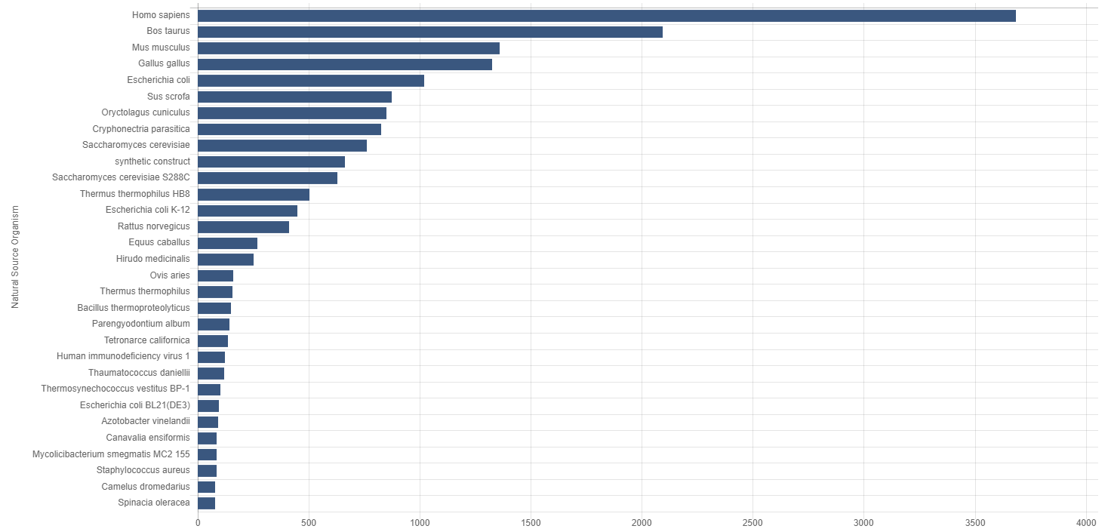
Some PDB statistics…
source organism of the gene – cells for gene amplification – cells for expression
Notes:
https://www.rcsb.org/stats/distribution-source-organism-natural
Mus musculus – home mouse
Rattus norvegicus – street rat

Slide 43
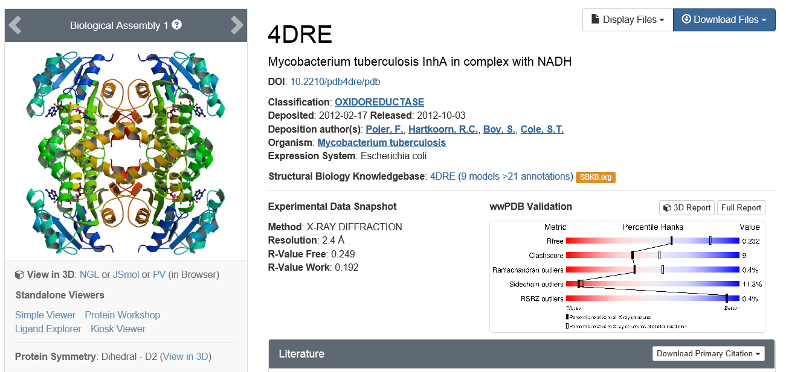
PDB

Slide 44
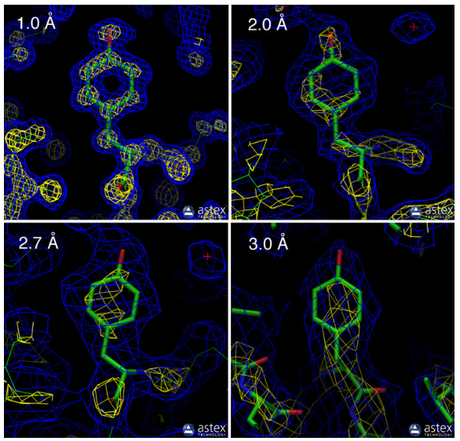
Evaluation of structure quality of proteins in PDB
RESOLUTION
at 1 Å – the positions of all heavy atoms are certain
at 3 Å – only the basics characteristics of protein backbone can be taken for sure (secondary structure), positions of side-chain atoms are uncertain
for docking studies – resolution should be less than 2.5 Å
Above mentioned resolution values are average for the whole protein. In disordered regions (loops, turns, coils etc.) the resolution will be much lower (i.e., higher values)
http://pdb101.rcsb.org/
Notes:
Resolution measures the amount of detail that may be seen in the experimental data

Slide 45
Evaluation of structure quality
R-value – measure of extent to which the model fits to measured reflections before artificial improvements of the model.
R- free (R-value for unmodified model) must not be much higher than R-value (modified model).
if R-free minus R-value > approx. 0.06 it means that there were too much artificial correction to the original results. The model is ‘over-interpreted’.
R-value – measure of how much the reflections calculated from the final model match the really measured reflections
Ideal match R-value = 0
Match to a random set of atoms R-value ≈ 0.63
Typically, R-value of a good structure is ≈ 0.2
AND R-free is not much higher, e.g. ≈ 0.26
Notes:
R-value measures how well the atomic model is supported by the experimental data found in the structure factor file
When solving the structure of a protein, the researcher first builds an atomic model and then calculates a simulated diffraction pattern based on that model. The R-value measures how well the simulated diffraction pattern matches the experimentally-observed diffraction pattern. A totally random set of atoms will give an R-value of about 0.63, whereas a perfect fit would have a value of 0. Typical values are about 0.20
The use of the R-free value is a less biased way to look at this. Before refinement begins, about 10% of the experimental observations are removed from the data set. Then, refinement is performed using the remaining 90%. The R-free value is then calculated by seeing how well the model predicts the 10% that were not used in refinement. For an ideal model that is not over-interpreting the data, the R-free will be similar to the R-value. Typically, it is a little higher, with a value of about 0.26.

Slide 46
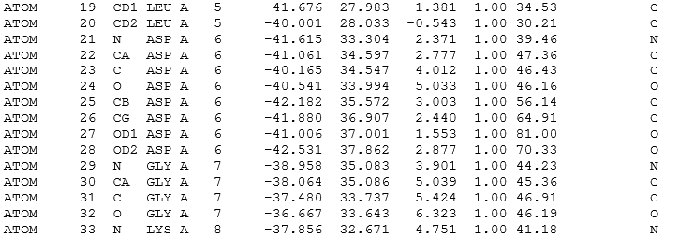
Example of PDB file – 4DRE
Occupancy
B-factor
Coordinates

Slide 47
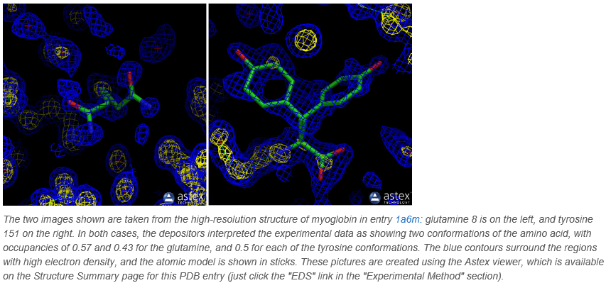
Occupancy value
1… atom is in the same position in all molecules of the crystal
0.5… atom is in the same position in 50% molecules of the crystal
http://pdb101.rcsb.org/

Slide 48
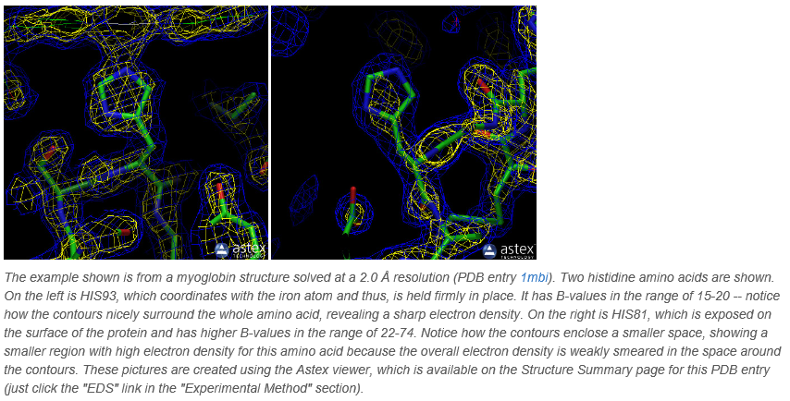
B-value = temperature factor
˂ 10… model of atom is very sharp
˃ 50… atom is moving much so, that it can be barely seen
http://pdb101.rcsb.org/

Slide 49
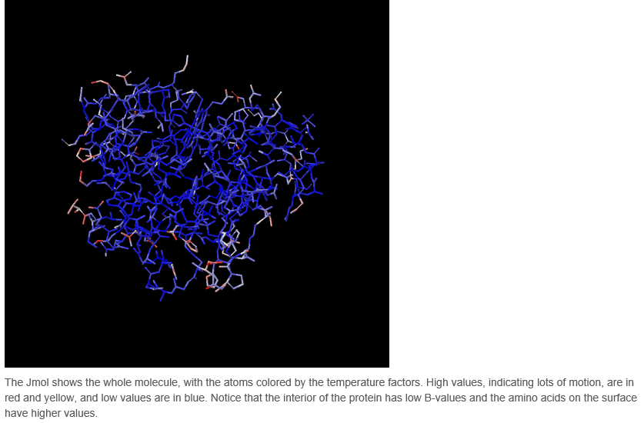
http://pdb101.rcsb.org/

Slide 50
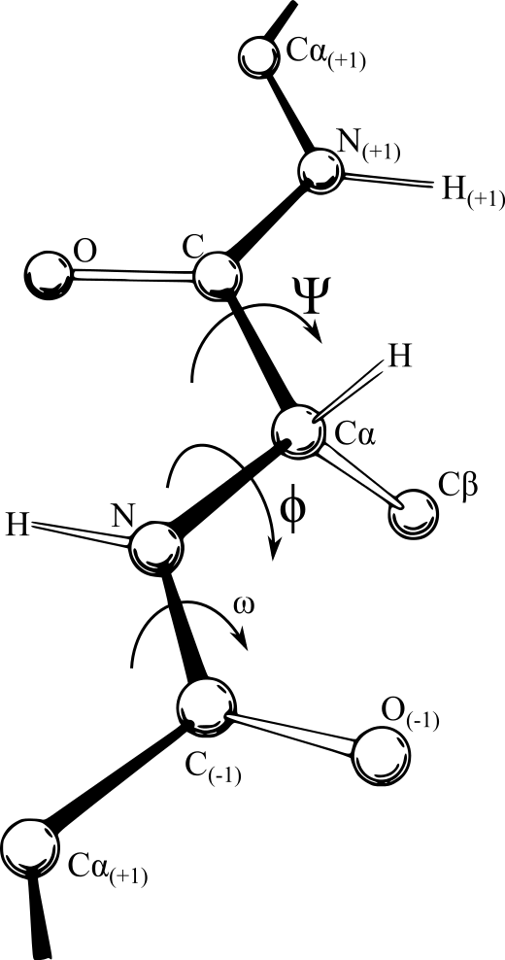
Angles in polypeptide backbone
dihedral angles
Ψ = psi – related to rotation of bond C-Cα
Φ = phi – related to rotation of bond N-Cα
ω = omega – related to rotation of bond C-N
– restrained rotation by partial double bond character of the peptide bond
ω = 180° trans amide bond
ω = 0° cis amide bond
Video – rotation of polypeptide - clashes

Slide 51
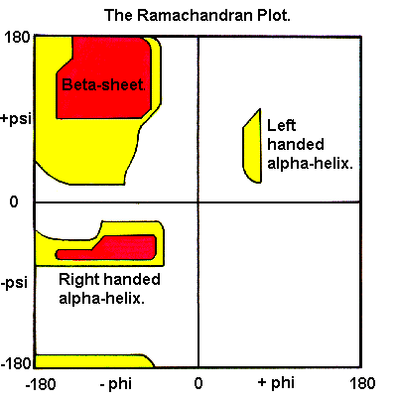
Ramachandran Plot
Energetically allowed regions (conformations) for backbone dihedral angles ψ against φ of amino acid residues in protein structure
Usage:
evaluate possible conformations of protein with unknown 3D structure
assess the quality of experimentally determined structure or model
WHITE – disallowed regions – steric clash
RED – energetically favourable, no steric clashes
YELLOW – no clashes when slightly diminished van der Waals radii used for calculations
Ψ
Φ
Notes:
This plot is for all of the standard amino acids but Gly. Gly has no C beta. Gly is more flexible than other AAs.

Slide 52
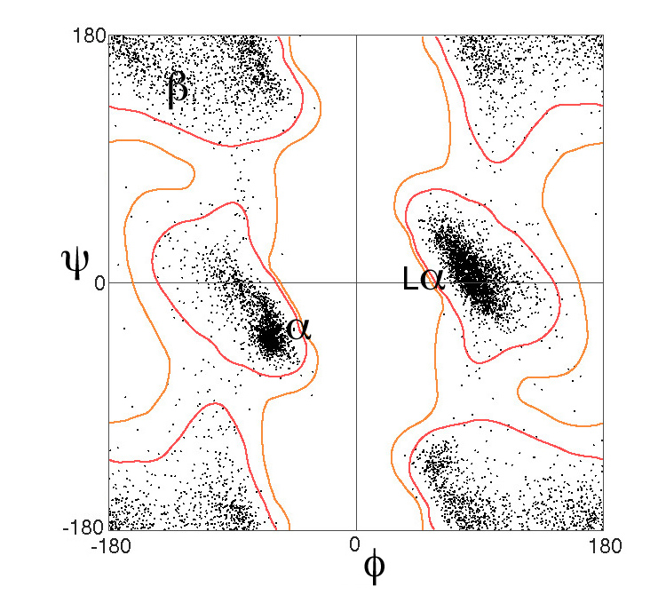
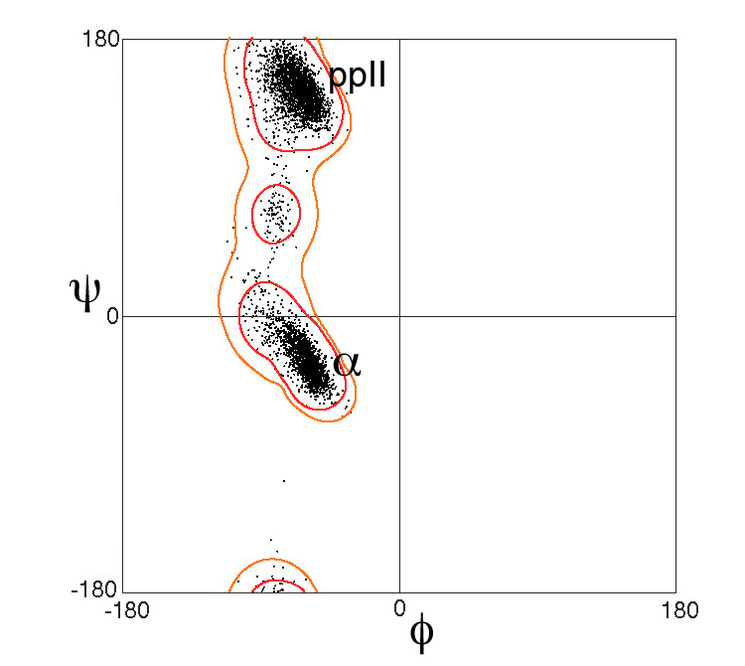
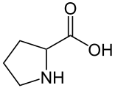

Ramachandran Plot
Pro
Gly

Slide 53
Evaluation of structure quality of proteins in PDB
Resolution < 2.0 Å
R-value ≈ 0.2 or less
R-free ≈ 0.26 or less
Ramachandran Plot outliers < 1% of amino acids
acceptable values for a protein intended for most of molecular modelling studies

Slide 54

Uniprot
The mission is to provide the scientific community with a comprehensive, high-quality and freely accessible resource of protein sequence and functional information
UniProt is a collaboration between the European Bioinformatics Institute (EMBL-EBI), the SIB Swiss Institute of Bioinformatics and the Protein Information Resource (PIR)
https://www.uniprot.org/

Slide 55
Homework – see all videos
https://pdb101.rcsb.org/learn/videos/methods-for-determining-atomic-structures

