Slide 1
Cold War History
Détente between East and West

Slide 2
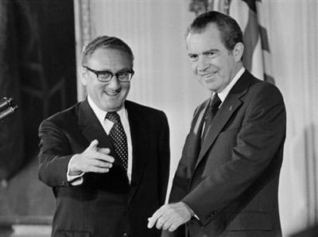
Nixon’s Foreign Policy
Nixon entered office in the midst of one of the gravest foreign policy crises in US history
Nixon felt that it was imperative to change America’s foreign policy
balance of power throughout the world in order to ensure peace and prosperity
Supported negotiations and peaceful competition
This era is called détente

Slide 3
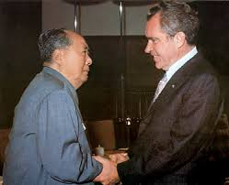
Nixon’s visit in China
In February of 1972, President Nixon and his National Security Adviser, Henry Kissinger, came to China
Nixon decided to pursue an initiative to normalize relations with both countries
China welcomed opening lines of communication with the United States in order to develop an ally against the Soviet Union
The result – US agreed to recognize the Communist government in Beijing as the government of China
The countries began trading with one another
Notes:
https://www.youtube.com/watch?v=uyCZDvec5sY

Slide 4
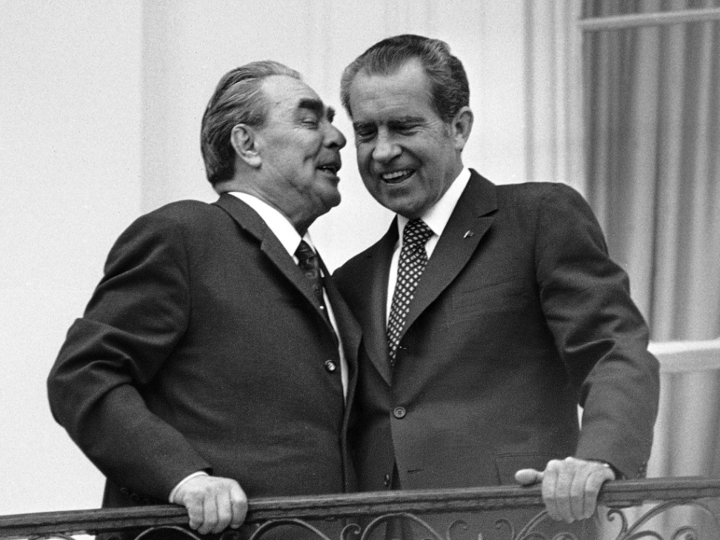
Relations with the Soviet Union
Nixon’s negotiations with Brezhnev resulted in several agreements
The first agreement was a three-year grain deal in which the U.S. agreed to sell at least $750 million worth of wheat, corn, and other grains to the Soviet Union
The second agreement was the Strategic Arms Limitation Treaty of 1972 (SALT I)

Slide 5
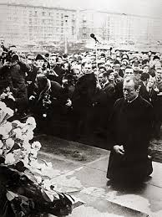
Brandt’s Ostpolitik
1969 - The Social-Liberal coalition headed by Willy Brandt in FRG
treaties with the East ( Ostverträge)
First was concluded between the West Germany and the USSR in Moscow on 12 August 1970
Treaty with Poland in Warsaw on 10 December 1970
The treaty with Czechoslovakia
On 21 December 1972, the two Germanys signed the Basic Treaty in which the two states recognised one another and established political and trade relations

Slide 6
Helsinki Summit
On 1 August 1975, the Final Act of the Helsinki Summit closed the Conference on Security and Cooperation in Europe (CSCE)
The CSCE was a standing forum for negotiation that sought to enhance cooperation and to overcome the division of Europe into two major blocs
The 35 participants, including members of the North Atlantic Treaty Organisation (NATO) and the Warsaw Pact
The Helsinki Agreement covered non-interference in internal affairs, military issues, economic, technical and scientific cooperation, democratic principles and even environmental protection

