Slide 1
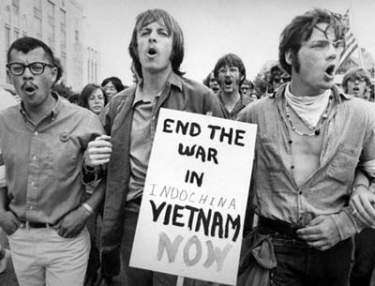
Vietnam War
Cold War History

Slide 2
French Indochina
France began its conquest of Indochina in the late 1850s
by 1888 the area of the current-day nations of Cambodia and Vietnam was made into the colony of French Indochina
Various Vietnamese opposition movements existed during this period – e.g. Viet Minh (1941), controlled by the Indochinese Communist Party
1940 – Japan invaded Indochina
On 2 September 1945 Ho Chi Minh declared the independent Democratic Republic of Vietnam

Slide 3
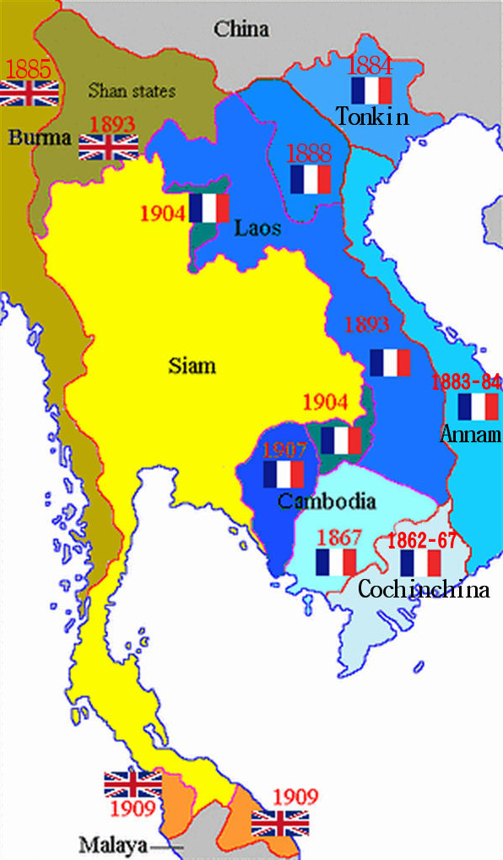
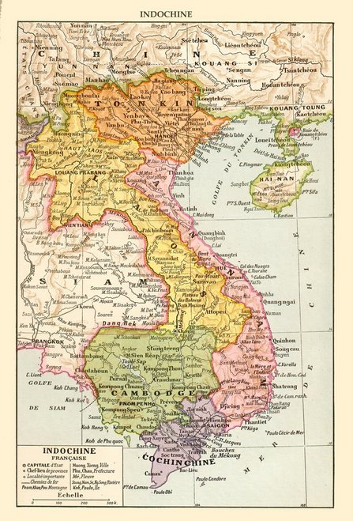
French Indochina

Slide 4
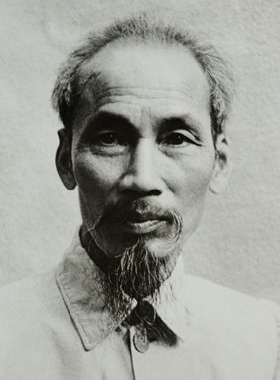
Ho Chi Minh
Born in 1890 in in a village in central Vietnam (then part of French Indochina)
Living in France during World War I.
Inspired by the Bolshevik Revolution, he joined the Communist Party
He helped found the Indochinese Communist Party in 1930 and the League for the Independence of Vietnam, or Viet Minh, in 1941
He declared a Democratic State of Vietnam in 1945

Slide 5
In 1959, armed conflict broke out again, as Communist guerrillas known as the Viet Cong began launching attacks on targets in South Vietnam
Ho Chi Mingh died in 1969
In 1975 North Vietnam forces seized control of Saigon, that was renamed Ho Chi Minh City
Flag of National Liberation Front (Viet Cong)

Slide 6
French Indochina after 1945
France’s long struggle to hold on to its colony in Asia ended in 1954 with the signing of the Geneva Accords
Laos and Cambodia became neutral states, while Vietnam was divided along the 17th parallel, with the Vietminh under nationalist Communist leader Ho Chi Minh in control of the North
In 1955 the Republic of Vietnam in the South was declared
The United States offered support to Ngo Dinh Diem’s South Vietnam government

Slide 7
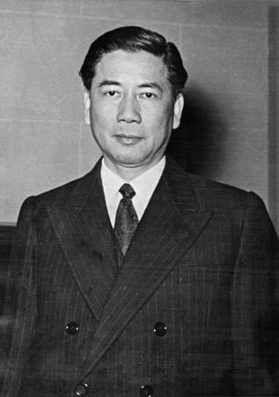
US involvement was escalated gradually
In November 1961 there were about 948 military advisers in the country
The number of military personnel rose to 12 000 by end of 1962 and to 75 000 in the middle of 1965
U.S. organized coup by South Vietnamese generals in the fall of 1963, which resulted in Diem’s assassination
Ngo Dinh Diem (1901-1963)

Slide 8
Vietnam War
As the war in Vietnam increased in intensity, the Soviet Union became more active (between 1967 and 1972 it was about one billion dollars annually)
The conflict in Indochina also tied up substantial US resources
For new U.S. president Lyndon Johnson, the decision to continue the Vietnam commitment followed the path of his predecessors
Gulf of Tonkin Resolution in 1964 authorizing the President to take all measures necessary to protect the armed forces
In February 1965, Johnson authorized the sustained bombing of North Vietnam
Notes:
https://www.youtube.com/watch?v=Fd8wKKfN7sM

Slide 9
Vietnam War
By early 1968, one-half million American troops were in Vietnam
Over 25,000 Americans had already been killed
Tet offensive of North Vietnam and the Viet Cong in 1968 – it proved that war’s end was nowhere in sight
Antiwar protest in the U.S.
Johnson announced to a nationwide television audience that he would not seek re-election
The war in Vietnam would continue to rage for five more years and claim an additional 33,000 American lives

Slide 10
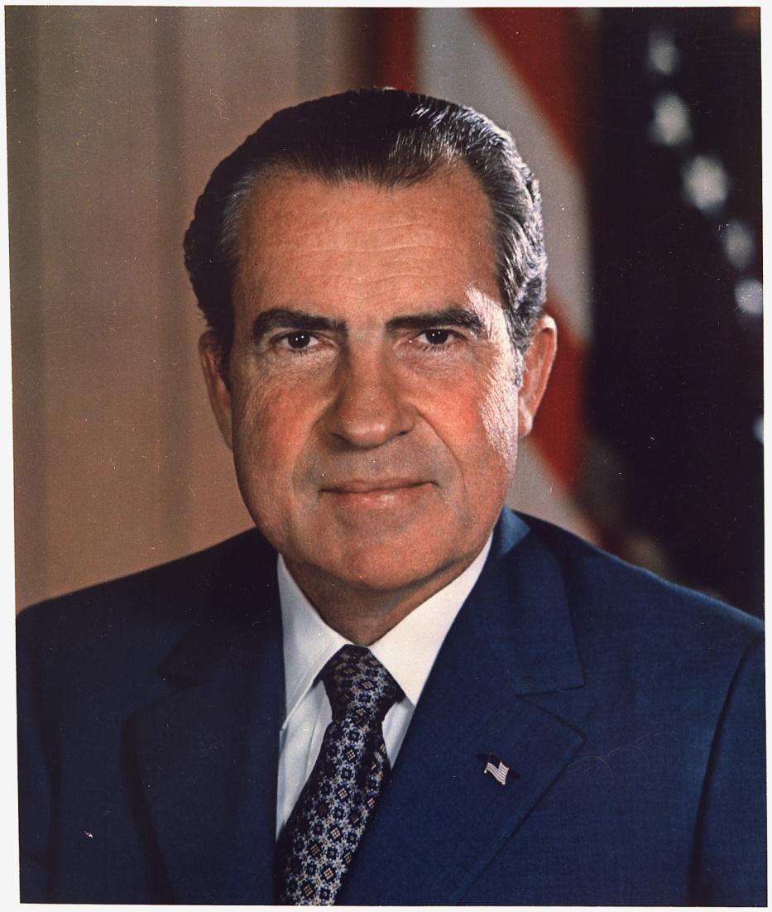
Nixon and end of the Vietnam War
Nixon’s Vietnam policy:
1) “Vietnamization” - responsibility for fighting would be turned over to the Vietnamese
2) “madman” approach – U.S. would warn the North Vietnamese that unless they settled soon they would be subjected to carpet bombing of cities, mining of harbours etc.
3) “linkage” in dealing with the Soviets: trade agreements to be proposed to the Soviets would require a quid pro quo - Moscow would have to pressure Hanoi to agree to a settlement

Slide 11
Nixon’s Vietnam policy failed
Nixon announced the withdrawal of a half million troops
By January 1973, only 25 000 American troops remained in Vietnam. The combat effectiveness of the South Vietnamese did not improve
In October 1972, the Paris Peace Talks were reopened
With the presidential election of 1972 approaching, Nixon wanted a settlement of the war
In 1975 the North and South Vietnam were unified under Communist rule
Even a total expenditure of 150 billion dollars and the employment more than 500 000 US soldiers could not prevent the events in Vietnam form resulting in victory for North Vietnam and the Viet Cong

Slide 12
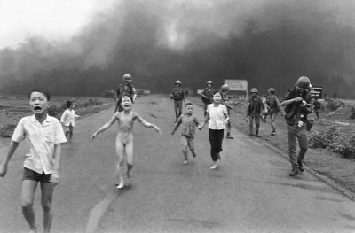
Legacy of Vietnam War
The US warfare in general, and the bombing in particular, led to widespread reactions in many countries, including among Americans themselves
US objectives in Indochina seemed unclear for increasing numbers of people
first televised war
The Vietnam War also illustrated how limited the influence of the superpowers could be
War crimes – e. g. My Lai Massacre
Notes:
https://www.youtube.com/watch?v=rHk4TGWx0ZM

Slide 13
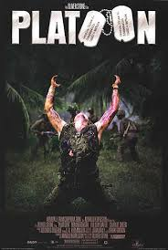
The Vietnam War also has played a large role in American popular culture, especially in film. Prominent films such as Taxi Driver (1976), Coming Home (1978), The Deer Hunter (1978), Apocalypse Now (1979), Platoon (1986), Full Metal Jacket (1987), or Born on the Fourth of July (1989)
dealt with topics ranging from the brutality of the war itself to the difficulty of Vietnam veterans’ attempts to readjust to American society and cope with war trauma after returning to the United States.

Slide 14
Antiwar movement
Movement against U.S. involvement in the Vietnam War began as a small group among peace activists and leftist intellectuals on college campuses
On October 21, 1967, one of the most prominent anti-war demonstrations took place, as some 100,000 protesters gathered at the Lincoln Memorial
By early February 1968, a Gallup poll showed only 35 percent of the population approved of Johnson’s handling of the war
Notes:
https://www.youtube.com/watch?v=eTMv2FmSXWg

