Slide 1
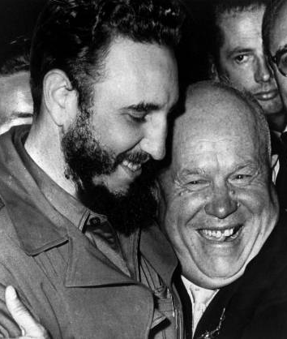
Cold War History
Cuba and the Missile Crisis

Slide 2
Cuban Revolution (1953-1959)
resulted in the overthrow of Fulgencio Batista and the creation of a new communist government under Fidel Castro
Guantanamo – U.S. naval base in Cuba
Castro emerged as leader of 26th of July Movement - leftist revolutionary organization committed to ousting Batista

Slide 3
Cuban revolution
in the imprisonment of Castro in 1953
In 1956, hereturned to Cuba to continue his revolution - guerrilla warfare against Batista's government
In early January 1959, the movement succeeded in ousting Batista

Slide 4
Notes:
https://www.youtube.com/watch?v=oPlnGiS488s

Slide 5
Che Guevara
was a leading figure of the Cuban Revolution until he was hunted down and executed in 1967
Notes:
https://www.youtube.com/watch?v=SSRVtlTwFs8
"Hasta Siempre, Comandante", or simply "Hasta Siempre", is a 1965 song by Cuban composer Carlos Puebla. The song's lyrics are a reply to revolutionary Che Guevara's farewell letter when he left Cuba, in order to foster revolution in the Congo and later Bolivia.
The lyrics recount key moments of the Cuban Revolution, describing Che Guevara and his role as a revolutionary commander. The song became iconic after Guevara's death, and many left-leaning artists did their own cover versions of the song afterwards. The title is a part of Guevara's well known saying "¡Hasta la Victoria Siempre!" ("Until Victory, Always!"). The song was re-released by Nathalie Cardone in 2002.

Slide 6
Bay of Pigs Invasion
President Dwight D. Eisenhower came up with a secret plan to invade Cuba and have Castro removed from power – it was coordinated by the Central Intelligence Agency (CIA)
When John F. Kennedy became president following the election of 1960, he was informed of the plan
Bay of Pigs Invasion took place from April 17-19, 1961
Invasion failed - over 100 exiles had been killed and nearly 1,200 had surrendered

Slide 7
Kennedy’s foreign policy
came to office with a preference for foreign affairs
using more aggressive rhetoric
accusing his Republican opponents of being soft on communism
he showed some initiative in trying to reduce Cold War tensions and improve American-Soviet relations

Slide 8
Cuban Missile Crisis
In 1962 Khrushchev decided to send secretly about 80 nuclear missiles to Cuba
By August 1962 the first rumours of Soviet missiles in Cuba, from émigré reports and CIA leaks
This made the sense of shock when missiles were discovered by a U-2 spy plane, on 14 October 1962
Kennedy immediately consulted the situation with his top advisers - Executive Committee of the National Security Council (ExComm)
options available to respond to the Soviet threat - air strikes on the missile bases, a full-scale invasion of Cuba, or a naval blockade of the island

Slide 10
Cuban Missile Crisis
Kennedy eventually chose a blockade, or quarantine
For 14 days in October 1962 the world stood on the brink of nuclear war
Khrushchev sent a long letter to Kennedy, appealing to reason and trust to prevent a catastrophe
Kennedy insisted that the missiles in Cuba must be removed and offered to end the blockade and pledged not to invade Cuba if that happened
A new message was received from Moscow offering a specific deal by which the missiles in both Turkey and Cuba would be removed and the USA and USSR would jointly guarantee the security of both nations
Notes:
https://www.youtube.com/watch?v=W50RNAbmy3M

