Slide 1
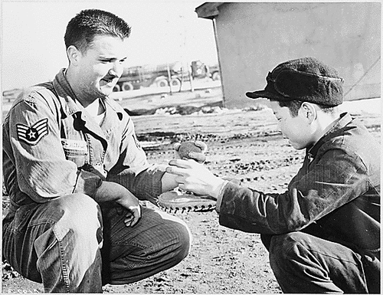
Cold War Expands to the Third World
Cold War History

Slide 2
China
Civil war - Communists vs. Chinese Nationalists
nationalist leader Chiang Kai-shek
Communist leader Mao Tse-tung
China Act of 1948. It declared to “maintain the genuine independence and the administrative integrity of China, and to sustain and strengthen principles of individual liberty and free institutions in China through a program based on self-help and cooperation.”
When the Nationalist government collapsed in 1949 and the Communists established the People’s Republic of China, Chiang Kai-shek and the Nationalists retreated to the island of Formosa (Taiwan).

Slide 3
Superpower’s Asian Policies
The Communist victory in China led to a re-evaluation of Moscow’s Asian policies
Malenkov declared that Mao’s victory would lead to a new and higher stage in the people’s struggle for independence in Asia
In December 1949, Truman approved National Security Council (NSC) 48/2 - basis for escalation of U.S. economic and military assistance to Asia
special attention was to be paid to the situation in Vietnam

Slide 4
Korean War 1950-1953
President Truman proposed after WWII a joint occupation of Korea by the two powers where the Soviets would occupied the territory north of the 38 parallel, while the U.S. would control the area south of the line.
Neither the Soviet Union or the U.S. wanted the peninsula to fall into the other’s hand
North Korea’s invasion of South Korea in 1950 brought about a United Nations’ action against the aggressors. That immediately produced heavy military and naval involvement by the United States.

Slide 5
Korean War
Although 16 countries sent troops, the Korean War was largely a United States operation
Altogether, more than 1,5 million American men and women served in Korea
By March 1951, the fighting had stabilized, and Truman was ready to negotiate a settlement to restore the pre-invasion boundary

Slide 6
On 27 July 1953, with a new regime in the Soviet Union and the blunting of a final Communist offensive, negotiations concluded and fighting ended
Korea was still divided (38 parallel)
The Cold War “warmed up”

Slide 7
U.S. foreign policy during Eisenhower’s era
In 1953 it was inaugurated the new U.S. president Dwight D. Eisenhower
Two month later the Soviet leader J. V. Stalin died
Eisenhower administration sought to portray the USSR as strictly an aggressor state
The main Eisenhower adviser in foreign affairs became State Secretary John Foster Dulles - domino theory

Slide 8
Indochina
France’s long struggle to hold on to its colony in Asia ended in 1954 with the signing of the Geneva Accords
Laos and Cambodia became neutral states, while Vietnam was divided along the 17th parallel, with the Vietminh under nationalist Communist leader Ho Chi Minh in control of the North and France and the State of Vietnam (which became the Republic of Vietnam in 1955) governing the South
The United States offered support, including military aid, to Ngo Dinh Diem’s South Vietnam government

Slide 9
Southeast Asia Treaty Organization ( SEATO)
Members: Philippines, Thailand, Pakistan, Australia, New Zealand, Great Britain, France, and the United States

Slide 10
Near and Middle East
Eisenhower’s policy in the Middle East was to restrict Soviet influence and to keep the oil supply open to the United States and other Western countries
Suez Crisis (1956) - Gamal Abdel Nasser nationalized the Suez Canal
Eisenhower Doctrine, more than 14,000 American soldiers were sent to Lebanon in 1958 at the request of the pro-Western government
Notes:
https://www.youtube.com/watch?v=LitFBCPElZg

Slide 11
Latin America
Since the Monroe Doctrine of 1823, Washington had considered the Western hemisphere its “backyard”
Rio Treaty in 1947 and the Organization of American States in 1948 - the United States had formalized its role as the only major power in this part of the world
In 1950, the United States began using covert operations to bring about political change in Latin America
In 1954CIA supported the overthrow of the government of Colonel Jacobo Arbenz Guzman of Guatemala
Notes:
http://www.youtube.com/watch?v=rNG6xzQu1Mw&feature=related

Slide 12
Guatemala 1954
Arbenz supported agrarian land reform
United Fruit Company had excellent contacts within the Eisenhower administration
CIA was carry out a coup in cooperation with opposition groups in Guatemala

