Slide 1
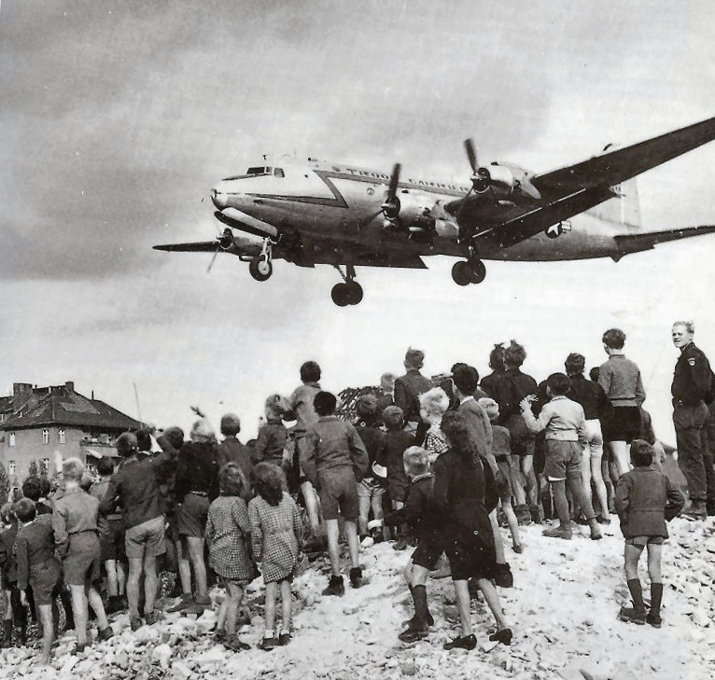
The Cold War Takes Shape
Cold War History

Slide 2
Iron Curtain Speech
Winston Churchill articulated this opinion at Westminster College in Fulton, USA on 5 March 1946: “From Stettin in the Baltic to Trieste in the Adriatic, an iron curtain has descended across the continent.”

Slide 3
The Truman Doctrine
One of the first focus area of the Cold war was Eastern Mediterranean
In September 1946 Greek Communists launched an armed rebellion against the postwar Greek government
Communist triumph in Greece could bring complete Soviet domination of the Balkans, would be the prelude to heavy pressure against Turkey and the gateway to the Middle East
On 12 March 1947 US president Harry S. Truman called Congress for $400 million of funding to aid Greece and Turkey

Slide 4
This economic and military aid was called “Truman Doctrine”
This was only the beginning of an extensive American program of intervention in foreign affairs in all parts of the world to halt the advance of Communist power
Truman Doctrine was basic document of new containment policy

Slide 5
Marshall Plan
In June 1948 State Secretary George Marshall announced a long-term economic aid program to make possible the economic rehabilitation of Europe
This assistance officially named the European Recovery Program (ERP) soon became known as the Marshall Plan (in honor of its originator the American Secretary of State George Marshall)
It offered the aid to the Soviet Union and Eastern European countries but they did not accept it
About $13 billion in economic and technical assistance were given to help the recovery of the European countries

Slide 7
Harry. S Truman (1945–1953)
Truman became President with the death of Franklin D. Roosevelt on April 12, 1945
Truman's policies abroad, and especially toward the Soviet Union in the emerging Cold War, would become staples of American foreign policy for generations
In response to what it viewed as Soviet threats, the Truman administration constructed foreign policies to contain the Soviet Union's political power and counter its military strength
Elected in 1948
Truman's popularity sank during his second term (soft on communism)

Slide 8
Divided Germany

Slide 9
Berlin Crisis 1948-1949

Slide 10
All the occupiers were worried about a reborn and rearmed unified Germany which would again threaten peace in Europe
the Soviet leaders were worried about a unified and capitalist West Germany working closely with the U.S.
On 20 June 1948 a new currency was introduced into the three allied zones
The Soviet Union responded by blocking all access to Berlin in June 1948
Stalin hoped to force the Western powers to either relinquish Berlin to the Communists or end the plan to unify West Germany

Slide 11
The United States and its allies responded with a massive airlift that delivered supplies to the people of Berlin
The Soviets suffered a defeat in the first Berlin crisis (1948-49) and the division of Berlin became a permanent picture of Cold War geography
1949 was formed Federal Republic of Germany tand the German Democratic Republic
Notes:
https://www.youtube.com/watch?v=CZidBq8QS-g

Slide 12
Communist Coup in Czechoslovakia
The betrayal of Czechoslovakia by the British and French at Munich in 1938 had created a sense of skepticism toward the West in that country
Communist Party of Czechoslovakia (KSČ) won free elections in 1946
Czechoslovakia refused Marshall plan in 1947 (forced by Soviets)
By February 1948 the communists had forced the other coalition parties out of the government
On February 25, President Benes accepted the resignations of the non-Communist ministers and appointed a new government in accordance with KSČ demands

