Slide 1
You are graduating and want to start a business. What factors matter when choosing a business form?

Slide 2
Business forms (UK)
Sole trader
Partnership
Limited partnership
Private limited company
Public limited company
Limited liability partnership

Slide 3

Choose an appropriate business form
1. John is a graphic designer who works from home and mainly provides services to small clients online.

Slide 4

Choose an appropriate business form
2. Tina is starting a construction company that will take large contracts for building houses and office buildings.

Slide 5
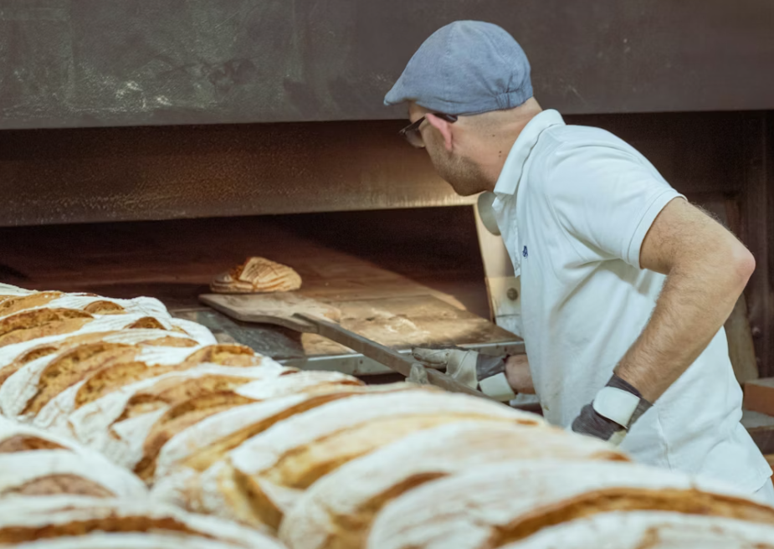
Choose an appropriate business form
3. Jennifer wants to open a small bakery with her partner and possibly pass it on to their children in the future. They value long-term stability and flexibility in management within the family.

Slide 6
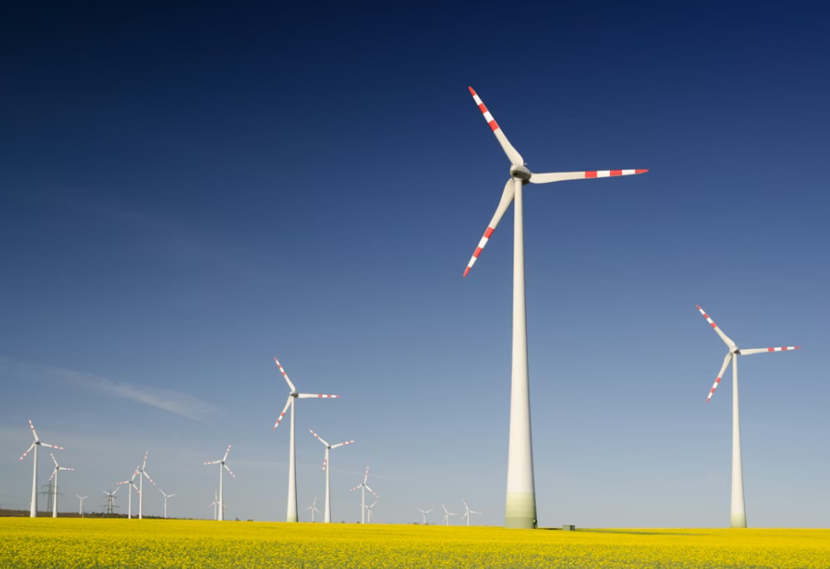
Choose an appropriate business form
4. Martin and Anna are founding a large energy company that plans to build and operate wind farms across several countries. The project requires extremely high levels of investment, and Martin and Anna intend to raise capital from the public by issuing shares on the stock market.

Slide 7
Which business form?
Charles began making garden furniture in his shed as a hobby after being made redundant two years ago. He now sells to local customers, has built a strong reputation, and receives a steady stream of orders.
Demand has increased significantly, and Charles is considering turning his activity into a formal business. A large home improvement retailer, B&Q, has indicated it would place monthly orders worth around £10,000 if he can guarantee delivery.
His cousin Martin wants to join the venture and suggests they carefully choose an appropriate business form, especially as expansion would require leasing larger premises and hiring staff.
Charles finds this daunting and he seeks your legal advice.

Slide 8
Legal personality
Incorporation
Piercing the corporate veil

Slide 9
Identify the legal concept:
The sole shareholder of a company takes CZK 1 million from the company’s bank account to pay for his children’s education, arguing that “it is my company, so it is my money.”

Slide 10
Identify the legal concept:
A company owes CZK 1 million to a supplier but cannot pay. The supplier demands payment from the shareholder personally.

Slide 11
Identify the legal concept:
A business owner signs a contract in his own name and later realises that it will be unprofitable. He then sets up a company and transfers the contract to the company. When problems arise, he argues that only the company is liable.

Slide 12
Company management
What is the difference between the role of shareholders and directors in a company?
Which role is more heavily regulated: that of shareholders or directors?
What does it mean if directors act ultra vires?
Why is the Annual General Meeting (AGM) important for corporate governance?
What is a quorum, and what problems might arise if a quorum is not reached at a meeting?

Slide 13
Identify the legal concept:
A company, GreenBuild Ltd, is registered to operate in eco-friendly construction and renovation projects. Its articles of association state that the company may only engage in construction-related activities.
The directors decide to invest CZK 5 million of company funds into a cryptocurrency start-up, hoping for high returns. The investment is highly speculative and unrelated to construction. No shareholder approval is obtained.

Slide 14
Company finance
Why do companies have registered capital?
What are the 2 main ways a company can raise capital?
What is a charge? Why would a lender prefer a fixed charge over a floating charge?
What is a rights issue? What is a pre-emption right?
What is the motivation of shareholders to participate in a rights issue?

Slide 15
Company constitution…?

Slide 16
Company constitution…
Articles of association – what is its purpose?

Slide 17
Create your own business
What product or service will your business provide, and what is the level of risk involved?
Which legal form will you choose (e.g. sole trader, partnership, Ltd, PLC), and why?
How will your choice affect liability, management structure, and control?
What are the main cost and administrative implications of this form?

Slide 18
Piercing the corporate veil
“Management control of PRL has always been in the hands of the husband, ostensibly as chief executive under a contract of employment conferring on him complete discretion in the management of its business. The judge found that none of the companies had ever had any independent directors. The husband is a director of PRL Nigeria, but otherwise the directors are all nominal or professional directors, generally his relatives, who accept directions from him. The directors of PRL are Mr Murphy (the principal of its corporate secretary) and a lady in Nevis who appears to have been the couple's cleaner there.”
The parties to the case:
The facts:
The legal issue:

Slide 19
Revision
sole proprietor
public limited company
legal personality
incorporation
articles of association
AGM
rights issue
director
shareholder
ultra vires
fixed charge
quorum

