Slide 1
Practical use of antibiotics
Tereza Rudová

Slide 2
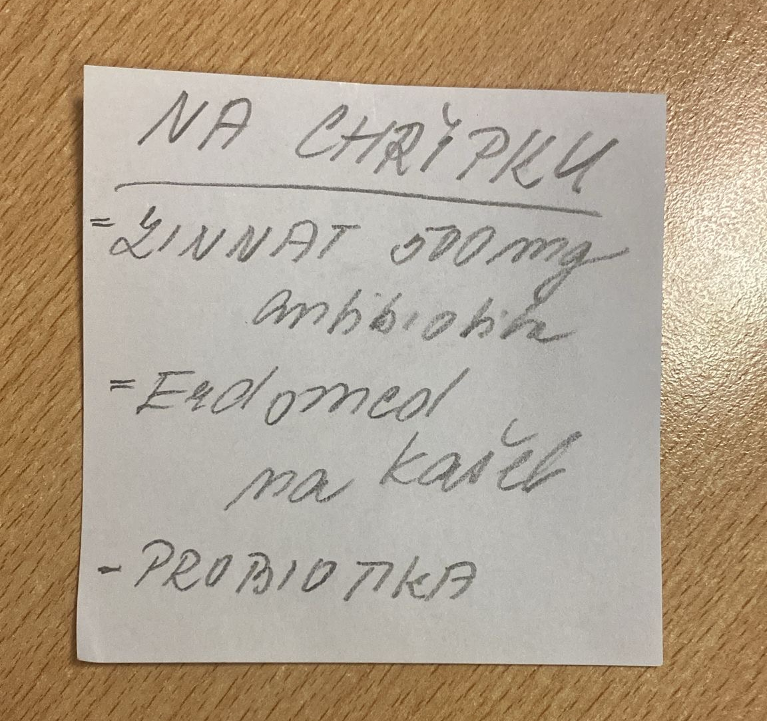

Slide 3
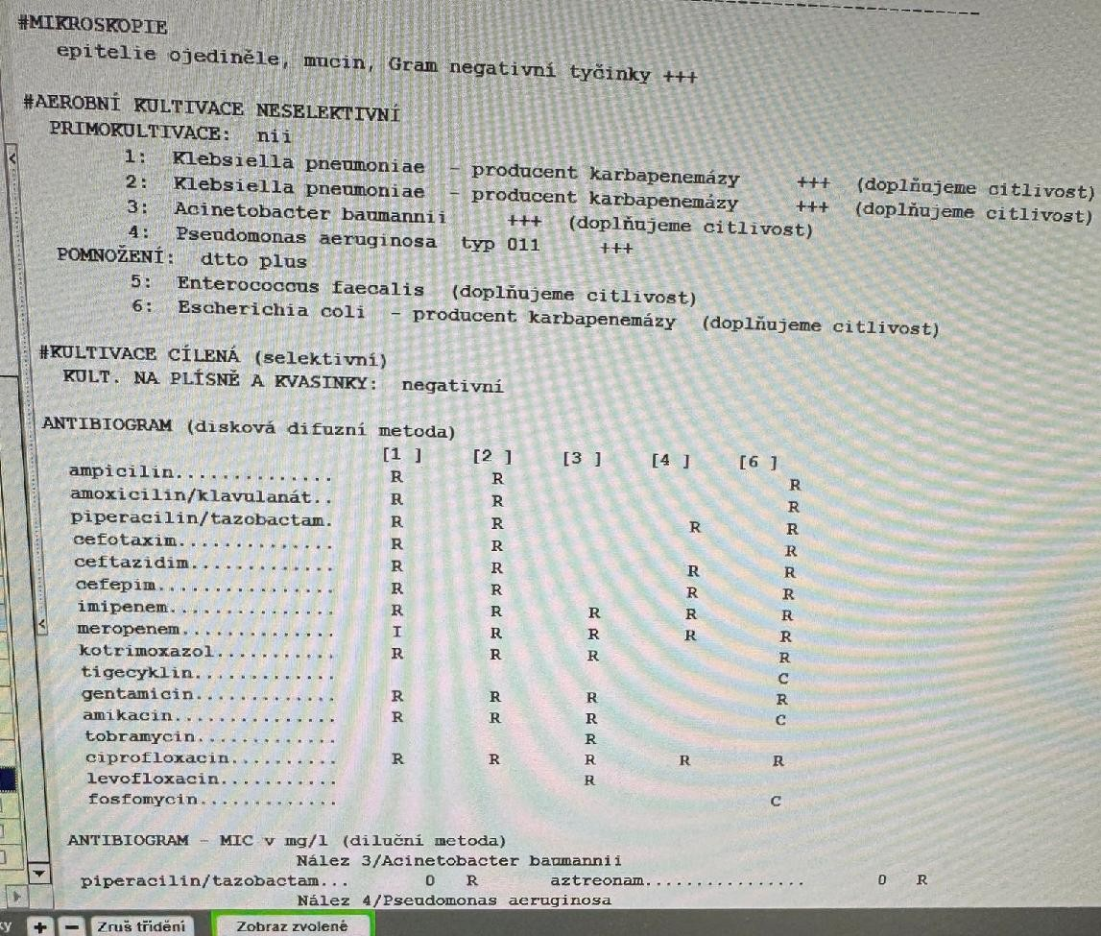


Slide 4

WHO?

Slide 5
WHAT?
Specifics of antibiotic treatment compared to conventional drugs
Virulence of the bacterial pathogen
Bacterial life form (rapid multiplication vs. stationary state)
Site of infection in the human body
Blood supply to the site of infection
Individual susceptibility/resistance of the bacterial pathogen
Patient's immune status

Slide 6
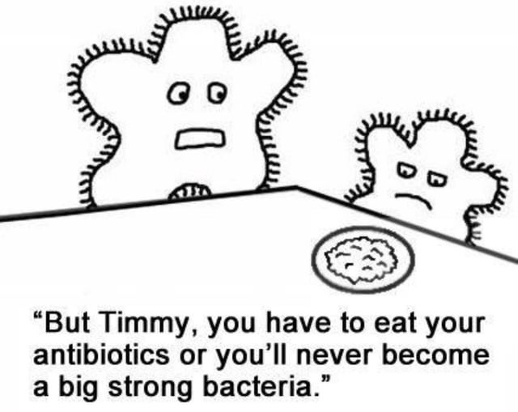

Slide 7
WHAT?
Risks
Toxicity
Allergic reactions
GIT difficulties
Influencing the microbiome
Clostridial enterocolitis
Selection of resistant strains
Notes:
<číslo>

Slide 8
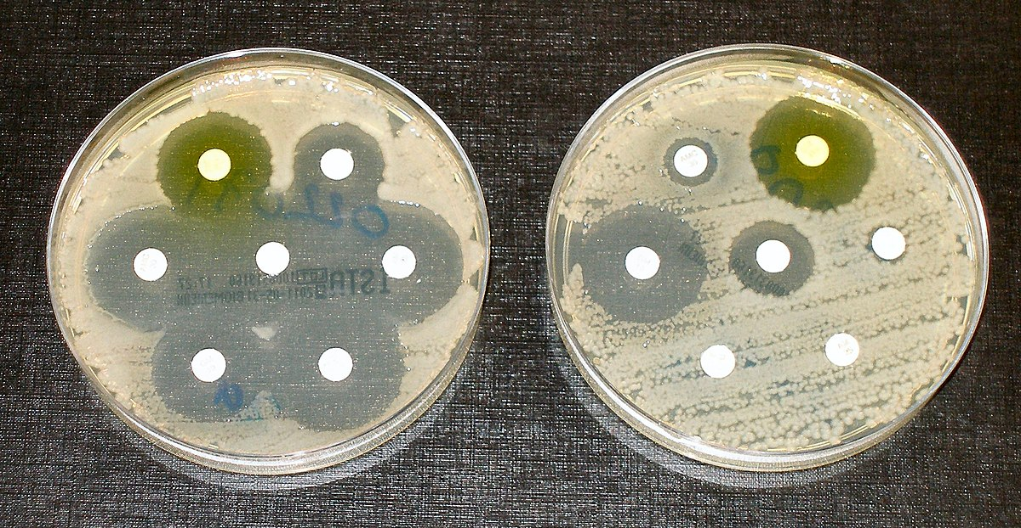

Slide 9
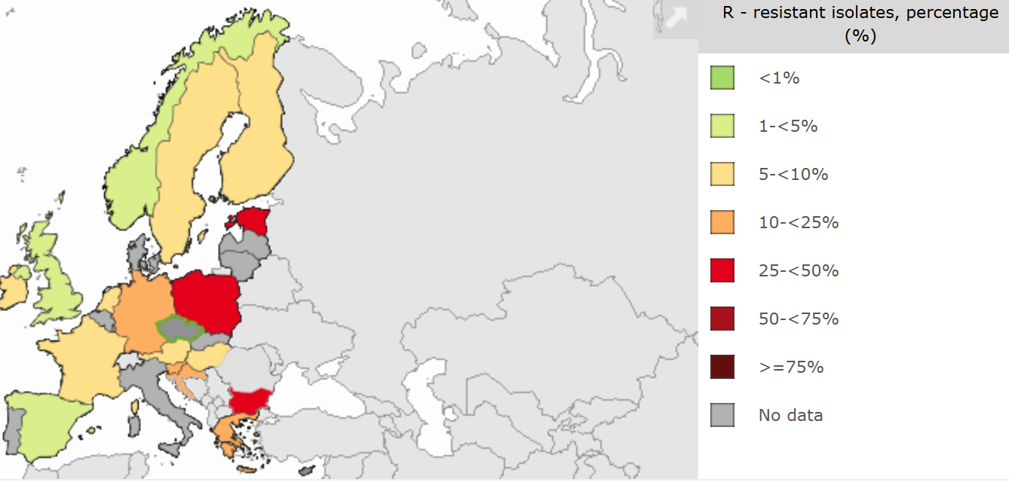
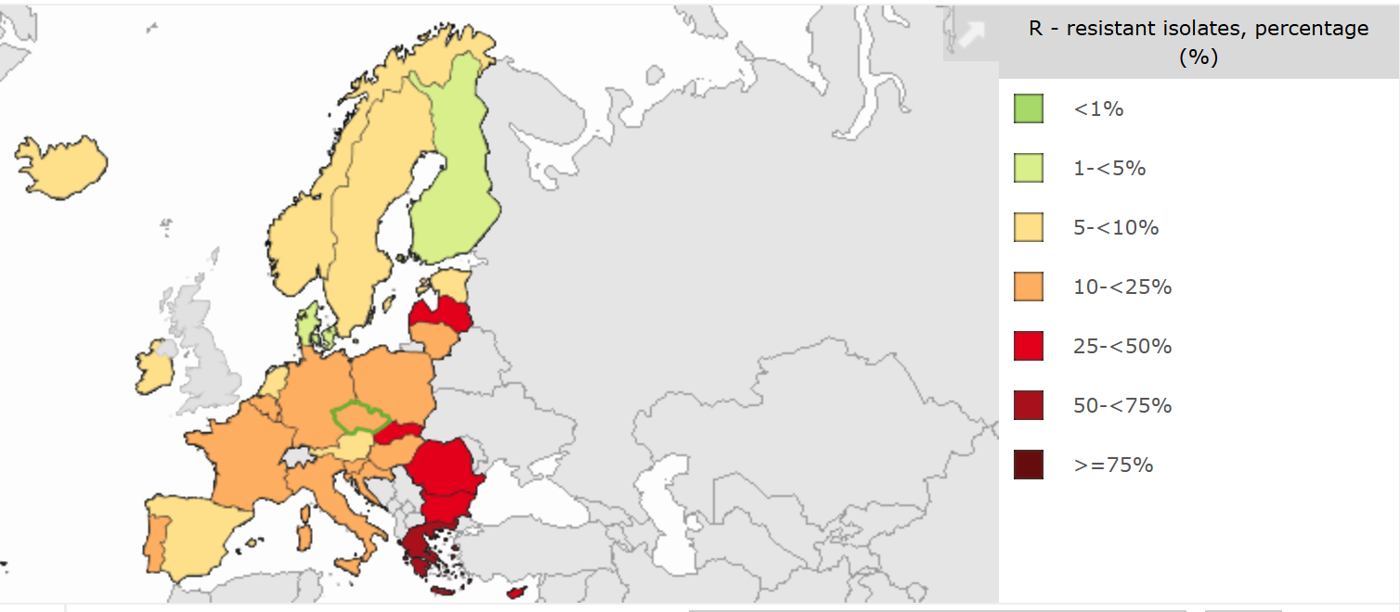
Pseudomonas aeruginosa a rezistence na piperacilin/tazobaktam
2005
2024

Slide 10
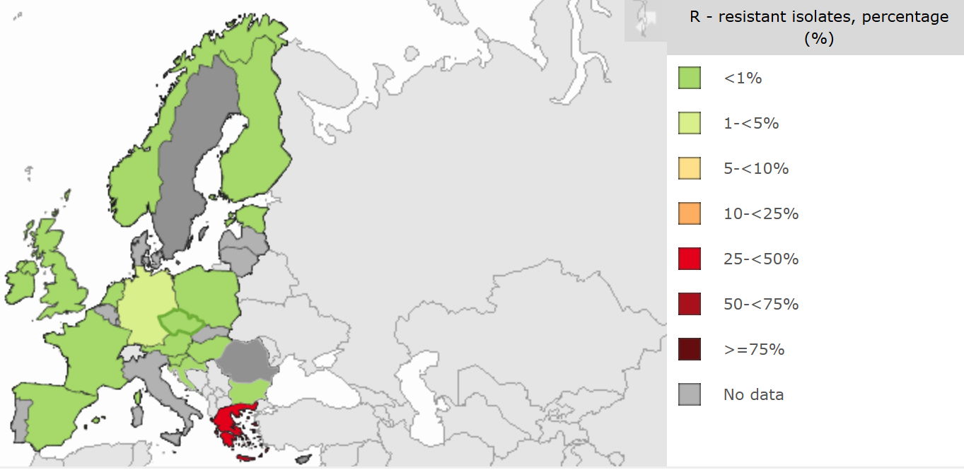
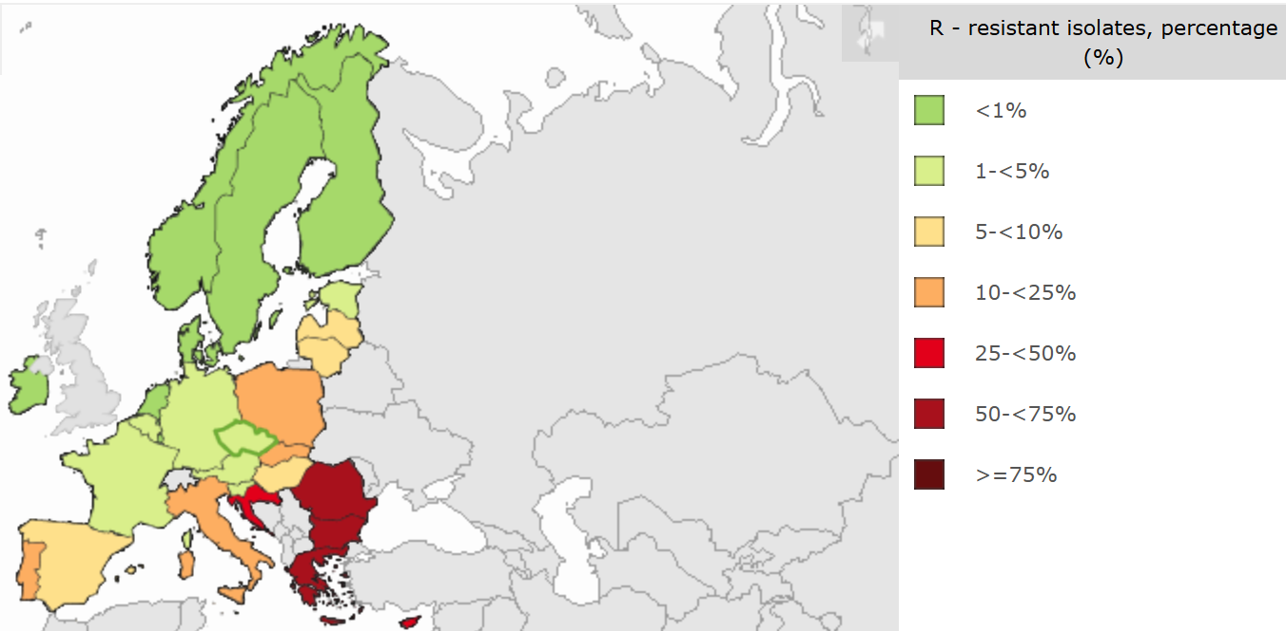
Klebsiella pneumoniae a rezistence na karbapenemy
2005
2024

Slide 11
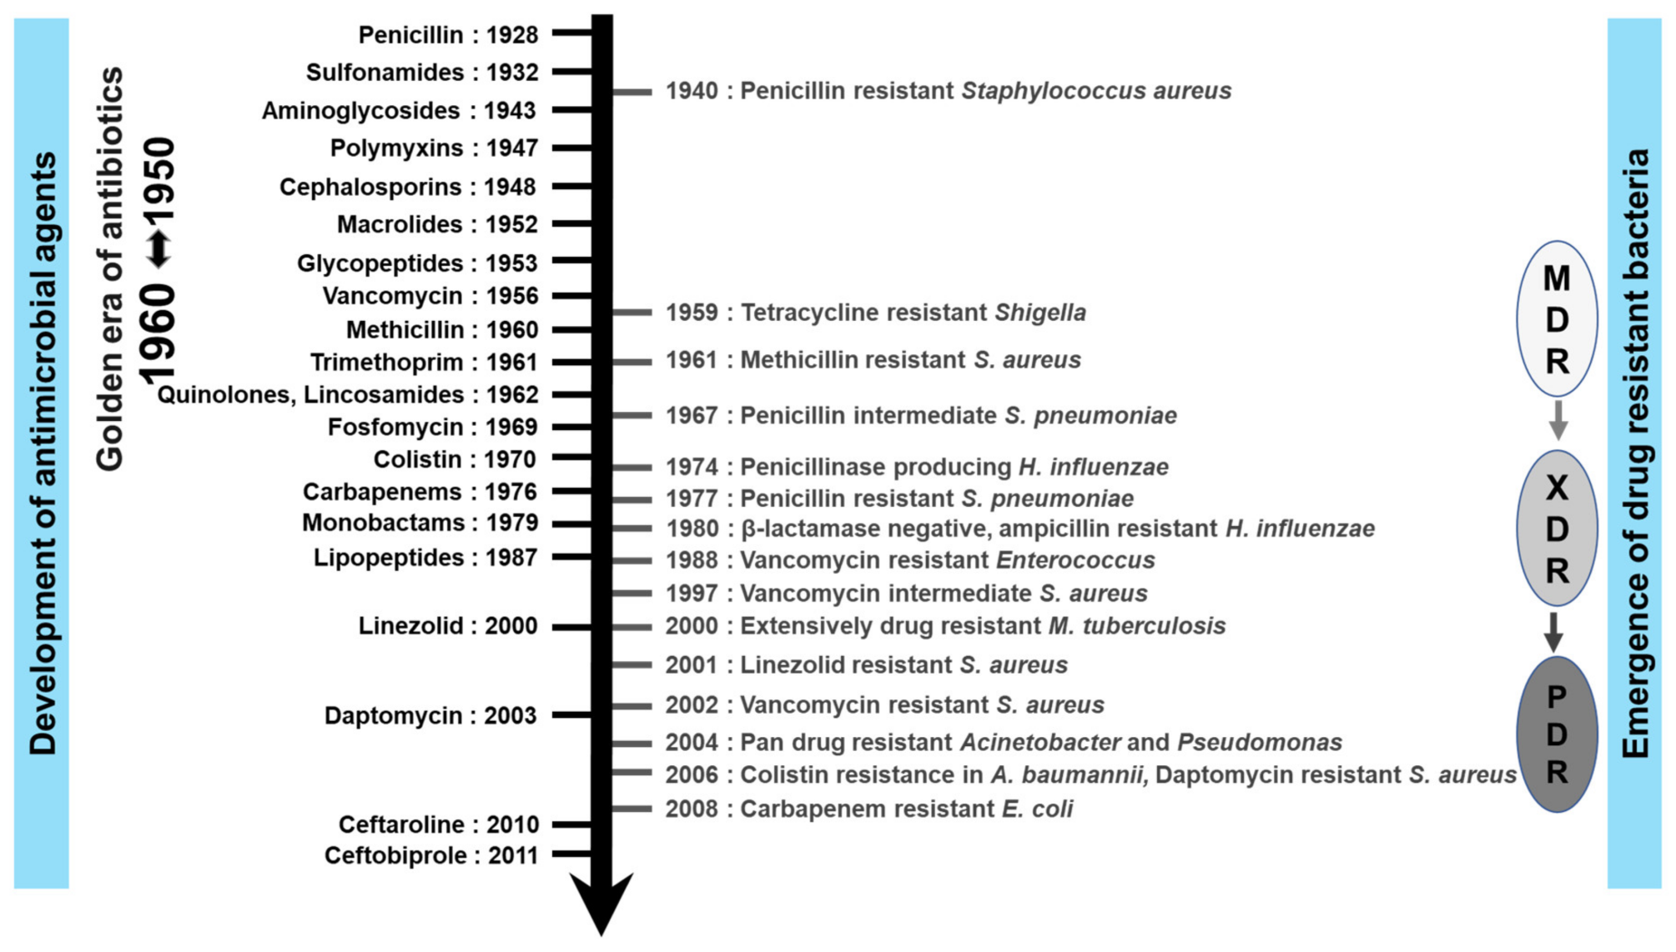
History of antibiotics

Slide 12
case 1
83 year old woman
PA: type 2 diabetes, hypertension, hypothyroidism, recurrent urinary tract infections
Current illness: patient sent from nursing home for few hours of fever, vomiting, diarrhea, confusion
BP 80/50, 70/min, saturation 90%, dehydration, bradypsychia

Slide 13
case 1
Laboratory results:
Leukocytes: 20,0 x10⁹/l
Neutrophils: 17,6 x10⁹/l
NLR: 29
CRP: 36 mg/l
Urea: 11,5 mmol/l
Kreatinin: 135 umol/l

Slide 14

case 1

Slide 15
case 1
Laboratory results next day:
Leukocytes: 34,5 x10⁹/l
Neutrophils: 28,6 x10⁹/l
NLR: 18
CRP: 281 mg/l
PCT: 53 µg/l
Urea: 17,5 mmol/l
Kreatinin: 136 µmol/l

Slide 16
case 1
After collection of biological materials we started empiric antibiotic therapy with 3rd generation cephalosporin
Rehydration, inotropic support
Blood cultures – sensitive E.coli, deescalation of antibiotics to ampicillin

Slide 17
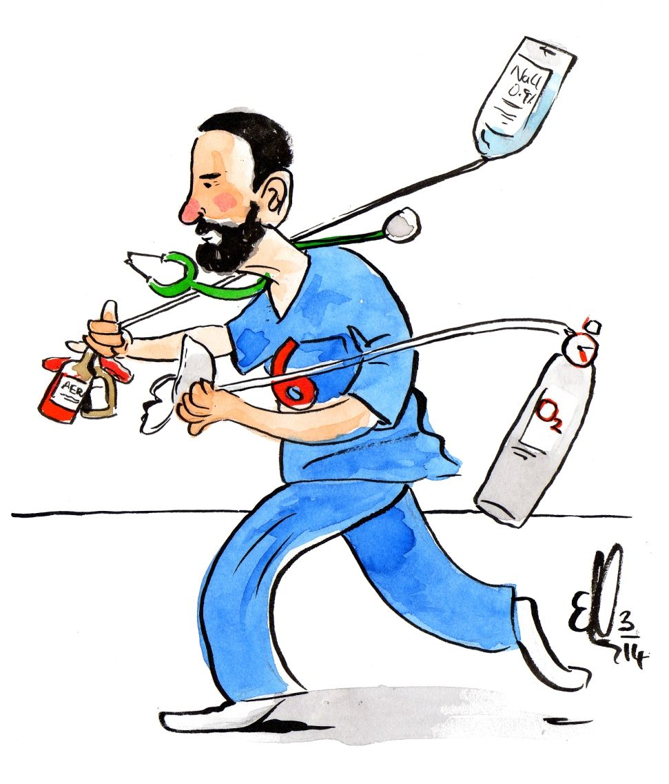

Slide 18
sepsis
Common sources: urinary tract infections, respiratory infections, intraabdominal infections, skin and soft tissue infections, infective endocarditis
Multisystem approach, inclunding antibiotics
Bactericidal, broad-spectrum antibiotics
Intravenous administration

Slide 19
sepsis
Rapid antibiotic administration
Usually beta-lactam antibiotics
Community-acquired: aminopenicillin with beta-lactamase inhibitor or higher-generation cephalosporin
Healthcare-associated: carbapenem (possibly with vancomycin)

Slide 20
Amoxicillin/clavulanate
Clavulanate extends the spectrum of amoxicillin to cover beta-lactamase-producing bacteria
Oral and intravenous forms
Broad-spectrum antibiotic
Side effects: GI issues, liver damage, Clostridioides difficile infection
Empirical therapy for various community-acquired infections (urinary, respiratory)
Treatment of polymicrobial infections – e.g., intra-abdominal infections, diabetic foot syndrome, animal bites.

Slide 21
Ampicillin/sulbactam
Indications are similar to amoxicillin/clavulanate
In addition, treatment of acinetobacter infections (sulbactam)
The possibility of administering a higher dose compared to amoxicillin/clavulanate

Slide 22
Cephalosporins
5 generations
Baktericidal
Not effective against enterococci, listeria, or atypical bacteria
Some active against MRSA and Pseudomonas aeruginosa
Grampositive bacteria - mainly the 1st generation, then decreases until the 3rd generation
Gramnegative bacteria – activity increases from the 1st to the 4th generation

Slide 23
cephalosporins
Unreliable effect on anaerobes (combination with metronidazole)
Risk of resistance development (ESBL, VRE)
Risk of Clostridium difficile colitis
Often overused!!!

Slide 24
Cephalosporins
1st generation
- Perioperative prophylaxis, soft tissue infections
2nd generation
- Community infections (respiratory, urinary), perioperative prophylaxis
3rd generation
- Empirical treatment of bacterial meningitis
4th generation
- Healthcare-associated infections, the broadest spectrum
5th generation
- MRSA

Slide 25
3rd generation cephalosporins
High antibacterial activity, broad spectrum
Cefotaxime, ceftriaxone, ceftazidime
Ceftriaxone:
- Intravenous administration
- CNS infections, respiratory, intra-abdominal, UTI, skin and soft tissue infections, IE, sepsis
- LB, leptospirosis, salmonellosis, gonorrhea
- OPAT
- Excreted mainly via the biliary tract (risk of biliary sludge)

Slide 26

Carbapenems
Autor: Dr. Ježek

Slide 27
Carbapenems
High antibacterial activity
The broadest spectrum (gram-positive and gram-negative bacteria, anaerobes)
Reserve antibiotics
Resistant to the action of many beta-lactamases (ESBL)
The occurrence of resistance is epidemiologically highly significant ( carbapenemases )
Empirical therapy of healthcare-associated infections, targeted therapy of infections caused by MDR bacteria
Imipenem/cilastatin, meropenem, ertapenem

Slide 28
Carbapenems
Meropenem
- Polymicrobial infections, healthcare-associated infections, infections caused by MDR bacteria
Imipenem/cilastatin
- Not for the treatment of CNS infections (risk of convulsions)
Ertapenem
- Does not work on enterococci and pseudomonas
- Administration once daily (OPAT)

Slide 29


Slide 30
Acute pyelonefritis
Primarily Gram-negative bacteria (E. coli, Klebsiella pneumoniae)
10% rule: antibiotics can be used if resistance is below 10% (for example: E.coli - ampicillin 43 %, co-trimoxazol 25 %)
Empirical regimens:
- amoxicillin/clavulanate (possibly in combination with gentamicin to expand the spectrum)
- cefotaxim or ceftriaxon i.v (risk of resistance development)

Slide 31
Acute pyelonefritis
Increasing resistance of community bacteria to amoxicillin/clavulanate
For healthcare-associated infections, multi-resistant bacteria (pseudomonads, enterobacteria producing broad-spectrum beta-lactamases) should be considered
The antibiotic of choice for ESBL-producing enterobacteria are carbapenems

Slide 32
Acute cystitis
Most commonly E. coli, followed by other Gram-negative bacteria, enterococci, and Staphylococcus saprophyticus
20% rule: antibiotics are effective if resistance prevalence is below 20%
Options:
- Nitrofurantoin p.o. – first choice
- Pivmecilinam p.o – alternative if the first choice is ineffective or not available
- Fosfomycin p.o. – alternative (ESBL)
- Cotrimoxazol p.o. – alternative based on confirmed sensitivity

Slide 33
nitrofurantoin
Nitrofurans
Not suitable for treating pyelonephritis or sepsis (low serum concentrations)
It reaches high concentrations in urine
Low prevalence of resistance
It also affects some ESBL-producing strains
Side effects: gastrointestinal issues

Slide 34
Co-trimoxazol (Sulfamethoxazol and trimethoprim)
Bactericidal
Broad spectrum of activity: Gram-positive, Gram-negative bacteria, protozoa, fungi
Well absorbed from the gastrointestinal tract, good tissue penetration
Treatment of UTI (until sensitivity is verified), treatment of intestinal infections (salmonellosis, yersiniosis), prostatitis, for treatment of ENT infections, respiratory and skin infections as an alternative
Effective against many MRSA strains
Side effects: hypersensitivity reactions, cytopenias, hyperkalemia

Slide 35
pivmecilinam
Beta-lactams (penicillins)
Orally
Highly stable against beta-lactamases, including ESBL
High concentration in urine
Well tolerated
Limited negative impact on intestinal microflora

Slide 36
fosfomycin
Bactericidal
Broad spectrum of activity: Gram-positive and Gram-negative bacteria, including some MDR strains
Good tissue penetration
Orally – treatment of UTI
Parenteral – only for treatment of MDR infections

Slide 37
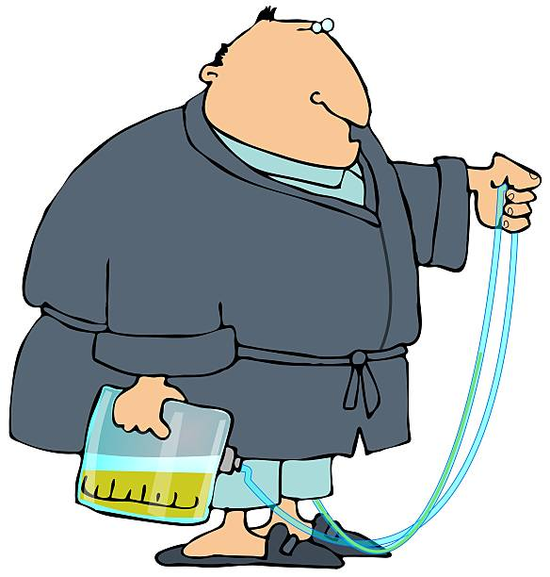
Asymptomatic bakteriuria
The presence of a significant amount of bacteria in the urine without clinical symptoms
Pregnancy, abnormalities of the urinary tract, indwelling urinary catheter
In 15-50% of seniors in aftercare facilities
Treatment only for pregnant women and persons before invasive urological procedures

Slide 38


Slide 39
Skin and soft tissues infections
We mainly differentiate between erysipelas and phlegmon (cellulitis)
Cellulitis usually extends deeper, is not so sharply defined, and the etiological agents are different (streptococci, staphylococci...)
Empirical therapy
- Erysipelas – natural PNC (crystalline PNC G, procaine benzylpenicillin, penicillin V), in allergic patients cefazolin, clindamycin (not sepsis)
- Cellulitis - cefazolin, potentiated aminopenicillin, natural PNC in combination with clindamycin

Slide 40
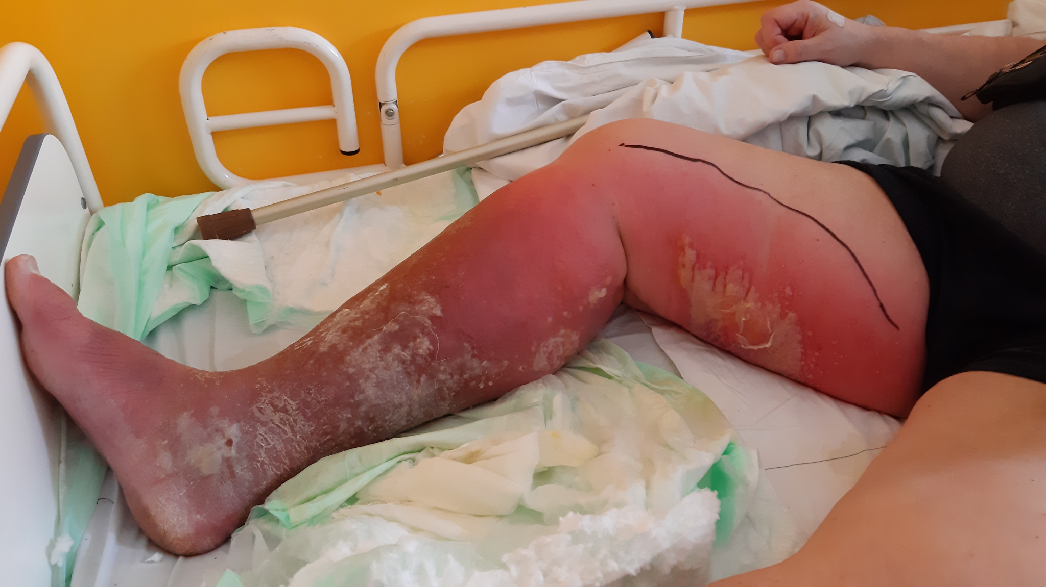

Slide 41
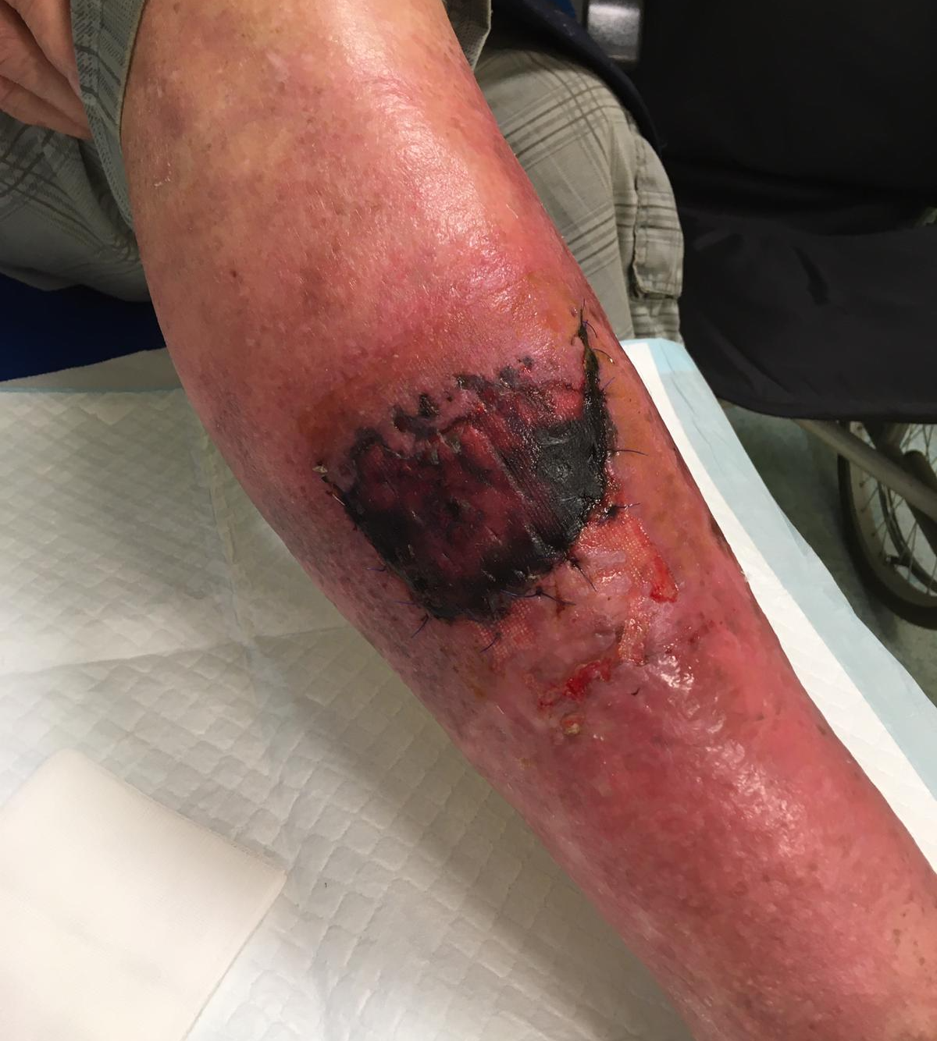

Slide 42
Penicillin G
In the form of potassium salt (CAVE - hyperkalemia)
Intravenous administration
Dose in International Units (IU), 1 million IU is 600 mg
Short biological half-life (dose interval 4-6 hours)
Severe streptococcal and pneumococcal infections
Anaerobic infection (oral cavity infection, actinomycosis), anthrax, diphtheria, neurosyphilis

Slide 43
Procain benzylpenicillin
Intramuscular administration
Once a day
OPAT
Hoigné syndrome (penetration of drugs into the bloodstream, neuropsychiatric manifestations)
Mild and moderate streptococcal infections (tonsillitis, scarlet fever, erysipelas), syphilis

Slide 44
Skin and soft tissues infections
In immunocompromised patients, it is also necessary to think about G – etiology (e.g. Pseudomonas aeruginosa)
Diabetics also have anaerobes
- Necessary to get hemoculture!!!

Slide 45
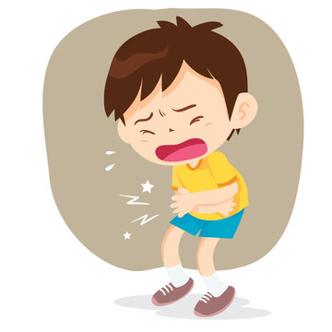

Slide 46
Intraabdominal infections
Diverticulitis, colitis, cholecystitis, cholangitis
Surgical intervention is often necessary
Polymicrobial infections (gram-negative and gram-positive infections, anaerobes)
Community: amoxicillin/clavulanate or 2nd or 3rd generation cephalosporin with metronidazole
Healthcare-associated infections: piperacillin/tazobactam, ceftazidime with metronidazole, carbapenem

Slide 47
metronidazol
Nitroimidazoles
Bactericidal
Anaerobes, some protozoa
Side effects: GIT problems, neurotoxicity
Disulfiram reaction with simultaneous alcohol consumption
Brain abscess, intra-abdominal infection, osteomyelitis…
Giardiasis, amebiasis, trichomoniasis

Slide 48



Slide 49
case 2
35 year old man
PA: Crohn's disease on biological therapy
Current illness: 6 days of fever and cough, after 3 day check-up with a general practitioner – diagnosis of pneumonia, start of amoksiklav
Febrile, BP 125/80, 110/min, saturation 95%, significantly weakened breathing on the left

Slide 50
case 2
Laboratory results:
Leukocytes: 11,8 x10⁹/l
Neutrophils: 8,9 x10⁹/l
NLR: 5
CRP: 352 mg/l
PCT: 0,3 µg/l
RTG – alar left-sided pneumonia

Slide 51
case 2

Slide 52
case 2
Positive antigen legionella sp. in urine
Antibiotic therapy - clarithromycin
Temporarily need of oxygenotherapy, improvement after five days of therapy

Slide 53
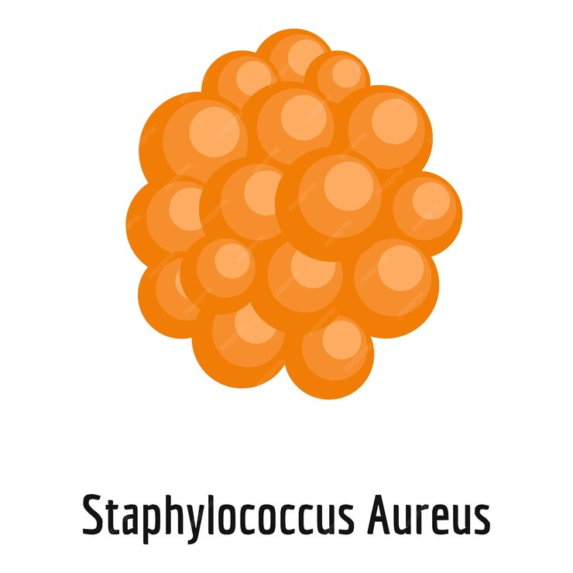

Slide 54
Antibiotics against staphylococcus
Oxacillin
- Basic anti-staphylococcal antibiotic
- Intravenous form
- Treatment of various spectrum of infections – sepsis, IE, spondylodiscitis, arthritis
- Side effects: hepatopathy, hematotoxicity
Flucloxacillin
- Intravenous and oral form
- Treatment of the same spectrum of infections as oxacillin
- Of the penicillin antibiotics, combined aminopenicillins and piperacillin/tazobactam also work on MSSA (but an unnecessarily broad spectrum)

Slide 55
Antibiotics against staphylococcus
Cefazolin
- 1st generation cephalosporins
- Intravenous administration
- drug of choice for MSSA bakteremia
- Important in perioperative prophylaxis
- Compared to oxacillin, the effect is also on gram-negative bacteria (but increasing resistance)

Slide 56
Antibiotics against staphylococcus
Clindamycin
- Lincosamides
- Bacteriostatic
- Good penetration into tissues, with the exception of the CNS
- Also effective against anaerobes and some protozoa
- Inhibitor of bacterial toxin production (toxic shock syndrome)
- CAVE – clostridial enterocolitis
Also doxycycline, co-trimoxazole (unnecessary broad spectrum)

Slide 57

Antistaphylococcal antibiotics - MRSA
Vancomycin
- Glycopeptides
- Bactericidal
- Effect on gram-positive bacteria
- Intravenous administration (oral for the treatment of clostridial enterocolitis)
- Pneumonia, skin and soft tissue infections, IE, bone and joint infections, foreign material infections
- Loading dose and level monitoring
- Side effects: nephrotoxicity

Slide 58
Antistaphylococcal antibiotics - MRSA
Linezolid
- Oxazolidinones
- Only for gram-positive bacteria
- Bacteriostatic
- Excellent distribution into tissues
- Indicated for the treatment of pneumonia and skin and soft tissue infections
- Backup antibiotic (MRSA, VRE)
- Inhibits the production of bacterial toxins
- Side effects – hematotoxicity, neurotoxicity

Slide 59
Antistaphylococcal antibiotics - MRSA
Daptomycin
- Lipopeptides
- Bactericidal
- Effect on gram-positive bacteria
- Intravenous administration
- Not for lung infections (inactivated by surfactant)
- Complicated skin and soft tissue infections, IE, bone and joint infections, intra-abdominal infections

Slide 60
Antistaphylococcal antibiotics - MRSA
Ceftaroline
- 5th generation cephalosporins
- Effective against gram-positive bacteria including MRSA , effective against gram-negative bacteria also maintained
- Intravenous administration
Tigecycline
- Glycylcyclines
- Backup antibiotic (MRSA, VRE, A.baumannii )
- Complicated skin and soft tissue infections, intra-abdominal infections

Slide 61
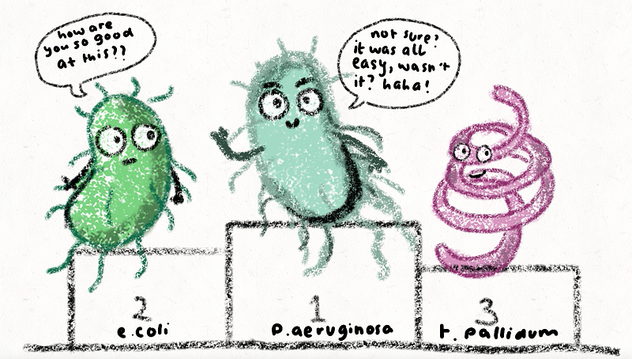

Slide 62
Antipseudomonas antibiotics
P.aeruginosa
- opportunistic pathogen , the most important cause of healthcare-associated infections
- weakened patients
Piperacillin/tazobactam
Ceftazidime, cefoperazone, cefepime, (anti-pseudomonad cephalosporins)
Carbapenems (not ertapenem)
Aminoglycosides
Ciprofloxacin
Colistin

Slide 63
Anti-pseudomonad cephalosporins
Ceftazidime (3rd generation)
- Infections caused by susceptible strains of P.aeruginosa (sepsis, meningitis, pneumonia, soft tissue infections, bone infections)
- Unreliable effect on gram-positive bacteria
Cefepime (4th generation)
- The broadest spectrum (gram-negative and gram-positive)
- Respiratory tract infections, UTI, skin and soft tissue infections, intra-abdominal infections, febrile neutropenia
- CAVE – neurotoxicity (epileptic seizures, disorders of consciousness)

Slide 64
Piperacillin/tazobactam
Broad spectrum of activity including activity against P.aeruginosa
Intravenous administration
Polymicrobial infections (intra-abdominal infections, soft tissue infections), complicated IMC and respiratory infections
Febrile neutropenia
Healthcare-associated infections

Slide 65
Colistin
Polymyxins
Bactericidal
Intravenous administration + inhalation and intrathecal
Effect on Gram-negative bacteria
Reserve antibiotic for the treatment of MDR strains
Always in combination (easy development of resistance)
Side effects: nephrotoxicity, neurotoxicity

Slide 66
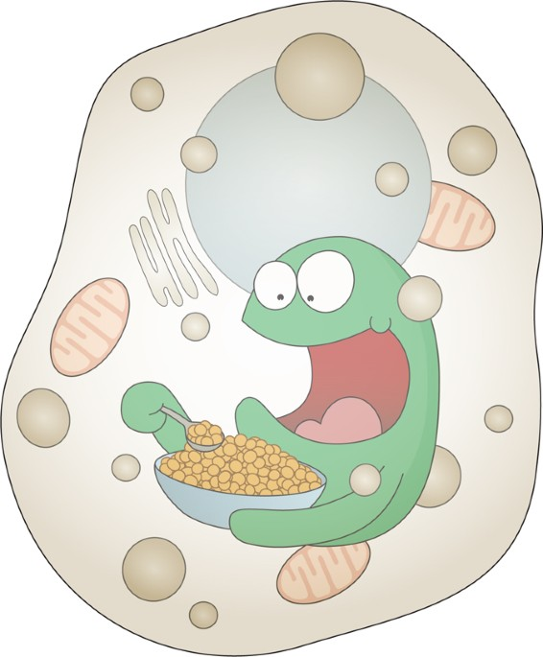

Slide 67
Antibiotics with concentration mainly in tissues and cells
Macrolides
Fluoroquinolones
Lincosamides
Tetracyclines
Linezolid

Slide 68
Macrolides
Bacteriostatic
They penetrate well into tissues and cells
Gram-positive, some Gram-negative bacteria and most atypical
Ineffective against gram-negative rods (enterobacteria) and enterococci
Risk of resistance development
Numerous drug interactions
Often overused in practice
Clarithromycin, azithromycin, spiramycin

Slide 69
Macrolides
Indication:
- Chlamydia and mycoplasma infections
- Pertussis
- Legionella pneumonia (respiratory quinolone is preferred)
- Campylobacteriosis
- Acute tonsillitis caused by Arcanobacterium haemolyticum
- Cat scratch fever
"Isn't it possible to use another antibiotic"?

Slide 70
Fluoroquinolones
Bactericidal
Good tissue penetration
Mainly against gram-negative bacteria , some also against gram-positive, atypical bacteria, anaerobes and mycobacteria
Serious adverse reactions : QT prolongation, Achilles tendon rupture, dysglycemia, decreased seizure threshold
Risk of CDI and selection of resistant strains
Risk of developing resistance already during treatment

Slide 71
Fluoroquinolones
Indication:
- Legionellosis
- Tularemia, anthrax
- Malignant external otitis
Alternative indications:
- Intestinal infections
- Prostatitis
- Combination therapy of mixed polymicrobial infections
- Chlamydia and mycoplasma infections
- Musculoskeletal infections

Slide 72
Fluoroquinolones
Ciprofloxacin
- Mainly effective against gram-negative bacteria (including pseudomonas)
Moxifloxacin
- It also acts on gram-positive bacteria and anaerobes (the only one)
- Not excreted in urine (not IMC treatment)
Levofloxacin
- Also effective against gram-positive bacteria

Slide 73
Tetracyclines
Bacteriostatic
Gram-positive, Gram-negative and atypical bacteria, spirochetes, some protozoa
Mainly treatment of zoonoses and infections caused by atypical bacteria
Contraindicated in pregnancy and in children under 8 years of age
Emergency: GIT problems, photosensitivity
Doxycycline
Tigecycline

Slide 74
Tetracyclines - doxycycline
Oral administration only
Indication:
- Chlamydia and mycoplasma infections
- Lyme disease
- Yersinia infections
- Tularemia
- Leptospirosis
- Malaria prophylaxis and treatment

Slide 75
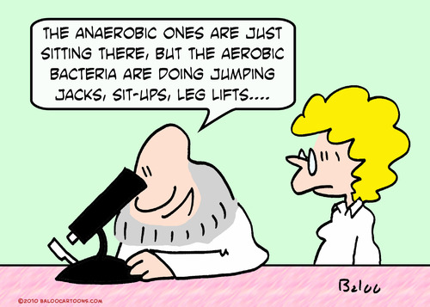

Slide 76
Anaerobic bacteria
Physiologically part of the microflora of the oral cavity, GIT and vagina
Various types of infections – gas gangrene, intra-abdominal infections, chest empyema, dental infections, brain abscess…
Often part of polymicrobial infections (abscesses, diabetic foot syndrome)

Slide 77
Anaerobic infections
Basic antibiotics: metronidazole and clindamycin
Metronidazole – bactericidal, does not work on Propionibacterium acnes and Actinomyces spp
Clindamycin – bacteriostatic, narrower spectrum
Others – penicillins, carbapenems and moxifloxacin

Slide 78
Major multidrug-resistant bacteria
Resistant bacteria | Suitable antibiotics
MRSA | Vancomycin, Daptomycin, Linezolid
VRE | Daptomycin, Linezolid, Tigecycline
G – bacteria with ESBL production | Carbapenems, event. Aminoglycosides
G – bacteria with carbapenemase production (e.g. KPC) | Ceftazidime/avibactam, Meropenem/vaborbactam, Imipenem/relebactam
Multidrug-resistant pseudomonad | Ceftazidime/avibactam, Ceftolozane/tazobactam, Imipenem/relebactam
Acinetobacter baumannii | Ampicillin/sulbactam, carbapenems, aminoglycosides, colistin

Slide 79

What about it and what happens next?

Slide 80
Restricting the use of antibiotics
One of the best ways to limit antibiotic resistance is to decrease antibiotic use
Important questions:
Does the patient have a infection?
Is the infection bacterial?

Slide 81
treatment initiation algorithm
Collection of biological materials
IMMEDIATELY x INTERVAL (24 – 48 – 72 hours)
The right antibiotic
Therapy effect

Slide 82
how to choose the right antibiotic?
Community X nosocomial infection
Immunocompetent X immunosuppressed patient
Others: age, pregnancy, allergy, chronic medication

Slide 83
Allergy
Allergy to penicillin antibiotics is the most commonly reported drug allergy
Allergy to PNC antibiotics is reported by 10 % of patients
Up to 90 % of patients do not actually have an allergy
Use of alternative antibiotics have a lots of risks

Slide 84
antibiotic use strategy
Empiric antibiotic therapy
Deescalation
Targeted therapy

Slide 85
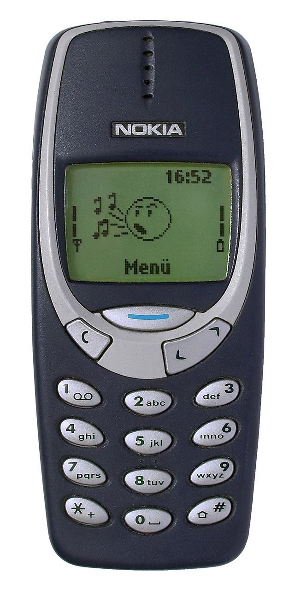

What ‘s next?

Slide 86
Old-new antibiotic
Chloramphenicol
- Amphenicols
- Bacteriostatic (in the case of pathogens causing meningitis – bactericidal)
- Broad spectrum (gram-positive and gram-negative bacteria, atypical bacteria)
- side effects: hematotoxicity (cytopenia, aplastic anemia)
- Alternative – CNS infections , typhoid and paratyphoid fever, severe salmonellosis, polymicrobial infections, abscesses
- Effect on some MDR strains

Slide 87
New possibilities
Imipenem/relebactam (Recarbrio)
Ceftazidime/avibactam (Zavicefta)
Ceftolozane/tazobactam (Zerbaxa)
Eravacycline (Xerava)
Cefiderocol (Fetroja)
Aztreonam/avibactam – in Czech Republic since 4/2025
Meropenem/vaborbactam (Vaborem) – not available in the Czech Republic
Plazomycin (Zemdri) – for special import

Slide 88
AMS – Antimicrobial Stewardship
Steward = guide
Concept, methodology
A coherent set of activities leading to the responsible use of antibiotics

Slide 89
Antimicrobial stewardship
WHY?
- 30 – 50% of hospitalized patients have prescribed antibiotics inappropriately (CDC)
↓ resistance
↓ costs
shortening hospitalization
↓ mortality
↓ side effects of antibiotics
↓ number of complications during hospitalization

Slide 90
Antimicrobial stewardship
WHO?
Infectious disease specialist
Clinical pharmacist
Microbiologist
AMS team
Epidemiologist
IT specialist

Slide 91
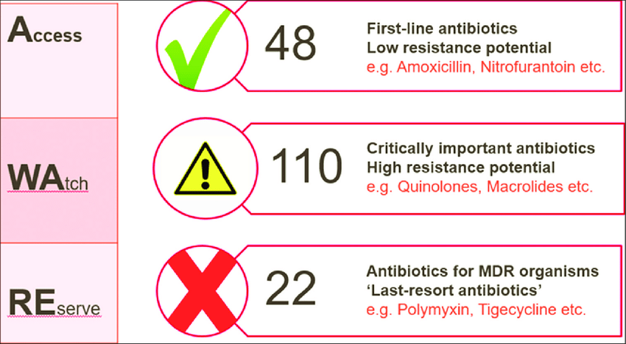
Aware classification (who)
AWaRe (Access, Watch, Reserve)

Slide 92
Access group
includes antibiotics that shows lower resistance potential than antibiotics in the other groups
antibiotics are recommended as essential first or second choice empiric treatment options
For example: penicillins, first generation of cephalosporins, nitrofurantoin, metronidazol, clindamycin, cotrimoxazol, aminoglykosides, doxycyklin

Slide 93
Watch group
Relatively high risk of selection of bacterial resistance
Should be prioritized as key targets of stewardship programs
For example: cephalosporines, macrolides,
fluoroquinolones, glykopeptides, rifampicin, piperacilin/tazobaktam, carbapenems

Slide 94
Reserve group
These antibiotics should be reserved for treatment of infections due to multi-drug-resistant organisms
“last resort” options
Protected and prioritized as key targets of national and international stewardship programs involving monitoring and utilization reporting, to preserve their effectiveness
For example: ceftarolin, ceftolozan/tazobaktam
ceftazidim/avibaktam, colistin, linezolid
tigecyklin, daptomycin, meropenem/vaborbaktam

Slide 95


