Slide 1
Culture – Discourse
Linguistic Discourse Analysis
Dr. habil. Ulrike Notarp
Katedra Mediálních Studií

Slide 2
Communicative model of CULTURE
represents a semantic environment
communication phenomenon - a system of shared meanings, ideas, values, judgments and beliefs
Members of a given society continuously shape this system by means of communication
(media) communication can be seen as a culturally conditioned environment
(Jírak/Köpplová 2009, 26-35)

Slide 3
Culture as a mode for orientation
(Notarp, 2020, 24-25)
framework for orientation in the social world
based on (linguistic) signs and communication
general mechanism that normatively regulates social life through communication (cultural values, norms, standards)
product of communication, permanently negotiated
a social community´s adaptation to their living conditions.
Notes:
structuring and organizing mode of social systems

Slide 4
culture as third reality
M. Fleischer 2006
semiotic, semantic and thus communicative third reality
hierarchically structured system of discourses that is based on the second, social (social groups, supra-groups, society) and first reality (physical and biological world)
each society has its own system of discourses – the interdiscourse, discourses and special discourses
Notes:
product of the second – the social reality with its mode of communication

Slide 5
Third Reality (≈ Culture)
Society +
Interdiscourse
Subculture
Subculture
Discourse
Social group
Social group
Discourse
Social group
Social group
Discourse
Social group
Special discourse
Social group
Special discourse
Interdiscourse
M. Fleischer 2006

Slide 6
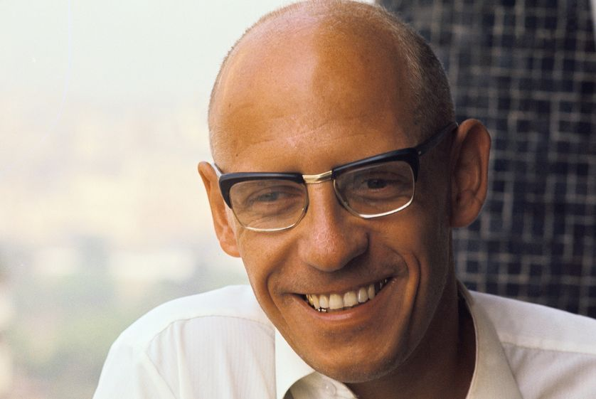
Michel Foucault
1926 – 1984
representative of the French intellectual avant-garde of the 1970s
Professor at the Collège de France, philosopher, sociologist and psychologist.
Books:
The Archaeology of Knowledge (1969)
The Order of Discourse (1971)

Slide 7
Discourse
using language in a certain way
way in which a society or one of their subcultures expresses itself
communicative rules and norms that apply in a social community
the abstract set of cultural knowledge that exists within each of us, according to which all communicative interaction takes place
(Michel Foucault)

Slide 8
Discourse –
Discursive structures and formations
not only the texts themselves as the final product of communication, but the set of assumptions (presuppositions) that condition the forms of these texts, on which these texts are based.
Michel Foucault

Slide 9
Institute of Linguistics and Social Studies in Duisburg Germany
Critical discourse theory in Duisburg
Journal kultuRRevolution – zeitschrift für diskurstheorie
Representatives:
Jürgen Link
Siegfried Jäger
Michael Fleischer

Slide 10
culture and Discourse
Michael Fleischer

Slide 11
culture as third reality
M. Fleischer 2006
semiotic, semantic and thus communicative third reality
hierarchically structured system of discourses that is based on the second, social (social groups, supra-groups, society) and first reality (physical and biological world)
each society has its own system of discourses – the interdiscourse, discourses and special discourses
Notes:
product of the second – the social reality with its mode of communication

Slide 12
Third Reality (≈ Culture)
Society +
Interdiscourse
Subculture
Subculture
Discourse
Social group
Social group
Discourse
Social group
Social group
Discourse
Social group
Special discourse
Social group
Special discourse
Interdiscourse
M. Fleischer 2006

Slide 13
Stratification of the social system
The social system of society consists of at least three real, interconnected and systematically connected subsystems
Social groups (eg. groups of friends, work groups, student circles, etc.) are part of subcultures. A cultural group can have its own discourse

Slide 14
Stratification of the social system
Subculture comprises several social groups that share a common catalog of norms, values and rules of behavior
In each subculture, a special discourse is used that characterizes that subculture
One subculture separates from other subcultures and from the upper system of society.

Slide 15
Stratification of the social system
Society (eg. the Polish or German society) is
based on its interdiscourse
has a common history and tradition and uses the same language
situated in one common geographical and political space
contains all subcultures and social groups of the community and their discourses

Slide 16
Discourse
the semiotic space is structured by discourses
related to social practice – way in which a society or one of their subcultures expresses itself
related to social professional practice (scientific, political, religious, artistic, legal discourse).
the abstract set of cultural knowledge that exists within each of us, according to which all communicative interaction takes place
contains values, norms, stereotypes that are common in the respective subculture

Slide 17
Interdiscourse
Interdiscourse refers to the overarching discourse of the entire national culture
it has a mediating, integrating and safeguarding function for the national culture
forms an integrative space for all discourses of subcultures that are part of the national culture

Slide 18
Special discourses
Specialized or subject-specific discourses (e.g. scientific, political, religious, artistic, mass media, legal, etc.)
part of discourses or the interdiscourse
organizes the (inter)discourses in the application to a more specific area

Slide 19
Third Reality (≈ Culture)
Society +
Interdiscourse
Subculture
Subculture
Discourse
Social group
Social group
Discourse
Social group
Social group
Discourse
Social group
Special discourse
Social group
Special discourse
Interdiscourse
M. Fleischer 2006

Slide 20
Linguistic Discourse Analysis
Media Texts are realizations of discourse and/or the interdiscourse
Media texts are suitable material to gain information about the discourses of a society through discursive analysis

Slide 21
Linguistic Discourse Analysis
Investigating the rules and conventions that regulate the appearance of a text
reconstruct the discourses (scientific, political, religious, artistic, mass media, legal, etc.) or the interdiscourse of a society
concerned with the historical and cultural conditions that determine the discourses and interdiscourse of a society

Slide 22
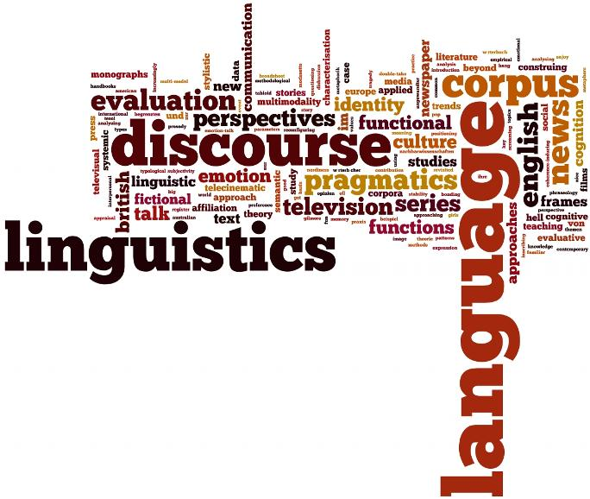
Linguistic Discourse Analysis
Category System
Values
Normatives
Stereotypes
Oppositions
(Fleischer 2001)
22

Slide 23
Cultural values
words that express an ideal or measure
considered ​​to be valuable in themselves
no appreciative or normative character, form the basis on which the valuation is performed, the basis on which we classify things, facts, or properties as valuable or worthless
positive concepts that formulate a goal, a desired state, or a desired property of a culture

Slide 24
Cultural values
homeland, old homeland,
family, children
Czech culture, nation, fellow citizens
truth, trust, solidarity
morality, honor
freedom, free world, freedom of speech
human dignity, humanic world, human life

Slide 25
NORMALITY
What is normal?
Yesterday I was visiting my friends.
Even though I was invited
no real food was served,
but only bread and salami.
Still, they were nice to me.
After dinner we drank two more bottles of wine
even though the meal was over.

Slide 26
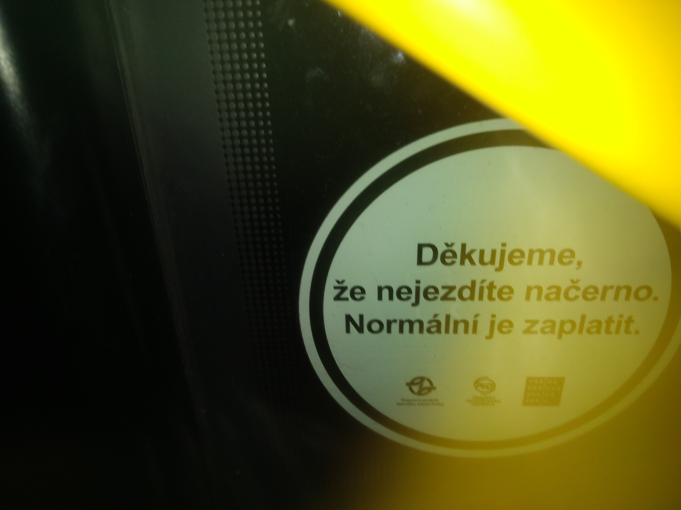
Thank you for not riding without a ticket. Paying is normal.

Slide 27
Normatives
tell us what a social community or society considers as ‘normal’ and „abnormal“.
elements of speech, that express „normality“ of a culture
measure things on the basis of ‘normality’, valid in a given culture
differentiate things in a judgmental way.
draw a distinction between the accepted "normal" and the "ab-normal" and evaluate accordingly
(Fleischer 2001, 387)

Slide 28
Normatives
normative forms are used on a variety of contents
aim to convince others - using normative phrases like
  everybody knows that …,
  it isn´t possible that …,
  it can´t be …
  it´s almost clear …

Slide 29
Normatives
present something as „self-evident“, as „right, normal, otherwise not possible“
things that are only then „natural, correct, normal“ etc., when the listener shares the cultural standards of normality

Slide 30
Simple Normatives
necessary, necessity, needed | tidy, orderly, in order
good, reasonable, honest | sure, certainly
the best, the greatest, the most important, the only | optimal, excellent
right, correct | dangerous
wrong, bad, faulty, incorrect | normally, usually
solid, serious | truly
trustworthy, reliable, credible | modern
self-evidently | really
fair | exemplary

Slide 31
Structured Normatives
We must/had to …, it is to be done …, it cannot and must not be … | It is irresponsible that …
It may … it must not be … | It would be wrong …
Who …, who must/will/ | It should be / should not be …
It is necessary to … | It should be self-evident that …
We have the duty to … | It is almost clear that …
We need … | True is … / fact is ….
Only when …. Only if …can … | It is proper …. It is right ….
Statements/assertions | Measures/standards
Demands/claims/imperativs

Slide 32
Normatives – Examples
… how much of the future of our children depends on a good education at home
responsibility means providing timely and appropriate answers to the challenges of the present and the future...
Anyone who wants to belong to Europe must share its common values: human dignity, democracy, fundamental rights, the rule of law, and international law.

Slide 33
Stereotypes
social classification of certain groups,
their representation by means of simplifying, unverifiable, generalizing statements
express a set of values, judgments, and assumptions about the typical characteristics of these groups and their behavior

Slide 34
Form of Stereotypes
formation of a social group through generalization, eg. „the Germans", „the Poles", „the Gypsies"
generalization aims at overriding differentiations: instead of saying “some poles” we say “the poles” or “all poles”, instead of “some students“ „the students” or “all students”.
evaluative attributive element, e.g. `the Poles are diligent',` the Germans are a humorless‘

Slide 35
Auto- and Hetero-Stereotypes
The main function of stereotypes is to secure your own group by demarcating it from other groups
Auto-stereotypes express positive characteristics of one´s own group: increase self-confidence, identification with one´s group
Hetero-stereotypes express mostly negative characteristics of other groups: demarcation from others

Slide 36
Oppositions
generally known and accepted contradictions
  black - white, poor - rich, healthy - sick, well - bad
functional oppositions contain culturally relevant opposites
  modern society, democratic constitution - traditional Islamic society, authoritarian constitution

Slide 37
Comparison / Metaphor
establishing a relationship between two objects that are comparable to each other on the basis of some criterion
these criteria can be the essence of one of the objects or be outside the objects as a third element
"St. Petersburg is considered the Venice of the North"

