Slide 1
Cross-Cultural Studies
Reading and Understanding
Scientific Texts about Culture
Ulrike Notarp

Slide 2
Culture, Collective Memory and
National Identity – and how they are related

Slide 3
Content
Culture & Discourse (Michael Fleischer)
History & Collective Memory (Maurice Halbwachs)
The Impact of Culture and Collective Memory on National Identity
The German Case
The Russian Case

Slide 4
1. Culture
M. Fleischer
semantic space – use of (linguistic) signs
based on communication discourses
system of shared meanings, ideas, values, judgments and beliefs (worldview)
continuously changed through communication
communication is culturally determined
Notes:
the members of a society continuously shape this system through communication
communication can be regarded as culturally determined

Slide 5
1.1 Society
Social groups
groups of friends, work groups, student circles
Supra-groups (≈ subcultures)
Punk, alternative sub-culture, ecological sub-culture (Fridays for Future)
Society (national society) common language & territory
Polish, German, Chinese society
Notes:
The social system consists of at least four real, interconnected and systematically connected subsystems
Supra-groups comprise several social groups that share a common catalog of norms, values and rules of behavior (eg. groups of friends, work groups, student circles, etc.) are part of subcultures.
In each subculture, a special discourse is used that characterizes that subculture
National society

Slide 6
Third Reality (≈ Culture)
Society +
Interdiscourse
Subculture
Subculture
Discourse
Social group
Discourse
Social group
Social group
Social group
Discourse
Social group
Special discourse
Social group
Special discourse
Interdiscourse
M. Fleischer 2006

Slide 7
1.2 Discourse
specific way in which the members of a supra-group (subculture) communicate
normative
contains values, norms, stereotypes that are common in the respective subculture
represents the worldview of a given social supra-group (subculture)
Notes:
we can distinguish one sub-culture from another by their subcultural discourses

Slide 8
1.3 Interdiscourse
the overarching discourse of the entire national society
integrative semiotic space for all discourses
fundamental values, norms and attitudes that are shared by the members of society
normative, regulates all communication
culturally determined
Notes:
general overarching discourse potentially mastered by all members of society
integrative semiotic space that can be and is used by all members of society
The interdiscourse produces – in line with all discourses it comprises – the culture of a society through communication and is at the same time culturally determined.
It contains fundamental values, norms and attitudes that are shared by the members of society, that are widely considered essential and on which there is a broad consensus.
Interdiscourse as such is normative; it regulates all communication and determines what can be said and in what way.

Slide 9
1.4 Special discourses
Specialized or subject-specific discourses are used in the frame of the discourses or the interdiscourse
scientific, political, religious, artistic, legal

Slide 10
Third Reality (≈ Culture)
Society +
Interdiscourse
Subculture
Subculture
Discourse
Social group
Discourse
Social group
Social group
Social group
Discourse
Social group
Special discourse
Social group
Special discourse
Interdiscourse
M. Fleischer 2006

Slide 11
2. History & Collective Memory
M. Halbwachs
HISTORICAL MEMORY
INDIVIDUAL / AUTO-BIOGRAPHICAL MEMORY
INTERNAL
COLLECTIVE MEMORY
EXTERNAL TO THE INDIVIDUAL
INTERNAL TO THE GROUP

Slide 12
Autobiographical memory; which contains personally experienced events
Collective memory; which contains events that are transmitted to an individual by other members of the community
Historical memory; which shapes the past through the works of historians

Slide 13
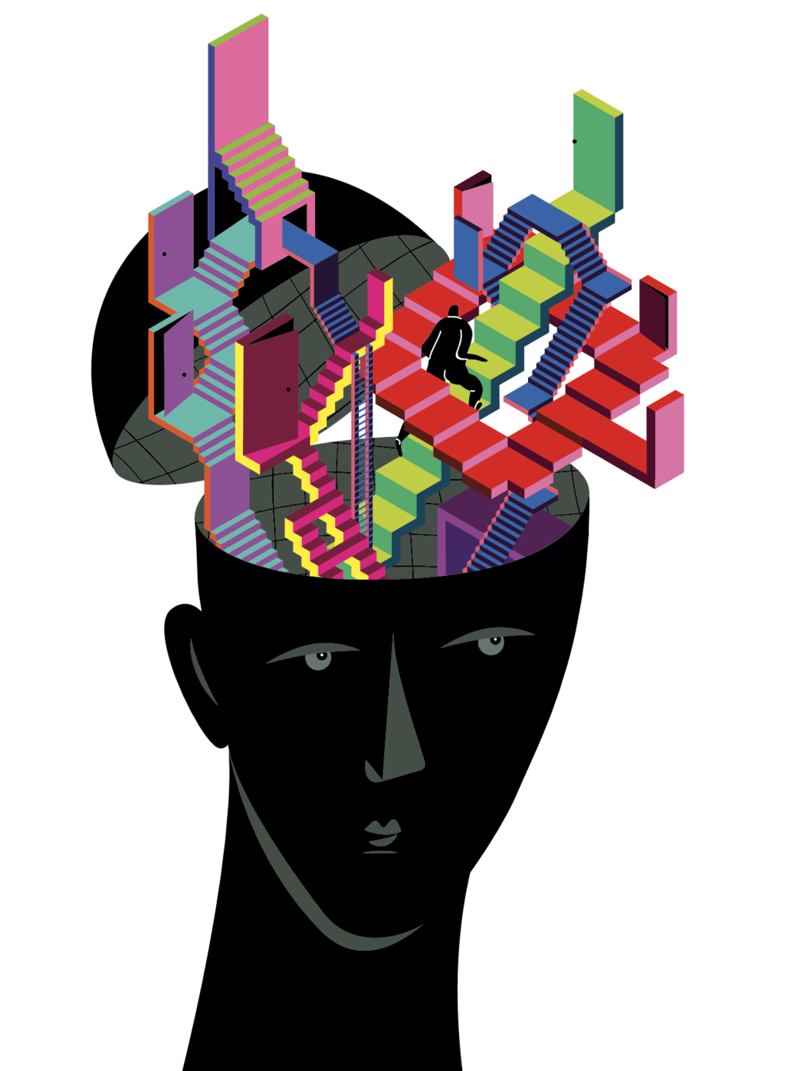
The Individual (Autobiographical) Memory
internal
is unique, placed in the framework of one´s personality
one´s own experience
based on words (language) and ideas (concepts)
is not isolated from others
goes back to reference points determined by the community

Slide 14
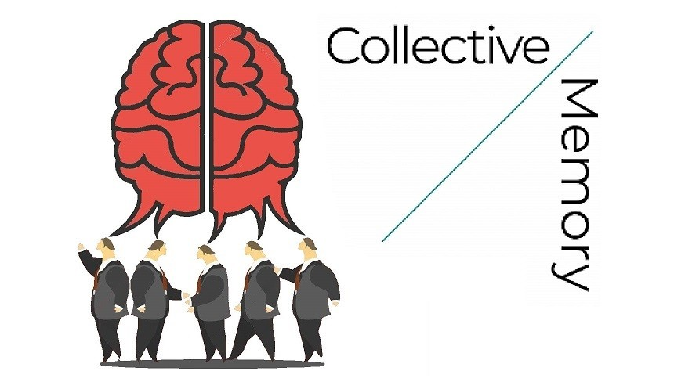
Collective Memory
external to the individual
framework for individual memories
individual memory relates to
reference points determined by
the community

Slide 15
Collective Memory
shared memories and experiences of a social group
retains what still lives in the consciousness of the groups
constantly transformed along with the group itself
values, beliefs, narratives, and cultural heritage collectively held by a group or society
mentality of a social community, habits, traditions
Notes:
shared memories and experiences that help define a group or community´s identity
keeps alive familiar memories or experiences across generations
Retains only what still lives in the consciousness of the groups keeping the memory alive
continuous development, constantly transformed along with the group itself

Slide 16
History – Historical Memory
historians narrate the history (of their country) as a continuous story
present a unique and total image of the past
each period is considered as a whole, independent of those preceding and following periods

Slide 17
History
Unitary – one history
external to and above groups – Collection of the most notable facts in the memory of man
preserving past events by writing them down in a coherent narrative as a coherent story
gives a unique and total image of the past
A record of changes
Collective Memory
Several collective memories
Retains only what still lives in the consciousness of the groups keeping the memory alive
Groups don’t give equal significance to events, places, and periods that have not affected them equally
Marked by irregular and uncertain boundaries.
The present is not contrasted to the past (the past no longer exists)
A record of resemblances

Slide 18
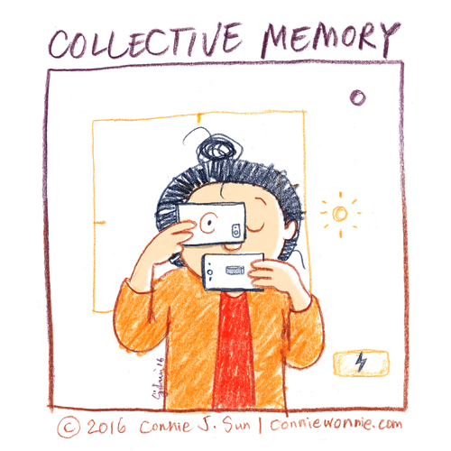
Collective Memory Collective Identity
shared memories and experiences that help
define a group or community´s identity
shared values, beliefs, narratives, and
cultural heritage
provides the group a self-portrait that unfolds
through time, since it is an image of the past that allows the group to recognize itself
Notes:
shared values, beliefs, narratives, and cultural heritage collectively held by a group or society
provides the group a self-portrait that unfolds through time, since it is an image of the past that allows the group to recognize itself

Slide 19
National Society & Culture
Subculture &
Discourse
Collective National Self-Image
Collective Memory &
Collective Self-Images
Subcultre &
Discourse
Sub-cultural self-image
Subculture &
Discourse
Sub-cultural self-image
Sub-Cultural Memory & Sub-Cultural Self-Images
Interdiscourse
19

Slide 20
Collective National Self-Image – National Identity
based on the self-images of previous generations (collective memory)
based on the interdiscourse
subordinate part of its culture - its worldview
that part of the worldview that is directed towards one's own community
continuously changed by the members of the community on the basis of communication and interaction (Halbwachs 1950)
Notes:
Collective memory provides the group a self-portrait that unfolds through time,
since it is an image of the past that allows the group to recognize itself
comprises values, norms, attitudes and assumptions about the character of one's own group

Slide 21
3. Impact of Culture and Collective Memory on the Collective self-image (National Identity)
Collective self-image
anchored in a specific context, a specific social, political and historical tradition and cultural heritage
shaped by the historical traditions of thought in which it is placed
the respective traditions of thought will be observable in the semantic alignment of the national self-image
Notes:
Assumption
We assume that a collective national self-image is shaped by the historical traditions of thought in which it is placed
We assume that the respective traditions of thought will be observable in the semantic alignment of the national self-image

Slide 22
Aspects of National Identity
Civic concept of nation (Staatsbürgernation)
  Belonging of the individual to a civic community
  common constitution
  Cultural concept of nation (Kulturnation)
  common cultural heritage
  common language
Ethnic concept of nation (Volksnation)
  common ancestry
  common history
Peters 2002
22

Slide 23
Civic Values
Ethno-Cultural
Democracy
Constitution, rule of law, justice
Freedom, freedom of speech
Equality
Individual rights
Solidarity, social cohesion
Humanity
Peace
Responsibility
Country, homeland
Family, children
National pride, national independence
Culture, language
Tradition, history
Cultural heritage
Respect
Dignity

Slide 24
4. Images of National Identity in
Germany, Poland, Russia
Methodology: Linguistic Discourse Analysis
Empirical Basis: New Year´s Addresses
Germany
President Joachim Gauck 2013, 2014, 2015, 2016
President Frank-Walter Steinmeier 2017, 2018, 2019, 2020
Russia
President Vladimir Putin 2014, 2015, 2016, 2017, 2018, 2019, 2020, 2021
24
Notes:
Reconstruction of …

Slide 25
German traditions of thought
long tradition of democratic thought
influence of the Enlightenment with thinkers such as Emanuel Kant
drafting of the first democratic constitution in St. Paul's Church Assembly in 1848
Weimar Republic from 1918-1933
democratic constitution in West Germany after the Second World War

Slide 26
Polish traditions of thought
Centuries of foreign rule and division
Soviet influence after World War II and the establishment of a communist regime
The resistance of Poles against the communist regime in the Solidarność movement at the beginning of the 1980s
gradual establishment of a democratic state order after the fall of communism in the 1990s
Notes:
can be seen almost as the first attempt at democratic reform.

Slide 27
Russian traditions of thought
long tradition of autocratic thought
centuries of autocratic rule by the tsars
totalitarian communist regime during the Soviet era - suppressed political opposition and centralized power in the Communist Party
Since the 2000s, Russian government under Vladimir Putin has maintained an authoritarian form of government that suppresses political dissidence while emphasizing nationalist and conservative values

Slide 28
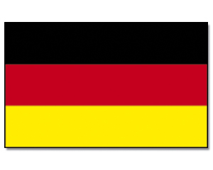
German National Identity
German National Identity
Civic Aspects of National Identity
democracy, peace, freedom, rule of law, responsibility, justice, humanity, solidarity
Ethno-Cultural Aspects of National Identity
family, Christian faith, tradition, security, German language
Structure of the German concept
open society, Europe
28

Slide 29

Polish National Identity
Civic Aspects of National Identity (Staatsbürgernation)
Democracy, rule of law, solidarity, justice, freedom
Ethno-Cultural Aspects of National Identity (Kultur-/Volksnation)
Poland, homeland, national independence, national pride, dignity, respect, family, solidarity
Polish language and culture, Polish traditions and history, cultural heritage
Structure of the Polish concept
tends to be closed
29

Slide 30
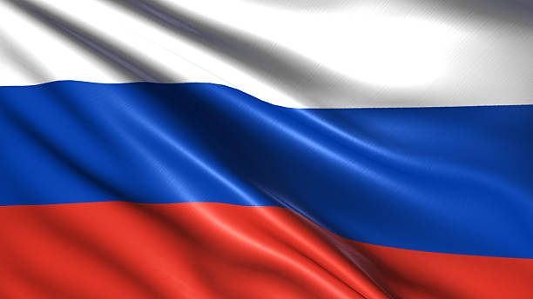
Russian National Identity
Ethno-Cultural Aspects of National Identity
Russia, motherland, warmth, tradition, honor, dignity, patriotism,
family, Russian family of peoples, respect for ancestors, caring, responsibility, kindness, mercy
Civic Aspects of National Identity
--
Structure of the Russian concept
closed society, victory over fascism
30

Slide 31
German Image of State and Country
What democracy needs are self-confident citizens - with optimism and drive, with reason, decency and solidarity. (Steinmeier 2019)
You have all become the face of a warm-hearted and humane country. (Gauck 2015)
... that we live in a reunited, free and democratic country. (Gauck 2015)
And let's trust this country! It is our country, it is our democracy. (Steinmeier 2018)

Slide 32
Polish Interdiscourse
Polish Image of State and Country
We all want Poland to be a country of peace and prosperity, a strong and safe country (Duda 2015).
The supreme power in our country belongs to the nation. Therefore, I believe that the law in the Republic of Poland should be created with the citizens and, above all, for the citizens (Duda 2015).
I wish all my compatriots, all citizens of the Republic of Poland, that we will become more and more of a community. Culture, language and, above all, love for the motherland connect us. (Duda 2015)
A people who love freedom, a people who are brave, proud and at the same time tolerant towards other nations and other faiths (Duda 2015).
32

Slide 33
Russian Image of State and Country
Love for the motherland is one of the strongest and most worthy feelings (Putin 2015).
Peace and prosperity for our great Russia - our beloved and only one! (Putin 2018)
in the fraternal support of the inhabitants of Crimea and Sevastopol after they decided to return to their homeland. (Putin 2015)
We have mastered this year together, with dignity, as befits a united people who honor the traditions of their ancestors. (Putin 2021)
33

Slide 34
Literature
Fleischer, Michael. 2006. Allgemeine Kommunikationstheorie. [General Theory of Communication.] Oberhausen: Athena.
Fleischer, Michael. 2003. Wirklichkeitskonstruktion. Beiträge zur systemtheoretischen Konstruktivismusforschung. [Constructing reality. Contributions to system-theoretical research on constructivism.]
Halbwachs, Maurice. 1992. [1952]. On Collective Memory. Edited and translated by Lewis A. Coser. Chicago: University Press.
Halbwachs, Maurice. 1980. [1950]. The Collective Memory. Translated by Francis J. Ditter, Jr. and Vida Yazdi Ditter. New York. Harper & Row.
Notarp, Ulrike. 2025. National Identity under a Magnifying Lens - a Study on National Identity in Germany, Poland and Russia. Preprint: http://dx.doi.org/10.13140/RG.2.2.23085.19684/1
Peters, Bernhard. 2002. A New Look at ‘National Identity’: How Should We Think about ‘collective’ or ‘National Identities’? Are There Two Types of National Identities? Does Germany Have an Ethnic Identity, and Is It Different? European Journal of Sociology, vol. 43/1, Cambridge University Press, 3–32.

Slide 35
Thank you!

