Slide 1
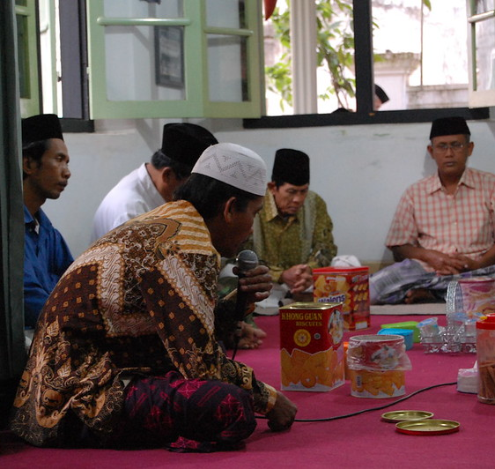
Clifford Geertz: Ritual and Social Change
Based on the essay: 'Ritual and Social Change: A Javanese Example'

Slide 2
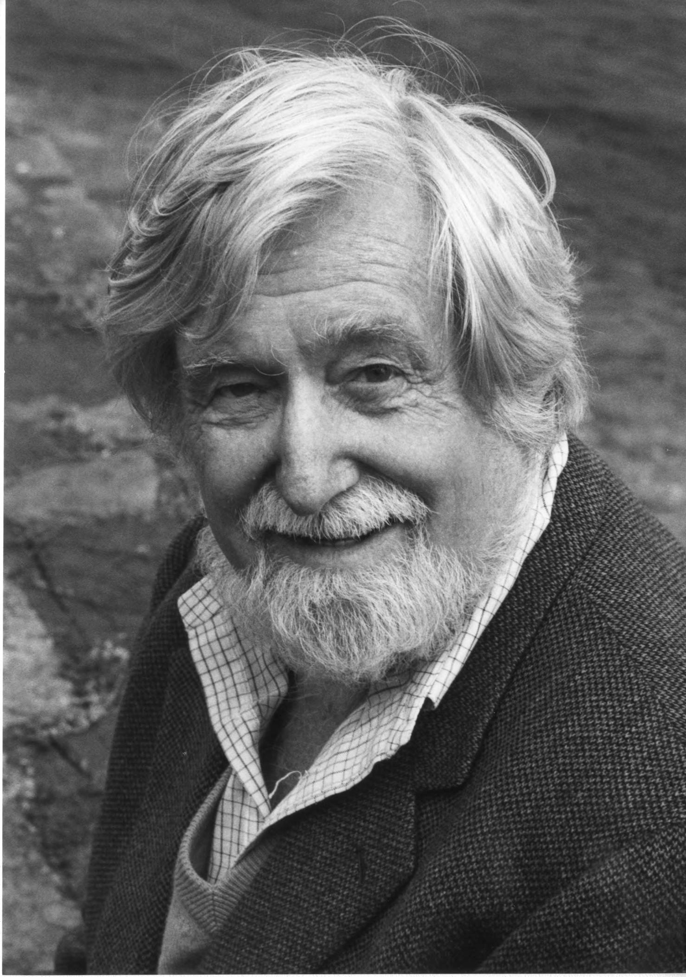
Who Was Clifford Geertz?
- Cultural anthropologist
- Known for 'thick description'
- Pioneered symbolic/interpretive anthropology
Notes:
Clifford Geertz was one of the most influential anthropologists of the 20th century. His work emphasized the interpretation of symbols and meanings in culture, rather than simply documenting structures or behaviors. He is especially known for his method of 'thick description,' which seeks to unpack the layers of meaning embedded in social practices.

Slide 3
Clifford Geertz: Life and Career
• Born 1926, San Francisco – 2006, Philadelphia
• Served in the US Navy (1943–1945)
• BA in Philosophy, Antioch College (1950)
• PhD in Anthropology, Harvard University (1956)
• Professor at the Institute for Advanced Study, Princeton
• Leading figure in symbolic anthropology
Notes:
Clifford Geertz was one of the most influential cultural anthropologists of the 20th century. Born in San Francisco in 1926, he served in the Navy during WWII, earned a BA from Antioch, and a PhD from Harvard. He studied under Talcott Parsons and Clyde Kluckhohn in the interdisciplinary Department of Social Relations. He spent most of his career at the Institute for Advanced Study in Princeton and was known for symbolic anthropology.

Slide 4
Doctoral Thesis: Religion in Modjokuto
• Fieldwork in Modjokuto (1952–1954)
• Lived with a railroad laborer's family
• Studied religious life in Java
• Dissertation: Religion in Modjokuto: A Study of Ritual Belief In A Complex Society (1956)
• Funded by Ford Foundation & MIT
Notes:
Geertz conducted his first major ethnographic fieldwork with his wife Hildred in the small Javanese town of Modjokuto from 1952 to 1954. They lived with a railroad laborer’s family, immersing themselves in local life. This research became the basis for his Harvard dissertation, focusing on religious beliefs in a complex society. It marked the beginning of his long engagement with Indonesian Islam and symbolic interpretation of ritual.

Slide 5
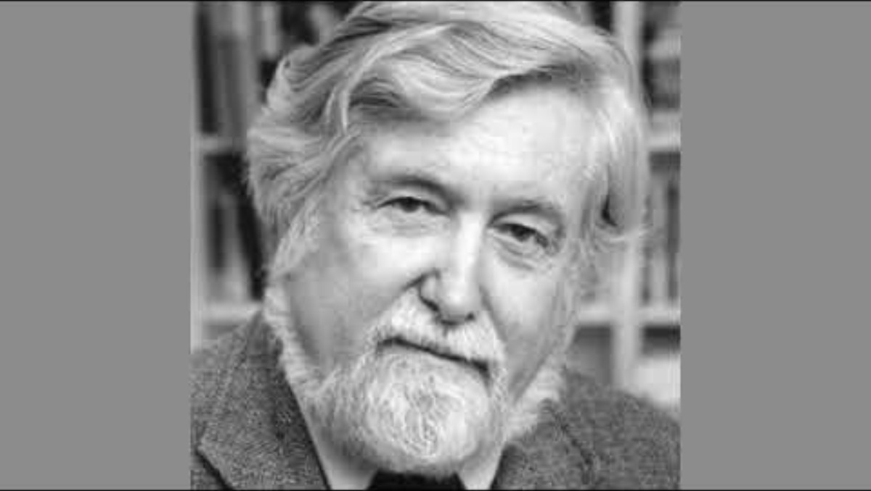
Geertz and the Study of Ritual
- Critiques static functionalism
- Emphasizes meaning and symbolism
- Rituals can reflect tension and change
Notes:
Geertz critiques classical functionalism, which viewed rituals as maintaining social equilibrium. Instead, he shows that rituals can also express social tensions and even catalyze change. They are not always stabilizing; they can also be sites of conflict, especially when cultural and social structures misalign.

Slide 6
Functionalism and Its Critics
• Durkheim: Religion reinforces collective conscience and social cohesion
• Malinowski: Religion helps individuals manage anxiety and crisis
• Gluckman: Rituals can release social tensions and restore balance
• Turner: Rituals mark transitions and foster communitas
• Geertz: But what about change? Rituals convey symbolic meaning — and sometimes fail
Notes:
Durkheim argued that religion functions to create social cohesion through collective representations. Malinowski focused on the psychological comfort rituals provide in moments of uncertainty. Max Gluckman added a twist, suggesting rituals may actually serve as outlets for tension, preventing conflict from escalating. Victor Turner emphasized rituals of transition — 'rites of passage' — and introduced the concept of communitas, a deep, shared experience of equality and bonding that can emerge during liminal stages. Geertz moves beyond these models. He stresses that rituals are about the interpretation of symbols — not just function — and asks: what happens when rituals no longer work, when shared meanings disintegrate?

Slide 7
Culture vs. Social Structure
- Culture: System of meanings (symbols)
- Social structure: Actual relations (behavior)
- These don't always align
Notes:
Geertz distinguishes between 'logico-meaningful' cultural systems and 'causal-functional' social systems. Culture is the symbolic framework; social structure is the pattern of relationships. Their misalignment can lead to breakdowns like the one we’ll see in the case study.

Slide 8
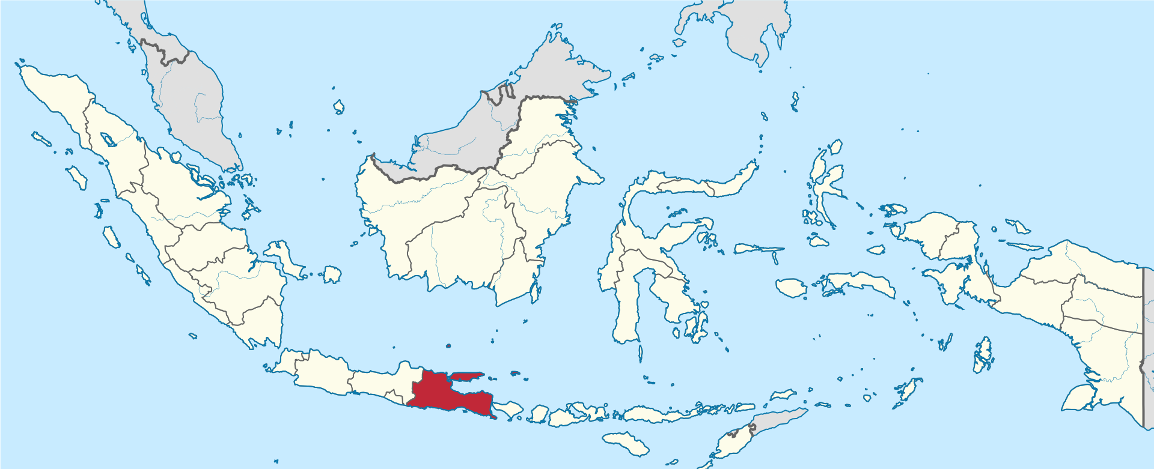
Java: Religious and Social Background
Layered traditions: Hinduism, Islam, Animism
Key split: Santri vs. Abangan
Context of modernization and nationalism
Notes:
Java’s religious landscape is historically syncretic, blending Hindu, Buddhist, Islamic, and indigenous beliefs. But in the 20th century, a sharper ideological divide emerges: Santri (orthodox Muslims) versus Abangan (more syncretic, local religious culture). This division becomes deeply politicized.

Slide 9

The Slametan Ritual
- Communal feast for social & spiritual harmony
- Central to Javanese ritual life
- Aimed at producing harmony (rukun) and detachment (iklas)
https://www.youtube.com/watch?v=Na017J80Xak
Notes:
The slametan is the heart of Javanese ritual life. It's a quiet feast that binds neighbors and communicates with the spirit world. Its goals include spiritual appeasement and social harmony—rukun—and emotional calm—iklas. It’s the i deal setting for Geertz’s analysis. The slametan (or selametan, slamatan, and selamatan) is the communal feast from Java, symbolizing the social unity of those participating in it. Clifford Geertz considered it the core ritual in Javanese religion, in particular the abangan variant.[1] The feast is common among the closely related Javanese, Sundanese and Madurese people. A slametan can be given to celebrate almost any occurrence, including birth, marriage, death, moving to a new house, and so forth. Depending on the intention, the mood and emphasis may vary somewhat, but the main structure is the same.[1] Geertz categorizes them into four main types:[2]
Those relating to the crises of life: birth, circumcision, marriage, and death
Those associated with events of the Islamic calendar
The bersih désa ("cleaning of the village"), concerned with the social integration of the village
Those held irregularly depending on unusual occurrences: departing for a long trip, moving residence, changing personal names, healing from illnesses, recovering from the effect of sorcery, and so on
The ceremony takes its name from the Javanese word slamet, from Arabic: salam, which refers to a peaceful state of equanimity, in which nothing will happen. This is what the host intends for both himself and his guests, by experiencing the egalitarian structure of the slametan and the petitions of supernatural protection from spirits.[

Slide 10
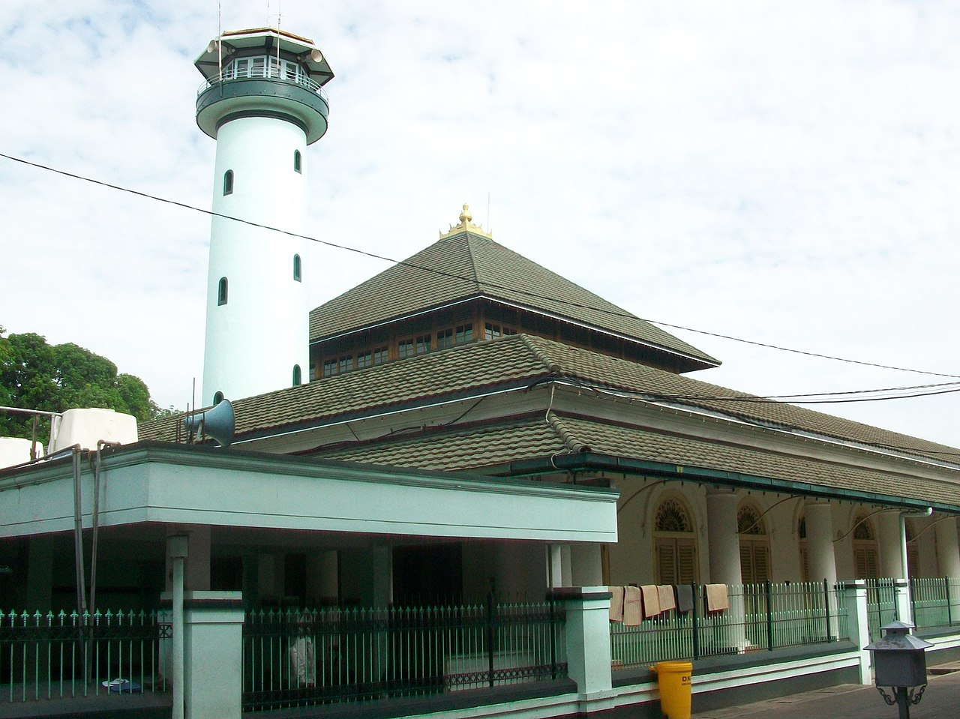
Setting: Modjokuto, East Java
- Small town, mixed population
- Political polarization: Masjumi vs. Permai
- Santri vs. Abangan tensions in daily life
Notes:
Geertz’s case study is set in Modjokuto, a town undergoing modernization. Here, traditional social structures are eroding, and ideological divisions—especially between the Islamic Masjumi party and the more syncretic, Marxist-leaning Permai—map onto the Santri-Abangan divide, creating conflict.

Slide 11
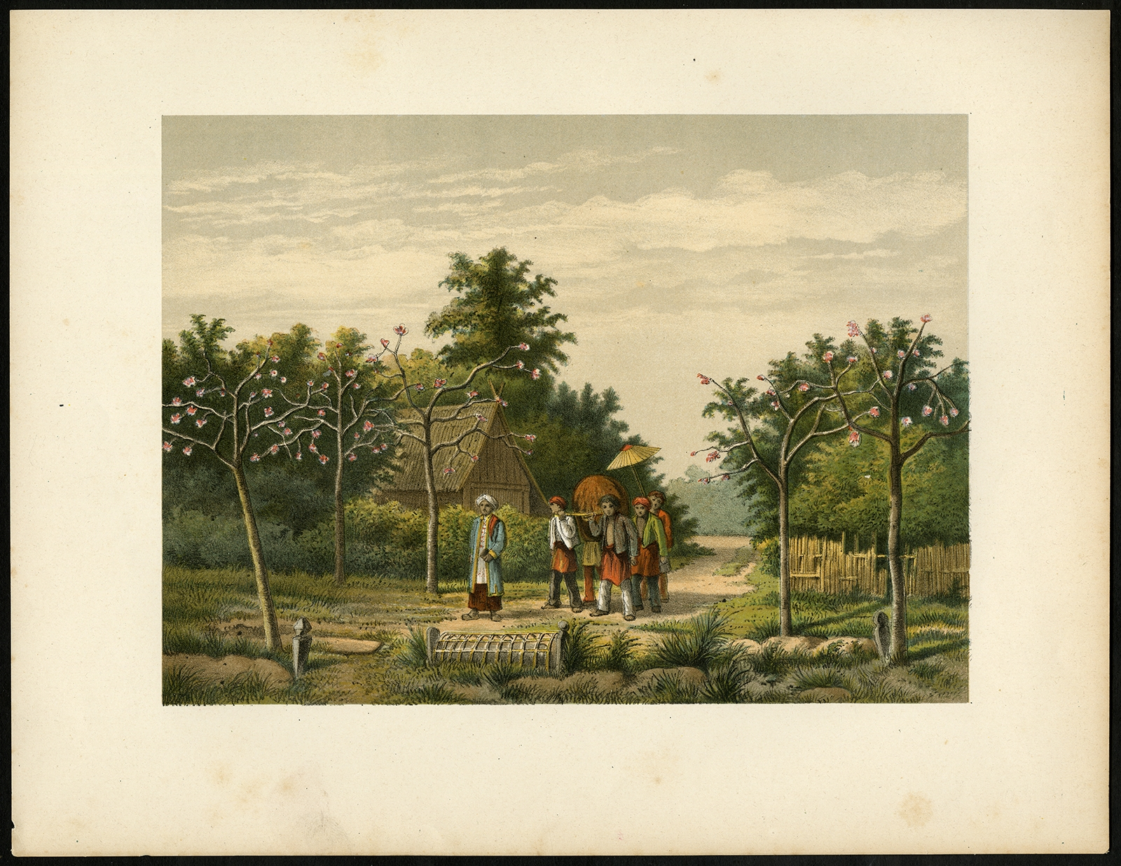
The Funeral That Failed
- Young boy's funeral disrupted
- Modin (ritual leader) refuses to officiate
- Political identity overrides ritual duty
Notes:
When a Permai member’s nephew dies, the expected Islamic funeral is disrupted. The Modin refuses to officiate because of political-religious differences. The result: ritual paralysis, emotional outbursts, confusion. What should be a stabilizing ritual becomes a scene of chaos and division.

Slide 12
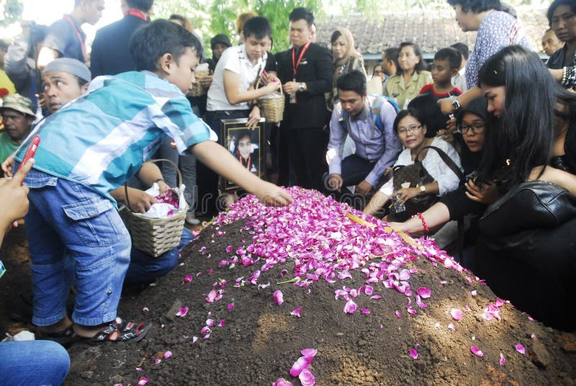
Social Tensions On Display
- Neighbors divided and confused
- Symbols become politicized
- Ritual fails to create harmony
Notes:
At the funeral, neighbors split into camps. Ritual tasks are delayed or abandoned. Political meanings interfere with religious meanings. Even a deeply embedded ritual like the slametan cannot override the growing social disjunctions. The ritual, in short, fails.

Slide 13
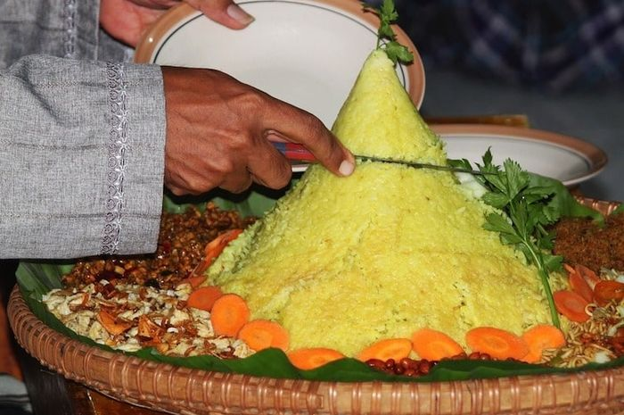
Why Did the Ritual Fail?
- Misalignment of culture and social structure
- Shared symbols now have conflicting meanings
- Rituals become ambiguous and contested
Notes:
The core of Geertz’s argument: the ritual failed because the cultural meaning of the symbols (shared, sacred) no longer aligned with the social context (divided, politicized). When one symbol stands for both religious faith and political allegiance, it becomes unstable, even dangerous.

Slide 14
Geertz’s Theoretical Insight
- Not all rituals 'work'
- Rituals can reveal societal fractures
- Anthropologists must study ritual failure too
Notes:
This is Geertz’s big contribution: rituals do not always function smoothly. They can expose the very fractures that societies try to conceal. Anthropologists must therefore analyze not just ritual success, but also ritual breakdowns—what they reveal, how they feel, and what they mean.

Slide 15
Beyond Static Functionalism
- Dynamic view of ritual and change
- Emphasis on history, power, ambiguity
- Culture and structure as interrelated, not mirror images
Notes:
Geertz challenges the idea that culture and structure are always aligned. He calls for a more dynamic functionalism, one that accounts for how rituals operate in changing, tense, and historical contexts. It’s a move away from timeless harmony and toward situated complexity.

Slide 16
Key Takeaways
- Rituals can both stabilize and destabilize
- Symbols carry multiple meanings
- Anthropology must capture ambiguity
Notes:
If you remember one thing from today: rituals are complex, symbolic performances that can both hold societies together and pull them apart. Geertz invites us to think deeply about the ambiguity of meaning and the fragility of tradition in moments of change.

Slide 17
Discussion Questions
- Can rituals always integrate society?
- What does this case tell us about modernity?
- How should anthropologists study rituals?
Notes:
Let’s end with some open-ended questions. What is the role of ritual in times of change? Can rituals be re-invented? How do we study rituals that fail—ethically, methodologically? These are key questions for the anthropology of ritual going forward.

Slide 18
Suggested Readings
- Geertz, *The Interpretation of Cultures*
- Eriksen, *Small Places, Large Issues*
- Asad, *Genealogies of Religion*
Notes:
For those of you who want to go deeper: Geertz’s essays are essential reading. Eriksen offers a broad view of cultural anthropology, and Asad provides a powerful critique of secularism in the study of religion.

